Slide 1
Bioinformatics Introduction to proteins
Presented by
Dr. Fayyaz-ul-Amir Afsar Minhas
http://faculty.pieas.edu.pk/fayyaz
Department of Computer & Information Sciences
Pakistan Institute of Engineering & Applied Sciences
PO Nilore, Islamabad 45650
Pakistan
Notes:
No. II will be presented prior to the introduction of proteomics later in the course

Slide 2
Introduction
Starting off on Piazza
Downloading and installing UGENE
Quiz 0

Slide 3
Topics Covered Earlier
Biochemistry of proteins
Concepts of amino acids, peptide bonds, hydrogen bonds, hydrophobic effect
Central Dogma
Transcription and Translation
Sequence-Structure-Function Relationship
Anfinsen’s experiment
Concepts of protein structure
Secondary, Super-Secondary Structure, Motifs, Domains, Chains

Slide 4
Topics Covered Earlier
Tools
Translation/Transcription, finding ORFs and gene identification
Exploring protein sequence and structure databases
BLAST Search
Sequence composition analysis

Slide 5
Importance of proteins
50% of the dry weight of the human body is protein
Up to 92% of the dry weight of the red blood cell is a single protein called Hemoglobin
Almost all cellular functions and biological functions involve proteins including
DNA Transcription
RNA Translation
Splicing
Muscular construction
Structural functions…

Slide 6
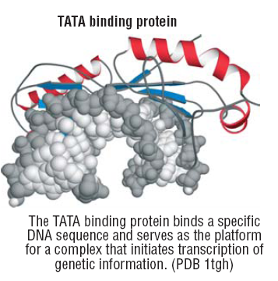
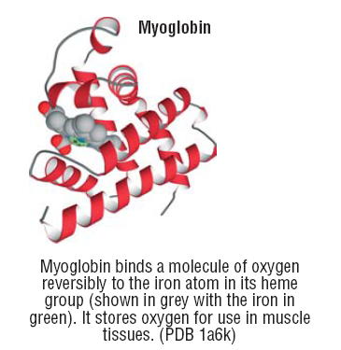
Binding
Notes:
Specific recognition of other molecules is
central to protein function. The molecule that is
bound (the ligand) can be as small as the
oxygen molecule that coordinates to the heme
group of myoglobin, or as large as the specific
DNA sequence (called the TATA box) that is
bound—and distorted—by the TATA binding
protein. Specific binding is governed by shape
complementarity and polar interactions such as
hydrogen bonding.

Slide 7
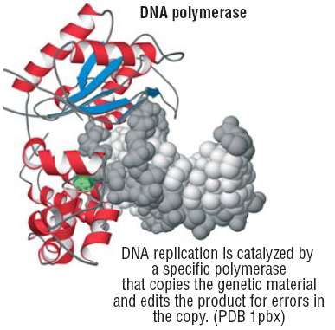
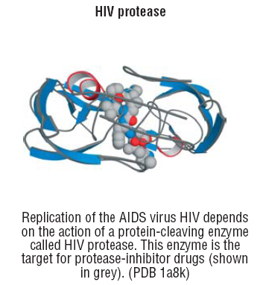
Catalysis
Notes:
Essentially every chemical reaction in the living
cell is catalyzed, and most of the catalysts are
protein enzymes. The catalytic efficiency of
enzymes is remarkable: reactions can be
accelerated by as much as 17 orders of
magnitude over simple buffer catalysis. Many
structural features contribute to the catalytic
power of enzymes: holding reacting groups
together in an orientation favorable for reaction
(proximity); binding the transition state of the
reaction more tightly than ground state
complexes (transition state stabilization);
acid-base catalysis, and so on.

Slide 8
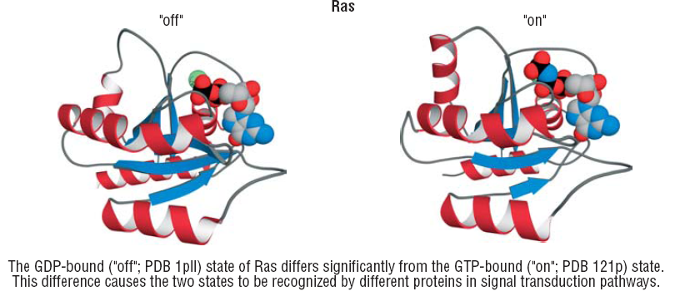
Switching
Signal cell growth
Notes:
Proteins are flexible molecules and their
conformation can change in response to
changes in pH or ligand binding. Such changes
can be used as molecular switches to control
cellular processes. One example, which is
critically important for the molecular basis of
many cancers, is the conformational change
that occurs in the small GTPase Ras when GTP
is hydrolyzed to GDP. The GTP-bound
conformation is an "on" state that signals cell
growth; the GDP-bound structure is the "off"
signal.

Slide 9
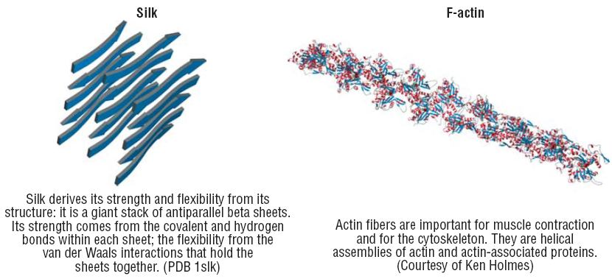
Structural proteins

Slide 10
The most versatile cellular molecule
Proteins are
Stable
Flexible
Versatile in terms of their function
Protein Function
Biochemical function of the molecule in isolation
Cellular function as part of larger assembly
Resulting Phenotype in the cell or the organism

Slide 11
How are proteins versatile?
Because of their structure!
What determines their structure?
Composed of amino acids
Amino acids are linked to form polymer
Significant hydrogen bonding between amino acids
Primary ideology
Sequence determines Structure determines Function
Proven by Anfinsen 1960

Slide 12
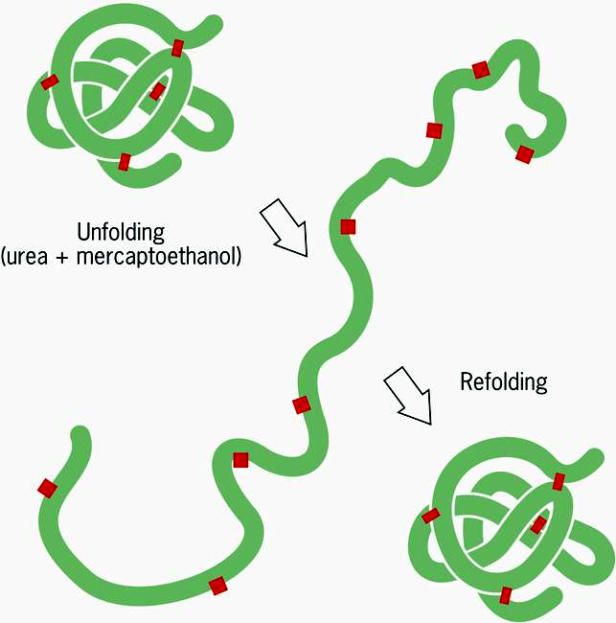
Anfinsen Experiment
Native structure of the protein is determined by the protein’s amino acid
Principles for protein folding
Native structure is
Unique
Stable
Kinetically accessible
Notes:
The seminal experiment reported by Anfinsen demonstrated that
RNase A could be fully denatured by:
1. reducing the disulfide bonds (using b-mercaptoethanol)
2. dissolving in 8 M urea
and then fully renatured on diluting out the urea and allowing
he disulfides to reoxidize. Essentially full return of catalytic activity
was obtained. This experiment demonstrated that all the information
necessary to determine the three-dimensional fold was incorporated
in the amino acid sequence. A large number of proteins have now
been shown to be able to be renatured in similar experiments. Thus,
it is clear that virtually all proteins, under appropriate conditions,
can be reversibly unfolded and refolded into their native structure
under in vitro conditions. This is known as spontaneous folding.

Slide 13
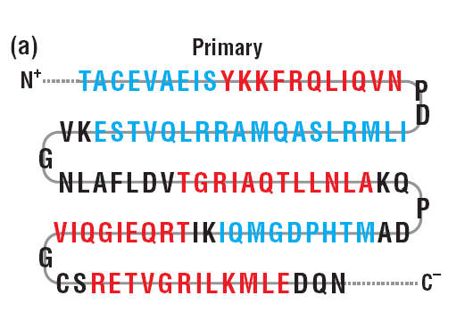
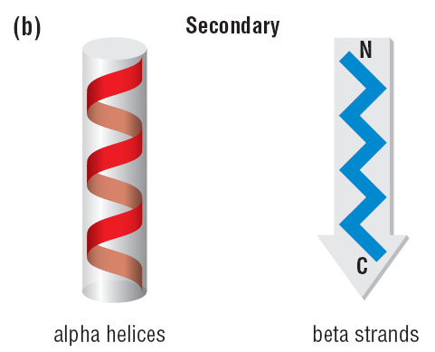
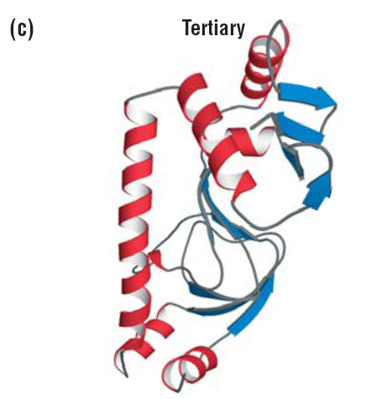
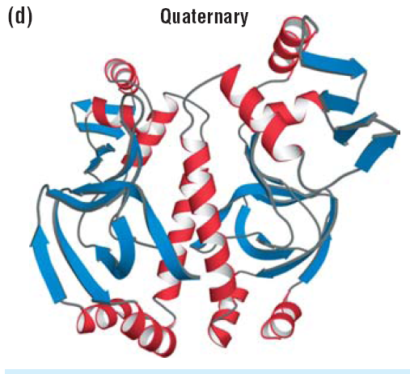
Protein Composition

Slide 14
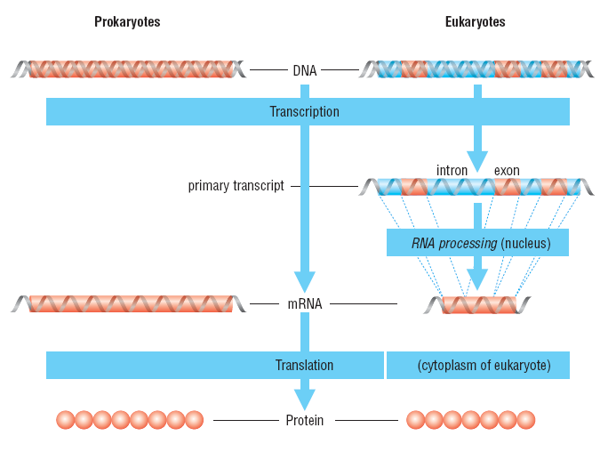
The Central Dogma

Slide 15
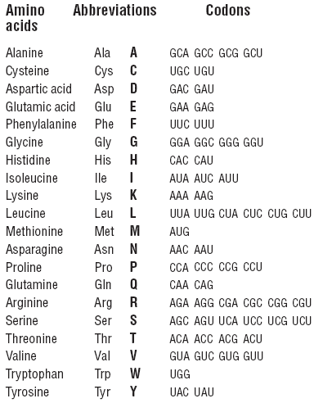
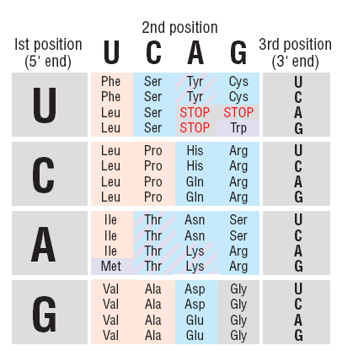
Codons

Slide 16
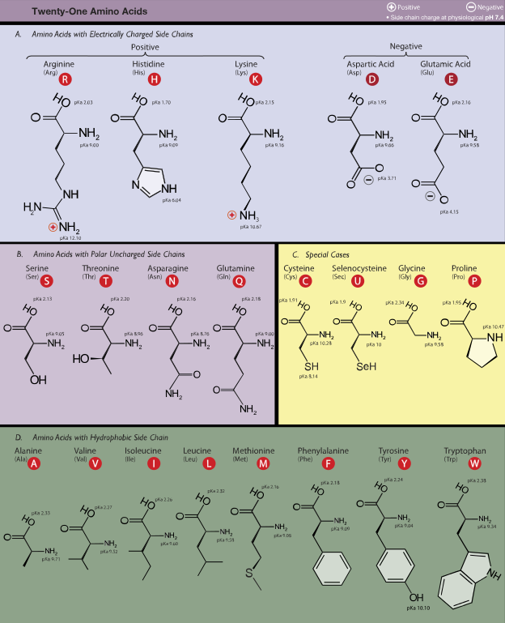
Types of amino acids

Slide 17
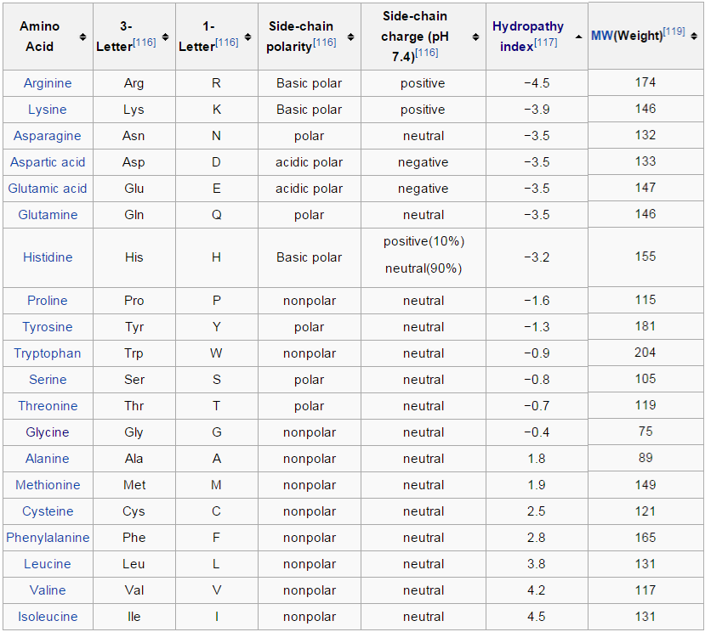
`

Slide 18
Interactions between amino acids
Interactions between backbone atoms
Interactions between side chains

Slide 19
Interactions between backbone atoms
Carbonyl oxygen and Amide Hydrogen form nearby amino acids in the chain can form oxygen bonds
This is energetically favorable
This gives rise to regular conformations
Alpha helices
Beta sheets

Slide 20
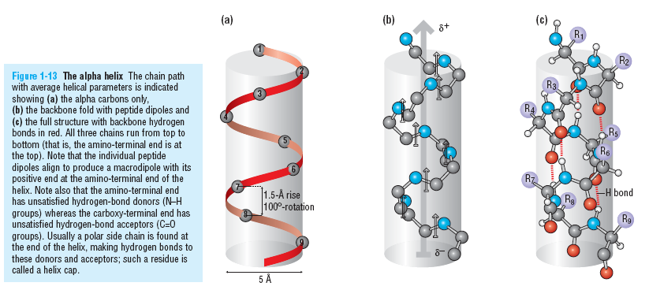
Alpha helices

Slide 21
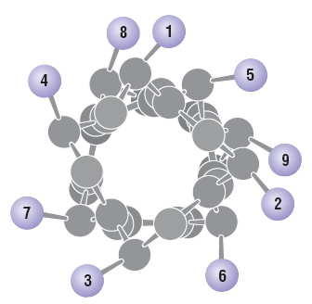
Alpha helices from top
3.6 residues per turn of the helix
Residues 3-4 amino acids apart in the sequence will project from the same face
In some proteins the surface face will be polar and the other face will be hydrophobic

Slide 22
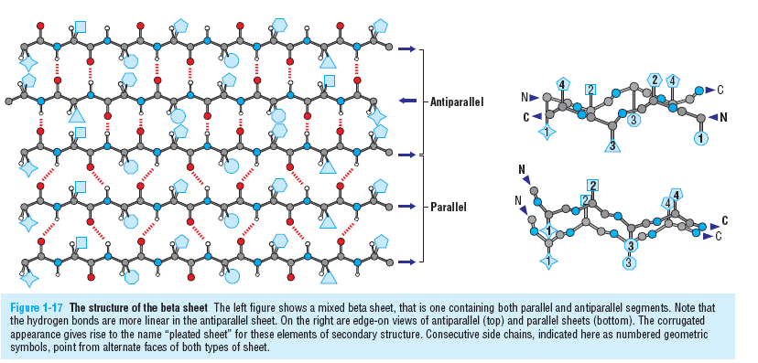
Beta sheets
Sometimes a hydrogen bond will be formed between residues that are faraway in sequence from each other to result in beta sheets. These can also be amphipathic.

Slide 23
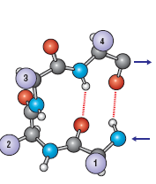
Beta Hairpin

Slide 24
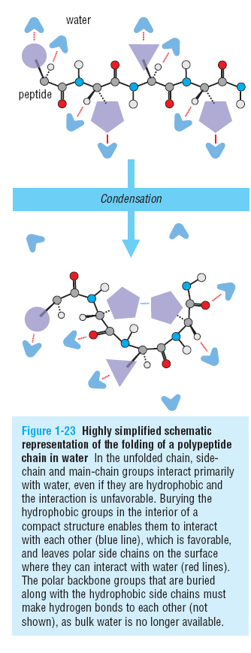
Shape of protein
The shape of the protein is determined by competition between self-interactions and interactions with water molecules
Condensation of multiple secondary structure elements leads to a tertiary structure

Slide 25
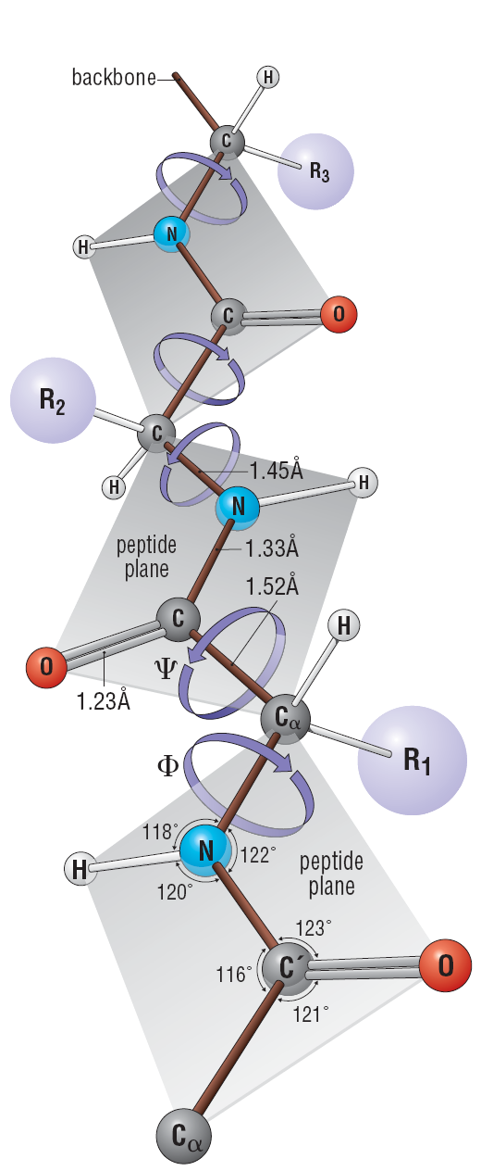
Torsion angles
N, C, O lie in the same plane
Rigid Structure
N–Ca and Ca–C bonds are rotatable and free rotation is allowed
Flexible
Can rotate as long as no steric clashes arise (i.e., no side chains collide with each other)
Phi torsion angle
The angle of the N–Ca bond to the adjacent peptide bond
Psi torsion angle
the angle of the C–Ca bond to the adjacent peptide bond

Slide 26
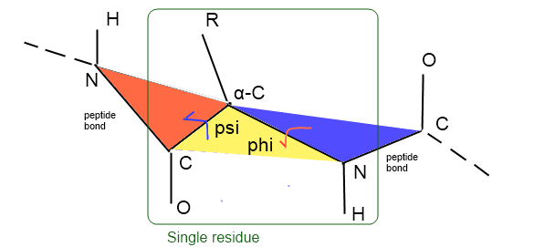
Torsion angles
Excellent tool: http://proteopedia.org/wiki/index.php/Psi_and_Phi_Angles

Slide 27
Torsion angles
A protein has alternating rigid and rotatable flexible covalent bonds
This combination greatly reduces the number of possible conformations a protein can have
Certain torsion angles will cause clashes
Ranges of torsion angles are also dependent upon the type of side chains

Slide 28
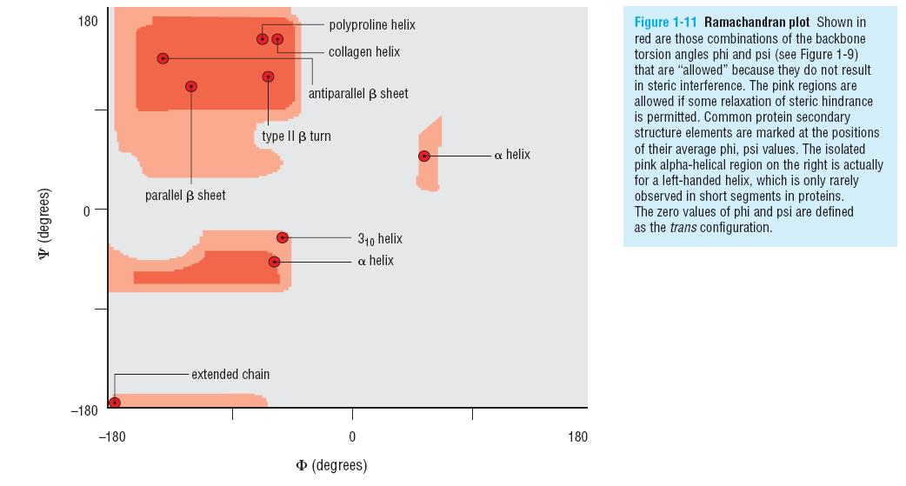
Ramachandran plot

Slide 29
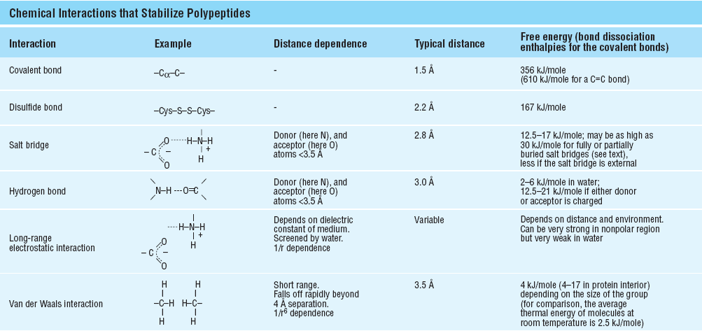
Interactions of amino acids

Slide 30
Protein folding
Although the long chain of amino acids is held together as a chain by strong covalent bonds, this chain folds into a three dimensional structure which is stabilized by weak non-covalent interactions
Gulliver in Lilliput analogy

Slide 31
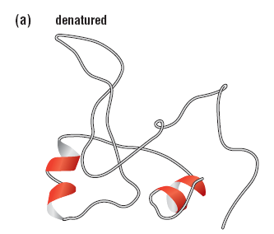
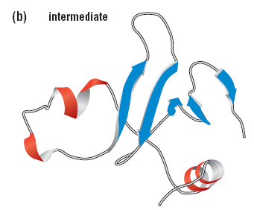
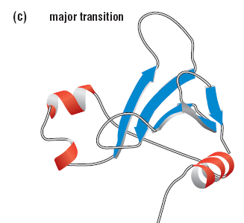
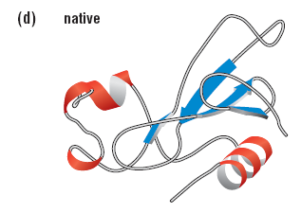
Protein folding

Slide 32
The energetics of protein folding
A protein will spontaneously fold only if the folded state is energetically more feasible than the unfolded state
Entropy
Enthalpy
Free energy
Non-bonding interactions
Entropy

Slide 33
Fold-it
http://fold.it/portal/info/about
Christopher B Eiben, Justin B Siegel, Jacob B Bale, Seth Cooper, Firas Khatib, Betty W Shen, Foldit Players, Barry L Stoddard, Zoran Popović, David Baker (2012). Increased Diels-Alderase activity through backbone remodeling guided by Foldit players. Nature Biotechnology, 2012. [PDF] [PROJECT]
Firas Khatib, Seth Cooper, Michael D. Tyka, Kefan Xu, Ilya Makedon, David Baker, Foldit players (2011). Algorithm discovery by protein folding game players. Proceedings of the National Academy of Sciences of the United States of America vol. 108 no. 47 18949-18953, 2011. [PDF] [PROJECT]
Firas Khatib, Frank DiMaio, Foldit Contenders Group, Foldit Void Crushers Group, Seth Cooper, Maciej Kazmierczyk, Miroslaw Gilski, Szymon Krzywda, Helena Zabranska, Iva Pichova, James Thompson, Mariusz Jaskolski, David Baker (2011). Crystal structure of a monomeric retroviral protease solved by protein folding game players. Nature Structural and Molecular Biology 18, 1175-1177, 2011. [PDF] [PROJECT]
Seth Cooper, Firas Khatib, Ilya Makedon, Hao Lu, Janos Barbero, David Baker, James Fogarty, Zoran Popović, Foldit players (2011). Analysis of Social Gameplay Macros in the Foldit Cookbook. Foundations of Digital Games, 2011. [PDF] [PROJECT]
Seth Cooper, Firas Khatib, Adrien Treuille, Janos Barbero, Jeehyung Lee, Michael Beenen, Andrew Leaver-Fay, David Baker, Zoran Popović, Foldit players (2010). Predicting protein structures with a multiplayer online game. Nature 446 p. 756-760, 05 August 2010. [PDF] [PROJECT]
Seth Cooper, Adrien Treuille, Janos Barbero, Andrew Leaver-Fay, Kathleen Tuite, Firas Khatib, Alex Cho Snyder, Michael Beenen, David Salesin, David Baker, Zoran Popović, >57,000 Foldit players (2010). The challenge of designing scientific discovery games. International Conference on the Foundations of Digital Games, 2010. [PDF] [PROJECT]
Other Miroslaw Gilski, Maciej Kazmierczyk, Szymon Krzywda, Helena Zábranská, Seth Cooper, Zoran Popović, Firas Khatib, Frank DiMaio, James Thompson, David Baker, Iva Pichová, Mariusz Jaskolskia (2011). High-resolution structure of a retroviral protease folded as a monomer. Acta Crystallographica D67, 907-914, 2011. [PDF] [PROJECT]

Slide 34
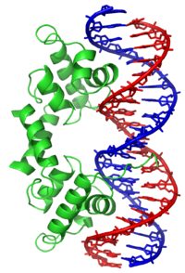
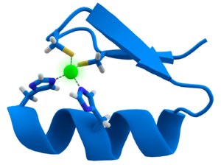
Supersecondary structures
Motif
A supersecondary structure that appears in a variety of molecules
Can appear in proteins with dissimilar functions
May not be associated with a sequence motifs
Examples
Helix-Turn-Helix
Zinc Finger
β-α-β
β-hairpin
Databases
PROSITE

Slide 35
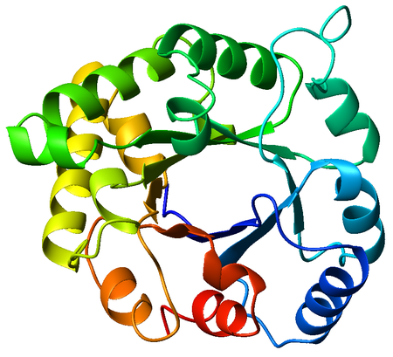
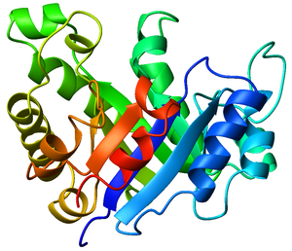
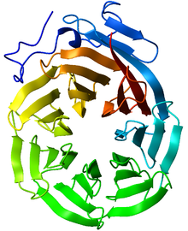
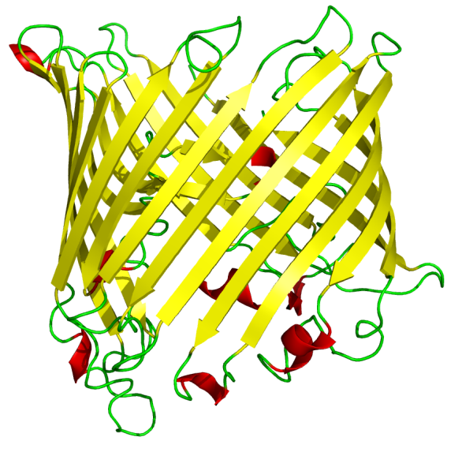
Super-secondary structures
Fold
A protein fold is defined by the way the secondary structure elements of the structure are arranged relative to each other in space.
Proteins can fold in only so many ways
Examples
TIM Barrel Fold (PDB: 8TIM)
Beta-Barrel
Beta Propellor (PDB: 1ERJ)

Slide 36
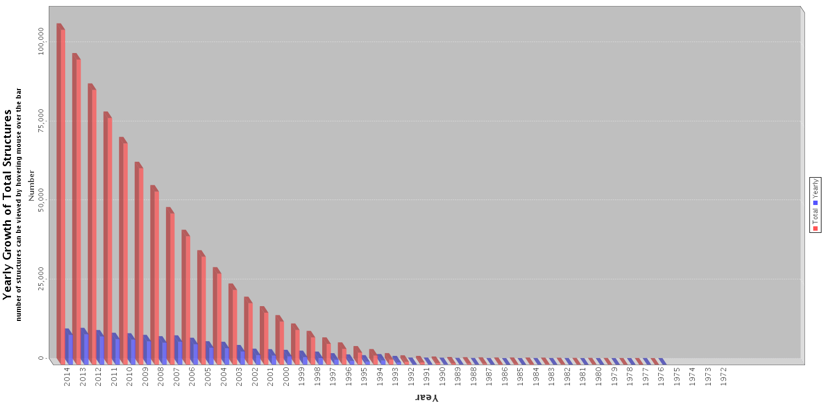
Growth in PDB

Slide 37
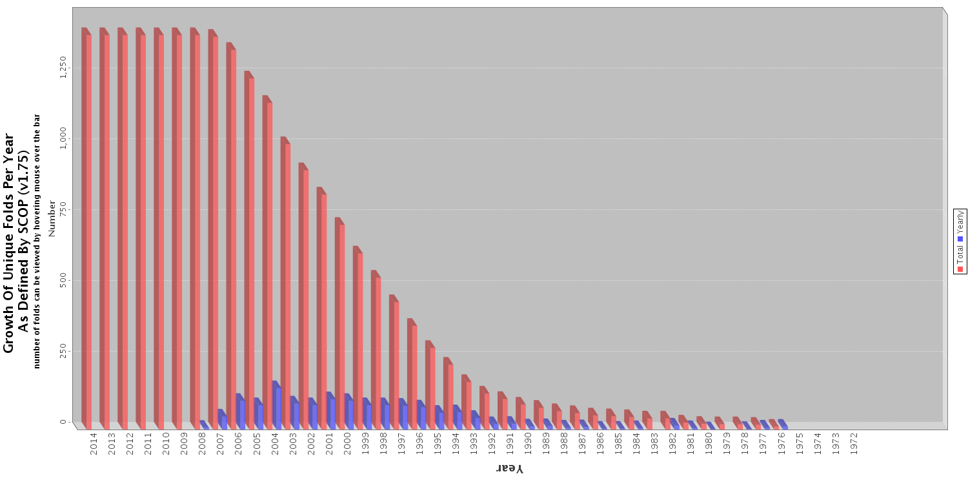
Growth of unique folds in PDB

Slide 38
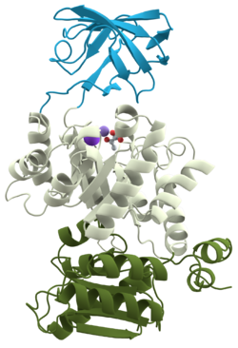
Supersecondary structures
Chain
A protein can have multiple independent chains of amino acids
Domains
A protein domain is a conserved part of a given protein sequence and (tertiary) structure that can evolve, function, and exist independently of the rest of the protein chain.
Two proteins having the same domain are said to belong to the same family
SCOP database
Pyruvate kinase, a protein with three domains (PDB 1PKN

Slide 39
Structure Determination
X-ray Crystallography
Nuclear Magnetic Resonance Spectroscopy
Electron Microscopy

Slide 40
Required Reading
Petsko & Ringe (2004)
Chapter 1: From Sequence to Structure
Chapter 5: Structure Determination
Placed in Piazza
Quiz Next time

Slide 41
Protein databases
Genbank: All DNA sequences
Uniprot
SCOP: Structural classification of proteins
manual classification of protein structural domains based on similarities of their structures and amino acid sequences.
Pfam
Pfam is a database of protein families that includes their annotations and multiple sequence alignments generated using hidden Markov models.
http://en.wikipedia.org/wiki/UniProt
http://en.wikipedia.org/wiki/Structural_Classification_of_Proteins_database
http://en.wikipedia.org/wiki/Pfam

Slide 42
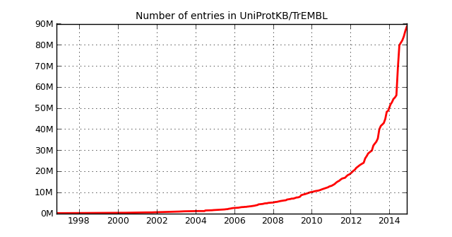
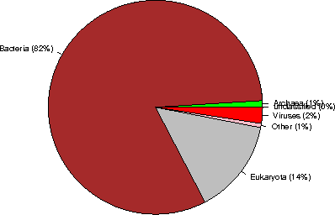
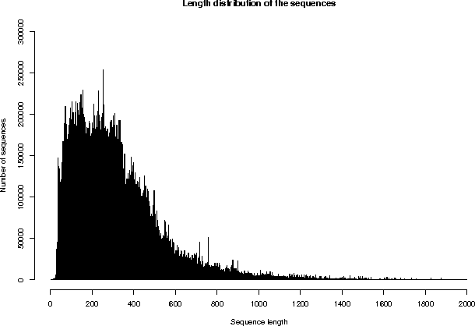
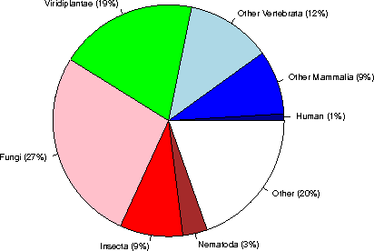
Uniprot Statistics
http://www.ebi.ac.uk/uniprot/TrEMBLstats

Slide 43
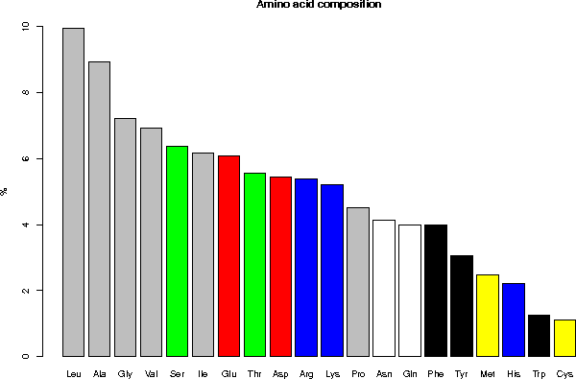
Usage of amino acids
gray = aliphatic, red = acidic, green = small hydroxy, blue = basic, black = aromatic, white = amide, yellow = sulfur
Notes:
AMINO ACID COMPOSITION 5.1 Composition in percent for the complete database Ala (A) 8.94 Gln (Q) 3.99 Leu (L) 9.94 Ser (S) 6.37 Arg (R) 5.37 Glu (E) 6.08 Lys (K) 5.20 Thr (T) 5.56 Asn (N) 4.12 Gly (G) 7.21 Met (M) 2.48 Trp (W) 1.26 Asp (D) 5.43 His (H) 2.21 Phe (F) 3.98 Tyr (Y) 3.05 Cys (C) 1.10 Ile (I) 6.16 Pro (P) 4.52 Val (V) 6.93 Asx (B) 0 Glx (Z) 0 Xaa (X) 0.01

Slide 44
Uniprot structure
“The primary mission of Universal Protein Resource (UniProt) is to support biological research by maintaining a stable, comprehensive, fully classified, richly and accurately annotated protein sequence knowledgebase, with extensive cross-references and querying interfaces freely accessible to the scientific community”
Each protein has a uniprot accession number
“Ongoing and future developments at the Universal Protein Resource,” Nucleic Acids Res., vol. 39, no. Database issue, pp. D214–D219, Jan. 2011.

Slide 45
Protein databases: Sequence
Sequence
UniProt
UniProt Knowledgebase (UniProtKB): Expertly curated annotations
The UniProt Archive (UniParc): Reflects history of all proteins
UniProt Reference Clusters (UniRef): Closely related proteins are merged
UniProt Metagenomic and Environmental Sequences Database (UniMES)
14%
“Ongoing and future developments at the Universal Protein Resource,” Nucleic Acids Res., vol. 39, no. Database issue, pp. D214–D219, Jan. 2011.
Notes:
Where is the protein data at?
Uniprot is the gen-bank of proteomics

Slide 46
Uniprot structure
UniProt Knowledgebase (UniProtKB)
Expertly curated database,
Central access point for integrated protein information
Cross-references to multiple sources.
The UniProt Archive (UniParc)
is a comprehensive sequence repository
Reflects the history of all protein sequences
UniProt Reference Clusters (UniRef)
Merge closely related sequences based on sequence identity to facilitate sequence similarity searches
Using CD-HIT
UniProt Metagenomic and Environmental Sequences Database (UniMES)
Caters for the expanding area of metagenomic data.

Slide 47
Uniprot structure
UniProtKB/Swiss-Prot
542,782 sequence entries in 2014_03 release
Reviewed, manually annotated entries
Annotations include
Protein and gene names
Function
Enzyme-specific information such as catalytic activity, cofactors and catalytic residues
Subcellular location
Protein-protein interactions
Pattern of expression
Locations and roles of significant domains and sites
Ion-, substrate- and cofactor-binding sites
Protein variant forms produced by natural genetic variation, RNA editing, alternative splicing, proteolytic processing, and post-translational modification
UniProtKB/TrEMBL
Automatic annotation

Slide 48
Example
http://www.uniprot.org/uniprot/P62158

Slide 49
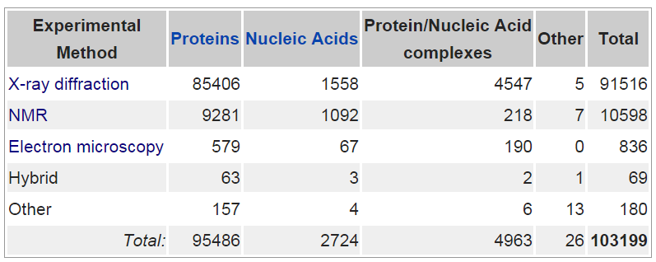
Protein Databank
http://proteopedia.org/wiki/index.php/Believe_It_or_Not
http://en.wikipedia.org/wiki/Protein_Data_Bank

Slide 50
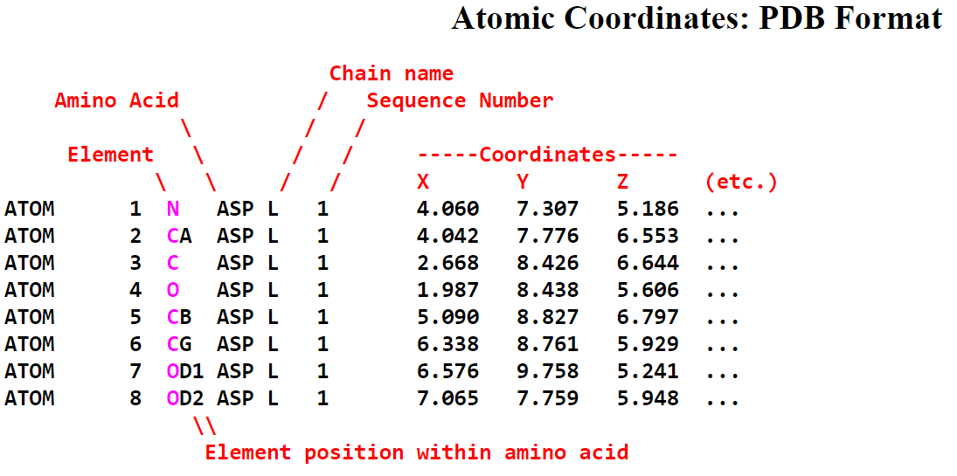
The PDB File
Also contains header and other information
http://en.wikipedia.org/wiki/Protein_Data_Bank_(file_format)
http://proteopedia.org/wiki/index.php/Atomic_coordinate_file

Slide 51
Other tools
OCA
FirstGlance
PDBSum
ccPDB

Slide 52
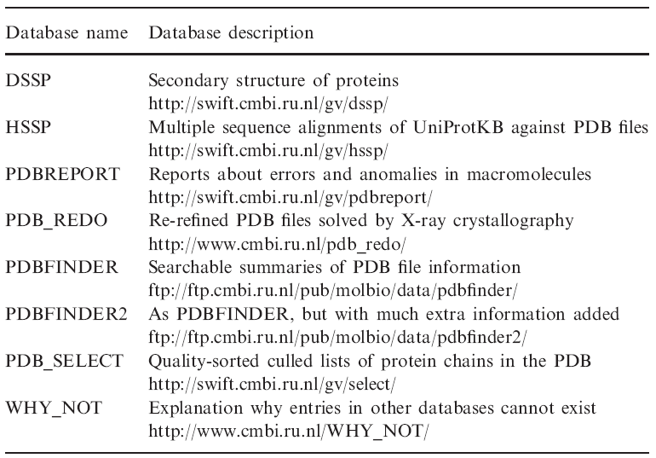
Tools for PDB
R. P. Joosten, T. A. H. te Beek, E. Krieger, M. L. Hekkelman, R. W. W. Hooft, R. Schneider, C. Sander, and G. Vriend, “A series of PDB related databases for everyday needs,” Nucleic Acids Res., vol. 39, no. suppl 1, pp. D411–D419, Jan. 2011.

Slide 53
What is our fundamental objective?
Find all information about a protein
What does a protein do? (Function)
Where does it occur? (Localization)
What is its biological significance (Biological process)
What is its structure?
What are its properties?
What are its interaction partners?
What are the binding sites and interfaces?
What is the effect of mutations?

Slide 54
How do we find it out?
The most basic idea is
Similarity Search
Sequence Similarity
Structure Similarity
Most tools are solutions to these problems

Slide 55
Computational Problems in Protein Biology
Identification and Structure Determination
Visualization
Databases
Alignments
Sequence based: Local, global, homology, phylogenetics, co-evolution, motif-finding
Structure based alignments
Structure prediction
Secondary and tertiary, contact maps, fold, domain localization, family identification
Prediction of structures of larger protein assemblies
Molecular dynamics, normal mode analysis
Protein folding, folding-pathways
Properties: Surface area, trans-membrane portions, signal peptides, functional sites, post-translational modifications
Cellular Function prediction, phenotype prediction
Cellular localization
Biological process prediction
Mutation analysis
Protein interactions: Binding, binding sites, protein, nucleic acid, water, ions, ligands
Drug discovery and design
Protein design and engineering

Slide 56
Tools
UGENE
A free bioinformatics tool for analysis of biological data
Download
http://ugene.unipro.ru/download.html

Slide 57
What can you do with UGENE for proteins?
Create, edit and annotate sequences
Searching in sequences
MSA
Online database search
BLAST
Alignments
3D Visualization of structures
Secondary Structure Prediction
Phylogenetic trees
…

Slide 58
Tasks covered today
Creating a project
Read a protein sequence
Searching (Exact and inexact)
Find basic properties of the protein sequence
Introduction to workflow design: Converting the file format
BLASTING
Connecting to remote database for downloading sequence
Visualization of protein structure
Introduction to annotations
Using DAS for sequence annotation

Slide 59
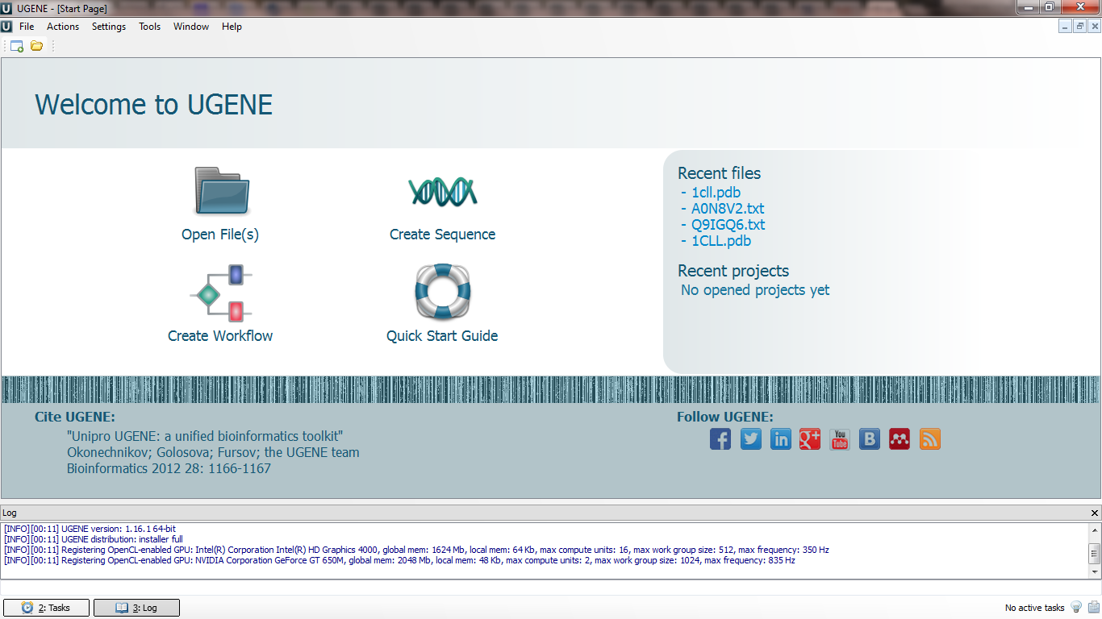
The UGENE Interface

Slide 60
UGENE Projects
UGENE projects allow you save your Bioinformatics files, workflows and objects
A project can have multiple files
FASTA
A file can have multiple objects
Sequences
Structures
Workflows (covered in the next lectures) manipulate the objects to produce others

Slide 61
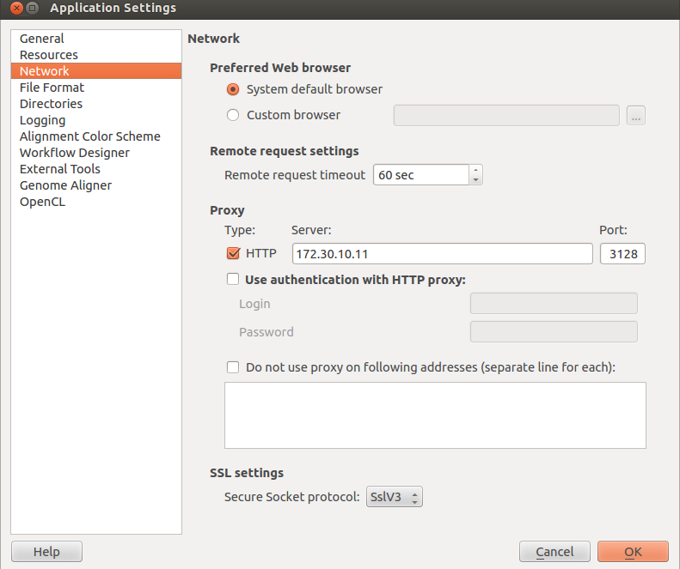
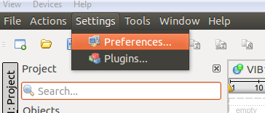
Setting up proxy
If you are behind a proxy server you will need to specify it in UGENE for it to be able to access the Internet

Slide 62
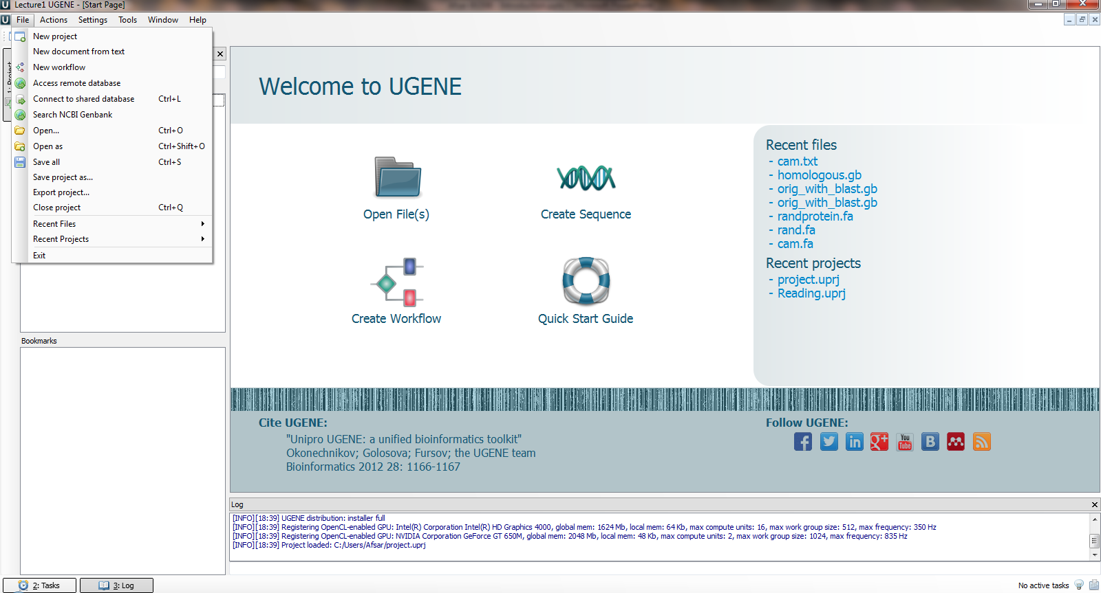
Create a new project
Notes:
We will cover protein databases in a later lecture

Slide 63
Create a new project

Slide 64
Download the cam.txt file from Piazza and save it to your Desktop

Slide 65
File > Open > (File Dialog) and open ‘cam.txt’
A “Select correct document format” dialog opens
Use it to select “Raw Sequence” and click ok

Slide 66
UGENE Sequence View
Sequence overview
Sequence zoomed view
objects
Annotation view

Slide 67
Looking at sequences

Slide 68
Search
Annotations highlighting
Statistics
DAS Annotations

Slide 69
Looking at sequence statistics

Slide 70
Searching in sequences

Slide 71
Inexact Searching
Using Regular Expressions
Select “Search Algorithm” > Regular Expressions
We can find a pattern such as
R[KE].K*D
Starts with R followed by a K or an E followed by any other character (.) followed by zero or more occurences of K (*) followed by a D

Slide 72
Inexact Searching
There are two occurrences of this pattern in the sequence

Slide 73
Regular Expressions (Exercise 1-1)
To find any patterns you can use regular expressions
More details on how to build regular expressions is available online
Build a regular expression that, within the cam sequence, searches for
three consecutive E’s followed by two other characters followed by another E
Two consecutive E’s followed by 3 other characters followed by another E
Once you are done, post your answers to piazza
Please include the question or exercise number

Slide 74
More on searching
You can also play with other options within the search to locate a certain pattern (exact or inexact) within the whole or a part of the sequence using “search in”
You can also restrict the results you get in “other settings”

Slide 75
Creating annotations
Such searches can be used for creating annotations
Annotations are saved in .gb files
Here in “Annotation parameters” give
Group name of your choice
Annotation type and annotation name of your choice and then click “create annotations”
You can then click on the annotation you have created to view where they occur in the sequence

Slide 76
2
1
Notice the annotations
3

Slide 77
Where is this used?
Let’s say you know that the binding site in a certain protein has the general pattern R..K and you want to find out where in the protein does this occur, i.e., where is the binding site
You can also annotate it to keep a record

Slide 78
Exercise 1-2
You are given a file on piazza called cam_binders3.fasta
Download that file
It contains 3 sequences of proteins that bind Calmodulin
R..K is a known Calmodulin binding motif
Let’s search for R..K within these three proteins
And create annotations with
Annotation type: Misc. Binding Site
Annotation Name: cam binding R..K
Once you are done report the positions of R..K within each protein on Piazza
This way you can find the correct binding site of Calmodulin within these proteins for 2 out of the 3 given proteins
For background reading:
Yap, Kyoko L., Justin Kim, Kevin Truong, Marc Sherman, Tao Yuan, and Mitsuhiko Ikura. “Calmodulin Target Database.” Journal of Structural and Functional Genomics 1, no. 1 (March 1, 2000): 8–14. doi:10.1023/A:1011320027914.

Slide 79
Still more searching
Assignment
You can also use Smith Waterman Algorithm for searching and determining sequence similarity

