Slide 1
CIS529: Bioinformatics Revision and Protein Structure Prediction
Presented by
Dr. Fayyaz-ul-Amir Afsar Minhas
http://faculty.pieas.edu.pk/fayyaz
Department of Computer & Information Sciences
Pakistan Institute of Engineering & Applied Sciences
PO Nilore, Islamabad 45650
Pakistan
Notes:
No. II will be presented prior to the introduction of proteomics later in the course

Slide 2
Gene Ontology (GO)
Gene ontology, or GO, is a major bioinformatics initiative to unify the representation of gene and gene product attributes across all species. More specifically, the project aims to:
Maintain and develop its controlled vocabulary of gene and gene product attributes;
Annotate genes and gene products, and assimilate and disseminate annotation data;
Provide tools for easy access to all aspects of the data provided by the project, and to enable functional interpretation of experimental data using the GO, for example via enrichment analysis.
http://geneontology.org/page/documentation
Notes:
http://david.abcc.ncifcrf.gov/home.jsp

Slide 3
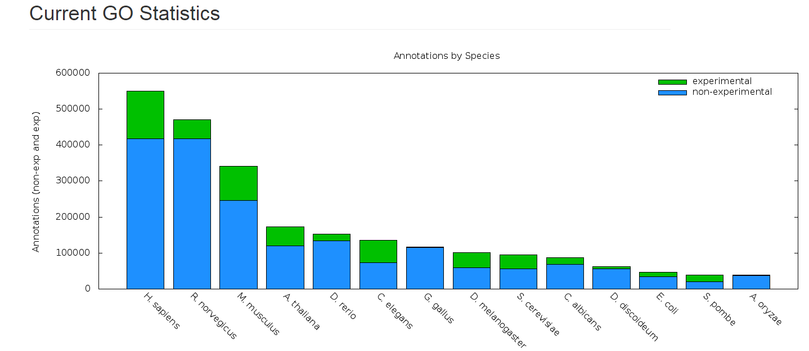
GO
http://geneontology.org/page/current-go-statistics

Slide 4
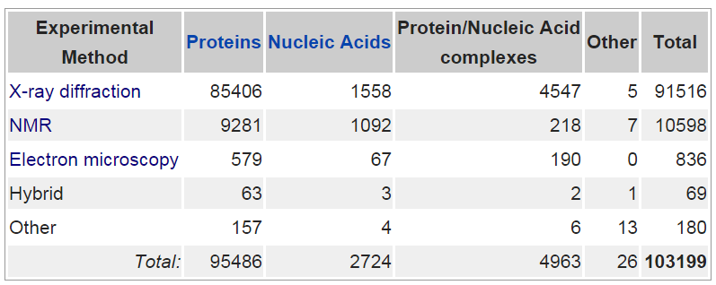
Protein Databank
http://proteopedia.org/wiki/index.php/Believe_It_or_Not
http://en.wikipedia.org/wiki/Protein_Data_Bank

Slide 5
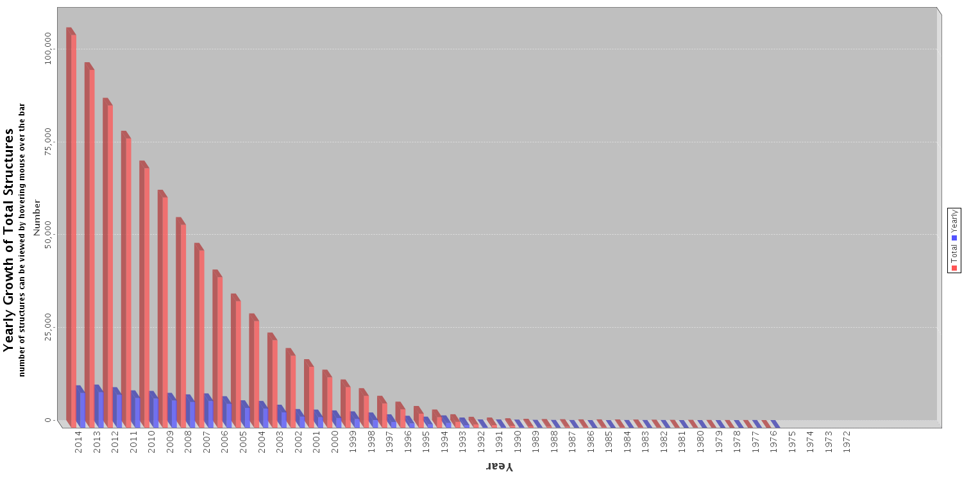
Growth in PDB

Slide 6
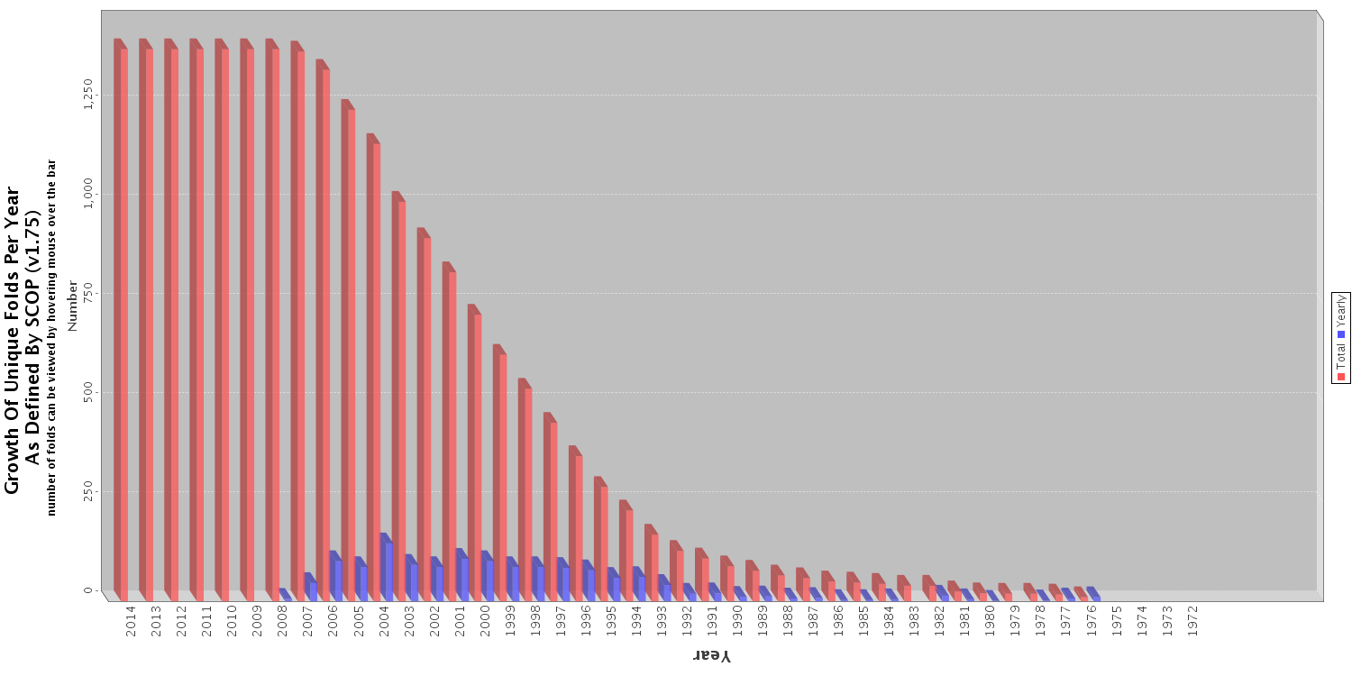
Growth of unique folds in PDB

Slide 7
How big is the protein conformation space?
Assume that:
each of the torsion angles can take 2 or 3 values
In practice these angles are continuous
Side chains are fixed
We have a protein of length L
Thus the number of possible “conformations” is:
2L or 3L
If L = 100, this means 10³⁰ or 10⁴⁷ conformations

Slide 8
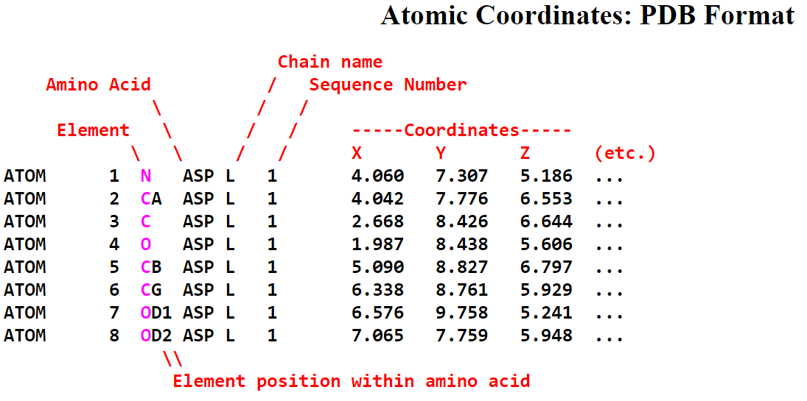
The PDB File
Also contains header and other information
http://en.wikipedia.org/wiki/Protein_Data_Bank_(file_format)
http://proteopedia.org/wiki/index.php/Atomic_coordinate_file

Slide 9
Other tools
OCA
http://oca.weizmann.ac.il/oca-docs/oca-home.html
http://oca.weizmann.ac.il/oca-bin/ocamain
FirstGlance:
PDBSum
ccPDB

Slide 10
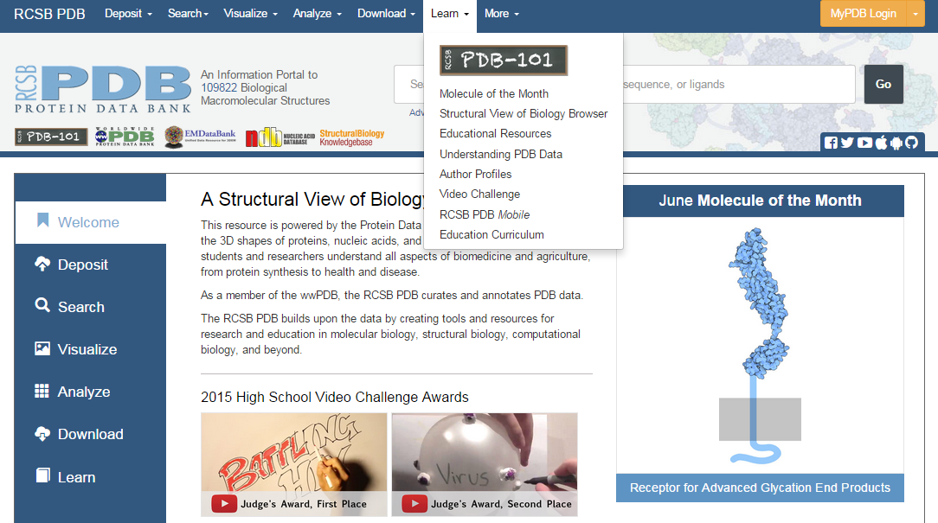
PDB 101

Slide 11
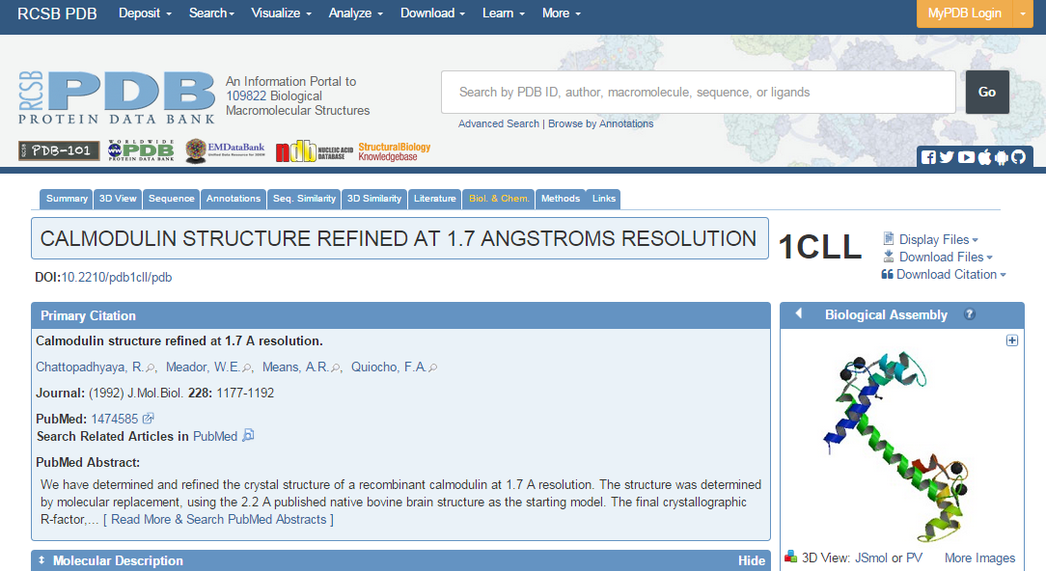
PDB Itself

Slide 12
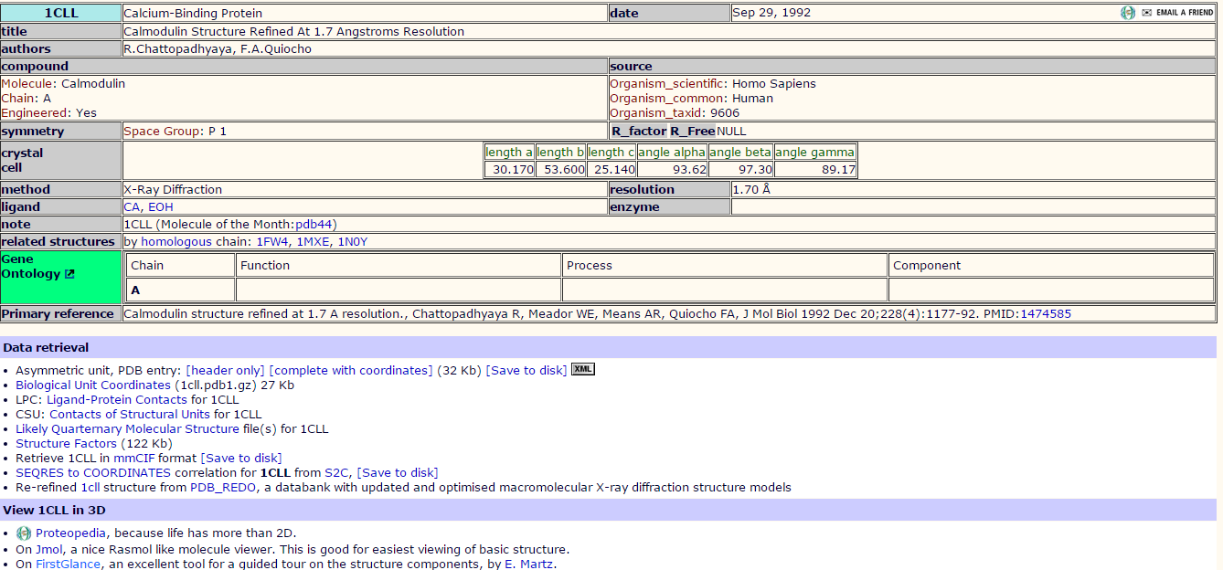
OCA

Slide 13
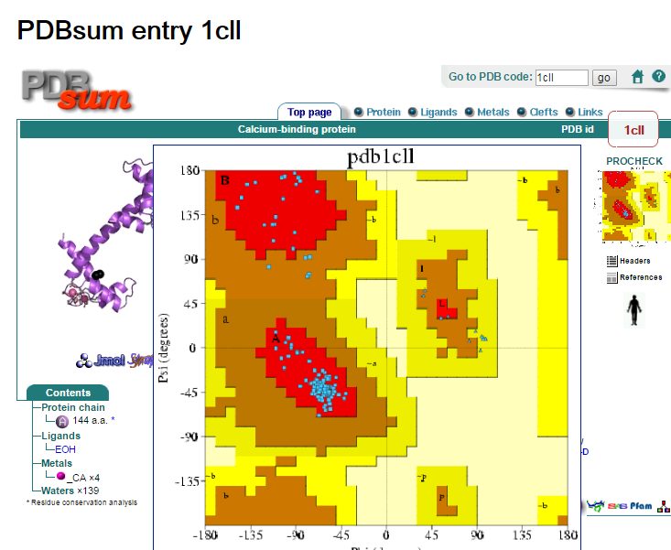
PDBSum
Notes:
It shows the molecule(s) that make up the structure (ie protein chains, DNA, ligands and metal ions) and schematic diagrams of their interactions. Extensive use is made of the freely available RasMol molecular graphics program to view the molecules and their interactions in 3D.

Slide 14
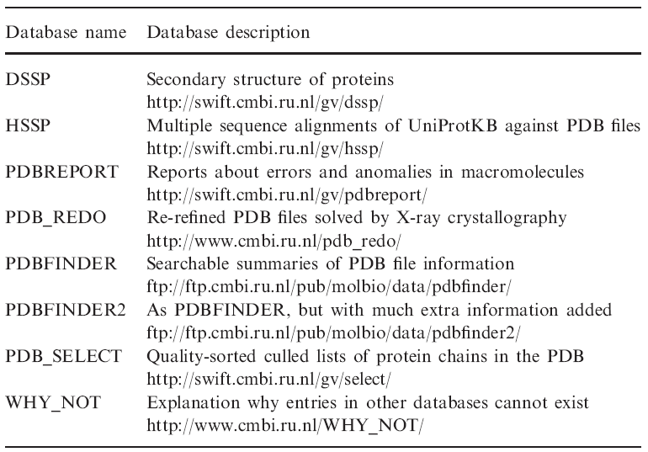
Tools for PDB
R. P. Joosten, T. A. H. te Beek, E. Krieger, M. L. Hekkelman, R. W. W. Hooft, R. Schneider, C. Sander, and G. Vriend, “A series of PDB related databases for everyday needs,” Nucleic Acids Res., vol. 39, no. suppl 1, pp. D411–D419, Jan. 2011.

Slide 15
Handling PDB Files
You can view them in UGENE
Get Annotations as well
However, PyMOL is much much better!

Slide 16
PyMOL
PyMOL
Free *for academic use (http://pymol.org/edu/?q=educational/)
Tool for molecular visualization
http://www.pymolwiki.org/index.php/Practical_Pymol_for_Beginners

Slide 17
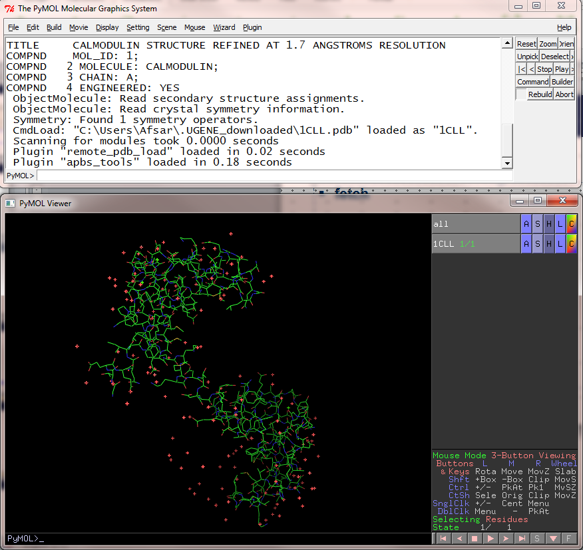
Menus
PyMOL Molecular Graphics System
Python Commands
PyMOL Viewer
Objects
Action,
Show, Hide
Label
Color
Selection Controls
Python Commands
Object View

Slide 18
Visualization types
Types:
Lines
Sticks
Cartoon
Space-fill
Surface
How are secodnary structures assigned?
DSSP
STRIDE (http://en.wikipedia.org/wiki/STRIDE_%28protein%29)

Slide 19
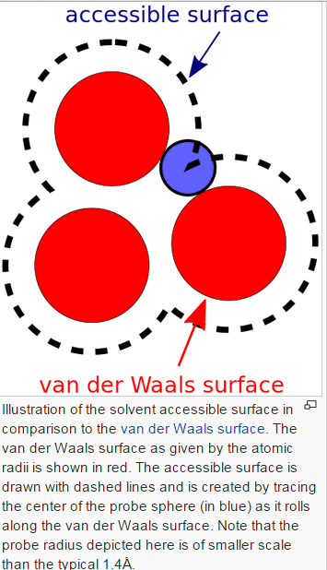
Determining the Accessible Surface Area
Role a ball around the molecule to obtain the surface
Methods:
STRIDE

Slide 20
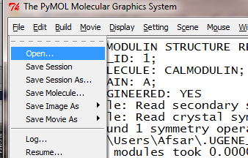
Commands
Fetch
Open
Using Mouse
Hold Left Click and rotate
Hold Right Click and zoom in and out
Left Click for selection
Right Click for Menu
Middle Click and hold to move
Roll to change the z-min and z-max of the view window

Slide 21
PyMOL
Actions
Center
Hydrogens
Remove Waters
Deleting
Show
As – lines, sticks, ribbon, cartoon, dots, spheres, mesh and surface
Hide
Everything or certain views
Label
Hide – label
Color
Spectrum or in certain ways

Slide 22
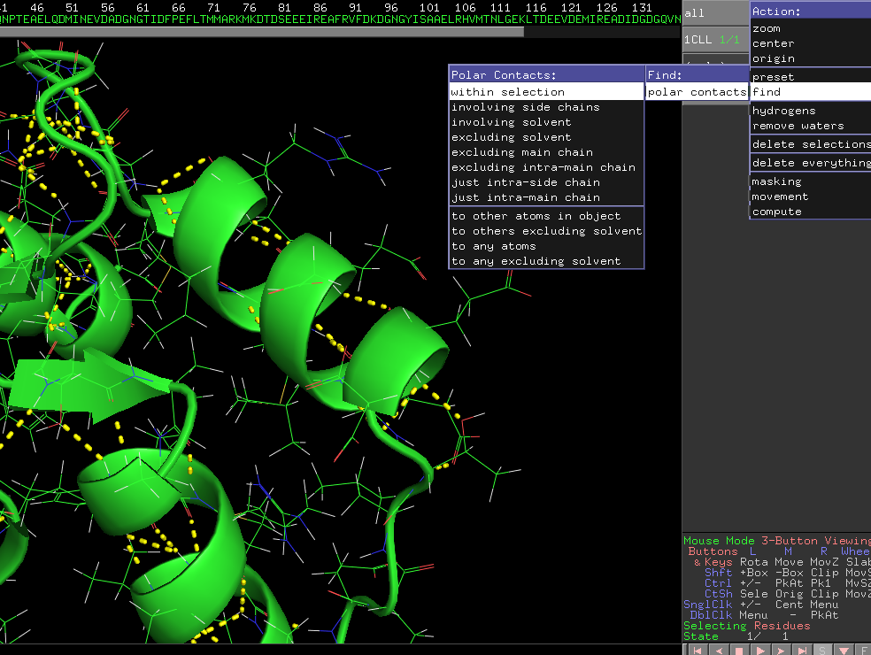
Polar contacts

Slide 23
PyMOL Visualization Exercise
Load 1CLL
Visualize 1CLL
Show the structure as a cartoon
Hide lines
Try Action-> Presets (Ligand, technical, b-value)
Get rid of Water-atoms
Show the Calcium ions as spheres
Show lines
Show hydrogens
Find polar contacts of the calcium ions
Select all atoms in an alpha helix and show the hydrogen bonds between them
Do the same for a beta sheet
Show surface
Show Binding sites of EOH

Slide 24
Saving views
You can save sessions
You can also create images
R click “ray”
Display -> Background -> White
File -> Save Image As ->…

Slide 25
Using PyMOL for analysis
View Binding Site of Calcium
EOH

Slide 26
MORE HELP ON PYMOL
You can even do programming in Python for visualization
VIDEOS!
http://www.pymolwiki.org/index.php/Main_Page
http://www.protein.osaka-u.ac.jp/rcsfp/supracryst/suzuki/jpxtal/Katsutani/en/index.php

Slide 27
Structure Related Tasks
Protein stability and energy calculations
Protein Tertiary structure alignments
Covered in more detail in “Machine learning in Bioinformatics” Course
Protein secondary structure prediction
Protein contact map prediction
Protein torsion angle prediction
Protein ASA prediction
Protein disorder prediction
Protein tertiary structure prediction

Slide 28
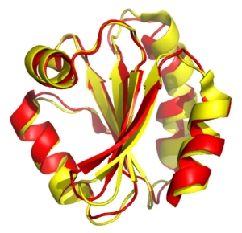
Structural Alignment
Types
Global
Local
Multiple structure alignment
RMSD
Methods
DALI
FSSP
ProBiS
PyMol
http://en.wikipedia.org/wiki/Structural_alignment

Slide 29
PyMOL Visualization Assignment
Load 1CFD & 1DMO
Is it showing hydrogens?
Align the two structures
http://www.pymolwiki.org/index.php/Align
http://pldserver1.biochem.queensu.ca/~rlc/work/teaching/BCHM823/pymol/alignment/
http://pymol.sourceforge.net/newman/user/toc.html

Slide 30
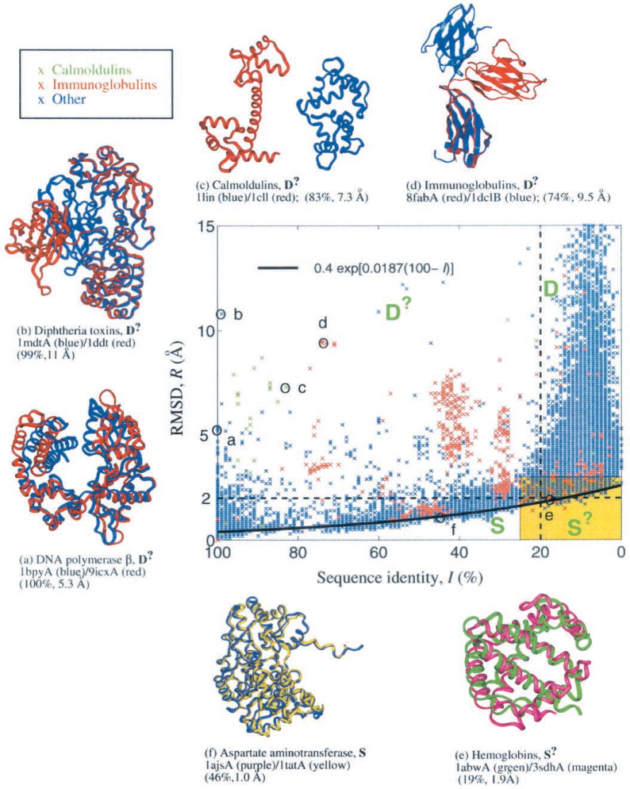
Seq. vs. RMSD
Sequence/structure map of 53,383 protein pairs displayed as a root-mean-square deviation (RMSD or R) versus percent sequence identity, I, plot. The 465 probe proteins listed in Table 1 were used to generate these pairs using the FSSP algorithm. Only alignments >75 residues are included. Sequence/structure coordinates are marked by blue × symbols except for those resulting from calmodulin (1cll, green) and immunoglobulin (8fabA, red) probes. The map is subdivided into regions as discussed in the text: expected similarity (S); unexpected similarity (S?); expected dissimilarity (D); and unexpected dissimilarity (D?). Superpositions of selected protein pairs in different regions are marked and displayed. The thick black line corresponds to the empirical exponential function of Eq. 2.
H. Hark Gan, R. A. Perlow, S. Roy, J. Ko, M. Wu, J. Huang, S. Yan, A. Nicoletta, J. Vafai, D. Sun, L. Wang, J. E. Noah, S. Pasquali, and T. Schlick, “Analysis of Protein Sequence/Structure Similarity Relationships,” Biophys. J., vol. 83, no. 5, pp. 2781–2791, Nov. 2002.

Slide 31
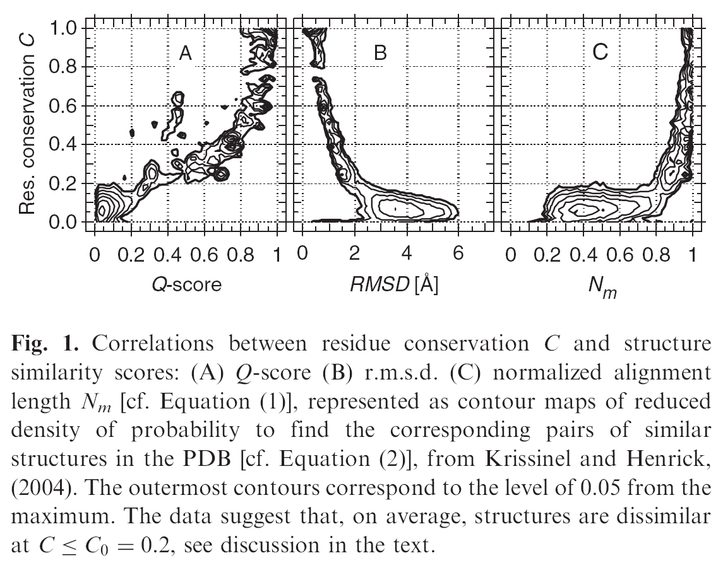
Sequence vs. Structure
E. Krissinel, “On the relationship between sequence and structure similarities in proteomics,” Bioinformatics, vol. 23, no. 6, pp. 717–723, Mar. 2007.

Slide 32
Energy Calculations
A protein molecule in 3D space can be visualized as a group of objects which interact with each other with forces
Electrical
Chemical
Bond
Clashes
These interactions determine the energy of the object
A protein folds spontaneously if the change in its free energy is negative

Slide 33
Force Fields
AMBER
CHARMM
GROMACS
…
Only Approximation
Modeling molecular water
Empirical terms
Knowledge based

Slide 34
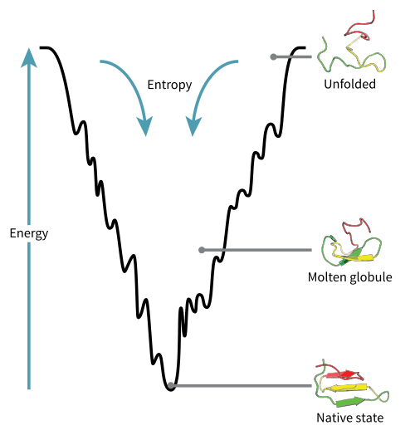
Energy Landscape of Protein Folding
The native state of the protein is the conformation of the protein with the lowest energy
http://en.wikipedia.org/wiki/Folding_funnel

Slide 35
Tertiary Structure Prediction Methods
Comparative/Homology Modeling Based Techniques
Fold Recognition and Threading
De novo prediction (from first principles)
According to Science, the problem remains one of the top 125 outstanding issues in modern science.^{[1]}
The protein folding problem: when will it be solved?
“So Much More to Know …,” Science, vol. 309, no. 5731, pp. 78–102, Jul. 2005.

Slide 36
Comparative Modeling
Principle
Sequence drives structure
Evolutionarily related sequences exhibit similar three dimensional structure

Slide 37
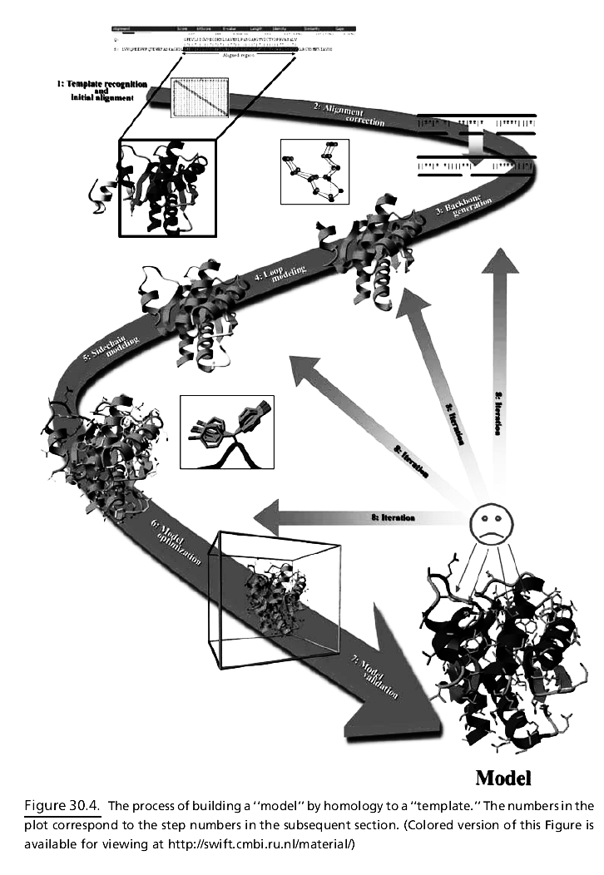
H. Modeling
Steps
Homology detection
Alignment of target sequence to template structures
Modeling of structurally conserved regions using known templates
Modeling side chains and loops which are different from the templates
Refinement
(READ)
Venselaar et al., “Homology Modeling”, Chapter 30 in Structural Bioinformatics, editors: Gu and Bourne, 2011.

Slide 38
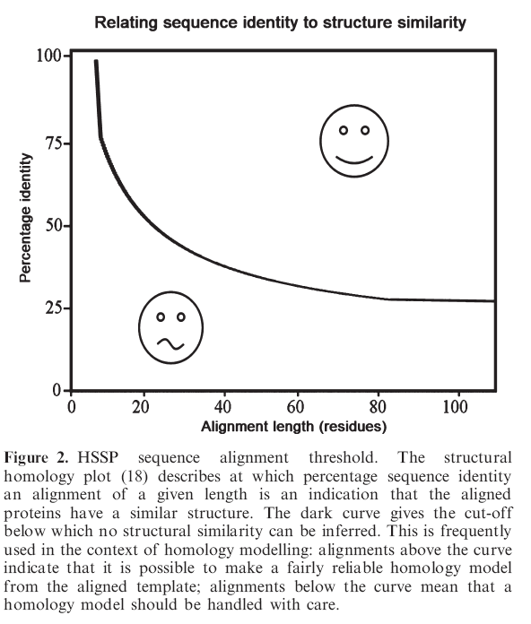
Comparative Modeling
During alignment or homology detection, should we use protein sequences or the DNA sequence that produced the protein?
Why?
If two proteins have >30% sequence identity
More than 80% of the C-alpha atoms can be expected to be within 3.5 Angsrtoms of their true positions
Otherwise errors
B. Rost, “Twilight zone of protein sequence alignments,” Protein Eng., vol. 12, no. 2, pp. 85–94, Feb. 1999.

Slide 39
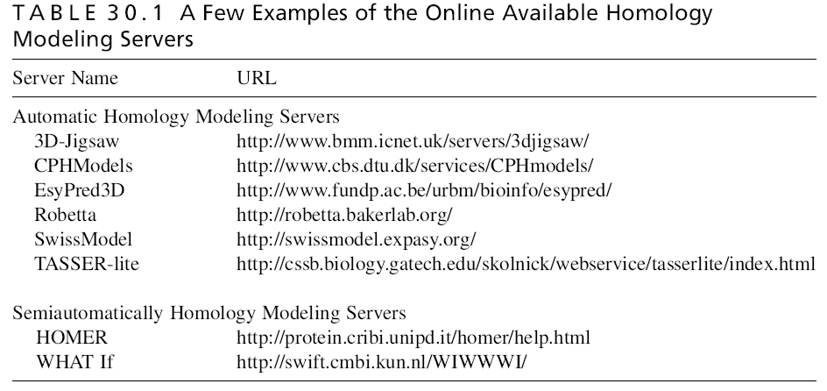
Examples

Slide 40
SWISS-model
Use BLAST to fetch homologous sequences
If no suitable templates are found, HHSearch is used for detection of remotely related sequences
Database: Uses SWISS-MODEL Template Library which is derived from PDB
Alignment of target sequence and template structure(s)
Model Building and Energy Minimization
A rigid fragment assembly approach for modeling
Assessment of model quality
QMEAN, ANOLEA, GROMOS
http://en.wikipedia.org/wiki/Swiss-model

Slide 41
Fold Recognition / Threading
Main idea:
The number of unique folds is limited
Fit a target sequence to a known structure in a library of folds
Inverse folding
threading
http://en.wikipedia.org/wiki/Threading_(protein_sequence)

Slide 42
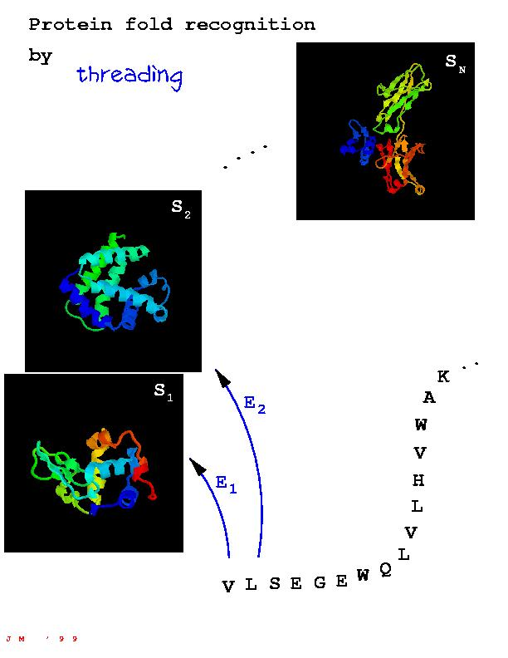
Threading
Components
Library of templates (SCOP, FSSP…)
Scoring Function
Measures the fitness of a sequence to structure alignment
Abstract form: F(sequence, structure)
F(sequence, structure) is low if there is good correspondence between the sequence and the given structure
High otherwise
Sequence to structure alignment
Find the best alignment between a fixed sequence (given) and structure
Notes:
Next, one takes the sequence and "threads" it through each template in the library as shown in Fig. 2 . The word threading implies that one drags the sequence (ACDEFG...) step by step through each location on each template, but really one is searching for the best arrangement of the sequence as measured by some score or quasi-energy function.

Slide 43
Methods
Hhpred
RAPTORX
Phyre
Limitations
A completely new fold?
http://en.wikipedia.org/wiki/Threading_%28protein_sequence%29

Slide 44
De novo protein structure prediction
With database support
Rosetta
Knowledge based scoring function
Without database support
Using first principles without any database information
Physics based scoring function
J. Lee, S. Wu, and Y. Zhang, “Ab Initio Protein Structure Prediction,” in From Protein Structure to Function with Bioinformatics, D. J. Rigden, Ed. Springer Netherlands, 2009, pp. 3–25.
Notes:
رشيد

Slide 45
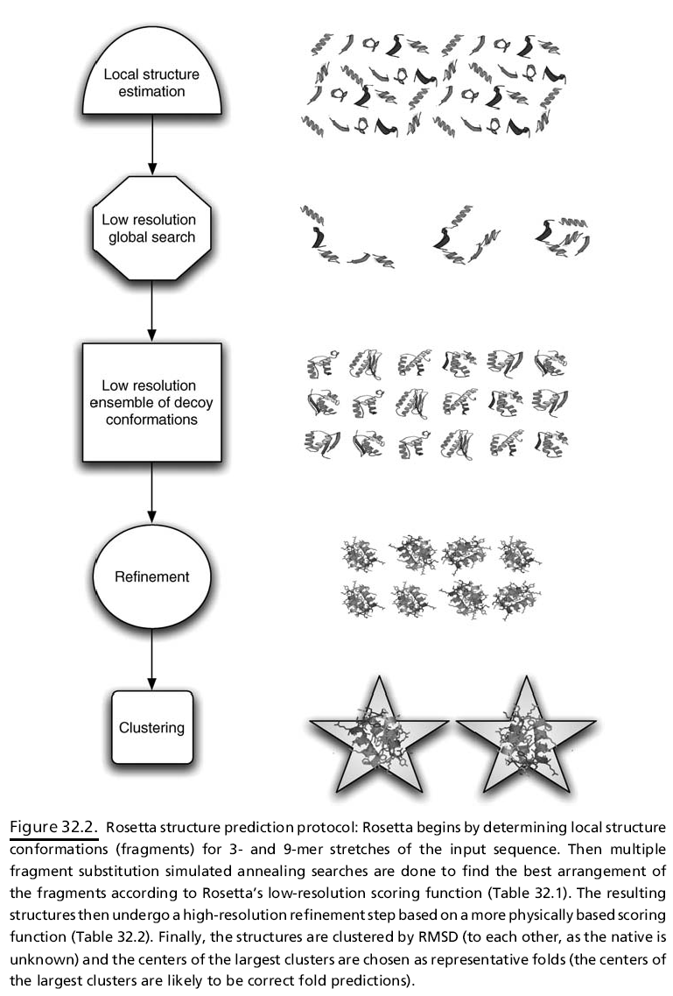
Rosetta
Fragment Assembly Approach
Uses PDB information to estimate the possible conformations for local sequence segments
3 and 9 residue matches between the query sequence and a given structure
Fragment substitution
Initial low resolution refinement using a scoring function
Second stage refinement
http://en.wikipedia.org/wiki/Rosetta@home

Slide 46
First principles without database information
Find the lowest free energy state of a protein using only physics laws and the amino acid sequence
Use a force field and optimize it across conformations

Slide 47
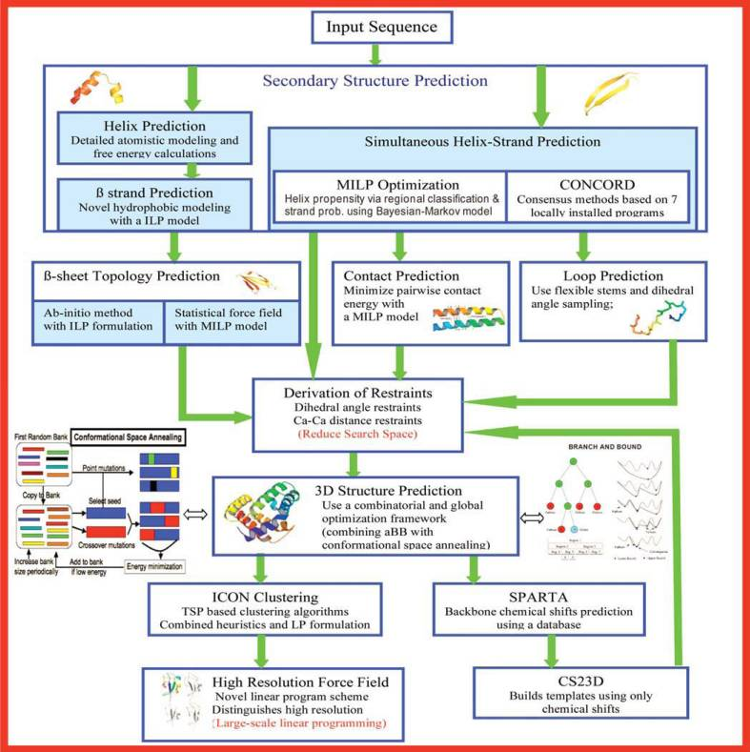
ASTRO FOLD

Slide 48
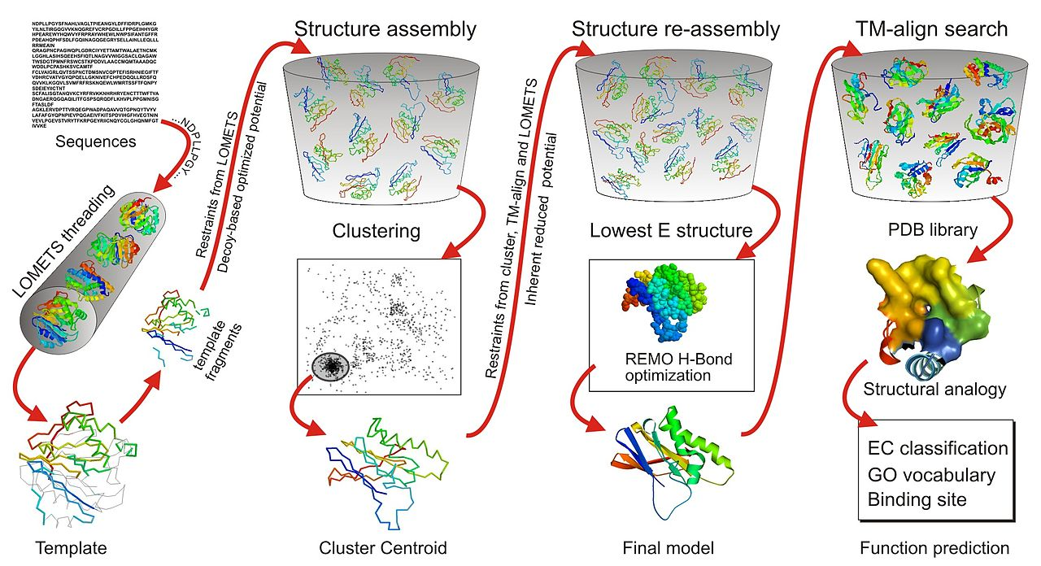
I-TASSER

Slide 49
I-TASSER
Roy, Ambrish, Dong Xu, Jonathan Poisson, and Yang Zhang. “A Protocol for Computer-Based Protein Structure and Function Prediction,” no. 57 (November 3, 2011): e3259. doi:10.3791/3259.
VIDEO

Slide 50
Comparison
CASP
CAMEO
http://www.cameo3d.org/sp/1-year/

Slide 51
Assignment
Take a protein sequence with a known structure
Get its sequence
Make some changes to the sequence of the protein
Submit it for prediction of structure
Align the new structure with the existing one
See how much error you get

Slide 52
What’s left?
Enrichment Analysis
DAVID
http://david.abcc.ncifcrf.gov/
GORILLA
cbl-gorilla.cs.technion.ac.il
http://amigo.geneontology.org/rte
Co-evolution analysis
Molecular Movements / Conformational changes
Prediction of Interactions
Predictions of Interfaces

Slide 53
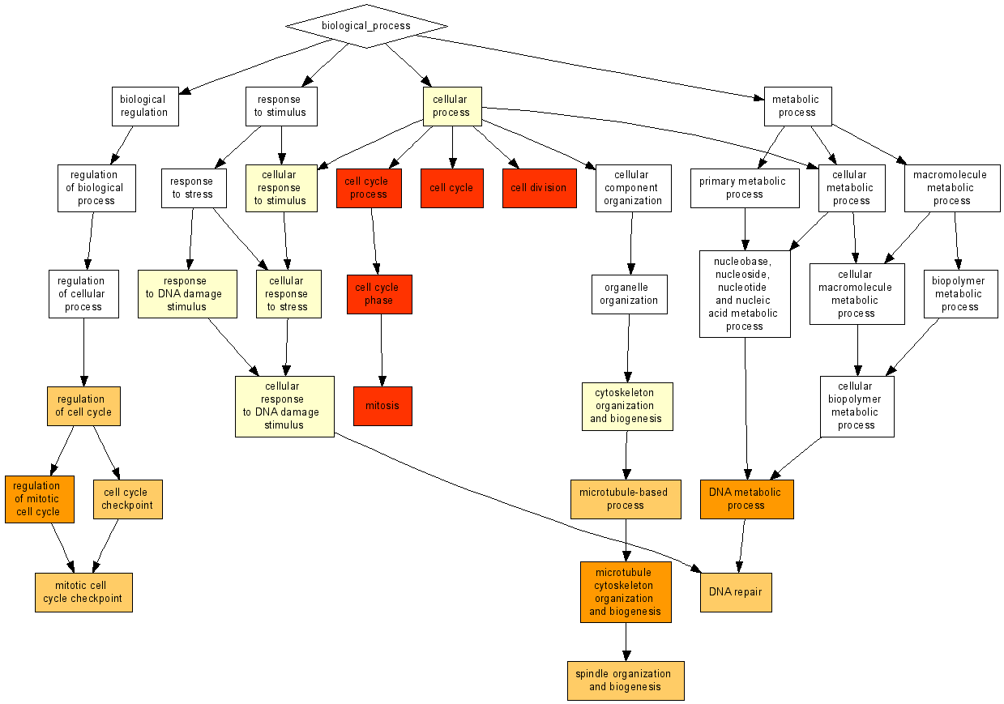
http://cbl-gorilla.cs.technion.ac.il/example.html

Slide 54
Binding Prediction
Interaction Prediction
Binding Site Prediction
Interface Prediction
Hotspot Prediction
Mutational analysis
Interacting isoform prediction
Genome wide interaction analysis
Cross-species interaction analysis
Domain interaction analysis
Interaction network and interactome analysis

Slide 55
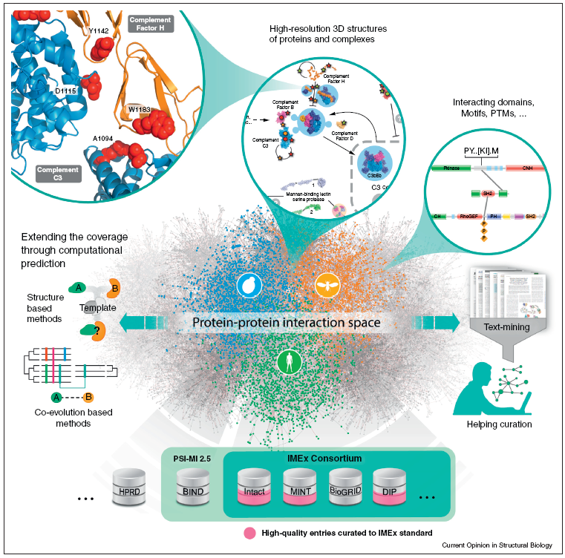
MUST READ
Mosca, Roberto, Tirso Pons, Arnaud Céol, Alfonso Valencia, and Patrick Aloy. “Towards a Detailed Atlas of Protein–protein Interactions.” Current Opinion in Structural Biology, Catalysis and regulation / Protein-protein interactions, 23, no. 6 (December 2013): 929–40. doi:10.1016/j.sbi.2013.07.005.

Slide 56
Predicting Interactions
Servers
Interologs -- BIPS. Biana Interolog Prediction Server
http://www.ncbi.nlm.nih.gov/pubmed/22689642
http://sbi.imim.es/web/index.php/research/servers/bips
iLoops
http://sbi.imim.es/iLoops.php
http://www.ncbi.nlm.nih.gov/pubmed/23842807
PrePPI
http://www.ncbi.nlm.nih.gov/pmc/articles/pmid/23193263/
http://bhapp.c2b2.columbia.edu/PrePPI

Slide 57
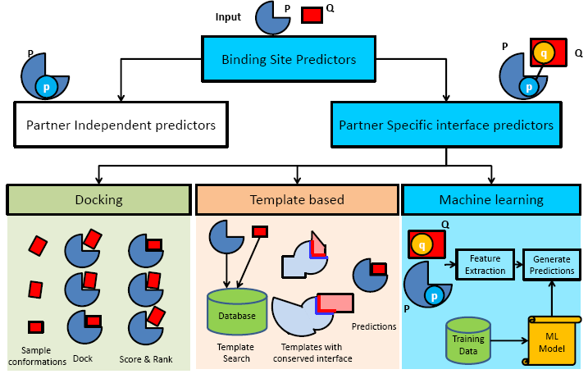

Slide 58
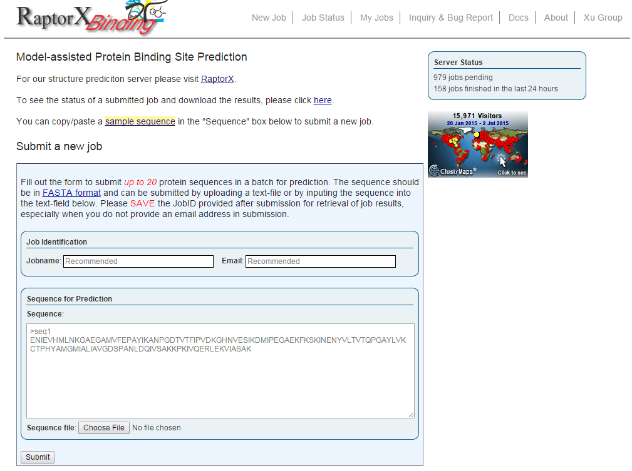
http://raptorx.uchicago.edu/BindingSite/

Slide 59
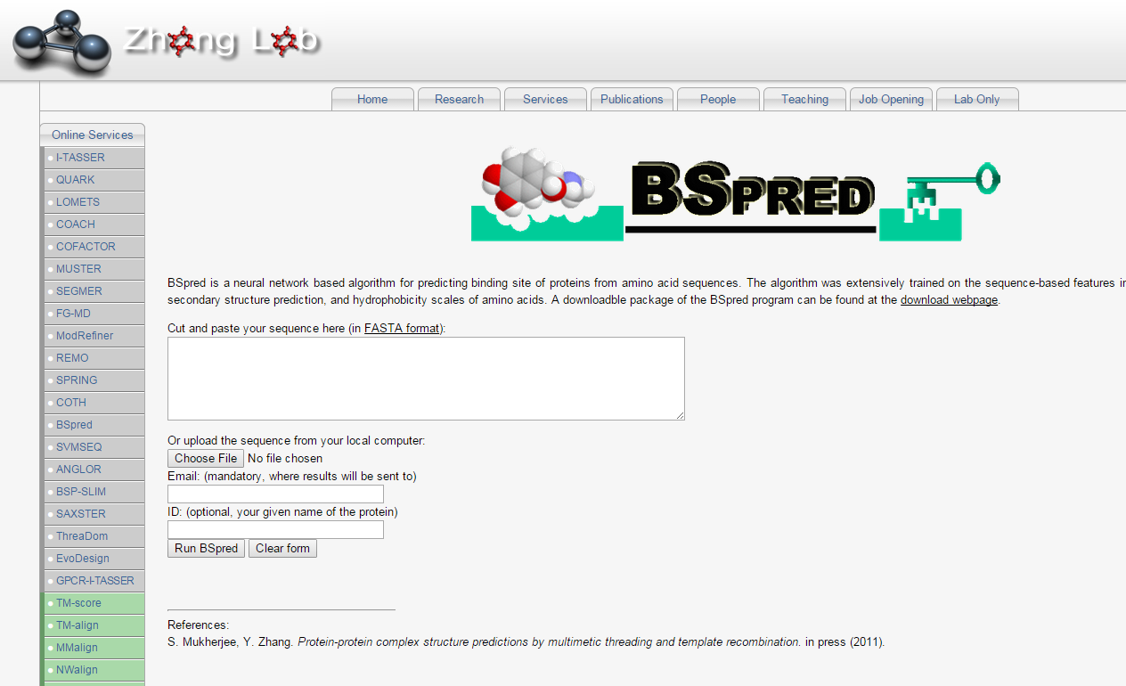
http://zhanglab.ccmb.med.umich.edu/BSpred/

Slide 60
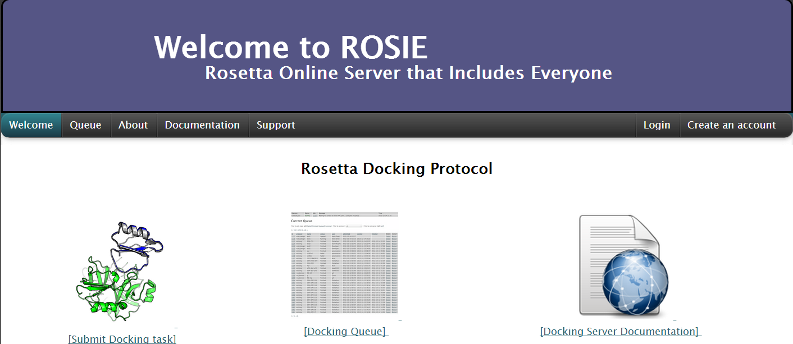
Docking
http://rosie.rosettacommons.org/docking/

Slide 61
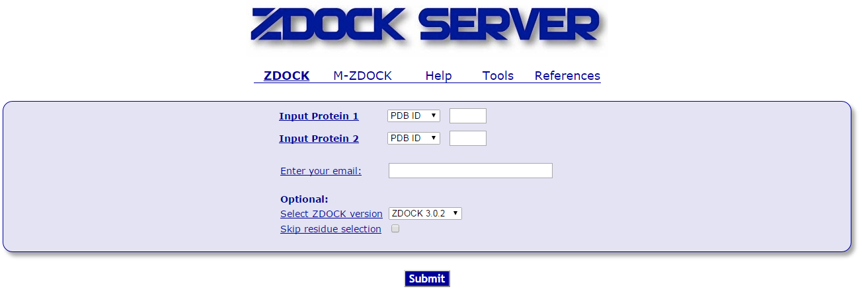
Docking
D
http://zdock.umassmed.edu/

Slide 62
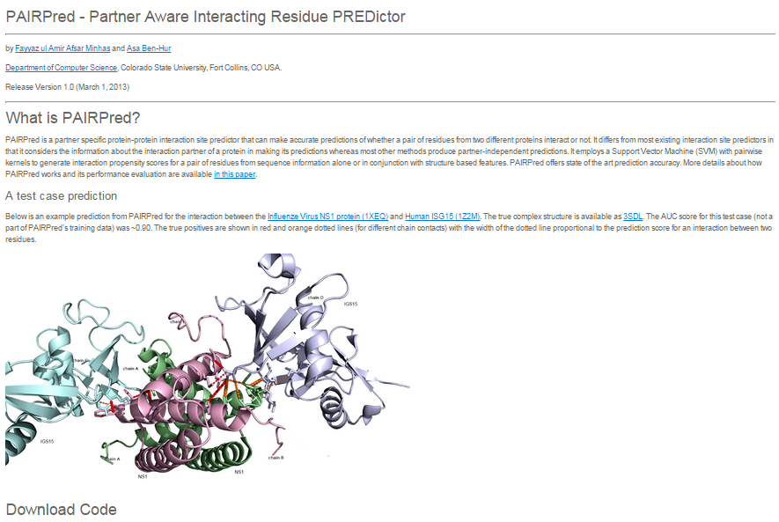
http://combi.cs.colostate.edu/supplements/pairpred/

Slide 63
CAPRI
http://www.ebi.ac.uk/msd-srv/capri/round27/round27.html
https://en.wikipedia.org/wiki/Critical_Assessment_of_Prediction_of_Interactions

Slide 64
Conclusions
We tried to cover
Sequence to Function
Structure to Function
Sequence to Structure
Interactions
Databases
Alignments
Local, global
Multiple Sequence
Remote Homology
For generating Functional annotations
Structures
Visualization, Alignments, Prediction
Good luck!

