Slide 1
CSE 190 Caffe Tutorial

Slide 2
Summary
Caffe is a deep learning framework
Define a net layer-by-layer
Define the whole model from input-to-loss
Data and derivatives flow through net during forward/backward passes
Information is stored, communicated and manipulated as blobs
Blobs are a unified memory interface for holding data (data, model parameters, derivatives)
Notes:
A blob is a N-dimensional array stored in a C-contiguous fashion

Slide 3
SoftmaxLossLayer
Caffe: Main classes
Blob: Stores data and derivatives
Layer: Transforms bottom blobs to top blobs
Net: Many layers; computes gradients via forward / backward
Solver: Uses gradients to update weights
fc1
data
data
diffs
InnerProductLayer
W
b
data
data
data
X
diffs
diffs
DataLayer

Slide 4
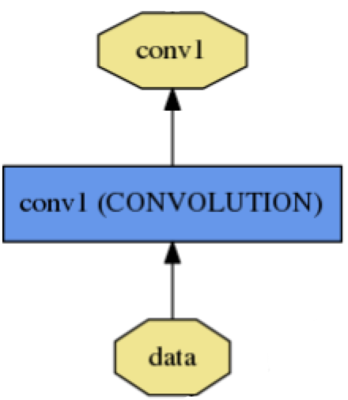
Blob
name: "conv1"
type: CONVOLUTION
bottom: "data"
top: "conv1"
… definition …
Blobs are N-D arrays for storing and communicating information.
hold data, derivatives, and parameters
lazily allocate memory
shuttle between CPU and GPU
top blob
Data
Number x K Channel x Height x Width
256 x 3 x 227 x 227 for ImageNet train input
Parameter: Convolution Weight
N Output x K Input x Height x Width
96 x 3 x 11 x 11 for CaffeNet conv1
Parameter: Convolution Bias
96 x 1 x 1 x 1 for CaffeNet conv1
bottom blob

Slide 5
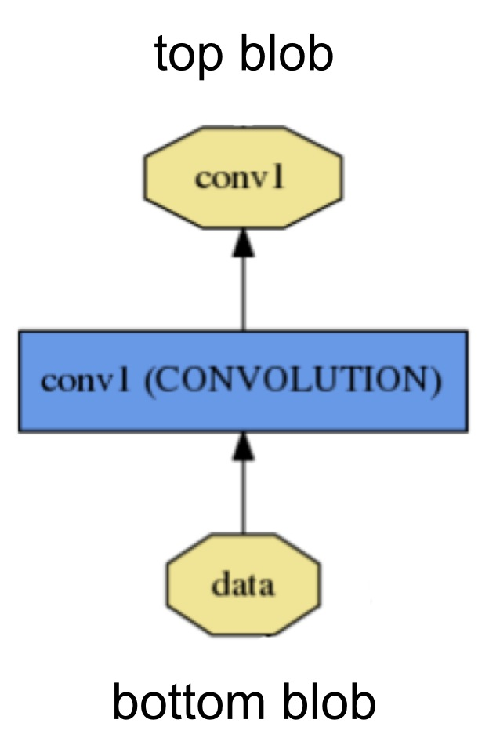
Layer
Layers are the essence of the model (convolutions, pooling, fully-connected, etc.)
Input: bottom
Output: top
Critical computations:
setup
forward
backward
Notes:
Setup: initialize the layer and connections
Forward: Given input from bottom, compute output and send to top
Backward: Given gradient w.r.t. top output, compute the gradient w.r.t. the input and send to the bottom

Slide 6
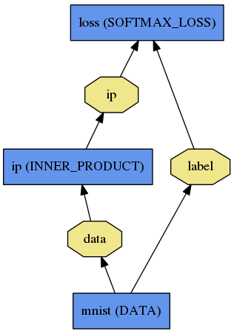
Net
A network is a set of layers and their connections:
name: "dummy-net"
layer { name: "data" …}
layer { name: "conv" …}
layer { name: "pool" …}
… more layers …
layer { name: "loss" …}
LogReg ↑
Caffe creates and checks the net from the definition.
Data and derivatives flow through the net as blobs – an array interface
LeNet →
ImageNet, Krizhevsky 2012 →

Slide 7
Protocol Buffers
Like strongly typed, binary JSON
Developed by Google
Define message types in .proto file
Define messages in .prototxt or .binaryproto files (Caffe also uses .caffemodel)
Notes:
JSON: JavaScript Object Notation

Slide 8
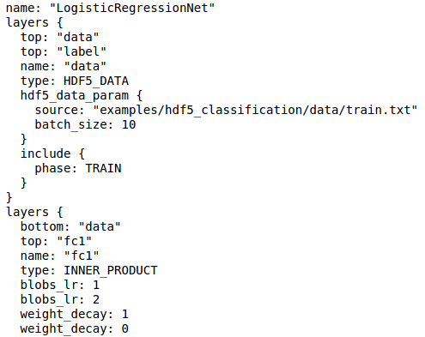
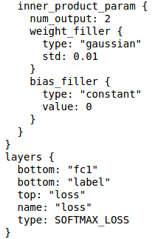
Prototxt: Define Net

Slide 9
Prototxt: Define Net
Layers and Blobs often have same name!

Slide 10
Prototxt: Define Net
Layers and Blobs often have same name!
Learning rates (weight + bias)
Regularization (weight + bias)

Slide 11
Prototxt: Define Net
Layers and Blobs often have same name!
Number of output classes
Learning rates (weight + bias)
Regularization (weight + bias)

Slide 12
Solver Prototxt
Optimization like model definition is configuration.
train_net: "lenet_train.prototxt"
base_lr: 0.01
momentum: 0.9
weight_decay: 0.0005
max_iter: 10000
snapshot_prefix: "lenet_snapshot"
All you need to run things on the GPU.
> caffe train -solver lenet_solver.prototxt -gpu 0
Stochastic Gradient Descent (SGD) + momentum ·
Adaptive Gradient (ADAGRAD) · Nesterov’s Accelerated Gradient (NAG)

Slide 13
Recipe for Brewing
Convert the data to Caffe-format
lmdb, leveldb, hdf5 / .mat, list of images, etc.
Define the Net
Configure the Solver
caffe train -solver solver.prototxt -gpu 0
Examples are your friends
caffe/examples/mnist,cifar10,imagenet
caffe/examples/*.ipynb
caffe/models/*

