Slide 1
Theoretical Foundations
Dr. Fayyaz ul Amir Afsar Minhas
PIEAS Biomedical Informatics Research Lab
Department of Computer and Information Sciences
Pakistan Institute of Engineering & Applied Sciences
PO Nilore, Islamabad, Pakistan
http://faculty.pieas.edu.pk/fayyaz/

Slide 2
Topics Covered
Revision of SVM
Principles of SVM
Structural Risk Minimization
Introducing the family of large margin classifiers
Classification
Regression
Ranking
Multi-class prediction
Multi-label prediction
Structured output prediction

Slide 3
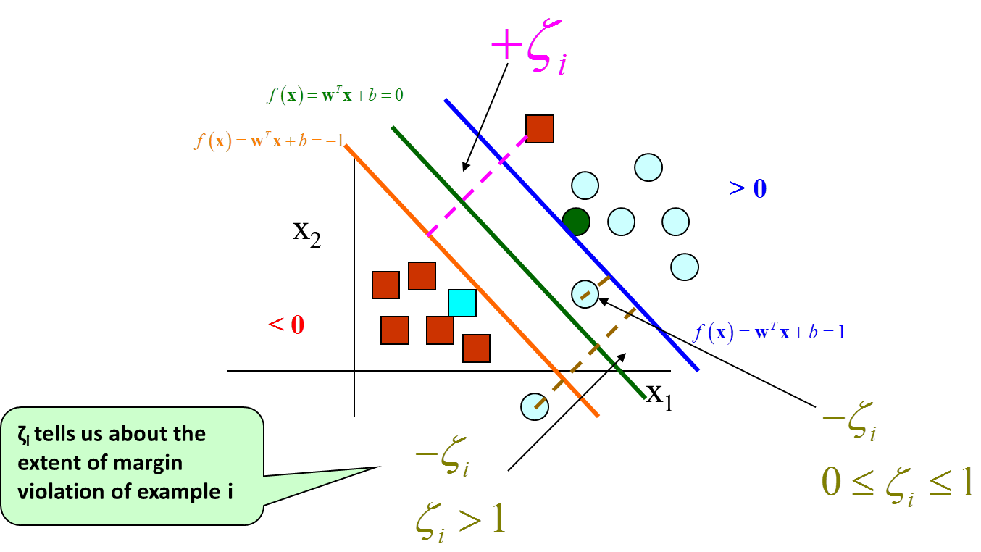
Primal
Question: When does an example violate the margin?
When: $ζ_{i}>0$
Equivalently: $y_{i}f\left(x_{i}\right)<1$ or $1−y_{i}f\left(x_{i}\right)>0$
Thus, $ζ_{i}=max(0,1−y_{i}f\left(x_{i}\right))$
What if I remove “C” and multiply $λ$ with $w^{T}w$ ?

Slide 4
Dual
The dual for of the SVM is obtained by substituting the KKT conditions into the primal and inverting the order of the maximization and minimization
If the solution exists then, at the optimal point, the value of the primal and the dual are the same
$$w=\sum_{i=1}^{N}{α_{i}y_{i}x^{(i)}}$$
$$f\left(x\right)=b+\sum_{i=1}^{N}{α_{i}y_{i}K\left(x,x^{\left(i\right)}\right)}$$

Slide 5
C
Some Observations
α_{i} will be non-zero (positive) only for the points that are support vectors
$\text{0}≤ \text{α}\text{i} ≤\text{C}$
C is the weight of the penalty of the term representing margin violation
If C is small, then more margin violations will occur
If C is large, lesser margin violations will result

Slide 6
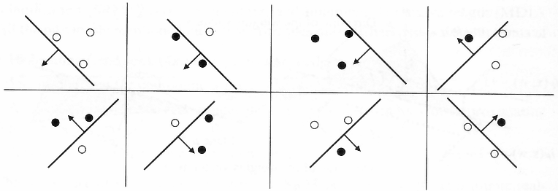
VC Dimension
What’s the maximum number of arbitrarily labeled non-colinear distinct points in space that can always be separated by a linear classifier?

Slide 7
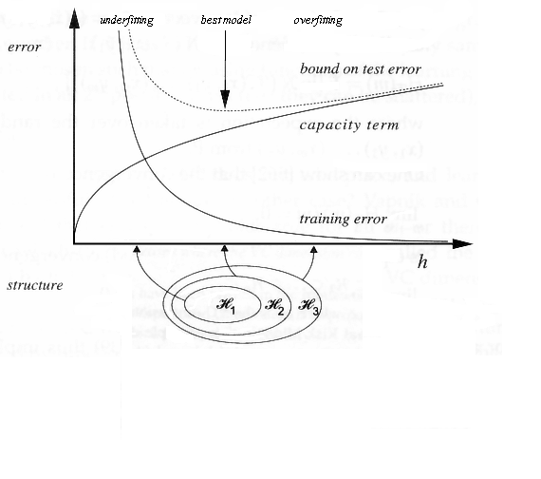
Structural Risk Minimization
Vapnik and Chervonekis, 1974 showed that
To reduce the error on test data we must reduce
Training Error
Complexity (capacity or freedom) of the model
However, these are, often, conflicting objectives
Example
Nearest Neighbor
Zero Training Error
Infinite Complexity/Capacity
Linear Classifier
Low capacity
High training error on data that is not linearly separable
Test Error $≤$ Training Error + Complexity of set of Models
VC Dimension

Slide 8
Margin and VC Dimensions
The VC Dimension of the hyper-plane in d-dimensional space with margin $ρ$ is bounded by:
$h\left(ρ\right)≤min\left(1+\frac{D^{2}}{{4ρ}^{2}},d\right)$
D is the diameter of the smallest sphere containing the training data points
Vapnik (1998, theorem 8.4)
High VC Dimensions
Large d
Large D (can be normalized)
Small margin
This is the basis for the theory for why margin needs to be controlled, especially in high dimensions
$$D=\sqrt{2}$$
$$d=2$$
$$ρ$$

Slide 9
Margin and VC Dimensions
SVM separates points using a “slab” of a certain width called the margin
Large margin means
Large “slab” Which means
Lesser freedom to move the line
Lesser points can be shattered
Smaller VC Dimension
It’s more difficult to cross a bigger moat by accident

Slide 10
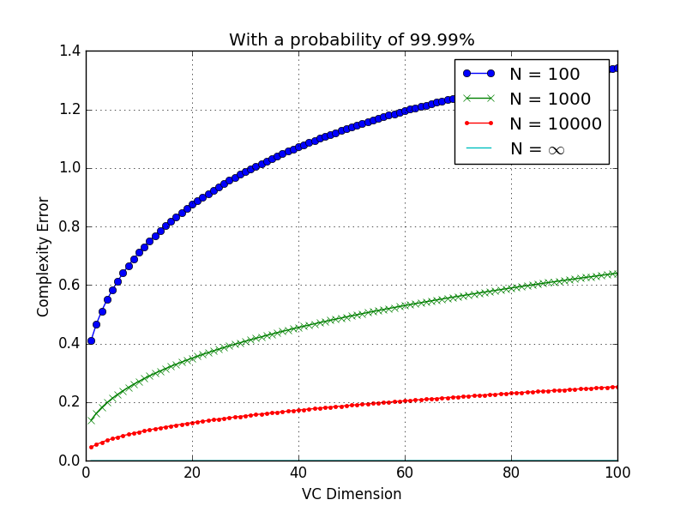
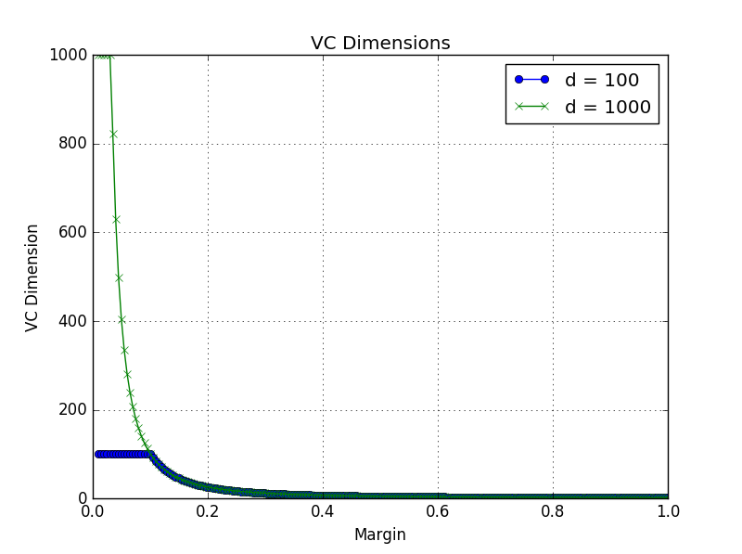
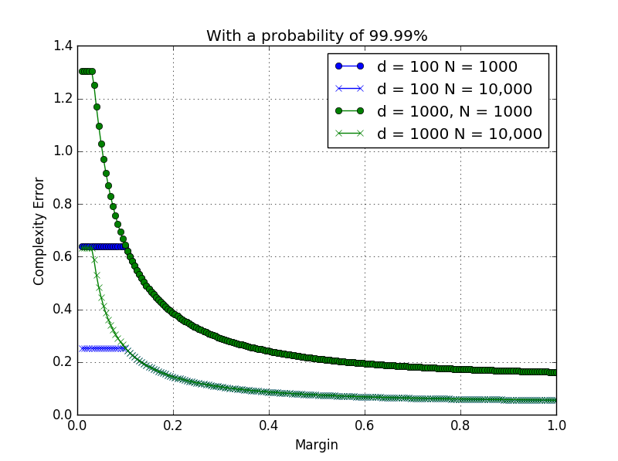
Understanding SRM
Complexity Error increases with VC
but decreases with N
Vapnik Proved that
Test Error $≤$ Training Error + Complexity of set of Models
Specifically,
Given $N$training points, then with probability $1−p$
$$Test Error≤Training Error+ \sqrt{\frac{log\left(2m\right)+1}{m}−\frac{log\left(p/4\right)}{N}}$$
Where
$m=\frac{N}{h}$, $h=VC Dimension$
For SVM: $h\left(ρ\right)≤min\left(1+\frac{D^{2}}{{4ρ}^{2}},d\right)$, d is dimensionality
$Training Error= \frac{1}{2N}\sum_{i=1}^{N}{\left|y_{i}−f\left(x_{i};θ\right)\right|}$
$Test Error=\frac{1}{2}\int{\left|y−f\left(x;θ\right)\right|}dP\left(x,y\right)$
Generalization Error
VC dimension decreases with margin
but increases with feature dimensionality
Complexity Error decreases with increase in margin
Also decreases with increasing N
Increases with increasing d
Effective Control over curse of dimensionality
with large margin: small N and large d
seem to matter less

Slide 11
Structural Risk Minimization
Thus, to optimize the generalization of a classifier
Reduce Training Error
Reduce Classifier Complexity
By margin maximization
Mathematically,
$$f^{∗}={argmin}_{f} \left\{L\left(X,Y;f\right)+λg\left(\left\|f\right\|\right)\right\}$$
$X,Y$ is the training data
$f$ is the learning function
Regularization
Classifier Complexity
(smoothing) term
Empirical Loss (or risk)
term
Structural Risk

Slide 12
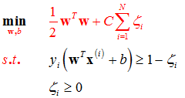
SVM and SRM
For SVM
We can represent It as:
$\min_{w,b} \frac{λ}{2}{\left\|w\right\|}^{2}+\sum_{i=1}^{N}{max\left(0, 1−y_{i}\left(w^{T}x_{i}+b\right)\right)}$
SVM can be mapped to the form :
$f\left(x\right)=\left\langle w,x\right\rangle$ is the discriminant function
kernel trick allows non-linear classification
$L\left(X,Y;f\right)=\sum_{i=1}^{N}{{\left\lfloor 1−y_{i}\left\langle w,x_{i}\right\rangle \right\rfloor }_{+}}$
${\left\lfloor θ\right\rfloor }_{+}=θ for θ≥0 and 0 otherwise$
Hinge loss function
$g\left(\left\|f\right\|\right)={\left\|w\right\|}_{2}^{2}$
This setting allows for convex optimization
Single local and global minima
$$f^{∗}={argmin}_{f} \left\{L\left(X,Y;f\right)+λg\left(\left\|f\right\|\right)\right\}$$
$l_{i}$ = ${\left\lfloor 1−y_{i}f\left(x_{i}\right)\right\rfloor }_{+}$
$$1$$
$$y_{i}f\left(x_{i}\right)$$

Slide 13
SVM, SRM, Margin and Complexity
SVMs are learning machines that reduce structural risk (Vapnik, 1961) by
Reducing the empirical error
Controlling complexity of the classifier
Through the control on the upper bound on the VC dimension (remember Vapnik, 1995: $VC\left(ρ\right)≤\frac{D^{2}}{4ρ^{2}}$)
By maximizing the margin: $\frac{1}{{\left\|w\right\|}^{2}}$
The reduction in structural risk minimizes the upper bound on the generalization error (Vapnik and Chervonekis, 1974)
This leads to good generalization performance
$$\sum_{i=1}^{N}{max\left(0, 1−y_{i}\left(w^{T}x_{i}+b\right)\right)}$$

Slide 14
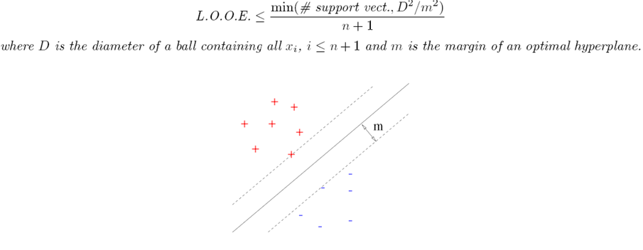
Generalization Performance bounds
The leave one out cross validation error of an SVM is bounded as:

Slide 15
A tighter bound on LOO Error: Vapnik 2000
Error is the leave one out error
E indicates the expected value
n = m + n* is the number of support vectors
n* = number of support vectors for which $0<α<C$
m = number of support vectors for which $α=C$
l = number of examples
S: The span is the largest distance of any support vector from its approximation based on a constrained linear combination of all other support vectors
D is the diameter of the largest sphere containing the data points
C is the margin violation parameter
Notes:
The span is the largest distance of any point in the data set from its approximation based on a constrained linear combination of all other points in the data set.

Slide 16
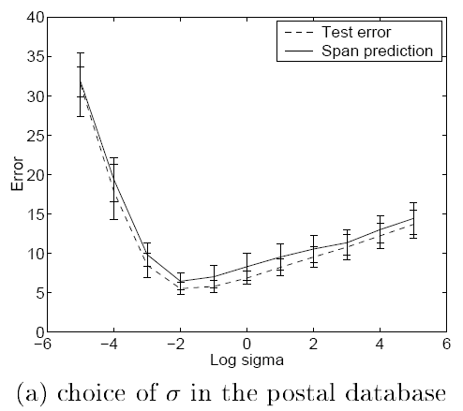
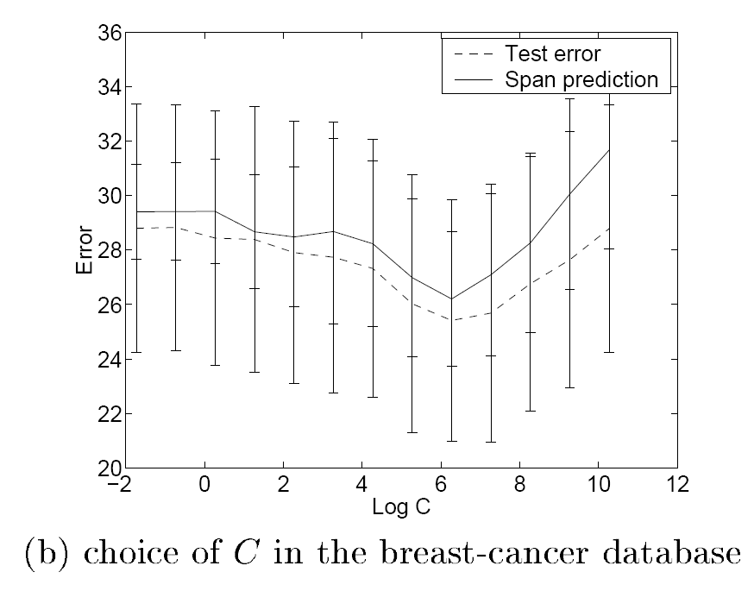
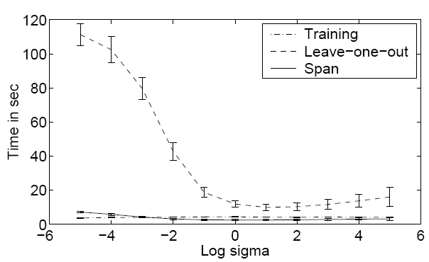
Impact of bounds
These bounds can be used for model selection
Choosing the value of sigma in the RBF kernel or the ‘C’ parameter
The time required to compute the span is not prohibitive and is a good alternative to computing the true leave one out error for model selection purposes
V. Vapnik and O. Chapelle, “Bounds on Error Expectation for Support Vector Machines,” Neural Comput, vol. 12, no. 9, pp. 2013–2036, Sep. 2000.

Slide 17
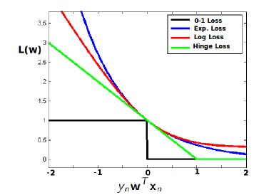
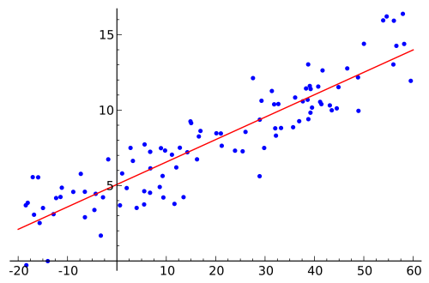
What can we do with SRM?
The principal of SRM allows us to develop a family of large margin learning machines by changing its components
Example
SVM: $\min_{w,b} \frac{λ}{2}{\left\|w\right\|}^{2}+\sum_{i=1}^{N}{{\left\lfloor 1−y_{i}f\left(x_{i}\right)\right\rfloor }_{+}}$
Regularized least square regression
$\min_{w,b} \frac{λ}{2}{\left\|w\right\|}^{2}+\sum_{i=1}^{N}{{\left(y_{i}−f\left(x_{i}\right)\right)}^{2}}$
Support Vector Regression
$\min_{w,b} \frac{λ}{2}{\left\|w\right\|}^{2}+\sum_{i=1}^{N}{{\left\lfloor \left|y_{i}−f\left(x_{i}\right)\right|−ε\right\rfloor }_{+}}$
Feature selection
$\min_{w,b} \frac{λ}{2}{\left\|w\right\|}_{1}^{2}+\sum_{i=1}^{N}{{\left\lfloor 1−y_{i}f\left(x_{i}\right)\right\rfloor }_{+}}$

Slide 18
Regularizers
There are also other regularizers
${\left\|w\right\|}_{2}^{2}=w_{1}^{2}+w_{2}^{2}+…+w_{d}^{2}$
Convex, Smooth
${\left\|w\right\|}_{1}^{1}=\left|w_{1}\right|+\left|w_{2}\right|+…+\left|w_{d}\right|$
Used for feature reduction
“1-norm Support Vector Machine”, Zhu et al. (2004)
${\left\|w\right\|}_{0}=number of non−zero elements in w$
Minimization of this norm will lead to feature selection
“Use of the Zero-Norm with Linear Models and Kernel Methods”, JMLR, Weston et al., (2003)

Slide 19
What are kernels?
Kernels are
A way of Data representation
Inner Products
Measures of similarity
Measures of function regularity

Slide 20
Data Representation: Kernels
Advantages of kernel representation
Nonlinear Feature Mapping
Always of size n x n
Computationally very attractive
No need of explicit feature representation
Example
No obvious way to represent protein sequences as vectors in a biologically relevant way
Meaningful pairwise sequence comparison methods exist
Is the Local alignment score a kernel?
Notes:
See 1.7

Slide 21
Representer theorem
(Schölkopf, LNCS, 2001)
Any problem represented as follows with a strictly monotonically increasing function ‘g’ and an arbitrary risk function ‘L’
Has a solution of the form
$f^{∗}\left(x\right)=\sum_{i=1}^{N}{α_{i}k\left(x,x_{i}\right)}$
$k\left(x,x_{i}\right)$ is the kernel function used
How do SVMs satisfy the Representer theorem?
$$f^{∗}={argmin}_{f} \left\{L\left(X,Y;f\right)+λg\left(\left\|f\right\|\right)\right\}$$

Slide 22
Representer theorem
The Representer theorem allows us to represent the decision function of any learning machine with a regularizer and an empirical loss function in terms of the data points alone
This, has great implications in solving the optimization problems posed by different learning algorithms
$$f^{∗}\left(x\right)=\sum_{i=1}^{N}{α_{i}k\left(x,x_{i}\right)}$$

Slide 23
Kernels, Regularization and the Curse of dimensionality
How does the SVM control the curse of dimensionality?
We know that we can also express the function as
Thus, $\left\|f\right\|=α^{T}Kα$
Now, regularization requires that we minimize $\left\|f\right\|$, which will, in essence, produce a small set of non-zero $α$
The number of positive $α$ controls the number of effective dimensions in the kernel space
Thus, regularization allows effective control over the curse of dimensionality when using kernels
This is one reason why the generalization performance of SVMs is dependent on the number of support vectors
$f\left(x\right)= \sum_{i=1}^{N}{α_{i}K\left(x_{i},x\right)}$

Slide 24
Allows Learning from Data
Reduces bias errors
Minimize Empirical Error over Training Data
Control of Bias Variance Dilemma
Reduces variance errors
Vapnik and Chervonekis, 1974
Vapnik, 1961
Provides upper bound on generalization error
Smooth decision functions
Structural Risk Minimization
C or $λ$
Cortes, 1995
Controls effective data dimensionality
Minimize Model Complexity
Limits effects of curse of dimensionality
Scholkopf
Representer’s theorem
Mercer’s Conditions
Through Regularization of the decision functional
Allows the use of kernels
Handling of nonlinear boundaries in controlled manner
Promotes sparse solutions
Margin Maximization
Moore-Aronszajn Theorem
Generalization to different types of data (even non-vectoral), learning problems & algorithms for solution
Implicit feature representation in terms of pairwise similarities
Underlying feature representation in RKHS
Vapnik (1995)
Control of VC dimension

Slide 25
Reasons for using a SVM
Use of structural risk minimization
Reduction of empirical error
Reduction of complexity
Tunable Complexity
Effects of curse of dimensionality is reduced due to the control over complexity
Can have linear or non-linear boundaries through kernels
Kernels allow use of implicit feature representation
Absence of local minima
Sparseness of the solution: Not every data point is required – only support vectors determine the solution
Guaranteed error bounds
Very flexible to different types of problems in machine learning
Multiple instance, ranking, multi-view, regression, clustering, structured output learning …
Can be molded to explicitly optimize performance metrics such as AUC, ${AUC}_{α→β}$
Allow for large scale learning:
O(n) algorithms exist for linear boundaries – n is the number of examples
$O\left(\frac{d}{λε}\right)$ algorithms exist for linear boundaries to achieve an $ε$ accurate solution
d is the number of non-zero feature vectors, $λ$ is the regularization parameter

Slide 26
Issues with SVMs
Perhaps the biggest limitation of the support vector approach lies in choice of the kernel." Burgess (1998)
"A second limitation is speed and size, both in training and testing." Burgess (1998)
"Discete data presents another problem..." Burgess (1998)
"...the optimal design for multiclass SVM classifiers is a further area for research." Burgess (1998)
"Although SVMs have good generalization performance, they can be abysmally slow in test phase, a problem addressed in (Burges, 1996; Osuna and Girosi, 1998)." Burgess (1998)
"Besides the advantages of SVMs - from a practical point of view - they have some drawbacks. An important practical question that is not entirely solved, is the selection of the kernel function parameters - for Gaussian kernels the width parameter [sigma] - and the value of [epsilon] in the [epsilon]-insensitive loss function...[more]" Horváth (2003) in Suykens et al.
"However, from a practical point of view perhaps the most serious problem with SVMs is the high algorithmic complexity and extensive memory requirements of the required quadratic programming in large-scale tasks." Horváth (2003) in Suykens et al. p 392
Kernels determine regularization so the choice of a kernel makes the SVM prone to over-fitting

Slide 27
Required Reading
C. J. C. Burges, “A Tutorial on Support Vector Machines for Pattern Recognition,” Data Min Knowl Discov, vol. 2, no. 2, pp. 121–167, Jun. 1998.
Cited by: 14248
Optional
Zhang, ChunHua, YingJie Tian, and NaiYang Deng. “The New Interpretation of Support Vector Machines on Statistical Learning Theory.” Science in China Series A: Mathematics 53, no. 1 (January 28, 2010): 151–64. doi:10.1007/s11425-010-0018-6.
Abe, Prof Dr Shigeo. “Variants of Support Vector Machines.” In Support Vector Machines for Pattern Classification, 163–226. Advances in Pattern Recognition. Springer London, 2010. http://link.springer.com/chapter/10.1007/978-1-84996-098-4_4.
Section-III: Constructing Kernels in J. Shawe-Taylor and N. Cristianini, Kernel Methods for Pattern Analysis. New York, NY, USA: Cambridge University Press, 2004.
J. Vert, K. Tsuda, and B. Scholkopf, “A primer on kernel methods,” in Kernel Methods in Computational Biology, MIT Press, 2004, pp. 35–70.

Slide 28
Assignment (20 Marks)
If an example does not violate the margin and does not lie on the margin what will be its α_{i}? Why? [1]
If an example violates the margin, what will be its α_{i}? Why? [1]
If an example lies exactly on the margin, what will be its α_{i}? Why? [1]
What is the relationship between α_{i} of the dual and $ξ_{i}$ of the primal for an example $i$? [1]
How has the Representer’s theorem been used to solve the SVM problem in the primal in the paper given below? [2]
O. Chapelle, “Training a Support Vector Machine in the Primal,” Neural Comput, vol. 19, no. 5, pp. 1155–1178, May 2007.
What is the Gram matrix? [1]
Why should a kernel satisfy the Mercer’s conditions? [1]
If a kernel doesn’t satisfy Mercer’s conditions, will the corresponding SVM be convex? [1]
What happens we choose ||w||₁ or ||w||₀ instead of ||w||₂ in the optimization? How? [1]
What happens if we choose $\sum_{i}{ξ_{i}^{2}}$ instead of $\sum_{i}{ξ_{i}^{}}$ in the optimization and remove the constraints $ξ≽0$? [2]
How does margin maximization lead to better generalization? Explain in terms of Structural Risk Minimization. [1]
How is the Representer Theorem Useful? [1]
What are the error bounds of an SVM useful for? [1]
How can you create a bias-less SVM Without any loss in accuracy? [1]
What is meant by a regularization path? [1]
How can you make a kernelized Nearest Neighbor Classifier? [1.5]
How can you make a regularized nearest neighbor classifier? [1.5]
Why does the generalization error bound increase with increase in the number of support vectors? [1]

Slide 29
End of Lecture
I believe that learning has just started, because whatever we did before, it was some sort of a classical setting known to classical statistics as well. Now we come to the moment where we are trying to develop a new philosophy which goes beyond classical models.
- Vapnik
http://www.learningtheory.org/learning-has-just-started-an-interview-with-prof-vladimir-vapnik/

