Slide 1
How Groupon utilizes Consumer Insights & Data
Feb 2016
Eric Rasmussen
VP Consumer Insights

Slide 2
Agenda
Groupon Overview
Analytics
Marrying Behavioral Data with Market Research
  Case Study #1 - Merch Attrition
  Case Study #2 – TTD
Segmentation

Slide 3
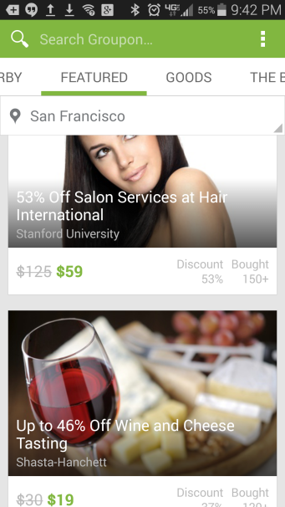

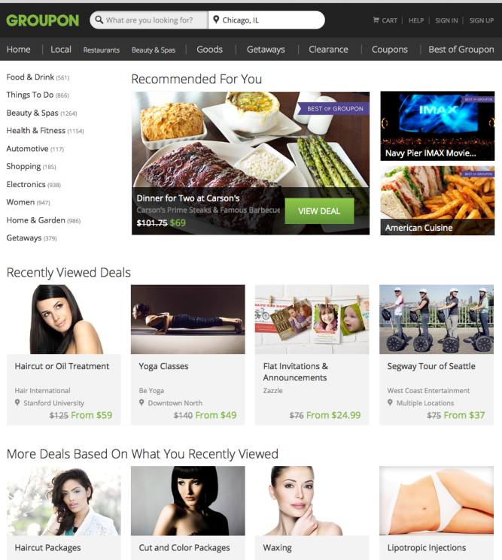
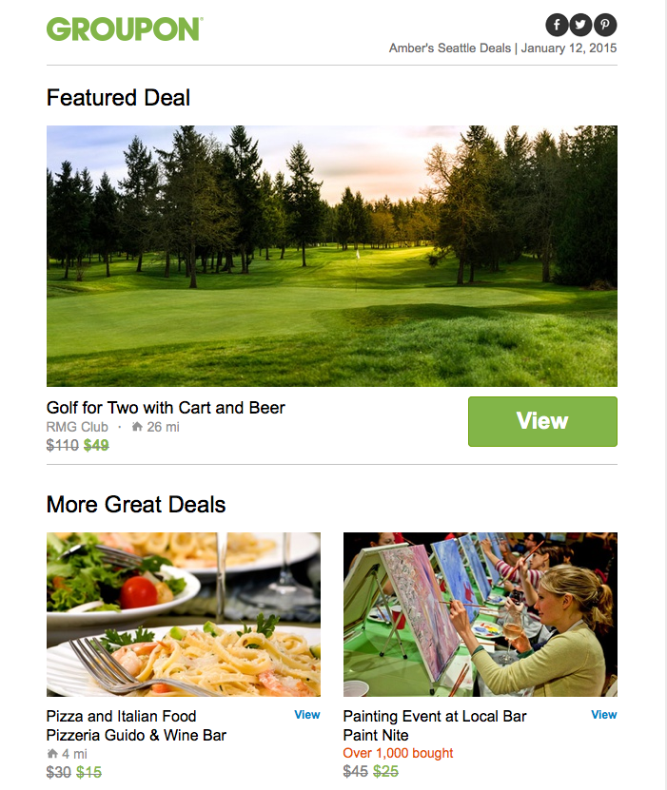
Groupon is the global leader in local commerce
making it easy for people around the world to search
and discover great businesses at unbeatable prices.
WORLDWIDE
260M+ subscribers 160M+ monthly visitors 500+ markets 700M+ deals sold
$7.5B in 2014 billings 12,000+ global employees
Source: Internal data,, March 2014

Slide 4
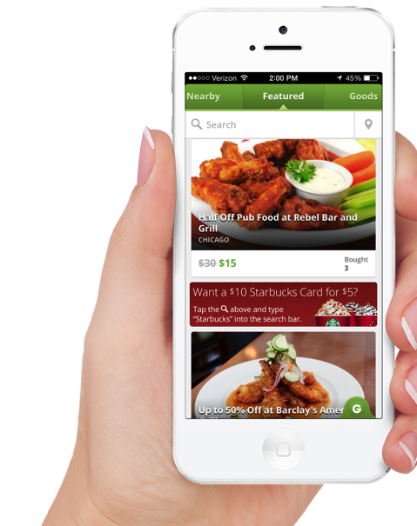
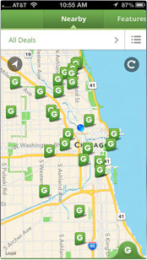
… and a leader in mobile commerce
Groupon’s vibrant mobile marketplace connects
consumers with their local economy
110 million+ people worldwide have downloaded our mobile app to date
More than half of our Global transactions completed on a mobile device in Q4 2014
Our mobile app is available in 43 countries.
One of the 25 most downloaded free apps of all time
Sources: Internal Data; iTunes ranking for US stores available here - https://itunes.apple.com/WebObjects/MZStore.woa/wa/viewFeature?id=500873243&mt=8&v0=www-itunes25Bcountdown-appstore
Notes:
Well positioned to catch the ecommerce move to mobile

Slide 5
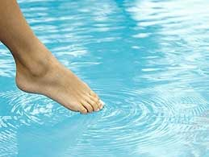
Groupon has become their guide to new things:
Groupon is the new “Discovery Engine”
Groupon has become the “Discovery Engine”: Delighting consumers and supporting local businesses
Notes:
We are the Discovery Engine – a great place to be

Slide 6
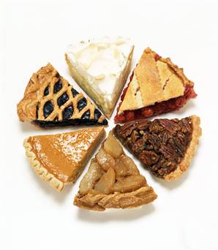
Primary Research
External/syndicated
Research
Data Analytics
Competitive Intelligence
UX Research

Slide 7
Groupon Leading with Data
100MM daily user interactions
Petabytes of data on Teradata, Hive, Hbase
Real-time aggregates using Storm & Kafka
Batch processing using 100s of Hadoop jobs
Spark for real-time personalization (in the works)
Extensive use of Tableau visualizations

Slide 8
Feynman: Groupon’s Relevance System
Launched 3Q 2014 to replace old system
Designed for easy customization for multiple platforms and product variations
Core ranking models grounded in statistical concepts and Bayesian analysis
Personalization uses both direct activity, and stats-based priors
Uses novel algorithms for managing freshness and diversity
Notes:
Feynman is actively being developed further.
Diversity is a unique angle at Groupon due to the nature of its business of exposing the user to things that are more leisure/pleasure oriented.

Slide 9
Feynman Logical Architecture
User Info
Search Index (sharded)
Aggregator
Ranked Deals
Deal Info
Statistical model of conversion
Personalization
Exploration
Revenue/profit model
Co-ranking
Diversity
User-deal
events
User interactions
Real-time data capture and aggregation (Watson)
Notes:
Odds
DDO
Combination using bayesian ideas
Positive personalization based on positive user events – clicks, purchases, queries
Negative personalization via deal freshness and purchase backoff
Time bound boosts of new deals, subject to exposure controls. Use of statistical hypothesis tests to terminate exposure early, or to prevent blasting of unproven deals via email.
Calibration of cvr using approaches like isotonic regression are useful when absolute estimates are needed – some use cases could be when we need to decide whether to show a widget based on revenue potential, or select a few widgets from a palette of many based on revenue potential.
Mapping of cvr to eBooking and eProfit via booking and margin models and combination into a multi-objective score
Mixing of deal types to ensure diversity.
Local shuffle to break stickiness and encourage discovery.

Slide 10
Experiment, Experiment, Experiment
Define an
experiment
Construct a
representation
Hypothesize
Model
Refine
Add it to
the engine
Analyze
Implement
Learn from
the data
Evaluate
Determine if
it worked
Run
Try it out
on some users
Notes:
Some types of experiments – such as testing new ways of exploration – are tricky as it is not sufficient to split on the user dimension, due to cross-learning effects through the deals.
This requires careful design which minimizes cross-learning effects, by splitting the deal set across treatments and ensuring homogeneity.
Apart from business metrics (some of which are noisy and take time to converge, such as bookings), leading metrics such as clicks (which converge soon), and data analysis on long-lived
user cohorts are often needed to deep dive results and reach a conclusion. Just going for “statistical significance” is not usually sufficient.

Slide 11
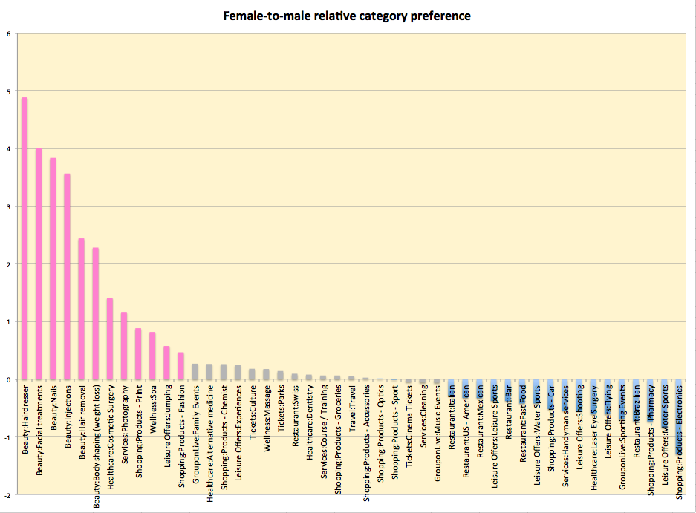
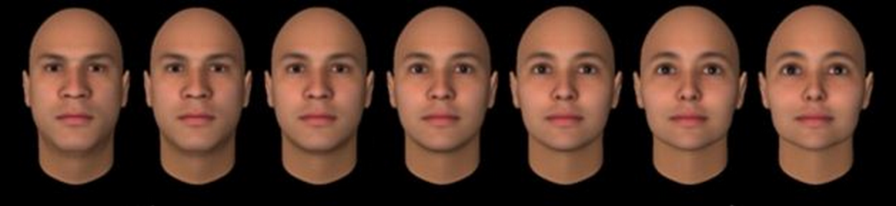
How gender influences purchase
Notes:
The plot is the ratio of the purchase likelihood of males and females, conditioned on a purchase. If males were more likely to buy, the ratio is inverted and shown as a negative for visual clarity.
It supports the intuition that women spend more of their money on beauty products, while men spend a bit more on electronics and sports. However, there is much individual variation calling for personalization.

Slide 12
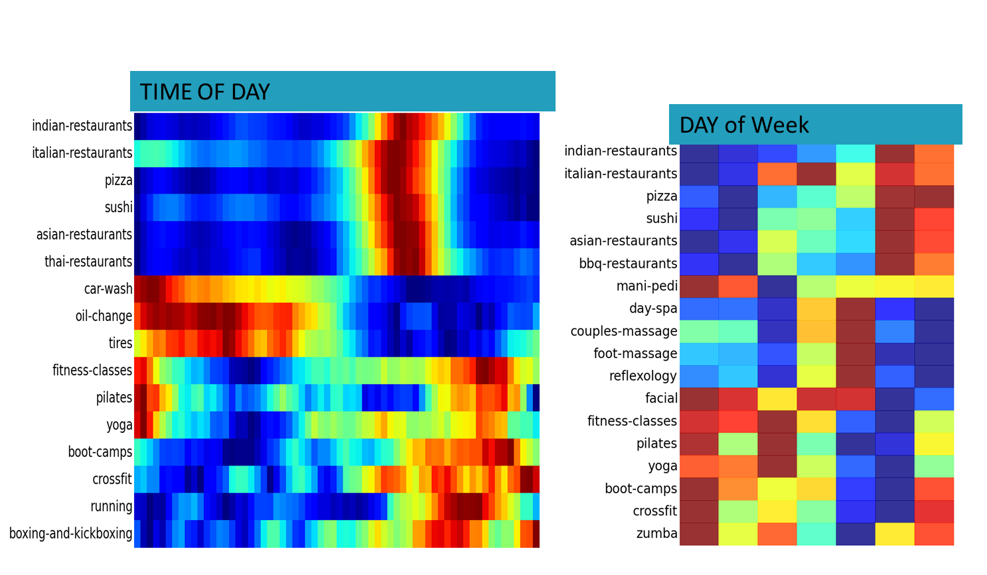
Context: Time of day & week
Notes:
The plot is the ratio of the purchase likelihood of males and females, conditioned on a purchase. If males were more likely to buy, the ratio is inverted and shown as a negative for visual clarity.
It supports the intuition that women spend more of their money on beauty products, while men spend a bit more on electronics and sports. However, there is much individual variation calling for personalization.

Slide 13
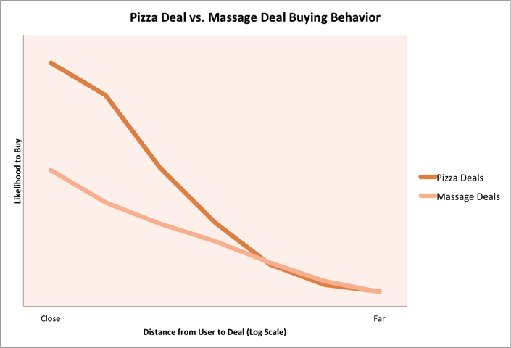
How distance influences purchase
Notes:
People are willing to travel from further for music events. The second plateau represents traveling users who come from far away. The data suggests modeling/targeting these differently.

Slide 14













User-deal Matching: ‘Big data’ challenge
Assess
Demand
Source
deals
Match to
right users
Notes:
What does Groupon do? Core business – match local merchants to local users. 100s of thousands of deals and merchants matched to 100s of millions of users. Delight users with exciting deals.
Deal selection and ranking is a key problem, but matching supply to demand, setting up the right deal structure (discount, groupon’s take) etc are also important problems in closing the loop.
Good ranking adds 30-40% business lift to a baseline of several billion dollars of revenue.

Slide 15
What is Market Research and should I care?
(Hint: Crucially important slice of the information pie)

Slide 16

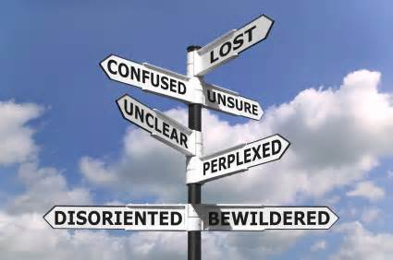
Why is Research the most important department?
Driving backwards
Research can Provide:
Market landscape
Strategic direction
Forward looking/Predictive data
Understanding the “why” behind the data
  Engagement/Attrition
  Concept testing

Slide 17

CASE STUDIES: Research delivers!
    Global metric to track & compare Merchant satisfaction
    Ability to identify problems, causes and action needed to improve
    Understanding our user base
    Target our deals, communications, tone, etc.
Merchant Attrition
Segmentation

Slide 18
GROUPON MERCHANT ATTRITION
INSIGHTS

Slide 19

Merchant Tracking
In an ideal world we would have hard facts/data proving the correlation between tracking and Groupon ratings
Groupon Rating
Assess promotional impact on staff, business process, logistics, etc.
Identify/track new customers from the promotion
Identify/track repeat customers after the promotion
Number of coupon redemptions with spend above face amount
Number of coupons redeemed
Number of coupons sold
Proactively measure customer satisfaction as a result of the promotion
Total sales for coupon period vs. same period last year
Total sales for coupon period vs. similar time frame before/afterwards
N=10K+ surveys Groupon Merchant Satisfaction Study
Notes:
From internal and external studies this data point remains solid – tracking and Sat correlate closely (same internationally)

Slide 20

Merchant Attrition
Good News: Majority of Groupon Merchants Very Satisfied
Question: What could be done to minimize the number that don’t refeature?
Data of “Pausing/Attriting” Merchants doesn’t indicate WHY
Market Research Study probes these merchants and discovers the whys and some solutions
BC
AB
A

Slide 21
Q2 2015 Merchant Attrition & Expectations
Strongest retention = Setting performance expectations & delivering on performance.
Strongest churn = Not setting performance expectations & under-delivering on performance.
Staff thoroughly discussed deal performance expectations
Yes=55%
No=29%
Received amount of customers expected or more
Yes=68%
Yes=30%
Plan to Re-feature with Groupon*
Yes=61%
Yes=8%
*Yes/NO = Top 4 Box/Bottom 4 Box on Re-feature 10-pt scale.

Slide 22
Segmentation
& TTD Case Study

Slide 23
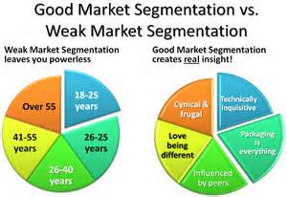
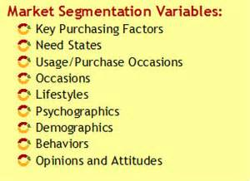
Segmentation
  Let’s go beyond Demographics
  Strive for Actionable!

Slide 24
TTD INSIGHTS FROM OUR CONSUMER SEGMENTATION

Slide 25
Segmentation Process:
Step1
Consumer Survey
Primarily US, with some English Speaking Canadian respondents.
Online Interviewing among Groupon subscribers who have engaged with Groupon in some way within the past year
=

Slide 26
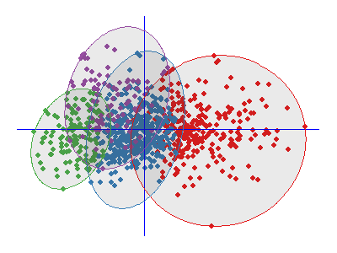
Segmentation Process:
Step 2
Advanced Analytics Identify Groupings (Segments) based on attitudes & needs

Slide 27



Segmentation Analysis
Data Collection
ATTITUDE
ATTITUDE
ATTITUDE
NEED
NEED
NEED
How strongly do individuals identify with attitudes and needs?
ATTITUDE
ATTITUDE
ATTITUDE
NEED
NEED
ATTITUDE
ATTITUDE
Cluster Analysis
What are defining dimensions?
How are people grouped based on response patterns?
Segmenting & Profiling
Segment A
Segment B
Segment C
How do they differ?
What are their attitudes and needs?
Who are they?
How do they shop?
What do they think of Brands?
Etc.

Slide 28
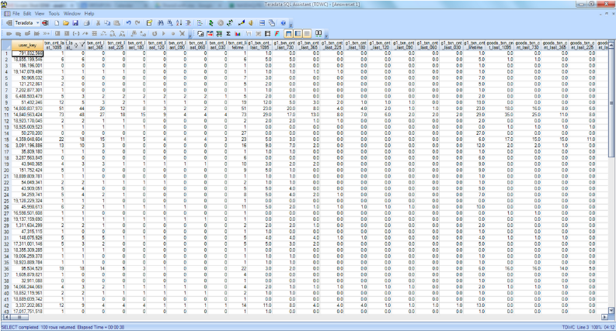
Segmentation Process:
Step 3
Profiling segments using behavioral data from our Data Warehouse

Slide 29



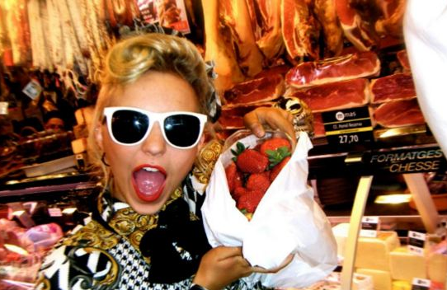
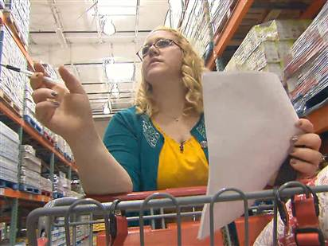

US Consumer Segments
Groupies
Positive Pragmatists
Sideline Skeptics
Home Town Tourists
Disillusioned Departers
Family Maestros

Slide 30

Groupies: Habits
What do they read?
What do they do/ like?
75% read about news regularly
  Local Newspaper (print & online)
  New York Times (online)
  USA Today (online)
24% read blogs regularly
  Huffington Post
  Buzzfeed
  TMZ
  Gawker
  Business Insider
  CNN Political Ticker
46% read magazines regularly
  Home & Gardening (print)
  Celebrity News/ Gossip (print & online)
  Fashion & Style (print & online)
  Women’s Entertainment (print & online)
They’re “into” lots of stuff! Over-index on:
Attend cultural/ art events
Charities/ volunteer work
Electronics
Fashion/ clothing
Health/ organics
Home Improvement/ Decorating
Music
Movies
Book reading
Wildlife/ environmental issues
Cooking/ gourmet foods & wines

Slide 31

Groupies: Habits
Other Online Habits
Websites Visited Weekly
(by at least 25%):
  Groupon
  Google
  YouTube
  Yahoo!
  Amazon
  Wikipedia
  Ebay
  Craigslist
  Pinterest
  Weather Channel
  Instagram
  Netflix
Social Networks Used
(by at least 25%):
  Facebook
  YouTube
  Google+
  Pinterest
  LinkedIN
  Instagram
Technology Use:
“I tend to like technology, but prefer to be careful and wait for others to try new technologies out before jumping on board”

Slide 32
Consider all pieces of the information pie
Connect the dots
Tell a good story
Balance the tactical and strategic

