Slide 1
Vector Semantics
Introduction

Slide 2
Why vector models of meaning? computing the similarity between words
“fast” is similar to “rapid”
“tall” is similar to “height”
Question answering:
Q: “How tall is Mt. Everest?”
Candidate A: “The official height of Mount Everest is 29029 feet”

Slide 3
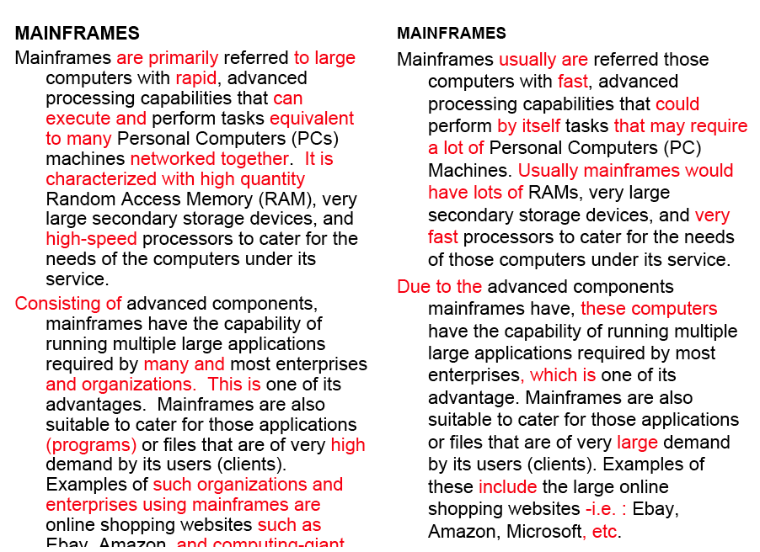
Word similarity for plagiarism detection

Slide 4
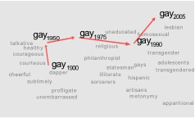
Word similarity for historical linguistics: semantic change over time
Sagi, Kaufmann Clark 2013
Kulkarni, Al-Rfou, Perozzi, Skiena 2015

Slide 5
Problems with thesaurus-based meaning
We don’t have a thesaurus for every language
We can’t have a thesaurus for every year
  For historical linguistics, we need to compare word meanings in year t to year t+1
Thesauruses have problems with recall
  Many words and phrases are missing
  Thesauri work less well for verbs, adjectives

Slide 6
Distributional models of meaning
= vector-space models of meaning
= vector semantics
Intuitions: Zellig Harris (1954):
  “oculist and eye-doctor … occur in almost the same environments”
  “If A and B have almost identical environments we say that they are synonyms.”
Firth (1957):
  “You shall know a word by the company it keeps!”

Slide 7
Intuition of distributional word similarity
Nida example: Suppose I asked you what is tesgüino?
    A bottle of tesgüino is on the table
    Everybody likes tesgüino
    Tesgüino makes you drunk
    We make tesgüino out of corn.
From context words humans can guess tesgüino means
  an alcoholic beverage like beer
Intuition for algorithm:
  Two words are similar if they have similar word contexts.

Slide 8
Four kinds of vector models
Sparse vector representations
  Mutual-information weighted word co-occurrence matrices
Dense vector representations:
  Singular value decomposition (and Latent Semantic Analysis)
  Neural-network-inspired models (skip-grams, CBOW)
  Brown clusters

Slide 9
Shared intuition
Model the meaning of a word by “embedding” in a vector space.
The meaning of a word is a vector of numbers
  Vector models are also called “embeddings”.
Contrast: word meaning is represented in many computational linguistic applications by a vocabulary index (“word number 545”)
Old philosophy joke:
  Q: What’s the meaning of life?
  A: LIFE’

Slide 10
Vector Semantics
Words and co-occurrence vectors

Slide 11
Co-occurrence Matrices
We represent how often a word occurs in a document
  Term-document matrix
Or how often a word occurs with another
  Term-term matrix
    (or word-word co-occurrence matrix
    or word-context matrix)

Slide 12
Term-document matrix
Each cell: count of word w in a document d:
  Each document is a count vector in ℕ^{v}: a column below

Slide 13
Similarity in term-document matrices
Two documents are similar if their vectors are similar

Slide 14
The words in a term-document matrix
Each word is a count vector in ℕ^{D}: a row below

Slide 15
The words in a term-document matrix
Two words are similar if their vectors are similar

Slide 16
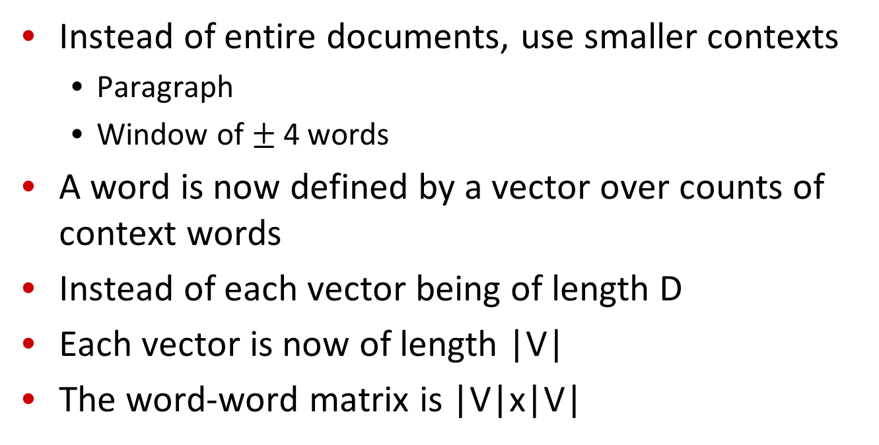
The word-word or word-context matrix
Instead of entire documents, use smaller contexts
  Paragraph
  Window of $±$ 4 words
A word is now defined by a vector over counts of context words
Instead of each vector being of length D
Each vector is now of length |V|
The word-word matrix is |V|x|V|

Slide 17
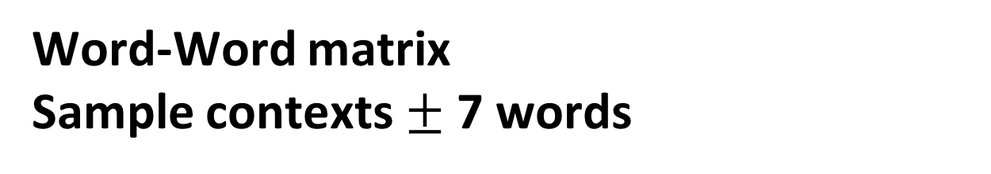
Word-Word matrix
Sample contexts $±$ 7 words
…
…

Slide 18
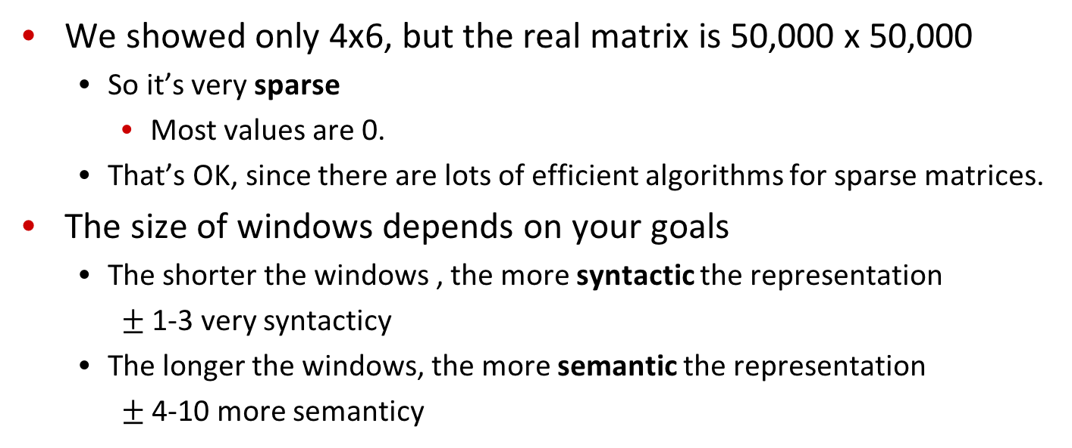
Word-word matrix
We showed only 4x6, but the real matrix is 50,000 x 50,000
  So it’s very sparse
    Most values are 0.
  That’s OK, since there are lots of efficient algorithms for sparse matrices.
The size of windows depends on your goals
  The shorter the windows , the more syntactic the representation
    $±$ 1-3 very syntacticy
  The longer the windows, the more semantic the representation
    $±$ 4-10 more semanticy

Slide 19
2 kinds of co-occurrence between 2 words
(Schütze and Pedersen, 1993)
First-order co-occurrence (syntagmatic association):
  They are typically nearby each other.
  wrote is a first-order associate of book or poem.
Second-order co-occurrence (paradigmatic association):
  They have similar neighbors.
  wrote is a second- order associate of words like said or remarked.

