Slide 1
GPU Computing CIS-543
Lecture 07: CUDA Execution Model
Dr. Muhammad Abid,
DCIS, PIEAS

Slide 2
CUDA Execution Model
What's an Execution Model?
  an execution model provides an operational view of how instructions are executed on a specific computing architecture.
CUDA execution model
  exposes an abstract view of the GPU parallel architecture, allowing you to reason about thread concurrency.
Why CUDA execution model?
  provides insights that are useful for writing efficient code in terms of both instruction throughput and memory accesses.

Slide 3
Aside: GPU Computing Platforms
NVIDIA’s GPU computing platform is enabled on the following product families:
  Tegra: for mobile and embedded devices
  GeForce: for Consumer graphics
  Quadro: for professional visualization
  Tesla: for datacenters

Slide 4
GPU Architecture Overview
The GPU architecture is built around a scalable array of Streaming Multiprocessors (SM).
GPU hardware parallelism is achieved through the replication of SMs.

Slide 5
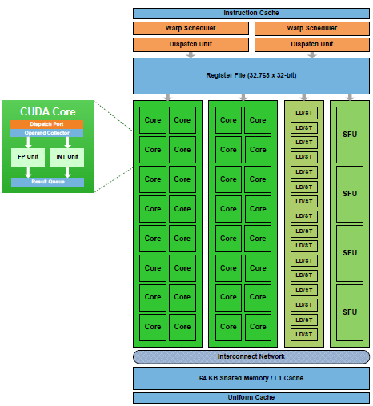
GPU Architecture Overview: Fermi SM
CUDA Cores
Shared Memory/L1 Cache
Register File
Load/Store Units
Special Function Units
Warp Scheduler
Notes:
When a kernel grid is launched, the thread blocks of that kernel grid are
distributed among available SMs for execution. Once scheduled on an SM, the threads of a thread
block execute concurrently only on that assigned SM. Multiple thread blocks may be assigned to the
same SM at once and are scheduled based on the availability of SM resources. Instructions within
a single thread are pipelined to leverage instruction-level parallelism, in addition to the thread-level
parallelism you are already familiar with in CUDA.

Slide 6
GPU Architecture Overview
CUDA employs a Single Instruction Multiple Thread (SIMT) architecture to manage and execute threads in groups of 32 called warps.
All threads in a warp execute the same instruction at the same time.
Each thread has its own instruction address counter and register state, and carries out the current instruction on its own data.
Each SM partitions the thread blocks assigned to it into 32-thread warps that it then schedules for execution on available hardware resources.
Notes:
SIMT vs SIMD
The SIMT architecture is similar to the SIMD (Single Instruction, Multiple Data) architecture. Both
SIMD and SIMT implement parallelism by broadcasting the same instruction to multiple execution
units. A key difference is that SIMD requires that all vector elements in a vector execute together in
a unifi ed synchronous group, whereas SIMT allows multiple threads in the same warp to execute
independently. Even though all threads in a warp start together at the same program address, it is
possible for individual threads to have different behavior. SIMT enables you to write thread-level parallel
code for independent, scalar threads, as well as data-parallel code for coordinated threads.
The SIMT model includes three key features that SIMD does not:
➤ Each thread has its own instruction address counter.
➤ Each thread has its own register state.
➤ Each thread can have an independent execution path.

Slide 7
Threadblock Scheduling
A thread block is scheduled on only one SM. Once a thread block is scheduled on an SM, it remains there until execution completes.
An SM can hold more than one thread block at the same time.

Slide 8
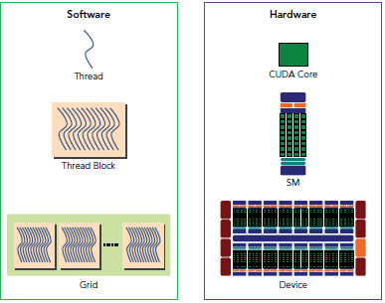
Threadblock Scheduling

Slide 9
Warps Scheduling
While warps within a thread block may be scheduled in any order, the number of active warps is limited by SM resources.
When a warp idles for any reason (for example, waiting for values to be read from device memory), the SM is free to schedule another available warp from any thread block that is resident on the same SM.
Switching between concurrent warps has little overhead because hardware resources are partitioned among all threads and blocks on an SM, so the state of the newly scheduled warp is already stored on the SM.

Slide 10
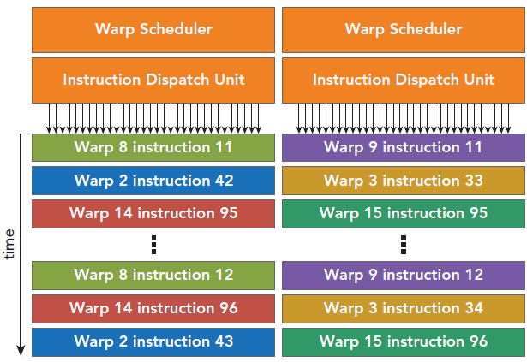
Warps Scheduling
Cores are grouped into 32-core group
Notes:
For devices of compute capability 2.0, the two instructions issued every other cycle are
for two different warps. For devices of compute capability 2.1, the four instructions
issued every other cycle are two pairs for two different warps, each pair being for the
same warp.
For devices of compute capability 3.x, the eight instructions issued every cycle are four
pairs for four different warps, each pair being for the same warp.

Slide 11
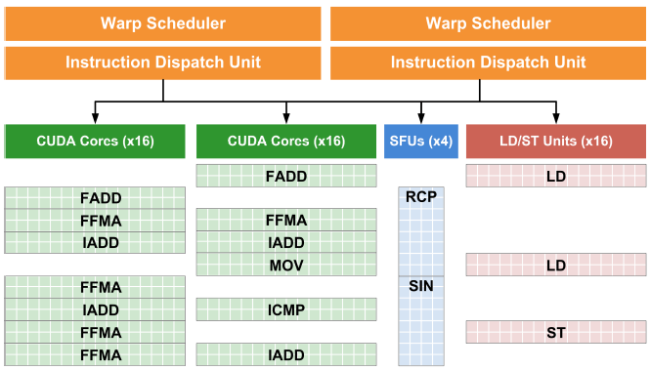
Warps Scheduling
Cores are grouped into 16-core group
Insts belong to different warps
Notes:
Compute Capability 2.x
At every instruction issue time, each scheduler issues:
‣ One instruction for devices of compute capability 2.0,
‣ Two independent instructions for devices of compute capability 2.1,
for some warp that is ready to execute, if any. The first scheduler is in charge of the
warps with an odd ID and the second scheduler is in charge of the warps with an even
ID. Note that when a scheduler issues a double-precision floating-point instruction, the
other scheduler cannot issue any instruction.
A warp scheduler can issue an instruction to only half of the CUDA cores. To execute
an instruction for all threads of a warp, a warp scheduler must therefore issue the
instruction over two clock cycles for an integer or floating-point arithmetic instruction.

Slide 12
Shared Memory and Registers
Shared memory and registers are precious resources in an SM.
Shared memory is partitioned among thread blocks resident on the SM and registers are partitioned among threads.
Threads in a thread block can cooperate and communicate with each other through these resources.
While all threads in a thread block run logically in parallel, not all threads can execute physically at the same time.

Slide 13
Aside: SM: The heart of the GPU arch.
The Streaming Multiprocessor (SM) is the heart of the GPU architecture.
Registers and shared memory are scarce resources in the SM. CUDA partitions these resources among all threads resident on an SM. Therefore, these limited resources impose a strict restriction on the number of active warps in an SM, which corresponds to the amount of parallelism possible in an SM.

Slide 14
The Fermi Architecture
First complete GPU computing architecture to deliver the features required for the most demanding HPC applications.
Fermi has been widely adopted for accelerating production workloads.
Notes:
The G80 Architecture
NVIDIA’s GeForce 8800 was the product that gave birth to the new GPU Computing model.
Introduced in November 2006, the G80 based GeForce 8800 brought several key innovations
to GPU Computing:
• G80 was the first GPU to support C, allowing programmers to use the power of the
GPU without having to learn a new programming language.
• G80 was the first GPU to replace the separate vertex and pixel pipelines with a single,
unified processor that executed vertex, geometry, pixel, and computing programs.
• G80 was the first GPU to utilize a scalar thread processor, eliminating the need for
programmers to manually manage vector registers.
• G80 introduced the single-instruction multiple-thread (SIMT) execution model where
multiple independent threads execute concurrently using a single instruction.
• G80 introduced shared memory and barrier synchronization for inter-thread
communication.
Fermi features:
• Improve Double Precision Performance—while single precision floating point performance
was on the order of ten times the performance of desktop CPUs, some GPU computing
applications desired more double precision performance as well.
• ECC support—ECC allows GPU computing users to safely deploy large numbers of GPUs in
datacenter installations, and also ensure data-sensitive applications like medical imaging and
financial options pricing are protected from memory errors.
• True Cache Hierarchy—some parallel algorithms were unable to use the GPU’s shared memory,
and users requested a true cache architecture to aid them.
• More Shared Memory—many CUDA programmers requested more than 16 KB of SM shared
memory to speed up their applications.
• Faster Context Switching—users requested faster context switches between application
programs and faster graphics and compute interoperation.
• Faster Atomic Operations—users requested faster read-modify-write atomic operations for
their parallel algorithms.

Slide 15
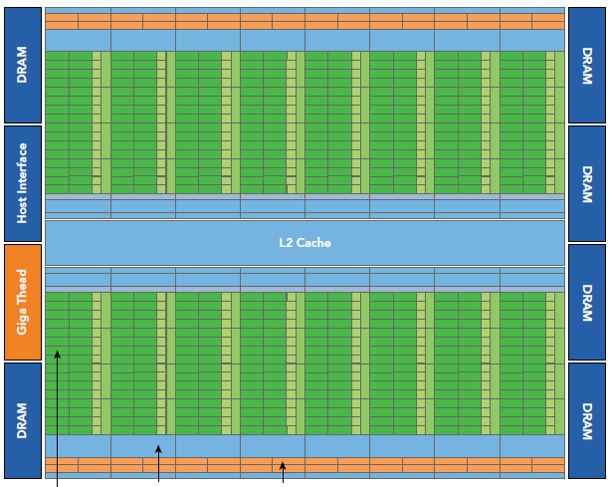
The Fermi Architecture
graphics-specific components largely omitted.
512 CUDA cores
Each SM represented by a vertical rectangular strip
CUDA Core, Register file, Warp scheduler & dispatching unit, SFU

Slide 16
The Fermi Architecture
Each CUDA core has a fully pipelined integer arithmetic logic unit (ALU) and a floating-point unit (FPU) that executes one integer or floating-point instruction per clock cycle.
The CUDA cores are organized into 16 streaming multiprocessors (SM), each with 32 CUDA cores.
Fermi has six 64-bit GDDR5 DRAM memory interfaces supporting up to a total of 6 GB of global on-board memory, a key compute resource for many applications.

Slide 17
The Fermi Architecture
A host interface connects the GPU to the CPU via the PCI Express bus.
The GigaThread engine is a global scheduler that distributes thread blocks to the SM warp schedulers.
Each multiprocessor has 16 load/store units allowing source and destination addresses to be calculated for 16 threads (a half-warp) per clock cycle.
Special function units (SFUs) execute intrinsic instructions such as sine, cosine, square root, , and interpolation.

Slide 18
The Fermi Architecture
Each SFU can execute one intrinsic instruction per thread per clock cycle.
Each SM features two warp schedulers and two instruction dispatch units.
Shared/ L1 cache : 48kB or 16kB
L2$ : 768KB
Register File: 32k * 32-bit
Concurrent kernels execution: 16 Kernels

Slide 19
The Kepler Architecture
released in the fall of 2012, is a fast and highly efficient, high-performance computing architecture.

Slide 20
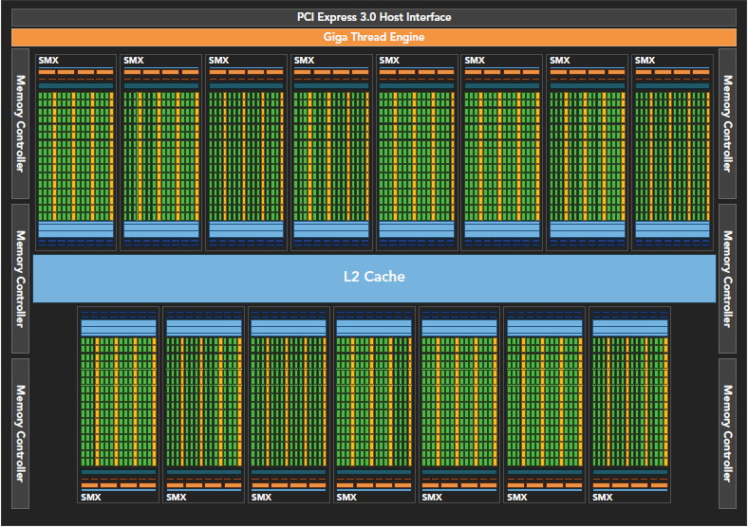
Kepler K20X chip block diagram

Slide 21
Kepler Architecture Innovations
Enhanced SMs
Dynamic Parallelism
Hyper-Q

Slide 22
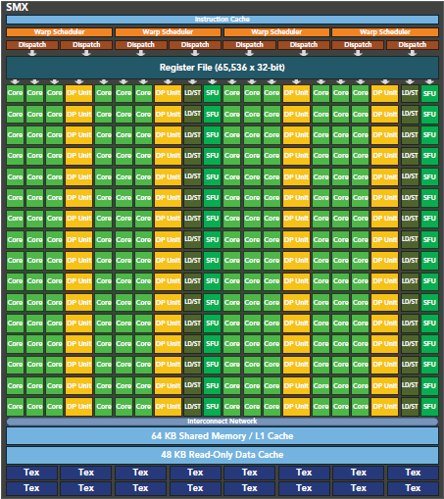
Kepler Architecture Innovations: Enhanced SMs

Slide 23
Kepler Architecture Innovations: Enhanced SMs
192 single-precision CUDA cores
64 double-precision units,
32 special function units (SFU), and
32 load/store units (LD/ST)
Register file size: 64k
four warp schedulers and eight instruction dispatchers
The Kepler K20X:
  can schedule 64 warps per SM for a total of 2,048 threads
  1 TFlop of peak double-precision computing power

Slide 24
Kepler Architecture Innovations: Dynamic Parallelism
allows the GPU to dynamically launch new kernels
makes it easier for you to create and optimize recursive and data-dependent execution patterns.
Notes:
Dynamic parallelism broadens GPU applicability in various disciplines.??????

Slide 25
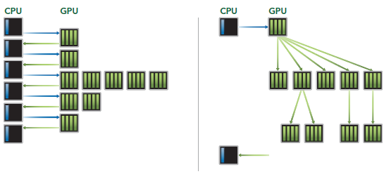
Kepler Architecture Innovations: Dynamic Parallelism

Slide 26
Kepler Architecture Innovations: Hyper-Q
adds more simultaneous hardware connections between the CPU and GPU,
  enabling CPU cores to simultaneously run more tasks on the GPU.
  increased GPU utilization
  reduced CPU idle time
Fermi GPUs rely on a single hardware work queue to pass tasks from the CPU to the GPU, which could cause a single task to block all other tasks behind it in the queue from making progress. Kepler Hyper-Q removes this limitation.

Slide 27
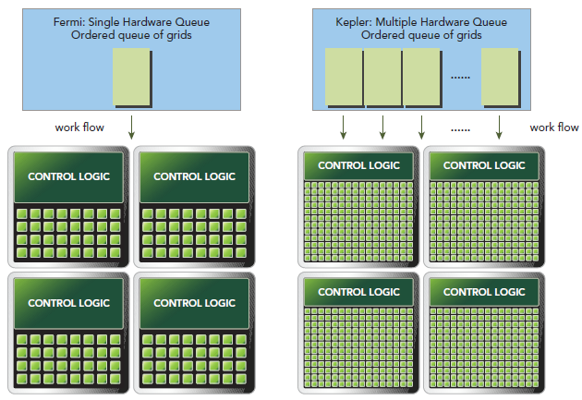
Kepler Architecture Innovations: Hyper-Q

Slide 28
Kepler Architecture Innovations: Hyper-Q
Hyper-Q enables more concurrency on the GPU, maximizing GPU utilization and increasing overall performance.
Lesson: Use multiple streams in your application

Slide 29
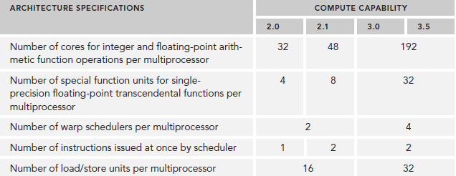
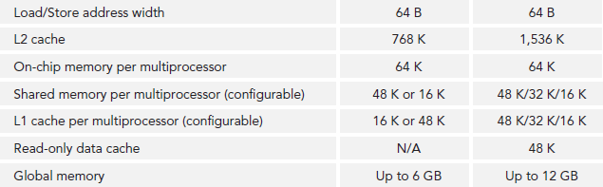
Compute Capability & Arch. Features
Notes:
Number of instructions issued at once per warp scheduler

Slide 30
Threadblock and Warps
Warps are the basic unit of execution in an SM.
When you launch a grid of thread blocks, the thread blocks in the grid are distributed among SMs.
Once a thread block is scheduled to an SM, threads in the thread block are further partitioned into warps.

Slide 31
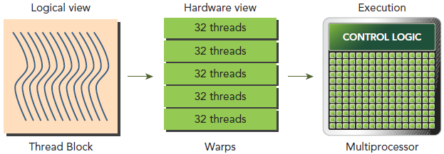
Threadblock and Warps
A warp consists of 32 consecutive threads and all threads in a warp are executed in Single Instruction Multiple Thread (SIMT) fashion; that is, all threads execute the same instruction, and each thread carries out that operation on its own private data.

Slide 32

Threadblock and Warps
Thread blocks can be configured to be one-, two-, or three-dimensional. However, from the hardware perspective, all threads are arranged one-dimensionally.
Each thread has a unique ID in a block.
For a one-dimensional thread block, the unique thread ID is stored in the CUDA built-in variable threadIdx.x.
Threads with consecutive values for threadIdx.x are grouped into warps.

Slide 33
Threadblock and Warps
The logical layout of a two or three-dimensional thread block can be converted into its one-dimensional physical layout by using:
  threadIdx.y * blockDim.x + threadIdx.x.
  threadIdx.z * blockDim.y * blockDim.x + threadIdx.y * blockDim.x + threadIdx.x

Slide 34
Threadblock and Warps
The number of warps for a thread block can be determined as follows:
WarpsPerBlock = ceil ( ThreadsPerBlock /
warpSize )
A warp is never split between different thread blocks.
If thread block size is not an even multiple of warp size, some threads are left inactive ( still consume SM resources, such as registers.)

Slide 35
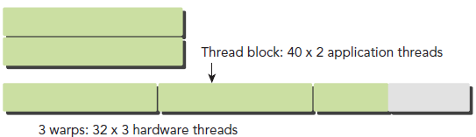
Threadblock and Warps
Lesson: Keep threadblock size multitple of warp size:
  This doesn't waste GPU resources
  Definitely likely to improve performance
Run the vector addition using <<<N,1>>>
  N equals number of elements in a vector

Slide 36
Aside Threadblock: Logical View vs Hardware View
From the logical perspective, a thread block is a collection of threads organized in a 1D, 2D, or 3D layout.
From the hardware perspective, threads in a thread block are organized in a 1D layout, and each set of 32 consecutive threads forms a warp.

Slide 37
Warp Divergence
Occurs when threads in a warp follow different execution paths.
if (cond) { ... } else { ... }
  assume this code in a kernel
  Also assume, for some threads cond is true while for others cond is false. This situation creates warp divergence
If threads of a warp diverge, the warp serially executes each branch path, disabling threads that do not take that path.
Warp divergence can cause significantly degraded performance.

Slide 38
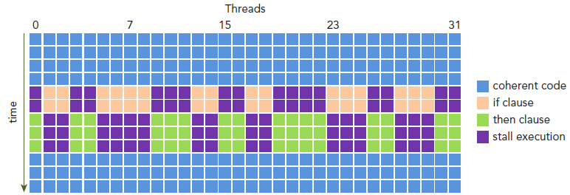
Warp Divergence

Slide 39
Warp Divergence
Lesson:
  Try to avoid different execution paths within the same warp.
  Keep in mind that the assignment of threads to warp in a thread block is deterministic. Therefore, it may be possible (though not trivial, depending on the algorithm) to partition data in such a way as to ensure all threads in the same warp take the same control path in an application.

Slide 40
Warp Execution Context
Warp: basic unit of execution in GPUs
Main resources include:
  Program counters
  Registers
  Shared memory
Eacp warp's execution context maintained on-chip during the entire lifetime of the warp. Therefore, switching from one execution context to another has little overhead (1 or 2 cycles).

Slide 41
Warp Execution Context
Each SM has a set of 32-bit registers stored in a register file that are partitioned among threads, and a fixed amount of shared memory that is partitioned among thread blocks.
The number of thread blocks and warps that can simultaneously reside on an SM for a given kernel depends on 1) the number of registers, 2) amount of shared memory and 3) execution configuration

Slide 42
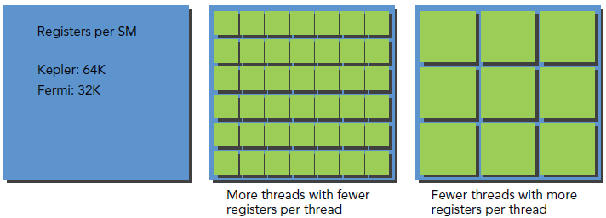
Warp Execution Context

Slide 43
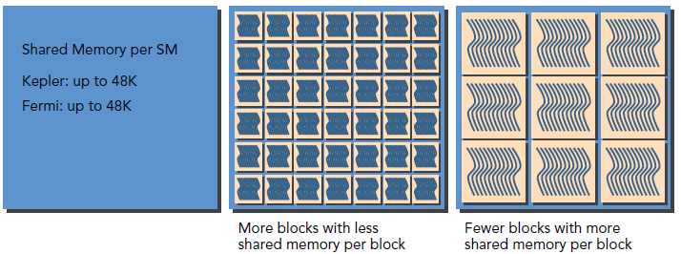
Warp Execution Context

Slide 44
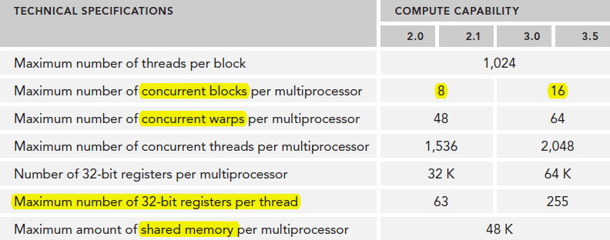
Warp Execution Context
Resource availability generally limits the number of resident thread blocks per SM.
If there are insufficient registers or shared memory on each SM to process at least one block, the kernel launch will fail.

Slide 45
Warp Execution State
Active thread block when compute resources, such as registers and shared memory, have been allocated to it. The warps it contains are called active warps.
Active warps can be further classified into the following three types:
  Selected warp: actively executing now
  Stalled warp: not ready for execution
  Eligible warp: ready for execution but not currently executing

Slide 46
Warp Execution State
The warp schedulers on an SM select active warps on every cycle and dispatch them to execution units.
In order to maximize GPU utilization, you need to maximize the number of active warps.

Slide 47
Latency Hiding/ Full Utilization
An SM relies on thread-level parallelism to maximize utilization of its functional units.
  Utilization is therefore directly linked to the number of resident warps.
Full compute resource utilization is achieved when all warp schedulers have an eligible warp at instruction issue time.
  This ensures that the latency of each instruction can be hidden by issuing other instructions in other resident warps.
Notes:
Inst latency: the number of intervening cycles b/w an instruction that produces a result and instruction that uses the result
The number of clock cycles between an instruction being issued and being completed is defined as instruction latency.

Slide 48
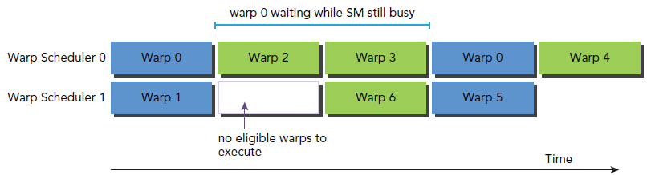
Latency Hiding/ Full Utilization

Slide 49
Latency Hiding/ Full Utilization
When considering instruction latency, instructions can be classified into two basic types:
  Arithmetic instructions
  Memory instructions
Notes:
Arithmetic instruction latency is the time between an arithmetic operation starting and its output being produced.
Memory instruction latency is the time between a load or store operation being issued and the data arriving at its destination.
➤ 10-20 cycles for arithmetic operations
➤ 400-800 cycles for global memory accesses

Slide 50
Latency Hiding/ Full Utilization
Estimating the number of active warps required to hide latency.
  Number of Required Warps = Inst latency × Throughput (in terms of warp)
  Fine-grained multithreading in each CUDA core
  Single thread: assume inst2 depends on inst1 and inst1 latency is 20 cycles then to hide inst1 latency this thread needs 20 instructions b/w inst1 and inst2. The same basic principal applies to GPUs except that instructions come from different threads, i.e. fine-grained multithreading.

Slide 51
Arith. Inst Latency Hiding/ Full Utilization
For arithmetic operations, the required parallelism can be expressed as the number of operations required to hide arithmetic latency. The arithmetic operation used as an example here is a 32-bit floating-point multiply-add (a + b × c), expressed as the number of operations per clock cycle per SM.
The throughput varies for different arithmetic instructions.

Slide 52
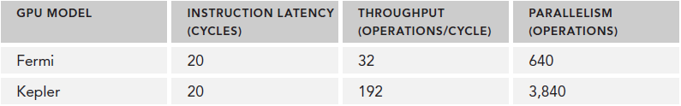
Arith. Inst Latency Hiding/ Full Utilization
To keep SM fully utilized for MAD inst:
  Fermi needs 640 MAD operations
  Kepler needs 3,840 MAD operations
These independent operations come from 640 or 3,840 threads or fewer threads but with more indep operations per thread
Notes:
A simple formula for calculating the required parallelism is to multiply the number
of cores per SM by the latency of one arithmetic instruction on that SM. For
example, Fermi has 32 single-precision fl oating-point pipeline lanes and the latency
of one arithmetic instruction is 20 cycles, so at minimum 32 x 20 = 640 threads per
SM are required to keep your device busy. However, this is a lower bound.

Slide 53
Arith. Inst Latency Hiding/ Full Utilization
Lesson: Two ways to maximize SM arithmetic resources:
  Create many threads → more warps
    Write Fine-grained threads, i.e. theads perform few ops
  Fewer threads but more independent operations per thread, i.e. loop unrolling
    Write course-grained threads
Best: combine both: large number of threads with many indep operations

Slide 54
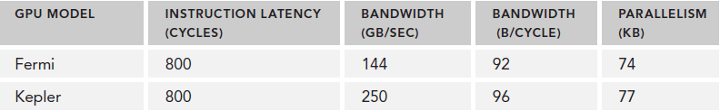
Mem. Inst Latency Hiding/ Full Utilization
For memory operations, the required parallelism is expressed as the number of bytes per cycle required to hide memory latency.
144 GB/Sec ÷ 1.566 GHz ≅ 92 Bytes/Cycle
74 or 77KB for the whole device
Notes:
Multiplying bytes per cycle by memory latency, you derive the required parallelism for Fermi memory
operations at nearly 74 KB of memory I/O in-flight to achieve full utilization. This value is for
the entire device, not per SM, because memory bandwidth is given for the entire device.

Slide 55
Mem. Inst Latency Hiding/ Full Utilization
Connecting these values to warp or thread counts depends on the application.
  Suppose each thread moves one float of data (4 bytes) from global memory to the SM for computation, we would require 18,500 threads or 579 warps to hide all memory latency on Fermi GPUs:
    74 KB ÷ 4 bytes/thread ≅ 18,500 threads
    18,500 threads ÷ 32 threads/warp ≅ 579 warps
    The Fermi architecture has 16 SMs. Therefore, we require 579 warps ÷ 16 SMs = 36 warps per SM to hide all memory latency.
  If each thread performed more than one independent 4-byte load, fewer threads would be required to hide the memory latency.

Slide 56
Mem. Inst Latency Hiding/ Full Utilization
Lesson: Same conclusion as for "Arithmetic Inst Latency Hiding".
Two ways to maximize available device bandwidth:
  Create many threads → more warps
    Write Fine-grained threads, i.e. theads perform few memory operations
  Fewer threads but more independent memory operations per thread, i.e. loop unrolling
    Write course-grained threads with lots of indep memory operations
Best: combine both: large number of threads with many indep operations

Slide 57
Aside
Latency hiding depends on the number of active warps per SM,
  determined by the execution configuration and resource constraints (registers and shared memory usage in a kernel).
  Choosing an optimal execution configuration is a matter of striking a balance between latency hiding and resource utilization.

Slide 58
Occupancy
Ideally, you want to have enough warps to keep the cores of the device occupied.
Occupancy is the ratio of active warps to maximum number of warps, per SM.
  Occupancy = active warps / maximum warps
Calculating maximum warps per SM:
  Get val of maxThreadsPerMultiProcessor member of cudaDeviceProp structure and divide by 32.
CUDA Occupancy calculator : assists in choosing thread block size based on shared memory and per-thread reg requirements.

Slide 59
Using Occupancy Cal
Specify compute capability of the GPU
Next enter the following parameters (which determine No. of active warps per SM):
  Threads per block (execution configuration)
  Registers per thread (resource usage)
  Shared memory per block (resource usage)
The registers per thread and shared memory per block:
  Use --ptxas-options=-v or -Xptxas -v flag with nvcc

Slide 60
Using Occupancy Cal: optimal values for reg/thread and shared memory
compute capability = 3.5
  Max. 32-bit regs = 65536 = 2¹⁶
  Register allocation unit size = 256 = 2⁸
  Total reg allocation units = 2¹⁶ / 2⁸ = 2⁸
  Tot. reg allocation units per warp = 2⁸ / 2⁶ = 4
  Tot. regs per thread = 2² * 2⁸ = 2¹⁰ / 2⁵ = 2⁵
  If reg/thread <= 32, amount of parallelism is never limited by this factor
Configured shared mem = 49152 bytes
  Per block shared memory = 49152 / 16 = 3072 bytes, so max no. of block/SM can be scheduled
  If shared mem per block <= 3072B, amount of parallelism is never limited by shared memory

Slide 61
Using Occupancy Cal: optimal values for reg/thread and shared memory
As long as kernel is using regs <= 32 per thread and shared memory per block <= 3072 bytes, amount of parallelism is not limited by either reg/ thread or shared memory/block
  Only Execution Configuration can limit amount of parallelism
    Keep the number of threads per block a multiple of warp size (32).
    Avoid small block sizes: Start with at least 128 or 256 threads per block.
CUDA Occupancy calculator :
Notes:
Occupancy & performance
Higher occupancy does not necessarily mean higher performance. If a kernel is not bandwidth-limited or latency-limited, then increasing occupancy will not necessarily increase performance. If a kernel grid is already running at least one thread block per multiprocessor in the GPU, and it is bottlenecked by computation and not by global memory accesses, then increasing occupancy may have no effect. In fact, making changes just to increase occupancy can have other effects, such as additional instructions, more register spills to local memory (which is off-chip), more divergent branches, etc. As with any optimization, you should experiment to see how changes affect the *wall clock time* of the kernel execution. For bandwidth-bound applications, on the other hand, increasing occupancy can help better hide the latency of memory accesses, and therefore improve performance.

Slide 62
Occupancy Cal
Occupancy Cal gives no info about:
  Arrangement of threads in a thread block
  Thread block size should be a multiple of warp size, i.e. 32
  Performance
  Real-time usage of SM resources
  Memory bandwidth utilization
  Static occupancy calculation
  Use achieved_occupancy metric to cal average active warps per cycle per SM
    Achieved occupancy = average active warps per cycle / tot
    warps per SM

Slide 63
Occupancy: Controlling Register Count
Controlling registers per thread:
  Use –maxrregcount=NUM flag with nvcc, tells the compiler to not use more than NUM registers per thread.
  Optimal NUM val: obtained from occupancy calculator or from prevous slide
Notes:
The option -maxrregcount tells the compiler to not use more than NUM registers per thread.
Small/ large Threadblock size:
Although each case will hit different hardware limits, both cause compute resources to be underutilized
and hinder the creation of suffi cient parallelism to hide instruction and memory latency.
Occupancy focuses exclusively on the number of concurrent threads or warps per SM. However, full
occupancy is not the only goal for performance optimization. Once a certain level of occupancy is
achieved for a kernel, further increases may not lead to performance improvement. There are also
many other factors you need to examine for performance tuning. You will learn all these issues in
detail in subsequent chapters.

Slide 64
Aside: Grid and Threadblock size
Keep the number of threads per block a multiple of warp size (32).
Avoid small block sizes: Start with at least 128 or 256 threads per block.
Adjust block size up or down according to kernel resource requirements.
Keep the number of blocks much greater than the number of SMs to expose sufficient parallelism to your device.
Conduct experiments to discover the best execution configuration and resource usage.

Slide 65
Grid & Threadblock heuristics
A must have have skill for CUDA C Programmer
Using occupancy cal we found the optimal threadblock size. However, we learnt no info on how to arrange these threads in a threadblock
Run prog with different combination of threadblock sizes and measure exec. time.
  2D threadblock in matrix addition: 32 X 32, 512 X 2, 1024 X 1, 1 X 1024
Notes:
$ nvprof --metrics achieved_occupancy ./application_name 32 32

Slide 66
Backup Slides just for your information

Slide 67
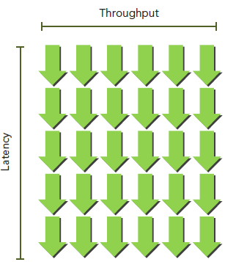
Latency Hiding
Suppose the average latency for an instruction in your kernel is 5 cycles.
To keep a throughput of 6 warps executed per cycle, you will need at least 30 warps in-flight.

