Slide 1
GPU Computing CIS-543 Lecture 08: CUDA Memory Model
Dr. Muhammad Abid,
DCIS, PIEAS

Slide 2
Aside
Arrangement of threads in a thread block (i.e. mapping of threads to data):
CUDA execution units do not care about it
CUDA memory model performance strongly depends on arrangement of threads in a thread block
Example: 2D thread block of 1024 threads: 32 X 32 ; 16 X 64; 1 X 1024. why one execution configuration performs better? Memory access pattern

Slide 3
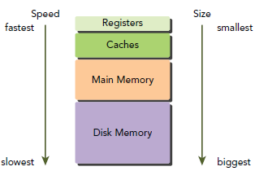
Introducing the CUDA Memory Model
The performance of many HPC applications is limited memory bandwidth, i.e. how rapidly they can load and store data.
Computing systems employ memory hierarchy so that memory appears to be large and fast for applications employing principal of locality
Notes:
In this memory hierarchy, data is either kept in lowlatency,
low-capacity memory when it is actively being used by the processor, or in high-latency,
high-capacity memory when it is being stored for later use. This memory hierarchy can provide the
illusion of large but low-latency memory.

Slide 4
CUDA Memory Model
To programmers, there are generally two classifications of memory:
Programmable: You explicitly control what data is placed in programmable memory.
Non-programmable: You have no control over data placement, and rely on automatic techniques to achieve good performance. E.g., CPU's L1/L2$
CUDA memory model exposes many types of programmable memory:
Registers , Shared memory , Local memory
Constant memory, Global memory

Slide 5
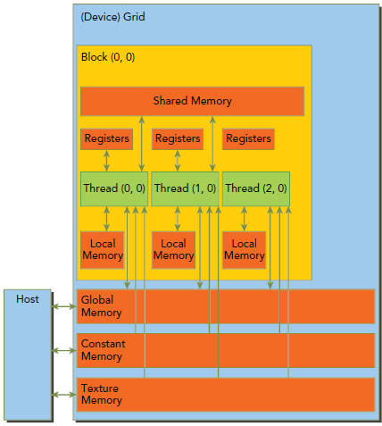
CUDA Memory Model
Each thread can:
R/W per-thread registers and local mem
R/W per-block shared memory
R/W per-grid global memory (~500 cycles)
R per-grid constant/ texture memory

Slide 6
CUDA Memory Model
Each memory has a different scope, lifetime, and caching behavior.
Variable declaration | Memory | Copy | Lifetime | Declaration
int LocalVar; | register | thread | thread | kernel
float var[100]; | local | thread | thread | kernel
__shared__ int Var; | shared | block | block | kernel
__device__ int Var; | global | grid | application | outside
__constant__ int Var; | constant | grid | application | outside

Slide 7
Registers
fastest memory space on a GPU.
An automatic variable declared in a kernel without any type qualifier is generally stored in a register.
Register variables are private to each thread.
Notes:
Arrays declared in a kernel may also be stored in registers, but only if the indices used to reference the array are constant and can be determined at compile time.

Slide 8
Registers
A kernel typically uses registers to hold frequently accessed thread-private variables.
Registers limit: 63 (Fermi), 255(Kepler)
Nvcc -Xptxas -v: display info about:
number of regs used per kernel
bytes of shared memory per kernel
bytes of constant memory per kernel
bytes of Spill loads/ stores
bytes of stack frame
Notes:
Register variables share their lifetime with the kernel. Once a kernel completes execution, a register variable cannot be accessed again.

Slide 9
Register Spilling
If a kernel uses more registers than the hardware limit, the excess registers will spill over to local memory. This register spilling can have adverse performance consequences.
The nvcc compiler uses heuristics to minimize register usage and avoid register spilling. You can optionally aid these heuristics by providing additional information for each kernel to the compiler in the form of launch bounds:
Notes:
__global__ void
__launch_bounds__(maxThreadsPerBlock, minBlocksPerMultiprocessor) kernel(...) {
// your kernel body
}
Controlling the maximum number of registers used by all kernels:
nvcc -maxrregcount=32
ignored for any kernels that have launch bounds specified
The number of registers used by a kernel can have a signifi cant impact on the number of resident
warps
‣ maxThreadsPerBlock specifies the maximum number of threads per block with
which the application will ever launch MyKernel(); it compiles to the .maxntid
PTX directive;
‣ minBlocksPerMultiprocessor is optional and specifies the desired minimum
number of resident blocks per multiprocessor; it compiles to the .minnctapersm
PTX directive.
If launch bounds are specified, the compiler first derives from them
the upper limit L on the number of registers the kernel should use to
ensure that minBlocksPerMultiprocessor blocks (or a single block if
minBlocksPerMultiprocessor is not specified) of maxThreadsPerBlock threads
can reside on the multiprocessor (see Hardware Multithreading for the relationship
between the number of registers used by a kernel and the number of registers allocated
per block). The compiler then optimizes register usage in the following way:
‣ If the initial register usage is higher than L, the compiler reduces it further until it
becomes less or equal to L, usually at the expense of more local memory usage and/
or higher number of instructions;
‣ If the initial register usage is lower than L
‣ If maxThreadsPerBlock is specified and minBlocksPerMultiprocessor is
not, the compiler uses maxThreadsPerBlock to determine the register usage
thresholds for the transitions between n and n+1 resident blocks (i.e., when
using one less register makes room for an additional resident block as in the
example of Multiprocessor Level) and then applies similar heuristics as when no
launch bounds are specified;
‣ If both minBlocksPerMultiprocessor and maxThreadsPerBlock are
specified, the compiler may increase register usage as high as L to reduce the
number of instructions and better hide single thread instruction latency.
A kernel will fail to launch if it is executed with more threads per block than its launch
bound maxThreadsPerBlock.
using the __CUDA_ARCH__ macro introduced in Application Compatibility
#define THREADS_PER_BLOCK 256
#if __CUDA_ARCH__ >= 200
#define MY_KERNEL_MAX_THREADS (2 * THREADS_PER_BLOCK)
#define MY_KERNEL_MIN_BLOCKS 3
#else
#define MY_KERNEL_MAX_THREADS THREADS_PER_BLOCK
#define MY_KERNEL_MIN_BLOCKS 2
#endif
// Device code
__global__ void
__launch_bounds__(MY_KERNEL_MAX_THREADS, MY_KERNEL_MIN_BLOCKS)
MyKernel(...)
{
...
}

Slide 10
Local Memory
Located in device memory so high latency and low bandwidth
Required efficient memory access patterns
Local memory:
Local arrays referenced with indices whose values cannot be determined at compile-time.
Large local structures or arrays that would consume too much register space.
Any variable that does not fit within the kernel register limit

Slide 11
Local Memory
For GPUs with compute capability >=2.0, local memory data is also cached in a per-SM L1 and per-device L2 cache

Slide 12
Shared Memory
On-chip memory , low latency, high-bandwidth
Declared with __shared__ qualifier in a kernel
Partitioned among thread blocks
More shared memory per thread block → less no. of resident thread blocks per SM → less no. of active warps
Basic means for inter-thread communication in a thread block

Slide 13
Shared Memory
On-chip memory is partitioned b/w L1 cache and shared memory for an SM
On-chip memory can be dynamically configured, per-kernel basis, at runtime using:
cudaError_t cudaFuncSetCacheConfig(const void* func, enum cudaFuncCache cacheConfig);
cacheConfig values: cudaFuncCachePreferNone: (default), cudaFuncCachePreferShared, cudaFuncCachePreferL1, cudaFuncCachePreferEqual
Notes:
// Device code
__global__ void MyKernel() { ... }
// Host code
// Runtime API
// cudaFuncCachePreferShared: shared memory is 48 KB
// cudaFuncCachePreferEqual: shared memory is 32 KB
// cudaFuncCachePreferL1: shared memory is 16 KB
// cudaFuncCachePreferNone: no preference
cudaFuncSetCacheConfig(MyKernel, cudaFuncCachePreferShared)

Slide 14
Constant Memory
R-only memory located in device memory
Caches in per-SM constant cache
Declared outside of any kernel, global scope, with __constant__ qualifier
64KB constant memory for all compute apabilities.
Notes:
Constant memory is statically declared and visible to all kernels in the same compilation unit.

Slide 15
Constant Memory
performs best when all threads in a warp read from the same memory address coz a single read from constant memory broadcasts to all threads in a warp.

Slide 16
Global Memory
Located in device memory
High latency, large in size, most commonly used memory on a GPU
Statically and dynamically allocated.
To allocate dynamically use cudaMalloc()
To allocate statically, use __device__ qualifier; declare outside of any kernel;
__device__ int vec[1000];
Scope: all threads running on a GPU can R/W
Lifetime: application level

Slide 17
Global Memory
accessible via 32-byte, 64-byte, or 128-byte memory transactions, naturally aligned
When a warp performs a memory load/store, the number of transactions required to satisfy that request typically depends on the following two factors:
Distribution of memory addresses across the threads of that warp.
Alignment of memory addresses per transaction.
In general, the more transactions → the higher the potential for unused bytes to be transferred → reduction in throughput efficiency.

Slide 18
GPU Caches
Per-SM caches:
L1: caches local/ global memory and reg spills; glds caching can be disabled;st are not cached
Read-only constant: caches constant memory
Read-only: caches texture memory; also glds
Per-device cache: shared by al SMs
L2: serve all load, store, and texture requests
provides efficient, high speed data sharing across the GPU.
Notes:
L2 Cache: Algorithms for which data addresses are not known beforehand, such as physics solvers, raytracing, and sparse matrix multiplication especially benefit from the cache hierarchy. Filter and convolution kernels that require multiple SMs to read the same data also benefit.

Slide 19
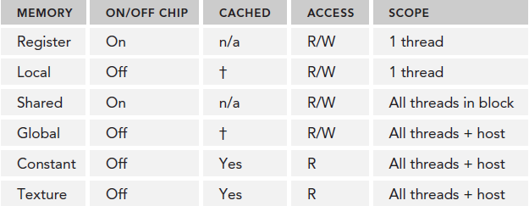
GPU Caches
ᶧ cached only in 2.x

Slide 20
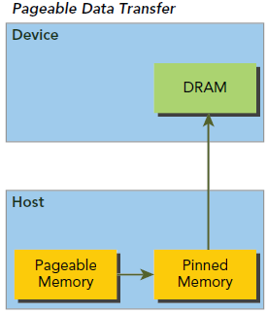
Pinned or Page-locked Memory
C malloc() function allocates pageable memory that is subject to page fault operations
The GPU cannot safely access data in pageable host memory because it has no control over when the host operating system may choose to physically move that data.
Notes:
When transferring data from pageable host memory to device memory, the CUDA driver first allocates temporary page-locked
or pinned host memory, copies the source host data to pinned memory, and then transfers the data
from pinned memory to device memory,

Slide 21
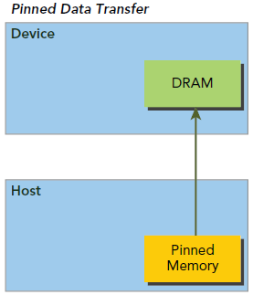
Pinned or Page-locked Memory
The CUDA runtime allows us to directly allocate pinned host memory using:
cudaError_t cudaMallocHost(void **devPtr, size_t count);
cudaError_t cudaFreeHost(void *ptr);
read/ written with much higher bandwidth than pageable memory.
Excessive allocation may degrade host system performance
Notes:
However, allocating excessive amounts of pinned
memory might degrade host system performance, since it reduces the amount of pageable memory
available to the host system for storing virtual memory data.

Slide 22
Zero-Copy Memory
Both the host and device can access zero-copy memory.
Pinned memory mapped into the device address space and host address space.
Use following fun to create a mapped, pinned memory region:
cudaError_t cudaHostAlloc(void **pHost, size_t count, unsigned int flags);
cudaError_t cudaFreeHost(void *ptr);
cudaError_t cudaHostGetDevicePointer(void **pDevice, void *pHost, unsigned int flags);
Notes:
cudaHostAllocDefault makes the behavior of cudaHostAlloc identical to cudaMallocHost.
Setting cudaHostAllocPortable returns pinned memory that can be used by all CUDA contexts,
not just the one that performed the allocation. The fl ag cudaHostAllocWriteCombined returns
write-combined memory, which can be transferred across the PCI Express bus more quickly on
some system confi gurations but cannot be read effi ciently by most hosts. Therefore, write-combined
memory is a good option for buffers that will be written by the host and read by the device using
either mapped pinned memory or host-to-device transfers. The most relevant fl ag to zero-copy
memory is cudaHostAllocMapped, which returns host memory that is mapped into the device
address space.

Slide 23
Zero-Copy Memory
Advantages using zero-copy memory in CUDA kernels:
Leveraging host memory when there is insufficient device memory
Avoiding explicit data transfer between the host and device
Sharing data b/w host and device
Notes:
When using zero-copy memory to share data between the host and device, you must synchronize
memory accesses across the host and device. Modifying data in zero-copy memory from both the
host and device at the same time will result in undefined behavior.

Slide 24
Zero-Copy Memory
Disadvantage:
Using zero-copy memory as a supplement to device memory with frequent read/write operations will significantly slow performance. Because every memory transaction to mapped memory must pass over the PCIe bus, a significant amount of latency is added even when compared to global memory

Slide 25
Aside: Zero-copy
Two common categories of heterogeneous computing system architectures:
Integrated and discrete.
In integrated architectures, CPUs and GPUs are fused onto a single die and physically share main memory. In this architecture, zero-copy memory is more likely to benefit both performance and programmability because no copies over the PCIe bus are necessary.

Slide 26
Aside: Zero-copy
For discrete systems with devices connected to the host via PCIe bus, zero-copy memory is advantageous only in special cases. Be careful to not overuse zero-copy memory. Device kernels that read from zerocopy memory can be very slow due to its high-latency.

Slide 27
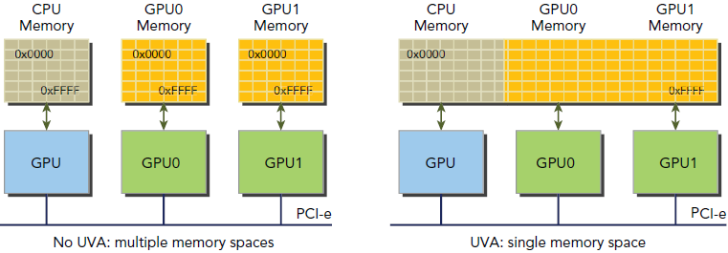
Unified Virtual Addressing (UVA)
UVA provides a single virtual memory address space for all processors in the system.
Host memory and device memory share a single virtual address space
Notes:
Devices with compute capability 2.0 and later support a special addressing mode called Unifi ed
Virtual Addressing (UVA). UVA, introduced in CUDA 4.0, is supported on 64-bit Linux systems.

Slide 28
Unified Virtual Addressing (UVA)
Under UVA, pinned host memory allocated with cudaHostAlloc() has identical host and device pointers. You can therefore pass the returned pointer directly to a kernel function
Without UVA:
Allocated mapped, pinned host memory.
Acquired the device pointer to the mapped, pinned memory using a CUDA runtime function.
Passed the device pointer to your kernel.
With UVA, there is no need to acquire the device pointer or manage two pointers to what is physically the same data.

Slide 29
Memory Access Pattern
Memory access patterns determine how efficiently device use memory bandwidth.
Applies to all types of memory reside in the device memory. E.g. global/ local/ constant/ texture memory [Need to confirm].
CUDA applications heavily use global memory, so applications must optimize global memory access patterns
Like inst issue/ execution, memory operations are also issued on per-warp basis
Notes:
When executing a memory instruction, each thread in a warp provides a memory address it is loading
or storing. Cooperatively, the 32 threads in a warp present a single memory access request comprised
of the requested addresses, which is serviced by one or more device memory transactions.

Slide 30
Memory Access Pattern
Two main features of memory access pattern:
Aligned memory accesses
Coalesced memory accesses
Aligned memory accesses occur when the first address of a device memory transaction is an even multiple of the cache granularity being used to service the transaction (either 32 bytes for L2 cache or 128 bytes for L1 cache).
Performing a misaligned load will cause wasted bandwidth.

Slide 31
Memory Access Pattern
Coalesced memory accesses occur when all 32 threads in a warp access a contiguous chunk of memory.
Aligned coalesced memory accesses are ideal
maximize global memory throughput

Slide 32
Memory Access Pattern
(a)
(b)
(a) Aligned and coalesced (b) Misaligned and uncoalesced

Slide 33
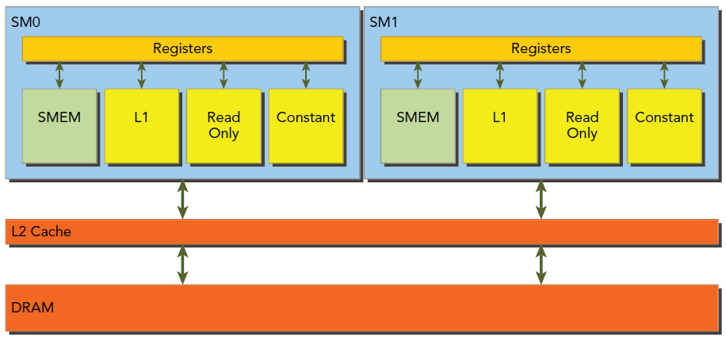
Device Memory Reads
In an SM, data is pipelined through one of the following three cache/buffer paths, depending on what type of device memory is being referenced:
L1/L2 cache or Constant cache or Read-only $

Slide 34
L1 Caching of Global Loads
Check if GPU supports caching of global loads in L1$ using:
Use globalL1CacheSupported of structure cudaDeviceProp
If GPU supports caching it can disabled/ enabled using:
nvcc -Xptxas -dlcm=cg (disable)
nvcc -Xptxas -dlcm=ca (enable)
L1 caching: 128B memory transaction
No L1 caching: memory transaction of 1, 2, or 4 segments. Segment size is 32B

Slide 35
Cached Global Loads
pass through L1 cache and are serviced by device memory transactions at the granularity of an L1 cache line, 128-bytes
Both are aligned and coalesced. 100% load efficiency

Slide 36
Cached Global Loads
Coalesced but not aligned. 50% load efficiency
All thread access the same address. 3.125% load efficiency
Addresses can fall across N cache lines, where 0 < N ≤ 32.

Slide 37
UnCached Global Loads
do not pass through the L1 cache
performed at the granularity of memory segments (32-bytes) and not cache lines (128-bytes).
more fine-grained loads, and can lead to better bus/ load utilization for misaligned or uncoalesced memory accesses.

Slide 38
UnCached Global Loads
Both are aligned and coalesced. 100% load efficiency. Each requires one memory transaction with 4 segments (4 * 32 = 128B)

Slide 39
UnCached Global Loads
Not aligned at 128B boundry but coalesced. 3 transactions with total 5 segments.
80% load efficiency
All thread access the same address. 12.5% load efficiency
Addresses can fall across N segments, where 0 < N ≤ 32.

Slide 40
Memory Access Pattern
Aligned and coalesced
Data [threadIdx.x]
Misaligned and/ or uncoalesced, depending on offset
Data [threadIdx.x + offset]
If offset = N * 32, where 32 is a warp size and N is an integer 0,1,2,3….., then aligned and coalesced

Slide 41
Global Memory Writes
Stores are not cached in L1 but rather in L2
Performed at a 32-byte segment granularity.
Memory transactions can be 1,2, or 4 segments at a time.
Notes:
For example, if two addresses fall within the same 128-byte region
but not within an aligned 64-byte region, one four-segment transaction will be issued (that is, issuing
a single four-segment transaction performs better than issuing two one-segment transactions).

Slide 42
Global Memory Writes

Slide 43
Array of Structures versus Structure of Arrays
struct innerStruct {
float x;
float y;
};
struct innerArray {
float x[N];
float y[N];
};
Notes:
-struct innerStruct myAoS[N];
-struct innerArray {
float x[N];
float y[N];
};

Slide 44
Array of Structures versus Structure of Arrays
Storing the data in SoA fashion makes full use of GPU memory bandwidth. Because there is no interleaving of elements, the SoA layout on the GPU provides coalesced memory accesses and can achieve more efficient global memory utilization.
Notes:
Many parallel programming paradigms, in particular SIMD-style paradigms, prefer
SoA. In CUDA C programming, SoA is also typically preferred because data elements
are pre-arranged for effi cient coalesced access to global memory, since data
elements of the same fi eld that would be referenced by the same memory operation
are stored adjacent to each other.

Slide 45
Memory Optimization
While optimizing your applications for memory performance, pay attention to:
Aligned and coalesced memory accesses
Sufficient concurrent memory operations to hide memory latency
Increasing the number of independent memory operations performed within each thread.
Expose sufficient parallelism to each SM using kernel execution configuration

Slide 46
Unified Memory (UM)
creates a pool of managed memory, accessible on both the CPU and GPU with the same memory address.
Supports automatic movement of data b/w host and device.
UM depends on UVA support. This enables host and device to use the same pointer.
UVA does not automatically migrate data from host to device or vice versa; that is a capability unique to Unified Memory.

Slide 47
Unified Memory (UM)
Advantages:
No need for separate host and device memories
No need to transfer data b/w host and device or vice versa
Maximize CUDA programmer's productivity
code is easier to maintain

Slide 48
Unified Memory (UM)
float *A, *B, *gpuRef;
cudaMallocManaged((void **)&A, nBytes);
cudaMallocManaged((void **)&B, nBytes);
cudaMallocManaged((void **)&gpuRef, nBytes);
initialData(A, nxy);
initialData(B, nxy);
sumMatrixGPU<<<grid, block>>>(A, B, gpuRef, nx, ny);
cudaDeviceSynchronize();

Slide 49
Read-only cache
originally reserved for use by texture memory loads.
For GPUs of compute capability 3.5 and higher, the read-only cache can also support global memory loads as an alternative to the L1 cache.
The granularity of loads through the read-only cache is 32 bytes.

Slide 50
Read-only cache
two ways to direct global memory reads through the read-only cache:
using the function __ldg: out[idx] = __ldg(&in[idx]);
u sing a declaration qualifier on the pointer being dereferenced:
__global__ void copyKernel(int * __restrict__ out, const int * __restrict__ in)
Notes:
It says that for the lifetime of the pointer, only the pointer itself or a value directly derived from it (such as pointer + 1) will be used to access the object to which it points. This limits the effects of pointer aliasing, aiding optimizations. If the declaration of intent is not followed and the object is accessed by an independent pointer, this will result in undefined behavior

