Slide 1
GPU Computing CIS-543
Lecture 09: Shared and Constant Memory
Dr. Muhammad Abid,
DCIS, PIEAS

Slide 2
Introduction to Shared Memory
On-chip program-managed memory
a key enabler for many high-performance computing applications.
  HPC applications cannot rely on GPU caches
  Difficult to reason about GPU caches coz hundreds of threads share L1$ and thousands of threads share L2$
20 to 30 times lower latency than device memory
Greater than 10 times higher bandwidth than device memory

Slide 3
Introduction to Shared Memory
Shared among all thread blocks per SM
Same lifetime as thread block
Shared memory usage can limit parallelism
Gives full control when data is moved/ evicted into/ out of memory
Supports multicast and broadcast
Greatly reduce the global memory bandwidth needed by kernels
Accessed on per-warp basis

Slide 4
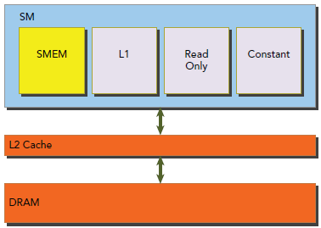
Introduction to Shared Memory

Slide 5
Applications of Shared Memory
An intra-block thread communication channel
A program-managed cache for global memory data
  Exploiting temporal locality in prog
Scratch pad memory for transforming data access pattern to improve global memory access patterns

Slide 6
Shared Memory Allocation
1D, 2D, and 3D shared memory arrays.
Can be declared as either local to a CUDA kernel or globally in a CUDA source code file statically or dynamically
Static allocation:
  __shared__ float tile[size_y][size_x];
Dynamic allocation: Only 1D allowed
  extern __shared__ float tile[];
  <<<g,b, size * sizeof(int)>>>

Slide 7
Shared Memory Banks
Memory Banks:
divided into 32 equally-sized memory modules, called banks, → high bandwidth,
1D address space.
If a shared memory load or store operation issued by a warp does not access more than one memory location per bank, the operation can be serviced by one memory transaction. Otherwise, the operation is serviced by multiple memory transactions, thereby decreasing memory bandwidth utilization.

Slide 8
Shared Memory Coflicts
Bank Conflict: Occurs when multiple addresses map to the same memory bank
  causing the request to be replayed.
  The hardware splits a request with a bank conflict into as many separate conflict-free transactions as necessary
Shared memory access pattern:
  Parallel access: multiple addresses accessed across multiple banks
  Serial access: multiple addresses accessed within the same bank
  Broadcast access: a single address read in a single bank

Slide 9
Shared Memory Coflicts
A bank conflict does not occur when two threads from the same warp access the same address.
  for read accesses, the word is broadcast to the requesting threads, and
  for write accesses, the word is written by only one of the threads — which thread performs the write is undefined.

Slide 10
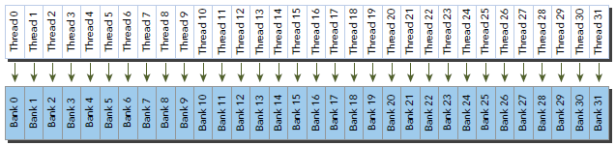
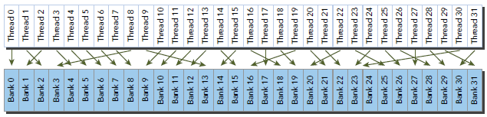
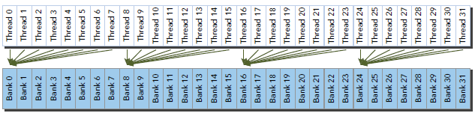
Shared Memory Access Pattern
(a) No Bank Conflict
(b) No Bank Conflict
(c) No Bank Conflict coz same address

Slide 11
Shared Memory Access Mode
Shared memory bank width defines which shared memory addresses are in which shared memory banks.
Bank widths:
  4 bytes (32-bits) for devices of compute capability 2.x
  8 bytes (64-bits) for devices of compute capability 3.x
Shared memory address to bank index:
  bank index = (byte address ÷ 4 bytes/bank) % 32 banks
Notes:
Successive 32-bit words map to successive banks.

Slide 12
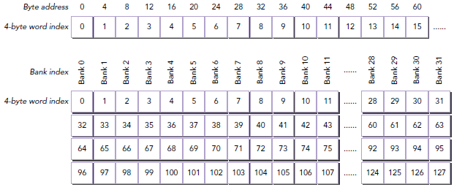
Shared Memory Access Mode
For Fermi
Notes:
For a Fermi device, the bank width is 32-bits and there are 32 banks. Each bank has a bandwidth of
32 bits per two clock cycles.

Slide 13
Shared Memory Access Mode
For Kepler devices, shared memory has 32 banks with the following two access modes:
  64-bit mode: bank width 64-bit
  32-bit mode: bank width 32-bit
Shared memory address to bank index:
  bank index = (byte address ÷ 8 bytes/bank) % 32 banks
If two threads access any sub-word within the same 64-bit word → No conflict
64-bit mode always causes the same or fewer bank conflicts for the same access pattern on Kepler devices relative to Fermi.
Notes:
In 64-bit mode, successive 64-bit words map to successive banks. Each bank has a bandwidth of 64
bits per clock cycle.

Slide 14
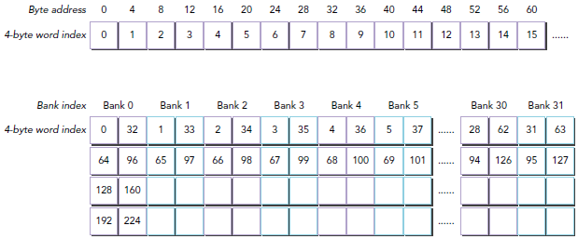
Shared Memory Access Mode
32-bit mode, Kepler device

Slide 15
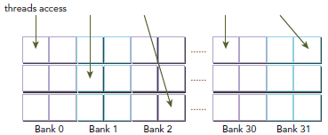
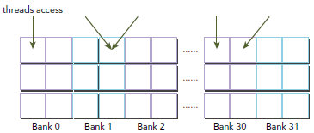
Shared Memory Access Mode
64-bit mode, Kepler device, no conflict

Slide 16
Access Mode Configuration
cudaError_t cudaDeviceGetSharedMemConfig (cudaSharedMemConfig *pConfig);
cudaError_t cudaDeviceSetSharedMemConfig(cudaSharedMemConfig config);
The supported bank confi gurations are:
  cudaSharedMemBankSizeDefault
  cudaSharedMemBankSizeFourByte
  cudaSharedMemBankSizeEightByte
Changing the shared memory bank size:
  no increase in shared memory usage or affect occupancy of kernels,
  perhaps a major effect on performance.
Notes:
-Recall that Kepler devices support 4-byte and 8-byte shared memory access modes. The default is
4-byte mode.
- Changing the shared memory configuration between kernel launches might require an implicit
device synchronization point.
-A
large bank size may yield higher bandwidth for shared memory access, but may result in more bank
confl icts depending on the application’s shared memory access patterns.

Slide 17
Shared Memory Size
Per-device configuration:
  cudaError_t cudaDeviceSetCacheConfig(cudaFuncCache cacheConfig);
Per-kernel configuration:
  cudaError_t cudaFuncSetCacheConfig(const void* func, enum cudaFuncCacheca cheConfig);
cacheConfig:
  cudaFuncCachePreferNone, cudaFuncCachePreferShared cudaFuncCachePreferL1, cudaFuncCachePreferEqual
Notes:
➤ Prefer more shared memory when a kernel uses more shared memory.
➤ Prefer more L1 cache when a kernel uses more registers.

Slide 18
Using Shared Memory
When writing a kernel, focus on the following two concepts:
  Mapping data elements across memory banks
  Mapping from thread index to shared memory offset
Optimal: threads in the same warp accessing separate banks.
Square Shared Memory
Rectangle Shred Memory

Slide 19
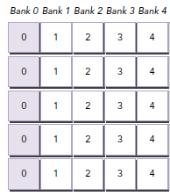
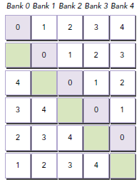
Memory Padding
Memory padding is one way to avoid bank conflicts
Bank Conflict
No Bank Conflict
Notes:
One way to resolve this type of bank confl ict is
to add a word of padding after every N elements, where N is the number of banks. This changes the
mapping from words to banks.

Slide 20
Matrix-Matrix Multiplication using
Shared Memory

Slide 21
Base Matrix Multiplication Kernel
__global__ void MatrixMulKernel(float* d_M, float* d_N, float* d_P, int Width)
{
// Calculate the row index of the Pd element and M
int Row = blockIdx.y*TILE_WIDTH + threadIdx.y;
// Calculate the column idenx of Pd and N
int Col = blockIdx.x*TILE_WIDTH + threadIdx.x;
float Pvalue = 0;
// each thread computes one element of the block sub-matrix
for (int k = 0; k < Width; ++k)
Pvalue += d_M[Row*Width+k]* d_N[k*Width+Col];
d_P[Row*Width+Col] = Pvalue;
}

Slide 22
Idea: Use Shared Memory to reuse global memory data
Each input element is read by WIDTH threads.
Load each element into Shared Memory and have several threads use the local version to reduce the memory bandwidth
  Tiled algorithms
N
WIDTH
P
M
ty
WIDTH
tx
WIDTH
WIDTH

Slide 23
Outline of Technique
Identify a block/tile of global memory content that are accessed by multiple threads
Load the block/tile from global memory into on-chip memory
Have the multiple threads to access their data from the on-chip memory
Move on to the next block/tile

Slide 24
Shared Memory Blocking Basic Idea
in
Global Memory
Thread 1
Thread 2
…
Global Memory
in
On-chip Memory
Thread 1
Thread 2
…

Slide 25
Work for Block (0,0) in a TILE_WIDTH = 2 Configuration
blockDim.x
blockDim.y
Col = 0
Col = 1
Col = 0 * 2 + threadIdx.x
Row = 0 * 2 + threadIdx.y
N_{0,0}
N_{0,1}
N_{0,2}
N_{0,3}
N_{1,0}
N_{1,1}
N_{1,2}
N_{1,3}
blockIdx.x
blockIdx.y
N_{2,0}
N_{2,1}
N_{2,2}
N_{2,3}
N_{3,0}
N_{3,1}
N_{3,2}
N_{3,3}
Row = 0
M_{0,0}
M_{0,1}
M_{0,2}
M_{0,3}
P_{0,0}
P_{0,1}
P_{0,2}
P_{0,3}
Row = 1
M_{1,0}
M_{1,1}
M_{1,2}
M_{1,3}
P_{1,0}
P_{1,1}
P_{1,2}
P_{1,3}
M_{2,0}
M_{2,1}
M_{2,2}
M_{2,3}
P_{2,0}
P_{2,1}
P_{2,2}
P_{2,3}
M_{3,0}
M_{3,1}
M_{3,2}
M_{3,3}
P_{3,0}
P_{3,1}
P_{3,2}
P_{3,3}

Slide 26
Tiled Multiply
bx
0
1
2
tx
Break up the execution of the kernel into phases so that the data accesses in each phase is focused on one subset (tile) of Md and Nd
0
TILE_WIDTH-1
1
2
Nd
TILE_WIDTH
WIDTH
TILE_WIDTH
Md
Pd
0
0
Pd_{sub}
1
ty
2
WIDTH
by
1
TILE_WIDTHE
TILE_WIDTH-1
TILE_WIDTH
TILE_WIDTH
TILE_WIDTH
2
WIDTH
WIDTH

Slide 27
Loading a Tile
All threads in a block participate
  Each thread loads one Md element and one Nd element in based tiled code
Assign the data elements to each thread such that the accesses within each warp is coalesced.
  Inner most dimension, e.g. x, shoud be multiple of warp size, e.g. 32.

Slide 28
Work for Block (0,0)
SN
N_{0,0}
N_{0,1}
N_{0,2}
N_{0,3}
N_{0,0}
N_{0,1}
N_{1,0}
N_{1,1}
N_{1,2}
N_{1,3}
N_{1,0}
N_{1,1}
N_{2,0}
N_{2,1}
N_{2,2}
N_{2,3}
N_{3,0}
N_{3,1}
N_{3,2}
N_{3,3}
SM
M_{0,0}
M_{0,1}
M_{0,2}
M_{0,3}
M_{0,0}
M_{0,1}
P_{0,0}
P_{0,1}
P_{0,2}
P_{0,3}
M_{1,0}
M_{1,1}
M_{1,2}
M_{1,3}
M_{1,0}
M_{1,1}
P_{1,0}
P_{1,1}
P_{1,2}
P_{1,3}
M_{2,0}
M_{2,1}
M_{2,2}
M_{2,3}
P_{2,0}
P_{2,1}
P_{2,2}
P_{2,3}
M_{3,0}
M_{3,1}
M_{3,2}
M_{3,3}
P_{3,0}
P_{3,1}
P_{3,2}
P_{3,3}

Slide 29
Work for Block (0,0)
N_{0,0}
N_{0,1}
N_{0,2}
N_{0,3}
N_{0,0}
N_{0,1}
SM
N_{1,0}
N_{1,1}
N_{1,2}
N_{1,3}
N_{1,0}
N_{1,1}
N_{2,0}
N_{2,1}
N_{2,2}
N_{2,3}
N_{3,0}
N_{3,1}
N_{3,2}
N_{3,3}
SM
M_{0,0}
M_{0,1}
M_{0,2}
M_{0,3}
M_{0,0}
M_{0,1}
P_{0,0}
P_{0,1}
P_{0,2}
P_{0,3}
M_{1,0}
M_{1,1}
M_{1,2}
M_{1,3}
M_{1,0}
M_{1,1}
P_{1,0}
P_{1,1}
P_{1,2}
P_{1,3}
M_{2,0}
M_{2,1}
M_{2,2}
M_{2,3}
P_{2,0}
P_{2,1}
P_{2,2}
P_{2,3}
M_{3,0}
M_{3,1}
M_{3,2}
M_{3,3}
P_{3,0}
P_{3,1}
P_{3,2}
P_{3,3}

Slide 30
Work for Block (0,0)
N_{0,0}
N_{0,1}
N_{0,2}
N_{0,3}
N_{0,0}
N_{0,1}
SM
N_{1,0}
N_{1,1}
N_{1,2}
N_{1,3}
N_{1,0}
N_{1,1}
N_{2,0}
N_{2,1}
N_{2,2}
N_{2,3}
N_{3,0}
N_{3,1}
N_{3,2}
N_{3,3}
SM
M_{0,0}
M_{0,1}
M_{0,2}
M_{0,3}
M_{0,0}
M_{0,1}
P_{0,0}
P_{0,1}
P_{0,2}
P_{0,3}
M_{1,0}
M_{1,1}
M_{1,2}
M_{1,3}
M_{1,0}
M_{1,1}
P_{1,0}
P_{1,1}
P_{1,2}
P_{1,3}
M_{2,0}
M_{2,1}
M_{2,2}
M_{2,3}
P_{2,0}
P_{2,1}
P_{2,2}
P_{2,3}
M_{3,0}
M_{3,1}
M_{3,2}
M_{3,3}
P_{3,0}
P_{3,1}
P_{3,2}
P_{3,3}

Slide 31
Work for next Block
N_{0,0}
N_{0,1}
N_{0,2}
N_{0,3}
N_{1,0}
N_{1,1}
N_{1,2}
N_{1,3}
N_{2,0}
N_{2,1}
N_{2,2}
N_{2,3}
N_{0,0}
N_{0,1}
N_{3,0}
N_{3,1}
N_{3,2}
N_{3,3}
N_{1,0}
N_{1,1}
SM
M_{0,0}
M_{0,1}
M_{0,2}
M_{0,3}
M_{0,0}
M_{0,1}
P_{0,0}
P_{0,1}
P_{0,2}
P_{0,3}
M_{1,0}
M_{1,1}
M_{1,2}
M_{1,3}
M_{1,0}
M_{1,1}
P_{1,0}
P_{1,1}
P_{1,2}
P_{1,3}
M_{2,0}
M_{2,1}
M_{2,2}
M_{2,3}
P_{2,0}
P_{2,1}
P_{2,2}
P_{2,3}
M_{3,0}
M_{3,1}
M_{3,2}
M_{3,3}
P_{3,0}
P_{3,1}
P_{3,2}
P_{3,3}

Slide 32
Work for next Block
N_{0,0}
N_{0,1}
N_{0,2}
N_{0,3}
N_{0,0}
N_{0,1}
SM
N_{1,0}
N_{1,1}
N_{1,2}
N_{1,3}
N_{1,0}
N_{1,1}
N_{2,0}
N_{2,1}
N_{2,2}
N_{2,3}
N_{3,0}
N_{3,1}
N_{3,2}
N_{3,3}
SM
M_{0,0}
M_{0,1}
M_{0,2}
M_{0,3}
M_{0,0}
M_{0,1}
P_{0,0}
P_{0,1}
P_{0,2}
P_{0,3}
M_{1,0}
M_{1,1}
M_{1,2}
M_{1,3}
M_{1,0}
M_{1,1}
P_{1,0}
P_{1,1}
P_{1,2}
P_{1,3}
M_{2,0}
M_{2,1}
M_{2,2}
M_{2,3}
P_{2,0}
P_{2,1}
P_{2,2}
P_{2,3}
M_{3,0}
M_{3,1}
M_{3,2}
M_{3,3}
P_{3,0}
P_{3,1}
P_{3,2}
P_{3,3}

Slide 33
Work for next Block
N_{0,0}
N_{0,1}
N_{0,2}
N_{0,3}
N_{0,0}
N_{0,1}
SM
N_{1,0}
N_{1,1}
N_{1,2}
N_{1,3}
N_{1,0}
N_{1,1}
N_{2,0}
N_{2,1}
N_{2,2}
N_{2,3}
N_{3,0}
N_{3,1}
N_{3,2}
N_{3,3}
SM
M_{0,0}
M_{0,1}
M_{0,2}
M_{0,3}
M_{0,0}
M_{0,1}
P_{0,0}
P_{0,1}
P_{0,2}
P_{0,3}
M_{1,0}
M_{1,1}
M_{1,2}
M_{1,3}
M_{1,0}
M_{1,1}
P_{1,0}
P_{1,1}
P_{1,2}
P_{1,3}
M_{2,0}
M_{2,1}
M_{2,2}
M_{2,3}
P_{2,0}
P_{2,1}
P_{2,2}
P_{2,3}
M_{3,0}
M_{3,1}
M_{3,2}
M_{3,3}
P_{3,0}
P_{3,1}
P_{3,2}
P_{3,3}

Slide 34
Barrier Synchronization
An API function call in CUDA
  __syncthreads()
All threads in the same block must reach the __synctrheads() before any can move on
Best used to coordinate tiled algorithms
  To ensure that all elements of a tile are loaded
  To ensure that all elements of a tile are consumed

Slide 35
Loading an Input Tile
bx
0
1
2
tx
0
TILE_WIDTH-1
1
2
Nd
Accessing tile 0 2D indexing:
M[Row][tx]
N[ty][Col]
m
TILE_WIDTH
bx
k
WIDTH
TILE_WIDTH
Row = by * TILE_WIDTH +ty
Md
Pd
by
0
m
0
Pd_{sub}
1
k
ty
2
WIDTH
by
1
TILE_WIDTHE
TILE_WIDTH-1
TILE_WIDTH
TILE_WIDTH
TILE_WIDTH
2
WIDTH
WIDTH

Slide 36
Loading an Input Tile
bx
0
1
2
tx
0
TILE_WIDTH-1
1
2
Nd
Accessing tile 1 in 2D indexing:
M[Row][1*TILE_WIDTH+tx]
N[1*TILE_WIDTH+ty][Col]
m
TILE_WIDTH
bx
k
WIDTH
TILE_WIDTH
Row = by * TILE_WIDTH +ty
Md
Pd
by
0
m
0
Pd_{sub}
1
k
ty
2
WIDTH
by
1
TILE_WIDTHE
TILE_WIDTH-1
TILE_WIDTH
TILE_WIDTH
TILE_WIDTH
2
WIDTH
WIDTH

Slide 37
Loading Input Tile m
However, M and N are dynamically allocated and can only use 1D indexing:
M[Row][m*TILE_WIDTH+tx]
M[Row*Width + m*TILE_WIDTH + tx]
N[m*TILE_WIDTH+ty][Col]
N[(m*TILE_WIDTH+ty) * Width + Col]
Col
d_N
TILE_WIDTH
m*TILE_WIDTH
…
WIDTH
TILE_WIDTH
d_M
d_P
Row
m*TILE_WIDTH
…
Pd_{sub}
WIDTH
TILE_WIDTHE
TILE_WIDTH
TILE_WIDTH
TILE_WIDTH
WIDTH
WIDTH

Slide 38
Tiled Matrix Multiplication Kernel
__global__ void MatrixMulKernel(float* d_M, float* d_N, float* d_P, int Width)
{
1. __shared__ float ds_M[TILE_WIDTH][TILE_WIDTH];
2. __shared__ float ds_N[TILE_WIDTH][TILE_WIDTH];
3. int bx = blockIdx.x; int by = blockIdx.y;
4. int tx = threadIdx.x; int ty = threadIdx.y;
// Identify the row and column of the Pd element to work on
5. int Row = by * TILE_WIDTH + ty;
6. int Col = bx * TILE_WIDTH + tx;
7. float Pvalue = 0;
// Loop over the Md and Nd tiles required to compute the Pd element
8. for (int m = 0; m < Width/TILE_WIDTH; ++m) {
// Coolaborative loading of Md and Nd tiles into shared memory
9. ds_M[ty][tx] = d_M[Row*Width + m*TILE_WIDTH+tx];
ds_N[ty][tx] = d_N[Col+(m*TILE_WIDTH+ty)*Width];
__syncthreads();
12. for (int k = 0; k < TILE_WIDTH; ++k)
13. Pvalue += ds_M[ty][k] * ds_N[k][tx];
14. __synchthreads();
15.}
16. d_P[Row*Width+Col] = Pvalue;
}

Slide 39
Compare with the Base Kernel
__global__ void MatrixMulKernel(float* d_M, float* d_N, float* d_P, int Width)
{
// Calculate the row index of the Pd element and M
int Row = blockIdx.y*TILE_WIDTH + threadIdx.y;
// Calculate the column idenx of Pd and N
int Col = blockIdx.x*TILE_WIDTH + threadIdx.x;
float Pvalue = 0;
// each thread computes one element of the block sub-matrix
for (int k = 0; k < Width; ++k)
Pvalue += d_M[Row*Width+k]* d_N[k*Width+Col];
d_P[Row*Width+Col] = Pvalue;
}

