Slide 1
CSE 2421
The C Language – Part 2 – I/O

Slide 2
C functions and I/O
Reminder: Before a function in a C program is invoked, or called, it must be declared. Otherwise, the compiler will output an error message when you compile. Remember also that a definition of a function includes a declaration.
When we want to use I/O functions in the C standard library, we will include stdio.h in our source file, which contains declarations of these library functions, so that the compiler can do type-checking of our calls to these functions.
We will only look at several of the most commonly used of these functions here.
They are all you need for the labs in this course (and all you are allowed to use).

Slide 3
Basic I/O
There is no input or output defined in C itself; functions have been written and incorporated into the standard library for input and output. Requires library stdio
Two basic types of I/O:
Character based (no format specifiers) – character by character I/O
getchar() - input
putchar(c) - output
Formatted - zero or more characters, with a requirement to specify the format of the input or output (how the sequence of characters read or written is to be interpreted):
scanf(parameters go in here) - input - white space is important!!!
printf(parameters go in here) - output
These functions use format strings to specify interpretation (% before string) – see next slide
#include <stdio.h>
int main()
{ /* check1.c – shows calls to scanf() and printf() */
int x;
scanf(“%d\n”, &x); /* Notice address operator & */
printf(“x=%d\n”, x);
}

Slide 4
Format Strings
Conversion Character | Displays Argument (Variable’s Contents) As
%c | Single character
%d, %i | Signed decimal integer (int)
%e | Signed floating-point value in E notation
%f | Signed floating-point value (float)
%g | Signed value in %e or %f format, whichever is shorter
%o | Unsigned octal (base 8) integer (int)
%s | String of text
%u | Unsigned decimal integer (int)
%x | Unsigned hexadecimal (base 16) integer (int)
%% | (percent character)
When programming in C, you use format strings — the percentage sign and a conversion code, for the most part (although some other characters between % and the conversion character are optional – see below) — as placeholders for variables you want to read from input or display. The above table shows the format strings and what they display...

Slide 5
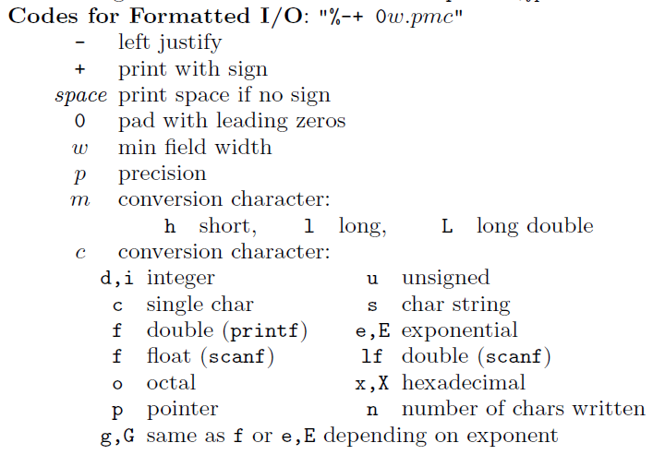

Slide 6
getchar() and putchar()
These functions can be used to do input and output one character at a time.
Prototypes/declarations (interfaces):
int getchar(void);
int putchar(int); /* the int value returned can be ignored */
Notice that both of these functions use the integer values which correspond to a given ASCII character. The integer must be cast before being assigned to a char variable, or must be printed with a %c format code to be output as a char.
An int is returned, rather than a char, because certain text file control values (EOF, or end of file, for example) do not have one byte ASCII encodings.

Slide 7
Example with getchar() and putchar()
/* assume #include <stdio.h> */
…
int code;
…
printf(“Please enter the appropriate single letter code, followed by enter: \n”);
code = getchar();
printf(“The code entered was: %c \n”, code); /* outputs int as a char */
/* another way to do it – again, assume #include <stdio.h> */
…
char code;
…
printf(“Please enter the appropriate single letter code, followed by enter: \n”);
code = (char) getchar(); /* cast int value read from input to char */
printf(“The code entered was: %c \n”, code);

Slide 8
Formatted output - printf examples
/* NOTE: Here, the codes for formatted I/O from slide
* 5 above are used */
printf("%d\t%d\n", fahr, celsius);
Causes the values of the two integers fahr and celsius to be printed, with a tab (\t) between them, and followed by a newline.
printf("%3d %6d\n", fahr, celsius);
To print the first number to three digits wide, and the second to six digits wide
NOTE: Each % format specifier in the first argument of printf is paired with the corresponding second argument, third argument, etc.; they must match up properly by number and type, or you will get wrong answers or a compile time error.
printf("\na=%f\nb=%f\nc=%f\nd=%f",a,b,c,d);
What does this statement print?

Slide 9
printf examples
float x = 3.14159;
printf("%4.3f\n", x);
printf("%4f\n", x);
printf("%.3f\n", x);
output:
3.142 /* minimum field width is 4! */
3.141590 /*minimum field width is 4, but no * *precision specified – 6 digits is default */
3.142

Slide 10
printf example
int y = 25;
printf("%d\n", y);
printf("%i\n", y);
printf("%4d\n", y);
printf("%1d\n", y);
printf("%05d\n", y);
output:
25
25
25 /* two spaces before two-digit value */
/* the minimum field width specified is too small to print the value of the data, so
* printf ignores it!
*/
00025 /* leading zeroes used to fill minimum field width */

Slide 11
Formatted I/O: printf vs scanf
Both format I/O
Both manipulate “standard I/O” location – the keyboard for input, and the terminal display for output (although we can use something called redirection to change this – more below)
printf - output
Converts values to character form according to the format string, and prints them to standard out
scanf - input
Converts characters from standard in according to the format string, and followed by pointer arguments (i.e., addresses) usually, indicating where the resulting values are stored

Slide 12
scanf examples
int day, month, year;
scanf("%d/%d/%d", &month, &day, &year);
Input:
01/29/64
Month has the value 1
Day has the value 29
Year has the value 64
int anInt;
scanf("%i%", &anInt);
Input:
23%
anInt has the value 23

Slide 13
More scanf examples
int int1; long l;
scanf("%d %ld", &int1, &l);
Input:
-23 200
int1 has the value -23 /*stored as 4 bytes */
/*on stdlinux*/
l has the value 200 /*stored as 8 bytes */
/*on stdlinux*/
double d;
scanf("%lf", &d);
Input:
3.14
d has the value 3.14 /*stored as 8 bytes */
/*on stdlinux*/

Slide 14
More scanf examples
IMPORTANT: scanf ignores leading (but not following) white space characters when it reads numeric values from input:
int i;
printf(“Enter an integer:\n”);
scanf(“%d”, &i);
/*scanf will ignore any leading white space characters */

Slide 15
More scanf examples
char string1[9];
scanf("%9s", string1); /*array identifier is */ /*address of 1st element*/
Input:
VeryLongString
string1==“VeryLongS”
int int1;
scanf("%*s %i", &int1); /*read arbitrary length*/
/*string of non-numeric*/ /*chars before int1 */
Input:
Age: 29
int1 has the value 29
NOTE: pressing enter causes characters in the input buffer to be transferred to standard in

Slide 16
More scanf examples
int int1, int2;
scanf("%2i", &int1);
scanf(“%2i”, &int2);
Input:
2345
int1 has the value 23
int2 has the value 45
NOTE: pressing enter causes characters in the input buffer to be transferred to standard in

Slide 17
Scanf examples
Letter | Type of Matching Argument | Auto-skip; Leading White-Space | Example | Sample Matching Input
% | % (a literal, matched but not converted or assigned) | no | int anInt; scanf("%i%%", &anInt); | 23%
d | int | yes | int anInt; long l; scanf("%d %ld", &anInt, &l); | -23 200
i | int | yes | int anInt; scanf("%i", &anInt); | 0x23
o | unsigned int | yes | unsigned int aUInt; scanf("%o", &aUInt); | 023
u | unsigned int | yes | unsigned int aUInt; scanf("%u", &aUInt); | 23
x | unsigned int | yes | unsigned int aUInt; scanf("%x", &aUInt); | 1A
a, e, f, g | float or double | yes | float f; double d; scanf("%f %lf", &f, &d); | 1.2 3.4
c | char | no | char ch; scanf(" %c", &ch); | Q
s | array of char | yes | char s[30]; scanf("%29s", s); | hello
n | int | no | int x, cnt; scanf("X: %d%n", &x, &cnt); | X: 123 (cnt==6)
[ | array of char | no | char s1[64], s2[64]; scanf(" %[^\n]", s1); scanf("%[^\t] %[^\t]", s1, s2); | Hello World field1 field2

Slide 18
Standard input and output; redirection
IMPORTANT: By default, in Unix/Linux, C programs read input from “standard input” (the keyboard) and write output to “standard output” (the screen).
We can change this using what is called redirection:
% prog1 < test_file > output_file
This will run prog1, and it will read input from test_file, and write output to output_file (which will be created if it does not already exist).
< redirects the input, and > redirects the output
It is important to make sure that test_file has an end of file (EOF) at the end [Be sure you hit enter at the end of the last line of the file].
You can redirect just the input or just the output (that is, you do not have to redirect both).
For labs, it will usually be convenient to just redirect the input, and allow output to go to standard out (the screen).

