Slide 1
Lecture 2: From random permutations to block ciphers
Announcements
Problem Set 1 posted, due Thurs, Feb 2 at 9pm
Office hours this week: Thurs 3-5pm
Slides will be posted to Piazza after lecture
Read Rogaway’s The Moral Character of Cryptographic Work, post your thoughts (~2 sentences) to Piazza before Monday

Slide 2
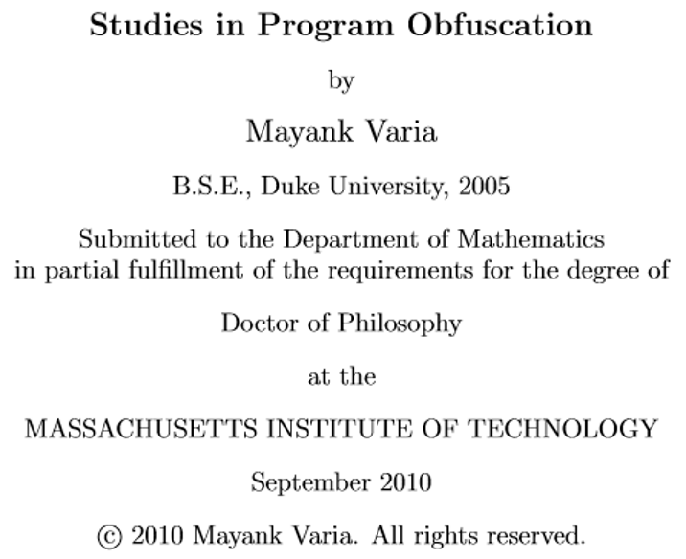
What is cryptography?
Cryptography rearranges power: it configures who can do what, from what. This makes cryptography an inherently political tool, and it confers on the field an intrinsically moral dimension.
– Prof. Phillip Rogaway, UC Davis
Source: http://web.cs.ucdavis.edu/~rogaway/papers/moral.html

Slide 3
Cryptographic method: define → construct → reduce
Math Tools
Primitives
Algorithms
Protocols
Modular arithmetic
Auth key exchange
Key evolution
Signal: messaging
Key encapsulation
TLS: internet PGP: email
(see CS 558)
Hash functions
Random(ish) permutations
Protected communication
Block ciphers
☏ Minicrypt
Cryptomania ✉

Slide 4
Today: Block cipher design
Block cipher = family of permutations
Design goals
Simple
Makes no sense
Simple to see that it makes no sense
Simple: build from ops that CPUs like
Logical operators: XOR & cyclic shifts
Table lookups
Makes no sense: unpredictable
How unpredictable can a cipher be?
Say each B_{K} were a truly random permutation chosen independently
Then we could each use our own without impacting anybody else
X
Y
B_{K}
B_{K}
⁻¹
Y
X
Notes:
Each K defines a new permutation B_{K}

Slide 5
Toward a formal definition
Pseudorandomness
Strong pseudorandomness
B_{K} looks like a truly random function, meaning nobody can tell them apart
Same thing, but now adversary has access to inverse functions too
X
X
B$
P
B$
P
B$
P
⁻¹
⁻¹
Y
Y

Slide 6
Flashback: The Data Encryption Standard
History
1972: NIST* seeks standard mechanism to protect the fed govt’s “sensitive but unclassified” info
1st request: Rejected all submissions
2nd request: accepted the Lucifer cipher by Horst Feistel & others at IBM
Lengths of DES components
Block length: 8 bytes
Key length: 7 bytes
NSA changes: ▲ cryptanalytic strength NSA changes: ▼ key length 64 → 56 bits
X
K_{DES}
DES
Y
Notes:
* Had a different name back then
Reminder: NIST only sought a standard that the federal government could use to encrypt unclassified but sensitive information. Their rules only apply to US gov't!
DES eventually published as Federal Information Processing Standard (FIPS) 46

Slide 7
Crypto war 1: key length
Question: how to increase key length without making a new standard?
Solutions
2DES: Run DES twice
3DES: Run DES three times
DESX (Rivest 84): mask input + output Resulting key = 15 bytes
Benefits of DESX
Fast: 1 block cipher call, quick re-keying
Available: RSA Security had in their BSAFE software since the late 1980s
X
K_{DES}
DES
K_{MASK}
Y
K_{DES}’
DES
Y
K_{DES}
DES
Y
Notes:
Late 80s = before the rise of open-source crypto software

Slide 8
Random permutation → block cipher
Question: What is the simplest possible construction of a block cipher that has a formal proof of security?
Even-Mansour 91: Rivest’s idea applies to any “public, random-looking permutation”
Theorems
Resulting block cipher is strongly pseudorandom
…even if Π is publicly known
Construction is minimal in the sense that nothing can be removed
X
X
DES
K_{DES}
Π
K_{MASK}
P
Y
Y
A
A
Π
Π
B
B
Notes:
Note: I’m only showing the (non-strong) pseudorandomness picture here. I omit the full picture of strong pseudorandomness because it is rather busy. See the hidden slide at the end of the presentation.

Slide 9
Proof of minimality
Thm. Construction is minimal in the sense that nothing can be removed.
Proof.
Removing either ⊕ allows adversary to learn the key with one X/Y pair and one query to Π.
Removing Π leaves the identity function.
X
X
Π
K_{MASK}
P
Y
Y
= X
A
A
Π
Π
B
B
Notes:
Issue: K_{mask} = Y ⊕ B

Slide 10
Proof of (strong) pseudorandomness
Thm. Construction is pseudorandom.
Proof.
Before making any queries, all choices of K_{MASK} are equally likely
To reduce the set of possible K_{MASK}, adversary must find collisions between P and Π, which are unlikely
For each (X, Y) and (A, B) pair, label the keys (X ⊕ A) and (Y ⊕ B) as bad; q queries yield only 2q² bad keys
All good keys are equally likely: they all fail to cause collisions anywhere
X
X
Π
K_{MASK}
P
Y
Y
A
A
Π
Π
B
B

Slide 11
Great, let’s build a block cipher!
Problems?
Hmm, how do we go about building a single random permutation Π?
Isn’t the truth table for Π huge?
Solution to 1: multiple rounds
Let’s make life easier: what if we make ρ that is somewhat random?
Then we can use the 3DES trick
Nitpicky detail: each round needs a different key to thwart slide attacks
X
Π
ρ
K_{round}
K_{MASK}
Y
⋮
ρ
Y
Notes:
Minor detail: the different rounds need to have different round keys in order to thwart a “slide attack”

Slide 12
Great, let’s build a block cipher!
Problems?
Hmm, how do we go about building a single random permutation Π?
Isn’t the truth table for Π huge?
Solution to 2: simple round function ρ
Linear functions are very simple!
Err, perhaps too simple; we could then solve for the key
We need non-linearity somewhere
But let’s keep its truth table small
X
Π
ρ
K_{round}
K_{MASK}
Y
⋮
ρ
Y

Slide 13
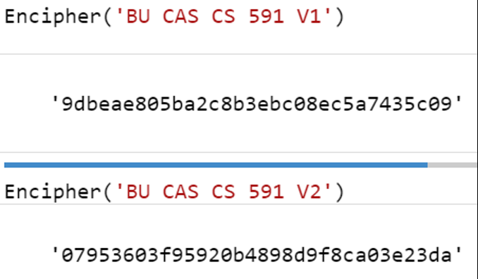
Designing ρ: The substitution-permutation model
State at beginning of round
❶ Substitution box (S-box)
Provides confusion, but at a cost
Huge S-box: very confusing but slow
Tiny S-box: fast but not as confusing
S
…
S
S
…
S
Permutation
❷ Linear permutation
Provides global diffusion
State at end of round
Middle
…
Middle
❸ AES-specific middle step
The wide trail strategy ensures that the bad linearity effect of small S-boxes is negatively correlated between rounds

Slide 14
AES Competition
NIST competition held 1997–2000
Required good performance for
8-bit smartcard
32-bit software
Dedicated hardware
Well-run competition
Included 3 conferences
Many candidates
15 initial submissions
5 finalists
Winner: Rijndael
Authors: Joan Daemen, Vincent Rijmen
 | Rijndael | Serpent | Twofish | MARS | RC6
General security | 2 | 3 | 3 | 3 | 2
Simplicity to implement | 3 | 3 | 2 | 1 | 1
Software performance | 3 | 1 | 1 | 2 | 2
Smart card performance | 3 | 3 | 2 | 1 | 1
Hardware performance | 3 | 3 | 2 | 1 | 2
Design features | 2 | 1 | 3 | 2 | 1
Total | 16 | 14 | 13 | 10 | 9

Slide 15
Two representations of bytes
Length 8 vector over GF(2)
Element of GF(256)
Byte b ↦ [b₇, b₆, b₅, b₄, b₃, b₂, b₁, b₀]
Addition = xor of bytes
Can also do matrix multiplication
Byte b ↦ polynomial Σ b_{i} · x_{i}
Addition = xor of bytes again
Can also multiply, calculate modulo x⁸ + x⁴ + x³ + x + 1 to save space

Slide 16
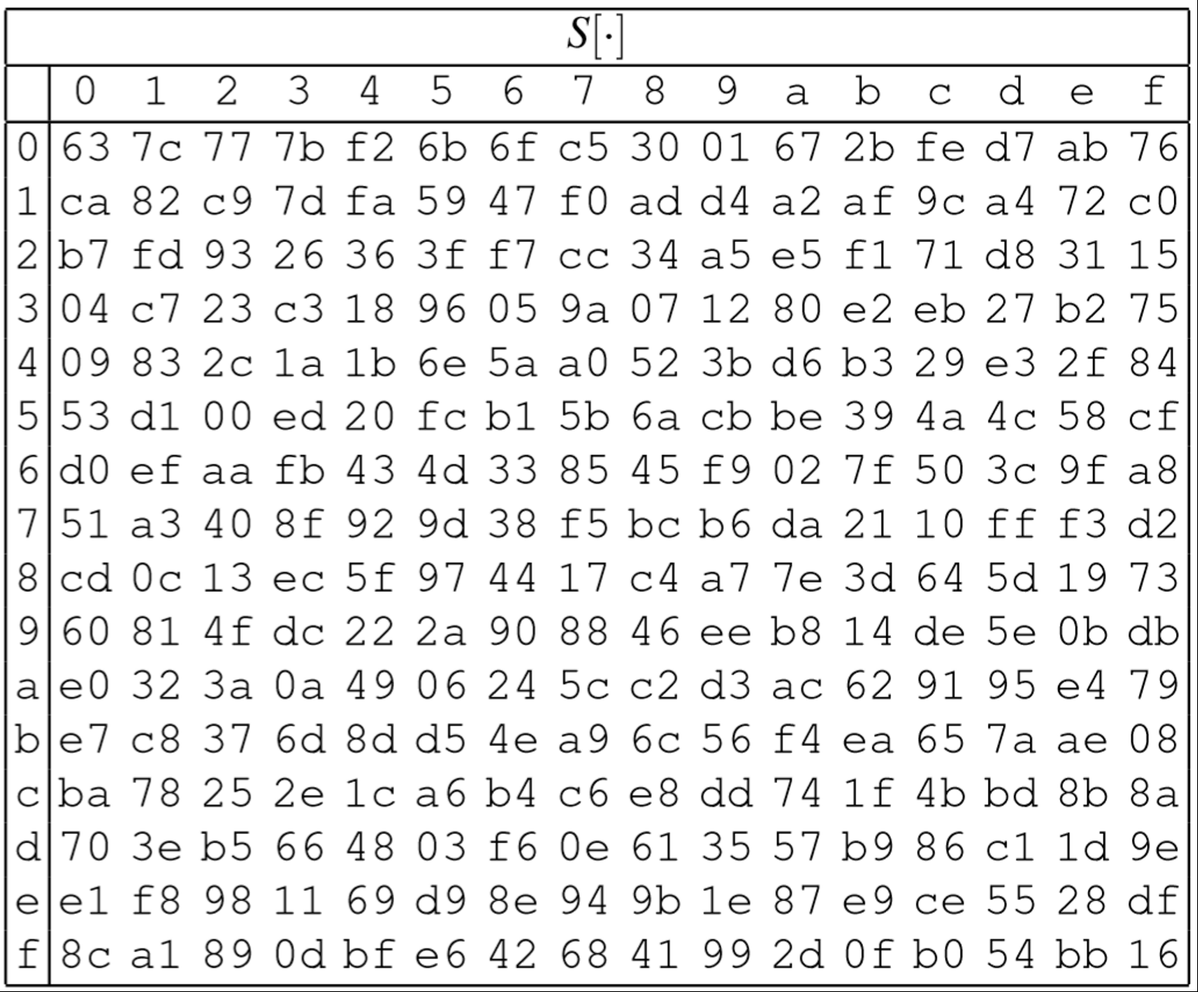
AES components
16 byte state
❶ SubBytes
❶ Table lookup, one byte at a time
S
…
S
S
…
S
ShiftRows
MixColumns
…
MixColumns
16 byte state

Slide 17
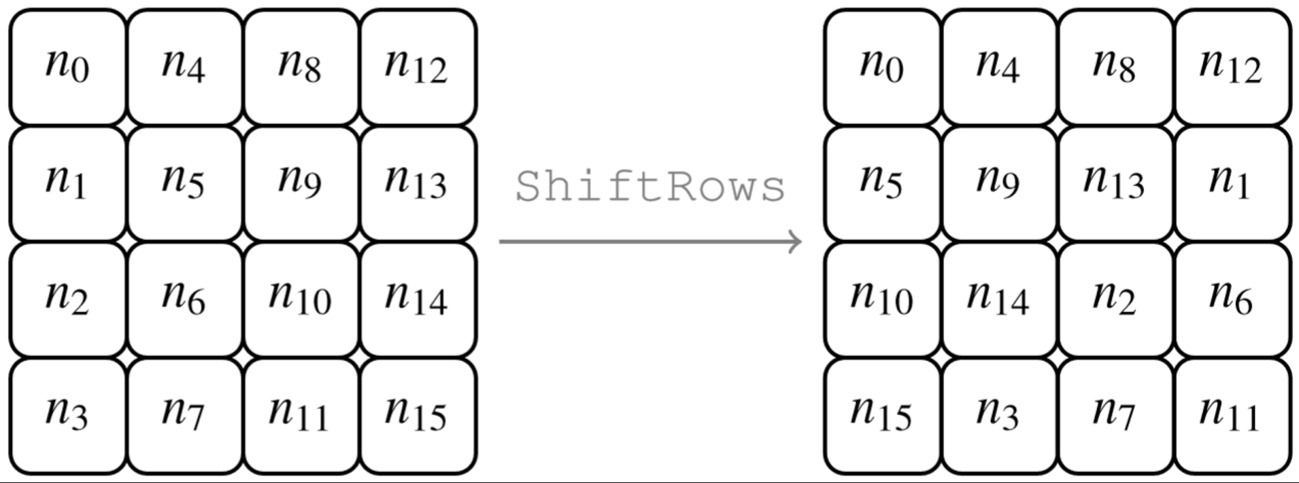
AES components
16 byte state
S
…
S
S
…
S
ShiftRows
❷ ShiftRows
❶ Byte-wise transposition
MixColumns
…
MixColumns
16 byte state

Slide 18
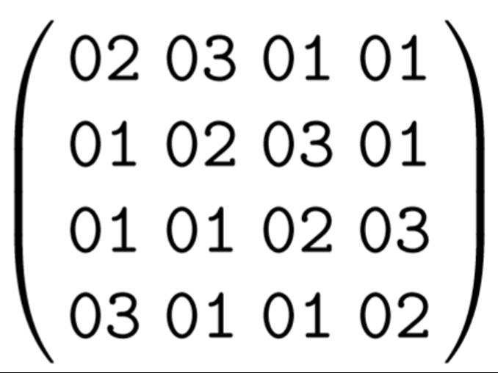
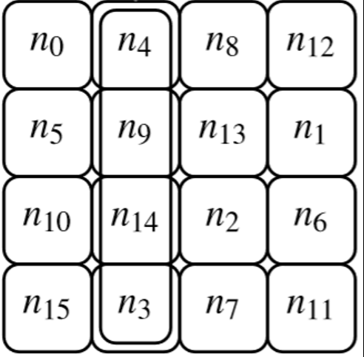
AES components
16 byte state
S
…
S
S
…
S
ShiftRows
MixColumns
…
MixColumns
❸ MixColumns
❶ Matrix multiplication in GF(256)
16 byte state

Slide 19
Summary of Rijndael, aka AES
S-box
Round₁
S-box
Round₉
Round₁₀
S-box
Input
+
ShiftRows
+
…
+
ShiftRows
+
ShiftRows
+
output
MixColumns
MixColumns
key₀
key₁
key₈
key₉
key₁₀
Key schedule
Key alternating structure
128, 192, or 256 bit key
Invertible key schedule
Round structure
Iterates over 10 to 14 rounds
Tunable security
3 invertible operations per round
Final round is slightly different
Only S-box is nonlinear
Our hope
AES is pseudorandom if the key is chosen uniformly at random
X
X
AES$
P
Y
Y
Notes:
The round structure provides a tunable security parameter.
Our hope is that AES with a randomly-chosen key is pseudorandom

Slide 20
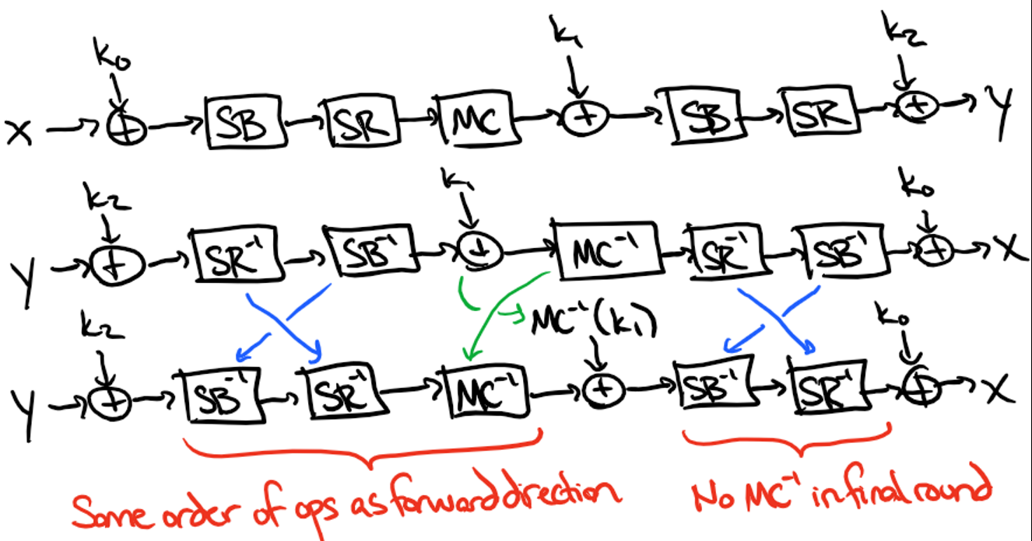
What about deciphering?
Each step individually invertible
SubBytes: store inverse table
ShiftRows: now shift to the right
MixColumns: multiply by M⁻¹
Really, should perform ops in backward order as well
Fix: exploit commutativity
SubBytes & ShiftRows
MixColumns & AddRoundKey

Slide 21
AES New Instructions (NI)
Intel CPUs include 6 instructions to perform AES quickly
4 for round functions
AESENC
AESDEC
AESENCLAST
AESDECLAST
2 for key expansion
AESKEYGENASSIST
AESIMC
Notes:
Keygenassist = perform key expansion
Imc = inverse mix columns trick (the green text) requires making the keys MC^-1(k)

Slide 22
Up next: Encryption via enciphering
Math Tools
Primitives
Algorithms
Protocols
Modular arithmetic
Auth key exchange
Key evolution
Signal: messaging
Key encapsulation
TLS: internet PGP: email
(see CS 558)
Hash functions
Random(ish) permutations
Protected communication
Block ciphers
☏ Minicrypt
Cryptomania ✉

Slide 23
Later: Side channels ⇒ tough to implement crypto securely
Source: moserware.com/2009/09/stick-figure-guide-to-advanced.html

Slide 24
Even-Mansour with strong pseudorandomness
Even-Mansour 91: Rivest’s idea generalizes!
Theorems
Resulting block cipher is strongly pseudorandom
…even if Π / Π⁻¹ are publicly known
Construction is minimal in the sense that nothing can be removed
X
Y
DES
Π⁻¹
K_{DES}
Π
K_{MASK}
Y
X
Π
Π⁻¹
Π
Π⁻¹
P
P ⁻¹

