Slide 1
Applied Cryptology: Design & Practice Lecture 1: Introduction, Block Ciphers
Instructor: Mayank Varia

Slide 2
Syllabus/course overview
One instructor: Mayank Varia (office hours: Tu 12-2, Fri 3-5 in MCS 164)
Two sites where course materials are posted, sign up ASAP!
Piazza: www.piazza.com
SageMathCloud: cloud.sagemath.com
Four types of assignments
Bi-weekly problem sets 50% of final grade
Weekly paper reading or video viewing 10% of final grade, together with participation
One in-class test on April 3 (no final) 20% of final grade
Final project (can work in small groups) 20% of final grade
No need to buy any textbooks; everything available online through BU library
Liberal collaboration policy, but zero tolerance for violations; read the syllabus!

Slide 3
What is cryptography?
What is cryptography cryptology?
Cryptology
Cryptography
Cryptanalysis
Notes:
kryptos is the Greek word for secret or hidden
cryptography = art of making codes
cryptanalysis = art of breaking codes

Slide 4
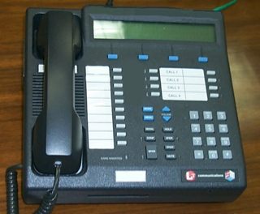
Secure communication in the presence of an adversary
✉ key encapsulation
key K
key K
key K
☏ protected
☏ communication
encode C = E(M)
encode C = E(K, M)
message M
decode M = D(C)
decode M = D(K, C)
???
Notes:
Remember: Bob could simply be a future version of Alice (think: full disk encryption)
Icons from https://www.iconfinder.com/iconsets/user-pictures
Analogy:
Envelopes sent through the US Postal System have pretty good privacy rules but long latency.
Telephones enable real-time communication but range widely in privacy, from “none” to Secure Terminal Equipment (https://en.wikipedia.org/wiki/Secure_Terminal_Equipment).

Slide 5
Complexity theoretic view of cryptography
Cryptomania (✉) = elegant
Millisecond speed
Built from modular arithmetic
Minicrypt (☏) = utilitarian
Nanosecond speed
Built from random-looking permutations
Notes:
Citation for terminology: Russell Impagliazzo. A Personal View of Average-Case Complexity.

Slide 6
Cryptographic method: define → construct → reduce
Math Tools
Primitives
Algorithms
Protocols
Modular arithmetic
Auth key exchange
Key evolution
Signal: messaging
Key encapsulation
TLS: internet PGP: email
(see CS 558)
Hash functions
?
Random(ish) permutations
Protected communication
Block ciphers
☏ Minicrypt
Cryptomania ✉
Notes:
Comments:
There is a lot more to crypto overall than just this picture/course
Modular arithmetic -> more generally, any finite group in which the discrete logarithm problem is hard (+ details…)
“AE” here is overloaded, we will later go into ~10 different definitions of security here & construct them all

Slide 7
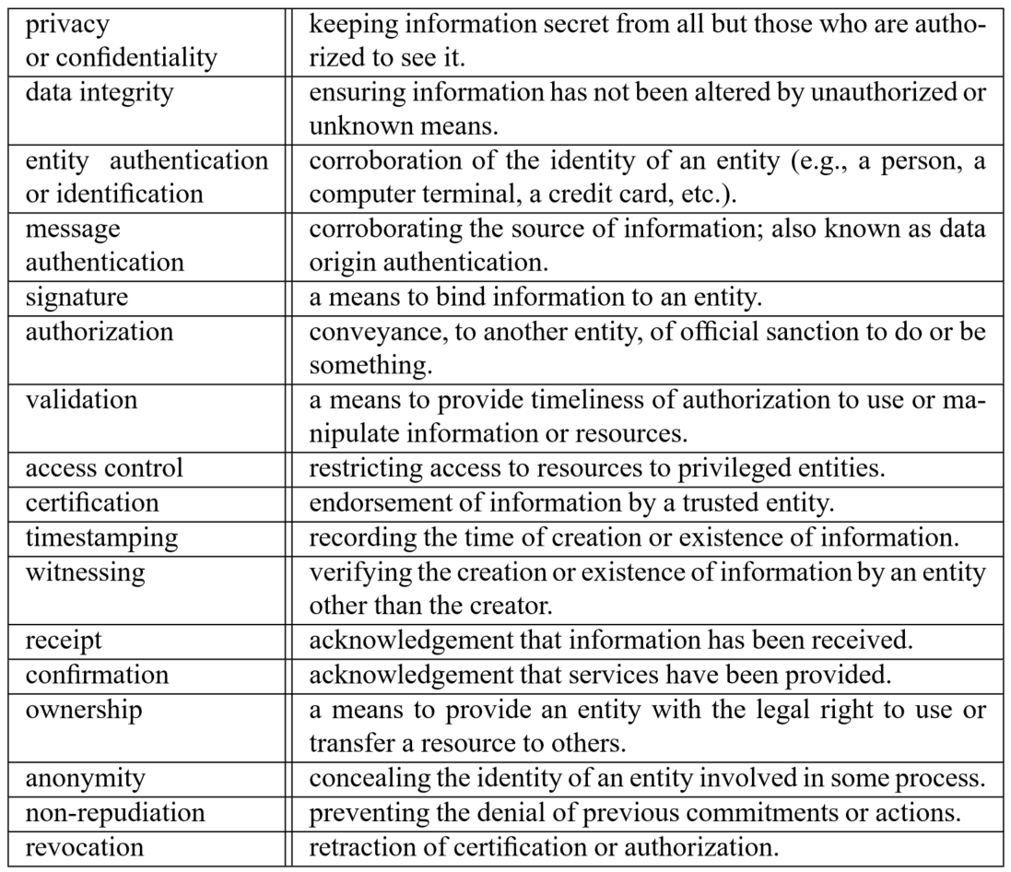
How exactly should we protect communication?
Source: Handbook of Applied Cryptography, Table 1.1

Slide 8
Focus of this course
Confidentiality xor authenticity is not possible.
If you don't have both, often you don't have either.
– Prof. Matthew Green, JHU
 | …at endpoints | …in transit
Authenticity
Privacy
 | …at endpoints | …in transit
Authenticity | Identity verification Bob knows Alice sent C
Privacy
 | …at endpoints | …in transit
Authenticity | Identity verification Bob knows Alice sent C
Privacy | Deniability (optional) Bob can’t prove Alice said M
 | …at endpoints | …in transit
Authenticity | Identity verification Bob knows Alice sent C | Binding Eve cannot alter M
Privacy | Deniability (optional) Bob can’t prove Alice said M
 | …at endpoints | …in transit
Authenticity | Identity verification Bob knows Alice sent C | Binding Eve cannot alter M
Privacy | Deniability (optional) Bob can’t prove Alice said M | Confidentiality Eve cannot learn M
Notes:
Source: Handbook of Applied Cryptography, Table 1.1

Slide 9
Let’s begin by studying confidentiality
Simplifying assumptions, for now
Pre-shared keys
Passive Eve
Alice + Bob online simultaneously
No need for deniability
Only one message X to transmit
X has a short, fixed length

Slide 10
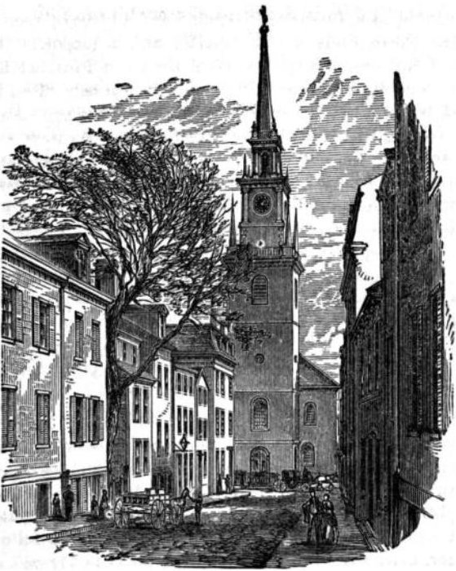
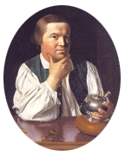
Paul Revere’s ride
Two potential messages
X₁ = one
X₂ = two
Suppose eavesdropper knows the valid messages & observes Y
We must construct a cipher that use the key to thwart the British
Y = Encipher(K, X)
Notes:
Robert Newman, sexton of the Old North Church

Slide 11
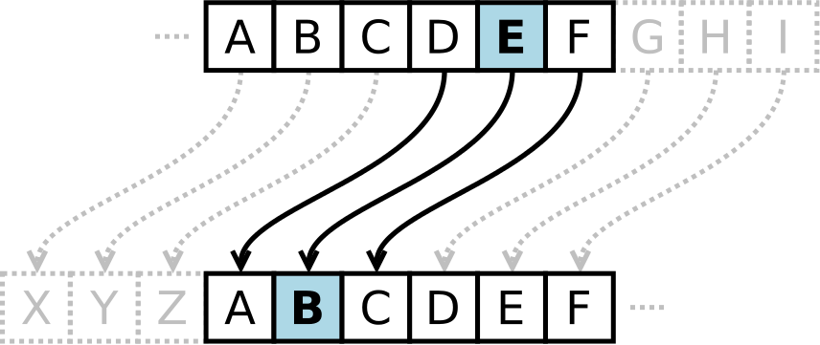
Ancient ciphers, and their modern counterparts
Caesar cipher
One-time pad
Transform if key K = 3key
one ↦ lkb
two ↦ qtl
Problem?
Encode: X ↦ X ⊕ K
Why secure? Apply Caesar cipher to each bit of X independently
Drawback?
Notes:
Pictures from Wikipedia

Slide 12
Ancient ciphers, and their modern counterparts
Vigenère cipher
Block cipher
Encode: X ↦ permutation_{K}(X)
Why secure? Entire K determines the permutation on the entire X
Drawback?
Transform if key K = key
one ↦ ejg
two ↦ jsq
Problem?
Notes:
Left image taken from Wikipedia
Right image is the Serpent S-box, taken from https://eprint.iacr.org/2016/1171.pdf

Slide 13
Block ciphers & their use in symmetric encryption
Block cipher = family of permutations
Each K defines a new perm B_{K}
Popular examples: DES, AES
Fast: MB/s to GB/s throughput
A mode of operation adds support for
Randomization
Variable-length messages
X
X
M₁
M₂
M₃
R
K
B
or
B_{K}
B_{K}
B_{K}
B_{K}
Y
Y
C₁
C₂
C₃
Notes:
Modes of operation provide “encryption by enciphering”

Slide 14
Cryptanalysis: brute force
One way to break a code is by brute force: simply try all possible keys
By eavesdropping one (X, Y) pair, we can break a block cipher by brute force
So, design a block cipher to be a large family of random-looking permutations
56
128
192
256
|K|
Data Encryption Standard (DES)
Advanced Encryption Standard (AES)
Notes:
Why?:
For the correct key X, we know that B_K ( X ) = Y
If we pretend that each B_K is a truly random permutation, then Pr[B_K’ ( X ) = Y ] = 2^-|Y|
More than 80 block ciphers described in https://eprint.iacr.org/2016/1171.pdf

Slide 15
Cryptanalysis: shortcuts
Cryptanalysis seeks to find attacks on ciphers that beat brute force
If we can program a computer to solve a cipher substantially faster than brute force, we declare it to be broken
For instance, consider all of the games in which a computer can beat humans via effective pruning of the search space
Game | Search size | Solved?
Connect 4 | 10^13 | ✓
Limit hold ’em | 10^14 | ✓
Checkers | 10^20 | ✓
Chess | 10^50
No limit hold ’em | 10^140
Go (19 × 19) | 10^171
Notes:
Note: 10^171 = 2^568 (in general, moving from powers of 10 to powers of 2 requires multiplication by ~3.3)
Source: https://fivethirtyeight.com/features/computers-are-learning-how-to-treat-cancer-and-diabetes-by-playing-poker-and-atari/

Slide 16
Wrapping up: Crypto is multi-disciplinary & impactful
Algorithms
Known for cipher design.
Primarily found in European academia.
Complexity theory
Known for reductions.
Primarily found in American academia.

A⇒B
🗲

Engineering
Known for software dev and side channel attacks.
Primarily found in industry.
Mathematics
Known for cryptanalysis.
Primarily found in government.
This class explores all 4 approaches

Slide 17
Crypto Wars: early 20th century
World War I: Zimmerman telegram
World War II: Enigma machine
Source: http://www.bbc.com/news/uk-38581861
Source: https://en.wikipedia.org/wiki/Enigma_machine

Slide 18
Crypto Wars: cold war edition
Modern Crypto Wars
Crypto Mistakes
Attacker motive
Crypto War 1: Key length
70s
Crypto Mistake 1:
Linear & differential cryptanalysis
80s
Crypto War 2: Key escrow
90s
90s
Fun
Crypto Mistake 2:
Oracles and side channels
00s
00s
Profit
Crypto War 3: Key deletion
(perfect forward secrecy)
10s
10s
Influence society
Notes:
Key management = key escrow
Perfect forward secrecy = you cannot reveal something you no longer have
Maybe have an overview lecture to explain all of these issues superficially before delving into each one. Start with crypto for a single, short message (4 bits?) before moving onto modes/expanders
For influence on society part: see Schneier's testimony to Congress in Oct/Nov 2016 about IoT + regulation of the tech industry

Slide 19
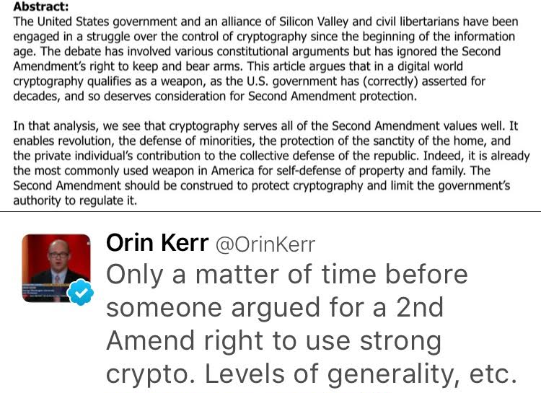
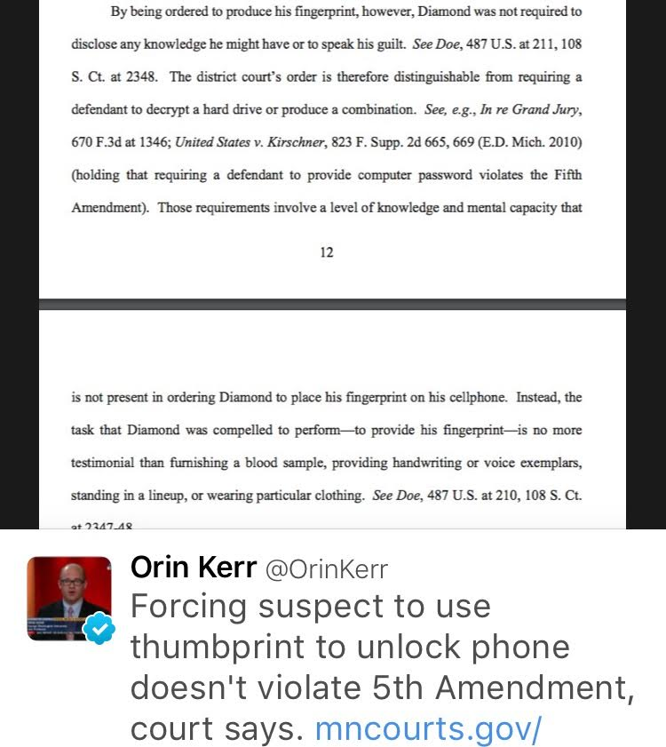
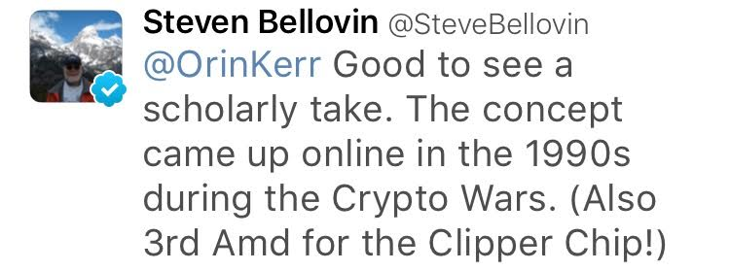
Crypto, meet the Bill of Rights
Crypto War 1: Key length
Crypto War 2: Key escrow
Crypto War 3: Key deletion
Notes:
Key management = key escrow
Perfect forward secrecy = you cannot reveal something you no longer have
Maybe have an overview lecture to explain all of these issues superficially before delving into each one. Start with crypto for a single, short message (4 bits?) before moving onto modes/expanders
For influence on society part: see Schneier's testimony to Congress in Oct/Nov 2016 about IoT + regulation of the tech industry

Slide 20
What is cryptography?
Cryptography rearranges power: it configures who can do what, from what. This makes cryptography an inherently political tool, and it confers on the field an intrinsically moral dimension.
– Prof. Phillip Rogaway, UC Davis
Source: http://web.cs.ucdavis.edu/~rogaway/papers/moral.html

Slide 21
Bruce Schneier’s 4 truths of computer everything security
1. Attackers have the advantage | “Complexity is the worst enemy of security, [and] the Internet is the most complex machine man has ever built by a lot.”
2. Interconnections → new vulnerabilities | “The more we connect things to each other, the more vulnerabilities in one thing affect other things.”
3. Attacks scale | “The Internet is a massive tool for making things more efficient. That's also true for attacking.”
4. Defense requires smart people who know what to do | “Our computers are secure [only because] the engineers at Google, Apple, Microsoft spent a lot of time on this.”
Notes:
Sources:
https://www.schneier.com/essays/archives/2016/11/testimony_at_the_us_.html
https://www.grc.com/sn/sn-587.htm

