Slide 1
Lecture 3: Encrypting by enciphering
Announcements
Problem Set 1 due on Thursday at 9pm
Start early!
Abbreviated office hours Tuesday: 12pm to 1:30pm
Note the late assignment policy, as per the syllabus
Late problem sets are not accepted (I want to return solution sets asap)
I will drop your lowest 2 problem sets from your final grade
Strongly recommend that you begin the assignment early!
Piazza course schedule updated with two papers to read in week 2

Slide 2
Rogaway’s The Moral Character of Cryptographic Work
Ethics & responsibility in science
Making an impact on society
Personal freedom vs. public safety
Experts vs. the rest of us

Slide 3
Rogaway’s The Moral Character of Cryptographic Work
Ethics & responsibility in science
Making an impact on society
With power comes moral responsibility. Academics in cryptography can no longer bury their noses during this time of social and political instability.
But then what *are* the ethical actions to take?
Those in scientific endeavors that is clearly socially negative/irresponsible such as creating the atomic bomb, or participating in government mass-surveillance are responsible for their actions.
It does seem Rogaway is pretty convinced of his view and not overly open to considering other possibilities.
I do agree with his viewpoint that in the end scientists and engineers should have accountability for the things they produce, but more than that I agree that it is important for us to have open dialogue about our ethical viewpoints. Mainly because what cryptologists can do goes beyond what will personally effect you.
When should people actually set aside time to question or think about their work and issues it is related to in the real world?
Rogaway seems to advocate for a constant evaluation of the social value of your work (whether it is convenient or not).
When you ask millennials what they are looking for in a job, making an impact on society is a common theme. Yet it's not as simple as that. … The reason why so many more people are working on behalf on the defense industry, versus on behalf of society (assuming for a second they are mutually exclusive), is because one area receives a lot more funding than the other.
It is difficult to try to work for the good of society, when today's society has a lot of funding in weapons development and other jobs that are “bad for society.”

Slide 4
Rogaway’s The Moral Character of Cryptographic Work
Personal freedom vs. public safety
Experts vs. the rest of us
Privacy is for the individual whereas security is for the whole
Studies in cryptography will be a large determinant of the level of privacy and individual rights that will be preserved in the upcoming years.
I question the assumption that there is never a need for cryptography that favors the powerful; I do think there is sometimes a need for surveillance
Couldn't the implementation of this total surveillance benefit us more despite the lack of privacy? I'm not saying I agree with this, but maybe there are some countries where the relation between government and citizens are strong enough to uphold such surveillance.
Sure, total surveillance and no privacy may lead to a better world in a particularly reality or even most realities, but the unknown of our presence in such realities keeps us from them. To me, that seems reasonable.
A society where mass surveillance is implemented … would suppress freedom of speech and social progress. The society is pressured to behave in accordance with values imposed by the authority rather than how they really are.
I enjoyed his discussion of those scientists that openly discussed the moral implications of their work in a very public manner, such as Carl Sagan, Richard Feynman, etc. However, I feel he somewhat missed a point here. I think that those scientists were instrumental in bringing an understanding of some level to the lay person. … I feel that those doing crypto-for-crypto should be allowed to work with pen and paper on esoteric problems as they please; however, there is an ever greater need for a popularization of cryptographic understanding in society. A sort of Carl Sagan for cryptography and security in general.
Rogaway's call to action seems to be mostly targeted at cryptographers and computer scientists which makes me wonder if there are ways a "normal" person might resist observation, especially since I think it is less common for people to be aware of how much their actions are catalogued.
That lead me to think about the mindset of if you have nothing to hide, then you have nothing to worry about, although then I suppose that leads to many other moral issues.

Slide 5
Encryption: define → construct → reduce to enciphering
Math Tools
Primitives
Algorithms
Protocols
Modular arithmetic
Auth key exchange
Key evolution
Signal: messaging
Key encapsulation
TLS: internet PGP: email
(see CS 558)
Hash functions
Confidential
Random(ish) permutations
Protected communication
Block ciphers
☏ Minicrypt
Cryptomania ✉

Slide 6
Recap: block cipher design
Block cipher
Key alternation
Iterated rounds
Substitution-Permutation
⇒
⇒
⇒
X
X
X
Input state
K₀
K
B
K
Π
ρ
S
…
S
S
…
S
K₁
Y
Y
Permutation
Y
⋮
K_{r-1}
Middle
…
Middle
X
X
ρ
B$
Π
K_{r}
Output state
Y
Y
Y

Slide 7
Rijndael, aka AES
S-box
Round₁
S-box
Round₉
Round₁₀
S-box
Input
+
ShiftRows
+
…
+
ShiftRows
+
ShiftRows
+
output
MixColumns
MixColumns
key₀
key₁
key₈
key₉
key₁₀
Key schedule
Key alternating structure
128, 192, or 256 bit key
Invertible key schedule
Round structure
Iterates over 10 to 14 rounds
Tunable security
3 invertible operations per round
Final round is slightly different
Only S-box is nonlinear
Notes:
The round structure provides a tunable security parameter.
Our hope is that AES with a randomly-chosen key is pseudorandom

Slide 8
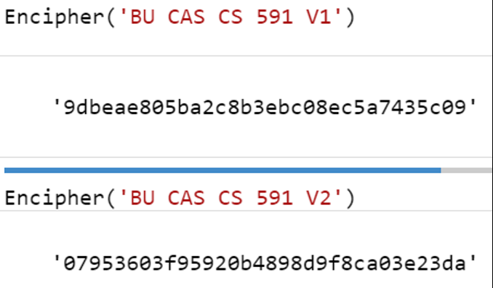
Shannon’s two security goals for block ciphers
Confusion
Diffusion
Uncertainty of K → cannot predict Y given X or vice-versa
Tough even to correlate X and Y
1 bit Δ X → huge ΔY
Hence, partial knowledge of input doesn’t help to learn output
Note: confusion ⇒ diffusion
Counterexample: combine 2 functions
If individually confusing, joint is too
But it doesn’t avalanche
X₁
X₂
B₁
B₂
Y₁
Y₂
Notes:
See Shannon’s many excellent papers for more details
Communication Theory of Secrecy Systems
A Mathematical Theory of Communication
A Mathematical Theory of Cryptography

Slide 9
Shannon’s two security goals for block ciphers
Confusion
Diffusion
Ideal: Prob[correlation] so small that attacker is better off with a brute force attack (takes 8 rounds in AES)
Ideal goal is avalanching: each bit of output depends on all input bits (takes 2 rounds in AES)
Security margin = (# rounds in a cipher) – (# rounds we can break)
2 rounds to avalanche (total diffusion)
8 rounds for wide trail strategy (total confusion)
S-box
Round₁
S-box
Round₉
Round₁₀
S-box
Input
+
ShiftRows
+
…
+
ShiftRows
+
ShiftRows
+
output
MixColumns
MixColumns
key₀
key₁
key₈
key₉
key₁₀
Notes:
Why do we have the key xor steps at the beginning/end of the cipher?

Slide 10
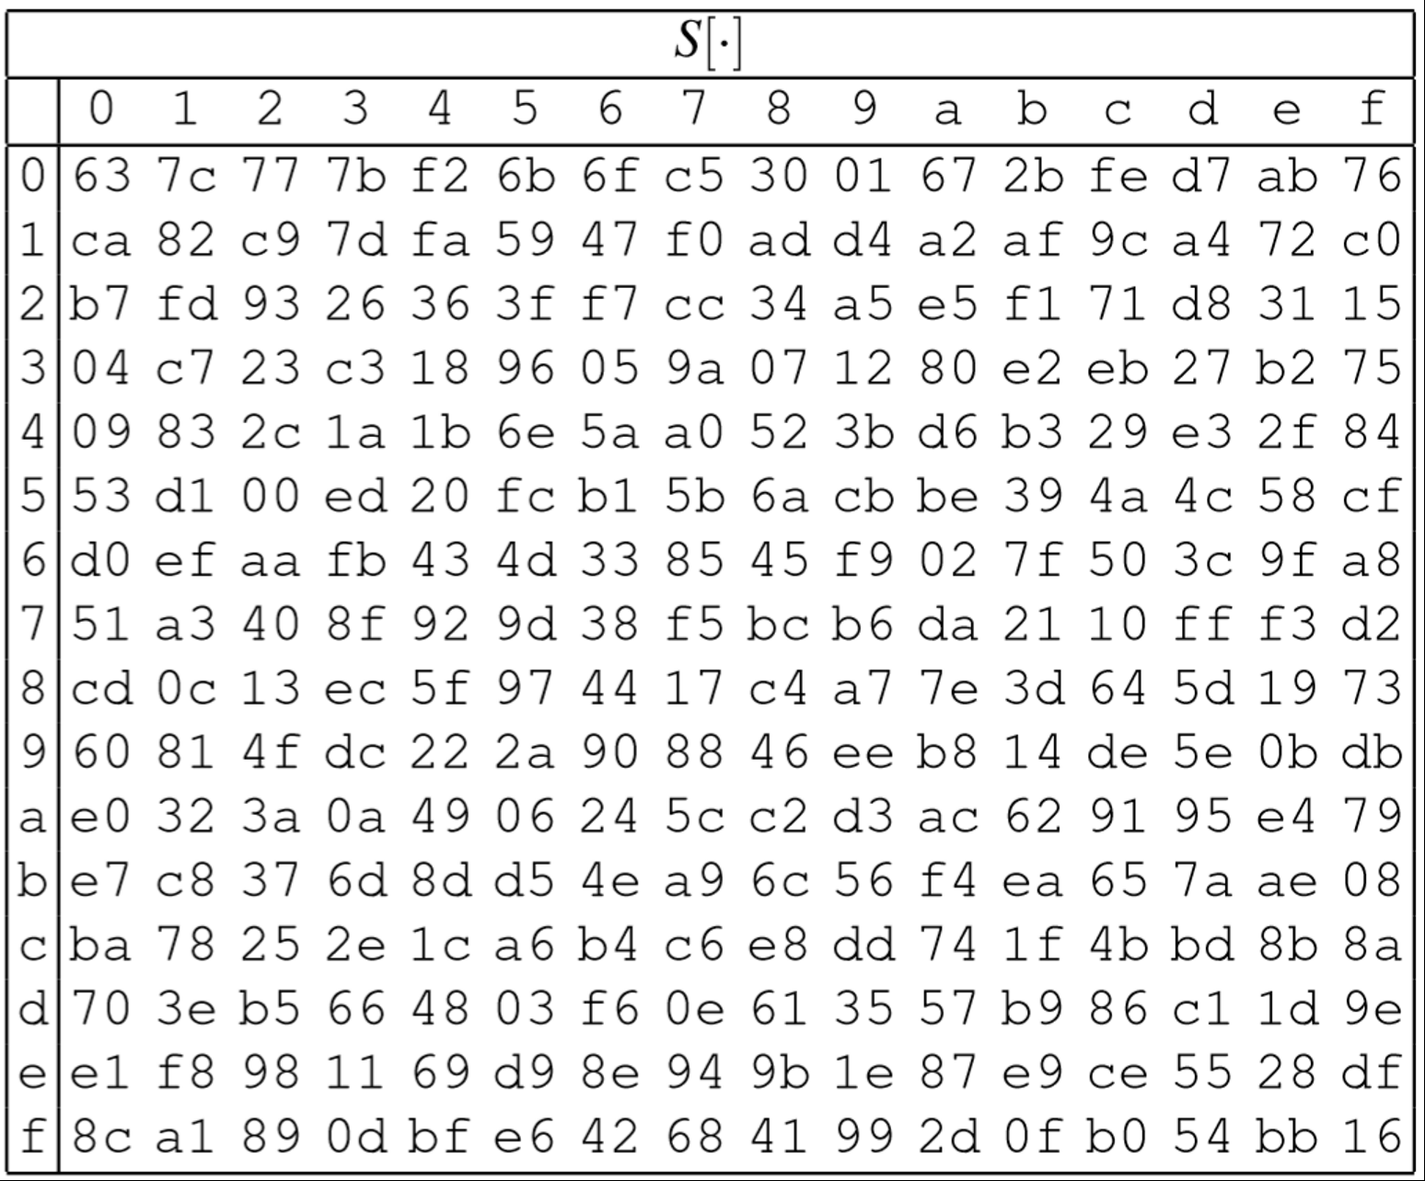
AES components
16 byte state
❶ SubBytes
❶ Table lookup, one byte at a time
S
…
S
S
…
S
ShiftRows
MixColumns
…
MixColumns
16 byte state

Slide 11
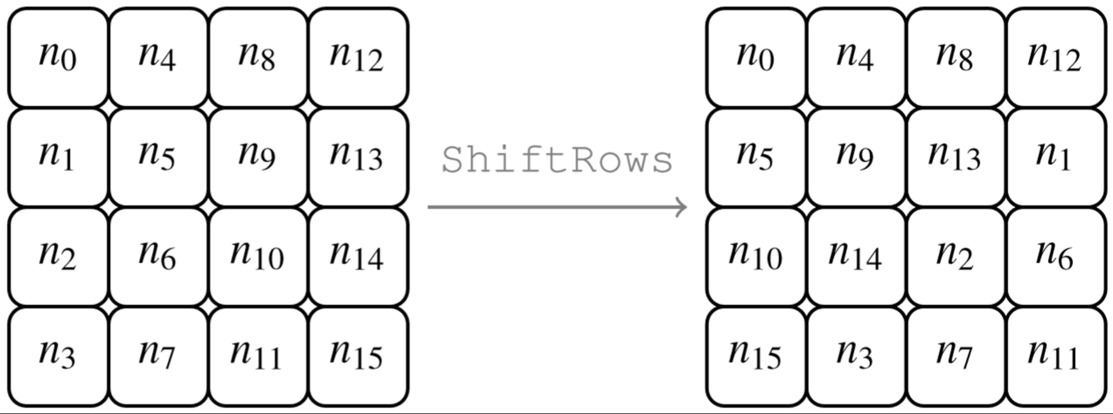
AES components
16 byte state
S
…
S
S
…
S
ShiftRows
❷ ShiftRows
❶ Byte-wise transposition
MixColumns
…
MixColumns
16 byte state

Slide 12
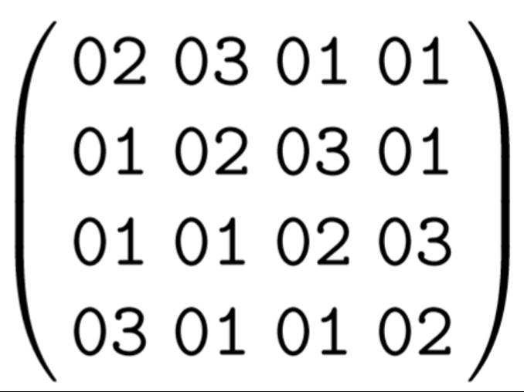
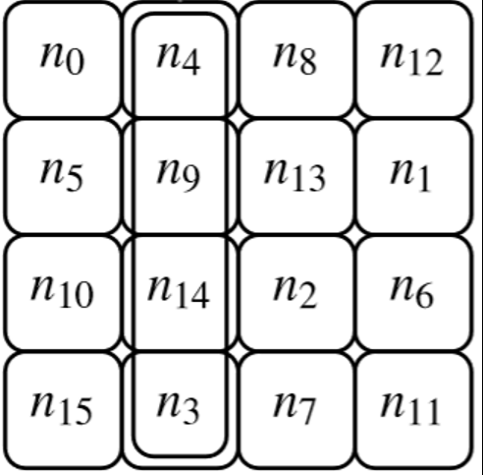
AES components
16 byte state
S
…
S
S
…
S
ShiftRows
MixColumns
…
MixColumns
❸ MixColumns
❶ Matrix multiplication in GF(256)
16 byte state

Slide 13
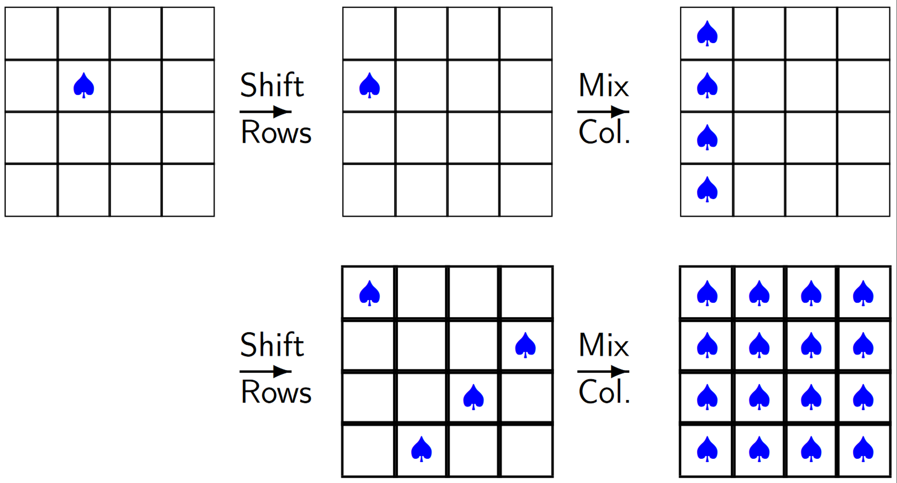
Avalanching in AES
Source: slide 17 of summerschool-croatia.cs.ru.nl/2014/slides/Advanced Encryption Standard.pdf
Notes:
Note: this argument is entirely key-independent. Hence, it doesn’t rely upon confusion at all.

Slide 14
Today: return to message confidentiality
 | …at endpoints | …in transit
Authenticity | Identity verification Bob knows Alice sent C | Binding Eve cannot alter P
Privacy | Deniability Bob can’t prove Alice said P | Confidentiality Eve cannot learn P
private data P
We informally claimed B_{K} suffices if
P has short, fixed length (namely, the block cipher’s length)
Only one message P to transmit
Questions
What happens with multiple Ps?
How about a long P?
What exactly is our goal here? How can we prove confidentiality?

Slide 15
Supporting longer messages
Def. A mode of operation connects multiple calls to a block cipher (with one K)
One simple mode: process each block of the message independently
This is called Electronic Codebook (ECB) mode
Why might this mechanism be insufficient?
P₁
P₂
P_{ℓ}
P
B_{K}
B_{K}
…
B_{K}
=
ECB
B_{K}
C₁
C₂
C_{ℓ}
C

Slide 16
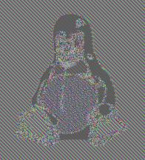
ECB mode ⇒ sad Linux penguins
Raw image of Linux penguin
Image after ECB mode
What we really want

Slide 17
What if message blocks don’t repeat?
key K
key K
encode C_{i} = B_{K}(P_{i})
encode C_{i} = Π(P_{i})
private data P₁, P₂, … P_{ℓ}
decode P_{i} = B_{K}(C_{i})
decode P_{i} = Π⁻¹(C_{i})
⁻¹
???
Notes:
Icons from https://www.iconfinder.com/iconsets/user-pictures
How to make this guarantee? Need a unique string!

Slide 18
Lessons learned
Nonces matter: We can confuse Eve! Just have to design a mode of operation that guarantees that each enciphered block is unique.
Definitions matter: Our argument leveraged the concept that a block cipher “looks like” a random permutation from Eve’s point of view.
P
nonce N
Mode
B_{K}
C

Slide 19
A new type of pseudorandomness
Block cipher
Encryption scheme
B_{K} looks like a truly random function, meaning nobody can tell them apart
Similar, except even making the same request twice yields different answers
X
X
P, N
P, N
B$
P
M
$
B_{K}
Y
Y
C
C
Notes:
We do not deem any single string (e.g., 0110100110) to be pseudorandom or not. Instead, we study the process by which a distribution over strings is produced.

Slide 20
A new type of pseudorandomness
Encryption scheme
Technical term: pseudorandom under chosen plaintext attack (IND$-CPA)
Two variants
Standard: Eve doesn’t choose N, instead it is chosen uniformly
Nonce-respecting: Eve chooses N, but each choice must be distinct
Similar, except even making the same request twice yields different answers
P, N
P, N
M
$
B_{K}
C
C

Slide 21
Cipher block chaining (CBC) mode
P₁
P₂
P₃
P
$
$
CBC
=
B_{K}
B_{K}
B_{K}
B_{K}
C
C₁
C₂
C₃
Notes:
The $ value is often called an “initialization vector”

Slide 22
Counter (CTR) mode
P
(N, 0)
(N, 1)
(N, 2)
N
CTR
=
B_{K}
B_{K}
B_{K}
B_{K}
P₁
P₂
P₃
C
C₁
C₂
C₃
Issues to consider
Tradeoff between the lengths of N and P
How do we choose N if the parties are stateless?
How to prove that CTR satisfies IND$-CPA?
What to do if N is accidentally repeated?
Notes:
The N value is often called an “initialization vector” or “counter”

Slide 23
Security reductions
Definition: A mechanism is (t, ε)-secure if every resource-bounded adversary (say, who runs in time at most t) breaks the scheme with probability at most ε.
Reduction: If an adversary A can break , then we can construct an adversary B that breaks almost as effectively.
CTR
B_{K}
B_{K}

Slide 24
Auguste Kerckhoffs’ principles
Six design principles for military ciphers (La Cryptographie Militaire, 1883)
The system must be practically, if not mathematically, indecipherable
Modern reinterpretation of #1: adversary may be computationally limited
Need some computational resource to restrict, such as time or space
Remember that any adversary can get lucky (e.g., brute force succeeds on first try), so we can only hope that such bad outcomes are unlikely, not impossible
We study probabilities over random choices made by an algorithm (Enc) or an adversary (Eve)
P, N
P, N
M
$
B_{K}
C
C
Notes:
See Wikipedia article for more information
Modern reinterpretation is due to Katz-Lindell. Compare with perfect (information-theoretic) secrecy.

Slide 25
Auguste Kerckhoffs’ principles
Six design principles for military ciphers (La Cryptographie Militaire, 1883)
The system must be practically, if not mathematically, indecipherable
It should not require secrecy, and it should not be a problem if it falls into enemy hands
It must be possible to communicate and remember the key without using written notes, and correspondents must be able to change or modify it at will
It must be applicable to telegraph communications
It must be portable, and should not require several persons to handle or operate
Lastly, given the circumstances in which it is to be used, the system must be easy to use and should not be stressful to use or require its users to know and comply with a long list of rules
Notes:
See Wikipedia article for more information
Compare with "security by obscurity": the idea isn't so much to have no secrets, or for your algorithm not to be obscure in some way. But, you should understand which pieces may be understood by your adversary, and ensure that everything else is easy to change if necessary.

Slide 26
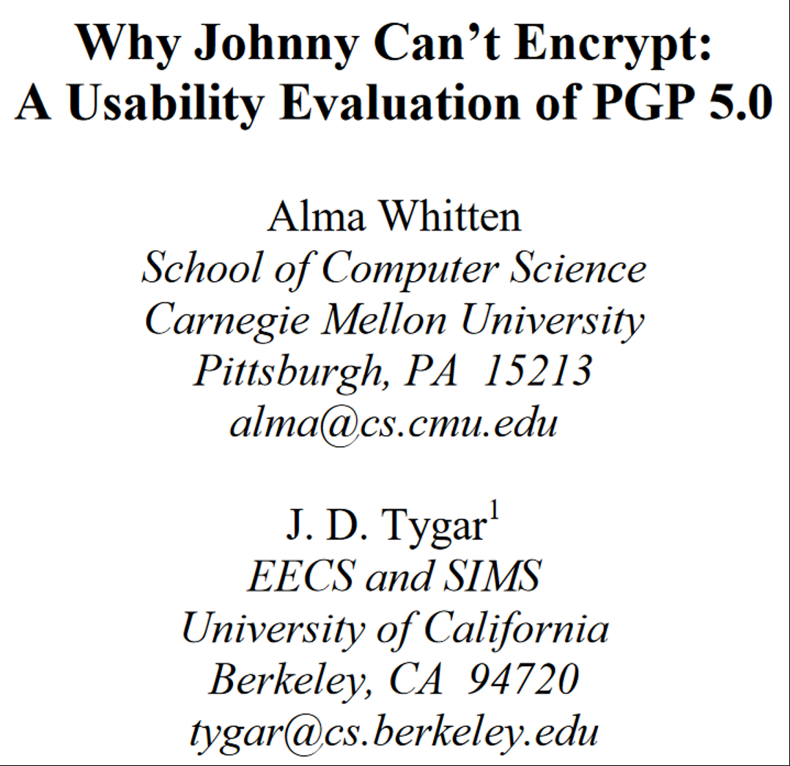
This week’s reading assignments

