Slide 1
Lecture 4: Practice-oriented provable cryptography
Announcements
Problem Set 1 due Friday, Feb 3 at 9pm
Two papers to read before Monday’s lecture
Why Johnny Can’t Encrypt
Why Jane Doesn’t Protect Her Privacy

Slide 2
Cryptographic method
Math Tools
Primitives
Algorithms
Protocols
Modular arithmetic
Auth key exchange
Key evolution
Signal: messaging
Key encapsulation
TLS: internet PGP: email
(see CS 558)
Hash functions
Random(ish) permutations
Protected communication
Block ciphers
☏ Minicrypt
Cryptomania ✉

Slide 3
Auguste Kerckhoffs’ principles
Six design principles for military ciphers (La Cryptographie Militaire, 1883)
The system must be practically, if not mathematically, indecipherable
It should not require secrecy, and it should not be a problem if it falls into enemy hands
It must be possible to communicate and remember the key without using written notes, and correspondents must be able to change or modify it at will
It must be applicable to telegraph communications
It must be portable, and should not require several persons to handle or operate
Lastly, given the circumstances in which it is to be used, the system must be easy to use and should not be stressful to use or require its users to know and comply with a long list of rules
Notes:
See Wikipedia article for more information
Item 1 -> against an adversary with bounded resources
Item 2 -> think carefully about how this interacts with data/code symmetry
Item 3 -> ability to recover from compromise is critical!
Item 6 -> a secure but unusable system isn’t really secure because users will flee to something else
Compare with "security by obscurity": the idea isn't so much to have no secrets, or for your algorithm not to be obscure in some way. But, you should understand which pieces may be understood by your adversary, and ensure that everything else is easy to change if necessary.

Slide 4
A new type of pseudorandomness
Block cipher
Encryption scheme
B_{K} looks like a random permutation, meaning nobody can tell them apart
Similar, except even making the same request twice yields different answers
Nonce-respecting rule: Eve chooses N, but each choice must be distinct
X
X
P, N
P, N
B$
Π
M
$
B$
Y
Y
C
C
Notes:
We do not deem any single string (e.g., 0110100110) to be pseudorandom or not. Instead, we study the process by which a distribution over strings is produced.

Slide 5
More formalism, fewer pictures
Def. A cryptographic mechanism is secure if every resource-bounded adversary breaks the scheme with probability at most ε.
Great! But what do secure and breaks mean…

Slide 6
Formalizing a block cipher
A block cipher with block length μ and key length λ comprises 3 algorithms
KeyGen: randomly choose a key K of length λ, often uniformly from {0,1}^{λ}
Encipher: given input X ∈ {0,1}^{μ}, outputs B_{K}(X) → Y, where Y ∈ {0,1}^{μ} too
Decipher: given Y ∈ {0,1}^{μ}, outputs B_{K}⁻¹(Y) → X, where X ∈ {0,1}^{μ} too
X
X
B$
Π
Y
Y
Notes:
KeyGen is not always generated uniformly over the bitstring space; for instance DES has a few pockets of “bad keys” that must be avoided.

Slide 7
Formalizing a block cipher
These algorithms satisfy 3 constraints
Performance: all 3 algorithms are efficiently computable
Correctness: for every K ∈ {0,1}^{λ} and X ∈ {0,1}^{μ}, it holds that B_{K}⁻¹ (B_{K}(X)) = X
(q, t, ε)-strong pseudorandomness: for every adversary A that makes ≤ q queries and executes in time ≤ t, | Pr[ A = 1] – Pr[ A = 1] | < ε where the probabilities are taken over the choices of key K ∈ {0,1}^{λ} and permutation Π : {0,1}^{μ} → {0,1}^{μ} , respectively
X
X
B$
Π
Y
Y
bit b
B_{K}, B_{K}⁻¹
Π, Π⁻¹
Notational shorthand for this claim:
A ≈ _{(q, t, ε)} A
B_{K}, B_{K}⁻¹
Π, Π⁻¹
Notes:
KeyGen is not always generated uniformly over the bitstring space; for instance DES has a few pockets of “bad keys” that must be avoided.

Slide 8
Formalizing a block cipher
These algorithms satisfy 3 constraints
Performance: all 3 algorithms are efficiently computable
Correctness: for every K ∈ {0,1}^{λ} and X ∈ {0,1}^{μ}, it holds that B_{K}⁻¹ (B_{K}(X)) = X
(q, t, ε)-pseudorandomness: for every adversary A that makes ≤ q queries and executes in time ≤ t, | Pr[ A = 1] – Pr[ A = 1] | < ε where the probabilities are taken over the choices of key K ∈ {0,1}^{λ} and permutation Π : {0,1}^{μ} → {0,1}^{μ} , respectively
X
X
B$
Π
Y
Y
A weaker definition suffices for today
bit b
B_{K}
Π
Notational shorthand for this claim:
A ≈ _{(q, t, ε)} A
B_{K}
Π
Notes:
KeyGen is not always generated uniformly over the bitstring space; for instance DES has a few pockets of “bad keys” that must be avoided.

Slide 9
Formalizing a symmetric key encryption scheme
A symmetric key encryption scheme also comprises 3 algorithms:
KeyGen(λ) outputs a key K ← {0,1}^{λ}
Encrypt_{K}(private P, nonce N) → C
Decrypt_{K}(ciphertext C, N) → P
These algorithms satisfy 3 constraints
Performance: all 3 algorithms are efficiently computable
Correctness: Dec_{K}⁻¹ (Enc_{K}(P, N)) = P for all K ∈ {0,1}^{λ} , N ∈ {0,1}^{μ} , and P ∈ {0,1}*
P, N
P, N
Enc
$
C
C
bit b
(q, t, ε)-IND$-CPA: for every nonce-respecting adversary A making queries totaling ≤ q blocks & running in time ≤ t, A ≈ _{(q, t, ε)} A where K ← {0,1}^{λ} and $ randomly chooses outputs of the proper length
Enc_{K}
$
Notes:
Notes:
- Typically |C| = |P|, though this need not always be the case
- $ ignores every property of its input other than length

Slide 10
Recall: Counter (CTR) mode
P
(N, 0)
(N, 1)
(N, 2)
N
CTR
=
B_{K}
B_{K}
B_{K}
B_{K}
P₁
P₂
P₃
C
C₁
C₂
C₃
Notes:
The N value is often called an “initialization vector” or “counter”

Slide 11
Formalizing the reduction
If we begin with:
Then we can construct:
B_{K}
CTR
a block cipher
that is (q_{B}, t_{B}, ε_{B}) pseudorandom
B_{K}
a symmetric key enc scheme
that is (q_{C}, t_{C}, ε_{C}) indistinguishable from
pseudorandom under chosen plaintext
attack

Slide 12
Formalizing the reduction: the contrapositive
If we begin with:
Then we can construct:
An adversary A_{CTR} who can distinguish
from
with probability > ε_{C} given time t_{C} and queries that total q_{C} blocks of data
An adversary A_{BC} who can distinguish
from
with probability > ε_{B} given time t_{B} and a total of q_{B} queries
CTR
$
B_{K}
B_{K}
Π

Slide 13
Visualizing the reduction
If we begin with:
Then we can construct:
An adversary A_{CTR} who can distinguish
from
An adversary A_{BC} who can distinguish
from
CTR
$
B_{K}
B_{K}
Π
adversary A_{CTR}
P¹, N¹
X¹
CTR
B_{K}
B_{K}
C¹
Y¹
or
adversary
A_{BC}
or
P², N²
X²
$
Π
C²
Y²
…
…
bit b
bit b’

Slide 14
How A_{BC} operates
Step 1:
Step 2:
Step 3:
Step 4:
Wait for A_{CTR} to output a (P, N) pair
Query A_{BC}’s own oracle on (N,0), (N,1), …, (N, |P|-1)
Concatenate response blocks, then xor with P
When A_{CTR} outputs a bit b, output b’ = b
adversary A_{CTR}
P¹, N¹
X¹
CTR
B_{K}
B_{K}
C¹
Y¹
or
adversary
A_{BC}
or
P², N²
X²
$
Π
C²
Y²
…
…
bit b
bit b’
Notes:
Here, I use |P| to denote the length of P in blocks

Slide 15
Why this reduction works
Left side
Right side
B_{K}
Π
If A_{BC} is talking to , then this procedure faithfully yields
If A_{BC} is talking to , then this procedure faithfully yields ,
looks like due to non-repetition
CTR
Π
B_{K}
$
adversary A_{CTR}
P¹, N¹
X¹
CTR
B_{K}
B_{K}
C¹
Y¹
or
adversary
A_{BC}
or
P², N²
X²
$
Π
C²
Y²
…
…
bit b
bit b’

Slide 16
CTR mode with Π ⇒ one time pad
P
(N, 0)
(N, 1)
(N, 2)
N
CTR
=
Π
Π
Π
Π
P₁
P₂
P₃
C
C₁
C₂
C₃
Notes:
The N value is often called an “initialization vector” or “counter”

Slide 17
Our final result
If we begin with:
Then we can construct:
An adversary A_{CTR} who can distinguish
from
with probability > ε_{C} given time t_{C} and queries that total q_{C} blocks of data
An adversary A_{BC} who can distinguish
from
with probability > ε_{C} given a total of q_{C} queries and t_{C} + q_{C} running time
CTR
$
B_{K}
B_{K}
Π

Slide 18
CTR mode ⇒ Confidential communication
Math Tools
Primitives
Algorithms
Protocols
Modular arithmetic
Auth key exchange
Key evolution
Signal: messaging
Key encapsulation
TLS: internet PGP: email
(see CS 558)
Hash functions
Random(ish) permutations
Protected communication
Block ciphers
☏ Minicrypt
Cryptomania ✉

Slide 19
Confidential communication on the Internet?
Math Tools
Primitives
Algorithms
Protocols
Modular arithmetic
Auth key exchange
Key evolution
Signal: messaging
Key encapsulation
TLS: internet PGP: email
(see CS 558)
Hash functions
Random(ish) permutations
Protected communication
Block ciphers
☏ Minicrypt
Cryptomania ✉

Slide 20
Let’s take a look!
https://www.google.com
https://www.bu.edu
Notes:
Accessed via Google Chrome on 1/31/2017

Slide 21
Returning to counter mode
2³²
Issues to consider
Tradeoff between the lengths of N and P
How to prove that CTR satisfies IND$-CPA?
How do we choose N if the parties are stateless?
What to do if N is accidentally repeated?
2⁹⁶
P
✔
N
CTR
✔
B_{K}
?
C
Notes:
The N value is often called an “initialization vector” or “counter”

Slide 22
Birthday bound, explained
# possible nonces
# messages to protect with CTR
Given a set of size L, say you wish to draw an item M times with replacement
Question: what is the chance that you pick the same element twice?
Easier to compute the opposite question: chance of distinct elements
Pr[ distinct elements ] = nPr(L, M) / L^{M}
= 1 × (1 – 1/L) × (1 – 2/L) × ⋯ × (1 – (M-1)/L)
≈ 1 × e^{-1/L} × e^{-2/L} × ⋯ × e^{-(M-1)/L} because 1 – x ≈ e^{-x}
= exp[ -M × (M – 1) / L]
≈ exp[ -M² / 2L]
For large L, the expected # of items to draw before the first collision is approx
π L / 2 ≈ 1.25 L
The distribution of M is tightly concentrated around its expected value
Notes:
Alternate representation, from https://www.cs.umd.edu/~waa/414-F11/IntroToCrypto.pdf (sec 4.2):
Suppose a bag has L balls in it, all of different colors. We draw one ball at a time from the bag and write down its color, we then replace the ball in the bag and
draw again. What’s then the probability, after M balls have been taken out of the bag, that we have obtained at least one repeated color?
Connection to the previous slide:
L = number of possible nonces
M = number of messages you try to protect using CTR

Slide 23
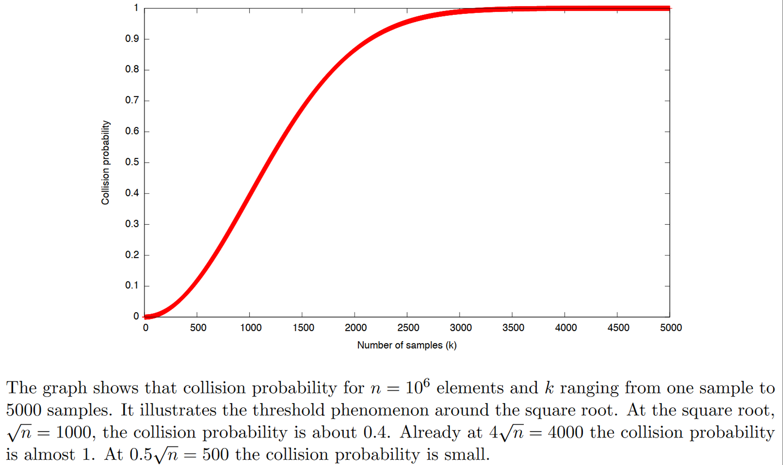
Birthday paradox, pictured

Slide 24
Birthday bound affects other aspects of protected comms
 | …at endpoints | …in transit
Authenticity | Identity verification Bob knows Alice/Bob sent C | Binding Eve cannot alter M
Privacy | Deniability (optional) Bob can’t prove Alice said M | Confidentiality Eve cannot learn M

Slide 25
Overview: Message authenticity
key K
subject to birthday bound?
key K
send A + signature T = MAC_{K}(A)
authenticated message A
validate T = MAC_{K}(A)
forge?
(make a valid A, T pair)

Slide 26
Overview: Authenticated encryption
key K
subject to birthday bound?
key K
send A along with CT = AE_{K}(P, A)
private data P,
authenticated A
validate, then decrypt
forge T ?
learn P ?

Slide 27
Overview: Collision-resistant hash functions
large, perhaps
infinite set
subject to birthday bound!
smaller, finite set
L
M

Slide 28
Our roadmap for Part 1
Math Tools
Primitives
Algorithms
Protocols
Modular arithmetic
Auth key exchange
Key evolution
Signal: messaging
Key encapsulation
TLS: internet PGP: email
(see CS 558)
Hash functions
Random(ish) permutations
Protected communication
Block ciphers
☏ Minicrypt
Cryptomania ✉

