Slide 1
Lecture 7: Sponge functions and Keccak
Assignments
Problem Set 2 posted, due Friday 2/17 at 9pm
Please type all answers in the responses file
Week 4 & 5 reading posted
Schedule
Office hours on Tuesday, Feb 14 shifted: now 10am to noon
Next week: no class on Monday 2/20, instead meet Tuesday 2/21
Office hours on Tuesday 2/21 will need to be moved…
Notes:
PDF slides used in this lecture are reproduced from the presentations listed at the bottom of this page: http://keccak.noekeon.org/papers.html

Slide 2
This week’s reading assignment

Slide 3
Underpinnings of the ROM
Notes:
Paper available at https://eprint.iacr.org/2013/424.pdf

Slide 4
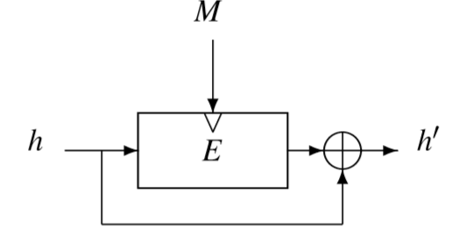
Last time: block cipher → compression → hash function
Davies-Meyer: block cipher → compression
Merkle-Damgard: compression → hash
M_{i}
C
B
H_{i - 1}
H_{i}
Admittedly this design is ad hoc, relies on a “compressing random oracle”
Sure, M-D has some weaknesses.
But at least building some kind of compression function is necessary to construct a hash function, right?

Slide 5
Today’s goal
Math Tools
Primitives
Algorithms
Protocols
Modular arithmetic
Auth key exchange
Key evolution
Signal: messaging
Key encapsulation
TLS: internet PGP: email
(see CS 558)
Hash functions
Random(ish) permutations
Protected communication
Block ciphers
☏ Minicrypt
Cryptomania ✉

Slide 6
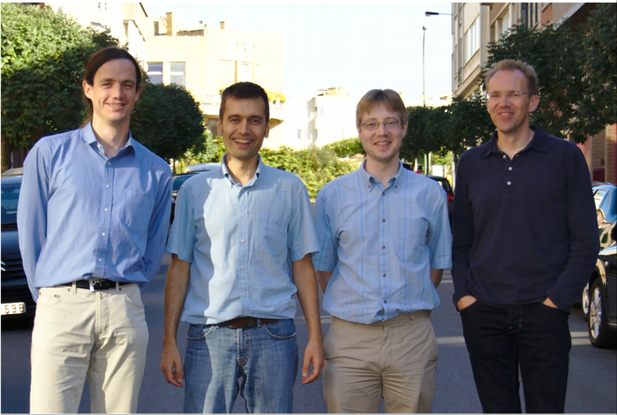
Today: Keccak, winner of the SHA-3 competition
STMicroelectronics
Guido Bertoni
Joan Daemen
Gilles Van Assche
NXP Semiconductors
Michaël Peeters

Slide 7
Preview: Why NIST chose Keccak, in their words
“Offers acceptable performance in software, and excellent performance in hardware.”
“Has a large security margin, suggesting a good chance of surviving without a practical attack during its working lifetime.”
“A fundamentally new and different algorithm that is entirely unrelated to the SHA-2 algorithms.” More specifically, it is “a hardware-oriented design that is based entirely on simple bit-oriented operations and moving bits around.”

Slide 8
Today’s objective: survey Keccak at 3 levels
Sponge function: constructing a variable-length hash function from a fixed-length permutation
Designing cryptosystems based upon sponge
Hashing (regular, salted)
Key derivation
MAC
(Authenticated) encryption
Keccak-f permutation: understand its design, which draws some features from Rijndael/AES but has several differences too

Slide 9
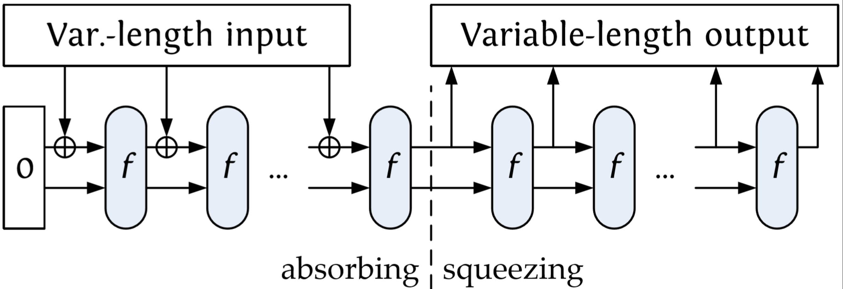
Sponge functions
r
c
Split state into two components
r = rate, which influences speed
c = capacity, which influences security
Arbitrary input and output length
More flexible than M-D hash functions
Facilitates design of higher-level crypto
Notes:
Picture + text taken from slide slide 12 of “Keccak, More than Just SHA3SUM” presentation

Slide 10
Benefits of sponge functions
Simple design: Need 1 permutation (subset of block cipher goal)
Tunable length: Output length can be bigger or smaller than input length! Don't even need to decide until time of computation. NIST calls this extendable-output functions (XOFs)
Utility: Produce a keyed function, encryption scheme, MAC directly from sponge functions without generic transformations
Security: No concern about length-extension attacks. (Why?)

Slide 11
Why use this design?
Davies-Meyer: block cipher → compression
Merkle-Damgard: compression → hash
M_{i}
C
B
H_{i - 1}
H_{i}
Notes:
Slides reproduced from the presentations listed at the bottom of this page: http://keccak.noekeon.org/papers.html

Slide 12
The 3 levels of Keccak
Sponge function: constructing a variable-length hash function from a fixed-length permutation
Designing cryptosystems based upon sponge
Hashing (regular, salted)
Key derivation
MAC
(Authenticated) encryption
Keccak-f permutation: understand its design, which draws some features from Rijndael/AES but has several differences too

Slide 13
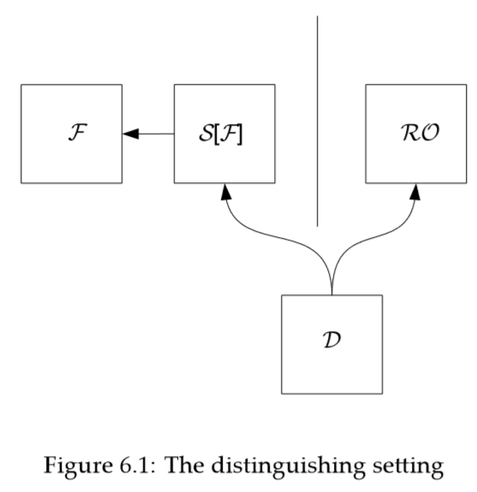
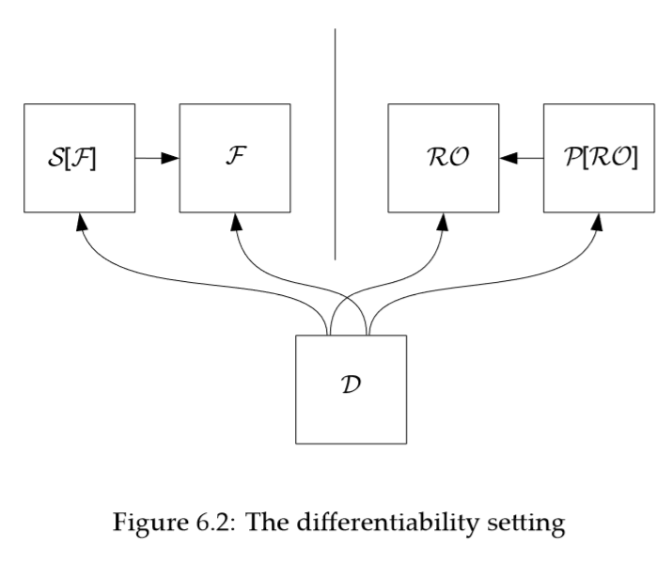
Security notions
Indistinguishability
Indifferentiability
Indifferentiability: get “closest thing to random oracle possible with fixed, finite state.”
Indifferentiability is the exact (i.e., necessary and sufficient) criterion needed to make general statements about security of cryptosystems when substituting their components.
Indistinguishability is a special case of indifferentiability. Indeed, if the resources have no public interface, indifferentiability is obviously equivalent to indistinguishability.
Notes:
Text of bullet 1 taken from Keccak guide available at http://keccak.noekeon.org/papers.html
Text of bullets 2 and 3 taken from Section 4 of https://eprint.iacr.org/2003/161.pdf

Slide 14
The 3 levels of Keccak
Sponge function: constructing a variable-length hash function from a fixed-length permutation
Designing cryptosystems based upon sponge
Hashing (regular, salted)
Key derivation
MAC
(Authenticated) encryption
Keccak-f permutation: understand its design, which draws some features from Rijndael/AES but has several differences too
Notes:
Padding: Keccak uses the pattern 10*1: a 1 bit, zero or more 0 bits (maximum r − 1), and a final 1 bit. The final 1 bit is required for the security proof to work for sponges of different rates, that is, different hash variants (multi-rate padding). Without it, different hash variants of the same short message would be the same up to truncation.

Slide 15
Performance of Keccak
Software
Hardware
Metric: CPU cycles per byte
Comparison
Similar to SHA-2
Other SHA-3 finalists: slower than Skein and Blake, faster than Grostl and JH
Compare: ~12-16 c/b for AES in software, or < 1 c/b using AESNI
Metric: chip space consumed
Keccak on its own consumes many more gates on a HW chip than AES
But, save space by not needing much additional circuitry for modes
In total: ends up as a wash, or perhaps a slight win for Keccak
Notes:
https://www.cryptopp.com/benchmarks.html

Slide 16
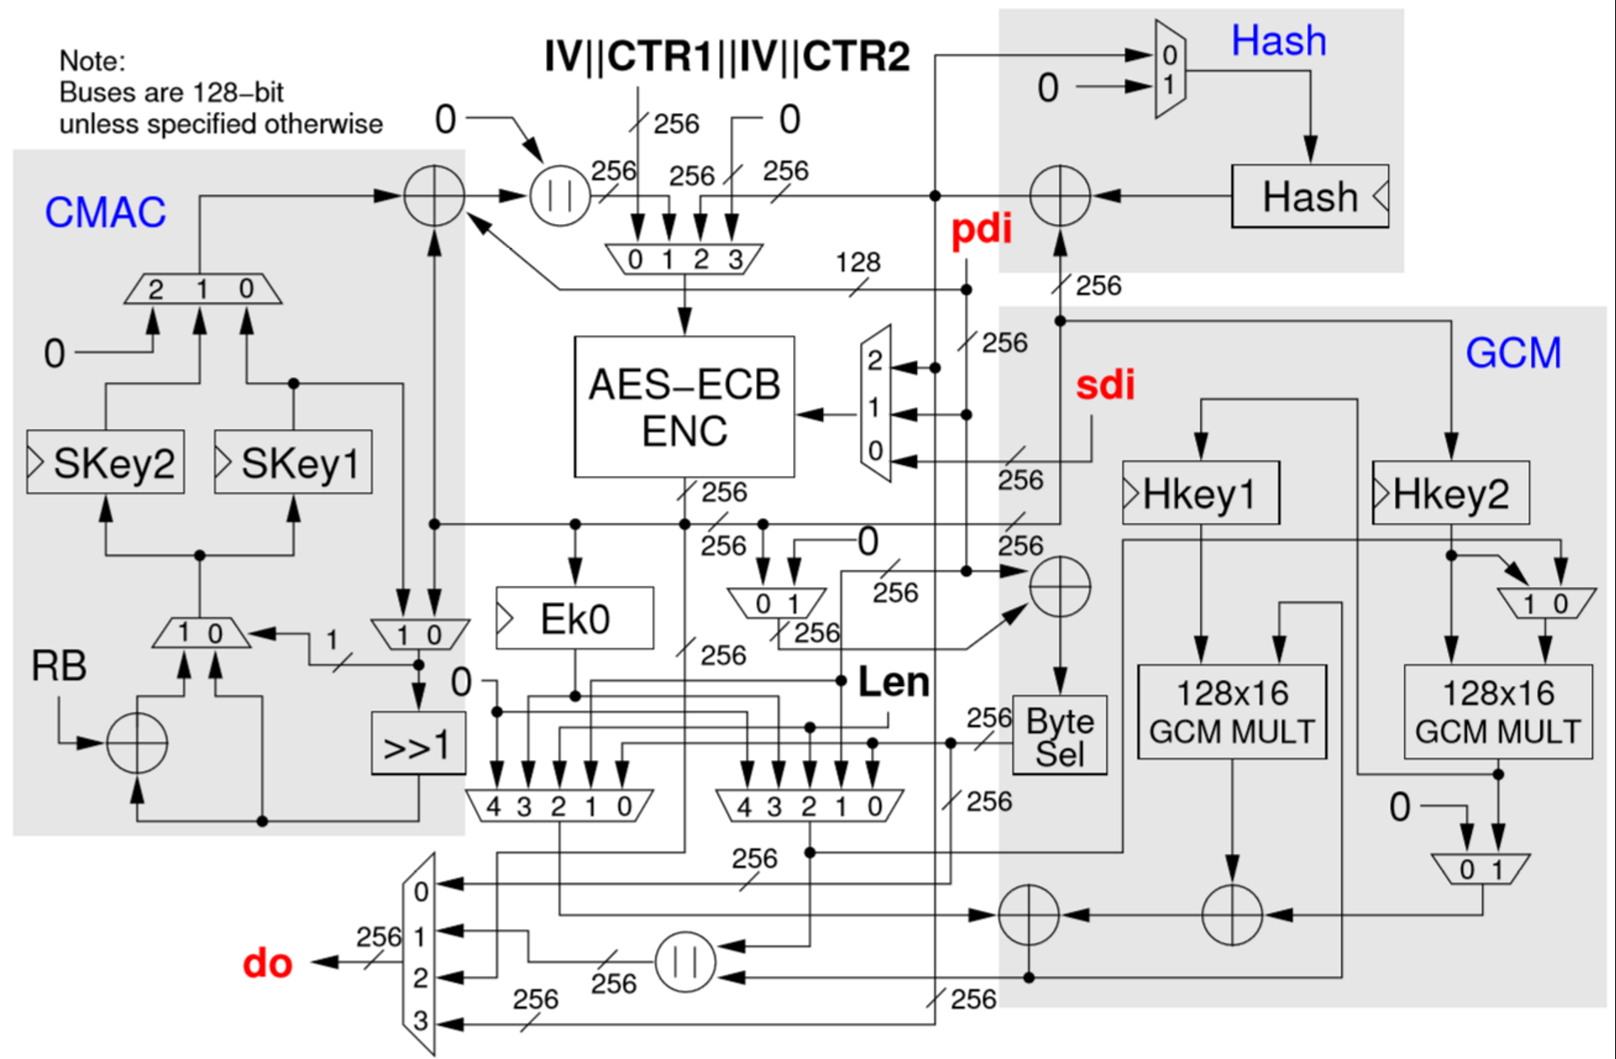
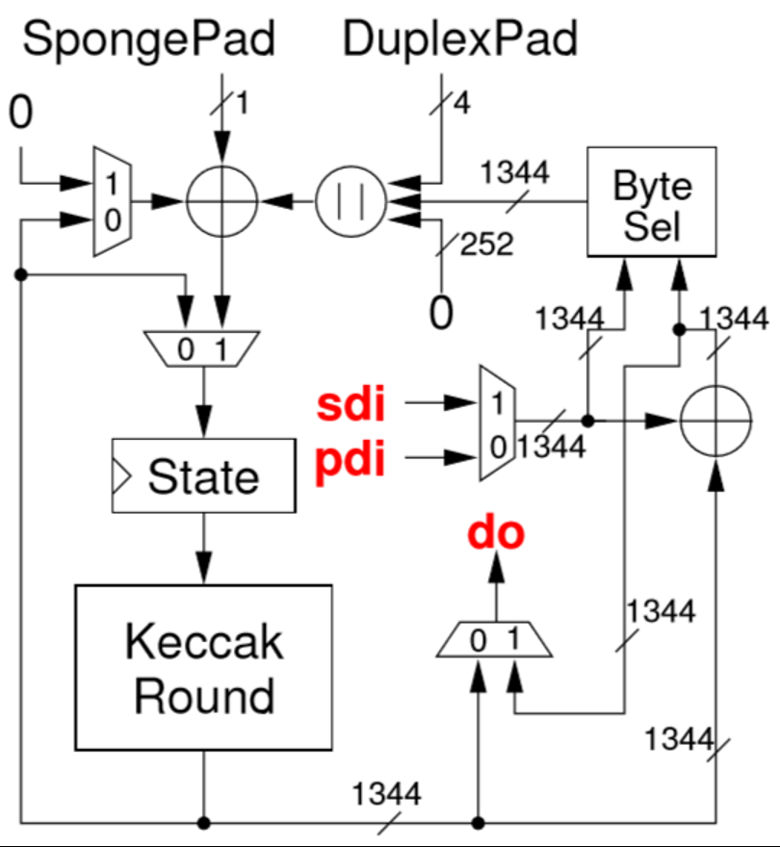
Comparison of cryptographic chip designs
Based on AES
Based on SHA-3
Rijndael itself: small space
Support for modes: large space
Keccak itself: large space
Support for modes: small space
Notes:
Hardware performance metric: chip space consumed
Keccak on its own consumes many more gates on a HW chip than AES
But, save lots of space by not needing additional circuitry for modes of operation
In total: ends up as a wash, or perhaps a slight win for Keccak

Slide 17
The 3 levels of Keccak
Sponge function: constructing a variable-length hash function from a fixed-length permutation
Designing cryptosystems based upon sponge
Hashing (regular, salted)
Key derivation
MAC
(Authenticated) encryption
Keccak-f permutation: understand its design, which draws some features from Rijndael/AES but has several differences too

