Slide 1
Lecture 10: Authenticated Encryption (part 2)
Assignments
Problem Set 3 posted, due Thursday 3/2 at 9pm
Please type all answers in the responses file
Week 4 & 5 reading due on Monday
Schedule
Office hours on Friday 2/24 are now at 2-4pm
Notes:
PDF slides used in this lecture are reproduced from the presentations listed at the bottom of this page: http://keccak.noekeon.org/papers.html

Slide 2
Today’s objective
Math Tools
Primitives
Algorithms
Protocols
Modular arithmetic
Auth key exchange
Key evolution
Signal: messaging
Key encapsulation
TLS: internet PGP: email
(see CS 558)
Hash functions
Random(ish) permutations
Protected communication
Block ciphers
TBCs
☏ Minicrypt
Cryptomania ✉

Slide 3
Recap from last time
Def. Authenticated encryption with associated data
KeyGen: just as always
Enc(private data P, authenticated data A, nonce N, length expansion L) → ciphertext C of length |C| = |P| + L
Dec(C, A, N) → P or ┴
Why combine? Simplicity for developers, better performance in time + space
Composition method | Privacy | Integrity
Encrypt and MAC | None | Plaintext
MAC, then encrypt | CPA | Plaintext
Encrypt, then MAC | CCA! | Ciphertext
Notes:
All of these compositions require separate keys for Enc and MAC. By contrast, the systems we study today tend to require only one key for both.

Slide 4
Chain of security guarantees: probabilistic edition
IND$-CPA
IND$-CCA
Probabilistic AE
P
P
Enc$(-,$)
$
Enc$(-,$)
$
Enc$(-,$)
$
Dec$(-)
$⁻¹
Dec$(-)
┴
C
C
CCA and authentication have goals even if achieved with similar constructions
CCA: ensure privacy against a strong Mallory who can make Dec queries
Authenticity: ensure Mallory cannot forge new messages that Bob will accept

Slide 5
Chain of security guarantees: nonce-based edition
P, N
P, N
Enc$(-,-)
$
Enc$(-,-)
$
Dec$(-,-)
┴
C
C
Nonce-based
IND$-CPA
Nonce-based AE
IND$-CPA
IND$-CCA
Probabilistic AE
Notes:
Subtle change: now Dec has two inputs as well! Let’s leverage the fact that the nonce is public anyway.

Slide 6
Counter with CBC-MAC (CCM)
P, A, N
T, P
N, A, |P|
CBC-MAC
CTR
Gen counter
B_{K}
B_{K}
tag T
ciphertext C
Novelties
CTR and CBC-MAC can use same key
Counter generation mechanism solves CBC-MAC’s length extension problem
Drawbacks
CTR mode → nonce reuse is catastrophic for privacy
CBC mode prevents parallelization and pipelining
Notes:
CCM was designed by Housley, Whiting, Ferguson 2003

Slide 7
Can we do better?
CCM has several different types of performance issues
2|P| block cipher calls
Many of the block cipher calls must be done sequentially
Cannot forget P after running CBC-MAC, will need it again for CTR
Online AE: realizable in constant memory with one left-to-right pass over P
P, A, N
T, P
N, A, |P|
CBC-MAC
CTR
Gen counter
B_{K}
B_{K}
tag T
ciphertext C

Slide 8
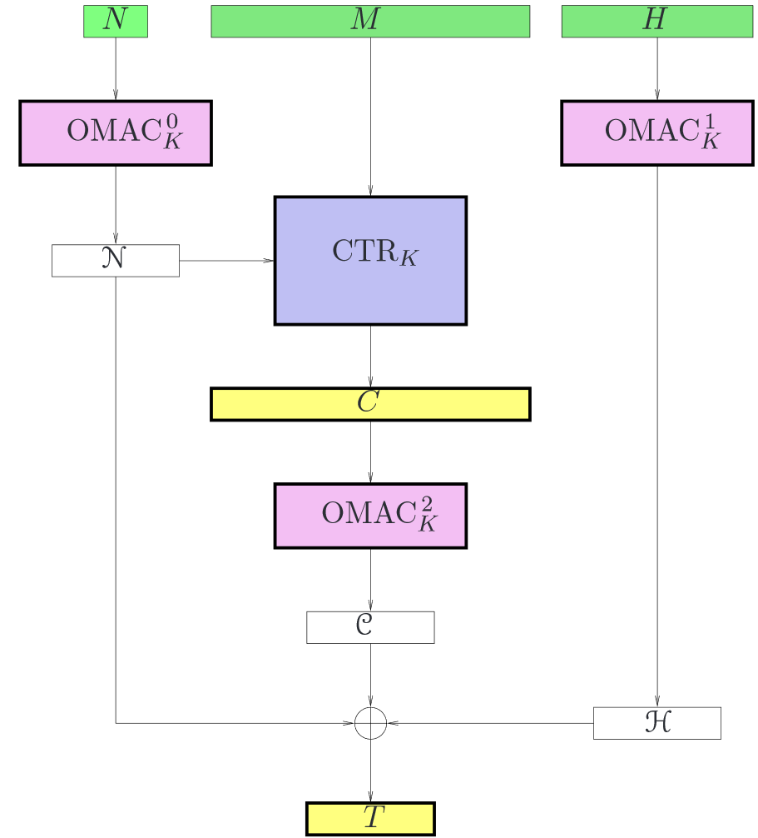
EAX: Bellare, Rogaway, Wagner 2004
Released one year after CCM
Replaces CBC-MAC with OMAC
Well… CMAC used in NIST standard
Novelties
Can pre-process associated data!
CTR and OMAC can be executed concurrently for online streaming
Can re-use key for CTR + all OMACs
Proof forms a “tweakable OMAC” as an intermediate step

Slide 9
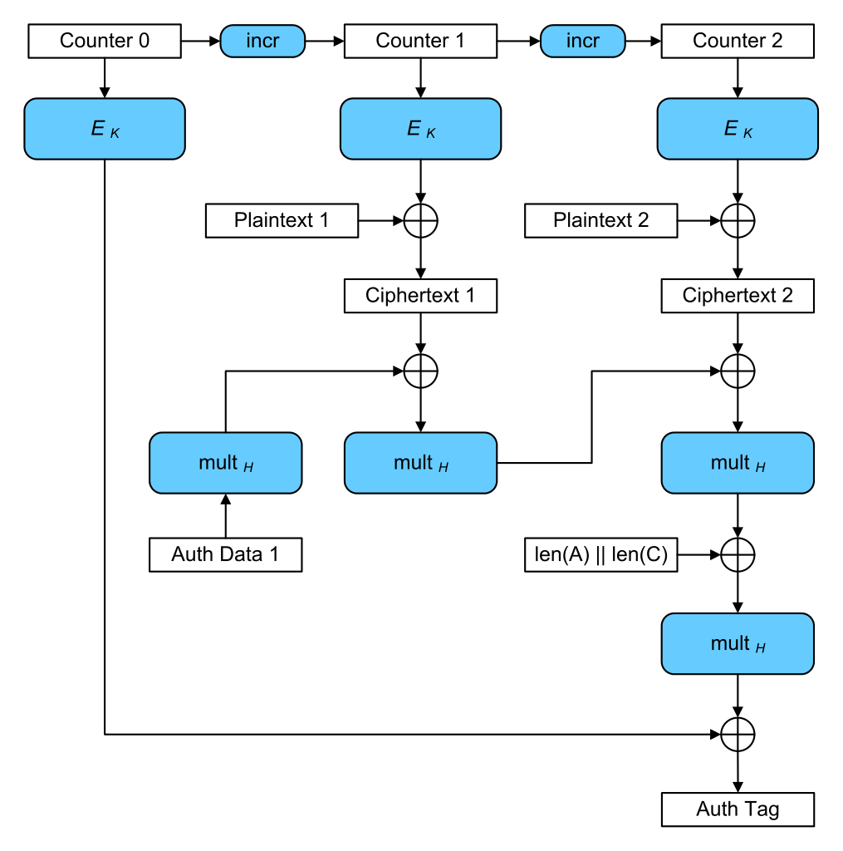
Galois/counter mode (GCM): McGrew, Viega 2005
Novelty
Only one round of block cipher calls
Intel’s AES-NI includes a PCLMULQDQ instruction for Galois mult in hardware
About the MAC
Assumes block length = 128 (built for AES)
Based on Galois multiplication in GF(2¹²⁸)
Carter-Wegman-style function is target collision resistant, aka a universal hash
Drawback
Very complicated to implement, raising chance that someone will do it wrong
Extensive cryptanalysis has exposed weak keys, lead to CAESAR competition
Notes:
CAESAR = Competition for Authenticated Encryption: Security, Applicability, and Robustness

Slide 10
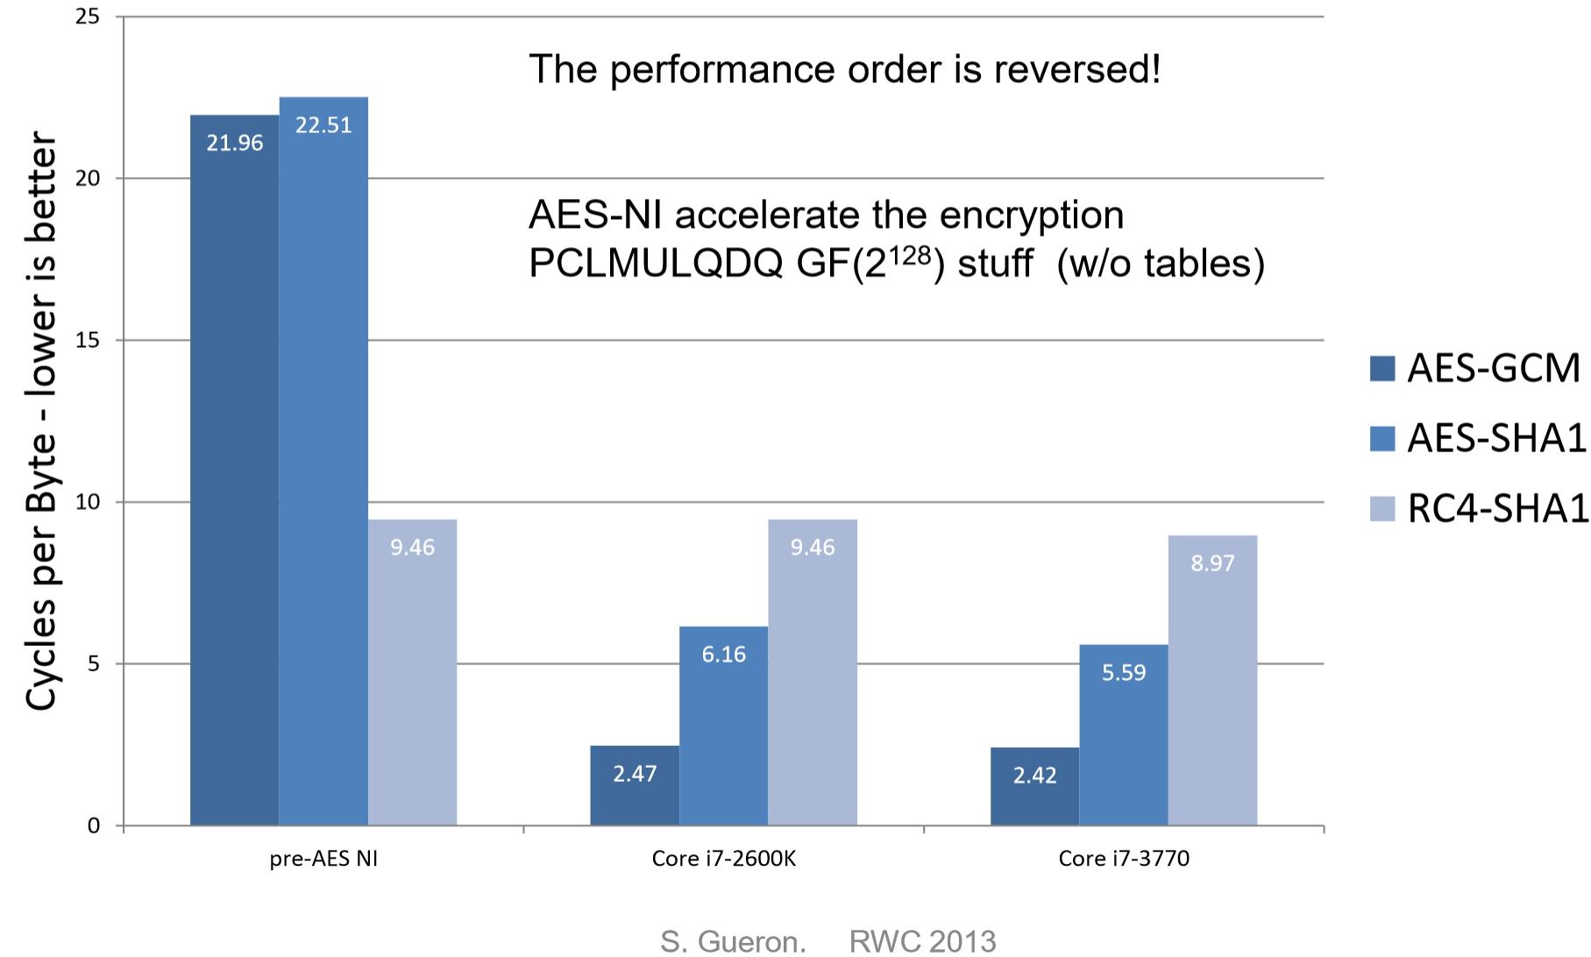
Speed of GCM in hardware
Notes:
Paper: https://eprint.iacr.org/2015/102.pdf

Slide 11
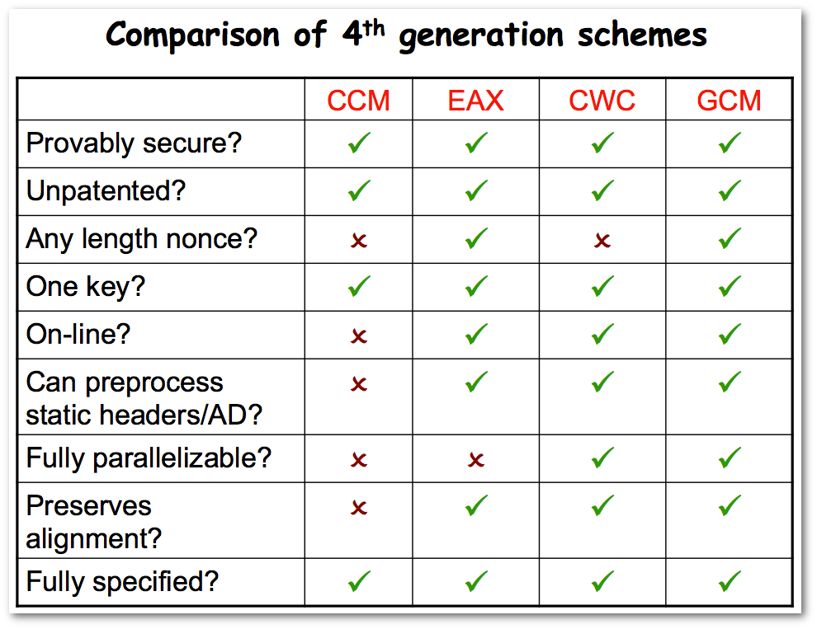
Where we stand
What’s left?
Even more speed: only |P| block cipher calls, but without cheating this time
Even more security: removing the need for the nonce N altogether

Slide 12
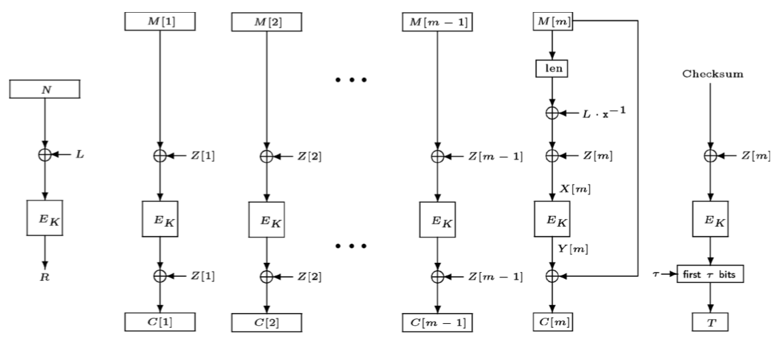
Offset codebook mode (OCB)
History
Jutla 2001: Integrity aware parallelizable mode (IPAM)
Rogaway 2002: OCB
Basic idea: XEX with finalization

Slide 13
Tweakable version of OCB
Thm [Liskov Rivest Wagner]. If E is a tweakable block cipher, then construction provides privacy and unforgeability against any nonce-respecting adversary.
Thm [Liskov Rivest Wagner]. If E is a tweakable block cipher, then construction provides privacy and unforgeability against any nonce-respecting adversary.
~
~
Π
Π
Π
Π
Π

