Slide 1
Lecture 11: Symmetric crypto, the end?
Announcements
Problem Set 3 posted, due Thursday 3/2 at 9pm
Start thinking about project ideas & finding partners
Notes:
PDF slides used in this lecture are reproduced from the presentations listed at the bottom of this page: http://keccak.noekeon.org/papers.html

Slide 2
Authenticated encryption: privacy AND authenticity
Math Tools
Primitives
Algorithms
Protocols
Modular arithmetic
Auth key exchange
Key evolution
Signal: messaging
Key encapsulation
TLS: internet PGP: email
(see CS 558)
Hash functions
Random(ish) permutations
Protected communication
Block ciphers
TBCs
☏ Minicrypt
Cryptomania ✉

Slide 3
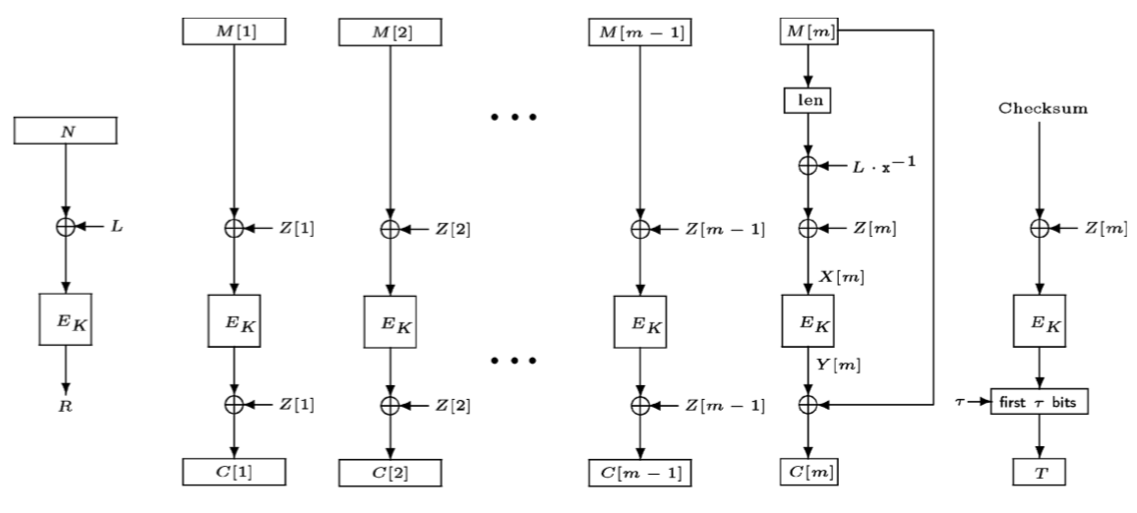
AE modes designed so far
OCB: Offset Codebook Mode

Slide 4
OCB’s licenses
Taken from http://web.cs.ucdavis.edu/~rogaway/ocb/license.htm
License for Open-Source Software Implementations of OCB (1/9/13) Under this license, you are authorized to make, use, and distribute open-source software implementations of OCB. This license terminates for you if you sue someone over their open-source software implementation of OCB claiming that you have a patent covering their implementation.
General License for Non-Military Software Implementations OCB (1/10/13) This license does not authorize any military use of OCB. Aside from military uses, you are authorized to make, use, and distribute (1) any software implementation of OCB and (2) non-software implementations of OCB for noncommercial or research purposes. You are required to include notice of this license to users of your work so that they are aware of the prohibition against military use. This license terminates for you if you sue someone over an implementation of OCB authorized by this license claiming that you have a patent covering their implementation.
Patent License for OpenSSL (11/13/13) This license was provided at the request of the OpenSSL Software Foundation to specifically authorize use of OCB in OpenSSL.

Slide 5
AE modes designed so far
OCB: Offset Codebook Mode
CCM: Counter with CBC-MAC
P, A, N
T, P
N, A, |P|
CBC-MAC
CTR
Gen counter
B_{K}
B_{K}
tag T
ciphertext C

Slide 6
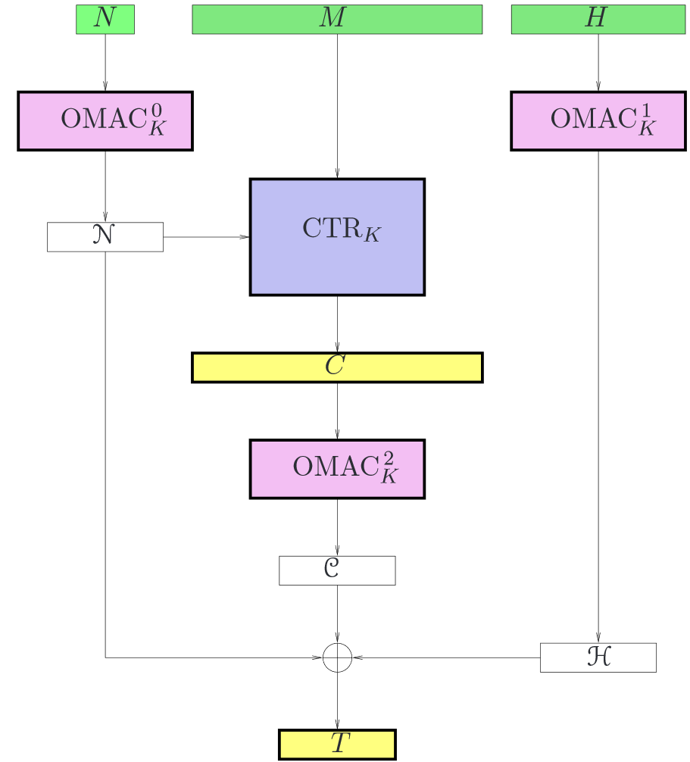
AE modes designed so far
OCB: Offset Codebook Mode
CCM: Counter with CBC-MAC
EAX: online authentication

Slide 7
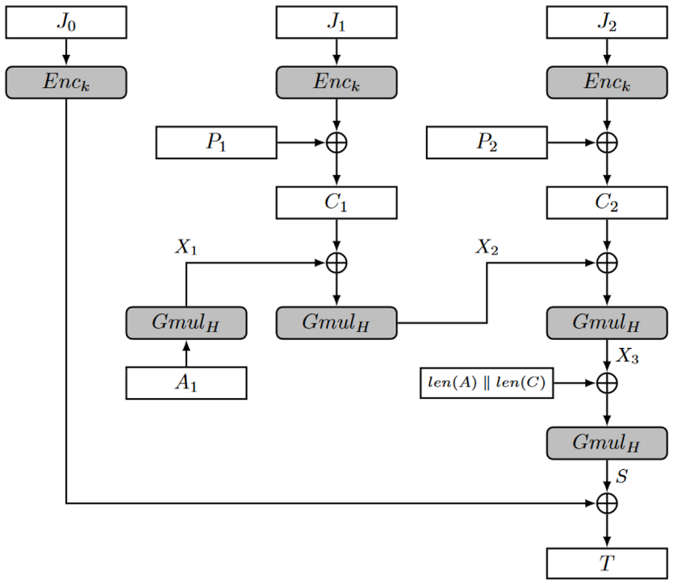
AE modes designed so far
OCB: Offset Codebook Mode
CCM: Counter with CBC-MAC
EAX: online authentication
GCM: Galois/counter mode Uses a non-block cipher auth

Slide 8
Speed of GCM in hardware
Notes:
Paper: https://eprint.iacr.org/2015/102.pdf

Slide 9
GCM: widespread use in practice
https://www.google.com
https://www.bu.edu
Notes:
Accessed via Google Chrome on 1/31/2017

Slide 10
Security guarantees so far
Nonce-based
IND$-CPA
(Online) Nonce-based AE
Enc$(-,-)
P, N
$
C
IND$-CPA
IND$-CCA
Probabilistic AE
Dec$(-,-)
┴
Notes:
Subtle change: now Dec has two inputs as well! Let’s leverage the fact that the nonce is public anyway.

Slide 11
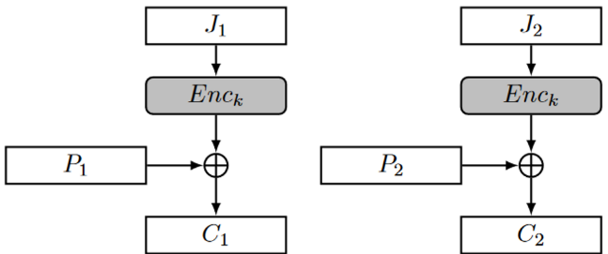
GCM nonce reuse: destroys privacy
For privacy, GCM = CTR
CTR mode w/ repeated nonces = two-time pad
We broke privacy in Problem Set 1
369f9e696bffa098d2bb383fb148bd90
23d7847f28e4b6cc86be386cb64ca281
a secret message
this is the text
’
’
’
’

Slide 12
GCM nonce reuse: destroys authenticity
Notes:
Source: https://eprint.iacr.org/2016/475.pdf

Slide 13
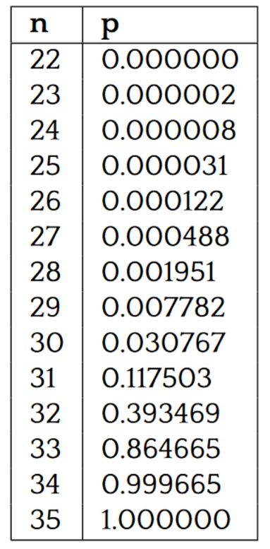
GCM nonce being chosen randomly: hurts authenticity
Notes:
Source: https://eprint.iacr.org/2016/475.pdf

Slide 15
Wait… why did we want nonces in the first place?
Main purpose for introducing nonces was to hide frequency analysis
Don’t want to reveal to Mallory whether Alice is encrypting the same message twice
But we’ve relied upon the nonce to protect much more than this!
That is, repeating the nonce reveals much more info than this
What if we make sure that nonce-reuse only reveals frequency analysis
Put another way: uniqueness of the message itself should serve as a type of “nonce”

Slide 16
Misuse-resistant AE
Novelty: Repeating N has limited damage
No impact to authenticity
Privacy damaged only to the extent that an adversary can detect repetitions
Drawback: Cannot be online
Every bit of C must depend on every bit of P
So, cannot output first bit of C before reading last bit of P

Slide 17
Synthetic Initialization Vector (SIV)
Designed by Rogaway and Shrimpton 2006
Novelty
Leverages structure of P, A to ensure uniqueness of CTR’s nonce
Can be deterministic!
Drawbacks
2 passes, 2 keys
Must decrypt, then verify
Cannot truncate tag
N
A
P
MAC
Nonce Enc
tag T
ciphertext C
Notes:
When used in MRAE, encoding must distinguish N from A

Slide 18
Deterministic AE
P, A
Leads to:
Misuse-resistant AE by replacing associated data A with (N, A)
Key wrapping!
Adversary cannot produce a valid C without knowing K
Even C corresponding to a message P that depends on the key K somehow
(Will explore in more detail on Wed)
Enc$(-,-)
R
C
C, A
Dec$(-,-)
┴
P

Slide 19
Strength of Deterministic SIV
Thm. Suppose that the MAC is EU-CMA and Enc satisfies nonce-based IND$-CPA.
If there exists an adversary running in time t and making q queries that breaks the DAE with probability ε_{dae}, then there exist adversaries breaking the MAC and Enc games making ≤ q queries such that:
ε_{mac} + ε_{enc} ≥ ε_{dae} - q/2^{|T|}.
A
P
MAC
Nonce Enc
tag T
ciphertext C

Slide 20
Proof sketch
Replace MAC with truly random R’
Let’s call modified scheme Enc’ / Dec’
Attempt to distinguish from R / ┴
Assume WLOG that our distinguisher stops successfully as soon as it makes a single Dec’ query that succeeds
Hence, Enc’ queries are useless. Until Dec’ gives useful info, Enc’ only provides unrelated data.
The probability of finding the correct tag on a new, unqueried (A, C) pair is simply 2^{|T|}
A
P
R’
Nonce Enc
tag T
ciphertext C
Enc$(-,-)
P, A
R
C
C, A
Dec$(-,-)
┴
P

Slide 21
Proof sketch
Replace MAC with truly random R’
Bring MAC back into the picture
We know forgeries are unlikely in Enc’
If forgeries can occur in the real Enc, use to distinguish!
A
P
MAC
Nonce Enc
tag T
ciphertext C

Slide 22
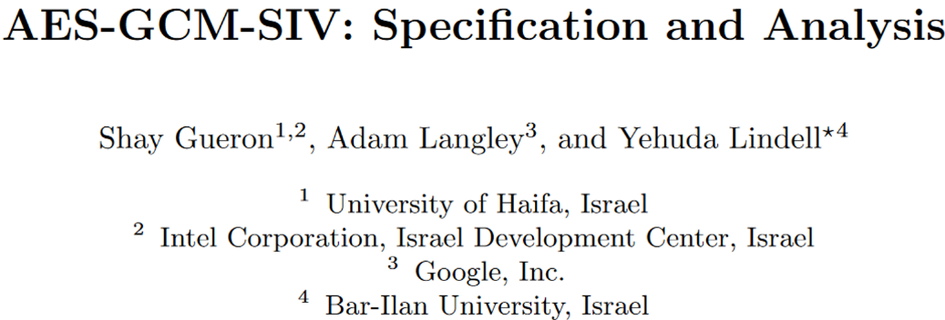
Combining GCM and SIV
Haswell | 1.17 cycle/byte
Broadwell | 0.92 cycle/byte
Notes:
Papers: https://eprint.iacr.org/2015/102 and https://eprint.iacr.org/2017/168.pdf

Slide 23
Performance vs message length
Cycles per byte
Message length, in bytes
Notes:
Source: http://web.cs.ucdavis.edu/~rogaway/ocb/performance/

Slide 24
Authenticated encryption: state of the art so far
Nonce-based
IND$-CPA
(Potentially online) Nonce-based AEAD
Misuse-resistant /
Deterministic AEAD
…
Robust AE
IND$-CPA
IND$-CCA
Probabilistic AEAD
For more info, read about the ongoing Competition for Authenticated Encryption: Security, Applicability, and Robustness (CAESAR) at https://competitions.cr.yp.to/caesar.html
Notes:
Subtle change: now Dec has two inputs as well! Let’s leverage the fact that the nonce is public anyway.

Slide 25
End of Part 1
Math Tools
Primitives
Algorithms
Protocols
Modular arithmetic
Auth key exchange
Key evolution
Signal: messaging
Key encapsulation
TLS: internet PGP: email
(see CS 558)
Hash functions
Random(ish) permutations
Protected communication
Block ciphers
☏ Minicrypt
Cryptomania ✉

Slide 26
End of Part 1
✉ key encapsulation
key K
key K
key K
✔
☏ protected
☏ communication
encode C = Enc(K, P)
private & auth
message P
recover P = Dec(K, C),
or receive error ┴
???

Slide 27
Four parts to this course
✔
The power of random-looking permutations
Cryptography meets systems: a love/hate story
Structured forgetfulness: dropping keys before they can be stolen
When reductions fail: dealing with the lowest layer

Slide 28
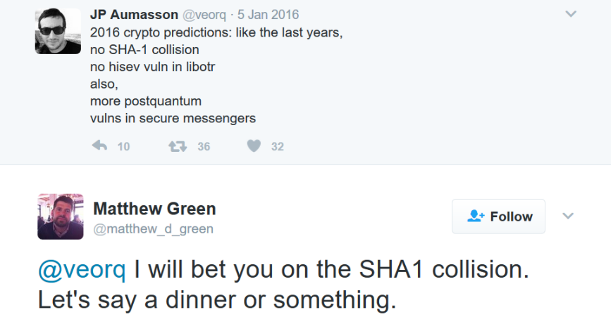
Recalling SHA-1
SHA-1 overview
Merkle-Damgard design
NSA-designed, NIST-approved
SHA-1 has 160 bit output, so security should hold for ~2⁸⁰ steps
Wang, Yin, Yu 2004: show algorithm that can find collision in 2⁶⁹ steps
Stevens, Karpman, Peyrin 2015: demonstrate SHA-1 compression function attack in 2⁵⁷ evaluations
Attack used a cluster of 64 GPUs
Estimated cost to attack full SHA-1: about $75-120k on Amazon EC2
Stated that full collision is “SHAppening”
M₁
M₂
M_{n}
64 B
C
C
…
C
IV
20 B
H(M)
Notes:
N bit output => find collision in 2^(N/2) time due to birthday bound

Slide 29
Last week: SHA-1 SHAttered!
Effort to find the collision
6500 CPU-years
110 GPU-years
# hashes: 9,223,372,036,854,775,808
≈ 9 quintillion = 9 · (10³)⁶
≈ 2³ · 2⁶⁰ = 2⁶³
(Actual effort, from paper: 2^{63.1})
“The SHAttered attack is 100,000 faster than the brute force attack that relies on the birthday paradox”
Notes:
Source: http://shattered.io/

Slide 30
Scale of computation
“One of the largest computations ever completed”
– Google blog
Bitcoin’s collective Double SHA-2 hash rate, Feb 2017
Notes:
Sources:
https://security.googleblog.com/2017/02/announcing-first-sha1-collision.html
https://blockchain.info/charts/hash-rate?timespan=30days

Slide 31
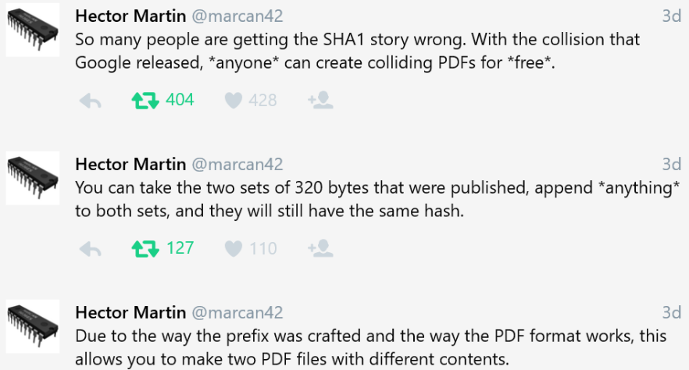
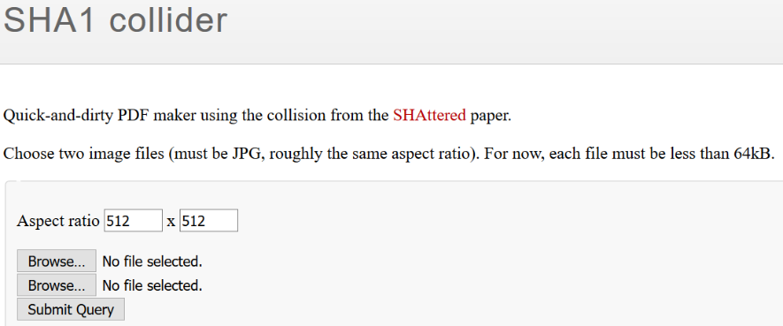
Replicating the attack
Finding your own message blocks that collide will take another 2^{63.1} effort
…Unless you exploit the length extension property of M-D!
Source: https://alf.nu/SHA1

Slide 32
SHA-1 PDF format trick

Slide 33
Formal comparison of attacks
MD5: Chosen prefix attack
SHA1: Identical prefix attack
Given any strings A and B, can find strings C and D such that:
MD5(A || C) = MD5(B || D)
There exist specific strings A and B such that for all strings C:
SHA1(A || C) = SHA1(B || C)

Slide 34
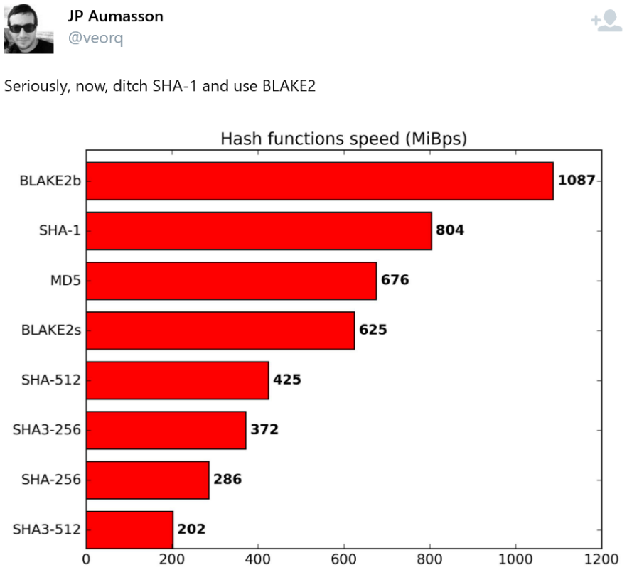
Reactions to the SHA-1 collision

Slide 35
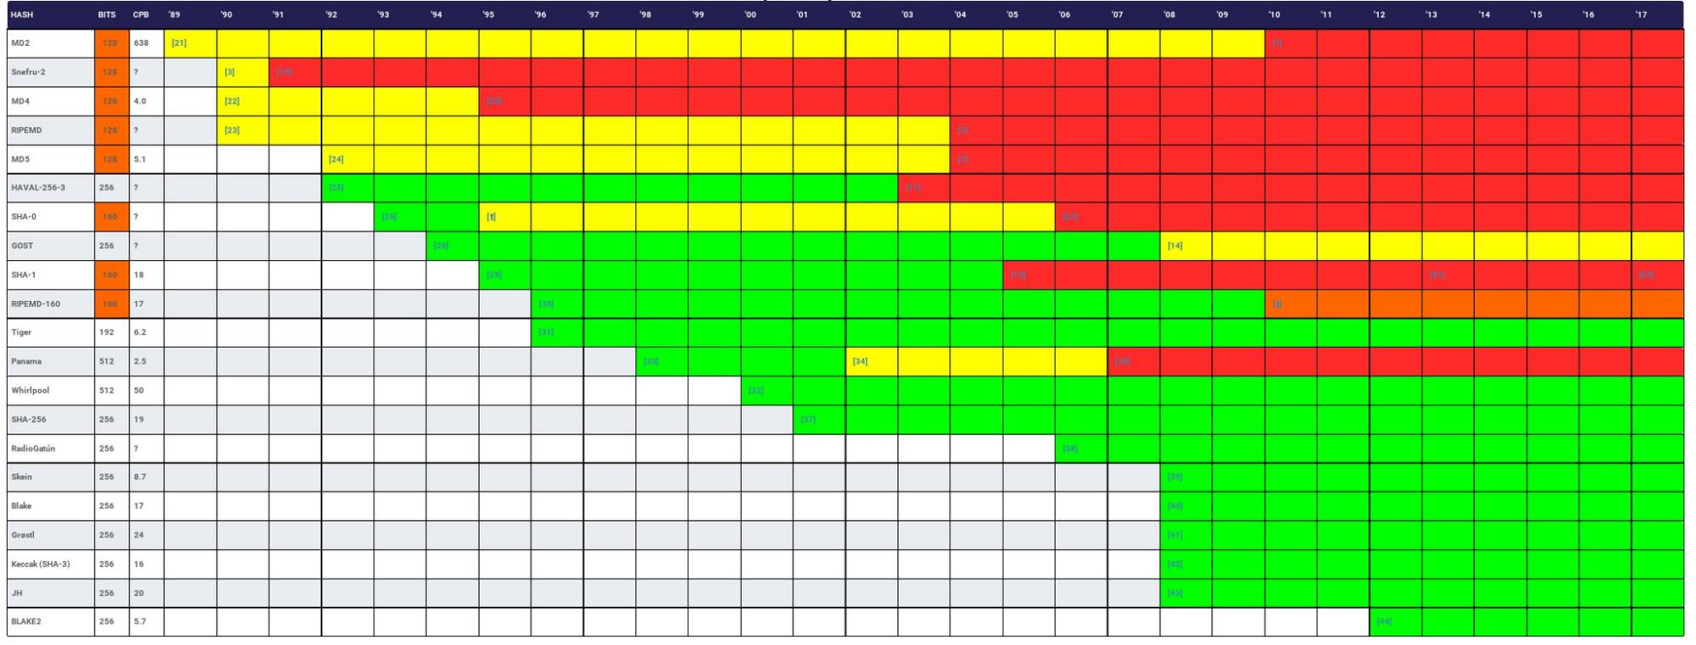
Hash function lifetimes: collision resistance
Source: https://z.cash/blog/hash-functions.html and http://valerieaurora.org/hash.html

Slide 36
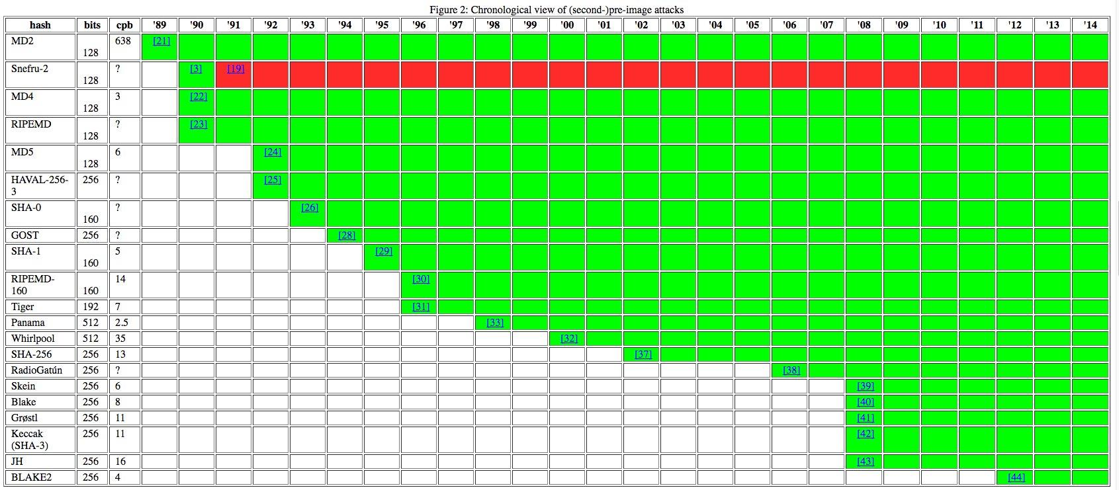
Hash function lifetimes: second preimage resistance
Source: https://z.cash/blog/hash-functions.html and http://valerieaurora.org/hash.html

Slide 37
What matters: theoretical flaw vs empirical attack

