Slide 1
Lecture 12: Protecting data at rest
Announcements
Problem Set 3 posted, due Thursday 3/2 at 9pm
Have an enjoyable spring break!
Notes:
PDF slides used in this lecture are reproduced from the presentations listed at the bottom of this page: http://keccak.noekeon.org/papers.html

Slide 2
This week’s reading assignment
View of cryptography | Purpose of crypto? | Objective? | You bless a crypto algorithm as secure based upon… | In the extreme version of this view: the other side is bogus because...
1. It is an empirical science (art?) | Design of secure applications | Build systems that won't be broken in the near future | Its resistance to cryptanalysis | Reduction proofs simply provide a flashlight to the adversary. Also, proofs are written by humans, and therefore often flawed anyway.
2. It is a mathematical science | Applied version of complexity theory | Understand the relationship between various hard problems | Reductions from it to simpler building blocks that are better understood/analyzed | Cryptanalysis simply shows the best attacks we know today, which is an ever-moving target. Instead, reductions stand the test of time.

Slide 3
Part 2
The power of random-looking permutations
Cryptography meets systems: a love/hate story
Structured forgetfulness: dropping keys before they can be stolen
When reductions fail: dealing with the lowest layer
→

Slide 4
Types of protections
Source: Handbook of Applied Cryptography, Table 1.1
Source: http://cacr.uwaterloo.ca/hac/about/chap1.pdf

Slide 5
Today’s agenda
Objectives
See where and how symmetric crypto primitives are used
See why they improve privacy
Products considered
Microsoft Bitlocker
Apple iOS 8’s security protections

Slide 6
Data at rest protection on laptops
Goal:
Data on a hard disk cannot be tampered with or exfiltrated
Even if the laptop is left unattended, lost, or stolen
Several products
Microsoft Bitlocker (standard on Windows 8 & 10)
Apple FileVault
Linux dm-crypt
Third-party products like TrueCrypt and SecureDoc (https://en.wikipedia.org/wiki/Comparison_of_disk_encryption_software)

Slide 7
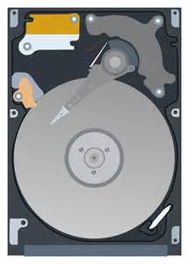
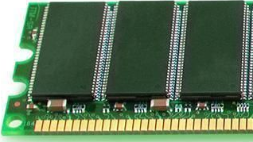
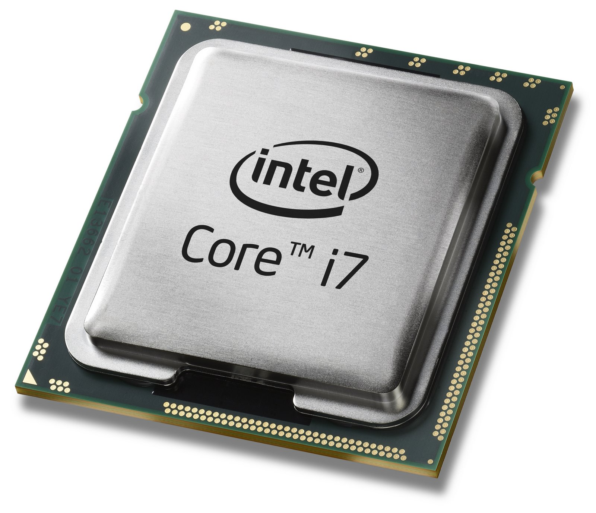
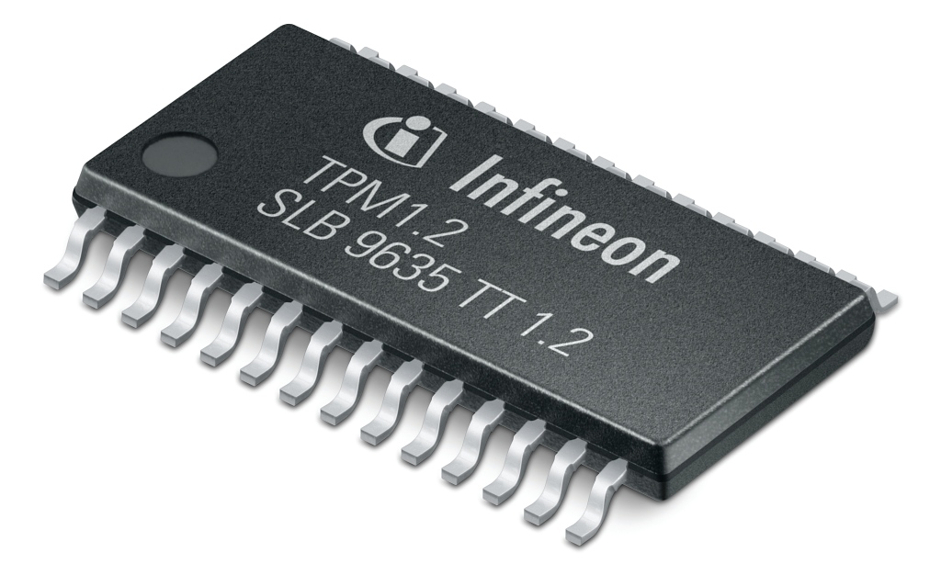
Data at rest protection on laptops: 4 components
Disk
Long-term storage
Always encrypted
Memory
Ephemeral storage
Erased upon shutdown*
CPU
Performs crypto quickly
Trusted Platform Module
Stores crypto keys

Slide 8
Disk encryption: Attempt 1
AES key
Enc(key, data)

Slide 9
Disk encryption: Attempt 2
Remaining questions:
What mode of operation to use?
How to protect TPM’s release of key?
AES key
Enc(key, data)
data

Slide 10
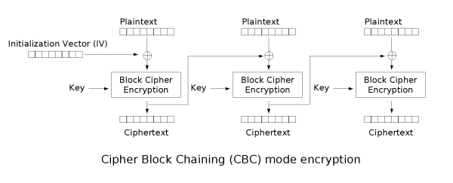
Mode of operation: CBC mode?
Ferguson (2006): Lacks diﬀusion in the CBC decryption operation.
If the attacker introduces a change ∆ in ciphertext block i, then plaintext block i is randomized, but plaintext block i+1 is changed by ∆. In other words, the attacker can ﬂip arbitrary bits in one block at the cost of randomizing the previous block.

Slide 11
Disk encryption: Threat model
Attacker can:
Read contents of disk at any time
Request disk to encrypt files of its choosing
Modify files/sectors on disk & request their decryption
Think: persistent malware!
Consequences of threat model:
Encrypt each sector of the disk individually
No two sectors should be processed identically → Tweakable enc!

Slide 12
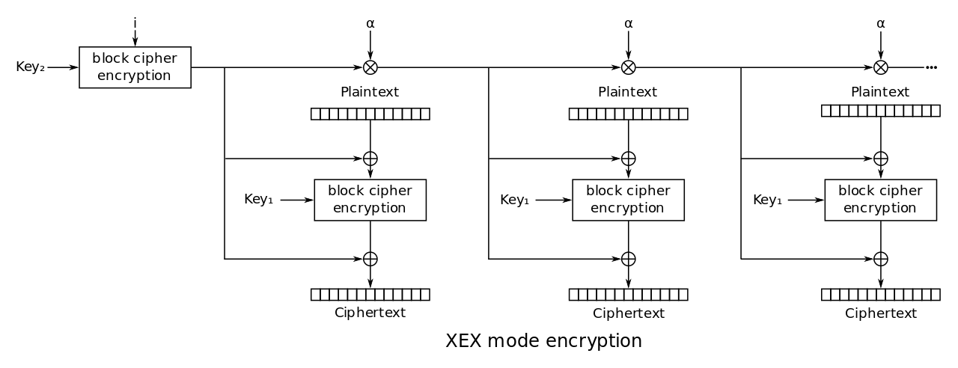
XEX mode
TBC designed in 2004 by Philip Rogaway
Even-Mansour style with constantly-changing tweak
Initial value i = sector number

Slide 13
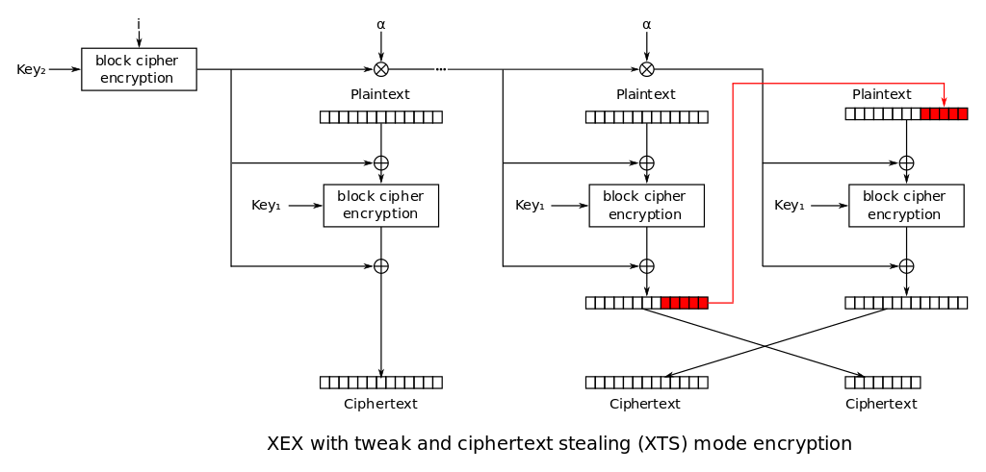
XTS mode

Slide 14
Key wrapping
What if multiple users should read the disk?
Different user accounts on the machine
Recovery key stored by Microsoft or escrowed to Active Directory
Don’t want to encrypt the entire drive several times!
Key wrapping = protect one key under another
Solved by standard encryption?
Suppose we wish to wrap a key in itself
CPA security game guarantees security against msg that Eve chooses
Eve doesn't have key! So, game doesn’t provide security if msg = key
Counterexamples: 1-time pad, CTR/CBC mode on modified AES that has been “punctured” in a key-dependent location, like AES_{k}(k) = 0 or k
Use caution when encrypting key-dependent messages!
Key wrapping = deterministic authenticated encryption (tl;dr: use SIV mode, RFC 5297)

Slide 15
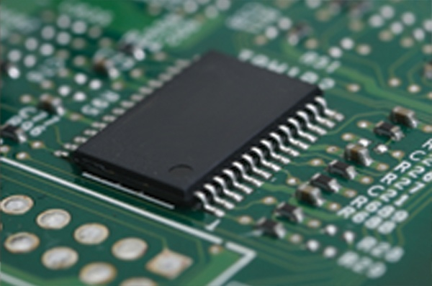
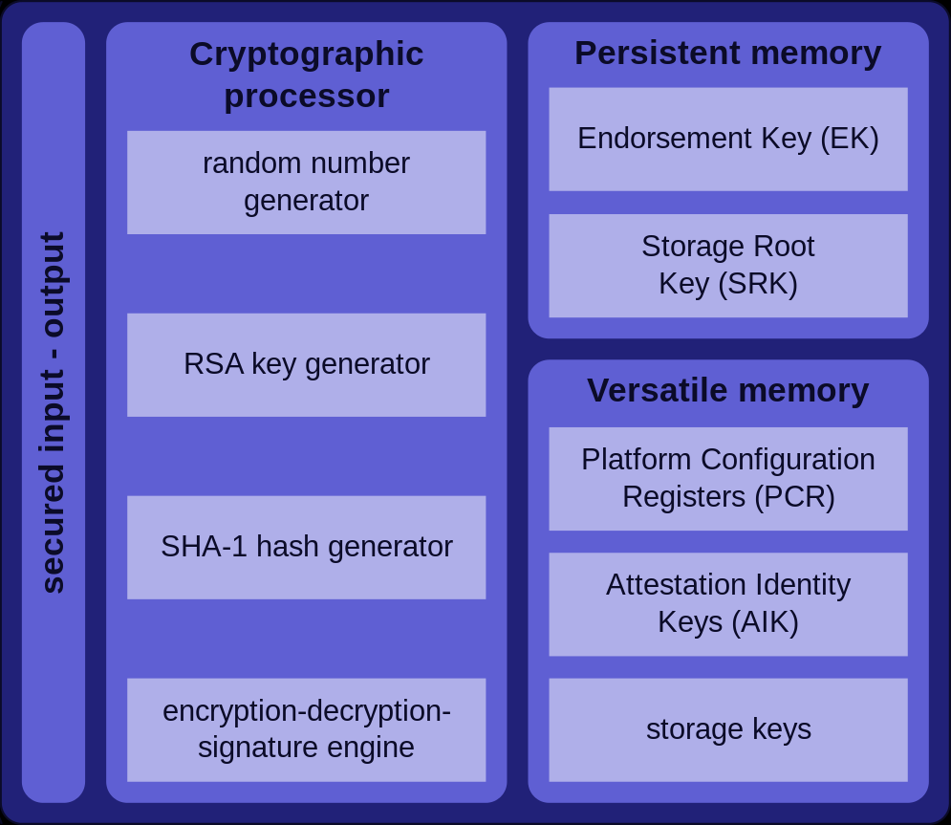
Trusted Platform Module
Generate key rather than storing it!
User’s master password (PBKDF2)
Machine’s state (“sealing”)
Notes:
See http://csrc.nist.gov/publications/nistpubs/800-132/nist-sp800-132.pdf for details on PBKDF2

Slide 16
Case study of Apple’s iPhone
Full disk encryption in iOS 8 and 9
TPM-like hardware protection of key material since 5s

Slide 17
Crypto on Apple’s mobile devices
Data for each application always encrypted
All OS components & applications signed by Apple, verified at boot before loading
Secure place to store keys & fingerprints
Hardware AES-256 engine on RAM-disk path
Unique AES-256 key for each device

Slide 18
Per-file encryption
Each file is encrypted with a its own key chosen by SE
File encrypted with AES-XTS, keywrap goes in metadata
Secure Enclave uses (NIST standard) CTR-DRBG
Use hardware RNG (ring oscillator) to get a short random seed
Then expand using counter mode
Picture from: John Kelsey (NIST), Picture from: Five DRBG algorithms based on Picture from: hash functions and block ciphers
Notes:
See http://csrc.nist.gov/groups/ST/toolkit/documents/rng/HashBlockCipherDRBG.pdf for more details on DRBGs

Slide 19
Four classes of data protection
Per-file key is wrapped with 1 of 4 “class keys” based on availability
Availability | Example | Crypto used | Key storage | When erased
Always | SIM PIN | Symmetric | Effaceable Storage | When user chooses “Erase all content and settings”
After 1st unlock | Wi-fi password | Symmetric | Secure Enclave | When phone is shut down
When locked | Mail attachments | Public-key (Curve 25519) | Secure Enclave | (Not needed)
When unlocked | Safari pwds & bookmarks | Symmetric | Secure Enclave | 10s after phone locks (w/o TouchID)

Slide 20
Four classes of data protection
Per-file key is wrapped with 1 of 4 “class keys” based on availability
Availability | Example | Crypto used | Key storage | When erased
Always | SIM PIN | Symmetric | Effaceable Storage | When user chooses “Erase all content and settings”
After 1st unlock | Wi-fi password | Symmetric | Secure Enclave | When phone is shut down
When locked | Mail attachments | Public-key (Curve 25519) | Secure Enclave | (Not needed)
When unlocked | Safari pwds & bookmarks | Symmetric | Secure Enclave | 10s after phone locks (w/o TouchID)

Slide 21
Four classes of data protection
Per-file key is wrapped with 1 of 4 “class keys” based on availability
Availability | Example | Crypto used | Key storage | When erased
Always | SIM PIN | Symmetric | Effaceable Storage | When user chooses “Erase all content and settings”
After 1st unlock | Wi-fi password | Symmetric | Secure Enclave | When phone is shut down
When locked | Mail attachments | Public-key (Curve 25519) | Secure Enclave | (Not needed)
When unlocked | Safari pwds & bookmarks | Symmetric | Secure Enclave | 10s after phone locks (w/o TouchID)

Slide 22
Four classes of data protection
?
Per-file key is wrapped with 1 of 4 “class keys” based on availability
Availability | Example | Crypto used | Key storage | When erased
Always | SIM PIN | Symmetric | Effaceable Storage | When user chooses “Erase all content and settings”
After 1st unlock | Wi-fi password | Symmetric | Secure Enclave | When phone is shut down
When locked | Mail attachments | Public-key (Curve 25519) | Secure Enclave | (Not needed)
When unlocked | Safari pwds & bookmarks | Symmetric | Secure Enclave | 10s after phone locks (w/o TouchID)

Slide 23
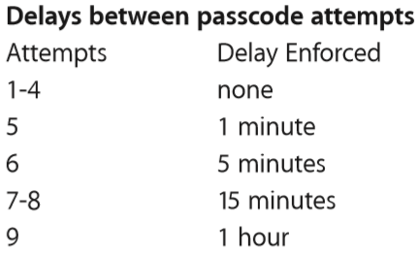
Deriving class keys
Remember our mantra: generate key rather than storing it!
Wrap sensitive class keys in a passcode key derived from:
User’s PIN or password
The unique AES-256 key fused into the chip at manufacture time
Unknown outside the Secure Enclave, (ostensibly) even by Apple
Use 10,000 iterations of PBKDF2
~80 ms per guess, so 5.5 yrs for 10⁶ tries
Secure Enclave pauses between tries
Phone can erase itself after 10 mistakes
Note: ∃ three other ways to derive class keys, enable iTunes & iCloud backups + corporate device management

Slide 24
Putting it all together
Wrap_{PK}(CK)
Wrap_{CK}(FK)
Enc_{FK}(Safari data)
PK = PBKDF2(pin, uid)
When phone is locked
Without Touch ID: CK is deleted from Secure Enclave’s memory
With Touch ID: Form new keywrap Wrap_{TouchID}(CK), then delete CK
P.S.: CK is changed whenever the passcode is changed P.S.: Memory used by Secure Enclave is itself encrypted w/ ephemeral key

Slide 25
Code signing
And now for something completely different…
Each step of the startup process contains components cryptographically signed by Apple to ensure integrity
Secure Enclave has a separate secure boot process
If any signature checks fail, device will not boot!
Separately: iOS kernel also validates that all applications are signed by Apple before they’re allowed to execute
Boot ROM (on chip)
Low-level bootloader
iBoot (next bootloader)
iOS kernel

Slide 26
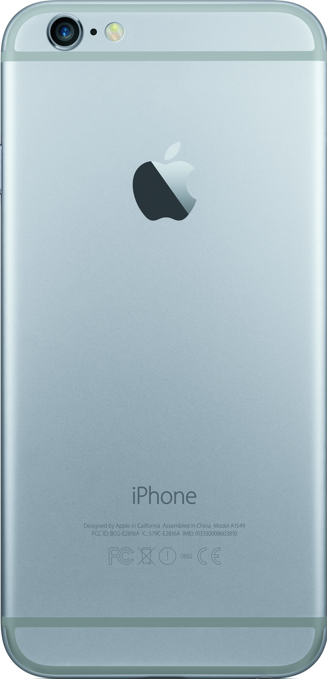
iOS over-the-air update process
Version of each component,
Nonce, Unique ECID
Upgraded iOS components,
Sign(Data, Nonce, ECID)
Signature contains:
Nonce to connect the response to the initial request
ECID to personalize the response to this particular phone
Why?

Slide 27
FBI-Apple Case
FBI wanted data on locked iPhone 5c, don’t have the PIN
PK = PBKDF2(pin, uid), so to read the files they they can:
Pry open the phone to find the uid
Brute-force the pin on the phone itself
FBI wants Apple to modify its operating system to enable a brute-force search of the PINs:
Allow PINs to be submitted via external interface, not by hand
Remove the delay between incorrect guesses
Remove the “poison pill” wiping of the phone after 10 misses
FBI needs Apple to produce & (crucially) sign this “GovtOS” update, or else the phone will reject it
iPhone 5c doesn’t have a Secure Enclave, so delay is software-enforced rather than hardware-enforced

