Slide 1
Lecture 15: Timing attacks
Announcements
Problem Set 4 due Friday 3/24
This week’s reading assignment has been posted
PSA: summer teaching opportunity + Wednesday seminar posted
Upcoming schedule
In-class test on Monday 4/3
Form a project team this week + initial project idea by next week
No reading assignment next week
You have 3 weeks to complete each of the final two Problem Sets

Slide 2
Part 2: Attacking crypto implementations
Cryptology
Cryptography
Cryptanalysis
Math of algorithm
Physics of implementation

Slide 3
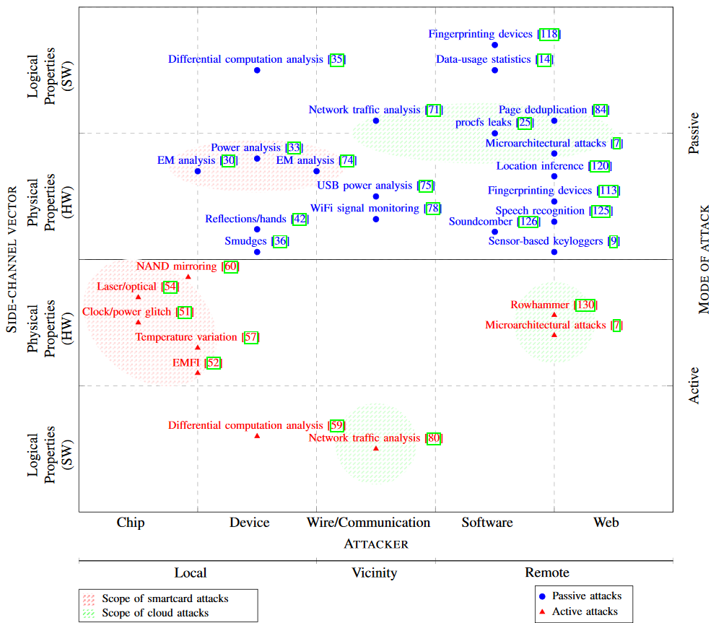
Week 8 reading: Systematic Classification of Side-Channel Attacks

Slide 4
Last time: Padding oracle attacks
Attack procedure
Send 256 CTs to Bob, one for each value of c
Wait for error messages
255 of the failures will be due to bad padding
1 failures will have valid pad, bad MAC
Compute the final byte of P: a = c ⊕ 0x01
End of Monday’s lecture: Even if we obscure the error code itself, attacker can distinguish the two possible errors based on their different running times
0x01
Notes:
Picture taken from https://blog.cloudflare.com/padding-oracles-and-the-decline-of-cbc-mode-ciphersuites/

Slide 5
Today: Timing side channels on ciphers
Issue: running time of a cipher might be key-dependent
Example: RSA’s square-and-multiply to compute C^{d} mod N
Will show how this algorithm works by example: computing 5²⁰ mod 33
Binary expand: 20 = 10100
Corresponding modular arithmetic
1 = 0 · 2 + 1
2 = 1 · 2 + 0
5 = 2 · 2 + 1
10 = 5 · 2 + 0
20 = 10 · 2 + 0
5¹ = (5⁰)² · 5¹ = 1 · 5 = 5 mod 33
5² = (5¹)² = 5² = 25 mod 33
5⁵ = (5²)² · 5¹ = 25² · 5 = 23 mod 33
5¹⁰ = (5⁵)² = 23² = 1 mod 33
5²⁰ = (5¹⁰)² = 1² = 1 mod 33
Notes:
Example taken from http://www.cs.sjsu.edu/faculty/stamp/students/article.html

Slide 6
Codifying a square-and-multiply algorithm
Generalizing the technique:
Construct the exponent in binary
Square & multiply from left to right
x = C
for j = 1 to n
x = mod(x2, N)
if d_{j} == 1 then
x = mod(xC, N)
end if
next j
return x
Why the technique is vulnerable:
Square operations always occur
But multiply operations are dependent upon the secret d
0
1

Slide 7
Our focus: Timing attacks on AES itself
Question: What timing issue might occur with AES?
Before answering this question, a quick reminder about how AES works…

Slide 8
Reminder: AES’ iterated round design
S-box
Round₁
S-box
Round₉
Round₁₀
S-box
Input
+
ShiftRows
+
…
+
ShiftRows
+
ShiftRows
+
output
MixColumns
MixColumns
key₀
key₁
key₈
key₉
key₁₀
Key schedule
Key alternating structure
128, 192, or 256 bit key
Invertible key schedule
Round structure
Iterates over 10 to 14 rounds
Tunable security
3 invertible operations per round
Final round is slightly different
Only S-box is nonlinear
Notes:
The round structure provides a tunable security parameter.
Our hope is that AES with a randomly-chosen key is pseudorandom

Slide 9
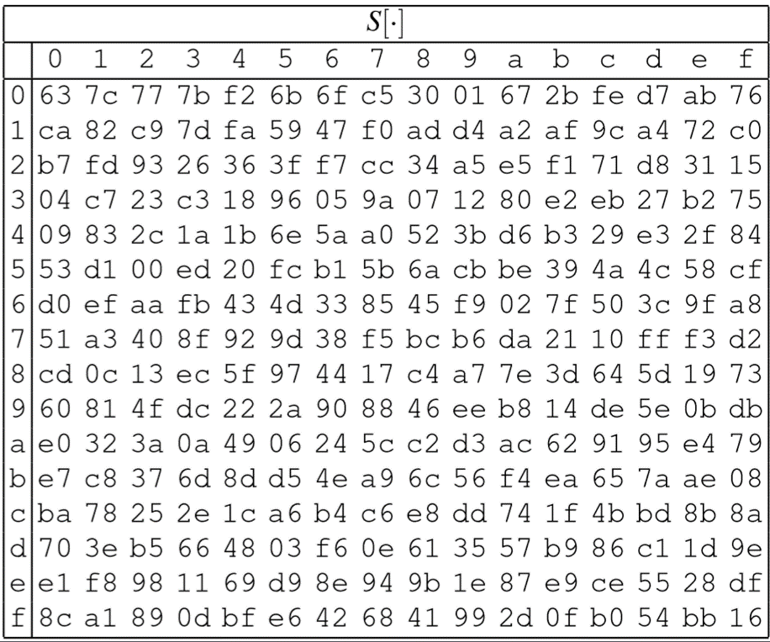
Reminder: single round of AES
16 byte state
❶ SubBytes
❶ Table lookup, one byte at a time
S
…
S
S
…
S
ShiftRows
MixColumns
…
MixColumns
16 byte state

Slide 10
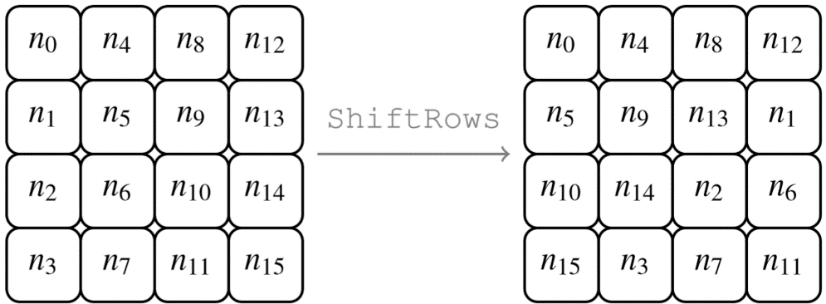
Reminder: single round of AES
16 byte state
S
…
S
S
…
S
ShiftRows
❷ ShiftRows
❶ Byte-wise transposition
MixColumns
…
MixColumns
16 byte state

Slide 11
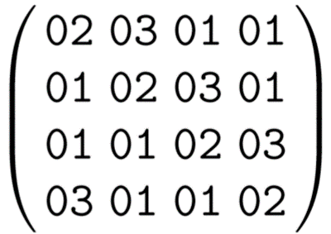
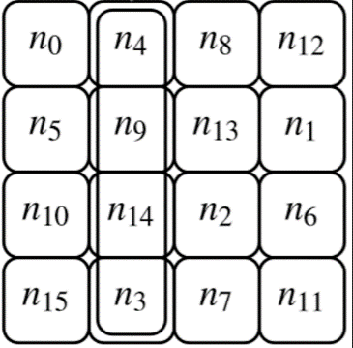
Reminder: single round of AES
16 byte state
S
…
S
S
…
S
ShiftRows
MixColumns
…
MixColumns
❸ MixColumns
❶ Matrix multiplication in GF(256)
16 byte state

Slide 12
Our focus: Timing attacks on AES itself
Question: What timing issue might occur with AES?
Answer: S-box table lookups!
Response of an array lookup depends upon whether the value is already in cache
This, in turn, depends on whether you’ve already looked up this value in the past
Side comment: table lookups aren’t required for the S-boxes
We saw in PS3 how we can implement the xtime function directly
But, we also saw how xtime itself is be vulnerable to a timing attack
For this reason, most software doesn’t “implement the math”

Slide 13
Let’s focus on one round
First round of AES:
Last round of AES:
S-box
S-box
+
x
y
x
y
+
pt
…
…
ct
key
key
Can easily learn key if
We know the plaintext
Note: don’t need to choose it
We can learn either x or y
Note: they’re equivalent
Similar issue with last round, except
We require known ciphertext instead
We learn the last round key instead
Bijection with into first round key

Slide 14
Computer architecture
Computers cache recently-accessed data on the principle that if you wanted it before, you may want it again
The code of AES includes tables to represent the S-box (+ MixColumns)
See https://github.com/openssl/openssl/blob/master/crypto/aes/aes_core.c
RAM (GB)
Cache (KB to MB)
CPU
(bytes)

Slide 15
Relevant parts of the AES code
Initial setup
s0 = GETU32(in ) ^ rk[0]; s1 = GETU32(in + 4) ^ rk[1];
s2 = GETU32(in + 8) ^ rk[2]; s3 = GETU32(in + 12) ^ rk[3];
First round of AES
t0 = Te0[s0 >> 24] ^ Te1[(s1 >> 16) & 0xff] ^ Te2[(s2 >> 8) & 0xff] ^ Te3[s3 & 0xff] ^ rk[4];
t1 = Te0[s1 >> 24] ^ Te1[(s2 >> 16) & 0xff] ^ Te2[(s3 >> 8) & 0xff] ^ Te3[s0 & 0xff] ^ rk[5];
t2 = Te0[s2 >> 24] ^ Te1[(s3 >> 16) & 0xff] ^ Te2[(s0 >> 8) & 0xff] ^ Te3[s1 & 0xff] ^ rk[6];
t3 = Te0[s3 >> 24] ^ Te1[(s0 >> 16) & 0xff] ^ Te2[(s1 >> 8) & 0xff] ^ Te3[s2 & 0xff] ^ rk[7];
Defining the constants
static const u32 Te0[256] = {0xc66363a5U, 0xf87c7c84U, 0xee777799U, 0xf67b7b8dU, …}
static const u32 Te1[256] = {0xa5c66363U, 0x84f87c7cU, 0x99ee7777U, 0x8df67b7bU, …}
static const u32 Te2[256] = {0x63a5c663U, 0x7c84f87cU, 0x7799ee77U, 0x7b8df67bU, …}
static const u32 Te3[256] = {0x6363a5c6U, 0x7c7c84f8U, 0x777799eeU, 0x7b7b8df6U, …}
Hint:
S[00] = 0x63
S[01] = 0x7c
S[02] = 0x77
S[03] = 0x7b
Notes:
See https://github.com/openssl/openssl/blob/master/crypto/aes/aes_core.c, lines 885-907 and 60-323

Slide 16
First round table lookups
In the first round, AES code will query S-box on 16 values
x₁ = key₁ ⊕ pt₁ x₂ = key₂ ⊕ pt₂ … x₁₆ = key₁₆ ⊕ pt₁₆
Suppose x₁ and x₂ are identical
Then the second table lookup will be faster than the first!
More generally, 1st round running time ~ # of distinct intermediate values
Can we use this to find the key?

Slide 17
Answer: almost!
Let’s say we feed input plaintext with pt₁ = 01, pt₂ = 02
Suppose I tell you that a cache hit occurs in the first two S-box lookups
Then, you know:
x₁ = x₂
key₁ ⊕ pt₁ = key₂ ⊕ pt₂
key₁ ⊕ key₂ = pt₁ ⊕ pt₂ = 03
Unfortunately this doesn’t tell you key₁ or key₂ directly
Good news: if all plaintext bytes cause collisions, you can also compute key₁ ⊕ key₃, key₁ ⊕ key₄, …, key₁ ⊕ key₁₆
So, you can learn 120 of the 128 bits of key!
Brute-force the rest if you have a (pt, ct) pair

Slide 18
Making this attack more realistic
Simplifying assumptions we’ve made so far
Our plaintext causes many cache collisions
We can tell which pair of x’s collide
We can isolate the 1st round’s running time
Our timing measurement is perfect, thus revealing exactly # of x’s that are equal
Tactics to remove these assumptions
Collect more pt samples (that is: gather stronger signal on the key)
Make guesses & hope you’re right! (that is: overcome noise)
Introspect the machine more carefully (that is: gather more precise signal)

Slide 19
Tactic 1: Collect more samples
Strategy
Don’t assume a single “magical” pt with many collisions
Instead, simply try many possible pts
If pts chosen randomly, probability that:
A given pair of bytes (e.g., bytes 1 and 2) collide = 1/256
Byte 1 collides with some other byte ≈ 1/16
There exists a collision = 1 – (256 choose 16)/(256¹⁶) ≈ 1 – 10⁻¹⁴
Each collision yields a constraint on the key
Lowers its entropy by 8 bits
Sample enough pts until we observe 15 indep constraints
We can “concentrate” the locations of constraints by fixing some byte values

Slide 20
Tactic 2: Guess & check
What if we don’t actually know which bytes of x collide?
We know that Time(AES) is smaller when x₁ = x₂ than when they differ,
i.e., when key₁ ⊕ key₂ = pt₁ ⊕ pt₂
Granted, the time depends on many other factors
Other bytes in the same cache line
Other bytes of the 1st round (or last round for a ct attack)
Other rounds
Network latency (if you’re conducting this attack remotely)
With enough samples, we can average over this noise!
Note: also use this tactic when collecting timing samples from padding oracles
Bin running times by pt₁ ⊕ pt₂, see which is smallest

Slide 21
Tactic 2 (continued)
Question: How can we handle AES-256? Its key is spread over 2 rounds
Answer: Once we know the 1st round key, we can simply push forward and attack the 2nd round in the same way!
Now we’ve modeled reality, in which nobody is kind enough to tell you fine-grained info about the cache … right?
Round₁
Round₂
Input
+
+
…
key₀
key₁

Slide 22
Tactic 3: Inspect the machine
Timing information may be viewable remotely (e.g., observe response times to TLS packets over the internet)
But what if you have closer proximity to your target?
Let’s say you are on the same machine as your target
Co-located VMs on the cloud
Unprivileged user on a multi-tenant Unix machine with full-disk encryption
Rather than merely passively viewing the time, you can now actively change the state of the cache!
Idea originally from Osvik, Shamir, Tromer 2006

Slide 23
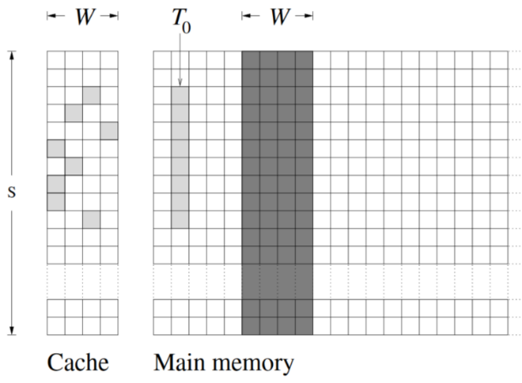
How the cache works
There’s a mapping between locations in memory & cache
If you control a large region of memory (~size of cache), you can fill in the cache with your own contents

Slide 24
Prime + Probe
Algorithm:
Fill the cache with a large array A that you control
Trigger an AES encryption (or wait for one to occur)
Re-read your array A and record the time to retrieve each byte
Upshot: AES evicted one line of your cache
Strength: Find key byte with ~800 samples over 65ms

Slide 25
Evict + Time
Algorithm:
Trigger an AES enc/dec with known pt/ct
Read a few bytes of your array A
Trigger another AES enc/dec with the same pt/ct
Upshot: 2nd AES is slower iff you evicted the right cacheline
Strength: Find key byte with ~50k samples over ~30s

Slide 26
Conclusion: Timing attacks
Ciphers can be vulnerable to timing attacks, just as modes can
Compare requirements
Timing attacks: known PT or CT, plus running time
IND-CPA/CCA definitions: chosen PT/CT, known CT/PT, no running time
Challenging, but possible, to design ciphers to avoid timing attacks
 | Rijndael | Keccak
Operations used | Table lookups Bitwise operations: AND, XOR | Bitwise ops: AND, XOR, NOT Rotations
Operations conspicuously absent | Ops that depend on register size: cyclic rotations, modular arithmetic Complicated S-box design: big S-box, many different S-boxes | Table lookups Modular addition
Why? | Generality: simple implementations across many computing platforms | Side-channel resistance (Part 2 of this course)

