Slide 1
Lecture 16: Power attacks
Announcements
Problem Set 4 due Friday 3/24 at 9pm
Week 8 reading: Systematic Classification of Side-Channel Attacks
Upcoming schedule
In-class test on Monday 4/3
Form a project team this week + initial project idea by next week
Notes:
Note: some slides from today’s lecture were originally produced by Merrielle Spain

Slide 2
Part 2: Attacking crypto implementations
Cryptology
Cryptography
Cryptanalysis
Math of algorithm
Physics of implementation

Slide 3
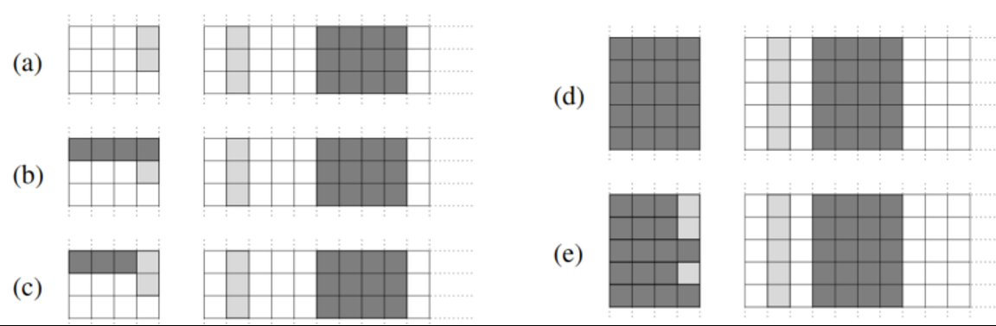
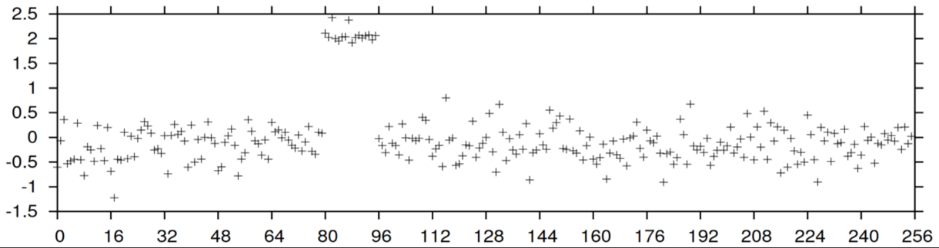
Last time: Cache timing attacks on software
Issue: computers cache data
from recent memory lookups
Strength: Find key with
~800 samples over 65ms
RAM
(GB)
Cache
(KB to MB)
CPU
(bytes)
Evict + Time
Prime + Probe

Slide 4
Side channel attacks on crypto
Issue:
Physical implementation of a device can reveal more than its desired outputs
Environments to attack:
Software on PCs
Small hardware devices
Common side channels:
Error messages
Time
Cache
Power
EM fields
Sound
Optics
Network
…

Slide 5
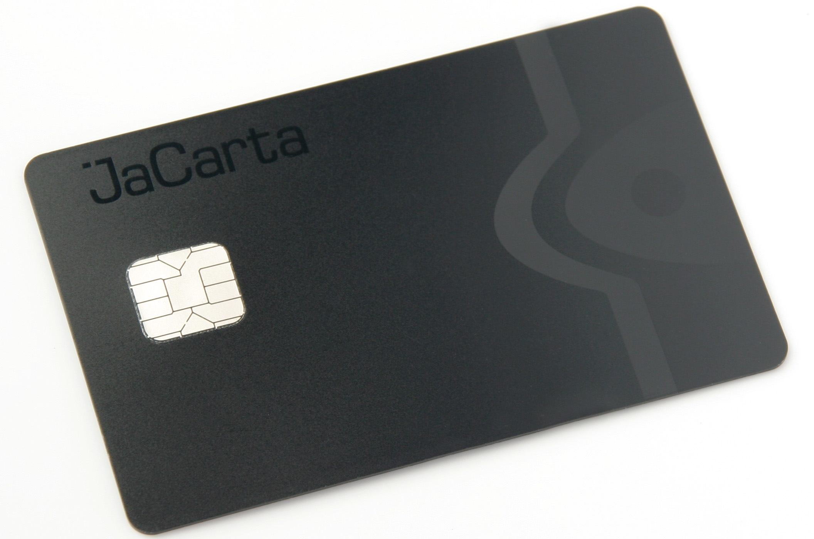
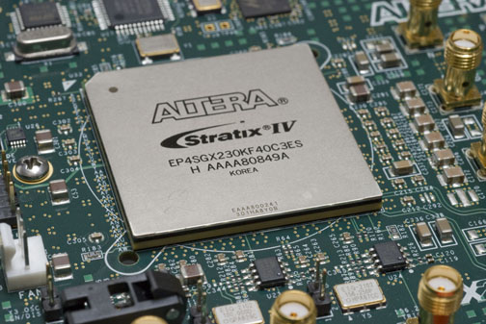
Today: Power attacks on hardware
Smartcards
FPGAs and ASICs
Why not software? Everything is possible, but the noise tends to be very large
Notes:
Image sources:
https://upload.wikimedia.org/wikipedia/commons/d/de/JaCarta_smart_card.JPG

Slide 6

Question: What cryptosystem is this?
Notes:
Source: https://www.youtube.com/watch?v=l5Oi9xNR60s

Slide 7
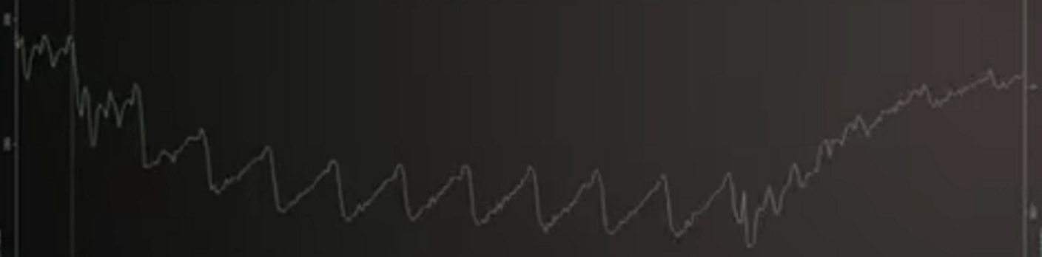
Question: What cryptosystem is this?
1
2
3
4
5
6
7
8
9
10
Notes:
Source: https://www.youtube.com/watch?v=l5Oi9xNR60s

Slide 8
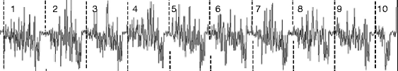
Here’s another example

Slide 9
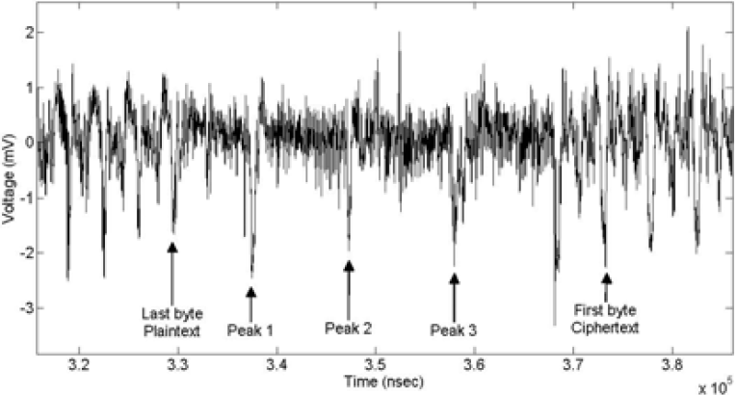
What about this one?

Slide 10
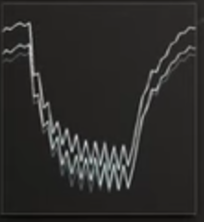
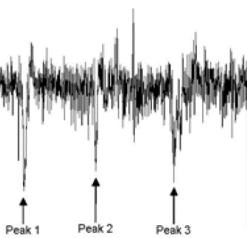
Note subtle differences between the iterations

Slide 11
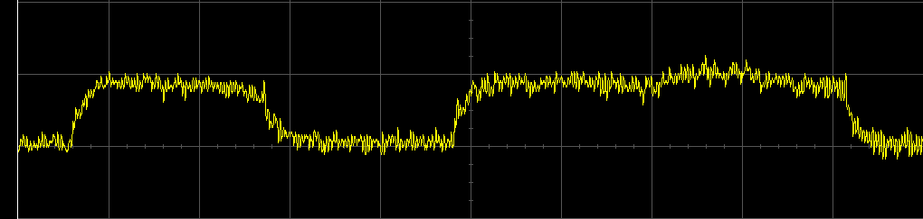
Power-based side channel attacks
Idea
What happens if we can observe the power of a device?
I claim that a power trace is an incredibly strong side channel!
Last time, we saw timing side channels, which provide a single number that somehow depends upon your secret state
But traces display a function of your secret state, over time
Simple power analysis (SPA)
“Read” power trace to determine a bit of state
Strategy works best on microcontrollers + smartcards
  Single-purpose device, so little noise from other components
  Passively powered by an external system (i.e., the attacker!)
0
1

Slide 12
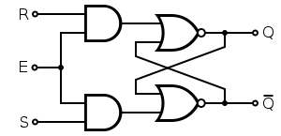
What consumes power, anyway?
Data transmission: Buses
Data storage: Flip-flops and Latches
Store logical 0/1 as voltage of a wire
Power consumed ~ Hamming weight of the bus
Designed only to consume power during transitions 0 → 1 or 1 → 0
Hence, power ~ Hamming distance
+5V
1
0
1
0V
+5V
1
0
0V
Notes:
Here, I mean ‘storage’ in a register (not, say, on a hard drive).

Slide 13
Attack methodology on (simplified) final round of AES
Guess one byte of the key
Compute the resulting intermediate value x
Hope it correlates with power: HW(x) or HW(x ⊕ y)
Notes
Attack works due to a divide and conquer approach: break 1 byte at a time
Can attack first round similarly, with known plaintext
With power side channels, easy to isolate the signal for each round
Key
SubBytes
y
Intermediate x
Ciphertext
Leakage( x )
Notes:
Why did SubBytes only operate on one byte of state at a time? Is it a viable countermeasures to make SubBytes ‘big’?

Slide 14
Differential Power Analysis (DPA)
Ciphertexts
Traces
34a2343de24f5385
78768b2346f725c7
6a4572c634576233
547c6253e476d7ba
b326457623547c2b
1
2
.
.
m
1
2
.
.
m
34a2343de24f5385
78768b2346f725c7
6a4572c634576233
547c6253e476d7ba
b326457623547c2b
Partitions
Difference of Means
1
2
.
.
m
0
1
1
…
0
1
0
0
…
0
0
0
0
…
1
0
1
.
.
255
…
0, 1, … 255
Kocher, Jaffe, and Jun, “Differential power analysis,” CRYPTO 1999.
Notes:
Collect pairs of ciphertexts and traces
Focus on one byte at a time
Guess the value of a key byte
Compute intermediate value
Partition traces into two bins based upon ‘high’ vs ‘low’ predicted power
Compute difference of means to validate your guess.

Slide 15
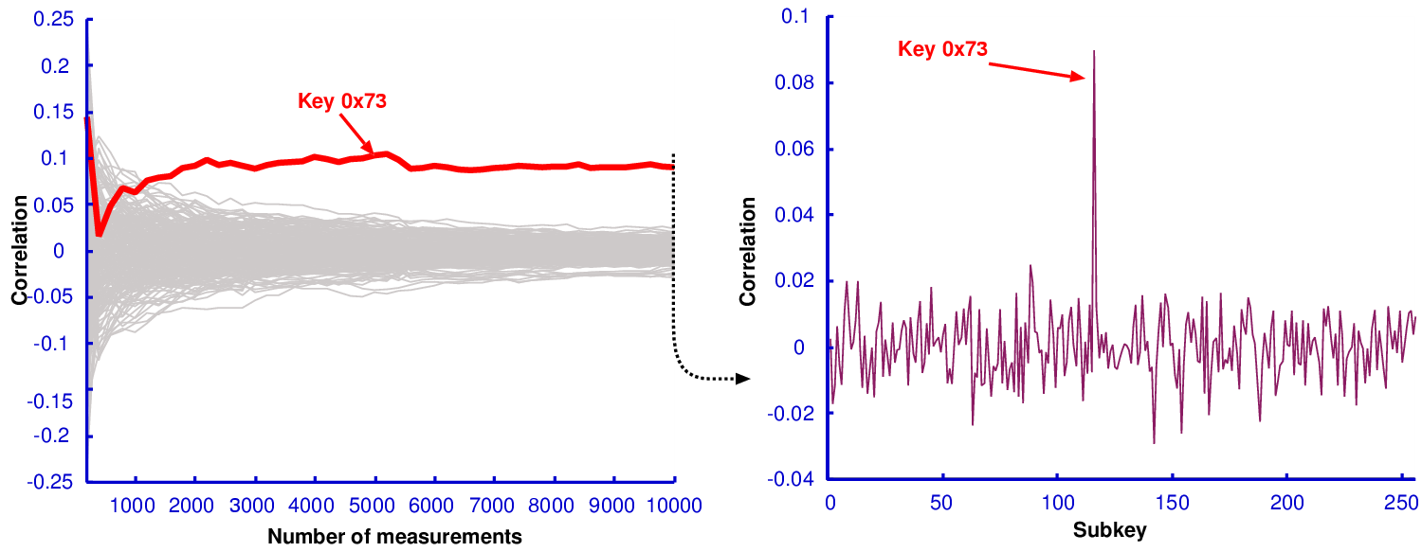
DPA Example
Note that correlation of incorrect keys fades quickly with additional samples

Slide 16
Template Attack: Profiling Phase
Keys
Ciphertexts
Traces
1
2
.
.
m
34a2343de24f538578768b2346f725c76a4572c63457623547c6253e476d7bb326457623547
34a2343de24f538578768b2346f725c76a4572c63457623547c6253e476d7bb326457623547
Ground truth partitions
Models
1
2
3
4
…
m
0187
…3
0
1
.
.
8
Chari, Rao, and Rohatgi. “Template attacks,” CHES 2002.
Notes:
Template attacks are stronger, though they require an identical copy of the target device.
Begin by profiling your own device with many keys and ciphertexts. No need to guess at IV, you know ground truth! Make a model for what power ‘should’ look like for each value of the leakage mode (HW, HD).

Slide 17
Template Attack: Attack Phase
Ciphertexts
Traces
1
2
.
.
m
34a2343de24f538578768b2346f725c76a4572c63457623547c6253e476d7bb326457623547
+
Partitions
P(key | models & traces)
1
2
.
.
m
0
1
2
…
0
1
4
4
…
1
0
7
6
…
2
…
0, 1, … 255
Chari, Rao, and Rohatgi. “Template attacks,” CHES 2002.
Notes:
Again partition based on key guesses, but now guess entire leakage mode (not just binary guess).
Match (average of) traces to corresponding templates. Determine how likely a key guess is to be correct.
From an information-theoretic POV, this is the strongest attack you can perform. Takes advantage of all modes of the trace distribution, not just means.

Slide 18
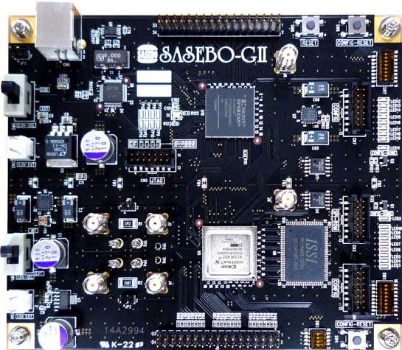
How well do these attacks work?
DPA contest v2
Key recovery attack contest
NIST AES 128-bit parallel block cipher encryption
Traces collected from a SASEBO-GII board with a Virtex-5 FPGA
208.333 samples per clock
15.6 clocks per trace
Attack with
  DPA and template attack
  Hamming distance and weight
Profiling | Testing
1,000,000 traces | 32 × 20,000 traces
Contest info presented at CHES 2009, CHES 2010, and COSADE 2011.
More information available at http://www.dpacontest.org/v2/
Notes:
We demonstrate attacks on the DPA contest v2 data.

Slide 19
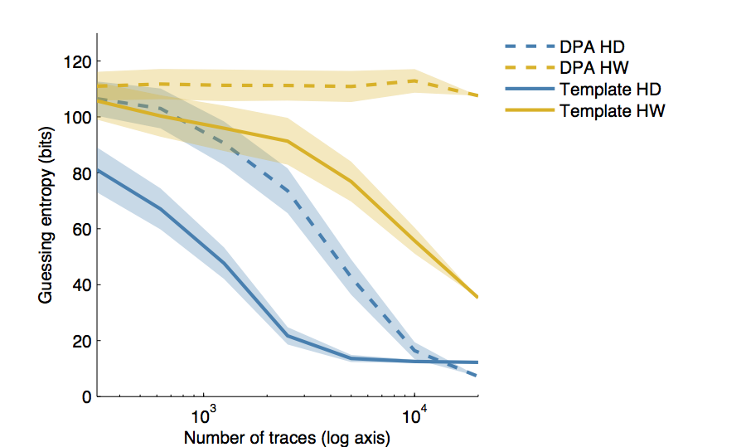
Capability of DPA & Template Attacks on AES
Takeaways: Template > DPA and Hamming Distance > Hamming Weight
Notes:
Assuming the wrong ShiftRows weakens DPA and template attacks
“Guessing entropy” measures the position of the correct key within the resulting attack (lower = better for the attacker)

Slide 20
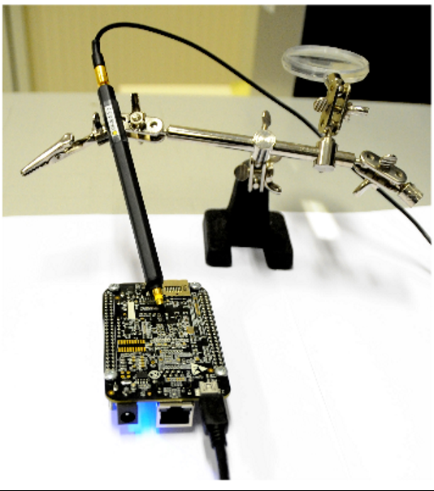
Alternatives: Electromagnetic probes
Obtain data ‘similar’ to power traces
Can localize measurement to the unit performing crypto within a circuit board
Notes:
EM probe image taken from https://eprint.iacr.org/2015/727.pdf
Two laptop image taken from http://www.tau.ac.il/~tromer/radioexp/

Slide 21
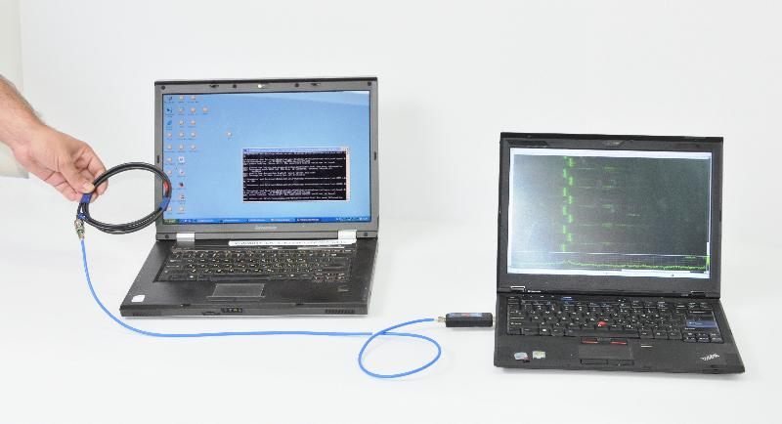
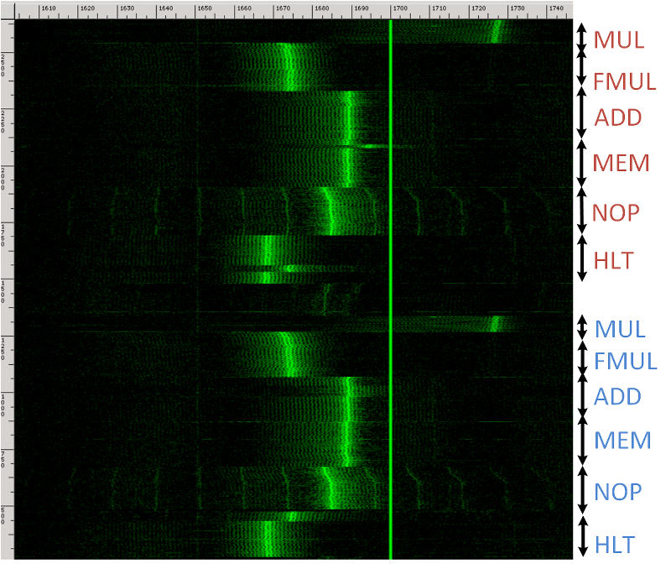
Alternatives: Electromagnetic probes
In the public key realm, even a low-frequency probe will do.
Can “see” differences in CPU instructions.
Notes:
Images taken from http://www.tau.ac.il/~tromer/radioexp/
Note that each segment of the right image corresponds to a long loop of several instructions of the same type (not just one instruction!).

Slide 22
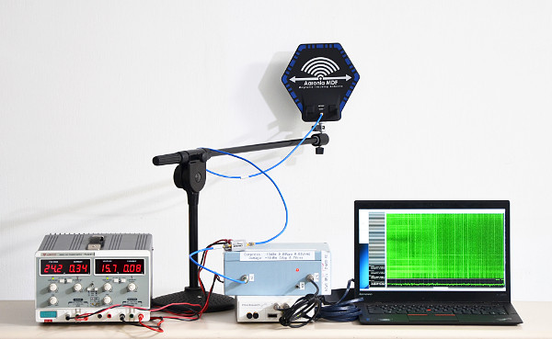

Alternatives: Electromagnetic probes
Can target a victim from a distance!
Notes:
Images taken from http://www.tau.ac.il/~tromer/ecdh/

Slide 23
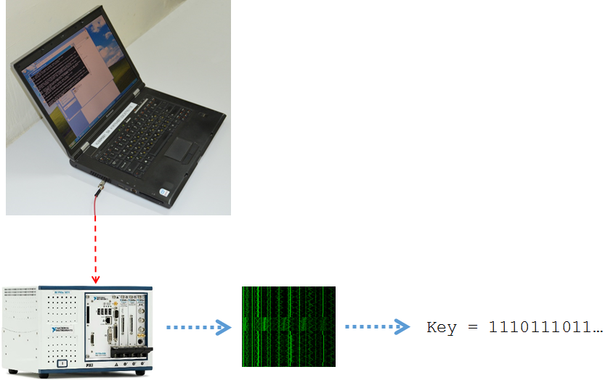
Alternatives: Chassis potential
Notes:
Image from http://www.tau.ac.il/~tromer/handsoff/

Slide 24
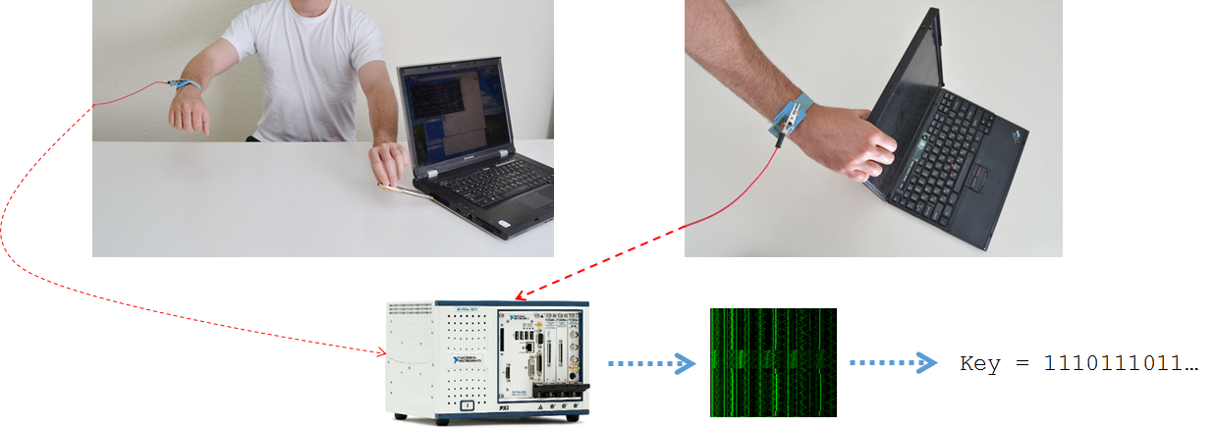
Alternatives: Chassis potential
Notes:
Image from http://www.tau.ac.il/~tromer/handsoff/

Slide 25
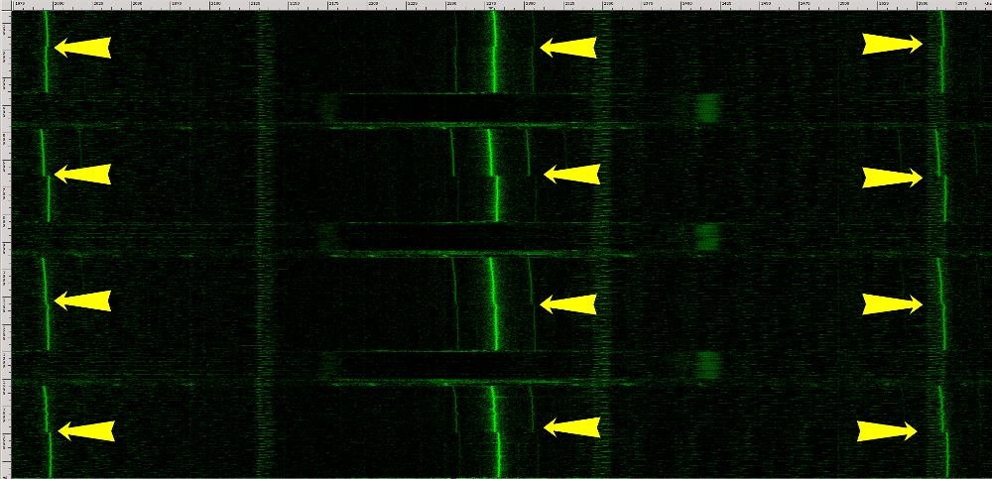
Alternatives: Chassis potential
Notes:
Arrows in the picture point to RSA decryptions
Image from http://www.tau.ac.il/~tromer/handsoff/

Slide 26
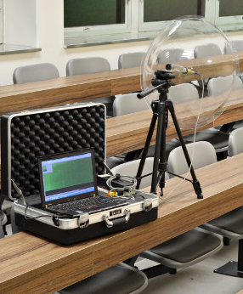
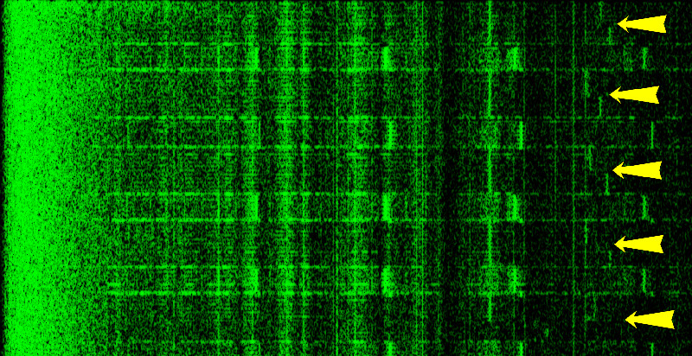
Alternatives: Sound
Notes:
Pictures from https://www.tau.ac.il/~tromer/acoustic/

Slide 27
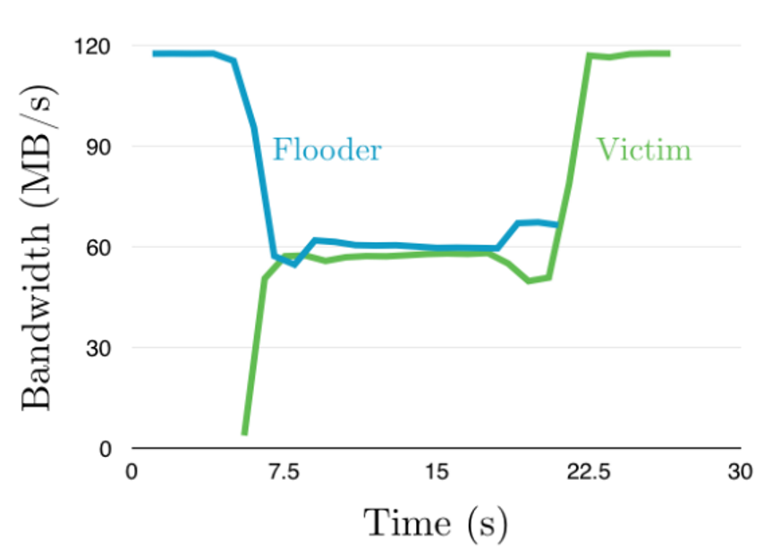
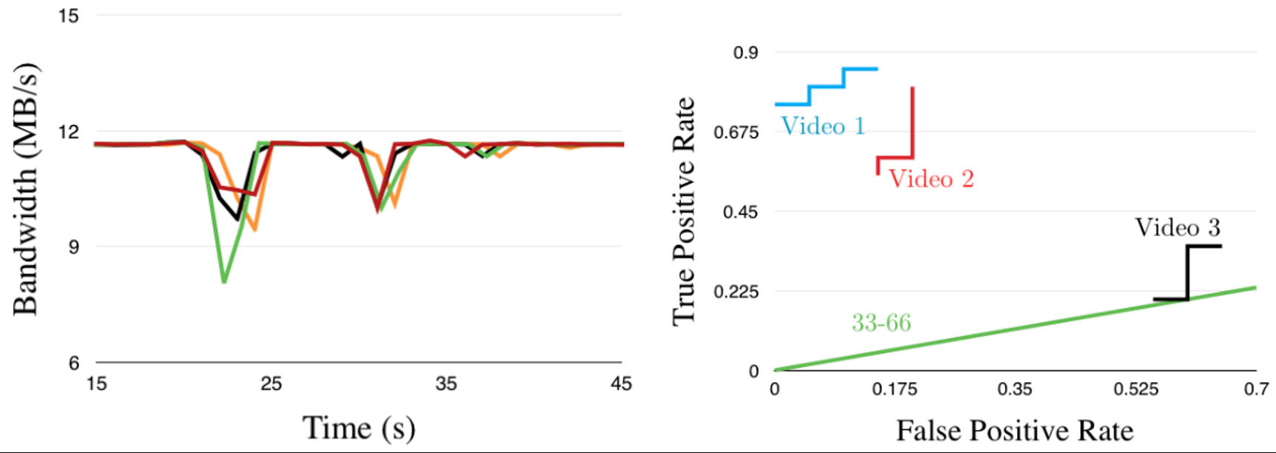
Alternatives: Network
Notes:
Images from https://open.bu.edu/handle/2144/20634

Slide 28
How might we thwart power attacks?
Root problem: side channel betrays some info about intermediate value x
Countermeasures:
Design circuitry so adv doesn’t see data-dep signal
Design circuitry so signal is unconnected with secrets
Shielding:
Physically enclose system so emanations cannot be captured
WDDL:
For every 0 → 1 transformation, perform a mirror op 1 → 0
ECC:
Perform ops directly over a const-weight error correcting code of data
Masking:
Split circuitry into pieces that can be recombined to construct output
Variety:
Don’t have just one SubBytes, but rather several so that x is unknown

Slide 29
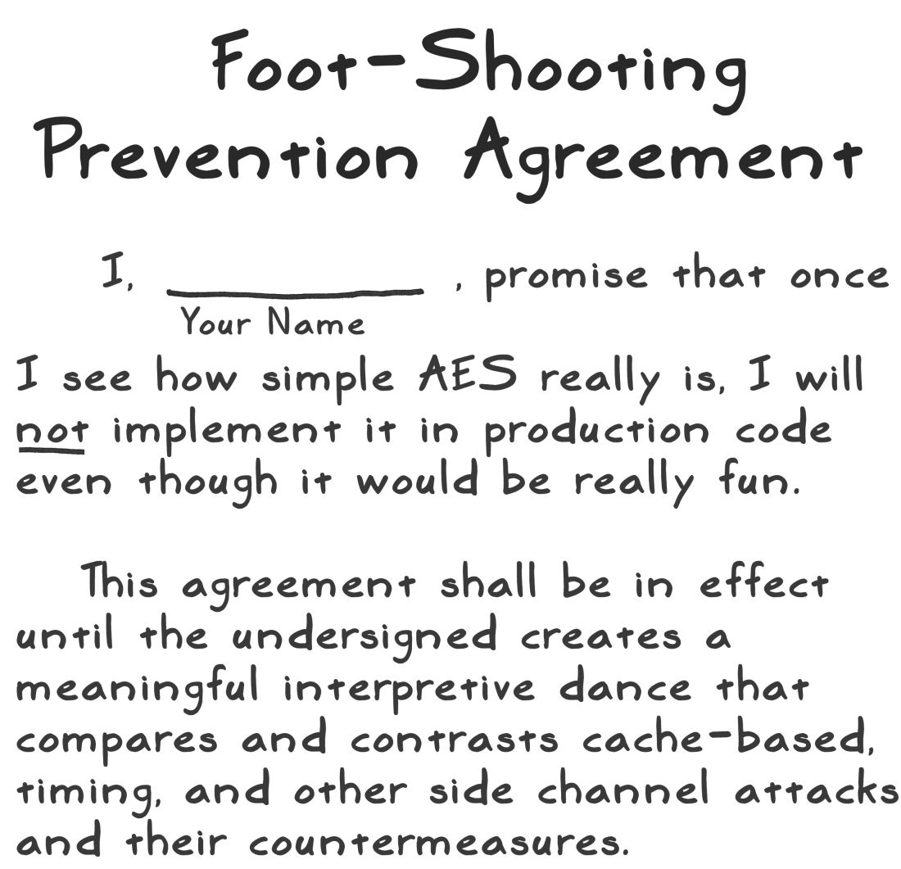
Side Channels ⇒ Difficult to Implement Crypto Securely

Slide 30
End of Part 2
The power of random-looking permutations
Cryptography meets systems: a love/hate story
Structured forgetfulness: dropping keys before they can be stolen
When reductions fail: dealing with the lowest layer
→

