Slide 1
Lecture 17: Public-key crypto & the importance of time
Announcements
PS5 to be posted by this Wed, due three weeks from now
No required reading this week, but there is an optional reading posted that might refresh Part 1 for you
Schedule
In-class test on Mon, April 3 on Parts 1 + 2 of the course
Office hours: this week Tu 12-2 and Th 10-12, none next week
Form an initial project idea by the end of this week

Slide 2
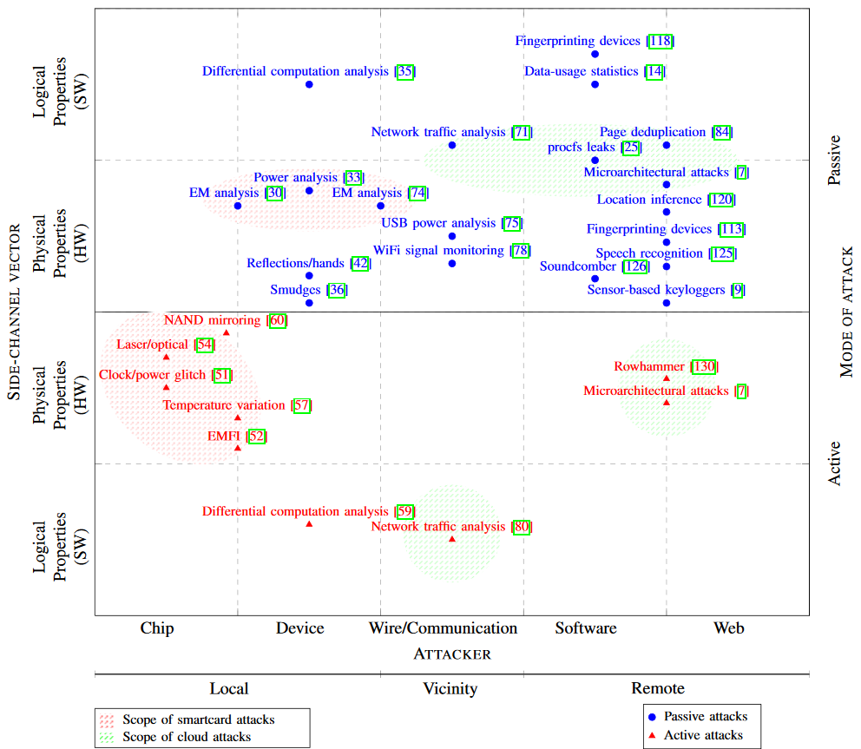
Week 8 reading: Systematic Classification of Side-Channel Attacks

Slide 3
Today: Start of Part 3
The power of random-looking permutations
Cryptography meets systems: a love/hate story
Structured forgetfulness: dropping keys before they can be stolen
When reductions fail: dealing with the lowest layer
→

Slide 4
Three new ideas to study in Part 3
Public authentication: signing a message so anybody knows you created it
Key negotiation and exchange: how to create a shared key over the internet
Forward secrecy: protecting privacy + integrity of messages from the past against key compromises in the future
Today, we begin our exploration into these three concepts individually. Later in the unit, we will put them together to design a strong message transmission system: the Signal messaging protocol.

Slide 5
Review: Focus of this course
Note that Authenticated Encryption meets all four goals!
So… are we all safe now?
 | …at endpoints | …in transit
Authenticity | Identity verification Bob knows Alice sent C | Binding Eve cannot alter M
Privacy | Deniability (optional) Bob can’t prove Alice said M | Confidentiality Eve cannot learn M

Slide 6
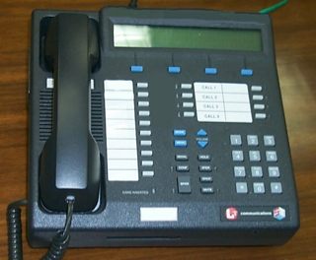
Review: Secure communication in presence of an adversary
✉ key encapsulation
key K
key K
key K
☏ protected
☏ communication
encode C = E(K, M)
message M
decode M = D(K, C)
???
Notes:
Remember: Bob could simply be a future version of Alice (think: full disk encryption)
Icons from https://www.iconfinder.com/iconsets/user-pictures
Analogy:
Envelopes sent through the US Postal System have pretty good privacy rules but long latency.
Telephones enable real-time communication but range widely in privacy, from “none” to Secure Terminal Equipment (https://en.wikipedia.org/wiki/Secure_Terminal_Equipment).

Slide 7
Review: Complexity theoretic view of cryptography
Cryptomania (✉) = elegant
Millisecond speed
Built from modular arithmetic
Minicrypt (☏) = utilitarian
Nanosecond speed
Built from random-looking permutations
Notes:
Citation for terminology: Russell Impagliazzo. A Personal View of Average-Case Complexity.

Slide 8
Review: Cryptographic tools
Math Tools
Primitives
Algorithms
Protocols
Modular arithmetic
Auth key exchange
Key evolution
Signal: messaging
Key encapsulation
TLS: internet PGP: email
(see CS 558)
Hash functions
Random(ish) permutations
Protected communication
Block ciphers
☏ Minicrypt
Cryptomania ✉
Notes:
Comments:
There is a lot more to crypto overall than just this picture/course
Modular arithmetic -> more generally, any finite group in which the discrete logarithm problem is hard (+ details…)
“AE” here is overloaded, we will later go into ~10 different definitions of security here & construct them all

Slide 9
Review: Message authentication code
Algorithms
Security game
KeyGen: randomly choose key K of length λ as before, e.g. uniform in {0,1}^{λ}
MAC_{K} (A ∈ {0,1} ^{α}) → tag T ∈ {0,1} ^{τ}
Usually deterministic (but can be random)
Would prefer short tags: τ < α
Verify_{K} (T ∈ {0,1} ^{τ}) → yes/no
If deterministic, Verify = re-compute MAC
Even after viewing many (A, T) pairs, Mallory cannot create a new one
Alice
Mallory
❷ submit A
❶ choose K ← {0,1}^{λ}
receive T
Mallory wins if
It’s a valid forgery
It’s new
❸ output (A*, T*)
Notes:
Note: cannot reduce EU-CMA to a game of an indistinguishability style like the encryption ones were

Slide 10
Let’s build a public method to authenticate message origin
secret key SK
key K
key K
send A along with signature T = MAC_{K}(A)
public key PK
send A along with signature σ = Sign_{SK}(A)
auth msg A
validate T = MAC_{K}(A)
check Verify_{PK} (A, σ)
forge?
(make valid A, T)
In the symmetric case, Alice & Bob have a key that nobody else has
As a result, Bob knows Alice sent A and that the message was intended for him
Tag is also deniable because either Alice or Bob could have made it
In the public case, Alice has a secret SK and everyone knows corresponding PK
So, anyone in the world can verify that Alice wrote that message (to somebody…)
Also, asymmetry leads to non-deniability: Bob can’t make σ anymore

Slide 11
Security for public-key signatures
secret key SK
send A along with signature σ = Sign_{SK}(A)
public key PK
auth msg A
check Verify_{PK} (A, σ)
EU-CMA security similar to before: Alice baits Mallory into producing a forgery
Alice
Mallory
❷ submit A
Mallory wins if
Valid forgery
It’s new
❶ choose SK, give Mallory PK
❸ output(A*, σ*)
receive σ

Slide 12
Combining symmetric encryption + public signatures
In the symmetric case, we learned that Enc-then-MAC is the best option
Intuition: Never expose the decryption key to an invalid message
Does this technique work as well with public key signatures?
PublicSign_{A}( SymEnc_{AB}(P) )

Slide 13
Combining symmetric encryption + public signatures
In the symmetric case, we learned that Enc-then-MAC is the best option
Intuition: Never expose the decryption key to an invalid message
Does this technique work as well with public key signatures?
No! Issue: Mallory can receive ciphertexts from Alice, claim them as her own!
Can lead to an oracle attack, as occurs with Apple’s iMessage
Pretend to be Alice,
send PublicSign_{A}( C )
Will decrypt C using the symmetric key K_{AB}!
Let C = SymEnc_{AM}(P)
Send PublicSign_{A}( C )
Notes:
For more details on the iMessage attack: https://isi.jhu.edu/~mgreen/imessage.pdf

Slide 14
Can build public-key encryption too
Public key signatures
Public key encryption
Authenticated
Private
Only Alice can generate signatures
Anybody can verify
Security guarantee: EU-CMA
Anybody can send ciphertexts
Only Bob can decrypt + read
Security guarantee: CPA or CCA

Slide 15
But don’t: consequence of losing control of is too high
Public key signatures
Public key encryption
Authenticated
Private
Problem: Eve forges msgs in future
Response: Alice can revoke her key
Problem: Eve reads msgs from past
Response: ???

Slide 16
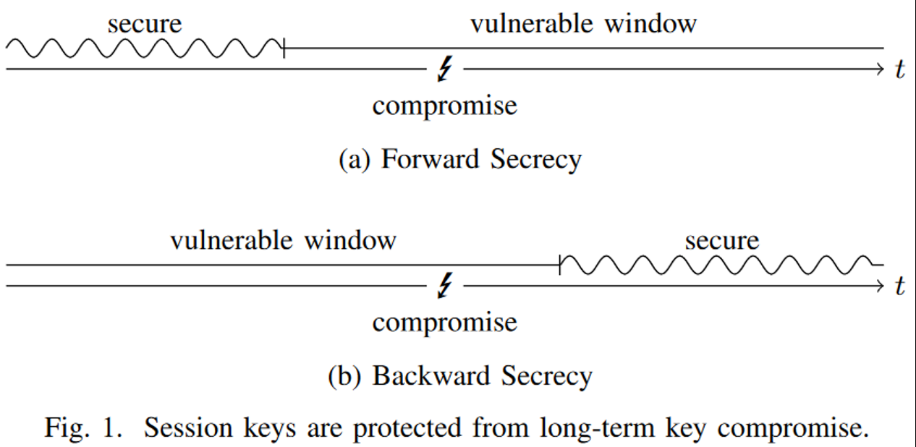
Perfect forward secrecy (PFS)
Goal: past messages remain private if long-term secrets are exposed later
Term coined by Christoph Gunther
Notes:
Image source: http://www.jbonneau.com/doc/UDBFPGS15-IEEESP-secure_messaging_sok.pdf
Upshot: time matters!

Slide 17
Alternative methods to achieve privacy
Key encapsulation mechanism: If you must use public key encryption, then only use it to encrypt a symmetric key that you will use from now onward
Authenticated key exchange: Negotiate new ephemeral key for each session
Next time we will design a key exchange protocol that uses cryptomania primitives. For today, let’s restrict our attention to minicrypt primitives.
Notes:
Image from Smart’s Cryptography Made Simple, p. 384

Slide 18
Needham–Schroeder protocol for key transport
Objective: Alice and Bob want a shared symmetric key.
Rely upon a common, trusted server to mediate their connection.
Want to make a new shared symmetric key K_{AB}
Shared symmetric key K_{AS}
Shared symmetric key K_{BS}
Notes:
Let’s begin by using only symmetric key protocols

Slide 19
Needham–Schroeder: take 1
Key idea: Let the trusted server choose K_{AB}
3: K_{AB}
2: K_{AB}
Problems?
Alice doesn’t know if K_{AB} came from trusted server
Bob doesn’t know this either (even if Alice did)
1: A, B

Slide 20
Needham–Schroeder: take 2
Key idea: Authenticate messages from the trusted server
3: A, {K_{AB}}_{BS}
2: {K_{AB}}_{AS}, {K_{AB}}_{BS}
Notation: Protect message contents using this key
1: A, B
Two Problems
Bob doesn’t know who he should communicate with
Server creates messages intended for other parties

Slide 21
Problem 1 in more detail
Issue: Mallory can con Bob into produce messages that weren’t intended for Alice, and then forward them along anyway
3: A, {K_{AB}}_{BS}
3: M, {K_{AB}}_{BS}
{I hate you}_{AB}
{I hate you}_{AB}

Slide 22
Problem 2 in more detail
Because the server signs messages intended for other parties, Mallory can use this capability to emulate the actions of the trusted server!
3: A, {K_{MA}}_{MS}
???
2: {K_{MA}}_{AS},
2: {K_{MA}}_{MS}
1: A, B
1’: M, A
2’: {K_{MA}}_{MS}, {K_{MA}}_{AS}

Slide 23
Needham–Schroeder: take 3
Both problems were due to the fact that people misinterpreted some of the server’s responses as intended for other participants. So, have server be explicit.
3: A, {K_{AB}, A}_{BS}
2: {K_{AB}, B}_{AS}, {K_{AB}, A}_{BS}
1: A, B
Problem: freshness
Mallory can always repeat message #2 from before. This would defeat forward secrecy.

Slide 24
Needham–Schroeder: take 4
Use nonces to ensure uniqueness messages 2 and 3 without maintaining state
3: A, {K_{AB}, A}_{BS}
2: { N_{A}, B, K_{AB}, {K_{AB}, A}_{BS} }_{AS}
1: A, B, N_{A}
Two Problems
Bob doesn’t know key is fresh
Alice doesn’t know if Bob received the key

Slide 25
Needham–Schroeder: take 5
Key idea: Have Alice and Bob immediately use their newly-received keys to make sure that they both have them and that they agree upon their freshness
1: …
3: A, {K_{AB}, A}_{BS}
4: {N_{B}}_{AB}
2: …
5: {N_{B}}_{AB}
Problem?
Anybody can produce message 5, since it equals message 4
We need Alice to do something that depends on the nonce but doesn’t equal it

Slide 26
Needham–Schroeder: take 6
Key idea: Alice sends a simple function of the nonce N_{B}
1: …
3: A, {K_{AB}, A}_{BS}
4: {N_{B}}_{AB}
2: …
5: {N_{B} - 1}_{AB}

Slide 27
Full Needham–Schroeder protocol
3: A, {K_{AB}, A}_{BS}
1: A, B, N_{A}
4: {N_{B}}_{AB}
2: { N_{A}, B, K_{AB}, {K_{AB}, A}_{BS} }_{AS}
5: {N_{B} - 1}_{AB}
Whew, we finally reproduced the full protocol
Needham and Schoeder constructed this in 1978
It has no remaining problems… right?

Slide 28
Full Needham–Schroeder protocol (1978)
3: A, {K_{AB}, A}_{BS}
1: A, B, N_{A}
4: {N_{B}}_{AB}
2: { N_{A}, B, K_{AB}, {K_{AB}, A}_{BS} }_{AS}
5: {N_{B} - 1}_{AB}
Whew, we finally reproduced the full protocol
It has no remaining problems… right?

Slide 29
Denning and Sacco (1981)
3: A, {K_{AB}, A}_{BS}
1: A, B, N_{A}
4: {N_{B}}_{AB}
2: { N_{A}, B, K_{AB}, {K_{AB}, A}_{BS} }_{AS}
5: {N_{B} - 1}_{AB}
Problem: Bob’s involvement begins in step 4; he has no idea if the first three steps of the protocol occurred recently before then
If Mallory has compromised key K_{AB} when it was used in the past, she can replay message #3 to start a “new” Needham-Schoeder instance with Bob that he will think is fresh when it isn’t

Slide 30
Denning and Sacco’s fix
Key idea: Get Bob involved early in the protocol so he also knows it is fresh
-1: A
0: {A, N_{B}’}_{BS}
1: A, B, N_{A}, {A, N_{B}’}_{BS}
2: {N_{A}, B, K_{AB}, {K_{AB}, A, N_{B}’}_{BS}}_{AS}
3: A, {K_{AB}, A, N_{B}’}_{BS}
4: {N_{B}}_{AB}
5: {N_{B} - 1}_{AB}

Slide 31
Related work
There is also a public key version of Needham–Schroeder
Allows Alice and Bob to learn each other’s public keys from a trusted intermediary
It has an even more subtle flaw that was noticed by Gavin Lowe in 1995
Needham-Schroeder forms the basis of the Kerberos ticketing protocol that permits Alice and Bob also to prove their identity to each other
See next week’s reading assignment!

Slide 32
Path forward
Wednesday: construct separately
Public key signatures
Public mechanism for exchanging keys
Next Wednesday: guest lecture by Prof. Ran Canetti on connecting the two
Week of 4/10: put everything together to build the Signal messaging system

