Slide 1
Lecture 18: Authentication and key exchange, separately
Announcements
PS5 to be posted today, due Thurs, April 13
No required reading this week, but there is reading next week
Schedule
In-class test on Mon, April 3 on Parts 1 + 2 of the course
Office hours: this week Tu 12-2 and Th 9-11, none next week
Form an initial project idea by the end of this week

Slide 2
Three ideas to study in Part 3
Public authentication: signing a message so anybody knows you created it
Key negotiation and exchange: how to create a shared key over the internet
Forward secrecy: protecting privacy + integrity of messages from the past against key compromises in the future

Slide 3
Public key cryptography
Public key signatures
Public key encryption
Authenticated
Private
Only Alice can generate signatures
Anybody can verify
Lost key = Eve forges msgs in future
Anybody can send ciphertexts
Only Bob can decrypt + read
Lost key = Eve reads msgs from past

Slide 4
Review: Secure communication in presence of an adversary
✉ authenticated key exchange
key K
key K
key K
☏ authenticated encryption
encode C = E(K, M)
message M
decode M = D(K, C)
???
Notes:
Icons from https://www.iconfinder.com/iconsets/user-pictures

Slide 5
Review: Complexity theoretic view of cryptography
Cryptomania (✉) = elegant
Millisecond speed
Built from modular arithmetic
Minicrypt (☏) = utilitarian
Nanosecond speed
Built from random-looking permutations
Notes:
Citation for terminology: Russell Impagliazzo. A Personal View of Average-Case Complexity.

Slide 6
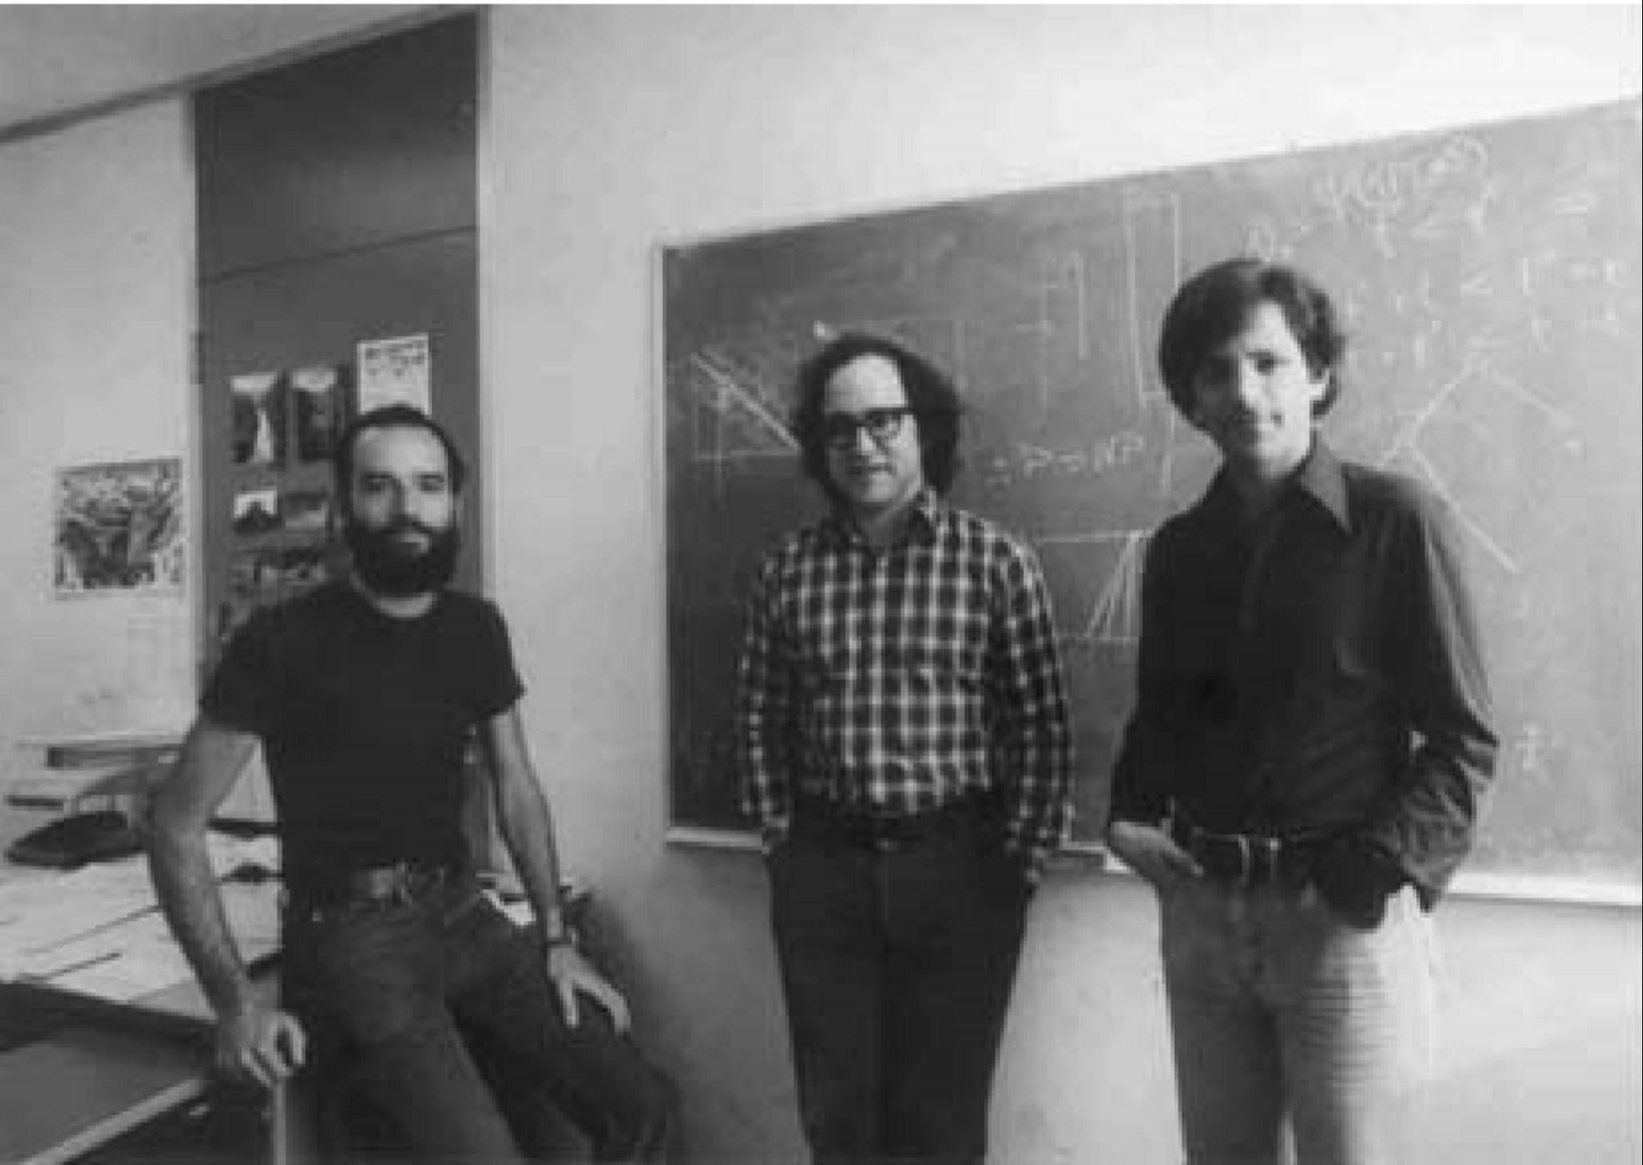
Public key cryptography: a partial timeline
1970: Key exchange by James Ellis, Clifford Cocks and Graham Williamson
1973: Public key encryption by Clifford Cocks
1976: Key exchange by Whitﬁeld Difﬁe, Martin Hellman and Ralph Merkle
1977: Public key encryption by Ron Rivest, Adi Shamir, and Leonard Adleman
1984-85: Taher ElGamal builds public key crypto in the Diffie-Hellman style
Early 90s: Improved signature schemes
Late 90s: UK’s GCHQ reveals…
2000s: Authenticated key exchange by Ran Canetti & Hugo Krawczyk, with follow-on works by others
Notes:
GCHQ = Government Communications Headquarters

Slide 7
Definitions from algebra
Abelian group
Galois field
An Abelian group = a set G together with mathematical operation · that is
Closed: ∀a, b ∈ G ⇒ a · b ∈ G
Associative: a · (b · c) = (a · b) · c
Commutative: a · b = b · a
Identity: ∃ a special element i ∈ G such that ∀a, i · a = a · i = a
Inverses: ∀a ∈ G, ∃b ∈ G such that a · b = i
Named after Niels Henrik Abel
A Galois field F = GF(n) contains a set together with two ops +, × such that
Finite: | F | = n for some integer n
<F, +> is an Abelian group with additive identity element ‘0’
<F \ {0}, ×> is also an Abelian group with multiplicative identity ‘1’
Distributive: ∀a, b, c ∈ F, a × (b + c) = a × b + a × c
Named after Évariste Galois

Slide 8
You’ve seen groups and fields before
Abelian group <G, ·>
Closed
Associative
Commutative
Identity
Inverses
Galois field <F, +, ×>
Finite
<F, +> is group
<F \ {0}, ×> is group
Distributive
(Non-)examples:
<N, +>
<Z, +>
<2Z, +>
<Z, ×>
<Z, +, ×>
<Q, +, ×>
2 × 2 matrices over Z
restriction to det = 1
<Z/pZ, +, ×>

Slide 9
Fields formed via modular arithmetic
Let p be any prime number
Galois field F_{p} = {0, 1, 2, …, p-1} has p elements, with +, × done mod p
Given some a ∈ F_{p}, its inverse is an element b such that a · b = 1 mod p
Example: compute 3⁻¹ mod 5
Answer: 2, because 2 · 3 = 6 = 1 mod 5
In general, all elements of F_{p} besides 0 are invertible
The notation F_{p}× = {set of all invertible elements of F_{p}} = {1, 2, …, p-1}
Note that F_{p}× is closed under × but is not closed under + anymore
So, it’s “merely” a multiplicative group

Slide 10
Modular arithmetic is cyclic
The group F_{p}× = {1, 2, …, p-1} is cyclic under multiplication. That is: there exists some element g ∈ F_{p}× such that {g¹, g², g³, g⁴, …, g^{p-2}, g^{p-1}} = F_{p}×
Example: 3 is a generator for the group F₇×
{3, 3², 3³, 3⁴, 3⁵, 3⁶} = {3, 2, 6, 4, 5, 1} mod 7
Implications:
It must be the case that g^{p-1} = 1 mod p (why?), this is Fermat’s little theorem
We can explicitly compute inverses: x⁻¹ = x^{p-2} mod p
We can build a group of prime order…

Slide 11
Constructing a prime-order group
On its own, F_{p}× isn’t a group of prime order: | F_{p}× | = p – 1 is even
We call p a safe prime if p = 2q + 1 for another prime q
Let’s grab the ‘even half’ of F_{p}×: {g¹, g², g³, g⁴, g⁵, g⁶, …, g^{2q-1}, g^{2q}}
I claim that the blue elements comprise a group of order q
Why closed?
Why associative and commutative?
Why do we have an identity and inverses?
Specifically, the set of blue elements G_{q} = quadratic residues of F_{p}×
Claim: Diffie-Hellman problems are difficult to solve in G_{q}!

Slide 12
Hard problems in (some!) finite groups
Let G = finite group of prime order q
Let g = publicly-specified generator of G
Discrete logarithm problem (DL): Challenger chooses h ← G uniformly at random Goal: find the exponent a ∈ {1, 2, …, q} such that gª = h
Computational Diffie-Hellman problem (CDH): Challenger chooses a, b ← [q] uniformly and computes h = gª, j = g^{b} Goal: given <g, h, j>, difficult to compute g^{ab}
Decisional Diffie-Hellman problem (DDH): Challenger chooses a, b ← [q] uniformly, and picks c = ab or uniform Goal: given <g, gª, g^{b}, g^{c}>, determine whether c = ab or not
Easier to solve
Notes:
Notation: [q] = {1, 2, …, q}
DDH problem: each of the two choices of c are chosen ½ of the time.

Slide 13
Another option: Elliptic curves
An elliptic curve = a cubic equation y² = x³ + ax + b
Consider the set of points on this curve
We can ‘multiply’ points using the rule P · Q · R = 1
Also difficult to break the Diffie-Hellman problems in elliptic curve groups
Notes:
Image from https://upload.wikimedia.org/wikipedia/commons/thumb/c/c1/ECClines.svg/680px-ECClines.svg.png

Slide 14
Diffie-Hellman key exchange
Protocol
Analysis
Choose a ← [q]
Compute A = gª
Choose b ← [q]
Compute B = g^{b}
Correctness: commutativity A^{b} = (gª)^{b} = g^{ab} = (g^{b})ª = Bª
Security: to learn the key, a passive Eve must break CDH problem
Knows g, gª, g^{b}
Wants to find g^{ab}
Forward secrecy: Choices of a, b are ephemeral, can delete when done
Active attacker can cause problems!
A
B
Output Bª
Output A^{b}
Shared secret = g^{ab}
k_{AM}
k_{MB}

Slide 15
Review: Public key signatures
secret key SK
key K
key K
send A along with signature T = MAC_{K}(A)
public key PK
send A along with signature σ = Sign_{SK}(A)
auth msg A
validate T = MAC_{K}(A)
check Verify_{PK} (A, σ)
forge?
(make valid A, T)
In the public case, Alice has a secret SK and everyone knows corresponding PK
So, anyone in the world can verify that Alice wrote that message (to somebody…)
Also, asymmetry leads to non-deniability: Bob can’t make σ anymore
The EU-CMA security game is defined just as in the symmetric case
Claim: Can build signatures schemes using groups in which DH is hard!

Slide 16
ElGamal → (EC)DSA → Schnorr signatures
Protocol
Analysis
KeyGen:
Sample s ← [q]
Compute P = g^{s}
Sign_{s}(M):
Choose r ← [q], computes R = g^{r}
Let t = H(M || R) and σ = r – s · t
Output (σ, t)
Verify_{P}(M, (σ, t)):
Compute R’ = P^{t} · g^{σ}
Check if t’ = H(M || R’) equals t?
Correctness follows from linearity
σ = r – s · t, so r = σ + s · t
Now consider all of this in the exponent
R’ = P^{t} · g^{σ} = g^{st} + g^{σ} = g^{r} = R
Informal security argument
Suppose Mallory forges (σ, t)
t uniquely identifies R due to hash H
σ uniquely identifies r = σ + s · t
Enforcing R = g^{r} requires breaking DL
Big concern: nonce reuse
σ₁ = r – s · t₁
σ₂ = r – s · t₂
Remember: signatures don’t need to be randomized, but this one is
size = 2 lg(q)

Slide 17
https://www.google.com
Chrome:
Firefox:

Slide 18
BU’s login page
Chrome:
Firefox:

