Slide 1
Lecture 21: Kerberos and key evolution
Announcements
Problem Set 5 due Thurs, April 13
No required reading this week (focus on PS5 + your project!)
Tests: will grade this week, plus note 1 student hasn’t taken it yet

Slide 2
Review: Three ideas to study in Part 3
Public authentication: signing a message so anybody knows you created it
Key negotiation and exchange: how to create a shared key over the internet
Forward secrecy: protecting privacy + integrity of messages from the past against key compromises in the future

Slide 3
Key distribution = initial agreement + subsequent evolution
Trusted server? | Crypto used | Method
No | Asymmetric | (Authenticated) Diffie-Hellman key exchange
Yes | Symmetric | Needham-Schroeder, which is the basis of the Kerberos system
No | Symmetric | Key evolution, once you have a single shared symmetric key

Slide 4
Review: Diffie-Hellman key exchange
Protocol
Analysis
Choose a ← [q]
Compute A = gª
Choose b ← [q]
Compute B = g^{b}
Correctness: commutativity A^{b} = (gª)^{b} = g^{ab} = (g^{b})ª = Bª
Security: to learn the key, a passive Eve must break CDH problem
Knows g, gª, g^{b}
Wants to find g^{ab}
Forward secrecy: Choices of a, b are ephemeral, can delete when done
Active attacker can cause problems!
A
B
Output Bª
Output A^{b}
Shared secret = g^{ab}
k_{AM}
k_{MB}

Slide 5
Review: Needham-Schroeder, with Denning and Sacco’s fix
-1: A
0: {A, N_{B}’}_{BS}
1: A, B, N_{A}, {A, N_{B}’}_{BS}
2: {N_{A}, B, K_{AB}, {K_{AB}, A, N_{B}’}_{BS}}_{AS}
3: A, {K_{AB}, A, N_{B}’}_{BS}
4: {N_{B}}_{AB}
5: {N_{B} - 1}_{AB}

Slide 6
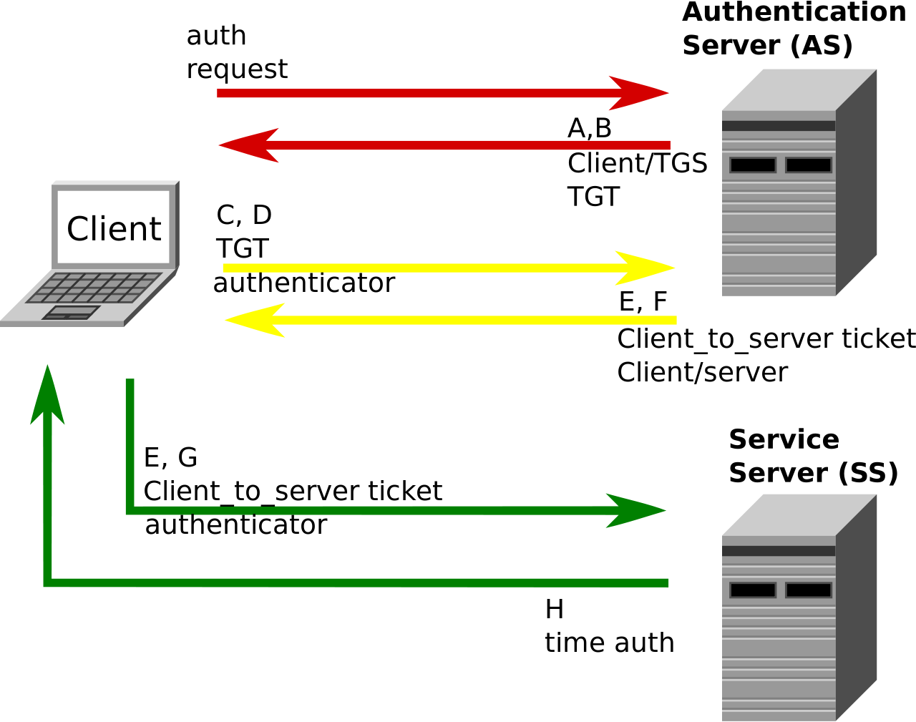
Week 10 reading: Kerberos authentication system
Requirements
Users only enter passwords once, at the beginning of each session
The network itself is untrusted: passwords and authentication tokens need protection in transit
A service must be able to prove that the person using a ticket == the person to whom it was issued
Clients must authenticate services before sending sensitive info to them (mutual authentication)
Notes:
Requirements from the week 10 reading assignment http://web.mit.edu/Kerberos/www/dialogue.html
Figure from Wikipedia: https://en.wikipedia.org/wiki/Kerberos_(protocol)#/media/File:Kerberos.svg

Slide 7
Key evolution
Question: Once Alice and Bob negotiate a shared symmetric key K_{AB} for authentication and/or encryption, must they re-execute another (expensive) key negotiation protocol each time they want to update the key?
Recall the algorithms for a MAC
KeyGen: randomly choose key K of length λ as before, e.g. uniform in {0,1}^{λ}
MAC_{K} (A ∈ {0,1} ^{α}) → tag T ∈ {0,1} ^{τ}
Verify_{K} (T ∈ {0,1} ^{τ}) → yes/no (If deterministic, Verify = re-compute MAC)
KeyUpdate ( K ) → K’ such that
Alice and Bob agree to use from K’ now onward
Cannot compute K from K’. So, even if K’ is revealed to Mallory, prior uses are safe

Slide 8
Key evolution via hash functions
Idea: Once we have a single shared key K_{AB}, expand using a chain of hash funcs
K_{AB} → H( K_{AB} ) → H( H( K_{AB} ) ) → H( H( H( K_{AB} ) ) ) → …
Algorithm:
Alice & Bob use N-S to generate K_{AB}
They begin by using K = K_{AB} as their shared key for (say) authenticated enc
After some time has passed, they can evolve their key by updating K ← H( K )
Here, “time” can denote actual wall-clock time or a message counter
Alice and Bob must stay in sync, or else the chain dies & they’ll need to redo N-S
Crucially, they ensure that old values of K are deleted from their system! After all, Mallory cannot steal something that isn’t around to be stolen (and isn’t being computed over anymore, so no side channels about it leak).
AuthEnc_{K}(P₁)
AuthEnc_{H(K)}(P₂)
…

Slide 9
Tradeoff: space vs computing time
Let’s consider our chain of keys more generically, and let’s try to save space
K₀ → K₁ → K₂ → K₃
h₀₁ = H(K₀, K₁) h₂₃ = H(K₂, K₃)
h = H(h₀₁, h₂₃)
Suppose that:
Message flow is unidirectional, from Alice to Bob
We are only concerned with authenticity (i.e., a MAC), but not encryption
Then we can simplify life for Bob: he need only store the root of a Merkle tree
Alice still needs to remember all keys K_{i} (at least, until she uses + deletes them)
She can convince Bob of K_{i}’s veracity by providing pieces that “chain” back to root h
Notes:
Along with each message, Alice can provide the relevant pieces of the Merkle tree to permit Bob to verify that the leaf node is a piece of the tree.
While Bob saves space in storing a compact secret key, he does require more running time: specifically, lg(# keys) hash computations.

Slide 10
Dynamic group keying (Naor, Naor, Lotspiech 2001)
This “tree of keys” primitive is incredibly useful! Let’s do something else with it.
K₀ K₁ K₂ K₃
h₀₁ = H(K₀, K₁) h₂₃ = H(K₂, K₃)
h = H(h₀₁, h₂₃)
So far we have built dynamic keys that can be used by a static group of people.
This tree construction also permits sending messages to a dynamic group!
Each person gets a distinct set of keys, specifically all keys from that leaf to the root
We can send AuthEnc messages to the whole group simply by using the key h
Furthermore, we can kick people out of the group! Use covering set of “good” parties
Notes:
For more information, see eprint.iacr.org/2001/059

Slide 11
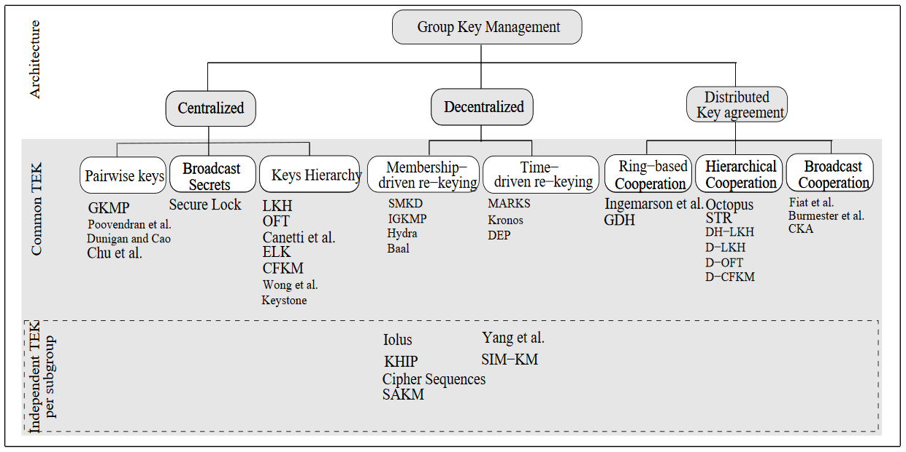
Dynamic group keying
Notes:
This is just one of many dynamic group keying schemes. See http://waset.org/publications/11804 for more info

