Slide 1
Lecture 22: Key ratcheting & the Signal messaging protocol
Announcements
Problem Set 5 due tomorrow (Thurs, April 13)
Tests returned in class today
No class on Monday, April 17

Slide 2
Test grading
Two problems thrown out
13: self-referential
33: semantically = CPA
Curve scale shown to the right
Curved = Raw/3 + 46.67
Average curved score = 87
Graded tasks still upcoming
2 Problem Sets (lowest 2 are discarded!)
Final Project: paper, presentation, code
Participation in class + reading assignments
Note: please don’t discuss the test publicly on Piazza yet
Raw | Curved
160 | 100
130 | 90
100 | 80
70 | 70
40 | 60

Slide 3
Review: Focus of this course
Authenticated Encryption meets all four goals!
Well, as long as Alice & Bob already have a shared key
 | …at endpoints | …in transit
Authenticity | Identity verification Bob knows Alice sent C | Binding Eve cannot alter M
Privacy | Deniability (optional) Bob can’t prove Alice said M | Confidentiality Eve cannot learn M

Slide 4
Review: public key primitives
Public key signatures
Public key encryption
Authenticated
Private
Only Alice can generate signatures
Anybody can verify
Security guarantee: EU-CMA
Anybody can send ciphertexts
Only Bob can decrypt + read
Security guarantee: CPA or CCA

Slide 5
Goals in a public key setting
Week 10 reading: Just use Sign-then-Encrypt-then-Sign?
Forward secrecy
protecting privacy + integrity of messages from the past against key compromises in the future
 | …at endpoints | …in transit
Authenticity | Identity verification Bob knows Alice sent C | Binding Eve cannot alter M
Privacy | Deniability (optional) Bob can’t prove Alice said M | Confidentiality Eve cannot learn M

Slide 6
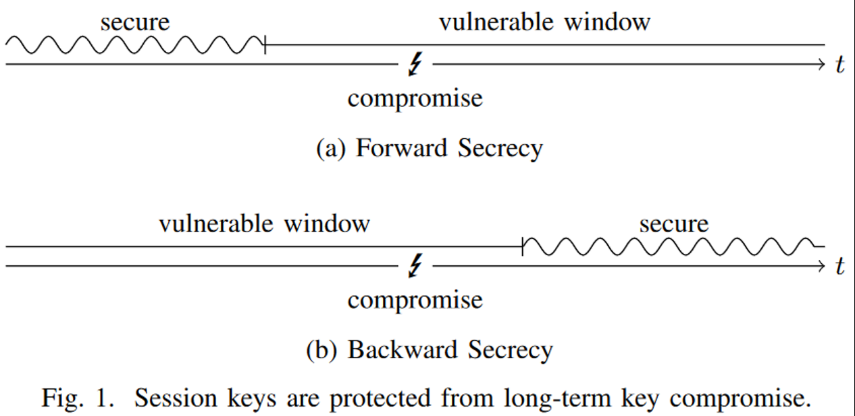
Review: forward and backward secrecy
Forward secrecy = past messages remain private if secret state is exposed later
Notes:
Image source: http://www.jbonneau.com/doc/UDBFPGS15-IEEESP-secure_messaging_sok.pdf

Slide 7
PGP: Why Johnny can’t get forward secrecy

Slide 8
Dealing with deniability
Choose a ← [q]
Compute A = gª
Choose b ← [q]
Compute B = g^{b}
1. Diffie-Hellman key exchange
(* But use the authenticated version)
A
B
Output Bª
Output A^{b}
2. Derive a symmetric key
K = Hash(Bª)
K = Hash(A^{b})
AuthEnc_{K}(P₁)
3. Use authenticated encryption
AuthEnc_{K}(P₂)
…
But how can we get forward secrecy too?

Slide 9
Review: Key evolution via hash functions
Idea: Once we have a single shared key K_{AB}, expand using a chain of hash funcs
K_{AB} → H( K_{AB} ) → H( H( K_{AB} ) ) → H( H( H( K_{AB} ) ) ) → …
Algorithm:
Alice & Bob generate K_{AB}
They begin by using K = K_{AB} as their shared key for (say) authenticated enc
After some time has passed, they can evolve their key by updating K ← H( K )
Here, “time” can denote actual wall-clock time or a message counter
Alice and Bob must stay in sync, or else the chain dies & they’ll need to redo N-S
Crucially, they ensure that old values of K are deleted from their system! After all, Mallory cannot steal something that isn’t around to be stolen (and isn’t being computed over anymore, so no side channels about it leak).
AuthEnc_{K}(P₁)
AuthEnc_{H(K)}(P₂)
…

Slide 10
Key evolution ⇒ forward secrecy! Can do at two levels
Choose a ← [q]
Compute A = gª
Choose b ← [q]
Compute B = g^{b}
Evolve public key
A
B
Output Bª
Output A^{b}
K = Hash(Bª)
K = Hash(A^{b})
AuthEnc_{K}(P₁)
Evolve symm key
AuthEnc_{K}(P₂)
…

Slide 11
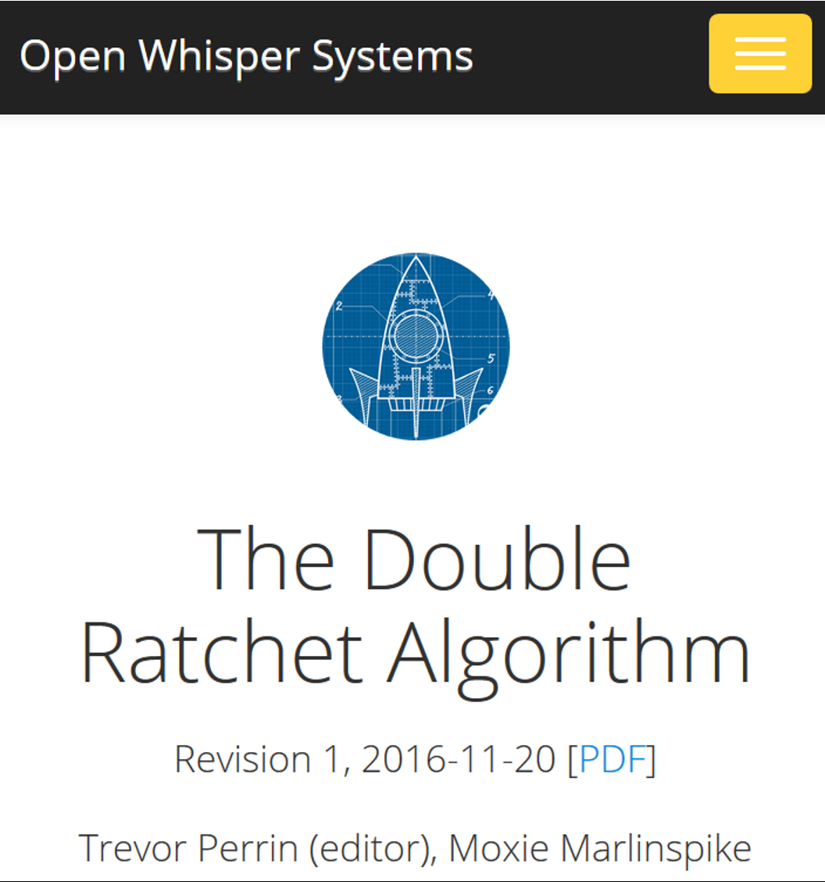
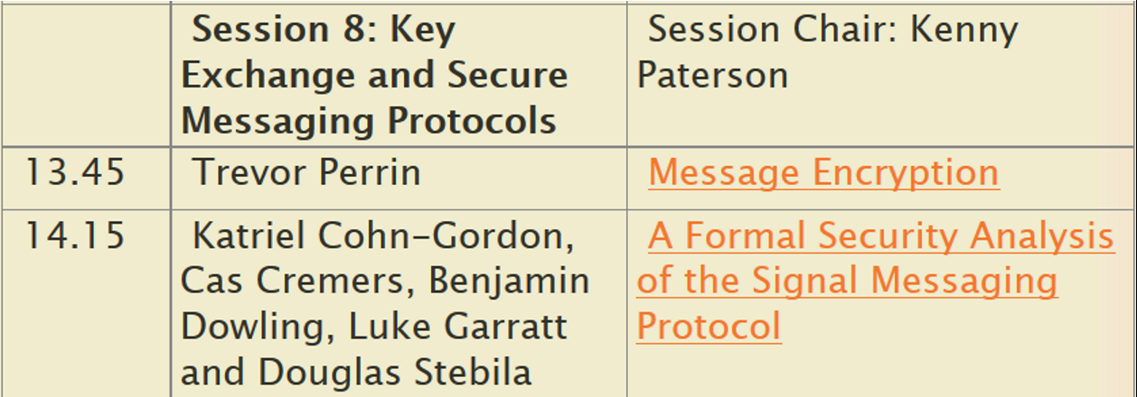
Axolotl protocol, aka Signal protocol, aka double ratchet
Real World Crypto 2017 program
Notes:
Sources:
https://whispersystems.org/docs/specifications/doubleratchet
https://www.realworldcrypto.com/rwc2017/program

Slide 12
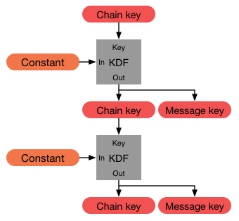
Symmetric ratchet
Remember the “chain of hash functions” idea
K → K1 = H( K ) → K2 = H( K1 ) → …
Constraints
Precondition: Alice & Bob have 1 shared secret K
Postcondition: Alice derives a new key per message sent to Bob, each msg key is used once + tossed
Signal’s ratcheting is more complex, uses HMAC to derive per-message key and next chain key
Questions
Engineering: How to handle out of order messages?
Concern: If initial K is lost, whole chain is insecure
Opportunity: If the “constant” has some entropy as well, then ∃ potential for post-compromise secrecy
AuthEnc_{K1}(P₁)
AuthEnc_{K2}(P₂)
…
Notes:
Source: https://whispersystems.org/docs/specifications/doubleratchet/

Slide 13
Public ratchet
Diffie-Hellman key exchange is incredibly well-suited to ratcheting/evolution
Choose a1 ← [q]
A1 = g^{a1}
B1 = g^{b1}
Choose b1 ← [q]
Shared secret g^{a1 · b1}
Choose a2 ← [q]
A2 = g^{a2}
Shared secret g^{a2 · b1}
B2 = g^{b2}
Choose b2 ← [q]
Shared secret g^{a2 · b2}

Slide 14
Double ratchet rules
When a message is sent or received, a symmetric ratchet step is applied to the sending or receiving chain to derive the message key
When a new ratchet public key is received, a public ratchet step is performed prior to the symmetric-key ratchet to replace the chain keys
Now we just need to connect the ratchets to each other

Slide 15
Public ratchet seeds symmetric ratchets (one per direction)
Notes:
Source: https://whispersystems.org/docs/specifications/doubleratchet/

Slide 16
Public ratchet seeds symmetric ratchets (one per direction)
Notes:
Source: https://whispersystems.org/docs/specifications/doubleratchet/

Slide 17
Public ratchet seeds symmetric ratchets (one per direction)
Notes:
Source: https://whispersystems.org/docs/specifications/doubleratchet/

Slide 18
Public ratchet seeds symmetric ratchets (one per direction)
Notes:
Source: https://whispersystems.org/docs/specifications/doubleratchet/

Slide 19
Add a third chain to achieve post-compromise secrecy

Slide 20
Alice’s full state
Alice has been initialized with
Bob's ratchet public key
A shared secret which is the initial root key
From this info, Alice derives
A new root key, whose “constant” depends on the public ratchet
The first sending key chain

Slide 21
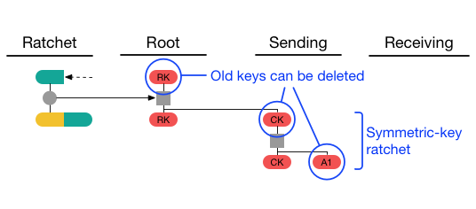
Alice’s full state
Alice sends her first message by
Ratcheting the sending key
Using the resulting single use message key to protect her new message
Engineering question:
How can Alice send message if Bob isn’t online to send a public ratchet?

Slide 22
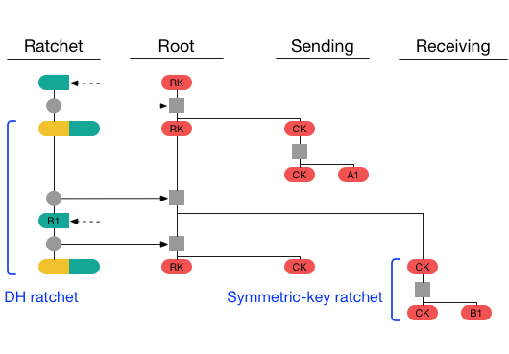
Alice’s full state
Suppose Bob sends a message next
Alice now has the other half of the key pair necessary to start a receiving chain
Alice can perform a public ratchet, and thus make a new sending chain

Slide 23
Ephemeral utopia
No long-term keys ⇒ great forward secrecy
Message key used to AuthEnc a message is used once and tossed
Chain key used to construct msg key is refreshed in each public ratchet
Diffie-Hellman key pairs chosen ephemerally in each public ratchet
Wait, actually is this a utopia or a dystopia?
If you don’t have any long-term state, then who are you?!
Notes:
Source: https://whispersystems.org/blog/safety-number-updates/

Slide 24
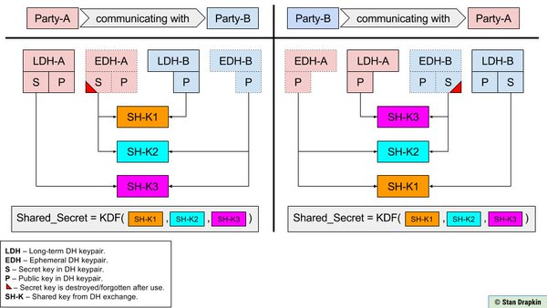
Solution: a more involved Triple-DH protocol
Notes:
Image source: https://twitter.com/sdrapkin/status/738419956371628033
For more details: https://whispersystems.org/docs/specifications/x3dh/

Slide 25
https://www.securemessagingapps.com

Slide 26
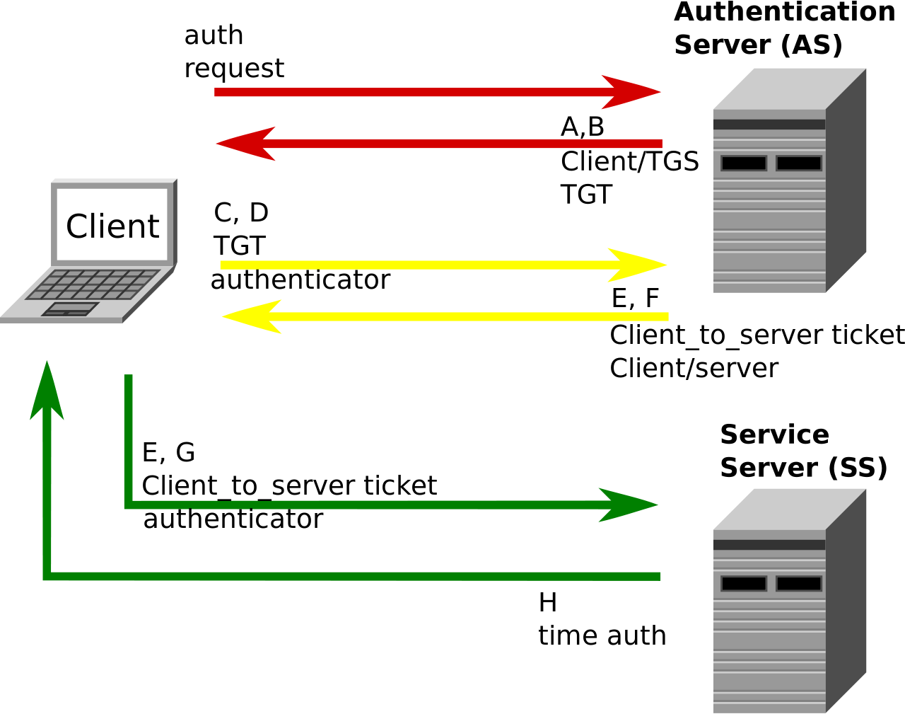
Week 10 reading: Kerberos authentication system
Requirements
Users only enter passwords once, at the beginning of each session
The network itself is untrusted: passwords and authentication tokens need protection in transit
A service must be able to prove that the person using a ticket == the person to whom it was issued
Clients must authenticate services before sending sensitive info to them (mutual authentication)
Notes:
Requirements from the week 10 reading assignment http://web.mit.edu/Kerberos/www/dialogue.html
Figure from Wikipedia: https://en.wikipedia.org/wiki/Kerberos_(protocol)#/media/File:Kerberos.svg

Slide 27
Rogaway on Kerberos and the theory vs practice divide
Notes:
Images from Phillip Rogaway’s Eurocrypt 2009 essay, available at http://web.cs.ucdavis.edu/~rogaway/papers/cc.pdf

Slide 28
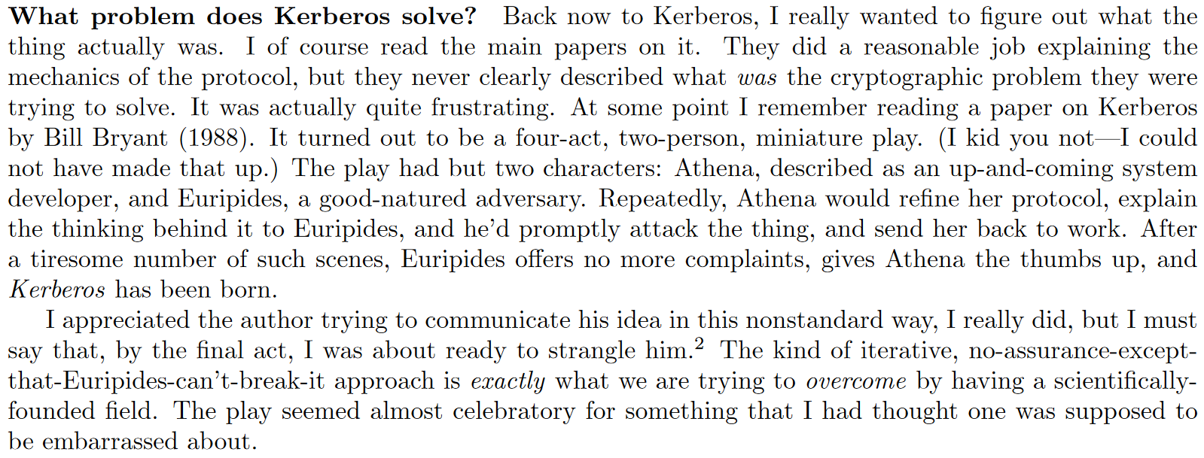
Rogaway on Kerberos and the theory vs practice divide
Notes:
Images from Phillip Rogaway’s Eurocrypt 2009 essay, available at http://web.cs.ucdavis.edu/~rogaway/papers/cc.pdf

