Slide 1
Lecture 23: Randomness
Announcements
If you have not yet received your test, see me at the end of class
Move Friday office hours to 1-3pm?
Problem Set 6 to be posted later today
Continue working on your final projects!

Slide 2
Final project teams
Title | Team members
TBD | Sarah Scheffler, Frederick Jansen, Aditi Dass
The Republic | Satoe Sakuma, Jennifer Tsui, Nicholas Louie
Crypto for Normal People | Selina Gerosa and Mike Magnione
Power Use side channel attack | Lucas Arruda and Adam Pearson
Obfuscation of message length | Clayton Ezzell and Ned Geeslin
Schnorr + Bitcoin | Josh Mosbey and Leen AlShenibr
Scanning for Bad Crypto Online | Konstantino Sparakis

Slide 3
Final project grading
Two deliverables: Written report and presentation
Feel free to include other deliverables, like code, as appropriate
Common rubric: report counts 2x presentation
Remember to cite all sources used!
% | Criterion
30 | Description of what you built: problem you are trying to solve, summary of the architecture you built to solve it (include diagrams, how-tos, … as appropriate)
30 | Explanation of decisions: why you followed this design, what unique features you have and why they relate to your problem, etc
30 | Security analysis: reductions, cryptanalysis, or anything else that gives you reason to believe that your project is “good” at solving the target problem
10 | Quality and clarity of writing/presentation

Slide 4
Today: Start of Part 4
The power of random-looking permutations
Cryptography meets systems: a love/hate story
Structured forgetfulness: dropping keys before they can be stolen
When reductions fail: dealing with the lowest layer
→

Slide 5
Complexity theoretic view of cryptography
Cryptomania (✉) = elegant
Minicrypt (☏) = utilitarian
Notes:
Citation for terminology: Russell Impagliazzo. A Personal View of Average-Case Complexity.

Slide 6
Crypto: art versus science?
View of cryptography | Purpose of crypto? | Objective? | You bless a crypto algorithm as secure based upon… | In the extreme version of this view: the other side is bogus because...
1. It is an empirical science (art?) | Design of secure applications | Build systems that won't be broken in the near future | Its resistance to cryptanalysis | Reduction proofs simply provide a flashlight to the adversary. Also, proofs are written by humans, and therefore often flawed anyway.
2. It is a mathematical science | Applied version of complexity theory | Understand the relationship between various hard problems | Reductions from it to simpler building blocks that are better understood/analyzed | Cryptanalysis simply shows the best attacks we know today, which is an ever-moving target. Instead, reductions stand the test of time.

Slide 7
Course roadmap
Math Tools
Primitives
Algorithms
Protocols
Modular arithmetic
Auth key exchange
Key evolution
Signal: messaging
Key encapsulation
TLS: internet PGP: email
(see CS 558)
Hash functions
?
Random(ish) permutations
Protected communication
Block ciphers
True randomness
☏ Minicrypt
Cryptomania ✉
Focus for today: How to build random number generators

Slide 8
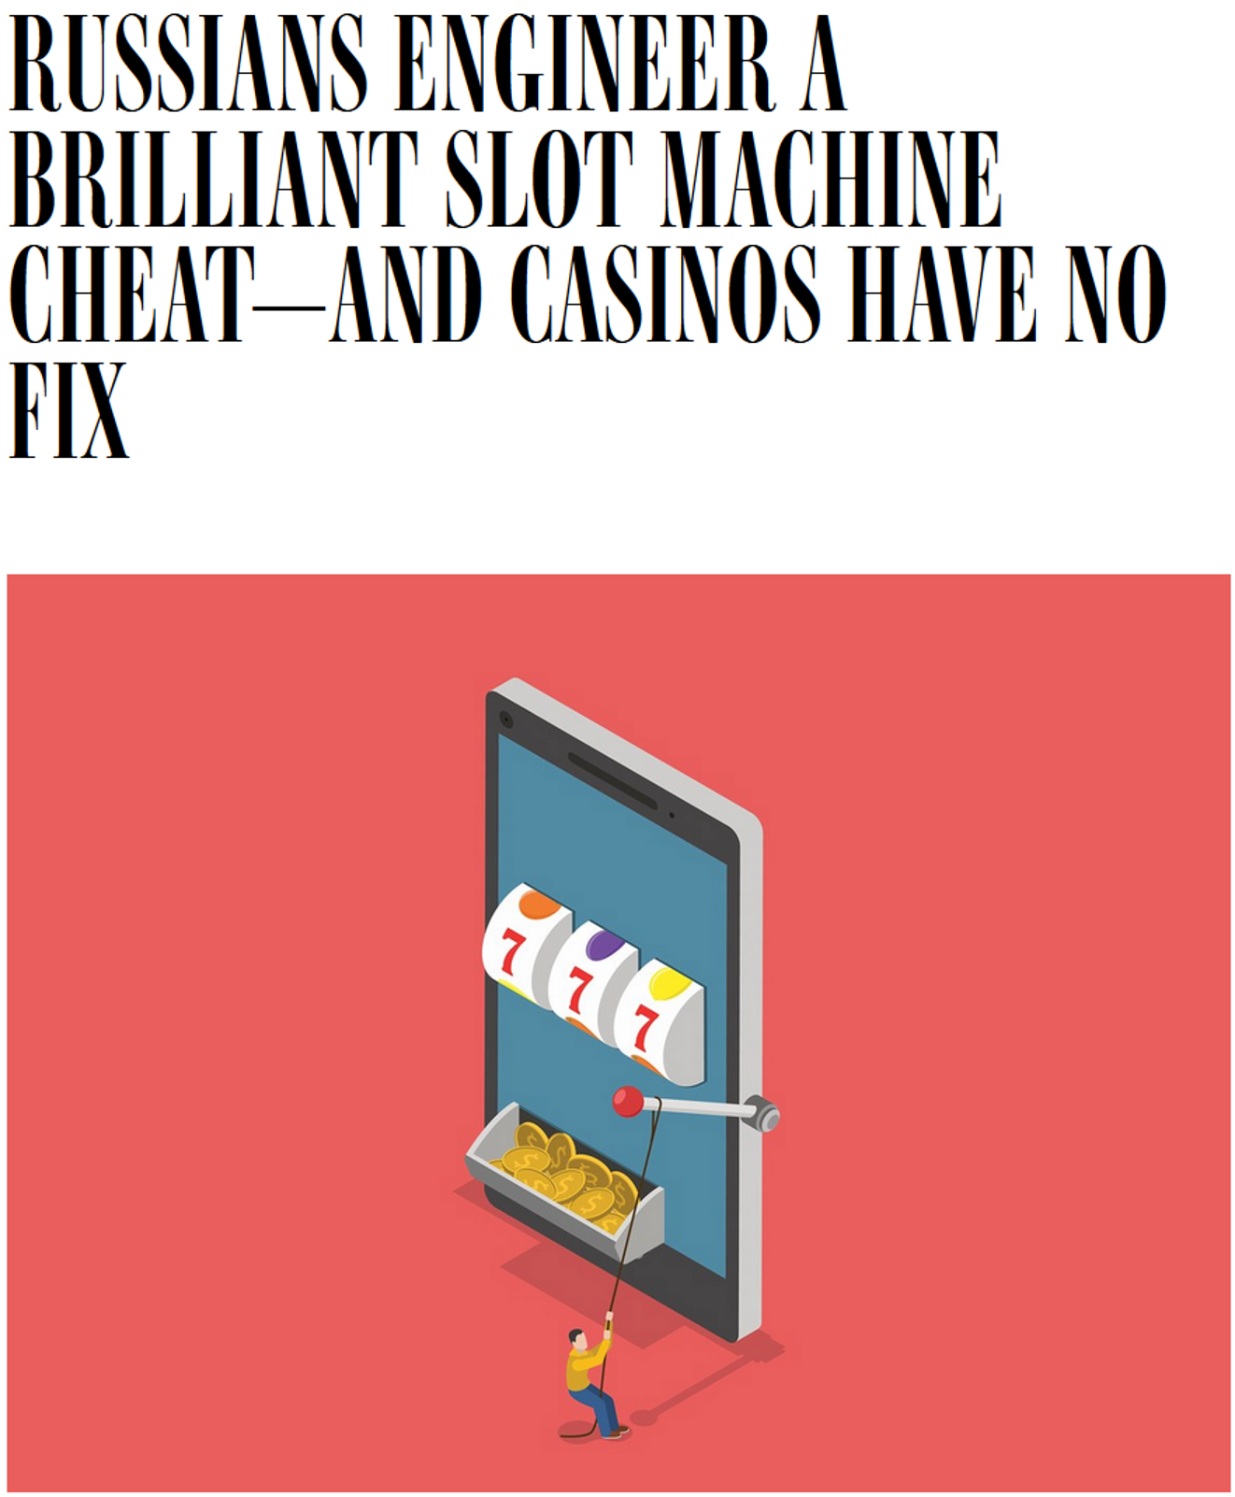
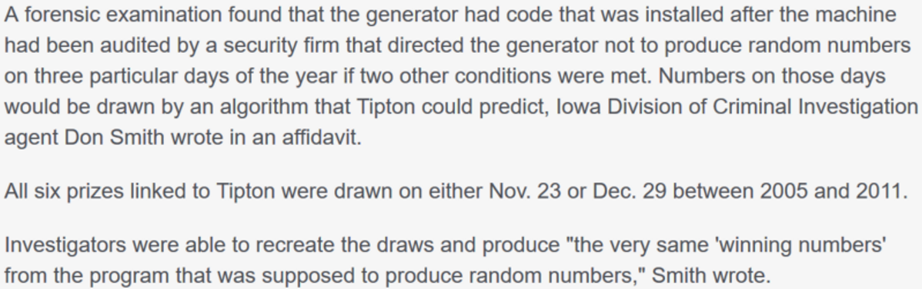
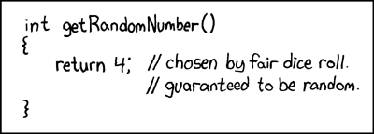
Bad randomness leads to
Lottery fraud
Weak SSL keys for 2 years on Debian machines
Weak RSA keys in the wild
Source: xkcd.com/221

Slide 9
Bad randomness in Debian
Bug forum discussion, 2003
Debian security advisory, 2008
I'm using Valgrind to debug a program that uses the OpenSSL libraries, and got warnings about uninitialized data in the function RSA_padding_add_PKCS1_type_2(), on the line with "} while (*p == '\0');" (line 171 in version 0.9.7a). The following patch ensures that the data is always modified, something that the bytes() method obviously fails to do.
--- openssl-0.9.7a/crypto/rand/rand_lib.c Thu Jan 30 2003
+++ openssl-0.9.7a-safe/crypto/rand/rand_lib.c Wed Feb 26 2003
@@ -154,6 +154,7 @@
int RAND_bytes(unsigned char *buf, int num)
{
[new code here]
Luciano Bello discovered that the random number generator in Debian's openssl package is predictable. This is caused by an incorrect Debian-specific change to the openssl package. As a result, cryptographic key material may be guessable.
This is a Debian-specific vulnerability which does not affect other operating systems which are not based on Debian. However, other systems can be indirectly affected if weak keys are imported into them.
It is strongly recommended that all cryptographic key material which has been generated by OpenSSL versions starting with 0.9.8c-1 on Debian systems is recreated from scratch. Furthermore, all DSA keys ever used on affected Debian systems for signing or authentication purposes should be considered compromised.
Notes:
For details on the Debian issue, see
https://rt.openssl.org/Ticket/Display.html?id=521&user=guest&pass=guest
http://taint.org/2008/05/13/153959a.html

Slide 10
Weak RSA keys

Slide 11
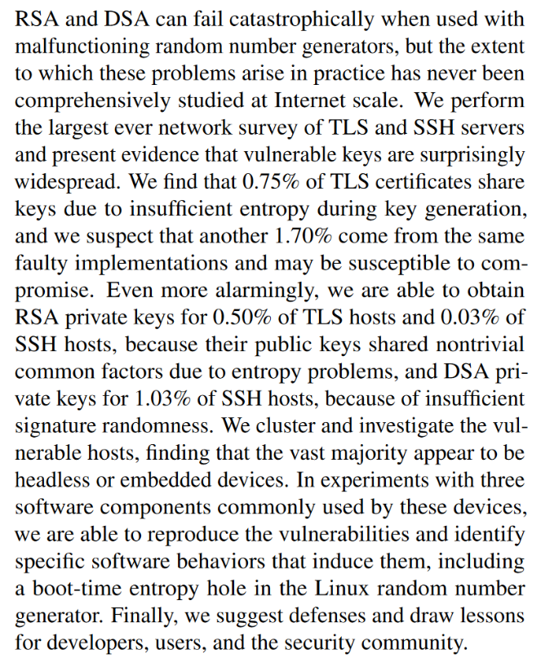
Weak RSA keys

Slide 12
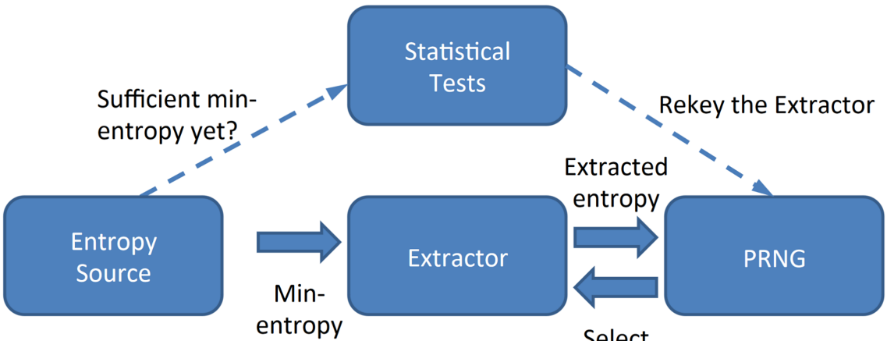
Generating randomness: Three step process
1. True randomness
Reliably produce a “pool” of entropy
2. Extractor
Produce ~128 nearly-uniform bits from the pool
3. Expansion via pseudorandomness
Deterministically produce an arbitrarily-large sequence of bits from seed + short state
Notes:
Source: https://crypto.stanford.edu/RealWorldCrypto/slides/jesse.pdf
For extractor, think “biometric/fingerprint” with large string yielding ~33 bits of entropy

Slide 13
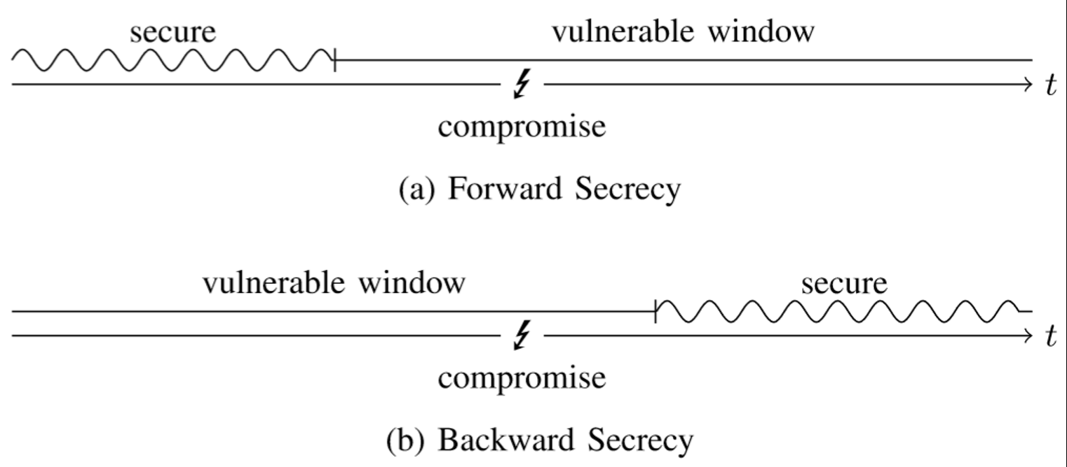
Security requirements
Performance: Be fast enough that people will use it
Hard fail: Only expand once the system has been adequately seeded with true entropy
Resilience: Adversary can’t predict future outputs, even if she can influence the source of true randomness
Forward (backward) secrecy: Adv cannot predict past (future) PRG outputs even if she knows seed + state
Notes:
How to accomplish
Resilience: have multiple sources + smart ways to combine them (cf. xor)
FS/BS: re-seed the PRG periodically with new TRG data

Slide 14
Generating randomness: Three step process
1. True randomness
Reliably produce a “pool” of entropy
2. Extractor
Produce ~128 nearly-uniform bits from the pool
3. Expansion via pseudorandomness
Deterministically produce an arbitrarily-large sequence of bits from seed + short state
Notes:
Source: https://crypto.stanford.edu/RealWorldCrypto/slides/jesse.pdf
For extractor, think “biometric/fingerprint” with large string yielding ~33 bits of entropy

Slide 15
(Some) sources of entropy that computers capture
Physics
EM radiation
Temperature
Human
Keystroke timings
Mouse movements
Logical gates
Clock drift
Thermal noise
Smartphone sensors
Microphone
Camera
Gyroscope
GPS/wiki/Bluetooth signals
Quantum mechanics
Beam splitters & Polarization filters
Tunneling
Entanglement

Slide 16
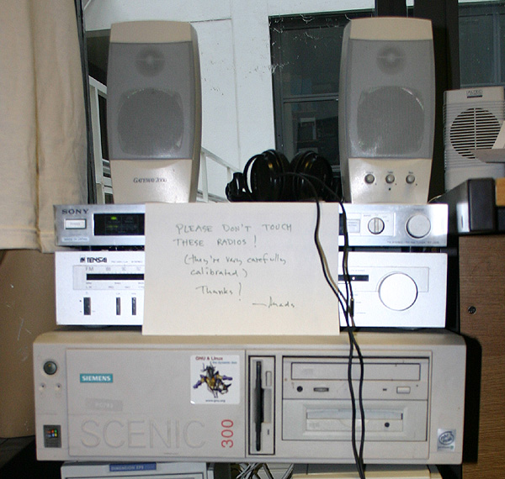
random.org
Physics
EM radiation
Temperature

Slide 17
Ring oscillators
Logical gates
Clock drift
Thermal noise
Apple’s Secure Enclave

Slide 18
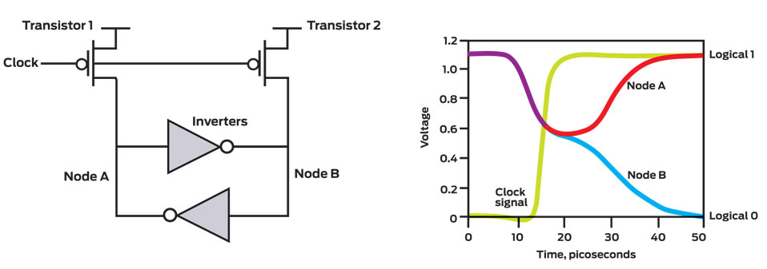
Intel’s hardware RNG
Logical gates
Clock drift
Thermal noise
Ironically, the solution [Intel] came up with breaks a cardinal rule of digital design: that a circuit should be in a well-defined state, outputting only logical 0s or logical 1s. A digital circuit element can, of course, spend short periods switching between these two possible states. But it should never remain teetering, uncertain of which way to go. That would introduce delays and could even produce system failures.
Notes:
See http://spectrum.ieee.org/computing/hardware/behind-intels-new-randomnumber-generator

Slide 19
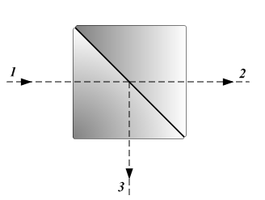
Measuring photons
Quantum mechanics
Beam splitters & Polarization filters
Tunneling
Entanglement

Slide 20
Generating randomness: Three step process
1. True randomness
Reliably produce a “pool” of entropy
2. Extractor
Produce ~128 nearly-uniform bits from the pool
3. Expansion via pseudorandomness
Deterministically produce an arbitrarily-large sequence of bits from seed + short state
Notes:
Source: https://crypto.stanford.edu/RealWorldCrypto/slides/jesse.pdf
For extractor, think “biometric/fingerprint” with large string yielding ~33 bits of entropy

Slide 21
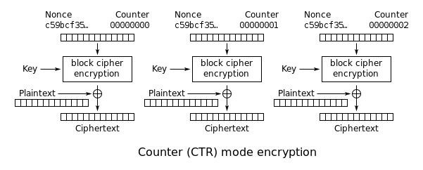
How to build a PRG
Use counter mode with a block cipher

Slide 22
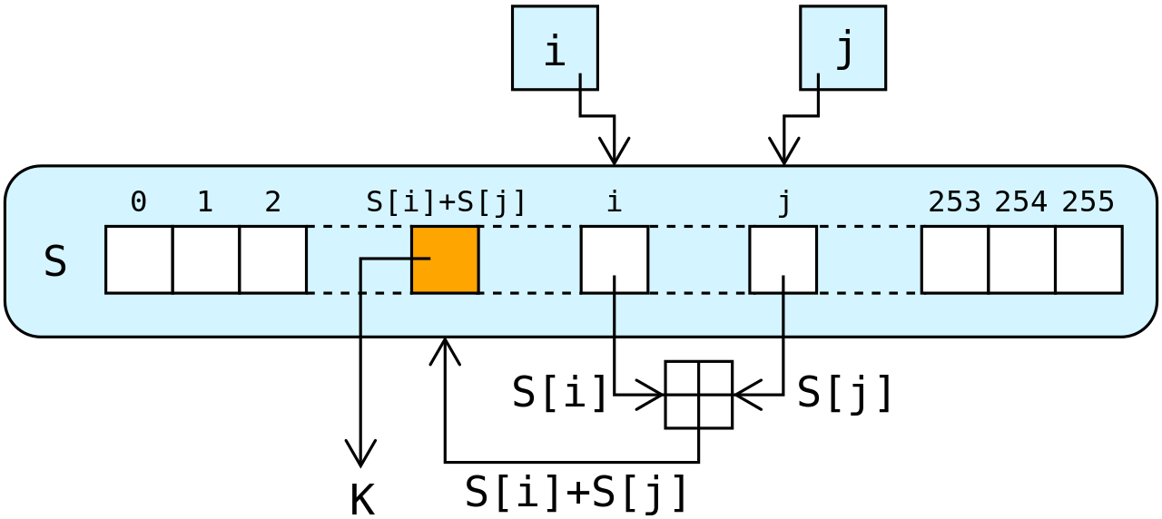
How to build a PRG
Build a dedicated stream cipher
Key scheduling
for i from 0 to 255
S[i] := i
endfor
j := 0
for i from 0 to 255
j := (j + S[i] + key[i mod keylength]) mod 256
swap values of S[i] and S[j]
endfor
Pseudorandom generation
i := 0
j := 0
while GeneratingOutput:
i := (i + 1) mod 256
j := (j + S[i]) mod 256
swap values of S[i] and S[j]
K := S[(S[i] + S[j]) mod 256]
output K
endwhile
Notes:
https://en.wikipedia.org/wiki/RC4

Slide 23
Four NIST-standardized DRBGs
Hash_DRBG
Source
NIST Special Publication 800-90A
Recommendation for Random Number Generation Using Deterministic Random Bit Generators
Notes:
http://csrc.nist.gov/publications/nistpubs/800-90A/SP800-90A.pdf

Slide 24
Four NIST-standardized DRBGs
Hash_DRBG
HMAC_DRBG
Source
NIST Special Publication 800-90A
Recommendation for Random Number Generation Using Deterministic Random Bit Generators
Notes:
http://csrc.nist.gov/publications/nistpubs/800-90A/SP800-90A.pdf

Slide 25
Four NIST-standardized DRBGs
Hash_DRBG
HMAC_DRBG
CTR_DRBG
Source
NIST Special Publication 800-90A
Recommendation for Random Number Generation Using Deterministic Random Bit Generators
Notes:
http://csrc.nist.gov/publications/nistpubs/800-90A/SP800-90A.pdf

Slide 26
Four NIST-standardized DRBGs
Hash_DRBG
HMAC_DRBG
CTR_DRBG
Dual_EC_DRBG
Notes:
http://csrc.nist.gov/publications/nistpubs/800-90A/SP800-90A.pdf

Slide 27
Four Three NIST-standardized DRBGs
Hash_DRBG
HMAC_DRBG
CTR_DRBG
Dual_EC_DRBG
Notes:
http://csrc.nist.gov/publications/nistpubs/800-90A/SP800-90A.pdf

Slide 28
Generating randomness: Three step process
1. True randomness
Reliably produce a “pool” of entropy
2. Extractor
Produce ~128 nearly-uniform bits from the pool
3. Expansion via pseudorandomness
Deterministically produce an arbitrarily-large sequence of bits from seed + short state
Notes:
Source: https://crypto.stanford.edu/RealWorldCrypto/slides/jesse.pdf
For extractor, think “biometric/fingerprint” with large string yielding ~33 bits of entropy

Slide 29
Hashing as an extractor
Let’s begin by taking a hash function H as an extractor
Extractors operate on the principle that including more entropy sources can't hurt: H(x,y,z) is at least as good a random number as H(x,y), no matter how awful z is
Concern is with poor sources that are adaptively chosen
Example
Generate a random z
Try computing H(x,y,z)
If H(x,y,z) doesn't start with bits 0000, go back to step 1
Else, output this value of z
Attack forces H(x,y,z) to start with four known bits of 0000, even if x and y were perfectly random
Also, attack is fast, taking 16 computations of H on average
Notes:
Adapted from https://blog.cr.yp.to/20140205-entropy.html

