Slide 1
Lecture 24: Differential cryptanalysis
Announcements
Final reading assignment due Monday 5/1
Problem Set 6 due Tuesday 5/2
Final project report due Wednesday 5/3

Slide 2
Talk: Cryptographically Protected Database Search
Speaker: Benjamin Fuller, University of Connecticut
Date and time: Wednesday, April 26, 2017 at 4:00 PM to 5:00 PM
Location: MIT Stata Center, room 32-G882
Abstract: Protected database search systems cryptographically isolate the roles of reading from, writing to, and administering the database. This separation limits unnecessary administrator access and protects data in the case of system breaches. Since protected search was introduced in 2000, the area has grown rapidly; systems are offered by academia, start-ups, and established companies.
However, there is no best protected search system or set of techniques. Design of such systems is a balancing act between security, functionality, performance, and usability. This challenge is made more difficult by ongoing database specialization, as some users will want the functionality of SQL, NoSQL, or NewSQL databases. This database evolution will continue, and the protected search community should be able to quickly provide functionality consistent with newly invented databases.
At the same time, the community must accurately and clearly characterize the tradeoffs between different approaches. In this talk, we survey the range of tradeoffs between security and privacy. In particular, we
Identify the important primitive operations across database paradigms,
Evaluate the current state of protected search systems in implementing these base operations, and
Analyze attacks against protected search for different base queries.

Slide 3
Part 4: When reductions fail
Cryptology
Cryptography
Cryptanalysis
Math of algorithm
Physics of implementation

Slide 4
Part 4: When reductions fail
Math Tools
Primitives
Algorithms
Protocols
Modular arithmetic
Auth key exchange
Key evolution
Signal: messaging
Key encapsulation
TLS: internet PGP: email
(see CS 558)
Hash functions
?
Random(ish) permutations
Protected communication
Block ciphers
Getting true randomness
☏ Minicrypt
Cryptomania ✉

Slide 5
Reminder: Crypto is multi-disciplinary & impactful
Algorithms
Known for cipher design.
Primarily found in European academia.
Complexity theory
Known for reductions.
Primarily found in American academia.

A⇒B
🗲

Engineering
Known for software dev and side channel attacks.
Primarily found in industry.
Mathematics
Known for cryptanalysis.
Primarily found in government.
This class explores all 4 approaches

Slide 6
Reminder: Even-Mansour
Question: What is the simplest possible construction of a block cipher that has a formal proof of security?
Even-Mansour 91: Apply Rivest’s DESx idea to any “public, random-looking perm”
Theorems
Resulting block cipher is strongly pseudorandom
…even if Π is publicly known
Construction is minimal in the sense that nothing can be removed
X
X
K_{DES}
Π
K_{MASK}
P
Y
Y
A
A
Π
Π
B
B
Notes:
Note: I’m only showing the (non-strong) pseudorandomness picture here. I omit the full picture of strong pseudorandomness because it is rather busy. See the hidden slide at the end of the presentation.

Slide 7
Reminder: Path toward block ciphers
Problems?
How do we go about building a ‘truly random’ permutation Π?
Isn’t the truth table for Π huge?
Solution to 1: multiple rounds
Let’s make life easier: what if we make ρ that is somewhat random?
Then we can repeat ρ as much as we want in order to boost security
X
Π
ρ
K_{round}
K_{MASK}
Y
⋮
ρ
Y
Notes:
Minor detail: the different rounds need to have different round keys in order to thwart a “slide attack”

Slide 8
Reminder: Path toward block ciphers
Problems?
How do we go about building a single random permutation Π?
Isn’t the truth table for Π huge?
Solution to 2: simple round function ρ
Linear functions are very simple!
Err, perhaps too simple; we could then solve for the key
We need non-linearity somewhere
But let’s keep its truth table small
X
Π
ρ
K_{round}
K_{MASK}
Y
⋮
ρ
Y

Slide 9
Substitution-permutation method of cipher design
State at beginning of round
❶ Substitution box (S-box)
Provides confusion, but at a cost
Huge S-box: very confusing but slow
Tiny S-box: fast but not as confusing
S
…
S
S
…
S
❷ Linear permutation
Provides global diffusion
Permutation
❸ AES-specific middle step
“Instead of spending most of its resources on large S-boxes, the wide trail strategy aims at designing the round transformations such that there are no [linear or differential] trails/characteristics of low weight”
State at end of round
Middle
…
Middle

Slide 10
What if S is still ‘too linear’?
Linear cryptanalysis
Differential cryptanalysis
Exploits the fact that S may behave ‘similarly’ to a linear function
Will explore on Wednesday
Exploits the fact that differences in inputs + outputs may be correlated
Our focus today

Slide 11
Our first differential cryptanalysis
K
Consider a one-time pad
Claude Shannon (and others) showed that it is ‘perfectly hiding’
Concretely: if you don’t know K, then it is impossible to correlate X and Y
What about a two-time pad?
Confusion disappears!
Concretely: even without knowing K, we can say for sure that ΔX = ΔY
ΔX = X ⊕ X’
ΔY = Y ⊕ Y’
X
Y
ΔX
ΔY
X’
Y’
K

Slide 12
The TOY Cipher
K₀
K₁
TOY cipher design = an S-box sandwiched by one-time pads
Concrete sizes
4-bit input X and output Y
8-bit total key
S-box has 2⁴ = 16 total inputs/outputs
Hope: can’t break TOY faster than a brute-force search of 256 keys
Sadly, this hope is false
X
S
Y

Slide 13
Differential cryptanalysis of TOY
K₀
K₁
Consider two input/output pairs
What do we know about differences?
ΔX = ΔI and ΔJ = ΔY, indep of key
This doesn’t directly relate ΔX and ΔY… but, at least we learned that it suffices to connect ΔI with ΔJ
One more observation: ΔJ = J ⊕ J’ = S[I] ⊕ S[I’]
Our plan: try all pairs I, I’ that differ by ΔI, see which yields a difference of ΔJ on the other side of the S-box
X
S
Y
I
J
ΔX = ΔI
ΔJ = ΔY
I’
J’
X’
S
Y’
K₀
K₁
Notes:
First

Slide 14
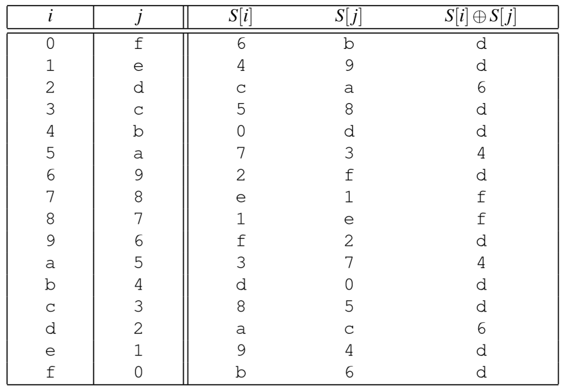
Concrete example
K₀
K₁
Input X = 0 maps to output Y = 11 (i.e., 0xB)
Input X’ = 15 maps to output Y’ = 15 (i.e., 0xF)
X
S
Y
I
J
I
I’
S[I]
S[I’]
S[I] ⊕ S[I’]
ΔX = ΔI ΔX = 15
ΔJ = ΔY ΔB = 4
I’
J’
X’
S
Y’
K₀
K₁
Two possible keys: (5,C) and (A,8)

Slide 15
Differential cryptanalysis of 2TOY
K₀
K₁
K₂
Lesson of E-M: if a cipher breaks, add more rounds & try again
Suppose that we knew ΔI
Then we’re back to TOY’s analysis
Let’s see if we can fake it!
Suppose ΔX = 0xF just as before
Then ΔI = 0xD with prob 10/16
Simply assume that’s the case, finish TOY’s cryptanalysis accordingly
Find which values of K₂ are consistent with ΔI = S⁻¹[Y] + S⁻¹[Y’]
If Pr[guess] is high enough, then will often get the right answer
X
S
S
Y
G
H
I
J
ΔX = ΔG
ΔH = ΔI
ΔJ = ΔY
G’
H’
I’
J’
X’
S
S
Y’
K₀
K₁
K₂
Notes:
First

Slide 16
Differential trails through 3TOY
K₀
K₁
K₂
K₃
X
S
S
S
Y
Differential trail:
ΔX
ΔI₁
ΔI₂
ΔY
Two central themes of differential cryptanalysis
We may not know values of internal variables, but we might know their differences
Narrow key space by testing when (parts of) key are consistent with known Δs
Notes:
First

Slide 17
Differential trails through 3TOY
K₀
K₁
K₂
K₃
X
S
S
S
Y
Differential trail:
ΔX
ΔI₁
ΔI₂
ΔY
Example:
F
D
6
4
Question: What is the probability of this trail occurring?
Notes:
First

Slide 18
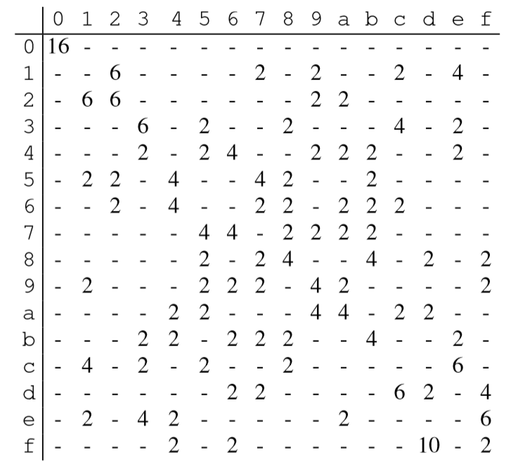
One-round difference propagation table
Output difference
Table is based upon S-box alone
Try all inputs differing by row value, see how often their outputs differ by column value
Computing Pr[trail]
Look up probability of each link, and multiply them together
Pr[ F → D → 6 → 4]
≈ Pr[ F → D] · Pr[D → 6] · Pr[6 → 4]
= 10/16 · 2/16 · 4/16 = 5/64
Because these probabilities get small quickly, define weight[trail] = -log( Pr[trail] )
Input difference

