Slide 1
Lecture 25: Linear cryptanalysis
Announcements
Final reading assignment due Monday 5/1
Problem Set 6 due Tuesday 5/2
Final project report due Wednesday 5/3
Final project presentations on Monday 5/1 and Wednesday 5/3
Talk on Cryptographically Protected Database Search this afternoon

Slide 2
Part 4: Dealing with the lowest layer
Cryptology
Cryptography
Cryptanalysis
Math of algorithm
Physics of implementation

Slide 3
Block cipher design
Iterated rounds…
each with substitution & permutation
X
State at beginning of round
Π
ρ
K_{round}
K_{MASK}
S
…
S
S
…
S
Y
⋮
Permutation
ρ
State at end of round
Y

Slide 4
Question: What if S is ‘too linear’?
Differential cryptanalysis
Exploits the fact that differences in inputs + outputs may be correlated
ΔX
ΔY
S

Slide 5
Recap: Differential trails through multiple rounds
K₀
K₁
K₂
K₃
X
S
S
S
Y
Y ?
Differential trail:
ΔX
ΔI₁
ΔI₂
ΔY
Y’ ?
Two central themes of differential cryptanalysis
We may not know values of internal variables, but we might know their differences
Narrow key space by testing when (parts of) key are consistent with known Δs
Notes:
First

Slide 6
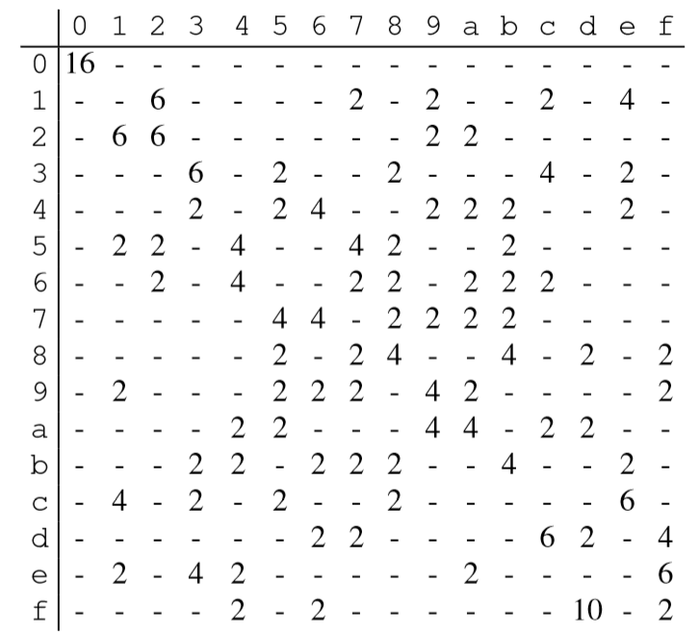
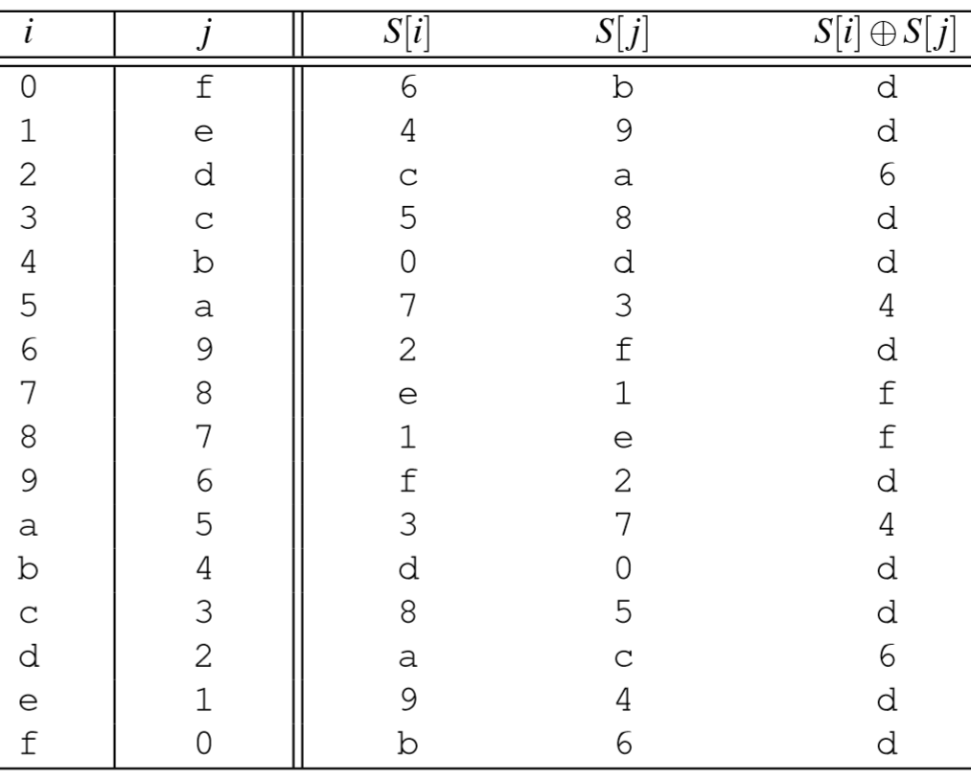
Recap: Difference propagation table through 1 round
Output difference
Input difference

Slide 7
Recap: Difference propagation table through 1 round
Output difference
Input difference
Def. Max difference propagation
Largest one-round difference propagation in the entire table

Slide 8
Question: What if S is ‘too linear’?
Differential cryptanalysis
Linear cryptanalysis
Exploits the fact that differences in inputs + outputs may be correlated
Exploits the fact that inputs & outputs of an S-box may be linearly correlated
ΔX
ΔY
X
Y
S
S

Slide 9
Non-linearity of S
Question: How can we measure the non-linearity of S?
One approach: calculate algebraic degree (example: AES’ S-box has deg 254)
Unfortunately, sometimes, non-linear functions can look ‘very close’ to linear ones
That is, there may exist a linear function L such that S(x) = L(x) most of the time
New defender goal: S should be ‘very far’ from any linear function
Unfortunately even this goal has its limits…

Slide 10
Correlation
For now, let’s restrict our attention to functions that output only 1 bit
Def. The correlation between two functions F, G: {0,1}^{n} → {0,1} is
C(F, G) = Pr[ F(x) = G(x) ] – Pr[ F(x) ≠ G(x) ]
Extremes:
C(F, G) = 1
C(F, G) = 0
C(F, G) = -1
|C(F, G)| tells you how well f can be used to predict g, and the sign tells you the direction of the connection
⇒ F and G are the same function (F = G)
⇒ F and G are independent: knowing F won’t help to predict G
⇒ F and G differ everywhere (F = G ⊕ 1)

Slide 11
Defining linearity
Question:
When considering functions that output only one bit, which functions L: {0,1}^{n} → {0,1} should we call linear?
Answer:
Take ⊕ of a subset of the input bits
Let u be a vector in {0,1}^{n}
Form the linear function
L _{u} ( x ) = <u, x> = ⊕_{i} ( u_{i} · x_{i} )
All coefficients in u are either 0 or 1, so we take the ⊕ of some of the x_{i}’s
Follow-up question:
What is the correlation between linear functions?
Answer: C( L_{u}, L_{v} ) =
→
→
1 if u = v
0 otherwise
→
→
→
→
→
→
→
→

Slide 12
Limits to non-linearity
Now consider the correlation of a linear function L_{u} with a non-linear function F
Thm [Parseval]. For any function F: Σ _{u} C( F, L _{u} )² = 1
Corollary. For any F, there exists a linear function such that | C( F, L _{u} ) | > 2^{-n/2}
If F has N inputs, there’s a linear function that matches it with advantage at least N
In the case of AES: N = 256, so N = 16
But hang on a second: AES S-box has more than 1 bit of output!
→
→
→
→

Slide 13
Simple thought experiments
K₀
K₁
X
S
Y
Form of the S-box
How to break a cipher
A linear function on all n bits
Linear ‘most of the time’
Has 1 bit of output that is a linear function of 1 bit of input
Subset of the output bits is linearly correlated with subset of input bits
Solve a system of linear equations
Solve linear programming problem
Same as #1 (partial breaks count too)
Consider more correlations…

Slide 14
Correlations in multiple bit functions
Now let’s consider an arbitrary function F: {0,1}^{n} → {0,1}^{m}
The correlation function we described before no longer works
It only describes functions with one bit of output
To understand bigger functions, simply measure all of its projections to 1 bit
Form a 2^{n} × 2^{m} matrix of correlations between subsets of outputs & inputs
C_{u,v} = C(u · x, v · F(x) )
For an S-box, we want to know how well this correlation can be
We refer to this relationship as a linear trail u ↦ v
u · x
v · y
S

Slide 15
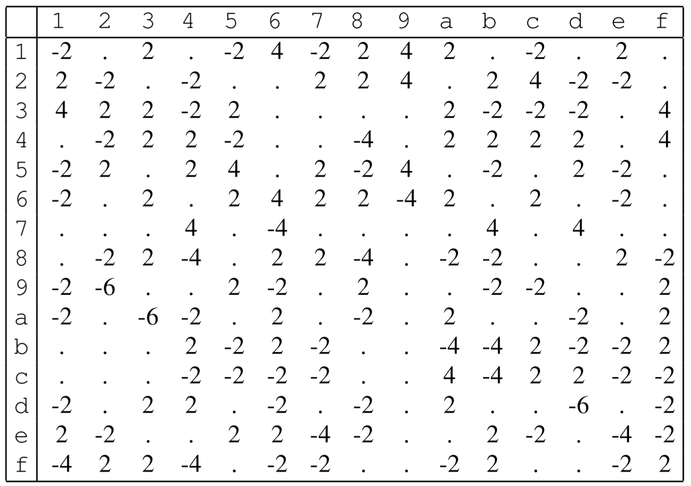
Linear approximation table
Parity of outputs
Take an S-box (here, the one for TOY)
For each row u and column v, compute how often u · x = v · F(x)
This will happen ½ of the time by chance
Record the difference
Def. Max linear bias
Biggest number in this table, in absolute value
Partiy of inputs
Notes:
Source: The Block Cipher Companion, table 7.1

Slide 16
Properties of correlation matrices
Composition: if H = F ∘ G, then C^{H} = C^{G} × C^{F}
XOR with a constant: if F(x) = x ⊕ k, then C^{F} is diagonal matrix with ±1 entries
Constant mult: if F(x) = Mx for a matrix M, then C^{F} is a permutation matrix
Properties ⇒ only the values in C^{S} matter when analyzing a block cipher

Slide 17
Linear trails through multiple rounds
i
j
x
S
S
S
y
u₀ · x
u₁ · i
u₂ · j
u₃ · y
Linear trail:
u₀
u₁
u₂
u₃
Remember, only the S-box affects the strength of linear correlations
But we may need to correlate different subsets of inputs vs. outputs
A linear trail continues this connection across multiple rounds
C[ trail ] = Π C[ each step ]

Slide 18
Linear bias in the AES S-box

Slide 19
Wide trail strategy through 4 rounds of AES
DC argument holds for LC too
≥ 25 active S-boxes in 4 rounds
Each has max linear bias of 2⁻³
So C [four-round trail] ≈ 2⁻⁷⁵
An 8-round trail has C < 2⁻¹⁵⁰
A 12-round trail has C < 2⁻²²⁵
Brute force search is better
“Instead of spending most of its resources on large S-boxes, the wide trail strategy aims at designing the round transformations such that there are no [linear or differential] trails/characteristics of low weight”

Slide 20
Cryptanalysis: the last 20 years
Additional metrics to measure confusion & diffusion
Auto-correlation and cross-correlation
Propagation/avalanching criteria and correlation immunity
Additional types of attacks
Impossible differential cryptanalysis
Boomerang attacks, and other high-order differential attacks
Differential-linear attacks
Saturation attacks
Key schedule attacks
Related key attacks
Cube attacks
…

Slide 21
Impossible differential cryptanalysis
Output difference
Input difference
Find long trails that never occur. If a key would cause this trail, then that key must be incorrect.

