Slide 1
UNIT I 8086 Microprocessor Architecture and Register Organization

Slide 2
Introduction to Microprocessor
The microprocessor is a general purpose programmable logic device.
It is the brain of the computer and it performs all the
computational tasks,
calculations
data processing etc. inside the computer.
In the computers, the most popular type of the processor is the Intel Pentium.
The microprocessors can be classified based on the following features:
Instruction set:
It is the set of the instructions that the microprocessor can execute.

Slide 3
Bandwidth:
The number of bits processed by the microprocessor in a single instruction, or the number of bits which are transfer via the bus in parallel.
For example, the 8086 microprocessor called 16-bits, i.e. because it can process, send, and evaluate 16 bits in parallel.
Clock Speed:
It determines the speed of the processing the instruction inside the processor and it is measured in Hz.

Slide 4
Historical Overview:
The first microprocessor is the Intel 4004, was a 4-bit microprocessor. It has 12-bit address lines to access 4096 memory location. The 4004 microprocessor has only 45 instructions.
The Intel released the 4040 microprocessor, as updated version of 4004 with enhancement in speed, and without any improvement in word length and memory size.
In 1971 announced the 8008 microprocessor, 8-bit and faster version of 4004 microprocessor. This version came up with expanded memory size up to 16 Kbytes and additional instructions to make total of 48 instructions.
In 1977 Intel introduced updated version of 8080, which was 8085 microprocessor. The 8085 is an 8-bit microprocessor.

Slide 5
In 1978, Intel came out with the 8086 processor which is our study in this course.
Today, the development of the microprocessors reached to the Pentium, Core-2-duo,Core i.

Slide 6
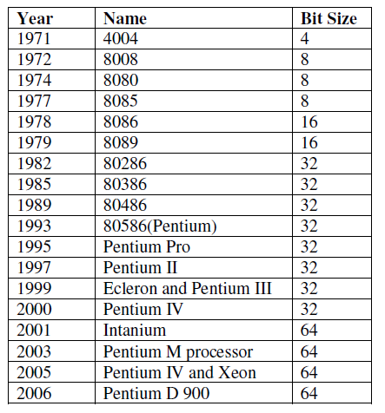

Slide 7
Basic Characteristics and features of the 8086 Microprocessor.
The 8086 microprocessor is a 16-bit microprocessor. The term “16-bit” means that its arithmetic logic unit, internal registers and most of its instructions are designed to work with 16-bit binary words.
The 8086 has a 16-bit data bus, so it can read data from or write data to memory and ports either 16 bits or 8 bits at a time.
The 8086 has a 20-bit address bus, so it can directly access 2^20 or 1,048,576 locations.
The 8086 can generate 16-bit I/O address; hence it can access 2^16 = 65536 I/O ports.
It has multiplexed address and data bus AD0- AD15
and A16 – A19.

Slide 8
Basic Characteristics and features of the 8086 Microprocessor.
The 8086 is designed to operate in two modes, namely the minimum mode and the maximum mode
The 8086 supports multiprogramming. In multiprogramming, the code for two or more processes is in memory at the same time and is executed in a time-multiplexed fashion.
An interesting feature of the 8086 is that it fetches up to six instruction bytes from memory and stores them in a queue in order to speed up instruction execution.
It requires +5V power supply.
A 40 pin dual in line package.

Slide 9
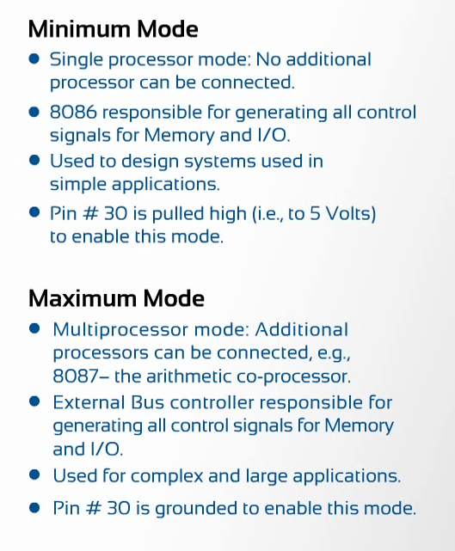

Slide 10
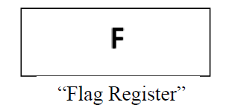
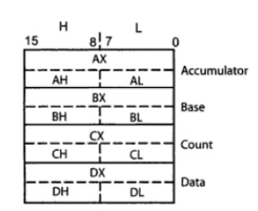
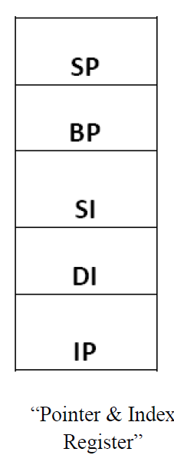
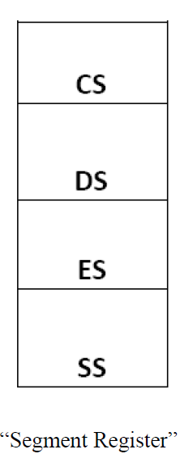
Register Organization of 8086
The 8086 has a powerful set of registers. It includes
General purpose/Data registers
Segment registers
Pointers & index registers
Flag register.
The registers organization of 8086 is shown below. All registers are 16-bit registers.
General Purpose Registers

Slide 11
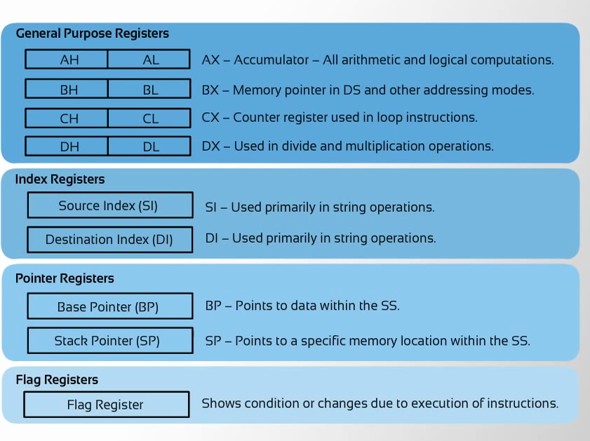

Slide 12
General Purpose Registers
The 8086 has four 16-bit general purpose registers labeled AX, BX, CX, and DX.
Each 16-bit general purpose register can be split into two 8-bit registers.
The letters L and H specify the lower and the higher bytes of a particular register.
For example, the BH means the higher byte (8-bits) of the BX register and BL means the lower byte (8-bit) of the BX register.
The letter X is used to specify the 16-bit register.
The general purpose register are either used for
holding data,
variables
intermediate result temporarily.

Slide 13
The Accumulator register (AX) is used as 16-bit accumulator. It is used for all
Input/output operations
Some arithmetic operations
String manipulations
For example, multiply, and divide.
The Base register(BX) is also used as offset storage for generating physical addresses in case of certain addressing modes.
The Count register(CX) is also used as a default counter in case of
String and loop instructions.
String manipulation and shift/rotate instructions.
Data register (DX) can be used as a implicit operand or destination register in case of a few instructions.
used as a port number in I/O operations.

Slide 14
Segment Registers
The physical address of the 8086 is 20-bits wide to access 1M byte memory locations.
We know that the logical addresses (size of registers in 8086) are just 16-bits wide.
How the 20-bits Physical address obtained?
And how 1Mbyte memory is addressed?

Slide 15
Unlike 8085, 8086 addresses a segmented memory.
The complete 1Mbyte memory is divided into 16 logical segments, with maximum size of segments with 16 Bits (i.e., 2^16)
Each segment thus contains 64k bytes of memory.
Thus, any location within the segment can be accessed using 16-Bits (offset address).

Slide 16
Segmented Memory
Segmented memory addressing: Physical ddress is a combination of a 16-bit segment value added to a 16-bit offset
one segment
linear addresses

Slide 17
The four segment registers are:
Code Segment (CS) Register
Data Segment (DS) Register
Stack Segment (SS) Register
Extra Segment (ES) Register
These are used to hold the 16-bits of the starting addresses of the four memory segments.
The starting address also called Base address or Segment address.
Functions of Segment Registers
The CS register holds the upper 16-bits of the starting address of the segment.
Used for addressing a memory location in the code segment of memory, where the executable programs are stored.

Slide 18
The SS register is used to hold the upper 16-bits of the starting address for the program stack (all stack related instructions will operate on stack).
SS – Used for addressing the stack segment of memory (I,e) memory which is used to store stack data.
ES register and DS register are used to hold the upper 16-bits of the starting address of the two memory segments respy, which are used for storing data.
While addressing any memory location from the memory bank, the 20 bit physical address is calculated from two parts
SEGMENT ADDRESS (16 bit)
OFFSET ADDRESSS (16 bit)

Slide 19
SEGMENT & OFFSET ADDRESS
Segment Registers
Contain 16 bit Segment address , related to different segments.
Any of the pointers and index registers or BX Reg
– Contain the offset address (i,e) 16 bit Address of the memory location residing within each segment.
ADVANTAGE: Instead of maintaining a 20 bit register for a physical address, the processor just maintains two 16 bit registers.

Slide 20
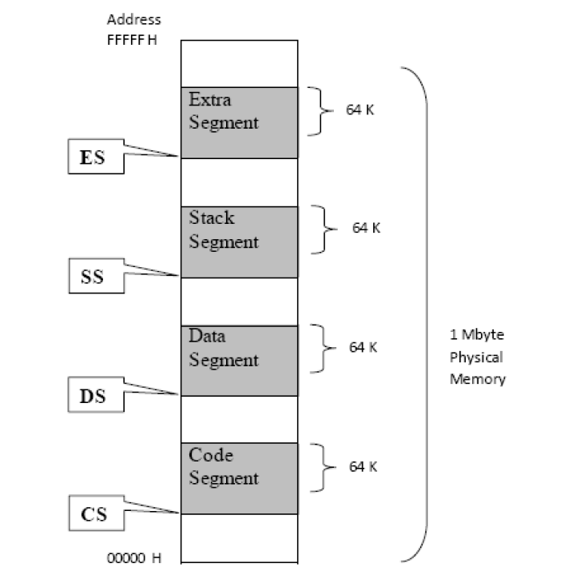

Slide 21
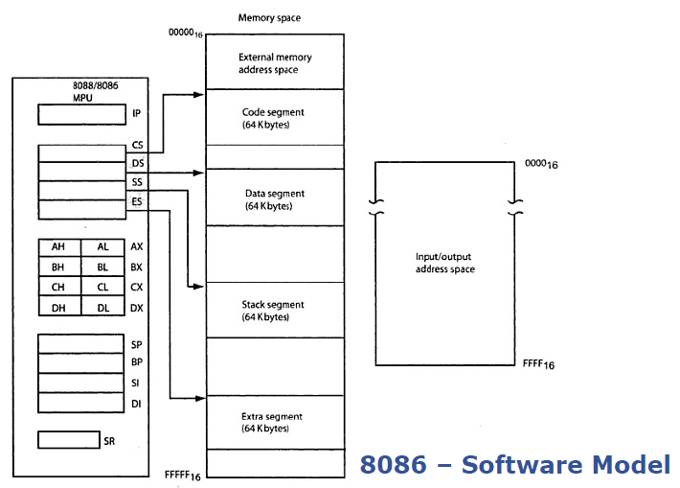

Slide 22
Pointers and Index Registers
All segment registers are 16-bit wide. But it is necessary to generate 20-bit address (physical address) on the address bus.
To get 20-bit physical address one or more pointer or index registers are associated with each segment register.

Slide 23
Pointers and index registers
The pointers IP, BP, SP usually contain offsets within the code, data and stack segments respectively.
Instruction Pointer (IP) is a 16-bit register pointing to instructions in code segment.
Stack Pointer (SP) is a 16-bit register pointing to program stack in stack segment.
Base Pointer (BP) is a 16-bit register pointing to data in stack segment.
BP register is also used for based, based indexed or register indirect addressing.

Slide 24
Index registers
Used as General purpose register as well as for offset storage in case of indexed, based indexed and register indirect addressing.
Also used in string manipulations.

Slide 25
Index registers
Source Index (SI) is a 16-bit register.
Used to store the offset address of source data in data segment.
SI is used for indexed, based indexed and register indirect addressing.
Destination Index (DI) is a 16-bit register.
Used to store the offset address of destination data in data segment or extra segment.
DI is used for indexed, based indexed and register indirect addressing.

Slide 26
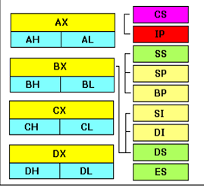
The table below shows the offset registers with their related segment registers.

Slide 27
Flag Register (FR)
The content of the flag register of 8086 indicate some conditions produced by the execution of an arithmetic or logic instruction.
It also has some control flag bits, controlling certain operations of the execution unit.

Slide 28
Architecture of 8086

Slide 29
8086 Architecture
Supports
A 16 bit ALU
A set of 16 bit registers
Provides segmented memory addressing capability
A rich instruction set
Powerful interrupt structure
Fetched instruction queue for overlapped fetching and execution.

Slide 30
It is internally divided into two separate functional units.
Bus Interface Unit (BIU) and
Execution Unit (EU)
These two functional units can work simultaneously to increase system throughput.
The throughput is a measure of number of instructions executed per unit time.
The major reason for this separation is to increase the processing speed of the processor.

Slide 31
Architecture Diagram

Slide 32
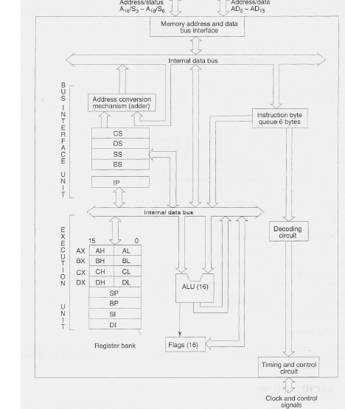

Slide 33
Bus Interface Unit (BIU)
Provides a full 16-bit bi-directional data bus and 20-bit address bus.
Contains the circuit for physical address calculations and an instruction byte queue (6 bytes long).
This unit is responsible for establishing communication with external devices & peripherals including memory via the bus.
In other words , The BIU interact with memory, input and output devices in fetching the instructions and data required by the EU

Slide 34
BIU contains
A. Instruction Queue
B. Segment Registers
C. Instruction Pointers
D. Address Summer
E. Bus Control Logic

Slide 35
Instruction byte Queue and Pipelining
In 8085, Once the opcode is fetched and decoded, the external bus remains free , while the processor internally executes the instruction.
This time slot is utilised in 8086 to achieve the overlapped fetch and execution cycles.
While the fetched instruction is executed internally , the external bus is not left free but used to fetch the opcode of the next instruction and arrange it in a queue called a PREDECODED INSTRUCTION BYTE QUEUE.

Slide 36
Instruction byte Queue and Pipelining
It is a 6 byte long, first-in-first-out structure.
Instructions from the queue are taken for decoding sequentially.
Once a byte is decoded, queue is rearranged by pushing it out and queue status is checked for the possibility of the next opcode fetch cycle.
While opcode is fetched by BIU, the EU executes the previously decoded instruction concurrently.
BIU along with EU thus forms a PIPELINE Structure.

Slide 37
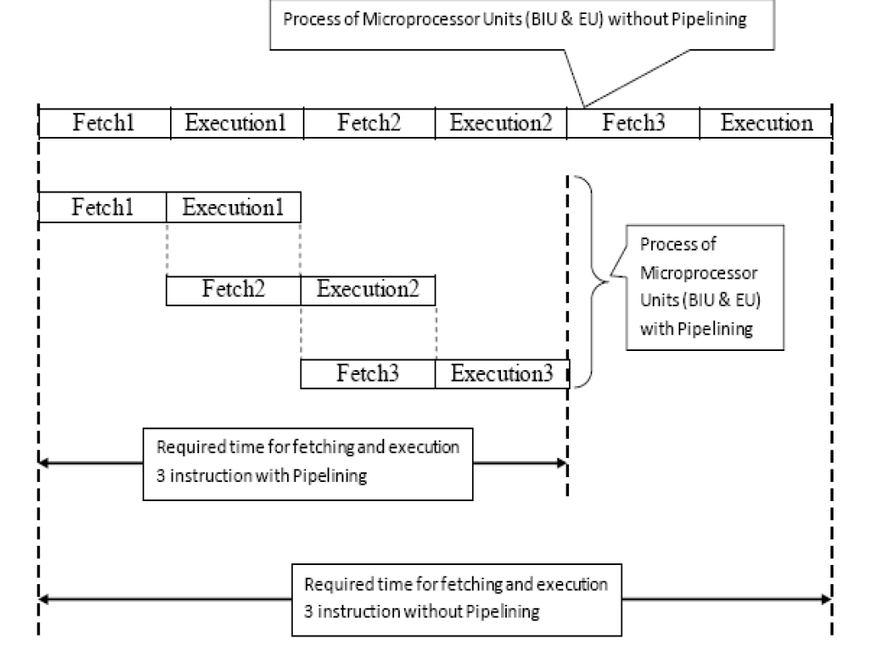

Slide 38
ADDRESS SUMMER
The BIU also contains a DEDICATED ADDER which is used to generate the 20 bit physical address that is output on the address bus.

Slide 39
Generation of 20-bit Address
The logical addresses that occur in the 8086 program are always 16 bits in length.
This is because all registers are 16 bits.
However, the physical addresses that are used to access 1MB memory are 20 bits in length.
The generation of the physical address involves combining a 16-bit offset values that is located in either an index register or pointer register or BX reg and a 16-bit base/segment address that is located in one of the segment register.

Slide 40
Segment & Offset registers
Segment Register – Indicates the base address or segment address of a particular segment
Offset address – Indicates the distance of the required memory location within the segment from the base address.

Slide 42
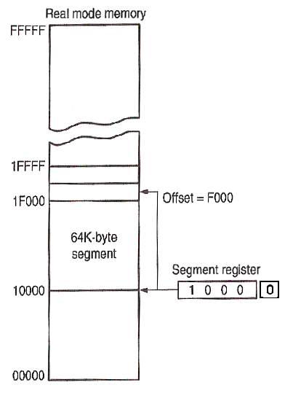
1 MB
(1 MB)
EA (Effective Address) of byte accessed
20-bit (5-byte)
Physical
Memory address
64 KB
Segment
+
16-bit each
Appended 4 bits (0H)
Segment number
In Segment Register

Slide 43
An Example for physical address calculation

Slide 44
BIU
The BIU is also responsible for generating bus control signals such as those for memory read or write and I/O read or write.

Slide 45
Execution Unit (EU)
EU is responsible for executing the instructions of the programs and to carry out the required processing.
The EU of 8086 tells the BIU from where to fetch instructions or data, decodes instructions and execute instructions. It contains:
Control Circuitry
Instruction Decoder
Arithmetic Logic Unit (ALU)
Flag Register
General Purpose Registers
Pointers and Index Registers

Slide 46
Control Circuitry
Control circuitry in the EU directs the internal operations.
Instruction Decoder
A decoder in the EU translates the instructions fetched from memory into a series of actions which the EU performs.
Arithmetic Logic Unit (ALU)
Does the arithmetic and logical operations like add, subtract, AND, OR, XOR, increment, decrements, complement and shift binary number.
Flag Register
A flag is a Flip-Flop (FF) which indicates some condition produced by the execution of an instruction or controls certain operations of the EU. The flag register contains (9) flags.

Slide 47
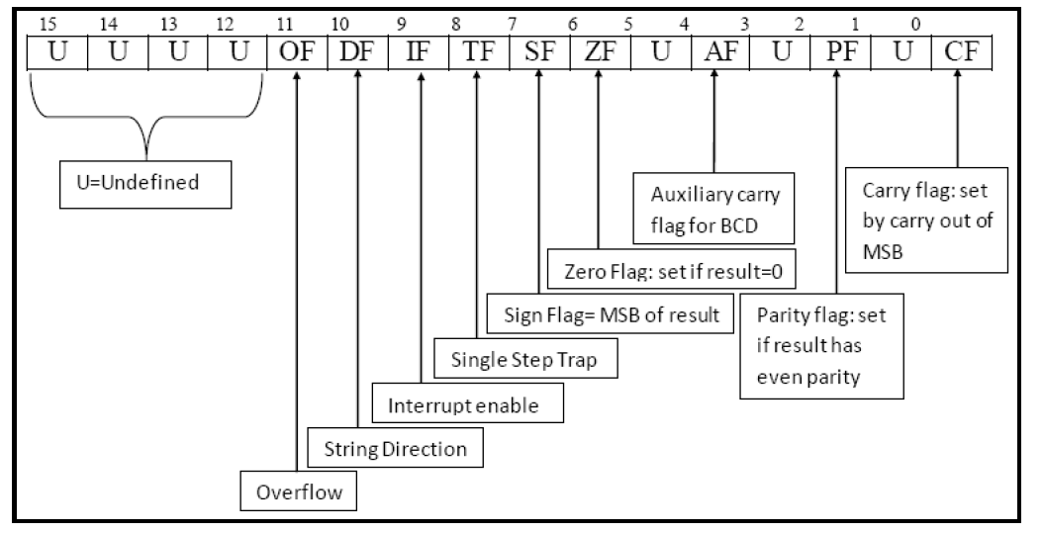

Slide 48
Carry flag (CF)
In the case of addition this flag is set if there is a carry out of the MSB. The carry flag also serves as a borrow flag for subtraction. In case of subtraction it is set when borrow is needed.
Parity Flag (PF)
It is set to 1 if result of byte operation or lower byte of the word operation contains an even number of ones; otherwise it is zero.
Auxiliary Flag (AF)
This flag is set if there is an overflow out of bit i.e., carry from lower nibble to higher nibble (D3 bit to D4 bit). This flag is used for BCD operations and it is not available for the programmer.

Slide 49
Zero Flag (ZF)
The zero flag sets if the result of operation in ALU is zero and flag resets if the result is non-zero. The zero flag also set if certain register content becomes zero following an increment or decrement operation of that register.
Sign Flag (SF)
After the execution of arithmetic or logical operations, if the MSB of the result is 1, the sign bit is set. Sign bit 1 indicates the result is negative; otherwise it is positive.
Overflow Flag (OF)
This flag is set if the result is out of range. For addition this flag is set when there is a carry into the MSB and no carry out of the MSB or vice-versa. For subtraction, it is set when the MSB needs a borrow and there is no borrow from the MSB, or vice-versa.

Slide 50
Trap Flag (TF)
When set to 1 (T=1), Processor enters the single step execution mode.
A trap interrupt is generated after execution of each instruction.
Interrupt enable Flag (IF)
when this flag is set to 1 CPU recognizes all maskable interrupts from external devices, otherwise ignored.
Direction Flag (DF)
This flag is used by String manipulations instructions
When set to 0 - Processing is done forward (i,e) String is processed from lowest to highest address.
When set to 1 - Processing is done backward, (i,e) String is processed from highest to lowest address.
Overflow Flag (OF)
set to 1 when there is a signed overflow

