Slide 1
Managerial Economics II: Business Strategy Lecture 7: Industry Structure II
Prof. Sarah Wolfolds
Cornell University
Dyson School of Applied Economics and Management
February 16th, 2017
Cornell Business

Slide 2
Logistics
Look for an e-mail this afternoon with questions for guest speaker Doug Newhouse
Final Exam: Tuesday, May 16th at 7:00 pm
Any questions?

Slide 3
Class Objectives/Plan
Review of Last Class
Applying Industry Analysis: Examples
Extending 5 Forces
Dynamic Competition
Segmentation and Strategic Groups
Airline Case

Slide 4
Class Objectives/Plan
Review of Last Class
Applying Industry Analysis: Examples
Extending 5 Forces
Dynamic Competition
Segmentation and Strategic Groups
Airline Case

Slide 5
Industry as Core of Macro Environment

Slide 6
What do you think?

Slide 7
The Spectrum of Industry Structures

Slide 8
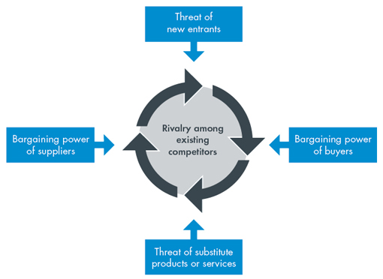
So, how to understand any industry?
Most well respected, time-tested method is Michael Porter’s Five Forces.
What are the Five Forces?
Suppliers (bargaining power)
Substitutes (threat of substitutes)
Buyers (bargaining power)
Potential entrants (threat of new entrants)
Industry competitors (competition/rivalry)
By analyzing these five forces a firm can figure out the profitability of an industry.

Slide 9
Production Economies
Production economies make it difficult for entrants to quickly enter and compete on the same level as existing firms.
ECONOMIES OF SCALE = Average unit costs decline with increased volume of a single product.
ECONOMIES OF SCOPE = Average unit costs decline when producing related products.
ECONOMIES OF LEARNING = Average unit costs decline with cumulative production.
NETWORK ECONOMIES = Attractiveness of product increases with number of users.

Slide 10
Rivalry Determinants (1)
Seller concentration
=Number and size distribution of firms competing in a market.
The closer your firm gets to monopoly, the more ability it has to charge higher prices.
Having a limited number of firms may allow coordinated pricing and higher profit.
Diversity of competitors
=How similar competitor firms are in origins, objectives, costs, and strategies.
The more similar competitor firms are, the easier it is to coordinate pricing and earn profit.
Product differentiation
=How similar or indistinguishable the goods/services offered by firms are.
When products are hard to distinguish, firms compete on price and earn less profit.

Slide 11
Rivalry Determinants (2)
Excess capacity
=When firms produce more than is demanded by customers.
When firms have excess capacity, they try to increase demand by lowering prices, even if that means lowering profit.
Exit barriers
=Costs associated with leaving an industry.
If it’s expensive for firms to leave an industry, say because they have a special machine that can only be used for their product and it’s hard to sell, they stay.
Cost conditions
=The nature of costs a firm faces.
If the costs a firm faces are such that they have to operate even during a downturn, the fall in profits can be even lower.

Slide 12
Why are the Five Forces useful?
Analyze and understand an industry.
This helpful in predicting how profitable a firm could be.
When forces are weak, firms make profit.
When forces are strong, few firms make large profits.
But industry analysis is more useful than that.
It can help firms design strategies that alter industry structure to its own advantage.

Slide 13
Porter, “The Five Forces that Shape Strategy”
What are the three ways a firm can use the Five Forces analysis to design a superior strategy?
Position your company where the forces are weakest.
Exploit changes in the forces.
Reshape the forces in your favor.
Examples:
Paccar
This truck company targeted private truck owners, tailoring their trucks to these customers, because there was less competition in the private truck market.
Apple
Apple designed the iPod to play mp3 files, which were new and widely shared.
Coca-Cola
To reduce rivalry with other beverages like water, soft drink companies introduced vending machines to increase substitutability of soda.

Slide 14
Don’t confuse industry structure with….
Industry growth rate
Fast growing industries are not always attractive.
Firms can still find themselves vulnerable to supplier bargaining power, customer bargaining power, or threat of substitutes.
Technology and innovation
Advanced technology industries seems “sexy”, but not always attractive.
Sexy industries often attract competitors; you’re better off with low-tech and high barriers to entry.
Government
Government involvement does not make an industry more or less attractive.
Best to just focus on how government affects the Five Forces.
Complementary products and services
Complementary products do not make an industry more or less attractive.
Again, focus on how complementary products affect the Five Forces.

Slide 15
Drawing Industry Boundaries
Key criterion: SUBSTITUTABILITY
On the demand side : are buyers willing to substitute between types of cars and across countries
On the supply side : are manufacturers able to switch production between types of cars and across countries
We may need to draw industry boundaries differently for different types of decisions
Wal-Mart example
Local: for product selection decisions
National/Global: for distribution decisions or online pricing

Slide 16
Class Objectives/Plan
Review of Last Class
Applying Industry Analysis: Examples
Extending 5 Forces
Dynamic Competition
Segmentation and Strategic Groups
Airline Case

Slide 17
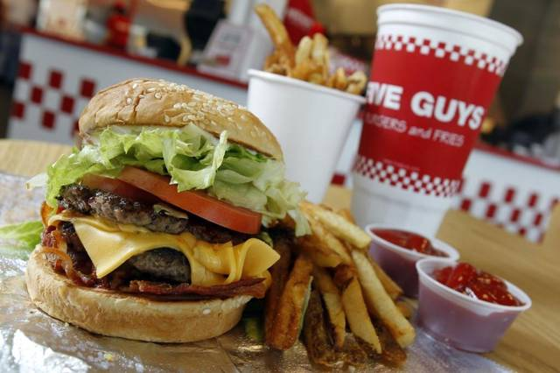
Let’s try this out: Five Guys
First, let’s define the boundaries of the industry.
Now
Competition from substitutes
Threat of entry
Rivalry with industry competitors
Bargaining power of customers
Bargaining power of suppliers

Slide 18
Marijuana Industry
Listen to the Following Clip
Background:
In Colorado, the sale of marijuana for recreational use had been legalized.
But production, possession, and sale of marijuana was still illegal under federal law.
Venture capitalists are interested in the investment opportunities presented by this emerging industry, including Founders Fund, a prominent venture capital investor.
Question:
For venture capital investors with a medium-term time horizon, how attractive is the Colorado marijuana industry as an investment destination?
How do you think the US marijuana industry will develop over the next ten years? What will be the implications of this development for competition and profitability?

Slide 19
Marijuana Industry Example
Question:
Would the legal marijuana industry offer the high levels of profitability associated with other industries supplying controlled substances such as alcohol, tobacco and pharmaceuticals?
Key takeaway:
While Porter’s framework is qualitative, in new and changing industries, this approach is more reliable than projecting revenues and costs into the future

Slide 20
Class Objectives/Plan
Review of Last Class
Applying Industry Analysis: Examples
Extending 5 Forces
Dynamic Competition
Segmentation and Strategic Groups
Airline Case

Slide 21
Does Industry Matter?

Slide 22
Five Forces or Six?
Complementary products do not make an industry more or less attractive.
Again, focus on how complementary products affect the Five Forces.
Hot Dogs and Buns
Here: buns are not specific to certain hot dogs, so complements don’t have a strong effect on industry profitability.
Except… if bun-makers have a found a way to make people purchase excess!

Slide 23
Platform-based Competition
Complements—especially in the markets for digital products—give rise to platform-based competition
A platform is an interface in a 2-sided market
E.g. A smartphone operating system (iOS or Android) links a market for smartphones to a market for applications
This complementary relationship gives rise to network externalities that create a winner-take-all market
I.e. In smartphones, developers write apps for the biggest selling smartphone platform; consumers buy the smartphone platform with the most apps
(However, in smartphones market big enough and segmented enough to support two winning platforms)

Slide 24
Takeaways
Complementary products are important, but mostly in how they influence the 5 Forces (like other environmental factors)
Industry might not matter a lot compared to firm effects in explaining firm performance
Next, we will explore a few reasons why that may be the case.

Slide 25
Class Objectives/Plan
Review of Last Class
Applying Industry Analysis: Examples
Extending 5 Forces
Dynamic Competition
Segmentation and Strategic Groups
Airline Case

Slide 26
Competition as a Dynamic Process
Porter framework assumes:
industry structure drives competitive behaviour
Industry structure is (fairly) stable.
But, competition also changes industry structure:
Schumpeterian Competition: A “perennial gale of creative destruction” –market leaders overthrown by innovation
Hypercompetition: “intense and rapid competitive moves…. continuously creating new competitive advantages and destroying existing competitive advantages”
Implication:
Within 5-forces framework:
INDUSTRY STRUCTURE COMPETITION
Under dynamic competition:
COMPETITIVE STRATEGY INDUSTRY STRUCTURE

Slide 27
Game Theory in Competitive Analysis
Value of Game Theory
Frames strategic decisions as interactions between competitors
Predicts outcomes of competitive situations involving a few,
evenly-matched players
Provides key insights into the nature and determinants of interactions among competitors. E.g.:
Competition and Cooperation—Game theory can show conditions where cooperation more advantageous than competition
Deterrence—changing the payoffs in the game in order to deter
a competitor from certain actions
Commitment—irrevocable deployments of resources that
give creditability to threats
Signaling—communication to influence a competitor's decision
Problems of game theory:
Able to explain past competitive behavior—weak in predicting future behavior.
Lack of an integrated general theory— Many different models; outcomes highly
sensitive to small changes in assumptions

Slide 28
Game Theory: Useful?
Useful: can explain why companies get into “advertising wars”
But: is advertising creating strong “brands”, and actually preventing competition solely on price?
Difficult to capture all possibilities into a single payout number.

Slide 29
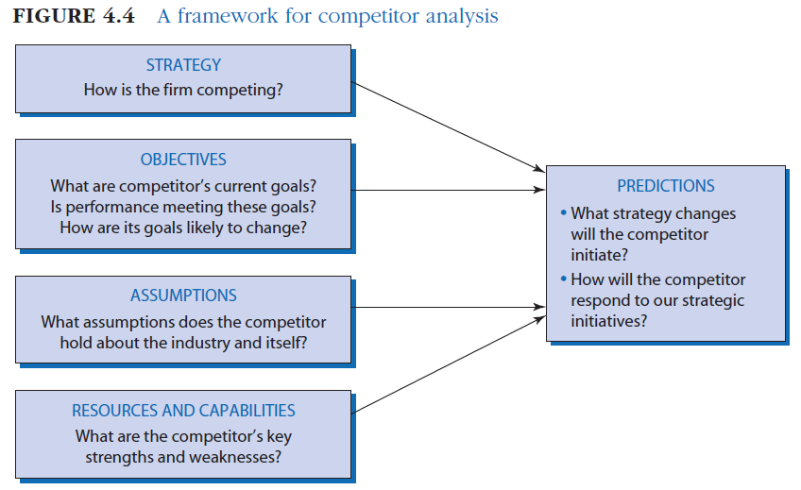
Framework for Competitor Analysis
Takeaway: use the ideas of how competitors may strategically respond (motivated by game theory), in a more flexible framework to generate useful future predictions

Slide 30
Class Objectives/Plan
Review of Last Class
Applying Industry Analysis: Examples
Extending 5 Forces
Dynamic Competition
Segmentation and Strategic Groups
Airline Case

Slide 31
Segmentation Analysis

Slide 32
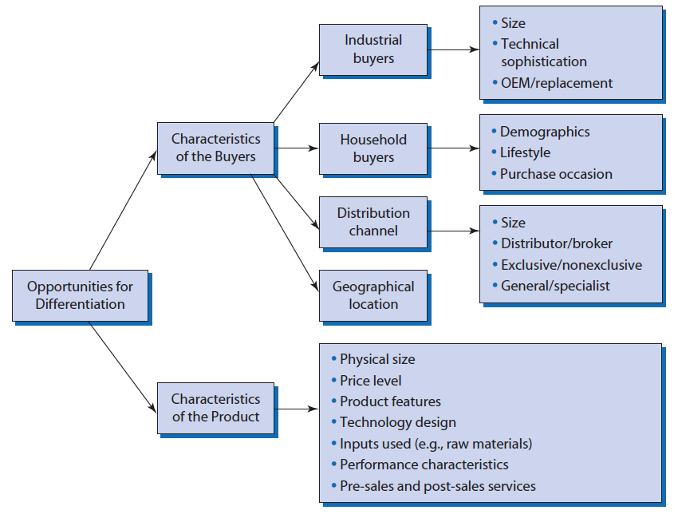
Segmentation Variables

Slide 33
Bicycles: Segmentation & Success Factors

Slide 34
Strategic Group Analysis
A strategic group is a group of firms in an industry that follow the same or similar strategies
Identifying strategic groups:
Identify principal strategic variables which distinguish firms.
Position each firm in relation to these variables.
Identify clusters.

Slide 35
Strategic Groups in Automobiles

Slide 36
Takeaways
Might want to consider segments, as opposed to entire industry, as relevant set of firms that comprise an “industry”
Similarly, can look for firms that follow similar strategies, in a “strategic group” as closest competitors

Slide 37
Class Objectives/Plan
Review of Last Class
Applying Industry Analysis: Examples
Extending 5 Forces
Dynamic Competition
Segmentation and Strategic Groups
Airline Case

Slide 38
U.S. Airline Industry
Let’s assess the overall financial performance of the U.S. airline industry during the past 20 years?

Slide 39
U.S. Airline Industry
To what extent can the industry’s low average profitability during this period be attributed to the structure of the industry?
Which of Porter’s Five Forces has had the biggest impact in depressing industry profitability?

Slide 40
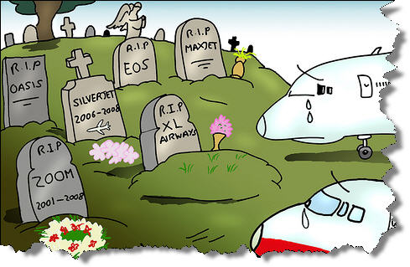
U.S. Airline Industry
What is the outlook for industry profitability during the next five years (2016-2020)?

Slide 41
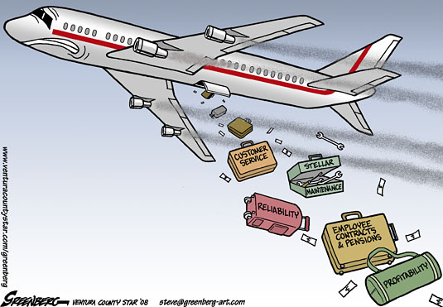
U.S. Airline Industry
Are there any strategies used by the airlines that have been effective in moderating the forces of competition?
Any strategies that the airlines could use to improve industry profitability in the future?

Slide 42
Key Takeaways from Case
Industry structure drives competition which in turn determines industry profitability.
Inability of the US airline industry to generate profits is not because the industry has managed by idiots. It’s because of the industry structure.
Porter’s Five Forces of Competition offers a useful framework for a detailed analysis of the impact of industry structure on competition and profitability.
Porter’s Five Forces is useful not just in explaining the past/present, but in
Predicting the intensity of competition/levels of profitability in the future.
Suggesting strategies that can moderate the forces of competition.
Porter’s Five Forces is not an algorithm that provides clear answers - it’s a way to organize thinking. Ultimately, this is a matter of judgement.

Slide 43
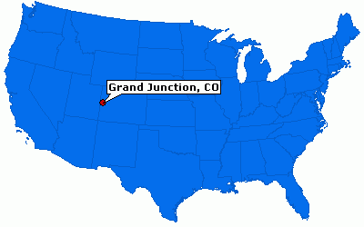
Health Care Article
What did Obama praise about Grand Junction, Colorado when he visited there in 2009?
He praised their good health outcomes and low medicare payments.
But what did he miss in this analysis?
People in Grand Junction pay some of the highest rates for private health insurance.
How did this happen?
The ACA encouraged hospitals to merge. The ones in Grand Junction did merge.
This allowed the hospital systems to reduce duplicate treatments, but it gave them a monopoly.
What does this say about industry structure of health care in Grand Junction?

Slide 44
End of Lecture: Happy Feb Break!
Thursday: Competitive Advantage I
Grant, Contemporary Strategy Analysis, Chapter 5, “Analyzing Resources and Capabilities”
Collis & Montgomery (2008), “Competing on Resources,” Harvard Business Review.*
Hansen (2012), “How Zara Grew into the World’s Largest Fashion Retailer,” The New York Times.*
*Posted on Piazza
Assignments:
Reading Questions 5 (not HW2)**
**Sent via e-mail tomorrow

