Slide 1
Managerial Economics II: Business Strategy Lecture 20: Government and Business
Professor Wolfolds
Cornell University
Dyson School of Applied Economics and Management
April 20th, 2017
Cornell Business

Slide 2
Logistics
Graded Problem Set 1 and Prelims are available for pick-up at the end of class
Problem Set 2 is available on Piazza (due April 25th)
Any questions?

Slide 3
Class Agenda
Review of last class
Class Objectives
Public Politics
Free the Grapes Example
Lobbying
Q&A

Slide 4
Class Agenda
Review of last class
Class Objectives
Public Politics
Free the Grapes Example
Lobbying
Q&A

Slide 5
Who is the bottom of the pyramid?
The largest socioeconomic group in the world is also the poorest
The 2.5 billion people living on less than $2.50/day
Significant market
$5 trillion consumer purchasing power
Significant unmet needs
Lack of access to: Water, Sanitation facilities, Health care, Electricity, Banking

Slide 6
Challenges in addressing the BOP
Bottom of the pyramid may not individually have access to capital to purchase
Geographic dispersion
Infrastructure issues
Complementary assets less available
Including imperfect contracting environment
Distribution and logistics more challenging
Plus additional “developing country” problems
Heavy bureaucracy, political instability, corruption
Scale needed, but fundamentally hard to “scale up”

Slide 7
Measures of Governance
Voice and Accountability: free press, democracy
Political Stability and the Absence of Violence: sudden (unexpected) changes in government
Government Effectiveness: public goods
Regulatory Quality: how well defined are they; price controls
Rule of Law: are contracts/laws enforced
Control of Corruption: bribery

Slide 8
BOP Strategy often includes
Localize value creation
Building local ecosystems
Local distribution
Local entrepreneurs
Enabling access via financing
Unique financing strategies
Payment plan, Informal credit
Difference in products themselves
Different functionality
No complementary assets
Cheaper to produce

Slide 9
Developing vs. Developed Country MNEs
Describe how operating in developing countries differs
How do developing MNEs compare to developed MNEs?
Bigger, better tech, more resources, strong brand, host gov’t preferences
BUT, developing MNEs are more familiar with operating in developing countries! (Smaller CAGE distance, and so may have relative advantages)
What are the factors firms should consider when operating in developing countries?
How well do resources and capabilities translate? How would they fit in with obtaining new capability of operating in developing countries?

Slide 10
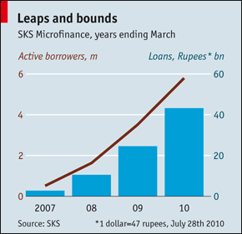
Is profit in microfinance good or bad?
Good
Capital markets can help scale
- SKS grew 3 times as fast as Grameen, reduced interest rates
Difficult and time-consuming to be aligned with the government
Bad
Ownership: money of the poor going to the very rich
Major shareholder of SKS is Vinod Khosla
Questionable ethical results at SKS

Slide 11
Review of Guest Lecture
First Book
Importance of business plans for non-profits
Do something that is scalable: issue of consistent revenue stream vs. donations
Partnerships: Junior League, Coast Guard, Corporations
Win-win with corporations
Disruption 1: Take books in Book Bank
Disruption 2: Marketplace guarantees access/no returns
Resources: network, organizational culture
Local advisory boards with national scale
Economies of Scale with negotiating with publishers
Economies of Scope with partnering to provide children with other needed items

Slide 12
Class Agenda
Review of last class
Class Objectives
Public Politics
Free the Grapes Example
Lobbying
Q&A

Slide 13
Class Objectives
Define what public politics are
Discuss strategies for public politics
Be able to advise companies on how to employ public politics
Discuss implementation techniques of public politics: lobbying

Slide 14
Class Agenda
Review of last class
Class Objectives
Public Politics
Free the Grapes Example
Lobbying
Q&A

Slide 15
Public Politics
PUBLIC POLITICS = Competition among interests in the arenas of government institutions.

Slide 16
Public Politics
PUBLIC POLITICS = Competition among interests in the arenas of government institutions.
Public Politics Strategies
Here, firms intervene in the public policy making process.
Firm actions are transformed into public policy through government institutions.

Slide 17
Business in Politics: Legal Right
First, what right does business have to interfere in politics?
Legal institutions
First Amendment to the Constitution
Grants persons, including companies, the right to free speech and the right to petition the government.
First National Bank of Boston v. Bellotti (435 U.S. 765 (1978)) Supreme Court
First clear definition of corporations’ right to free speech.
Specifically, protected right to make expenditures and participate in political competition on a state ballot proposition.
Pacific Gas & Electric Co. v. Public Utilities Commission of California (475 U.S. 1 (1986)) Supreme Court
Clarified corporations’ right to free speech included right NOT to.
California Public Utilities Commission (PUC) had ordered Pacific Gas & Electric to include an insert from a consumer group with bills.
Businesses thus have the legal right to participate in government processes.

Slide 18
Business in Politics: Moral Right
But, what about the moral right?
Criticism (1): Business shapes outcomes that are contrary to the public interest.
Common counterargument: Not clear what the public interest is.
Example: Antidumping laws
Put in place over 80 years ago.
Goal to prevent foreign companies from “dumping”.
Lowers prices for consumers.
Government rightly recognizes that dumping is used to limit competition.
So, in effect, dumping raises prices for consumers by limiting competition.
So, are antidumping laws in the public interest or against it?

Slide 19
Business in Politics: Moral Right
Criticism (2): Corporations have undue influence.
Legal structures are designed to allow pressure by the loudest voices.
Belief that the volume signals importance to constituents.
Corporations have enormous resources, giving them the power to be incredibly “loud”.
Does the possible conflict of corporations’ goals with consumers’ interests suggests their power should be constrained?
Supreme Court case Austin v. Michigan Chamber of Commerce (494 U.S. 652 (1990)) summarizes the debate well.
Upheld Michigan law prohibiting corporations from making expenditures on behalf of a candidate.
Thurgood Marshall (majority): “The corrosive and distorting effects of immense aggregations of wealth that are accumulated with the help of the corporate form.”
Antonin Scalia (dissent): “The fact that corporations amass large treasuries is not sufficient justification for the suppression of political speech unless one thinks it would be lawful to prohibit men and women whose net worth is above a certain figure from endorsing political candidates.”

Slide 20
Business in Politics: Moral Right
Most common counterarguments
Businesses represent people
As unions give a voice to members, corporations give a voice to shareholders.
Firms’ benefits are passed on to employees, suppliers, and hence, the local economy.
When business benefits, everyone does.
Businesses should be responsible, but are fallible, like people
Even with legal rights, businesses have a responsibility to engage in the political process responsibly and not abuse the system beyond what legal codes demand.
Most businesses adhere to this responsibility and get it wrong as often as individuals do.
Does this weigh out for you? Do businesses have the moral right to interfere in politics?

Slide 21
Engaging the political process effectively
A 4 step process for engaging a public politics strategy
Understand the institutions surrounding the competition among stakeholder groups.
Tool: Wilson-Lowi Matrix
Pick the government institution.
Pick the strategy.
Some tested broad categories of public politics strategies.
Optimize the outcomes.
Consider a coalition and legal action.

Slide 22
1. Understand the institutions surrounding stakeholder competition.
Wilson-Lowi Matrix
Wilson (1980) (based on Lowi (1964)) built a framework that categorizes the nature of political competition on non-market issues.
Designed around the benefits and harm from a non-market alternative.
The non-market alternative may be the adoption of a particular piece of legislation.
Benefits/harm is relative to the status quo.
Compares concentrated versus distributed outcomes (harm/benefits).
Concentrated outcomes are high per person.
Widely distributed outcomes are low per person.

Slide 23
Wilson-Lowi Matrix
Gives us four different types of politics
Interest Group Politics
Entrepreneurial Politics
Client Politics
Majoritarian Politics
 |  | Benefits from Enacting the Non-Market Alternative
 |  | Concentrated | Widely Distributed
Harm from Enacting the Non-Market Alternative | Concentrated | Interest Group Politics | Entrepreneurial Politics (converse of client politics)
 | Widely Distributed | Client Politics (converse of entrepreneurial politics) | Majoritarian Politics

Slide 24
Interest Group Politics
Interest Group Politics
Benefits/harm to opponents/supporters (or vice versa) are both concentrated.
Outcome
Determined by both the amount and effectiveness of the non-market action.
Amount: More stakeholders mobilized, more letters, more phonecalls, more bills, etc.
Effectiveness: Appeal to stakeholder interests (ex: human rights appeals), and appeal to policy maker interests (ex: getting re-elected).
Example: Trade policy (Trans-Pacific Partnership)
TPP includes a number of labor rights provisions (minimum wages, child labor restrictions) that have broad impacts on business.
Labor rights activists argue that the benefits to foreign workers is concentrated (intense).
Business argues that the damage to American workers is concentrated (intense).
Amount and effectiveness of either side’s strategy not clear for TPP yet. Tide could be shifting against trade agreements.

Slide 25
Entrepreneurial Politics
Entrepreneurial Politics
Benefits to supporters are diffuse; harm to opponents are concentrated.
Outcome
Determined by whether the supporters get an entrepreneur to represent their interests.
The entrepreneur is needed to mobilize or represent supporters.
Entrepreneur can be a member of Congress, an activist, or a business leader.
If no entrepreneur, the alternative is unlikely to occur.
Example: Tax inversions
Pfizer walked away from a merger with Allergan that would have allowed the company to move its headquarters to Ireland and lower taxes dramatically by not paying U.S. taxes.
Benefits from eliminating tax inversions are diffuse - all taxpayers will see a very small break.
Harm from eliminating tax inversions are concentrated - business interests claim they cannot compete with foreign companies who face lower taxes.
Obama is the entrepreneur – he called tax inversions “the most insidious tax loopholes out there”.

Slide 26
Client Politics
Client Politics
Benefits to supporters are concentrated; harm to opponents is diffuse.
Outcome
Determined by the beneficiaries, who are motivated to act.
Beneficiaries face little risk of competition from the opposition.
Beneficiaries become the “clients” of the officeholders.
Beneficiaries work and usually succeed in making officeholders serve their needs.
Example: Gramm-Leach-Bliley Act (1999)
Repealed parts of Glass-Steagall that prevented banking, securities, and insurance companies from consolidating.
GLBA offered concentrated benefits to the banking, securities, and insurance businesses.
Harm to securities firms’ clients and financial system at the time seemed widely distributed.
These financial firms passed GLBA easily with widespread bi-partisan support.

Slide 27
Majoritarian Politics
Majoritarian Politics
Benefits/harm to opponents/supporters (or vice versa) are both diffuse.
Outcome
Determined by the preferences of a majority.
Little to no non-market action is taken and democratic principles control outcome.
Example: Social security reform
Each individual benefits from social security, but each individual is also taxed.
Benefits to social security reform are diffuse to everyone.
Harm from social security reform are diffuse to everyone too.
Because no one group has concentrated benefits, little non-market activity has mobilized on the issue.

Slide 28
Engaging Public Politics Effectively
Understand the nature of the competition among interest groups.
Pick the government institution.
Multiple arenas/government institutions in which issues can be addressed

Slide 29
Public Politics Process Map
Public policy analysis (information)
Pluralistic private interests
Government Institutions
Public Policy
Non-market issue
Sometimes, businesses can choose the institutional arena in which the non-market issue is addressed.
Legislatures
Administrative agencies
Courts
International accords
Etc.

Slide 30
Institutional Choice Example: Cemex
Mexican cement producer
1990: The U.S. International Trade Commission rules Cemex was dumping in the southern United States.
Charged with a 58% duty (like a tariff) on all Cemex exports from Mexico into that region of the U.S.
Cemex then created a new department with full support to oversea a multi-pronged strategy aimed at overturning these duties.
Cemex tries to have the duty overturned at, in order
The International Trade Administration
The U.S. Court of International Trade
The General Agreement on Tariffs and Trade
The North American Free Trade Agreement
Finally, Congress
Cemex was trying to find the government institution that would rule in its favor.

Slide 31
Engaging Public Politics Effectively
Understand the nature of the competition among interest groups.
Pick the government institution.
Select your strategy.
Pick from a couple tested, proven public politics strategy types.
Representation strategies
Majority building strategies
Information provision strategies

Slide 32
Representation Strategies
Representation strategies target constituents.
Government officeholders are elected by their constituents.
Constituents may also be individuals who buy a firm’s goods and services.
Firms can build support for their firm’s agenda by appealing to these constituents.
Example: Cemex
Attempts to overturn antidumping duties were unsuccessful, so Cemex acquired a plant in Texas and built other plants throughout the southwest U.S.
Cemex now had constituents employed at their plants in Texas and elsewhere.
Cemex and the employees at the plants then argued to the representatives of areas that held plants that overturning the duties would help these constituents.
They effectively mobilized their elected Senators and Governors.

Slide 33
Majority-Building Strategies
Majority-building strategies target the needed votes in a legislature to enact/defeat a bill.
Support can come from the “majority” or % of votes needed.
Interest groups and officeholders recruit enough votes to win support for an agenda.
Interest groups can offer political support; officeholders can trade votes.
Support can also come from key individuals.
Pivotal voters: target voters who are most likely to switch an outcome from defeat to victory cheaply.
Example: Cemex
Majority
Cemex sought coverage in the U.S. media including The Wall Street Journal for what it termed “unfair” treatment, led by competitors in the U.S.
Pivotal
Senators and Governors from states where Cemex had plants then lobbied at U.S. Department of Congress.
Cemex also petitioned Mexican Commerce Department in hopes it would pressure the U.S. DOC (Mexico chose not to because of fear of jeopardizing NAFTA negotiations).

Slide 34
Informational Strategies
Target providing information to government officeholders.
Firms/interest groups provide this information to government officeholders.
While officeholders know that the information is in favor of the firm/interest group, the information can also inform their decisions.
Example: Cemex
Cemex argued that they faced a bulk market at home and that is why they sold abroad at lower costs.
Competitors disagreed. Effectively passed dumping duties.
Cemex was able to provide data that the bulk market in Mexico was not fictitious.

Slide 35
Engaging Public Politics Effectively
Understand the nature of the competition among interest groups.
Pick the government institution.
Pick the right strategy.
Optimize the outcomes of that strategy.
Increase impact and reduce costs
Consider a coalition.
Coalitions can reduce costs and increase benefits.
Consider legal pressure.
Legal action can be effective if the political process is strongly dominated by opponents.

Slide 36
Optimizing Outcomes
Coalition = A group of companies, organizations, or groups coming together to pursue a common goal.
Example: Cemex
Cemex formed a coalition with the National Association of Home Builders, who were impacted by the higher cement prices because of the duties.
NAHB is one of the largest trade association in the United States (140,000 members).
NAHB has vast non-market capabilities Cemex was able to employ.

Slide 37
Optimizing Outcomes
Consider legal pressure
Sometimes public politics pressure is not yielding benefits.
Before considering legal enforcement, consider costs of strategy and strength of legal argument.
Example: Cemex
Cemex took ITC decision to the U.S. Court of International Trade, arguing that ITC had considered Japanese data in addition to Mexican data (failed).
1992 GATT legal proceedings concluded U.S. had improperly imposed duties on Cemex, U.S. had to return $30 million in duties it had collected.
Based on the fact that the DOC had not confirmed that the committee of petitioners adequately represented industry.
Committee represented 61.7% of industry, while it was supposed to represent all of production according to GATT.

Slide 38
Class Objectives
Define what public politics are
Competition among interests in the arenas of government institutions.
Discuss strategies for public politics
Understand the institutions surrounding the competition among stakeholder groups.
Tool: Wilson-Lowi Matrix
Pick the government institution.
Pick the strategy.
Some tested broad categories of public politics strategies: representation, majority-building, and informational strategies.
Optimize the outcomes.
Consider a coalition and legal pressure.

Slide 39
Class Agenda
Review of last class
Class Objectives
Public Politics
Free the Grapes Example
Lobbying
Q&A

Slide 40
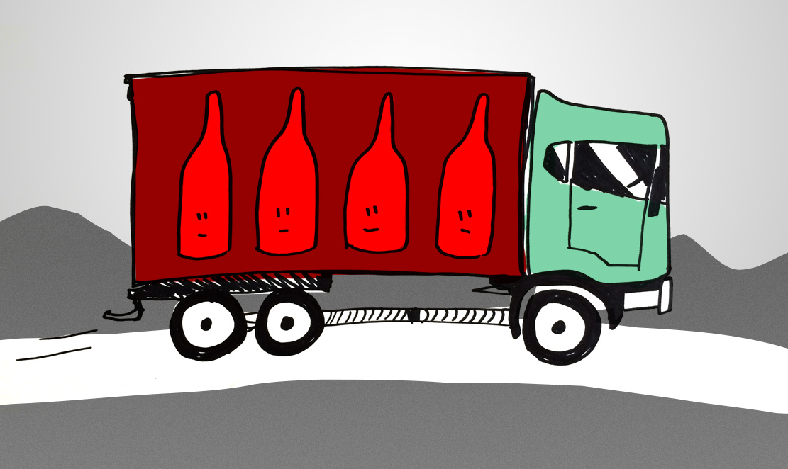
Free the Grapes: Wine Industry
Please read the following article

Slide 41
Free the Grapes: Wine Industry
Please read the following article
Let’s think about the industry here:
Who are the players?
What’s the non-market issue?

Slide 42
Applying Wilson-Lowi Matrix
Interests | For/Against Shipping (Benefit/Harm) | Why? | Concentrated/Diffuse Outcome (Benefit/Harm)
Consumers
Distributors
Producers
Legislators

Slide 43
What’s the barrier?
What is the major impediment to allowing direct-to-consumer shipping of wine?
Influence of distributors
Slow legislative process
Failure of wineries to act effectively
Protecting minors
Failure to motivate stakeholders
Cultural puritanism (think blue laws)
Bargaining to keep benefits local

Slide 44
What strategies is Free the Grapes considering?
Strategies | Pluses | Minuses
Legislative Approach (convince state officials to change their laws)
Legal Approach (overturn ban in court)
So, what should they do?

Slide 45
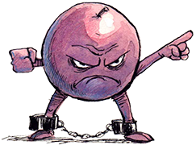
Case update
Mostly legislative strategy chosen
Five wine industry associations and centers formed Free the Grapes (a coalition) to represent the interests of consumers and wineries.
www.freethegrapes.org
Targeting lawmakers
Informing and encouraging consumer activism
Bringing together interest groups to achieve more
Some state by state legislative success..
2007: Two states transitioned from reciprocal to a DTC permit system (MO, WV) with additional states pending (OR, IL)
Still working at it….
2015: Indiana removed the “winery visit penalty,” requiring a consumer to first visit the winery before any wine can be direct shipped

Slide 46
Class Objectives
Be able to advise companies on how to employ public politics
Understand the institutions surrounding the competition among stakeholder groups: concentrated harm, diffuse benefits → entrepreneurial politics
Pick the government institution: state legislators
Pick the strategy: majority-building (PR Campaign)
Optimize the outcomes: coalition-building (Free the Grapes)
Broadly, how would regulation/public politics affect environment? Five Forces?

Slide 47
Class Agenda
Review of last class
Class Objectives
Public Politics
Free the Grapes Example
Lobbying
Q&A

Slide 48
Public Politics Implementation Activities
Lobbying
Electoral support
Coalition building
Grassroots and constituency campaigns
Testimony
Public advocacy
Judicial actions

Slide 49
1. Lobbying
LOBBYING = Strategic communication of politically relevant information to government officeholders.
Typically, happens behind the scenes (in contrast to public advocacy).
Big business
In 2012, $3.5 billion spent on registered lobbying in Washington DC by companies, unions, and other organizations.
Only calculated lobbying that is subject to reporting requirements.
Increasing
$1.44 billion --$2.47 billion from 1998-2005.

Slide 50
Who does it?
Top 10 Lobbying Firms in 2015 | Total
Akin, Gump et al | $39,530,000
Brownstein, Hyatt et al | $25,355,000
Squire Patton Boggs | $25,000,000
Podesta Group | $23,180,000
Van Scoyoc Assoc | $21,560,000
Holland & Knight | $19,520,000
K&L Gates | $18,150,000
BGR Group | $17,530,000
Capitol Counsel | $17,040,000
Williams & Jensen | $16,990,000
Top Lobbying Clients in 2015 | Total
US Chamber of Commerce | $84,730,000
National Assn of Realtors | $37,788,407
Blue Cross/Blue Shield | $23,292,049
American Medical Assn | $21,930,000
Boeing Co | $21,921,000
General Electric | $20,920,000
American Hospital Assn | $20,687,935
Business Roundtable | $19,250,000
Pharmaceutical Rsrch & Mfrs of America | $18,920,000
National Assn of Broadcasters | $17,360,000
The majority of lobbying is done by a professional lobbying firms or a law firm with lobbying expertise.
The majority of lobbying is done for big professional associations (e.g. AMA), or for big corporations (e.g. Boeing).
Center for Responsive Politics

Slide 51
Which industries and issues?
Top Lobbying Sectors 2015 | Total
Misc Business | $520,237,760
Health | $503,649,480
Finance/Insur/RealEst | $481,710,169
Communic/Electronics | $380,059,553
Energy/Nat Resource | $322,831,621
Transportation | $221,153,699
Other | $202,040,949
Agribusiness | $131,512,669
Ideology/Single-Issue | $130,974,552
Defense | $126,465,264
Top Lobbying Issues 2015 | No. of Clients*
Fed Budget & Appropriations | 3,013
Health Issues | 1,977
Taxes | 1,899
Transportation | 1,507
Defense | 1,128
Energy & Nuclear Power | 1,089
Trade | 1,050
Environment & Superfund | 969
Medicare & Medicaid | 964
Education | 934
The amount of lobbying in an industry typically depends on the amount of government control.
When industries are market controlled, less lobbying.
Center for Responsive Politics

Slide 52
Benefits to lobbying for Managers?
International trade (tariffs, customs classifications, and dumping)
Lobbying improves trade conditions for firms/industries that compete internationally
(Grasse and Heidbreder, 2011; Gawande et al., 2006, 2012; Stoyanov, 2009; Ehrlich, 2008; Lee and Baik, 2010)
Financial and regulatory accounting
Lobbying affects firms’ ability to influence financial regulation and legislation, allowing them to hide revenue, avoid fraud detection, and capture excess returns.
(Mian and Trebbi, 2011; Blau et al, 2013; Hochber et al, 2009).
Appropriations and budgeting
Interest groups and allies get more of government budget and more contracts.
(Evans, 1996; Helland, 2008, de Figueiredo and Silverman, 2006, 2007).
Unobservable benefits?
Absence of new bills on an issue could be an unobservable result of successful lobbying.
“Status calls” - calls to politicians to ensure law’s enforcement at unobservable.

Slide 53
Benefits to lobbying for Government?
If lobbying involves persuading government officials of an interest group’s position, why would they allow it?
Useful to government officials because it conveys information.
Technical information.
Government lawmakers, who may have to vote on 5,000 distinct bills, rely on lobbyists for information about a potential government action.
Example: What is the effect of a bill on sales in an industry?
Think of Toshiba example: Toshiba proposed a barrier between Toshiba Machine and Toshiba Corporation which sold important products to the U.S. (sales of $2.6 billion).
Political information.
Government lawmakers rely on lobbyists as an indicator of public support for a bill.
Example: How many jobs in their district will be lost?
Think of Toshiba example: Argued that Toshiba Machine plant employees (4,200) would be hurt by sanctions.

Slide 54
Lobbying – Legal Controls
Regulation of Lobbying Act of 1946 – principle law governing lobbying
Requires registration of lobbyists.
Primary purpose is to provide information to members of Congress about individuals who lobby them, and thereby reduce the influence of lobbyists.
United States v. Harriss (347 U.S. 612) (1954)
Lobbyists sued government, arguing that Regulation of Lobbying Act was unclear and vague.
Supreme Court upheld 1946 law, but interpreted the act as pertaining only to direct lobbying of Congress by a hired lobbyist.
Activities between firm managers and legislators is not lobbying.
Public relations is not lobbying.
Grassroots political activities is not lobbying.

Slide 55
Lobbying – Legal Controls
Lobbying Disclosure Act (1995)
Improve accountability in lobbying by increasing and making specific the reporting and registration requirements.
Requires registration
If an organization has one or more “lobbyist”.
Requires reporting
All registered entities must file a report quarterly that detail how much was spent and on what issue.
All registered entities must file semiannual reports that detail the feeds they receive, travel, contributions and gifts.
Clarifies who is a lobbyist
Any individual who spends 20% or more of their time lobbying over a 6 month period.
Any organization that spends $10,000 or more on lobbying activities over a year.

Slide 56
Legal Controls Clarification
Lobbying cannot take the form of gift giving.
Various laws prohibit gifts to members of Congress (for the most part)
Members of Congress can receive gifts worth less than $50, but not worth more than $100/year.
Meals, tickets to events, travel, and any physical goods are considered gifts.
Travel for “fact-finding” trips, meetings, or speeches are excepted.
Example: Mondavi and government officials
Robert Mondavi winery hosted the Secretary of Agriculture under Bill Clinton (1997) for dinner ($187 for wine, $207 for dinner).
Resulted in $150,000 in civil penalties for Mondavi winery.
Lobbying controls trying to limit the “revolving door”
Ethics in Government Act (1978)
Restricts contact of officials and regulators with their agency for 2 years after leaving.
Restricts members of Congress and their staff from lobbying 1 year after leaving office.

Slide 57
“Note on Lobbying”
What was Fred Smith’s goal of engaging public politics and what was his strategy?

Slide 58
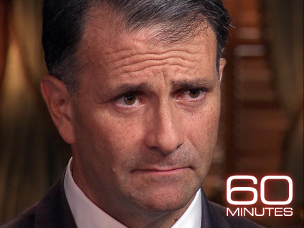
“Note on Lobbying”
Who’s this guy? And what did he do to get famous?

Slide 59
Class Objectives
Discuss implementation techniques of public politics: lobbying
Lobbying: Strategic communication of politically relevant information to government officeholders.
Everyone does it!
Tightly regulated, but an important part of public politics

Slide 60
Class Agenda
Review of last class
Class Objectives
Public Politics
Free the Grapes Example
Lobbying
Q&A

Slide 61
Q&A
Any questions?
Fill out muddiest card and leave here if anything was confusing today!

Slide 62
End of Lecture:
Tuesday: Government and Society
Porter & Kramer (2006), “Strategy and Society: The Link between Competitive Advantage and Corporate Social Responsibility”*
* Posted on Piazza
“Wal-Mart’s Business Environment,” HBS Case Study**
** Available in HBR Course Packet
Assignments:
Problem Set #2 due Tuesday

