Slide 1
Set Identities
Section 2.2

Slide 2
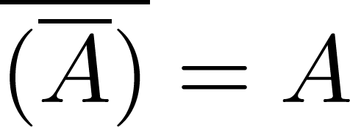
Set Identities
Identity laws
Domination laws
Idempotent laws
The Law of Double Complementation
Continued on next slide →

Slide 3
Set Identities
Commutative laws
Associative laws
Distributive laws
Continued on next slide →

Slide 4
Set Identities
De Morgan’s laws
Absorption laws
Complement laws

Slide 5
Proving Set Identities
Different ways to prove set identities:
Prove that each set (side of the identity) is a subset of the other.
Use set builder notation and propositional logic.
Membership Tables: Verify that elements in the same combination of sets always either belong or do not belong to the same side of the identity. Use 1 to indicate it is in the set and a 0 to indicate that it is not.
Use Venn Diagrams.

Slide 6
Proof of Second De Morgan Law
Example: Prove that
Solution: We prove this identity by showing that:
1) and
2)
Continued on next slide →

Slide 7
Proof of Second De Morgan Law
These steps show that:
Continued on next slide →

Slide 8
Proof of Second De Morgan Law
These steps show that:

Slide 9
Set-Builder Notation: Second De Morgan Law

Slide 10
Membership Table
Example:
Construct a membership table to show that the distributive law holds.
Solution:
A | B | C
1 | 1 | 1 | 1 | 1 | 1 | 1 | 1
1 | 1 | 0 | 0 | 1 | 1 | 1 | 1
1 | 0 | 1 | 0 | 1 | 1 | 1 | 1
1 | 0 | 0 | 0 | 1 | 1 | 1 | 1
0 | 1 | 1 | 1 | 1 | 1 | 1 | 1
0 | 1 | 0 | 0 | 0 | 1 | 0 | 0
0 | 0 | 1 | 0 | 0 | 0 | 1 | 0
0 | 0 | 0 | 0 | 0 | 0 | 0 | 0

