Slide 1
Applied Cryptography: Design & Practice Lecture 1: Introduction
Instructor: Mayank Varia

Slide 2
Syllabus/course overview
Instructor: Prof. Mayank Varia (office hours: Wed 3-5 in MCS 164)
Teaching assistants: Hanson Duan and Sarah Scheffler
Sign up for course page on www.piazza.com ASAP!
Four types of assignments
Weekly labs 35% of final grade
Two in-class tests: Feb 21 and April 2 30% of final grade (each one is 15%)
Final exam 25% of final grade
In-class + Piazza participation 10% of final grade
Textbook reading (no official grading)
No need to buy any textbooks; everything available online through BU library
Liberal collaboration policy, but zero tolerance for violations; read the syllabus!

Slide 3
What is cryptography?
What is cryptography cryptology?
Cryptology
Cryptography
Cryptanalysis
Notes:
kryptos is the Greek word for secret or hidden
cryptography = art of making codes
cryptanalysis = art of breaking codes

Slide 4
The Internet: 1968
Notes:
Source: https://twitter.com/pwnallthethings/status/935395453482520576

Slide 5
Facebook Friendships: 2010
Notes:
Source: https://www.facebook.com/note.php?note_id=469716398919

Slide 6
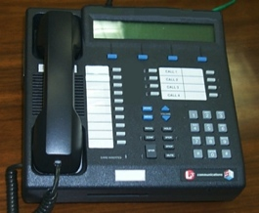
Secure communication in the presence of an adversary
✉ key encapsulation
key K
key K
key K
☏ protected
☏ communication
encode C = E(M)
encode C = E(K, M)
message M
decode M = D(C)
decode M = D(K, C)
???
Notes:
Remember: Bob could simply be a future version of Alice (think: full disk encryption)
Icons from https://www.iconfinder.com/iconsets/user-pictures
Analogy:
Envelopes sent through the US Postal System have pretty good privacy rules but long latency.
Telephones enable real-time communication but range widely in privacy, from “none” to Secure Terminal Equipment (https://en.wikipedia.org/wiki/Secure_Terminal_Equipment).

Slide 7
Complexity theoretic view of cryptography
Cryptomania (✉) = elegant
Millisecond speed
Built from modular arithmetic
Minicrypt (☏) = utilitarian
Nanosecond speed
Built from random-looking permutations
Notes:
Citation for terminology: Russell Impagliazzo. A Personal View of Average-Case Complexity.
Three properties of minicrypt ciphers: (1) simple, (2) makes no sense, (3) simple to see why it makes no sense.
Ciphers work in variety of settings: const-time software, low power/small chip space HW, parallelized ASIC

Slide 8
Cryptographic method: define → construct → reduce
Math Tools
Primitives
Algorithms
Protocols
Modular arithmetic
Auth key exchange
Key evolution
Signal: messaging
Key encapsulation
TLS: internet PGP: email
(see CS 558)
Hash functions
?
Random(ish) permutations
Protected communication
Block ciphers
☏ Minicrypt
Cryptomania ✉
Notes:
Comments:
There is a lot more to crypto overall than just this picture/course
Modular arithmetic -> more generally, any finite group in which the discrete logarithm problem is hard (+ details…)
“AE” here is overloaded, we will later go into ~10 different definitions of security here & construct them all
Minicrypt cryptosystems we will study
Encryption: hide data
Signature/MACs: ensure integrity
Collusion-resistant hash function: "a cryptographer's Swiss Army knife"

Slide 9
How should we protect communication?
Auguste Kirckhoffs’ design principles (La Militaire, 1883)
The system must be practically, if not mathematically, indecipherable
It should not require secrecy, and it should not be a problem if it falls into enemy hands
It must be possible to communicate and remember the key without using written notes, and correspondents must be able to change or modify it at will
It must be applicable to telegraph communications
It must be portable, and should not require several persons to handle or operate
Lastly, given the circumstances in which it is to be used, the system must be easy to use and should not be stressful to use or require its users to know and comply with a long list of rules
Notes:
See Wikipedia article for more information
Compare with "security by obscurity": the idea isn't so much to have no secrets, or for your algorithm not to be obscure in some way. But, you should understand which pieces may be understood by your adversary, and ensure that everything else is easy to change if necessary.

Slide 10
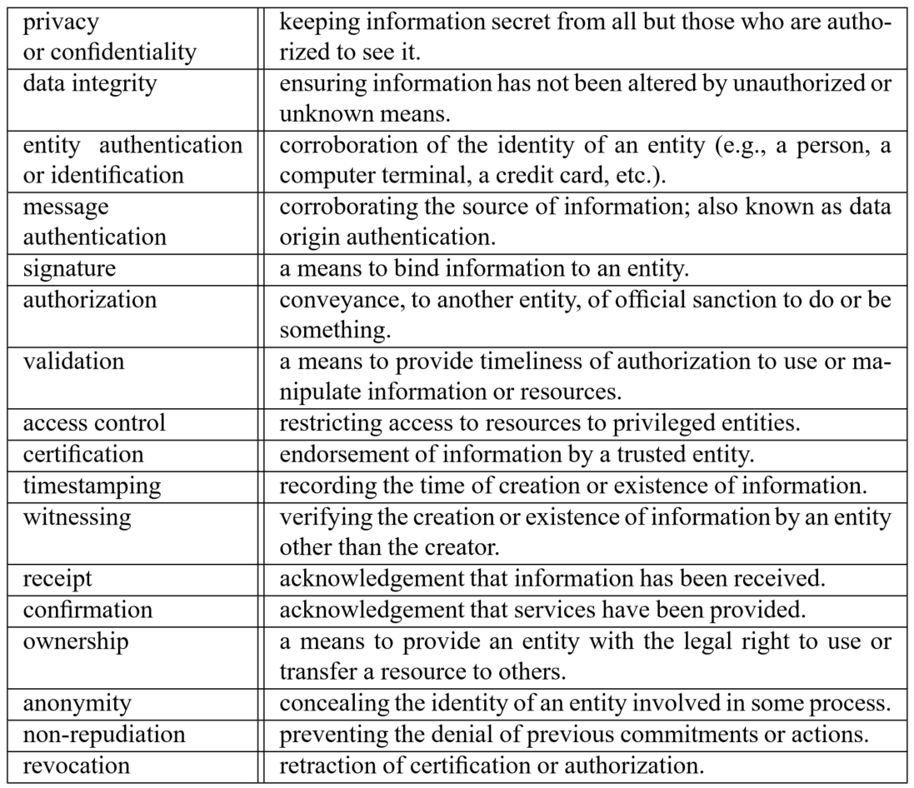
What protections do we want?
Source: Handbook of Applied Cryptography, Table 1.1

Slide 11
Focus of this course
Confidentiality xor authenticity is not possible.
If you don't have both, often you don't have either.
– Prof. Matthew Green, JHU
 | …at endpoints | …in transit
Authenticity
Privacy
 | …at endpoints | …in transit
Authenticity | Identity verification Bob knows Alice sent C
Privacy
 | …at endpoints | …in transit
Authenticity | Identity verification Bob knows Alice sent C
Privacy | Deniability (optional) Bob can’t prove Alice said M
 | …at endpoints | …in transit
Authenticity | Identity verification Bob knows Alice sent C | Binding Eve cannot alter M
Privacy | Deniability (optional) Bob can’t prove Alice said M
 | …at endpoints | …in transit
Authenticity | Identity verification Bob knows Alice sent C | Binding Eve cannot alter M
Privacy | Deniability (optional) Bob can’t prove Alice said M | Confidentiality Eve cannot learn M
Notes:
Source: Handbook of Applied Cryptography, Table 1.1

Slide 12
Let’s begin by studying message privacy in transit
Simplifying assumptions, for now
Pre-shared keys
Passive Eve
Alice + Bob online simultaneously
No need for deniability
Only one message X to transmit
X has a short, fixed length

Slide 13
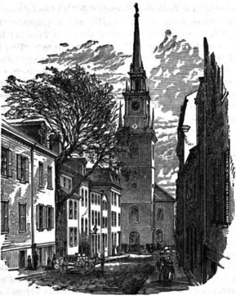
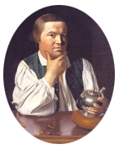
Paul Revere’s ride
Two potential messages
X₁ = one
X₂ = two
Suppose eavesdropper knows the valid messages & observes Y
We must construct a cipher that use the key to thwart the British
Y = Encipher(K, X)
Notes:
Robert Newman, sexton of the Old North Church

Slide 14
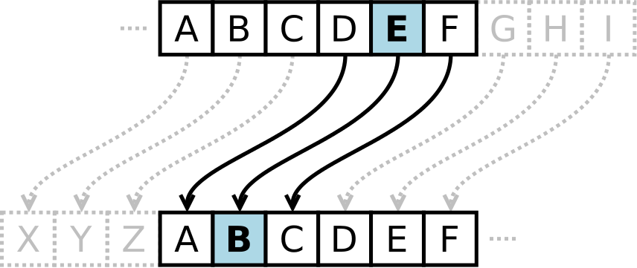
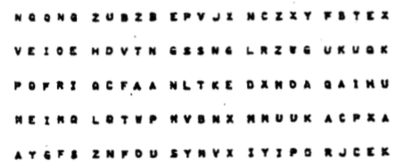
Ancient ciphers, and their modern counterparts
Caesar cipher
One-time pad
Transform if key K = 3key
one ↦ lkb
two ↦ qtl
Problem?
Encode: X ↦ X ⊕ K
Why secure? Apply Caesar cipher to each bit of X independently
Drawback?
Notes:
Pictures from Wikipedia

Slide 15
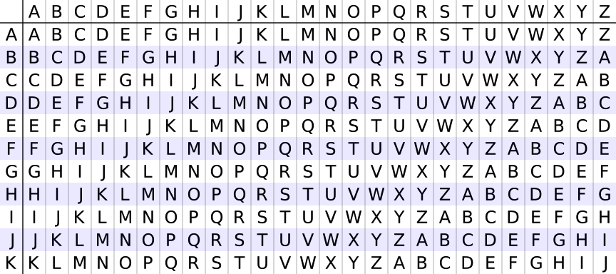
Ancient ciphers, and their modern counterparts
Vigenère cipher
Block cipher
Encode: X ↦ permutation_{K}(X)
Why secure? Entire K determines the permutation on the entire X
Drawback?
Transform if key K = key
one ↦ ejg
two ↦ jsq
Problem?
Notes:
Left image taken from Wikipedia
Right image is the Serpent S-box, taken from https://eprint.iacr.org/2016/1171.pdf

Slide 16
Cryptanalysis: brute force
One way to break a code is by brute force: simply try all possible keys
By eavesdropping one (X, Y) pair, we can break a block cipher by brute force
So, design a block cipher to be a large family of random-looking permutations
56
128
192
256
|K|
Data Encryption Standard (DES)
Advanced Encryption Standard (AES)
Notes:
Why?:
For the correct key X, we know that B_K ( X ) = Y
If we pretend that each B_K is a truly random permutation, then Pr[B_K’ ( X ) = Y ] = 2^-|Y|
More than 80 block ciphers described in https://eprint.iacr.org/2016/1171.pdf

Slide 17
Cryptanalysis: shortcuts
Cryptanalysis seeks to find attacks on ciphers that beat brute force
If we can program a computer to solve a cipher substantially faster than brute force, we declare it to be broken
If
For instance, consider all of the games in which a computer can beat humans via effective pruning of the search space
Game | Search size | Solved?
Connect 4 | 10^13 | ✓
Limit hold ’em | 10^14 | ✓
Checkers | 10^20 | ✓
Chess | 10^50
No limit hold ’em | 10^140
Go (19 × 19) | 10^171
Notes:
Note: 10^171 = 2^568 (in general, moving from powers of 10 to powers of 2 requires multiplication by ~3.3)
Source: https://fivethirtyeight.com/features/computers-are-learning-how-to-treat-cancer-and-diabetes-by-playing-poker-and-atari/

Slide 18
Wrapping up: Crypto is multi-disciplinary & impactful
Algorithms
Known for cipher design.
Primarily found in European academia.
Complexity theory
Known for reductions.
Primarily found in American academia.

A⇒B
🗲

Engineering
Known for software dev and side channel attacks.
Primarily found in industry.
Mathematics
Known for cryptanalysis.
Primarily found in government.
This class explores all 4 approaches

Slide 19
Crypto Wars: early 20th century
World War I: Zimmerman telegram
World War II: Enigma machine
Source: http://www.bbc.com/news/uk-38581861
Source: https://en.wikipedia.org/wiki/Enigma_machine

Slide 20
Crypto Wars: cold war edition
Modern Crypto Wars
Crypto Mistakes
Attacker motive
Crypto War 1: Key length
70s
Crypto Mistake 1:
Linear & differential cryptanalysis
80s
Crypto War 2: Key escrow
90s
90s
Fun
Crypto Mistake 2:
Oracles and side channels
00s
00s
Profit
Crypto War 3: Key deletion
(perfect forward secrecy)
10s
10s
Influence society
Notes:
Key management = key escrow
Perfect forward secrecy = you cannot reveal something you no longer have
Maybe have an overview lecture to explain all of these issues superficially before delving into each one. Start with crypto for a single, short message (4 bits?) before moving onto modes/expanders
For influence on society part: see Schneier's testimony to Congress in Oct/Nov 2016 about IoT + regulation of the tech industry

Slide 21
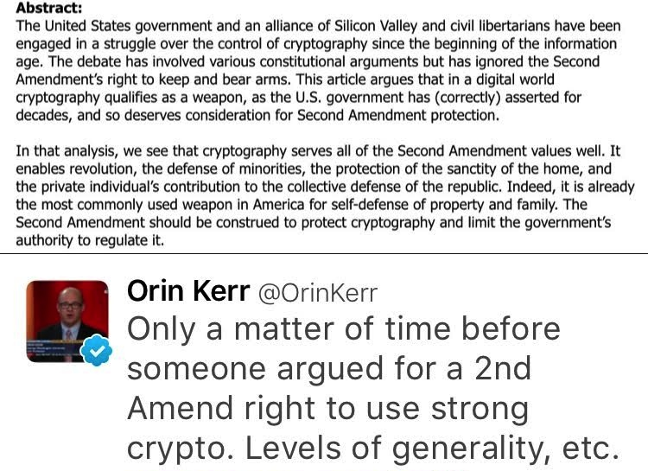
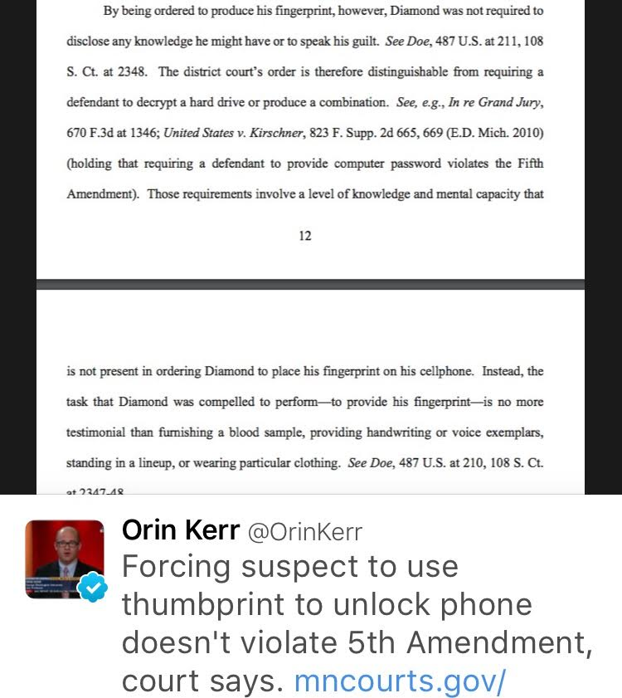
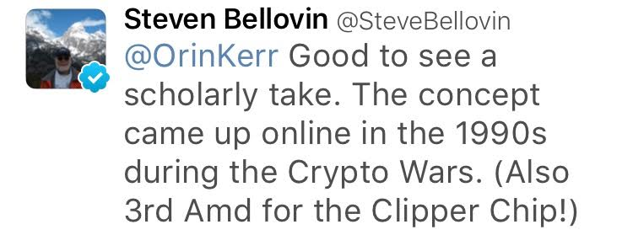
Crypto, meet the Bill of Rights
Notes:
Key management = key escrow
Perfect forward secrecy = you cannot reveal something you no longer have
Maybe have an overview lecture to explain all of these issues superficially before delving into each one. Start with crypto for a single, short message (4 bits?) before moving onto modes/expanders
For influence on society part: see Schneier's testimony to Congress in Oct/Nov 2016 about IoT + regulation of the tech industry

Slide 22
What is cryptography?
Cryptography rearranges power: it configures who can do what, from what. This makes cryptography an inherently political tool, and it confers on the field an intrinsically moral dimension.
– Prof. Phillip Rogaway, UC Davis
Source: http://web.cs.ucdavis.edu/~rogaway/papers/moral.html

