Slide 1
Lecture 3: Practice-oriented provable cryptography
Announcements
Week 2 reading + listening assignments posted to Piazza
Office hours this week: Wed 3-4pm, Thurs 2-4pm
Lab 2 posted later today, due on Sunday via gsubmit
Notes:
Image source: https://www.wired.com/2017/02/russians-engineer-brilliant-slot-machine-cheat-casinos-no-fix/

Slide 2
Recap: Study of truly random functions
Consider random functions R: {0,1}^{in} → {0,1}^{out} of various input + output lengths
Case: | in < out | in = out | in > out | in = ∞
One public function: | Stream cipher | Random permutation | Compression function | Hash function
Family of functions indexed by private key: |  | Block cipher | Message auth code
Notes:
Today, we will see random permutation → block cipher

Slide 3
Recap: block ciphers
Block cipher
Permutation family, indexed by key
Design goals
Simple
Makes no sense
Simple to see that it makes no sense
Pseudorandom
Deterministic, but random-looking
If an adversary A has not explicitly queried the oracle on some point x, then the value of P(x) is completely random…at least as far as A is concerned
–Jon Katz and Yehuda Lindell, Intro to Modern Cryptography
X
Y
X
X
B_{K}
B_{K}
encipher
⁻¹
decipher
B$
Π
Y
X
Y
Y
Notes:
Note: for the moment assume that there exists a “good” method to generate a perfectly-random key. We will explore later in the semester both the questions of:
How to go about building a good random number generator
How to build cryptographic primitives that work even in the presence of not-so-great sources of randomness

Slide 4
Recap: block ciphers
Block cipher
Permutation family, indexed by key
Design goals
Simple
Makes no sense
Simple to see that it makes no sense
Strongly pseudorandom
Same as before, but with inverses too
X
Y
B_{K}
B_{K}
B$
Π
encipher
⁻¹
decipher
Y
X
B$
Π
⁻¹
⁻¹

Slide 5
Block cipher design
Block cipher
Key alternation
Iterated rounds
Substitution-Permutation
⇒
⇒
⇒
X
X
X
Input state
K₀
K
B
K
Π
ρ
S
…
S
S
…
S
K₁
Y
Y
Permutation
Y
⋮
K_{r-1}
Middle
…
Middle
ρ
K_{r}
Output state
Y

Slide 6
Rijndael, aka AES
S-box
Round₁
S-box
Round₉
Round₁₀
S-box
Input X
+
ShiftRows
+
…
+
ShiftRows
+
ShiftRows
+
output Y
MixColumns
MixColumns
key₀
key₁
key₈
key₉
key₁₀
Key alternating structure
128, 192, or 256 bit initial key
Expand into r + 1 round keys, each of which is 128 bits long
Invertible key schedule: given key _{i} , can compute key _{i - 1} or key _{i +1}
Iterated round structure
16 bytes of state
Total of 10 to 14 rounds
Tunable security
3 invertible operations per round
Final round is slightly different
Only S-box is nonlinear
Notes:
Our hope is that AES with a randomly-chosen key is pseudorandom

Slide 7
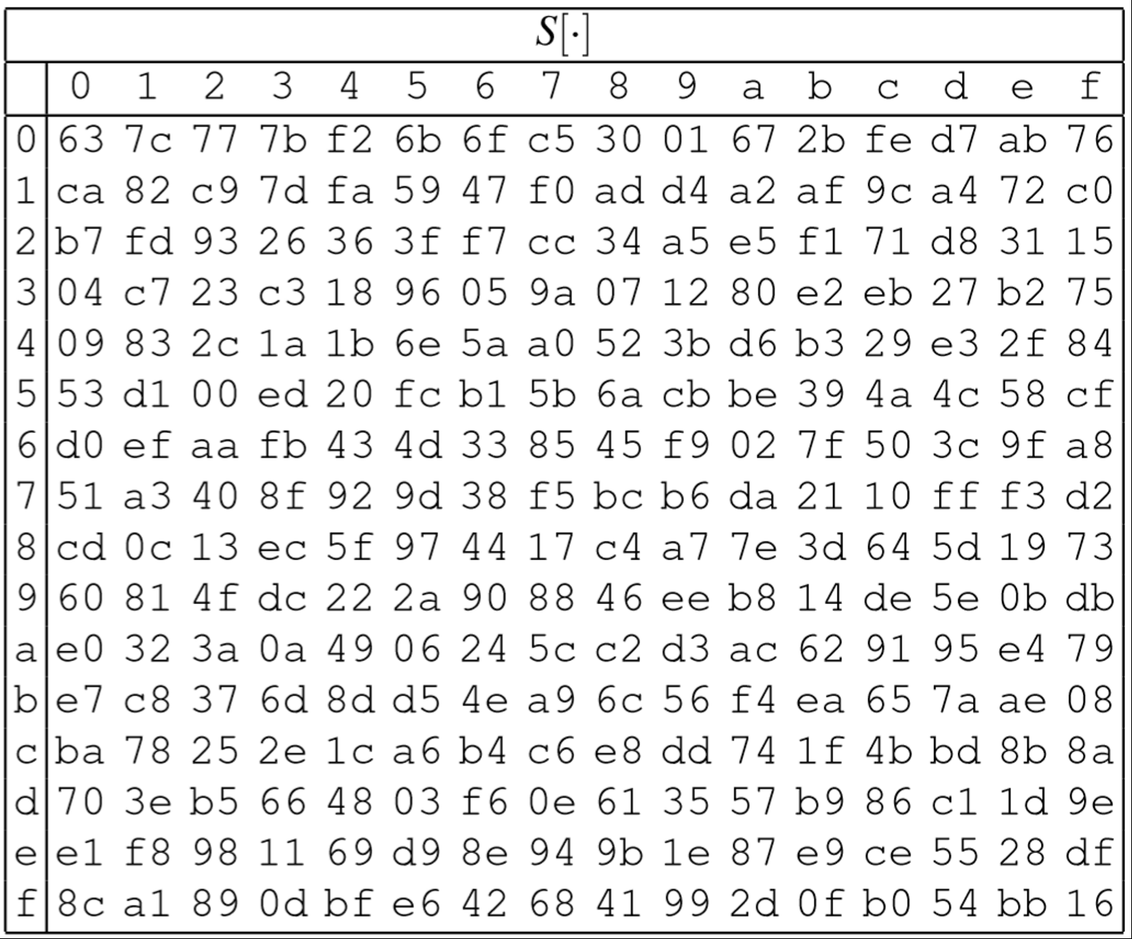
AES components
16 byte state
❶ SubBytes
❶ Table lookup, one byte at a time
S
…
S
S
…
S
ShiftRows
MixColumns
…
MixColumns
16 byte state
Notes:
This is a permutation because every value from 0 to 255 (that is, 00 to ff) appears exactly once in the table

Slide 8
AES components
16 byte state
S
…
S
S
…
S
ShiftRows
❷ ShiftRows
❶ Byte-wise transposition
MixColumns
…
MixColumns
16 byte state
Notes:
This is a permutation whose inverse == shifting rows to the right

Slide 9
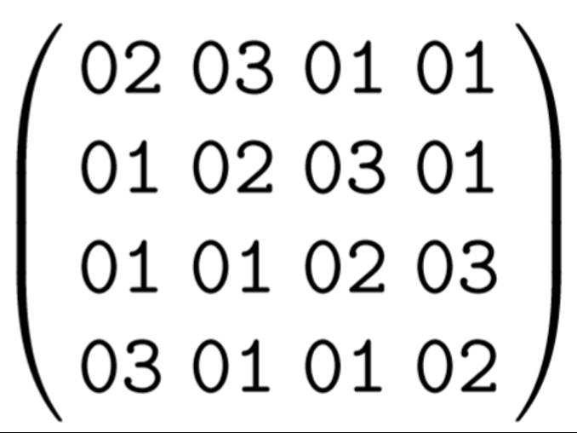
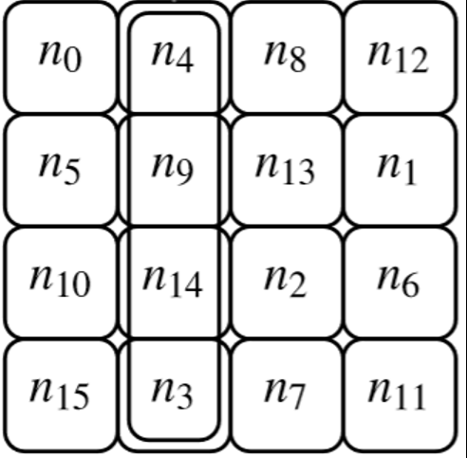
AES components
16 byte state
S
…
S
S
…
S
ShiftRows
MixColumns
…
MixColumns
❸ MixColumns
❶ Matrix multiplication in GF(256)
16 byte state
Notes:
This is a permutation because the matrix is invertible

Slide 10
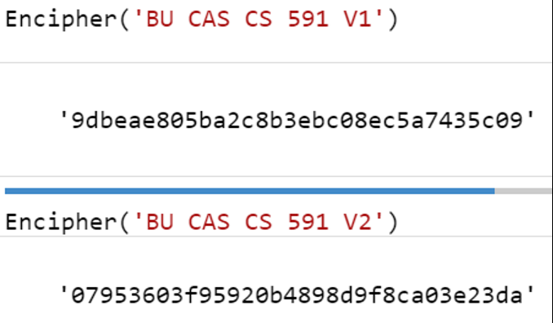
Claude Shannon’s two security goals for block ciphers
Confusion
Diffusion
Uncertainty of K → cannot predict Y given X or vice-versa
Tough even to correlate X and Y
1 bit Δ X → huge ΔY
Hence, partial knowledge of input doesn’t help to learn output
Note: confusion ⇒ diffusion
Counterexample: combine 2 functions
If individually confusing, joint is too
But it doesn’t avalanche
X₁
X₂
B₁
B₂
Y₁
Y₂
Notes:
See Shannon’s many excellent papers for more details
Communication Theory of Secrecy Systems
A Mathematical Theory of Communication
A Mathematical Theory of Cryptography

Slide 11
Claude Shannon’s two security goals for block ciphers
Confusion
Diffusion
Ideal: Prob[correlation] so small that attacker is better off with a brute force attack (takes 8 rounds in AES)
Ideal goal is avalanching: each bit of output depends on all input bits (takes 2 rounds in AES)
Security margin = (# rounds in a cipher) – (# rounds we can break)
8 rounds for wide trail strategy (total confusion)
2 rounds to avalanche (total diffusion)
S-box
Round₁
S-box
Round₉
Round₁₀
S-box
Input
+
ShiftRows
+
…
+
ShiftRows
+
ShiftRows
+
output
MixColumns
MixColumns
key₀
key₁
key₈
key₉
key₁₀
Notes:
Why do we have the key xor steps at the beginning/end of the cipher?

Slide 12
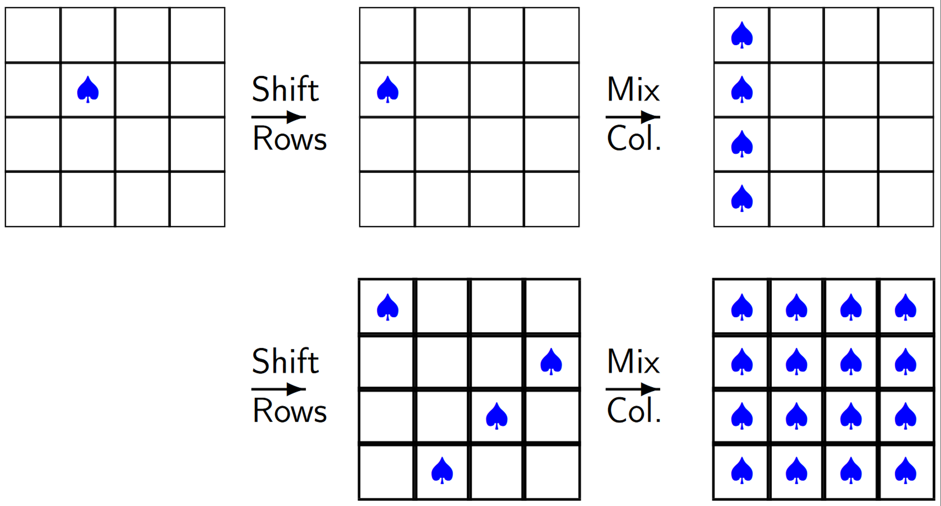
Avalanching in AES
Source: slide 17 of summerschool-croatia.cs.ru.nl/2014/slides/Advanced Encryption Standard.pdf
Notes:
Note: this argument is entirely key-independent. Hence, it doesn’t rely upon confusion at all.

Slide 13
Speed of AES
Intel AES-NI
Apple Secure Enclave
AMD’s Secure Memory Enc
Intel CPUs include 6 instructions to perform AES quickly
4 for round functions
AESENC
AESDEC
AESENCLAST
AESDECLAST
2 for key expansion
AESKEYGENASSIST
AESIMC
“Every iOS device has a dedicated AES-256 crypto engine built into the DMA path between the flash storage and main system memory, making file encryption highly efficient.”
Notes:
Sources:
https://www.apple.com/business/docs/iOS_Security_Guide.pdf
http://amd-dev.wpengine.netdna-cdn.com/wordpress/media/2013/12/AMD_Memory_Encryption_Whitepaper_v7-Public.pdf

Slide 14
Defining pseudorandomness
X
X
B$
Π
B$
Π
B$
Π
Y
Y
⁻¹
⁻¹
A cryptographic mechanism is secure if every resource-bounded adversary breaks the scheme with probability at most ε.
Great! But what do secure and breaks mean…

Slide 15
Formalizing a block cipher
A block cipher with block length μ and key length λ comprises 3 algorithms
KeyGen: randomly choose a key K of length λ, often uniformly from {0,1}^{λ}
Encipher: given input X ∈ {0,1}^{μ}, outputs B_{K}(X) → Y, where Y ∈ {0,1}^{μ} too
Decipher: given Y ∈ {0,1}^{μ}, outputs B_{K}⁻¹(Y) → X, where X ∈ {0,1}^{μ} too
X
X
B$
Π
Y
Y
Notes:
KeyGen is not always generated uniformly over the bitstring space; for instance DES has a few pockets of “bad keys” that must be avoided.

Slide 16
Formalizing a block cipher
These algorithms satisfy 3 constraints
Performance: all 3 algorithms are efficiently computable
Correctness: for every K ∈ {0,1}^{λ} and X ∈ {0,1}^{μ}, it holds that B_{K}⁻¹ (B_{K}(X)) = X
(q, t, ε)-pseudorandomness: for every adversary A that makes ≤ q queries and executes in time ≤ t, | Pr[ A = 1] – Pr[ A = 1] | < ε where the probabilities are taken over the choices of key K ∈ {0,1}^{λ} and permutation Π: {0,1}^{μ} → {0,1}^{μ} , respectively
X
X
B$
Π
Y
Y
bit b
B_{K}
Π
Notational shorthand for this claim:
A ≈ _{(q, t, ε)} A
B_{K}
Π
Notes:
KeyGen is not always generated uniformly over the bitstring space; for instance DES has a few pockets of “bad keys” that must be avoided.

Slide 17
Formalizing a block cipher
These algorithms satisfy 3 constraints
Performance: all 3 algorithms are efficiently computable
Correctness: for every K ∈ {0,1}^{λ} and X ∈ {0,1}^{μ}, it holds that B_{K}⁻¹ (B_{K}(X)) = X
(q, t, ε)-strong pseudorandomness: for every adversary A that makes ≤ q queries and executes in time ≤ t, | Pr[ A = 1] – Pr[ A = 1] | < ε where the probabilities are taken over the choices of key K ∈ {0,1}^{λ} and permutation Π: {0,1}^{μ} → {0,1}^{μ} , respectively
B$
P
B$
P
⁻¹
⁻¹
bit b
B_{K}, B_{K}⁻¹
Π, Π⁻¹
Notational shorthand for this claim:
A ≈ _{(q, t, ε)} A
B_{K}, B_{K}⁻¹
Π, Π⁻¹
Notes:
KeyGen is not always generated uniformly over the bitstring space; for instance DES has a few pockets of “bad keys” that must be avoided.

Slide 18
Does a cipher give us protected communication?
Yes, we can get authenticity + privacy!
But only if
Message length is exactly one block
(For privacy) Alice sends just 1 message
In general: no. Ciphers are a building block toward protected communication, but don’t provide it completely on their own.
encipher Y = B_{K}(X)

Slide 19
Message authenticity
key K
send A along with signature T = MAC_{K}(A)
key K
auth msg A
validate T = MAC_{K}(A)
forge?
(make valid A, T)
 | …at endpoints | …in transit
Authenticity | Identity verification Bob knows Alice sent A | Binding Mallory cannot alter A
Privacy | Deniability (optional) Bob can’t prove Alice said M | Confidentiality Eve cannot learn P
Notes:
Today’s goal: determine how Bob can authenticate that he's really receiving messages from Alice, not an active adversary Mallory

Slide 20
Limits of authenticity
Hide message contents: Need encryption for that
Thwart replay attacks: A higher-level protocol needs to handle this, say via nonces or timestamps
A, T = MAC_{K}(A)
 | …at endpoints | …in transit
Authenticity | Identity verification Bob knows Alice sent A | Binding Mallory cannot alter A
Privacy | Deniability (optional) Bob can’t prove Alice said M | Confidentiality Eve cannot learn P

Slide 21
New primitive: Message authentication code
Algorithms
Security game
KeyGen: randomly choose key K of length λ as before, e.g. uniform in {0,1}^{λ}
MAC_{K} (A ∈ {0,1} ^{α}) → tag T ∈ {0,1} ^{τ}
Usually deterministic, but can be random
Would prefer short tags: τ < α
Verify_{K} (T ∈ {0,1} ^{τ}) → yes/no
If deterministic, Verify = re-compute MAC
Even after viewing many (A, T) pairs, Mallory cannot create a new one
Alice
Mallory
❷ submit A
❶ choose K ← {0,1}^{λ}
receive T
Formal security definition: EU-CMA
MAC has (q, t, ε)-existential unforgeability against a chosen message attack if all adversaries that make ≤ q queries and run in time ≤ t win with probability < ε
Mallory wins if
It’s a valid forgery
It’s new
❸ output (A*, T*)
Notes:
Note: cannot reduce EU-CMA to a game of an indistinguishability style, like block ciphers and the forthcoming encryption definitions have

Slide 22
Block cipher → MAC
For our first MAC, let’s restrict |A| = |T| = block length of a block cipher
In this case, simply applying the block cipher suffices!
MAC_{K}(A) = B_{K}(A)
Thm. If is pseudorandom, then is EU-CMA for fixed-len msgs
Intuition. Suppose B_{K} were instead a truly random permutation Π. Intuition. Then, the output of Π( X ) doesn't depend on Π( X’ ) for any X ≠ X’.
Let’s prove this…
MAC
B_{K}
B_{K}

Slide 23
Formal reduction
Given adversary A_{MAC} that forges a MAC, we must construct an adversary A_{BC} that distinguishes a block cipher from a random permutation
Note that if we replace the block cipher with a truly random permutation, then Pr[forgery] ≤ 2 ^{-τ} because Π(A*) is independent of other queries
adversary A_{MAC}
A¹
X¹ = A¹
MAC
B_{K}
B_{K}
T¹ = Y¹
Y¹
adversary
A_{BC}
or
A²
X² = A²
Π
T² = Y²
Y²
…
…
forgery (A*, T*)
check validity
Notes:
Remember the Katz-Lindell quote:
If an adversary A has not explicitly queried the oracle on some point x, then the value of Π(x) is completely random…at least as far as A is concerned

Slide 24
This week: Message authenticity
Math Tools
Primitives
Algorithms
Protocols
Modular arithmetic
Auth key exchange
Key evolution
Signal: messaging
Key encapsulation
TLS: internet PGP: email
(see CS 558)
Hash functions
Authenticated
Random(ish) permutations
Protected communication
Block ciphers
☏ Minicrypt
Cryptomania ✉
Notes:
You may have heard that crypto provides “provable security.” Really, what this means is that we form reductions from more complex primitives to less complex primitives. In this way, everything we build will be fine as long as we rely on a few time-tested initial building blocks.

