Slide 1
Lecture 5: Random compression
Announcements
Week 3 lab posted to Piazza, due Friday 2/9
Week 3 reading assignment posted to Piazza
Notes:
Last time we discussed several message authentication codes, like CBC-MAC, CMAC, and OMAC. We ended the lecture by saying that actually none of them are the fastest to use in practice today. To understand a better approach, we must first add a new cryptographic primitive to our toolbox.

Slide 2
Minicrypt’s building blocks
XOR operation
Public random function
X
K
X
⊕
R
Y
Y
Secret random permutation
X
K
P
Y
Notes:
TCB = Trusted Computing Base

Slide 3
Today: Length-reducing random functions
Consider random functions R: {0,1}^{in} → {0,1}^{out} of various input + output lengths
Case: | in < out | in = out | in > out | in = ∞
One public function: | Stream cipher | Random permutation | Compression function | Hash function/random oracle
Family of functions indexed by private key: |  | Block cipher | Message auth code
If an adversary A has not explicitly queried the oracle on some point x,
then the value of R(x) is completely random… at least as far as A is concerned
–Jon Katz and Yehuda Lindell, Introduction to Modern Cryptography
Notes:
Today, we will see random permutation → block cipher

Slide 4
Random oracles & collision-resistant hash funcs
infinite set
finite set

Slide 5
Bellare Rogaway 1993: “Random oracles are practical”
Two step process:
Pretend we have random oracle R, produce crypto protocol P^{R} that uses it
Replace R with an “appropriately chosen” function H, and hope that it works
We argue that the random oracle model -- where all parties have access to a public random oracle -- provides a bridge between cryptographic theory and cryptographic practice. In the paradigm we suggest, a practical protocol P is produced by devising and proving correct a protocol P^{R} for the random oracle model and then replacing oracle accesses by the computation of an “appropriately chosen” function H. This paradigm yields protocols much more efficient than standard ones while retaining many of the advantages of provable security. We illustrate these gains for problems including encryption, signatures, and zero-knowledge proofs.
Notes:
Full paper title-
Random oracles are practical: a paradigm for designing efficient protocols

Slide 6
Counterpoint

Slide 7
Counter-counterpoint
Response from practitioners (including Halevi in the paper): for some reason this idea seems to work anyway… so just go with it
Theoreticians relent, but reluctantly. Usually, they reference constructions involving a random oracle derogatorily as heuristic in nature.

Slide 8
Bellare Rogaway 1993: “Random oracles are practical”
Two step process:
Pretend we have random oracle R, produce crypto protocol P^{R} that uses it
Replace R with an “appropriately chosen” function H, and hope that it works
✔
?

Slide 9
So… what is an “appropriately chosen” H?
Def. A hash function H: {0,1}* → {0,1} ^{η} is an efficiently-computable function that accepts unbounded input and outputs strings of a fixed length η
Security notions against adversaries who possess the code of H
Preimage resistance: given y = H(x) for a “randomly” chosen x, difficult to find any preimage x’ s.t. H(x’) = y
2nd preimage resistance: given “randomly” chosen x, difficult to find another x’ s.t. H(x’) = H(x’) noticeably faster than an exhaustive search of 2^{η} values
Target collision resistance: same as CR, except x chosen before H is known
Collision resistance: given only H, difficult to find two different inputs x and x’ s.t. H(x’) = H(x’) noticeably faster that a birthday bound search of 2^{η/2} values
stronger
Notes:
These definitions get stronger toward the bottom
Target collision resistance = 2-universal one-way hash function
Bellare Hoang Kelelveedhi 2015 paper "Instantiating Random Oracles via UCEs" provides the first mechanism that formally captures (part of) strength implicit in this random oracle: it's a universal computational extractor

Slide 10
So… what is an “appropriately chosen” H?
Def. A hash function H: {0,1}* → {0,1} ^{η} is an efficiently-computable function that accepts unbounded input and outputs strings of a fixed length η
Security notions against adversaries who possess the code of H
Notes
H is length-reducing → collisions must exist! Hope is that they're hard to find
“Given the code of H” piece is huge: not just an oracle to query like with block ciphers
Most block ciphers break if adv sees the code, since the key is readily identifiable from it
Birthday bound restricts the theoretical limit of difficulty of collision attack

Slide 11
Birthday bound, explained
Given a set of size L, say you wish to draw an item M times with replacement
Question: what is the chance that you pick the same element twice?
Easier to compute the opposite question: chance of distinct elements
Pr[ distinct elements ] = nPr(L, M) / L^{M}
= 1 × (1 – 1/L) × (1 – 2/L) × ⋯ × (1 – (M-1)/L)
≈ 1 × e^{-1/L} × e^{-2/L} × ⋯ × e^{-(M-1)/L} because 1 – x ≈ e^{-x}
= exp[ -M × (M – 1) / L]
≈ exp[ -M² / 2L]
For large L, the expected # of items to draw before the first collision is approx
π L / 2 ≈ 1.25 L
The distribution of M is tightly concentrated around its expected value
Notes:
Alternate representation, from https://www.cs.umd.edu/~waa/414-F11/IntroToCrypto.pdf (sec 4.2):
Suppose a bag has L balls in it, all of different colors. We draw one ball at a time from the bag and write down its color, we then replace the ball in the bag and
draw again. What’s then the probability, after M balls have been taken out of the bag, that we have obtained at least one repeated color?

Slide 12
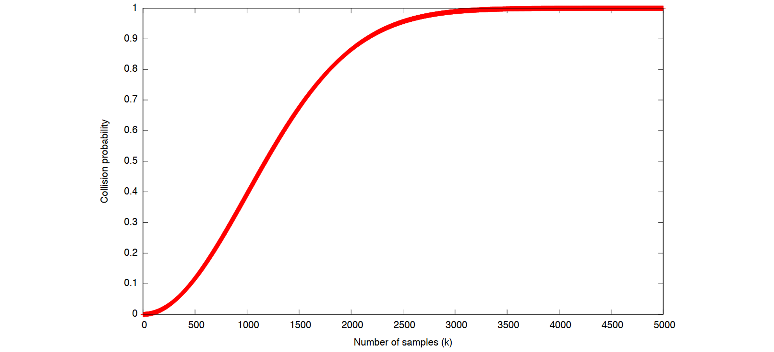
Birthday bound, pictured
For large L, the expected # of items to draw before the first collision is approx
π L / 2 ≈ 1.25 L
The distribution of M is tightly concentrated around its expected value
Notes:
Alternate representation, from https://www.cs.umd.edu/~waa/414-F11/IntroToCrypto.pdf (sec 4.2):
Suppose a bag has L balls in it, all of different colors. We draw one ball at a time from the bag and write down its color, we then replace the ball in the bag and
draw again. What’s then the probability, after M balls have been taken out of the bag, that we have obtained at least one repeated color?

Slide 13
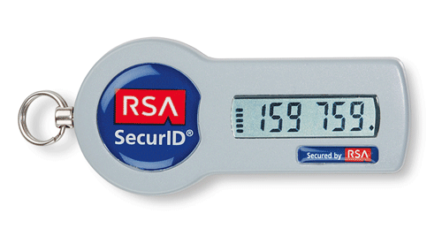
Uses of hash functions
Privacy
Building block ciphers [Even Mansour]
Random number generation
Key evolution for forward secrecy
Extraction of random-looking bits from a source with entropy (e.g., password, fingerprint)
Potentially also: derive a cryptographic key from it (Touch ID)
Note: only use a hash function that is specially crafted for this purpose!
Notes:
Images taken from https://upload.wikimedia.org/wikipedia/commons/d/d3/Token.gif and https://upload.wikimedia.org/wikipedia/commons/a/a7/IPhone_6S_Rose_Gold.png

Slide 14
Uses of hash functions
Privacy
Authenticity
Building block ciphers [Even Mansour]
Random number generation
Key evolution for forward secrecy
Extraction of random-looking bits from a source with entropy (e.g., password, fingerprint)
Potentially also: derive a cryptographic key from it (Touch ID)
Note: only use a hash function that is specially crafted for this purpose!
Digital signatures: both public and symmetric via HMAC [Bellare Canetti Krawczyk 96, RFC 2104]
Authenticating users, data, or code
Potentially timestamp for freshness
Conversely, modification detection scheme (Merkle trees)
Proof-of-work systems (Bitcoin): prohibit parallelization and pre-computation before you know input

Slide 15
Common theme of these applications
Don't need inverses!
In fact, strongly prefer that it's not possible/easy

Slide 16
Popular families of hash functions
Ron Rivest’s Message Digest family
Secure Hash Algorithm (SHA) family
1991 MD5 (128 bits) is most well-known, still sadly in use today despite being completely broken.
Some of the earlier iterations never reached the public domain, and all have mostly been discarded
MD6 was a submission to the SHA-3 competition. Its security analysis originally had problems, so the authors recommended that NIST not continue it.
NSA-designed, NIST-approved
The original SHA-0 was retracted before standardization
1995: SHA-1 (160 bits) is still in use today, though slowly fading
Wang, Yin, Yu 04: 2⁶⁹ step collision algorithm
Stevens et al 17: found collision in 2⁶³ steps
2001: SHA-2 family (224, 256, 384, or 512 bits) is the recommended hash function to use today
All follow a Merkle-Damgard design
Notes:
N bit output => find collision in 2^(N/2) time due to birthday bound
Ethan Heilman fixed the differential cryptanalysis study of MD6.

Slide 17
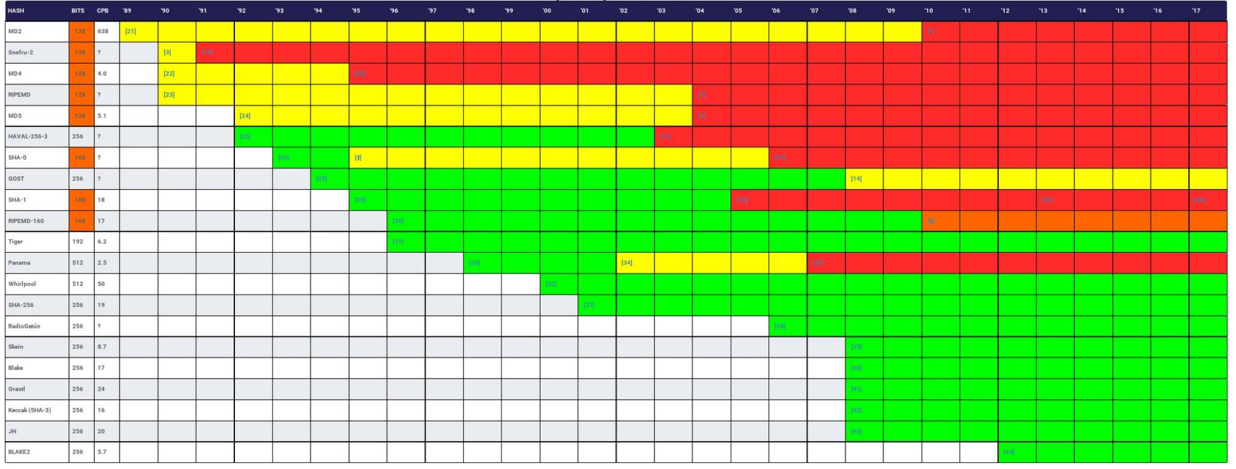
Hash function lifetimes: collision resistance
Source: https://z.cash/blog/hash-functions.html and http://valerieaurora.org/hash.html

Slide 18
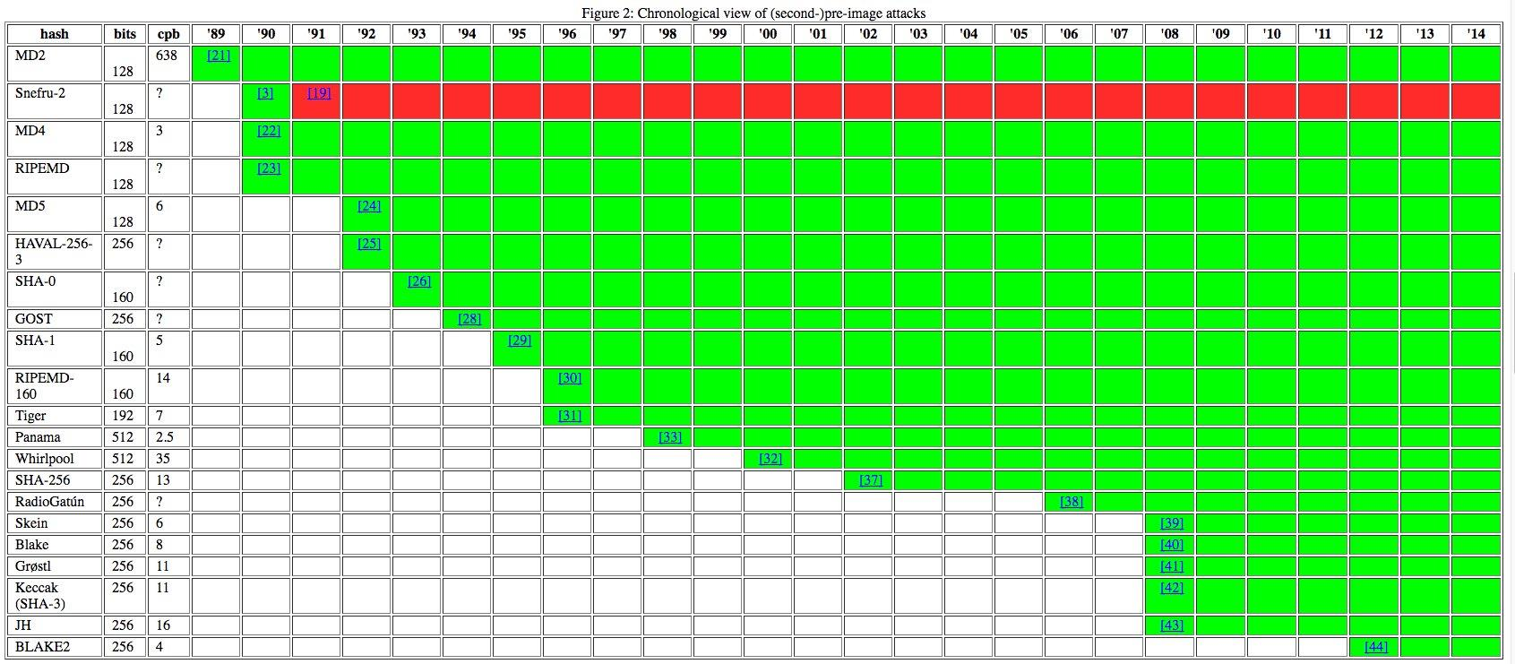
Hash function lifetimes: second preimage resistance
Source: https://z.cash/blog/hash-functions.html and http://valerieaurora.org/hash.html

Slide 19
Merkle-Damgard paradigm
Consider random functions R: {0,1}^{in} → {0,1}^{out} of various input + output lengths
Case: | in < out | in = out | in > out | in = ∞
One public function: | Stream cipher | Random permutation | Compression function | Hash function/random oracle
Family of functions indexed by private key: |  | Block cipher | Message auth code
Notes:
Today, we will see random permutation → block cipher

Slide 20
Merkle-Damgard design
As with variable-length MACs (and encryption schemes), the design of a variable-length input hash function requires building two separate primitives:
A fixed-length, compressing random-looking function
A mode of operation that iterates this function multiple times in a smart manner
M₁
M₂
M_{n}
C
C
…
C
IV
hash
IV for hash function is typically fixed in spec, not user configurable.
If you need something public-but-unique in addition to message, a salt is the hash function equivalent to a nonce from encryption.
Notes:
We begin with item #2

Slide 21
Merkle-Damgard design
“The vulnerability of [a hash function] construction is due to its finite state, [a limitation that does] not apply to a random oracle.”
–Keccak team, Cryptographic sponge functions
M₁
M₂
M_{n}
C
C
…
C
IV
hash
Notes:
We begin with item #2

Slide 22
Questions about Merkle-Damgard
Length extension attack
M₁
M₂
M_{n}
M_{n+1}
C
C
…
C
C
hash

Slide 23
Countermeasures to length extension
Add a finalization step
M₁
M₂
M_{n}
C
C
…
C
IV
final
hash

Slide 24
Countermeasures to length extension
Add a finalization step
Wide pipe strategy: C’s output > hash’s output, simply truncate at the end
M₁
M₂
M_{n}
C
C
…
C
IV
hash
Notes:
Note: wide pipe is a type of finalization

Slide 25
Questions about Merkle-Damgard
Length extension attack
Add a finalization step
Wide pipe strategy: C’s output > hash’s output, simply truncate at the end
Padding: Mihir Bellare’s 3 constraints for padding a variable-length input without creating collisions in the padding
Message M is always a prefix of pad(M)
If |M¹| = |M²|, then |pad(M¹)| = |pad(M²)|
If |M¹| ≠ |M²|, then last block of pad(M¹) ≠ last block of pad(M²)
One convention: write string length as the sole contents of final block

Slide 26
Why Bellare’s padding suffices
Thm. If C: {0,1}^{2η} → {0,1} ^{η} is collision-resistant, then H: {0,1}* → {0,1} ^{η} resulting from any fixed number of iterations of Merkle-Damgard is too.
Proof sketch. Show that collision in H ⇒ collision in C. Let |M| = L and |M’| = L’
If L ≠ L': Collision in the final steps: C(something || L) and C(something || L')
If L = L': State after each C start out different, become identical somewhere!
M₁
M₂
L
M₁’
M₂’
L’
C
C
…
C
C
C
…
C
IV
H(M)
IV
H(M)

Slide 27
Questions about Merkle-Damgard
Length extension attack
Add a finalization step
Wide pipe strategy: C’s output > hash’s output, simply truncate at the end
Padding: Mihir Bellare’s 3 constraints for padding a variable-length input without creating collisions in the padding
Message M is always a prefix of pad(M)
If |M¹| = |M²|, then |pad(M¹)| = |pad(M²)|
If |M¹| ≠ |M²|, then last block of pad(M¹) ≠ last block of pad(M²)
One convention: write string length as the sole contents of final block
Related to padding: what is the cleanest way to produce a keyed cipher without causing padding problems again?

Slide 28
Hash function → MAC
Recall: “we can partition input space via H(K || M) if K, M are distinguishable”
Length extension concerns allow distinguishing from a truly random function
NMAC: let’s use C one more time as a type of finalization
Essentially: H(K₁ || M) pares M down to a size that K₂ can process
M₁
L
K₁
C
C
…
C
K₂
C
IV
tag T
H(K₁ || M)

Slide 29
HMAC [Bellare Canetti Krawczyk 97]
Just as with CMAC → OMAC, nobody wants to carry around multiple keys
HMAC: use C itself to derive two “independent”-ish keys from one initial key
Uses fixed constants ipad = 0x5C, opad = 0x36 repeated to equal the length of the key
M₁
L
C
C
…
C
K ⊕ ipad
IV
C
K ⊕ opad
C
tag T
IV

Slide 30
Strength of HMAC
Thm. HMAC is an EU-CMA MAC as long as:
The compression function C is pseudorandom
The Merkle-Damgard iteration mechanism is collision-resistant
Bellare (2005) removed condition #2 to show that HMAC can apply to systems like MD5 and SHA1 that are no longer believed to be collision resistant
https://www.bu.edu:
Notes:
Remember: M-D isn’t pseudorandom on its own due to the length extension attack
Bellare paper: https://eprint.iacr.org/2006/043.pdf
BU website in 2017 used 3DES. In 2018 it uses AES-256.

