Slide 1
Lecture 6: Hash function design, continued
Announcements
Lab 3 due Friday 2/9 at 11pm
My office hours: this afternoon at 3-5pm in MCS 164
TA Hanson Duan to offer office hours Thurs 4-6pm in MCS 164
PSA: Summer mentoring opportunity posted to Piazza

Slide 2
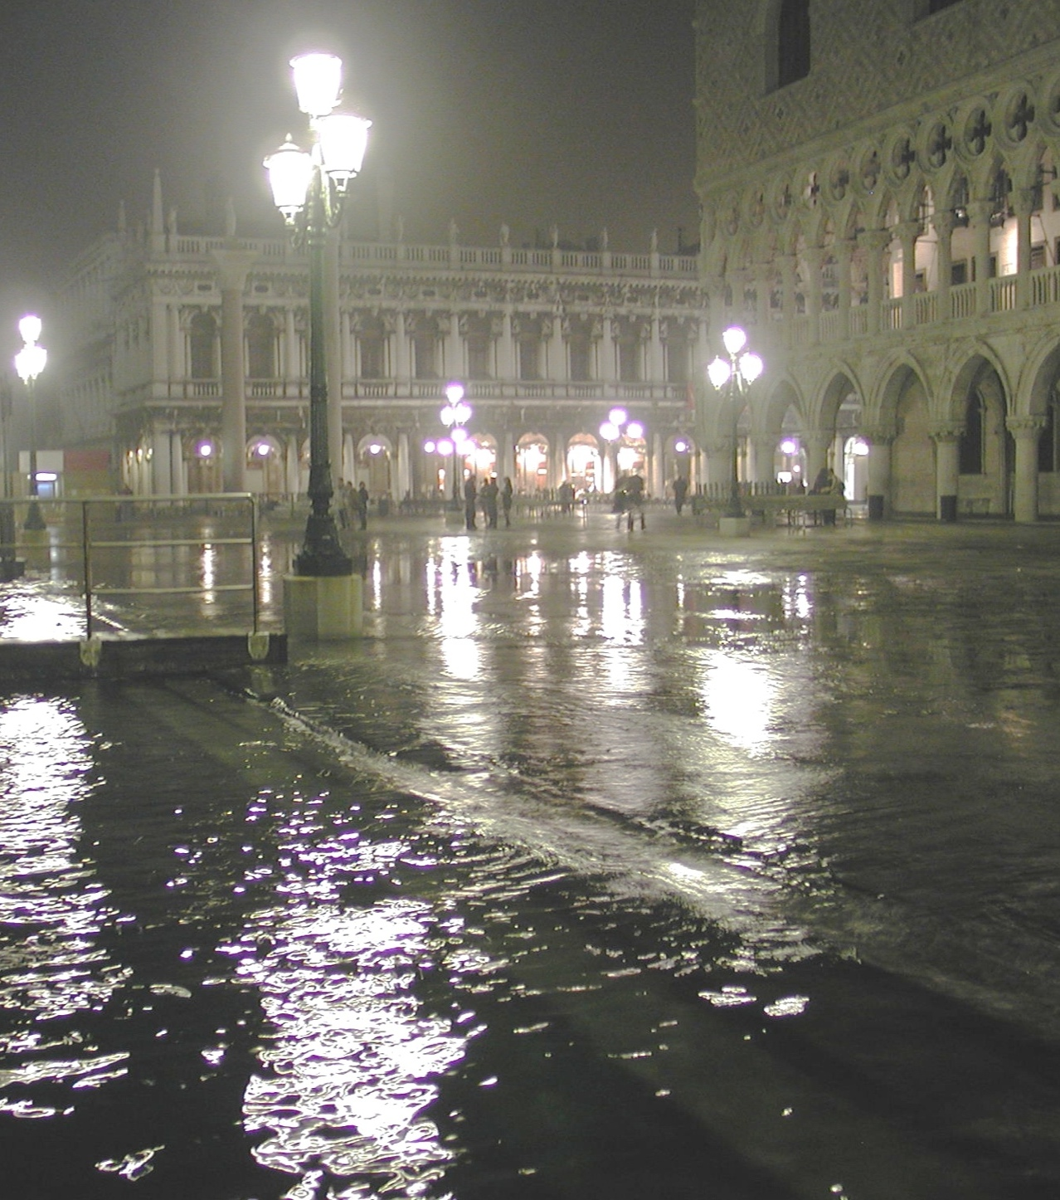
Recap: Minicrypt’s building blocks
XOR operation
Public random function
X
K
X
⊕
R
Y
Y
Secret random permutation
X
K
P
Y
Notes:
TCB = Trusted Computing Base

Slide 3
Recap: Merkle-Damgard paradigm
Consider random functions R: {0,1}^{in} → {0,1}^{out} of various input + output lengths
Case: | in < out | in = out | in > out | in = ∞
One public function: | Stream cipher | Random permutation | Compression function | Hash function/random oracle
M₁
M₂
M_{n}
C
C
…
C
IV
hash
Notes:
After finishing the Merkle-Damgard discussion by showing how to build a compression function, today we will explore an alternate method to build a hash function/random oracle directly from a random permutation

Slide 4
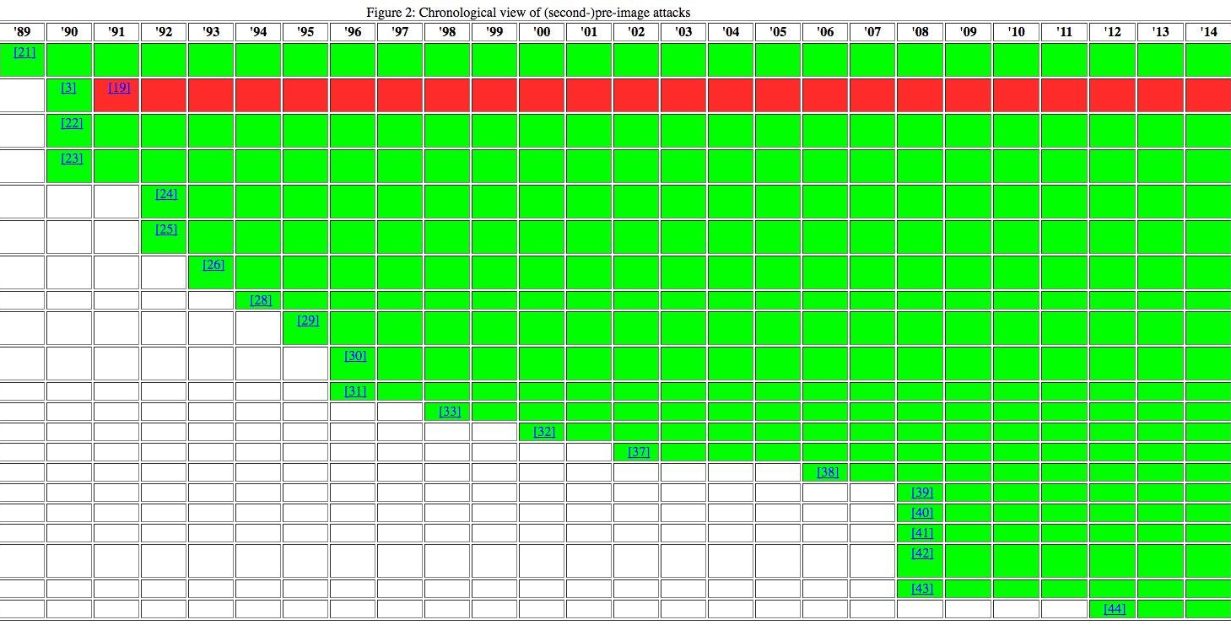
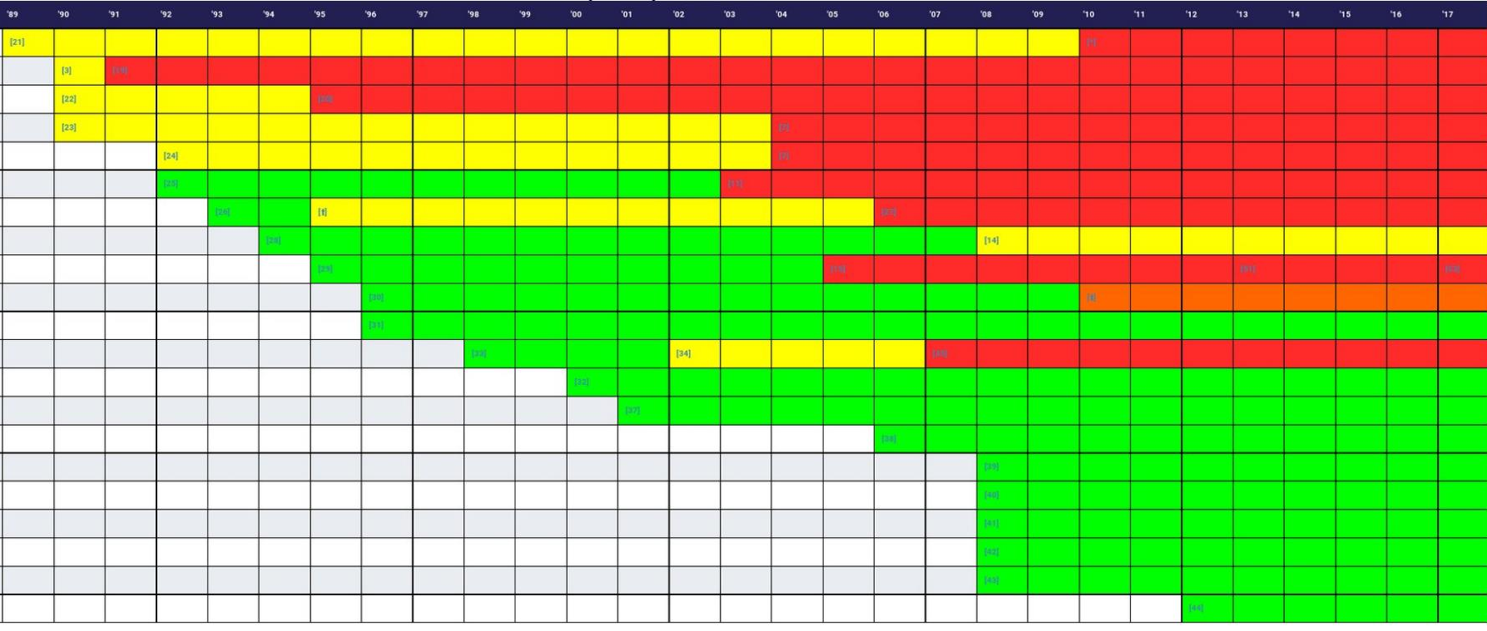
Recap: Definitions
Def. Hash function H: {0,1}* → {0,1} ^{η} has unbounded input, fixed length output
Preimage resistance: given y = H(x), tough to find any preimage x’
2nd preimage resistance: given x, tough to find new x’ s.t. H(x’) = H(x’)
Target collision resistance: same as CR, except x chosen before H known
Collision resistance: given only H, difficult to find two different inputs x and x’ s.t. H(x’) = H(x’) faster than a birthday bound search
stronger
Notes:
Image sources: https://z.cash/blog/hash-functions.html and http://valerieaurora.org/hash.html

Slide 5
Recap: Popular families of Merkle-Damgard hash functions
Ron Rivest’s Message Digest family
Secure Hash Algorithm (SHA) family
1991: MD5 (128 bits) is most well-known
Now we know how to break it completely
NSA-designed, NIST-approved
1995: SHA-1 (160 bits)
2001: SHA-2 family (224, 256, 384, or 512 bits) is recommended for use today
https://www.bu.edu
Notes:
Image shows the hash functions used in Cloudflare’s TLS connections.
Image source: https://blog.cloudflare.com/how-expensive-is-crypto-anyway/

Slide 6
Strength of HMAC [Bellare Canetti Krawczyk 97]
Thm. HMAC is an EU-CMA MAC as long as:
The compression function C is pseudorandom
The Merkle-Damgard iteration mechanism is collision-resistant
Bellare (2005) removed condition #2 to show that HMAC can apply to systems like MD5 and SHA1 that are no longer believed to be collision resistant
M₁
L
C
C
…
C
K ⊕ ipad
IV
C
K ⊕ opad
C
tag T
IV
Notes:
Remember: M-D isn’t pseudorandom on its own due to the length extension attack
Bellare paper: https://eprint.iacr.org/2006/043.pdf
BU website in 2017 used 3DES. In 2018 it uses AES-256.

Slide 7
Constructing a compression function
Recall that Merkle-Damgard requires two separate primitives:
A fixed-length (though not necessarily length-preserving) random-looking function
A mode of operation that iterates this function multiple times in a smart manner
Q: How can we build a compression function?
A: Use a block cipher?
?
✔
M_{i}
X
C
B
H_{i - 1}
H_{i}
K
Y
Notes:
We begin with item #2

Slide 8
❶ Rabin’s Digitalized Signatures (1978)
Idea: form a hash function through iterated DES
Q: Is it okay to use a message in place of a block cipher's key?
A: In general, no! While messages have structure and may even be adversarially-controlled, we have been assuming so far that keys are totally unpredictable to the adversary. But again, let’s just roll with this. The theoretical construct we actually want is called an ideal cipher (it’s a keyed random oracle).
Begin with some constant IV
Interpret message blocks as DES keys

Slide 9
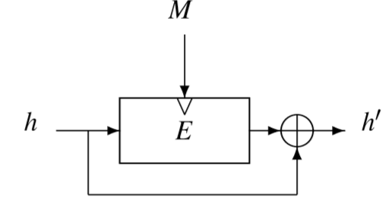
❷ Davies-Meyer
Deceptively compact picture
Detailed math
H0 = some pre-defined constant
H1 = B( M1, H0 ) ⊕ H0
H2 = B( M2, H1 ) ⊕ H1 = B( M2, B( M1, H0 ) ⊕ H0 ) ⊕ B( M1, H0 ) ⊕ H0
H3 = B( M3, H2 ) ⊕ H2 = B( M3, B( M2, B( M1, H0 ) ⊕ H0 ) ⊕ B( M1, H0 ) ⊕ H0 ) ⊕ B( M2, B( M1, H0 ) ⊕ H0 ) ⊕ B( M1, H0 ) ⊕ H0
…and so on!
key
B
SHA-2’s compression function has a Davies-Meyer design

Slide 10
Mental arithmetic on really big numbers
Changing base
2¹⁰ ≈ 10³
2²⁰ ≈ 10⁶
2³⁰ ≈ 10⁹
2⁴⁰ ≈ 10¹²
2⁵⁰ ≈ 10¹⁵
2⁶⁰ ≈ 10¹⁸
Time to perform really large calculations
1 ^{operation}/_{cycle} × 2³⁰ ^{cycles}/_{sec} × 2²⁵ ^{sec}/_{year} = 2⁵⁵ ^{operation}/_{year}
So a brute search of… takes at least…
2⁶³ size search space 2⁸ = 256 CPU core-years
2⁸⁰ size search space 2²⁵ = 32 million CPU core-yr
2¹²⁸ size search space 2⁷³ ≈ 8 sextillion CPU core-yr
2¹²⁸ size search space 2⁷³ = 2³³ × 2⁴⁰
2¹²⁸ size search space 2⁷³ = 1 trillion CPU-core years
2¹²⁸ size search space 2⁷³ = for each person on earth
…
“2⁸⁰ security is interesting.
2¹²⁸ security is boring.”
– Prof. Dan Bernstein, UIC

Slide 11
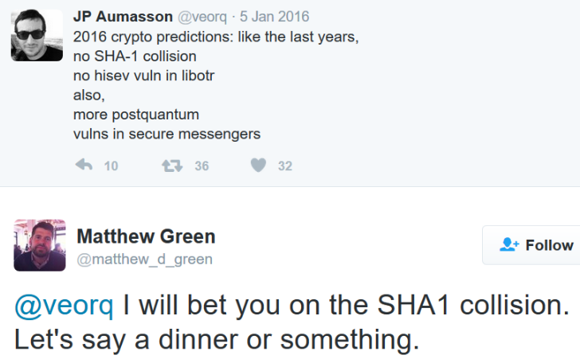
Back to SHA-1
160 bit output ⇒ birthday bound yields collisions in 2⁸⁰ steps
Wang, Yin, Yu 2004: discover an algorithm that can find a SHA-1 collision in 2⁶⁹ steps
M₁
M₂
M_{n}
64 B
C
C
…
C
IV
20 B
H(M)
Notes:
N bit output => find collision in 2^(N/2) time due to birthday bound

Slide 12
2017: SHA-1 SHAttered!
Effort to find the collision
6500 CPU-years
110 GPU-years
# hashes: 9,223,372,036,854,775,808
≈ 9 quintillion = 9 · (10³)⁶
≈ 2³ · 2⁶⁰ = 2⁶³
(Actual effort, from paper: 2^{63.1})
“The SHAttered attack is 100,000 faster than the brute force attack that relies on the birthday paradox”
Notes:
Source: http://shattered.io/

Slide 13
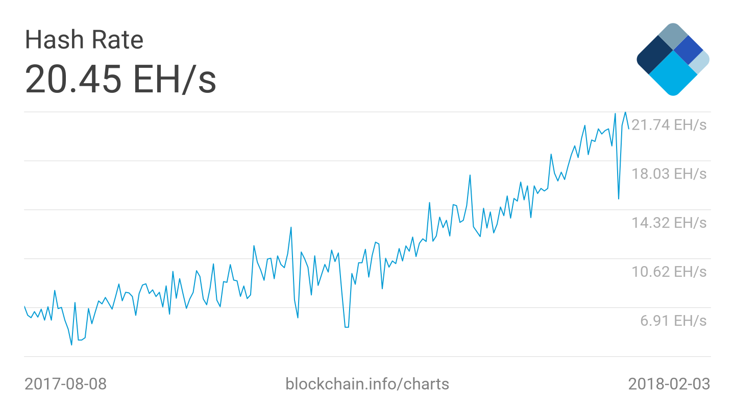
Scale of computation
“One of the largest computations ever completed”
– Google blog
Bitcoin’s collective Double SHA-2 hash rate, Feb 2018
> 16 · 2⁶⁰ = 2^{64 hash}/_{sec}
Notes:
Sources:
https://security.googleblog.com/2017/02/announcing-first-sha1-collision.html
https://blockchain.info/charts/hash-rate?timespan=30days

Slide 14
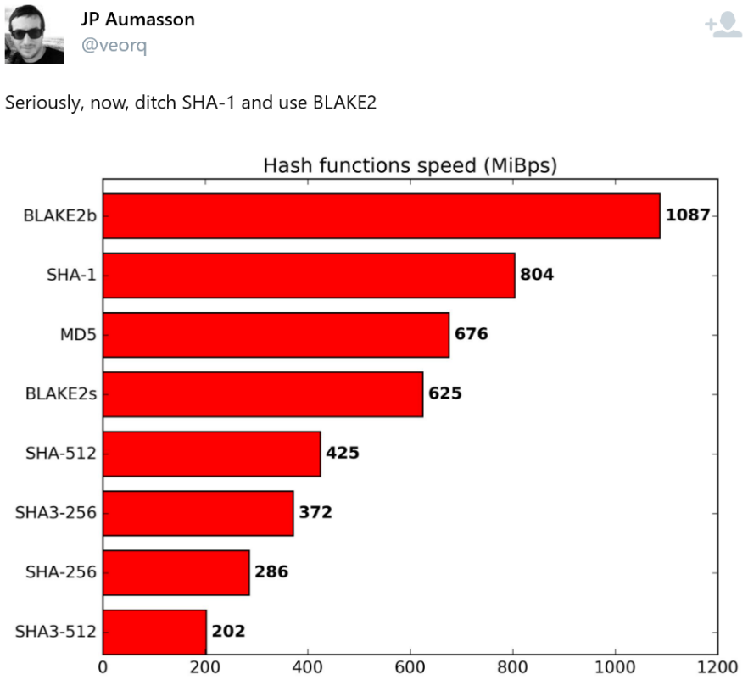
Reactions to the SHA-1 collision

Slide 15
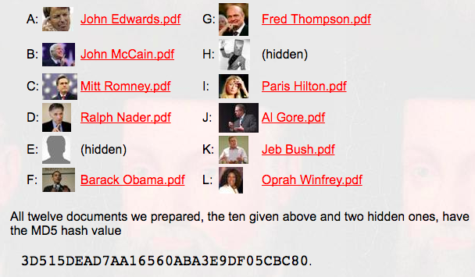
Formal comparison of attacks
SHA1: Identical prefix attack
MD5: Chosen prefix attack
There exist specific strings A and B such that for all strings C:
SHA1(A || C) = SHA1(B || C)
Given any strings A and B, can find strings C and D such that:
MD5(A || C) = MD5(B || D)
We have used a Sony Playstation 3 to correctly predict the outcome of the 2008 US presidential elections. In order not to influence the voters we keep our prediction secret, but commit to it by publishing its cryptographic hash on this website. The document with the correct prediction and matching hash will be revealed after the elections.
Site: http://www.win.tue.nl/hashclash/Nostradamus/

Slide 16
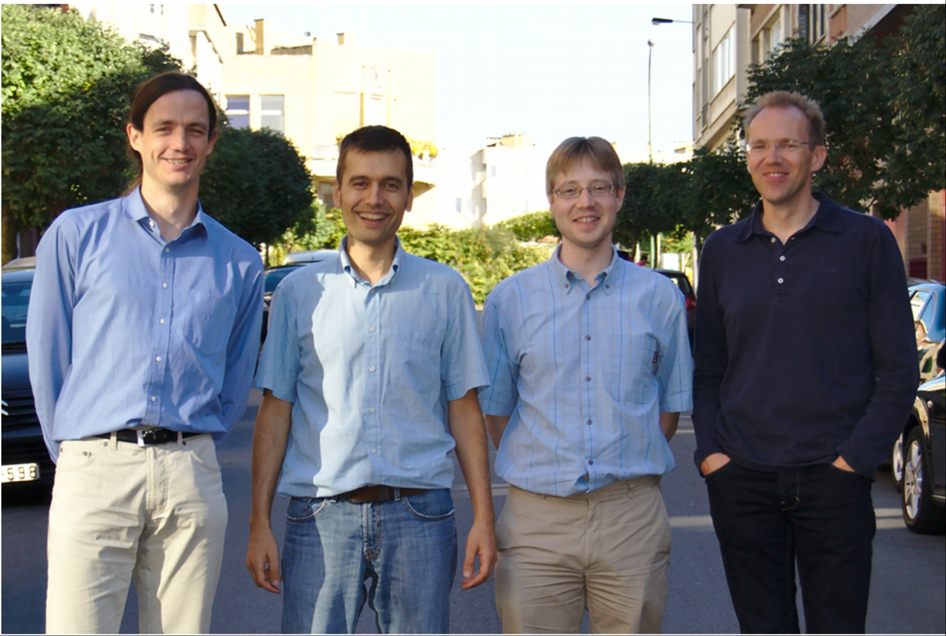
SHA-3: quest for a Merkle-Damgard alternative
2007: Call for submissions
2008: 64 submissions received
2009-12: Three workshops, one before each cutdown: 64 → 51 → 14 → 5 → 1
Oct 2012: Keccak announced as winner
Creators: Guido Bertoni, Joan Daemen, Michaël Peeters, and Gilles Van Assche
Aug 2015: NIST publishes Federal Information Processing Standard (FIPS) 202 standardizing Keccak

Slide 17
Why NIST chose Keccak, in their words
“Offers acceptable performance in software, and excellent performance in hardware.”
“Has a large security margin, suggesting a good chance of surviving without a practical attack during its working lifetime.”
“A fundamentally new and different algorithm that is entirely unrelated to the SHA-2 algorithms.”

Slide 18
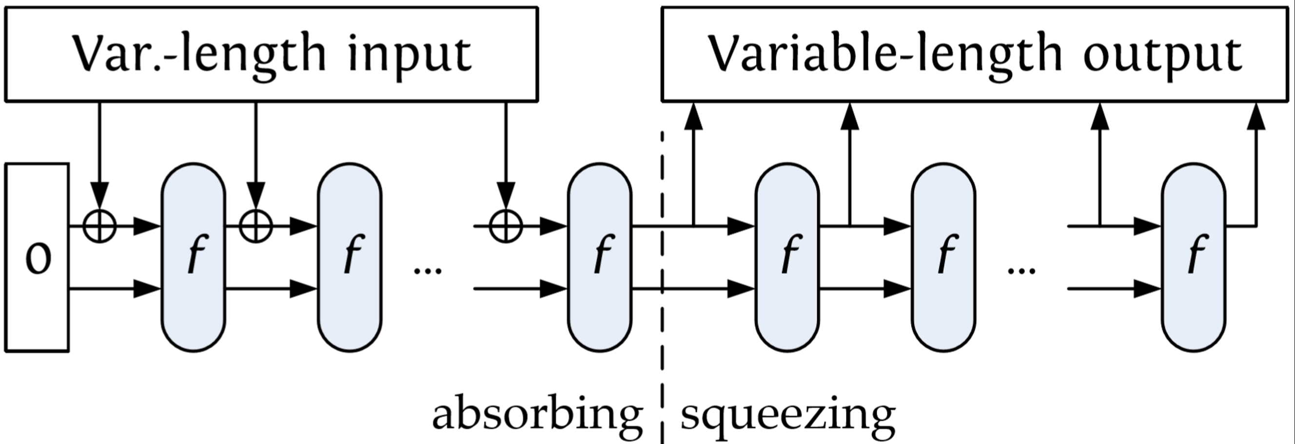
Sponge functions
r
c
Split state into two components
r = rate, which influences speed
c = capacity, which influences security
Arbitrary input and output length
More flexible than M-D hash functions
Facilitates design of higher-level crypto
Notes:
Picture + text taken from slide slide 12 of “Keccak, More than Just SHA3SUM” presentation

Slide 19
(switch to Keccak slides)

Slide 20
Next week: private communication
Math Tools
Primitives
Algorithms
Protocols
Modular arithmetic
Auth key exchange
Key evolution
Signal: messaging
Key encapsulation
TLS: internet PGP: email
(see CS 558)
Hash functions
Random(ish) permutations
Protected communication
Block ciphers
☏ Minicrypt
Cryptomania ✉

