Slide 1
Lecture 8: A variety of block cipher reductions
Labs
Lab 4 due Friday 2/16 at 11pm
Solution sets to Labs 2 and 3 to be posted later today
Upcoming schedule
Our next class is on Tuesday 2/20
In-class exam on Wednesday 2/21
Sarah Scheffler to host pre-test review session Tues 2/20 in MCS 135

Slide 2
This week: Encryption via enciphering
Math Tools
Primitives
Algorithms
Protocols
Modular arithmetic
Auth key exchange
Key evolution
Signal: messaging
Key encapsulation
TLS: internet PGP: email
(see CS 558)
Hash functions
Confidential
Random(ish) permutations
Protected communication
Block ciphers
☏ Minicrypt
Cryptomania ✉

Slide 3
Review: pseudorandom under a chosen plaintext attack
Block cipher
Encryption scheme
B_{K} looks like a random permutation, meaning nobody can tell them apart
Similar, except even making the same request twice yields different answers
Optional nonce-respecting rule: Eve chooses N, but each choice must be distinct
CTR achieves this; CBC does not
X
X
P, N
P, N
B$
Π
M
$
B$
Y
Y
C
C
Notes:
There are alternative methods to make an encryption scheme (for instance, using a stream cipher as described in the last lecture). But in this class we will only consider encryption schemes formed using a mode of operation over a block cipher.

Slide 4
Formalizing a symmetric key encryption scheme
A symmetric key encryption scheme comprises 3 algorithms:
KeyGen(λ) outputs a key K ← {0,1}^{λ}
Encrypt_{K}(private P, nonce N) → C
Decrypt_{K}(ciphertext C, N) → P
These algorithms satisfy 3 constraints
Performance: all 3 algorithms are efficiently computable
Correctness: Dec_{K} (Enc_{K}(P, N)) = P for all K ∈ {0,1}^{λ} , N ∈ {0,1}^{μ} , and P ∈ {0,1}*
P, N
P, N
Enc
$
C
C
bit b
(q, t, ε)-IND$-CPA: for every nonce-respecting adversary A making queries totaling ≤ q blocks & running in time ≤ t, A ≈ _{(q, t, ε)} A where K ← {0,1}^{λ} and $ randomly chooses outputs of the proper length
Enc_{K}
$
Notes:
Notes:
- Typically |C| = |P|, though this need not always be the case
- The orange box $ ignores every property of its input other than length

Slide 5
Review: CTR mode
Forward direction
Backward direction
(N, 0)
(N, 1)
(N, 2)
(N, 0)
(N, 1)
(N, 2)
B_{K}
B_{K}
B_{K}
B_{K}
B_{K}
B_{K}
Synthetic, one time use key K’
Regenerate the same OTP key K’
P₁
P₂
P₃
C₁
C₂
C₃
C₁
C₂
C₃
P₁
P₂
P₃
Notes:
CTR mode has two stages: first building a long one-time key K’ and then using it as a one-time pad

Slide 6
Informal CTR reduction by picture
Real CTR
CTR with ideal cipher
Ideal encryption scheme
(N, 0)
(N, 1)
(N, 0)
(N, 1)
P₁
P₂
B_{K}
B_{K}
Π
Π
$
$
One time key K’
One time key K’
C₁
C₂
P₁
P₂
P₁
P₂
C₁
C₂
C₁
C₂
Notes:
I gave a similar “hybrid argument” picture last time about CBC mode. This time, let’s work out the reduction for real.

Slide 7
CTR mode with Π ⇒ one time pad
P
(N, 0)
(N, 1)
(N, 2)
N
CTR
=
Π
Π
Π
Π
P₁
P₂
P₃
C
C₁
C₂
C₃
Notes:
The N value is often called an “initialization vector” or “counter”

Slide 8
How reductions work
If we begin with:
Then we can construct:
Mode
B_{K}
B_{K}
a block cipher
that is (q_{B}, t_{B}, ε_{B}) pseudorandom
symmetric key enc scheme
that is (q_{C}, t_{C}, ε_{C}) indistinguishable from
pseudorandom under chosen plaintext
attack
Mode
B_{K}
Contrapositive: If an adversary A can break , then we can construct an adversary A’ that breaks almost as effectively.
B_{K}

Slide 9
Formal CTR mode reduction
If we begin with:
Then we can construct:
An adversary A_{CTR} who can distinguish
from
with probability > ε_{C} given time t_{C} and queries that total q_{C} blocks of data
An adversary A_{BC} who can distinguish
from
with probability > ε_{B} given time t_{B} and a total of q_{B} queries
CTR
$
B_{K}
B_{K}
Π

Slide 10
Visualizing the reduction
If we begin with:
Then we can construct:
An adversary A_{CTR} who can distinguish
from
An adversary A_{BC} who can distinguish
from
CTR
$
B_{K}
B_{K}
Π
adversary A_{CTR}
P¹, N¹
X¹
CTR
B_{K}
B_{K}
C¹
Y¹
or
adversary
A_{BC}
or
P², N²
X²
$
Π
C²
Y²
…
…
bit b
bit b’

Slide 11
How A_{BC} operates
Step 1:
Step 2:
Step 3:
Step 4:
Wait for A_{CTR} to output a (P, N) pair
Query A_{BC}’s own oracle on (N,0), (N,1), …, (N, |P|-1)
Concatenate response blocks, then xor with P
When A_{CTR} outputs a bit b, output b’ = b
adversary A_{CTR}
P¹, N¹
X¹
CTR
B_{K}
B_{K}
C¹
Y¹
or
adversary
A_{BC}
or
P², N²
X²
$
Π
C²
Y²
…
…
bit b
bit b’
Notes:
Here, I use |P| to denote the length of P in blocks

Slide 12
Why this reduction works
Left side
Right side
B_{K}
Π
If A_{BC} is talking to , then this procedure faithfully yields
If A_{BC} is talking to , then this procedure faithfully yields ,
identical to by non-repetition
CTR
CTR
Π
B_{K}
$
adversary A_{CTR}
P¹, N¹
X¹
CTR
B_{K}
B_{K}
C¹
Y¹
or
adversary
A_{BC}
or
P², N²
X²
$
Π
C²
Y²
…
…
bit b
bit b’

Slide 13
Our final result
If we begin with:
Then we can construct:
An adversary A_{CTR} who can distinguish
from
with probability > ε_{C} given time t_{C} and queries that total q_{C} blocks of data
An adversary A_{BC} who can distinguish
from
with probability > ε_{C} given a total of q_{C} queries and t_{C} + q_{C} running time
CTR
$
B_{K}
B_{K}
Π

Slide 14
Encryption uses nonces for variety + support for long msgs
Math Tools
Primitives
Algorithms
Protocols
Modular arithmetic
Auth key exchange
Key evolution
Signal: messaging
Key encapsulation
TLS: internet PGP: email
(see CS 558)
Hash functions
Random(ish) permutations
Protected communication
Block ciphers
TBCs
☏ Minicrypt
Cryptomania ✉

Slide 15
Tweakable block ciphers consider these actions separately
Math Tools
Primitives
Algorithms
Protocols
Modular arithmetic
Auth key exchange
Key evolution
Signal: messaging
Key encapsulation
TLS: internet PGP: email
(see CS 558)
Hash functions
Random(ish) permutations
Protected communication
Block ciphers
TBCs
length
variety
☏ Minicrypt
Cryptomania ✉

Slide 16
Tweakable block ciphers
History
First proposed concretely by the “Hasty Pudding Cipher,” a first-round submission to the AES competition
Codified later by Liskov, Rivest, Wagner [Crypto 2002]
Why another input?
Variety: tweak is public, and yet the ciphers with different tweaks are “uncorrelated” in a strong way
Related tweak attacks are impossible
Note that pseudorandomness on its own never prohibits related key attacks
Agility: ideally, faster to change tweak than key (avoids key setup/expansion)
secret,
long-living
input X
key K
B
Many block ciphers have the property that changing the encryption key is relatively expensive, since a “key setup” operation needs to be performed. In contrast, changing the tweak should be cheaper.
– Liskov, Rivest, Wagner 02
tweak Z
public,
easy to change
output Y

Slide 17
Security definition
Family of independent permutations, indexed by the tweak
Notes
Key K chosen once uniformly (as always)
Tweaks can be related
Stronger than nonce: okay to reuse!
Alternate view: even given boxes for many tweaks, hard to break target
(Note: restricting picture to forward direction for simplicity. Really should be giving all B_{K}⁻¹ too.)
~
B_{K}(Z₁, -)
B_{K}(Z₂, -)
…
B_{K}(Z_{n}, -)
B$
Z, X
Z, X
Π
Y
Y
Z, Y
Z, Y
~
X
X
B$
Π
⁻¹
X
X
⁻¹
Π
B_{K}(Z*, -)
Y
Y

Slide 18
Constructions
~
Goal: find a generic way to transform a block cipher B into a tweakable one B
Attempt | Picture | Why it fails
1. DESx/Even-Mansour
Z
K
Z
X
B
Y

Slide 19
Constructions
~
Goal: find a generic way to transform a block cipher B into a tweakable one B
Attempt | Picture | Why it fails
1. DESx/Even-Mansour |  | Simple “related tweak” attack: Given tweak Z, can break tweak (Z + 1) say
Z
K
Z
X
B
Y

Slide 20
Constructions
~
Goal: find a generic way to transform a block cipher B into a tweakable one B
Attempt | Picture | Why it fails
1. DESx/Even-Mansour |  | Simple “related tweak” attack: Given tweak Z, can break tweak (Z + 1) say
2. Using part of the key as the tweak
Z
K
Z
X
B
Y
K || Z
X
B
Y

Slide 21
Constructions
~
Goal: find a generic way to transform a block cipher B into a tweakable one B
Attempt | Picture | Why it fails
1. DESx/Even-Mansour |  | Simple “related tweak” attack: Given tweak Z, can break tweak (Z + 1) say
2. Using part of the key as the tweak |  | Block cipher need not depend on every bit of key (e.g., 1st bit is inconsequential, rest is AES)
Z
K
Z
X
B
Y
K || Z
X
B
Y

Slide 22
Constructions
~
Goal: find a generic way to transform a block cipher B into a tweakable one B
Attempt | Picture | Why it fails
1. DESx/Even-Mansour |  | Simple “related tweak” attack: Given tweak Z, can break tweak (Z + 1) say
2. Using part of the key as the tweak |  | Block cipher need not depend on every bit of key (e.g., 1st bit is inconsequential, rest is AES)
3. XORing the key and the tweak |  | Same thing
Z
K
Z
X
B
Y
K || Z
X
B
Y
K ⊕ Z
X
B
Y

Slide 23
Two generic constructions that do work
“Triple DES” style
“Anti-Even-Mansour” style
K
Z
K
K
Z
K
X
B
B
B
Y
X
B
B
Y
Preferred due to quicker tweak change

Slide 24
Proof by picture
~
Thm. Let B be a (q, t, ε) block cipher. “Anti-EM” yields a (q, t, ε + θ(q²/2 ^{μ})) TBC B.
Proof. Consider 6 different constructions we could throw at a TBC adversary.
Case 1: real
Case 2: rand Π
Case 6: tweak Π
X
X
X
If adversary A can distinguish Case 1 from Case 2, we can use A to build a distinguisher between B and Π. By assumption, this probability must be at most ε.
~
K
B
Π
Z
Π
Z
Z
Y
K
B
Π
Y
ε
Y

Slide 25
Proof by picture
~
Thm. Let B be a (q, t, ε) block cipher. “Anti-EM” yields a (q, t, ε + θ(q²/2 ^{μ})) TBC B.
Proof. Consider 6 different constructions we could throw at a TBC adversary.
Case 1: real
Case 2: rand Π
Case 3: rand R
X
X
X
Eerily similar to the Even-Mansour analysis. Essentially, adv A can only distinguish case 2 from 3 by finding “bad tweaks” Z such that the permutation causes a collision when the random function won't. Following E-M argument: Pr[dist 2 from 3] ≤ θ(q²/2^{μ}).
K
B
Π
R
Z
Z
Z
K
B
Π
R
Y
ε
Y
q²/2 ^{μ}
Y

Slide 26
Proof by picture
~
Thm. Let B be a (q, t, ε) block cipher. “Anti-EM” yields a (q, t, ε + θ(q²/2 ^{μ})) TBC B.
Proof. Consider 6 different constructions we could throw at a TBC adversary.
Case 1: real
Case 2: rand Π
Case 3: rand R
Case 4: 2 Rs
Requires a collision involving the internal state. Unless we can feed in the same input to the two final oracles, no adversary can distinguish the two options.
A Luby-Rackoff argument, as used in DES, shows that
Pr[dist 3 from 4] ≤ θ(q²)/2^{μ}.
X
X
X
X
K
B
Π
R
R’
Z
Z
Z
Z
I₃
I₄
K
B
Π
R
R
Y
ε
Y
q²/2 ^{μ}
Y
q²/2 ^{μ}
Y

Slide 27
Proof by picture
~
Thm. Let B be a (q, t, ε) block cipher. “Anti-EM” yields a (q, t, ε + θ(q²/2 ^{μ})) TBC B.
Proof. Consider 6 different constructions we could throw at a TBC adversary.
Case 1: real
Case 2: rand Π
Case 3: rand R
Case 4: 2 Rs
Case 5: tweak R
X
X
X
X
X
I₅
Again, the only way to distinguish these two cases is to cause a collision.
~
K
B
Π
R
R
Z
R
Z
Z
Z
Z
Y
I₄
K
B
Π
R
R’
Y
ε
Y
q²/2 ^{μ}
Y
q²/2 ^{μ}
Y
q²/2 ^{μ}

Slide 28
Proof by picture
~
Thm. Let B be a (q, t, ε) block cipher. “Anti-EM” yields a (q, t, ε + θ(q²/2 ^{μ})) TBC B.
Proof. Consider 6 different constructions we could throw at a TBC adversary.
Case 1: real
Case 2: rand Π
Case 3: rand R
Case 4: 2 Rs
Case 5: tweak R
Case 6: tweak Π
X
X
X
X
X
X
~
~
K
B
Π
R
R
Z
R
Z
Π
Z
Z
Z
Z
Y
Y
A bounded adversary has no way to distinguish a random function from a random permutation.
K
B
Π
R
R’
Y
ε
Y
q²/2 ^{μ}
Y
q²/2 ^{μ}
Y
q²/2 ^{μ}
≈0

Slide 29
Two generic constructions that do work
“Triple DES” style
“Anti-Even-Mansour” style
✔
K
Z
K
K
Z
K
X
B
B
B
Y
X
B
B
Y
Remember that we simply explored generic transformations so far. Specifically constructing a tweakable block cipher from scratch may be much faster!

Slide 30
Variable-length modes of operation
Remember: each tweak produces an independent instance of the block cipher
Can encrypt a long message simply by choosing a new tweak for each block!
But this ciphertext is long…
M₁
M₂
M₃
Z₁
B_{K}
Z₂
B_{K}
Z₃
B_{K}
Z₁
C₁
Z₂
C₂
Z₃
C₃
ciphertext

Slide 31
Tweak block chaining
Similar to CBC, except with security against nonce-respecting adversaries too!
But I’m really stingy. Even this ciphertext can be too long if M₃ needs padding
M₁
M₂
M₃
Z
B_{K}
B_{K}
B_{K}
Z
C₁
C₂
C₃
Notes:
Unlike counter mode, here it does not appear that there is an “easy” solution to save space when the message doesn't fill the last block.

Slide 32
Nice property of CTR mode: no need for padding
Forward direction
Backward direction
(N, 0)
(N, 1)
(N, 2)
(N, 0)
(N, 1)
(N, 2)
B_{K}
B_{K}
B_{K}
B_{K}
B_{K}
B_{K}
Synthetic, one time use key K’
Regenerate the same OTP key K’
P₁
P₂
P₃
C₁
C₂
C₃
C₁
C₂
C₃
P₁
P₂
P₃
Notes:
CTR mode has two stages: first building a long one-time key K’ and then using it as a one-time pad

Slide 33
Can we crop the final block in (tweak) CBC mode?
P₁
P₂
P₃
P
IV
IV
CBC
=
B_{K}
B_{K}
B_{K}
B_{K}
C
C₁
C₂
C₃
C₁
C₂
C₃
C
IV
CBC⁻¹
=
B_{K}
B_{K}
B_{K}
B_{K}
⁻¹
⁻¹
⁻¹
IV
P
P₁
P₂
P₃

Slide 34
Ciphertext stealing (for CBC or Tweak block chaining)
How to encrypt
Compute the penultimate block
Partition it into two pieces, the first with length equal to |M_{n}|
Output CT for entire final block and just part of the penultimate block
How to decrypt
First decrypt the last block
This provides the value C’ needed to decrypt the penultimate block
M_{n-1}
M_{n} || C’
B_{K}
X || C_{n}
B_{K}
C_{n-2}
C_{n} || C’
C_{n-1}
rightmost portion of C_{n-2}
Notes:
Here, X = rightmost portion of C_{n-2}
This trick works for normal CBC mode too.

Slide 35
Privacy → authenticity?
Q: Why don’t our existing encryption schemes provide authenticity?
A: Encryption schemes can be malleable
ECB: Blocks are independent
CBC: (Think about this one yourself)
CTR: One-time pad, so can XOR old + new message
 | …at endpoints | …in transit
Authenticity | Identity verification Bob knows Alice sent A | Binding Mallory cannot alter A
Privacy | Deniability (optional) Bob can’t prove Alice said M | Confidentiality Eve cannot learn P

Slide 36
So far: privacy XOR authenticity
Privacy
Authenticity
IND$-CPA against nonce-respecting Eve
Even after viewing many (A, T) pairs, Mallory cannot forge a new one
Alice
Mallory
P, N
P, N
❷ submit A
M
$
❶ choose K ← {0,1}^{λ}
B$
receive T
C
C
Mallory wins if:
It’s a valid forgery
It’s new
❸ output (A*, T*)

Slide 37
What we want: privacy AND authenticity
Privacy
Authenticity
IND$-CPA against nonce-respecting Eve
Even after viewing many (A, T) pairs, Mallory cannot forge a new one
Alice
Mallory
P, N
P, N
❷ submit A
M
$
❶ choose K ← {0,1}^{λ}
B$
receive T
C
C
Mallory wins if:
It’s a valid forgery
It’s new
❸ output (A*, T*)

Slide 38
Authenticated encryption: privacy AND authenticity
key K
subject to birthday bound?
key K
send A along with CT = AE_{K}(P, A)
private data P,
authenticated A
validate, then decrypt
forge T ?
learn P ?

Slide 39
Part 2: (tweakable) block ciphers → protected comms
Math Tools
Primitives
Algorithms
Protocols
Modular arithmetic
Auth key exchange
Key evolution
Signal: messaging
Key encapsulation
TLS: internet PGP: email
(see CS 558)
Hash functions
Random(ish) permutations
Protected communication
Block ciphers
TBCs
☏ Minicrypt
Cryptomania ✉

Slide 40
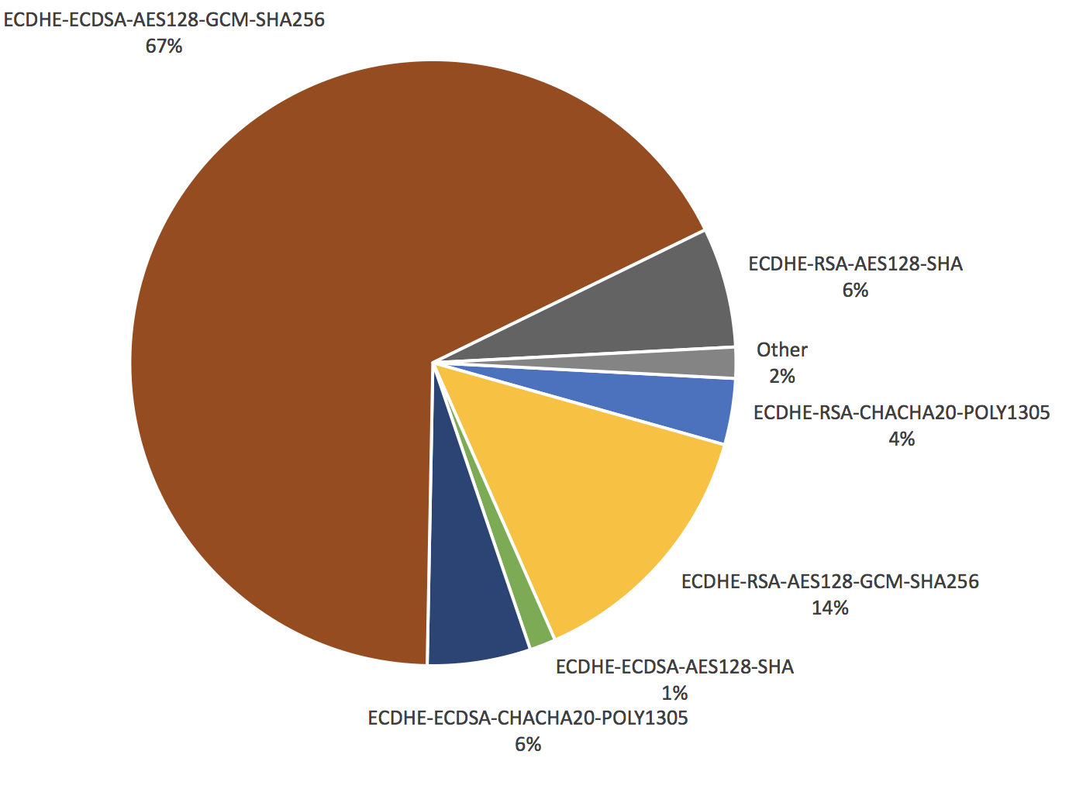
Ciphers used in TLS
Notes:
Source: https://blog.cloudflare.com/how-expensive-is-crypto-anyway/

Slide 41
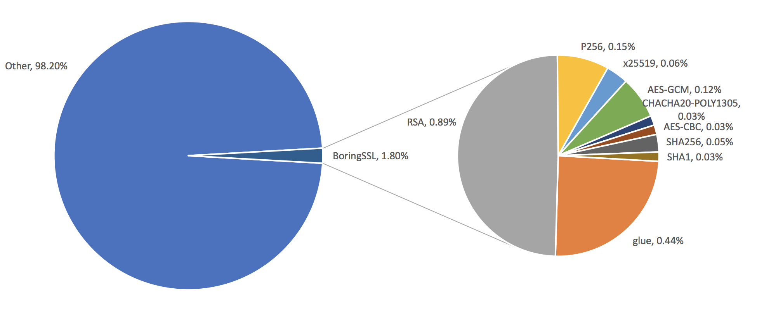
Performance of ciphers in TLS
everything else the server does

