Slide 1
Lecture 9: Protecting data at rest
Announcements
In-class test tomorrow!
Sarah Scheffler to host review session today at 4-6pm in MCS 135
Grades for labs 2 and 3 should have been sent to you via email; if you don’t get 2 emails with this info, let me + the graders know
No lab this week

Slide 2
Today’s agenda
Objectives
See where and how symmetric encryption primitives are used
See why they improve privacy
Today’s focus: protecting the privacy of data at rest
Will learn later in the semester how to protect smartphone messaging communications

Slide 3
Data at rest protection on laptops
Goal:
Data on a hard disk cannot be tampered with or exfiltrated
Even if the laptop is left unattended, lost, or stolen
Several products
Microsoft Bitlocker, standard on Windows 8 & 10
Apple FileVault, on by default from Mac OS X Yosemite (10.10)
Linux dm-crypt
Third-party products like TrueCrypt and SecureDoc (https://en.wikipedia.org/wiki/Comparison_of_disk_encryption_software)

Slide 4
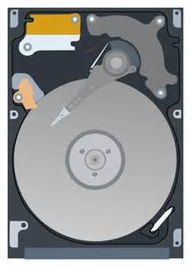
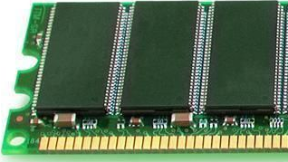
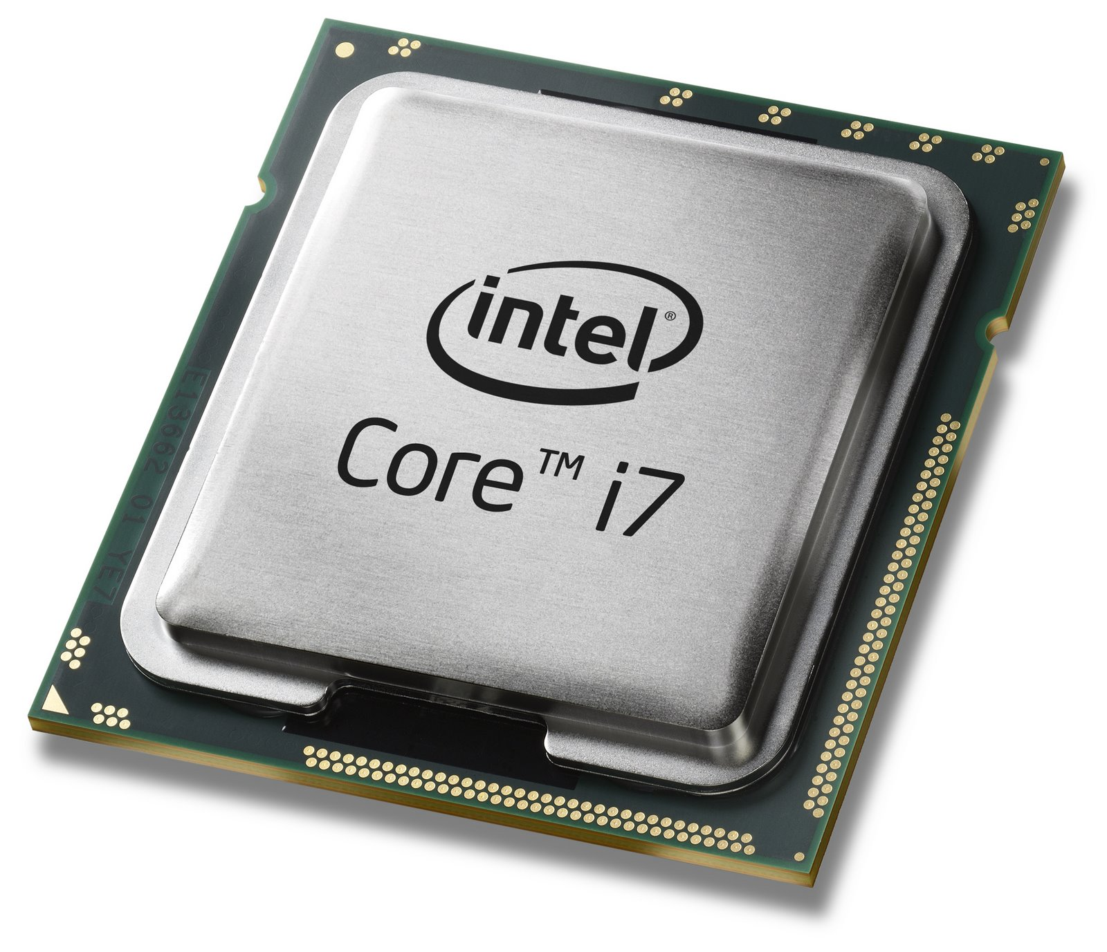
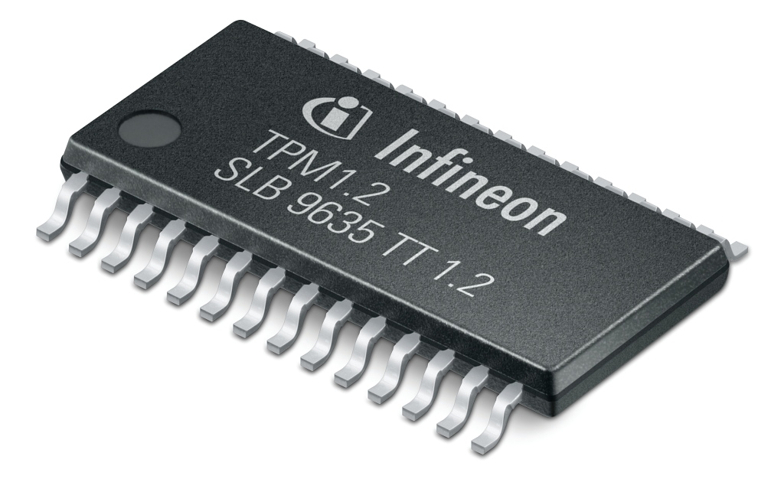
Data at rest protection on laptops: 4 components
Disk
Long-term storage
Always encrypted
Memory
Ephemeral storage
Erased upon shutdown*
CPU
Performs crypto quickly
Trusted Platform Module
Stores crypto keys**
Notes:
* But there is a risk of a “cold boot attack.” It is possible for an attacker to steal your RAM, immediately plug it into a friendly machine, and read its contents. That is: the contents of RAM take awhile to dissipate. One can extend this “time period to dissipate” by cooling the RAM first.
** Actually a TPM doesn’t store crypto keys. Instead it allows you to instrument your system and use the current state of the machine (plus perhaps a password) as a way to derive a key. We will correct that error in a few slides; for now let’s just pretend that the TPM stores keys directly.

Slide 5
Disk encryption: Attempt 1
AES key
Enc(key, data)

Slide 6
Disk encryption: Attempt 2
Remaining questions:
What mode of operation to use?
How to protect TPM’s release of key?
AES key
Enc(key, data)
data

Slide 7
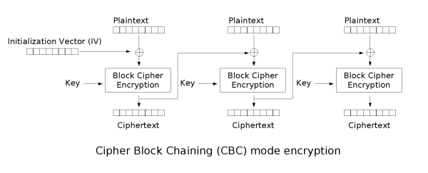
Mode of operation: CBC mode?
Ferguson (2006): Lacks diﬀusion in the CBC decryption operation.
If the attacker introduces a change ∆ in ciphertext block i, then plaintext block i is randomized, but plaintext block i+1 is changed by ∆. In other words, the attacker can ﬂip arbitrary bits in one block at the cost of randomizing the previous block.

Slide 8
Disk encryption: Threat model
Attacker can:
Read contents of disk at any time
Request disk to encrypt files of its choosing
Modify files/sectors on disk and request their decryption
Think: persistent malware!
Consequences of threat model:
Encrypt each sector of disk individually
No two sectors should be processed identically → Tweakable enc!
P, N
P, N
M
$
B$
C
C
B_{K}(Z₁, -)
B_{K}(Z₂, -)
…
B_{K}(Z_{n}, -)
X
X
B_{K}(Z*, -)
Π
Y
Y

Slide 9
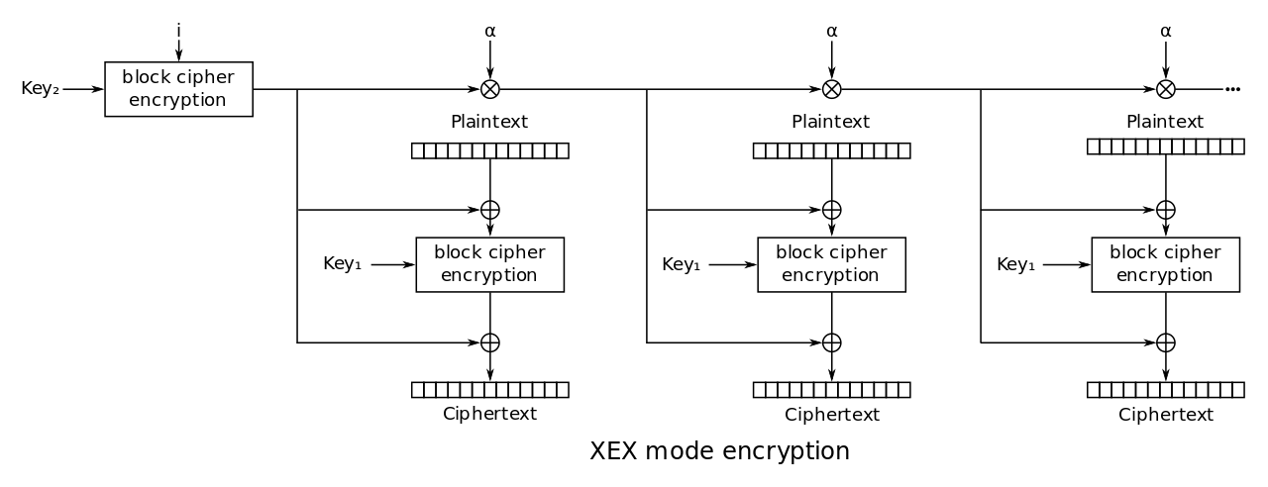
XEX mode
Z
TBC designed in 2004 by Philip Rogaway
Even-Mansour style with constantly-changing tweak
Tweak Z = sector number
Notes:
Note that two distinct AES keys are required: one to create the tweak and one for enciphering the tweaked input.

Slide 10
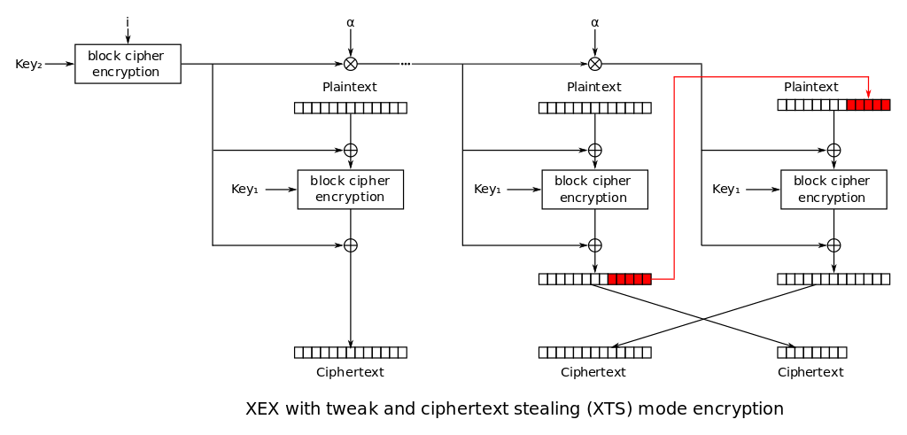
XTS mode

Slide 11
Key wrapping
What if multiple users should read the disk?
Different user accounts on the machine
Recovery key stored by Microsoft or escrowed to Active Directory
Don’t want to encrypt the entire drive several times!
Key wrapping = protect one key under another
Solved by standard encryption?
Suppose we wish to wrap a key in itself
CPA security game guarantees security against msg that Eve chooses
Eve doesn't have key! So, game doesn’t provide security if msg = key
Counterexamples: 1-time pad, CTR/CBC mode on modified AES that has been “punctured” in a key-dependent location, like AESk(k) = 0 or k
Use caution when encrypting key-dependent messages!
Key wrapping = deterministic authenticated encryption (tl;dr: use SIV mode, RFC 5297)

Slide 12
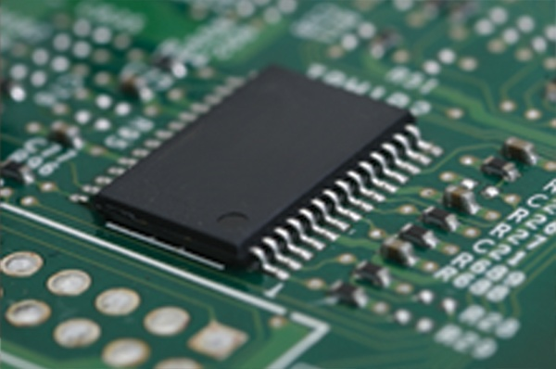
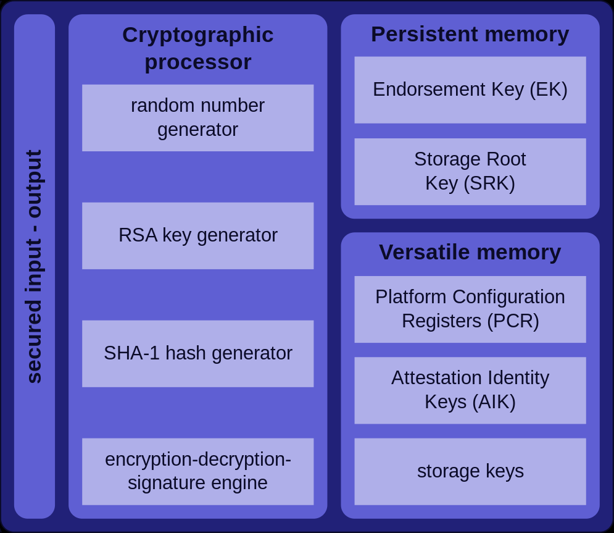
Trusted Platform Module
Generate key rather than storing it!
User’s master password (PBKDF2)
Machine’s state (“sealing”)
Notes:
See http://csrc.nist.gov/publications/nistpubs/800-132/nist-sp800-132.pdf for details on PBKDF2

Slide 13
Case study of Apple’s iPhone
Full disk encryption in iOS 8 and 9
TPM-like hardware protection of key material since 5s

Slide 14
Crypto on Apple’s mobile devices
Data for each application always encrypted
All OS components & applications signed by Apple, verified at boot before loading
Secure place to store keys & fingerprints
Hardware AES-256 engine on RAM-disk path
Unique hardware-stored salt for each device

Slide 15
Per-file encryption
Each file is encrypted with a its own key chosen by SE
File encrypted with AES-XTS, keywrap goes in metadata
Secure Enclave uses (NIST standard) CTR-DRBG
Use hardware RNG (ring oscillator) to get a short random seed
Then expand using counter mode
Picture from: John Kelsey (NIST), Picture from: Five DRBG algorithms based on Picture from: hash functions and block ciphers
Notes:
See http://csrc.nist.gov/groups/ST/toolkit/documents/rng/HashBlockCipherDRBG.pdf for more details on DRBGs

Slide 16
Four classes of data protection
Per-file key is wrapped with 1 of 4 “class keys” based on availability
Availability | Example | Crypto used | Key storage | When erased
Always | SIM PIN | Symmetric | Effaceable Storage | When user chooses “Erase all content and settings”
After 1st unlock | Wi-fi password | Symmetric | Secure Enclave | When phone is shut down
When locked | Mail attachments | Public-key (Curve 25519) | Secure Enclave | (Not needed)
When unlocked | Safari pwds & bookmarks | Symmetric | Secure Enclave | 10s after phone locks (without TouchID)

Slide 17
Four classes of data protection
Per-file key is wrapped with 1 of 4 “class keys” based on availability
Availability | Example | Crypto used | Key storage | When erased
Always | SIM PIN | Symmetric | Effaceable Storage | When user chooses “Erase all content and settings”
After 1st unlock | Wi-fi password | Symmetric | Secure Enclave | When phone is shut down
When locked | Mail attachments | Public-key (Curve 25519) | Secure Enclave | (Not needed)
When unlocked | Safari pwds & bookmarks | Symmetric | Secure Enclave | 10s after phone locks (without TouchID)

Slide 18
Four classes of data protection
Per-file key is wrapped with 1 of 4 “class keys” based on availability
Availability | Example | Crypto used | Key storage | When erased
Always | SIM PIN | Symmetric | Effaceable Storage | When user chooses “Erase all content and settings”
After 1st unlock | Wi-fi password | Symmetric | Secure Enclave | When phone is shut down
When locked | Mail attachments | Public-key (Curve 25519) | Secure Enclave | (Not needed)
When unlocked | Safari pwds & bookmarks | Symmetric | Secure Enclave | 10s after phone locks (without TouchID)

Slide 19
Four classes of data protection
?
Per-file key is wrapped with 1 of 4 “class keys” based on availability
Availability | Example | Crypto used | Key storage | When erased
Always | SIM PIN | Symmetric | Effaceable Storage | When user chooses “Erase all content and settings”
After 1st unlock | Wi-fi password | Symmetric | Secure Enclave | When phone is shut down
When locked | Mail attachments | Public-key (Curve 25519) | Secure Enclave | (Not needed)
When unlocked | Safari pwds & bookmarks | Symmetric | Secure Enclave | 10s after phone locks (without TouchID)

Slide 20
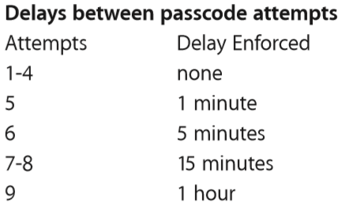
Deriving class keys
Remember our mantra: generate key rather than storing it!
Wrap sensitive class keys in a passcode key derived from:
User’s alphanumeric pin
The unique salt (uid) fused into the chip at manufacture time; unknown outside the Secure Enclave, (ostensibly) even by Apple
Use 10,000 iterations of PBKDF2
~80 ms per guess (how long to brute force?)
Secure Enclave pauses between tries
Phone can erase itself after 10 mistakes
Note: ∃ other ways to derive class keys in order to enable iTunes & iCloud backups + corporate device management
Notes:
To brute force a 6 character passcode it takes:
1 day for all numeric passcodes (8*10^-2 sec/guess * 10^6 guesses = 8 * 10 * 10^3 seconds = 2^3 * 2^3 * 2^10 seconds = 2^16 seconds which is about 1 day
5.5 years for all lowercase letters + numbers (8*10^-2 sec/guess * 36^6 guesses = 1/8 * 32^6 seconds = 2^-3 * 2^30 seconds = 2^27 seconds / (2^25 sec/yr) = 4 years, close enough…

Slide 21
Putting it all together
Wrap_{PK}(CK)
Wrap_{CK}(FK)
Enc_{FK}(Safari data)
PK = PBKDF2(pin, uid)
When phone is locked
Without Touch ID: CK is deleted from Secure Enclave’s memory
With Touch ID: Form new keywrap Wrap_{TouchID}(CK), then delete CK
P.S.: CK is changed whenever the passcode is changed P.S.: Memory used by Secure Enclave is itself encrypted w/ ephemeral key

Slide 22
Code signing
And now for something completely different…
Each step of the startup process contains components cryptographically signed by Apple to ensure integrity
Secure Enclave has a separate secure boot process
If any signature checks fail, device will not boot!
Separately: iOS kernel also validates that all applications are signed by Apple before they’re allowed to execute
Boot ROM (on chip)
Low-level bootloader
iBoot (next bootloader)
iOS kernel

Slide 23
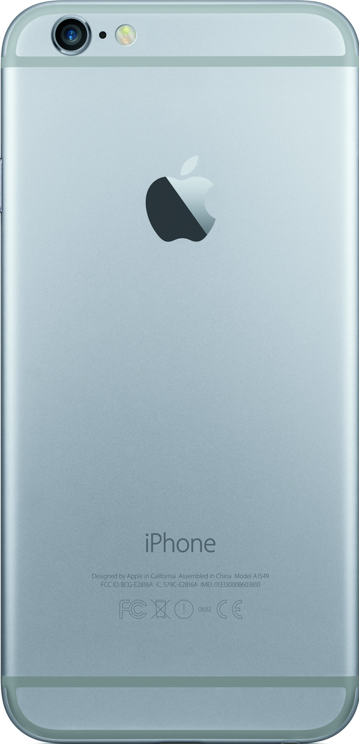
iOS over-the-air update process
Version of each component,
Nonce, Unique ECID
Upgraded iOS components,
Sign(Data, Nonce, ECID)
Signature contains:
Nonce to connect the response to the initial request
ECID to personalize the response to this particular phone
Why?

Slide 24
Apple vs. FBI Case
FBI wanted data on locked iPhone 5c, don’t have the PIN
PK = PBKDF2(pin, uid), so to read the files they could:
Pry open the phone to find the uid
Brute-force the pin on the phone itself
FBI wanted Apple to modify its operating system to enable a brute-force search of the PINs:
Allow PINs to be submitted via external interface, not by hand
Remove the delay between incorrect guesses
Remove the “poison pill” wiping of the phone after 10 misses
FBI wanted Apple to produce & (crucially) sign this “GovtOS” update, or else the phone will reject it
iPhone 5c doesn’t have a Secure Enclave, so delay is software-enforced rather than hardware-enforced

