Slide 1
Lecture 11: Padding & padding oracles
Announcements
Lab 5 posted online, due Fri 3/2 at 11pm
Test 1 returned in class today
Curved grade = 40 + 2/3 * raw score (essentially: 75 points gives an A)
With curve, median grade = 89%, mean grade = 86%
Fill out Piazza poll to pick test questions to review on Wednesday

Slide 2
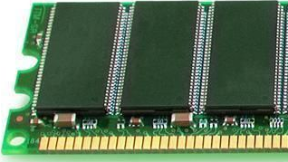
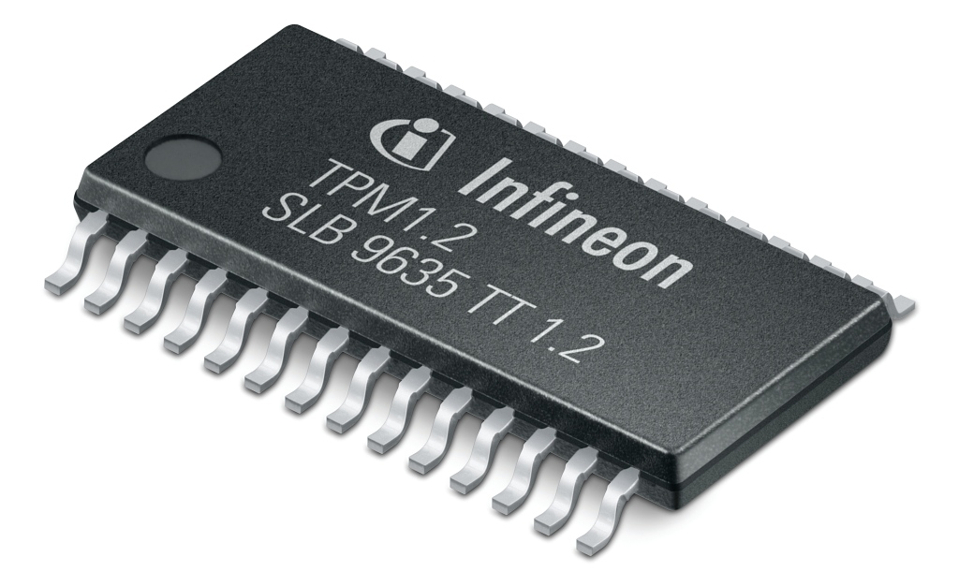
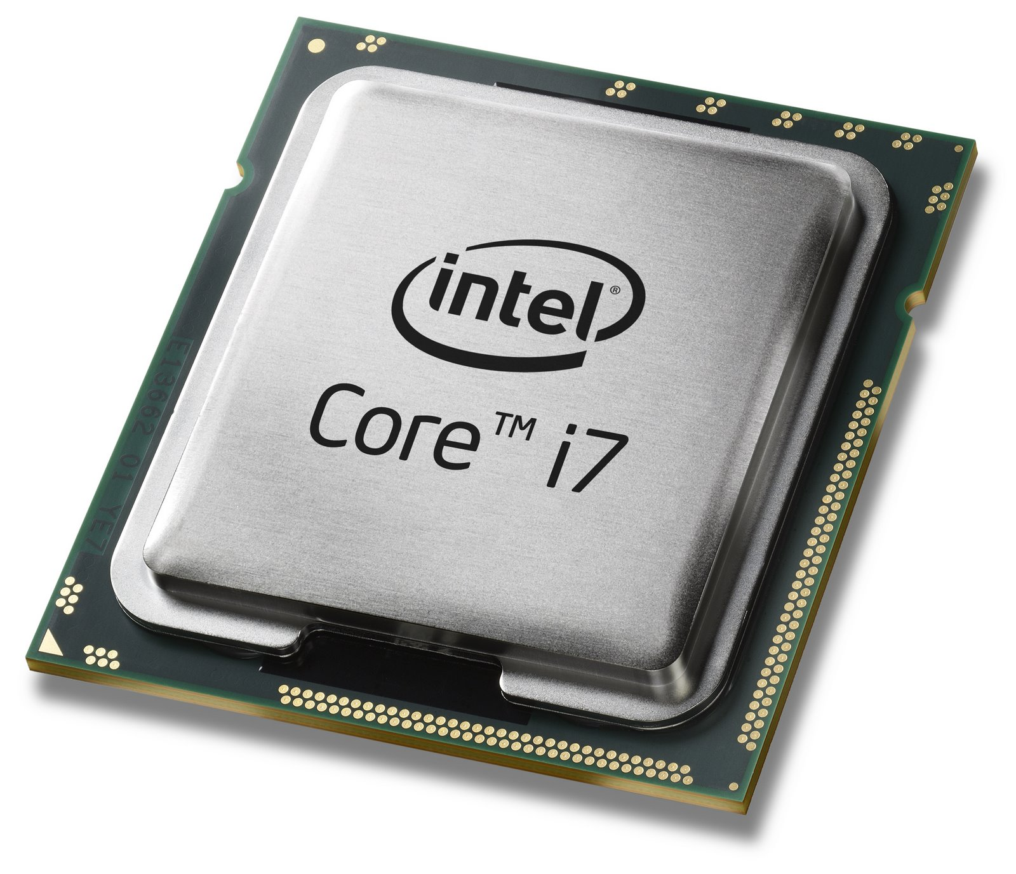
Last week: systems design + trusted hardware to help crypto
Laptops
Mobile phones
AES key K
Enc(K,D)
data D

Slide 3
Where we are in this course
The power of random-looking permutations
Cryptography meets systems: a love/hate story
Structured forgetfulness: dropping keys before they can be stolen
When reductions fail: dealing with the lowest layer
Special topics
→

Slide 4
Part 2: attacking crypto implementations
Cryptology
Cryptography
Cryptanalysis
Math of algorithm
Physics of implementation

Slide 5
Side channel attacks
So far, we have analyzed the security of cryptographic algorithms
Our security definitions ensure that a cryptosystem’s output is “harmless”
EU-CMA: cannot forge tag, even if you see tags for prior messages of your choice
IND$-CPA: ciphertexts look effectively random, even if you choose the messages
Nonce-based security: same thing, even if you choose the nonce too
But, implementations of crypto can reveal more than its desired outputs
Physical devices give error messages, require time, consume power, make noise, …
Collectively we refer to these issues as side channels: they’re potential channels of information that are outside of our definitions
But can they really cause problems?

Slide 6
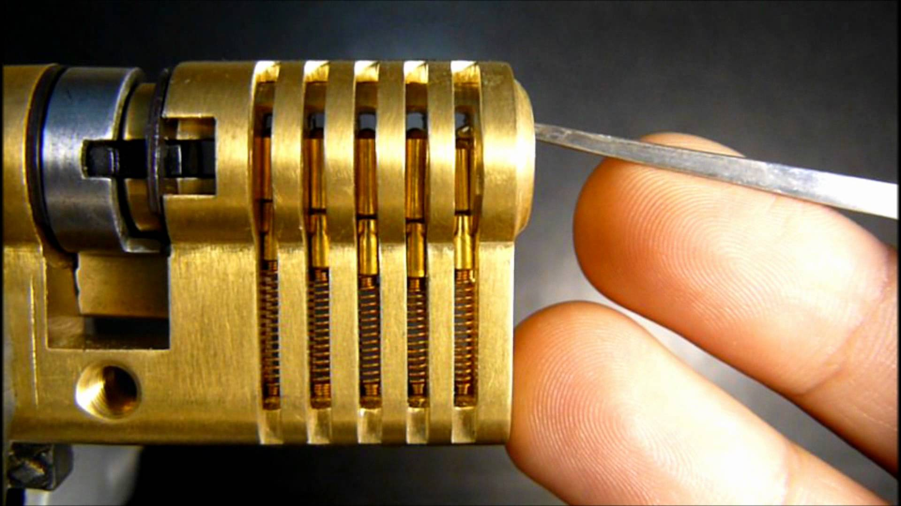
Divide and conquer
Attacks follow a divide and conquer approach: break 1 byte at a time
For each byte, simply guess all 256 values and check which one works
Notes:
Punchline: while enciphering is supposed to be an “all or nothing” transform where all bytes of key influence all bytes of state, implementation problems allow one to check each key byte separately.

Slide 7
Part 1: privacy XOR authenticity
Privacy
Authenticity
IND$-CPA against nonce-respecting Eve
Even after viewing many (A, T) pairs, Mallory cannot forge a new one
Alice
Mallory
P, N
P, N
❷ submit A
M
$
❶ choose K ← {0,1}^{λ}
B$
receive T
C
C
Mallory wins if:
It’s a valid forgery
It’s new
❸ output (A*, T*)
Notes:
Let’s step back and recap what we’ve done in Part 1. Alice wanted to send a message M to Bob. But she cannot send M itself because that wouldn't be safe from Eve/Mallory. So instead we built systems that allow her to do one of two things:
Send over total nonsense, but in a way that Bob can somehow recover M.
Protect the message M with a tag that ensures Mallory cannot maul it.
In part 2 we will want to combine these primitives. The goal is for Alice to be able to send over total nonsense and make sure that this is the only possible total nonsense that Alice could've possibly sent: if Mallory mauls this nonsensical string into any other nonsensical string, Bob will detect and reject it.

Slide 8
How to combine Enc and MAC?
Enc and MAC
MAC then Enc
Enc then MAC
P || pad
P
P || pad
Enc
MAC
MAC
pad
Enc
T
C
C
T
Enc
MAC
C
T
Intuitive concerns with MAC then Enc
The private data P is authenticated, but the tag is not!
Recipient must perform decryption before knowing whether the message is authentic
Notes:
Let’s explicitly consider encryption padding while we’re at it.

Slide 9
How to combine Enc and MAC?
Cryptographic doom principle
If you have to perform any crypto operation before verifying the MAC on a message you’ve received, it will somehow inevitably lead to doom!
– Moxie Marlinspike
MAC then Enc
Enc then MAC
P
P || pad
MAC
pad
Enc
T
C
Enc
MAC
C
T
Intuitive concerns with MAC then Enc
The private data P is authenticated, but the tag is not!
Recipient must perform decryption before knowing whether the message is authentic
Notes:
Let’s explicitly consider encryption padding while we’re at it.

Slide 10
Padding oracle attack: building blocks
CBC encryption mode
MAC then Encrypt
PKCS #7 padding
P₁
P₂
P
Padding is in whole bytes. The value of each added byte is the number of bytes that are added, i.e. N bytes, each of value N are added.
The padding will be one of:
01
02 02
03 03 03
04 04 04 04
05 05 05 05 05
etc.
$
HMAC
B_{K}
B_{K}
pad
T
C₁
C₂
CBC Enc
C
Notes:
Text in right column taken from Wikipedia: https://en.wikipedia.org/wiki/Padding_(cryptography)#PKCS7

Slide 11
Decryption + verification
Outcomes
Invalid padding
Valid padding, wrong HMAC
Valid padding, right HMAC
What to do in cases #1 and #2?
Typical answer: return an error message
We can use error messages to recover P!
C
CBC Dec
P
T
HMAC
pad
success?

Slide 12
Attack setup
MAC-then-Encrypt of private data P
many, many messages…
error codes
Notes:
Alice will only ever send one message P.
Bob doesn’t know that though. He will attempt to decrypt any message he receives.
Mallory takes advantage of this property by spamming Bob with a bunch of potential ciphertexts to see if Bob returns error messages.

Slide 13
Problems with CBC decryption?
C₁
C₂
Formally:
Doesn’t provide integrity
Isn’t nonce-respecting
…
Specific concerns to exploit today:
Propagation only goes forward… so it suffices to design a mechanism that recovers the final block P₂
Malleability: altering ciphertext block C₁ changes plaintext block P₂ in a byte by byte manner! (Destroys P₁ in the process, but no matter)
B_{K}⁻¹
B_{K}⁻¹
$
P₁
P₂

Slide 14
Padding oracle attack: the idea
private P
tag T
pad 030303
Mallory knows C for unknown msg
She uses mauling power to make all 256 options of final byte
Exactly one will have the final byte 01 & thus look like a valid pad!
The other mauled messages will have an invalid tag, such as 030302
Different error messages → can distinguish between these two cases
Use distinction to learn actual value of the final byte (here, 03)
Rinse, lather, repeat!
private P
tag T’
pad 0303xx
private P
tag (T’ || 0303)
pad 01

Slide 15
Padding oracle attack: the execution
Attack procedure
Send 256 CTs to Bob, one for each value of c
Probably all will fail, return error messages
255 of the failures will be due to bad padding
1 failures will have valid pad, bad MAC
Save the value of c causing the 2nd error!
0x01
Notes:
Picture taken from https://blog.cloudflare.com/padding-oracles-and-the-decline-of-cbc-mode-ciphersuites/

Slide 16
Padding oracle attack: computing the message
0x01
We can compute a in two ways: a = x ⊕ m = c ⊕ 0x01
So, the original message byte m = x ⊕ c ⊕ 0x01
Notes:
Picture taken from https://blog.cloudflare.com/padding-oracles-and-the-decline-of-cbc-mode-ciphersuites/

Slide 17
Padding oracle attack: getting more bytes
0x02
0x02
Notes:
Picture taken from https://blog.cloudflare.com/padding-oracles-and-the-decline-of-cbc-mode-ciphersuites/

Slide 18
How can we fix this?
Required effort
⇒ Read the padding bytes
⇒ Read padding bytes, compute the HMAC
⇒ Read padding bytes, compute the HMAC
Remember the three cases
Invalid padding
Valid padding, wrong HMAC
Valid padding, right HMAC
Bob’s solution: return the same error message in cases #1 and #2
Mallory’s countermeasure: can still distinguish the two cases by observing the time that the MAC-then-Encrypt system takes to execute!
Bob’s new solution: ensure that crypto software’s running time is independent of input; here, perform the HMAC test whether the padding is correct or not
Mallory’s new countermeasure: exploit timing variation within HMAC itself ☹

Slide 19
Lucky13
Insight: HMAC on 55 bytes takes less time to compute than HMAC on 56 bytes
Test by guessing the final two bytes of padding simultaneously
0x01
0x02
0x02

Slide 20
How to fix Lucky13?
Can check to make sure that you’re only performing HMAC over messages of the size that you expect
…but you had better make sure that this > check is itself timing-independent
…and even then the fix might introduce a side-channel of its own
Basically, timing-independence is really hard!
(So is software in general.)
Notes:
See https://blog.cloudflare.com/yet-another-padding-oracle-in-openssl-cbc-ciphersuites/

Slide 21
How to fix Lucky13?
(So is fighting against a compiler in general)
Basically, timing-independence is really hard!
(So is software in general.)
Notes:
https://twitter.com/dotMudge/status/956659492199989255

Slide 22
Padding Oracle Timeline
2002: Serge Vaudenay discovers CBC padding oracle attacks
2002-11: Extensions to specific systems like XML Encryption
2011: BEAST (Browser Exploit Against SSL/TLS) builds Java applet to perform the padding oracle in TLS 1.0
2013: Lucky 13 discovered
2014: POODLE (Padding Oracle On Downgraded Legacy Encryption) finds that the straightforward oracle works on SSL 3.0
2015: Extended Lucky 13 attack on Amazon’s timing-independent TLS implementation
2017: TLS 1.3 breaks backward compatibility, permits Enc-then-MAC
Notes:
Vaudenay’s paper: https://www.iacr.org/archive/eurocrypt2002/23320530/cbc02_e02d.pdf
I like Schaumann’s timeline from theoretical flaw to empirical attack

Slide 23
What you can do
Use good crypto coding conventions
Validate code for timing independence
Notes:
Links: https://cryptocoding.net/index.php/Coding_rules and https://github.com/agl/ctgrind

Slide 24
Related sources of error
Compression oracles
Format oracles
Basic idea: if you apply compression before encryption, then post-compression message length reveals some information about message!
2012: CRIME (Compression Ratio Info-leak Made Easy) recovers secret web cookies over HTTPS connections, hijacks sessions
2013: BREACH (Browser Reconnaissance and Exfiltration via Adaptive Compression of Hypertext)
Basic idea: if a higher-level protocol expects underlying message to obey some structural rules, can tinker with ciphertext until you find something that works
2011: “How to break XML encryption”
2015: “How to break XML encryption – automatically”
Notes:
For more about XML encryption flaws, see:
https://dl.acm.org/citation.cfm?id=2046756
https://www.ei.rub.de/media/nds/veroeffentlichungen/2015/08/11/breaking-xml-enc-automatically.pdf

Slide 25
Summary: attacker oracles
When we talk of ‘oracles’ in cryptanalysis, we mean that somehow the system is providing the attacker with the ability to compute f(P) for some function f
There are many possible sources of these ‘oracles’
Error messages
Message length, if a compression function is applied pre-encryption
Expected formatting of the underlying message (e.g., XML)
Time for a computation to finish
Performance speedup in running time due to the cache
Power consumed by the device
Unfortunately most of these ‘oracles’ can be exploited to recover the private data fully, as you will see for yourself in Labs 5 and 6

