Slide 1
Lecture 14: Authenticated Encryption
Assignments
Lab 6 due this Friday, March 16 at 11pm (re-download lab6.py)
My office hours this week shortened to Wed 3-4pm

Slide 2
Today’s objective
Math Tools
Primitives
Algorithms
Protocols
Modular arithmetic
Auth key exchange
Key evolution
Signal: messaging
Key encapsulation
TLS: internet PGP: email
(see CS 558)
Hash functions
Random(ish) permutations
Protected communication
Block ciphers
TBCs
☏ Minicrypt
Cryptomania ✉

Slide 3
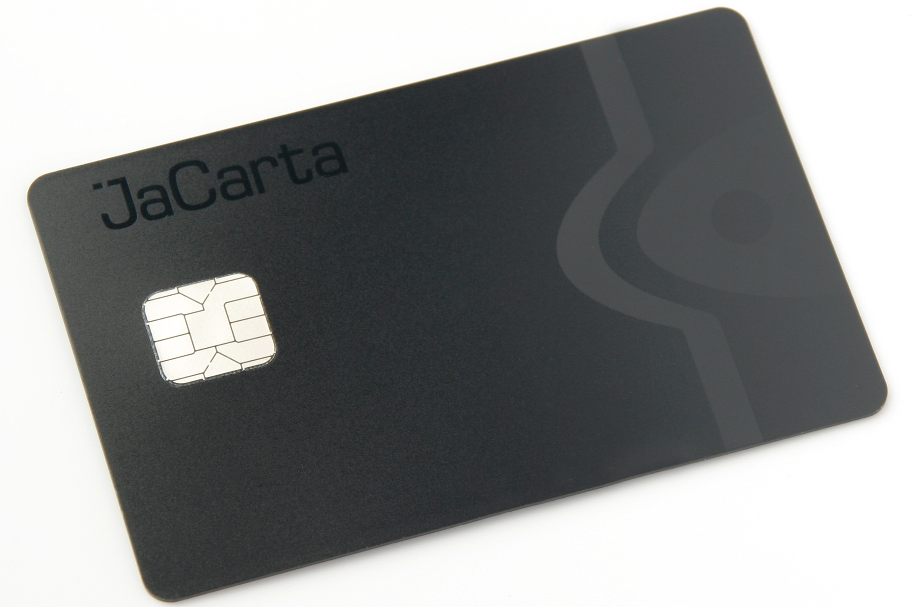
Side channel attacks on crypto
Issue:
Physical implementation of a device can reveal more than its desired outputs
Environments to attack:
Software on PCs
Small hardware devices
Common side channels:
Error messages
Time
Cache
Power
EM fields
Sound
Optics
Network
…

Slide 4
Side channel attack on encryption
key K
Math-approved way of protecting P
many, many messages…
Issues with Bob’s error messages
He only sends them sometimes, not always.
This decision depends upon the key.
Error messages depend upon “non-cryptographic” properties of the message, like whether the padding is correct.
error codes, timing, …
Notes:
To point #1: Knowing when an error is generated vs not (or distinguishing between different errors) allows you to perform a padding oracle or timing attack.

Slide 5
Our desired countermeasure
2. Ideally with minimal use of the key
key K
Math-approved way of protecting P
3. Distinguish Alice from Mallory cryptographically
many, many messages…
I’m not talking to you, Mallory
1. Bob always rejects Mallory’s messages
Notes:
Even though the stated goal of the Alice -> Bob communication is confidentiality, requirement #3 implies that we want the message to be authenticated too.

Slide 6
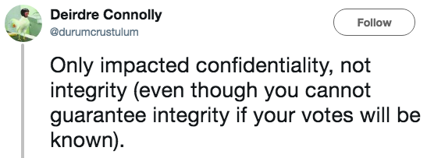
Remember my constant warning
Confidentiality xor authenticity is not possible. If you don't have both, often you don't have either.
– Prof. Matthew Green, Johns Hopkins
Lack of confidentiality can impact integrity
Lack of integrity can impact confidentiality
If you have to perform any cryptographic operation before verifying the MAC on a message you’ve received, it will somehow inevitably lead to doom!
– Moxie Marlinspike, “Cryptographic Doom Principle”

Slide 7
Authentication (xor) encryption
IND$-CPA for privacy
EU-CMA for authenticity
Even after viewing many (A, T) pairs, Mallory cannot forge a new one
P
P
Alice
Mallory
Enc
$
❷ submit A
C
C
❶ choose K ← {0,1}^{λ}
receive T
Mallory wins if:
It’s a valid forgery
It’s new
❸ output (A*, T*)
Notes:
Let’s step back and recap what we’ve done in Part 1. Alice wanted to send a message M to Bob. But she cannot send M itself because that wouldn't be safe from Eve/Mallory. So instead we built systems that allow her to do one of two things:
Send over total nonsense, but in a way that Bob can somehow recover M.
Protect the message M with a tag that ensures Mallory cannot maul it.
In part 2 we want to combine these primitives. The goal is for Alice to be able to send over total nonsense and make sure that this is the only possible total nonsense that Alice could've possibly sent: if Mallory mauls this nonsensical string into any other nonsensical string, Bob will detect and reject it.

Slide 8
First, let’s strengthen privacy
IND$-CPA
IND$-CCA
Same thing, but now Mallory has access to encryption and decryption oracles
Think about connection to padding oracles
P
P
Enc
$
Enc$
$
C
C
Dec$
$⁻¹
Notes:
This looks like strong pseudorandomness, but for encryption schemes.
Strangely, this strengthening doesn’t seem to incorporate error messages directly into our model, which if you recall is what we said the issue was with IND$-CPA way back when we initially discussed padding oracles. But, this stronger definition actually thwarts error-message-style attacks anyway. Remember how padding oracles worked: Mallory spammed Bob and was able to learn something about the decrypted plaintext corresponding to messages. This is way stronger: now Mallory can learn everything about the decrypted plaintext.
Cryptographers initially came up with this notion of CCA security in the late 1990s. But it took awhile for the engineering community to realize that cryptographers were serious about this notion and that it actually matters. There are several papers in the ~2005-2010 period that break the security of cryptosystems in the wild (e.g., XML encryption) by using padding oracle attacks. Eventually the engineers re-learn the lesson that cryptographers already figured out. So, now most systems used in practice are actually CCA secure.

Slide 9
Formalizing IND$-CCA
A symmetric key encryption scheme also comprises 3 algorithms:
KeyGen(λ) outputs a key K ← {0,1}^{λ}
Encrypt_{K}(message P, nonce N) → C
Decrypt_{K}(ciphertext C, nonce N) → P
These algorithms satisfy 3 constraints
Performance: all 3 algorithms are efficiently computable
Correctness: Dec_{K}⁻¹ (Enc_{K}(P, N)) = P for all K ∈ {0,1}^{λ} , N ∈ {0,1}^{μ} , and P ∈ {0,1}*
Enc$
$
Dec$
$⁻¹
(q, t, ε)
(q, t, ε)-IND$-CCA: for every nonce-respecting adversary A who makes ≤ q queries and runs in time ≤ t, A ≈ _{(q, t, ε)} A where $ responds randomly and so does $⁻¹ subject to consistency with $
Enc_{K}, Dec_{K}
$, $⁻¹
Notes:
Note: this definition talks about CCA for nonce-respecting adversaries. Hence, Enc and Dec take in a nonce as input. But you could analogously define CCA for an encryption scheme that takes a random IV as input.

Slide 10
Authenticating and encrypting
Enc and MAC
MAC then Enc
Enc then MAC
P || pad
P
P || pad
Enc
MAC
MAC
pad
Enc
T
C
T
Enc
MAC
C
C
T
Integrity | Plaintext integrity: Cannot make CT that decrypts to message that sender never encrypted | Ciphertext integrity: Cannot make new valid CTs, only know sender-made ones

Slide 11
Authenticating and encrypting
Enc and MAC
MAC then Enc
Enc then MAC
P || pad
P
P || pad
Enc
MAC
MAC
pad
Enc
T
C
T
Enc
MAC
C
C
T
Integrity | Plaintext integrity: Cannot make CT that decrypts to message that sender never encrypted |  | Ciphertext integrity: Cannot make new valid CTs, only know sender-made ones
Confidentiality | None | CPA | CCA!

Slide 12
Formalizing ciphertext integrity
Goal: Mallory cannot make a valid CT that wasn’t previously made by sender
Imagine that Mallory is trying to perform a padding oracle attack
If she spams Bob with malformed CTs, now he simply rejects them all!
Enc$
$
Dec$
T
Operation: This box returns a single “integrity failure” error message no matter what Mallory submits!
Restriction: Mallory cannot attempt to decrypt ciphertexts that are the result of prior encryptions.

Slide 13
Relating integrity and confidentiality
Thm. Suppose that an encryption scheme provides (q, t, ε₁)-CPA privacy and (q, t, ε₂)-ciphertext integrity. Then, it also provides (q, t, ε₁+2ε₂)-CCA privacy.
Intuition: If Mallory cannot forge new messages, then Dec oracle to her
Proof by picture.
Enc$
Dec$
$
$⁻¹
by CTXT
by CTXT, emulate $⁻¹ in Mallory’s head
Enc$
T
$
T
by CPA
Notes:
Remember Matt Green’s claim from the first lecture?

Slide 14
One last definition?
Def. Authenticated encryption with associated data (AEAD)
KeyGen: it randomly chooses a key, just as always
Enc(private data P, authenticated data A, nonce N, length expansion L) → ciphertext C of length |C| = |P| + L
Dec(C, A, N) → P or
Why combine authentication and encryption?
Better security: resist some of these physical side channel attacks
Simplicity: developers have fewer decisions (i.e., opportunities for mistakes)
Performance: save in time + space costs, also often only need 1 key
T
Notes:
The generic constructions require separate keys for Enc and MAC. By contrast, the systems we study today tend to require only one key for both.

Slide 15
Counter with CBC-MAC (CCM)
P, A, N
T, P
N, A, |P|
CBC-MAC
CTR
Gen counter
B_{K}
B_{K}
tag T
ciphertext C
Novelties
CTR and CBC-MAC can use same key
Counter generation mechanism solves CBC-MAC’s length extension problem
Drawbacks
CTR mode → nonce reuse is catastrophic for privacy
Using CBC mode for the MAC prevents parallelization and pipelining
Notes:
CCM was designed by Housley, Whiting, Ferguson 2003

