Slide 1
Lecture 15: Authenticated Encryption, part 2
Will post Lab 7 later today, due this Friday, March 23 at 11pm
Apologies for my bug in the test vector for Lab 6, Question 1

Slide 2
Side channel attack on encryption
key K
Math-approved way of protecting P
many, many messages…
Issues with Bob’s error messages
He only sends them sometimes, not always.
This decision depends upon the key.
Error messages depend upon “non-cryptographic” properties of the message, like whether the padding is correct.
error codes, timing, …
Notes:
To point #1: Knowing when an error is generated vs not (or distinguishing between different errors) allows you to perform a padding oracle or timing attack.

Slide 3
Our desired countermeasure
2. Ideally with minimal use of the key
key K
Math-approved way of protecting P
3. Distinguish Alice from Mallory cryptographically
many, many messages…
I’m not talking to you, Mallory
1. Bob always rejects Mallory’s messages
Notes:
Even though the stated goal of the Alice -> Bob communication is confidentiality, requirement #3 implies that we want the message to be authenticated too.

Slide 4
Authenticated Encryption with Associated Data (AEAD)
KeyGen: randomly chooses key, as always
Enc(authenticated data A, private + auth data P, nonce N) → ciphertext C of length |C| > |P|
Dec(C, A, N) → P or
Why combine authentication and encryption?
Better security: resist some of these physical side channel attacks
Simplicity: developers have fewer decisions (i.e., opportunities for mistakes)
Performance: save in time + space costs, also often only need 1 key
P
A, N
C, A, N
Auth Enc
Auth Dec
T
C
P or T
T

Slide 5
Chain of security guarantees: probabilistic edition
IND$-CPA
IND$-CCA
Probabilistic AE
P
P
Enc$(-,$)
$
Enc$(-,$)
$
Enc$(-,$)
$
Dec$(-)
$⁻¹
Dec$(-)
T
C
C
CCA and authentication have different goals even if achieved with similar constructions
CCA: ensure privacy against a strong Mallory who can make Dec queries
Authenticity: ensure Mallory cannot forge new messages that Bob will accept

Slide 6
Chain of security guarantees: nonce-based edition
P, N
P, N
Enc$(-,-)
$
Enc$(-,-)
$
Dec$(-,-)
T
C
C
Nonce-based
IND$-CPA
Nonce-based AE
IND$-CPA
IND$-CCA
Probabilistic AE
Notes:
Subtle change: now Dec has two inputs as well! Let’s leverage the fact that the nonce is public anyway.

Slide 7
CCM: Housley, Whiting, Ferguson 2003
P, A, N
T, P
N, A, |P|
CBC-MAC
CTR
Gen counter
B_{K}
B_{K}
tag T
ciphertext C
Novelties
CTR and CBC-MAC can use same key
Counter generation mechanism solves CBC-MAC’s length extension problem
Drawbacks
CTR mode → nonce reuse is catastrophic for privacy
Using CBC mode for the MAC prevents parallelization and pipelining…
Notes:
In today’s lecture we will briefly survey many different authenticated encryption schemes. You should focus on how they combine the building blocks we’ve already studied and why that yields the claimed strength and performance.

Slide 8
Performance comparison of CBC and CTR modes
Throughput of symmetric encryption on a Skylake Core-i5 running at 2.7 GHz
Data taken from https://cryptopp.com/benchmarks.html
Mode of operation | Key length | GiB/second | Cycles per byte
AES in CTR mode | 128 bit | 4.4 | 0.57
 | 192 bit | 3.8 | 0.67
 | 256 bit | 3.3 | 0.77
AES in CBC mode | 128 bit | 1.0 | 2.40
 | 192 bit | 0.90 | 2.80
 | 256 bit | 0.79 | 3.20

Slide 9
Performance vs message length
Cycles per byte
This data is for an older Clarkdale CPU
Message length, in bytes
Notes:
Source: http://web.cs.ucdavis.edu/~rogaway/ocb/performance/

Slide 10
Performance issues with CCM
P, A, N
T, P
N, A, |P|
CBC-MAC
CTR
Gen counter
B_{K}
B_{K}
tag T
ciphertext C
Running time: 2|P| block cipher calls
Lack of parallelism: Many of the block cipher calls must be done sequentially
Not streaming-friendly: can’t forget P after CBC-MAC, need it again for CTR
Online AE: realizable in constant memory with one left-to-right pass over P
Notes:
In today’s lecture we will briefly survey many different authenticated encryption schemes. You should focus on how they combine the building blocks we’ve already studied and why that yields the claimed strength and performance.

Slide 11
EAX: Bellare, Rogaway, Wagner 2004
Released one year after CCM
Replaces CBC-MAC with OMAC
Well… CMAC used in NIST standard
Novelties
Can pre-process associated data!
CTR and OMAC can be executed concurrently for online streaming
Can re-use key for CTR + all OMACs
Proof forms a “tweakable OMAC” as an intermediate step
N
P
A
Notes:
The Bellare et al paper uses OMAC in its construction + proof. However, NIST standardized this system using CMAC instead. Remember that these MACs are very similar: OMAC is simply the one-key variant of CMAC.

Slide 12
Galois/counter mode (GCM): McGrew, Viega 2005
Novelty
Only one round of block cipher calls
Intel’s AES-NI includes a PCLMULQDQ instruction for mult_{H} in hardware
About the MAC
Assumes block length = 128 (built for AES)
Based on Galois multiplication in GF(2128)
Carter-Wegman-style function is target collision resistant, aka a universal hash
Drawback
Very complicated to implement, raising chance that someone will do it wrong
Extensive cryptanalysis has exposed weak keys, lead to CAESAR competition
Counter mode
CBC-MAC style
Notes:
CAESAR = Competition for Authenticated Encryption: Security, Applicability, and Robustness

Slide 13
Speed of GCM in hardware
Notes:
Paper: https://eprint.iacr.org/2015/102.pdf. This slide is copied directly from Shay Gueron’s real world crypto (RWC) talk.

Slide 14
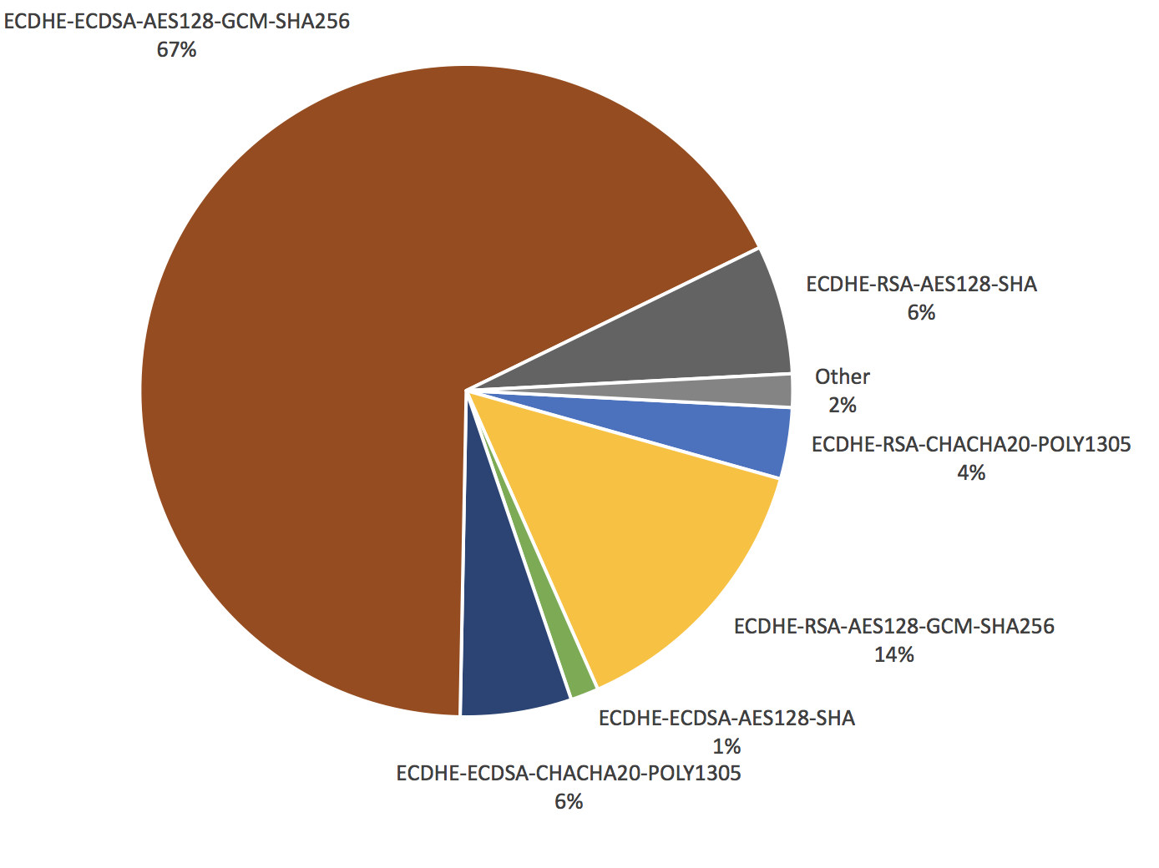
GCM: widespread use in practice
Notes:
Left panel: Accessed via Google Chrome on 1/31/2017
Right panel source: https://blog.cloudflare.com/how-expensive-is-crypto-anyway/

Slide 15
Where we stand
What’s left?
Even more speed: only |P| block cipher calls, but without cheating this time
Even more security: removing the need for the nonce N altogether

Slide 16
Offset codebook mode (OCB)
History
Jutla 2001: Integrity aware parallelizable mode (IPAM)
Rogaway 2002: OCB
Basic idea: XEX with finalization

Slide 17
Tweakable version of OCB
Thm [Liskov Rivest Wagner]. If E is a tweakable block cipher, then construction provides privacy and unforgeability against any nonce-respecting adversary.
~
~
Π
Π
Π
Π
Π
Why privacy?
Nonce-respecting ⇒ no tweak is repeated
Ergo each block cipher output looks pseudorandom, independent of any other output from other blocks
Why unforgeability
Same idea
Note that it is easy to form collisions in checksum
But, fresh tweaks ⇒ all tags are unpredictable

Slide 18
OCB’s licenses
Taken from http://web.cs.ucdavis.edu/~rogaway/ocb/license.htm
License for Open-Source Software Implementations of OCB (1/9/13) Under this license, you are authorized to make, use, and distribute open-source software implementations of OCB. This license terminates for you if you sue someone over their open-source software implementation of OCB claiming that you have a patent covering their implementation.
General License for Non-Military Software Implementations OCB (1/10/13) This license does not authorize any military use of OCB. Aside from military uses, you are authorized to make, use, and distribute (1) any software implementation of OCB and (2) non-software implementations of OCB for noncommercial or research purposes. You are required to include notice of this license to users of your work so that they are aware of the prohibition against military use. This license terminates for you if you sue someone over an implementation of OCB authorized by this license claiming that you have a patent covering their implementation.
Patent License for OpenSSL (11/13/13) This license was provided at the request of the OpenSSL Software Foundation to specifically authorize use of OCB in OpenSSL.

Slide 19
Security guarantees so far
Nonce-based
IND$-CPA
(Online) Nonce-based AE
Enc$(-,-)
P, N
$
C
IND$-CPA
IND$-CCA
Probabilistic AE
Dec$(-,-)
┴
Notes:
Subtle change: now Dec has two inputs as well! Let’s leverage the fact that the nonce is public anyway.

Slide 20
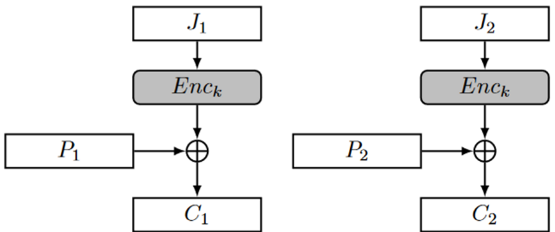
GCM nonce reuse: destroys privacy
For privacy, GCM = CTR
CTR mode with repeated nonces = two-time pad
We broke privacy in Lab 2
’
’
’
’

Slide 21
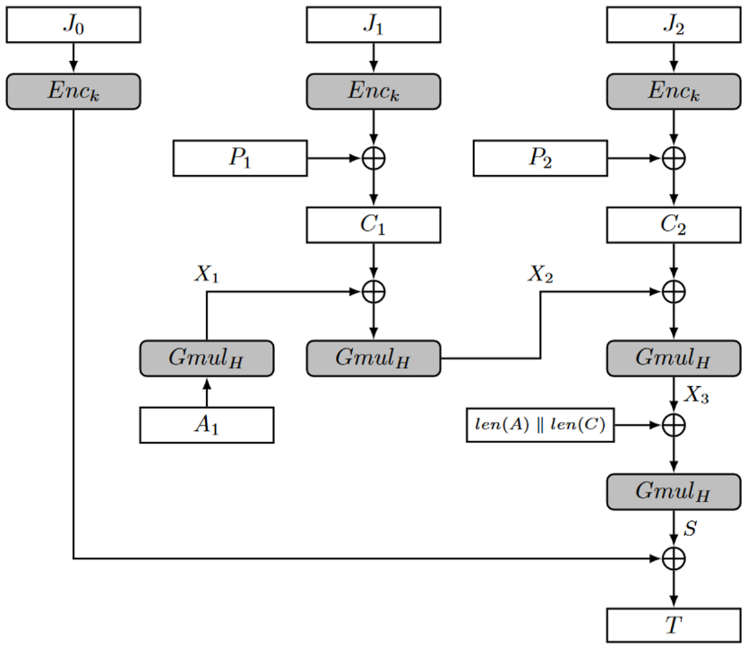
GCM nonce reuse: destroys authenticity
Notes:
Source: https://eprint.iacr.org/2016/475.pdf

Slide 22
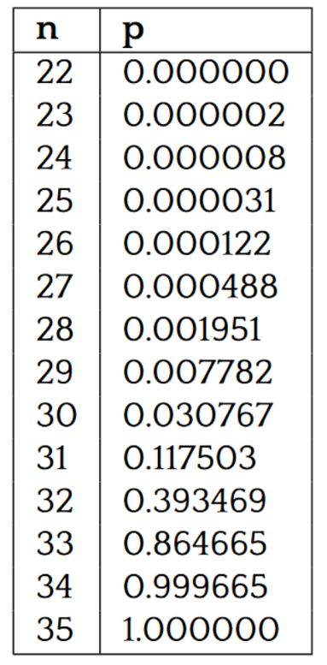
GCM nonce being chosen randomly: hurts authenticity
Notes:
Source: https://eprint.iacr.org/2016/475.pdf

Slide 23
Wait… why did we want nonces in the first place?
Main purpose for introducing nonces was to hide frequency analysis
Don’t want to reveal to Mallory whether Alice is encrypting the same message twice
But we then built systems in which we rely upon the nonce for more than this
How can we make sure that nonce-reuse only reveals frequency analysis?
Key idea: uniqueness of the message itself should also serve as a “nonce”

Slide 24
Misuse-resistant AE
Novelty: Repeating N has limited damage
No impact to authenticity
Privacy damaged only to the extent that an adversary can detect repetitions
Drawback: Cannot be online
Every bit of C must depend on every bit of P
So, cannot output first bit of C before reading last bit of P
Corollary: can omit the nonce entirely if you want, Enc can be deterministic!
Note how we’ve come full circle on this question

Slide 25
Deterministic AE
P, A
Leads to:
Misuse-resistant AE by replacing associated data A with (N, A)
Key wrapping!
Adversary cannot produce a valid C without knowing K
Even C corresponding to a message P that depends on the key K somehow
Recall that the full disk encryption lecture needed key wrapping
Enc$(-,-)
R
C
C, A
Dec$(-,-)
┴
P

Slide 26
Synthetic Initialization Vector (SIV)
Designed by Rogaway and Shrimpton 2006
Novelty
Leverages structure of P, A to ensure uniqueness of CTR’s nonce
Can be deterministic
Drawbacks
2 passes, 2 keys
Must decrypt, then verify
Cannot truncate tag
N
A
P
MAC
Nonce Enc
tag T
ciphertext C
Notes:
When used in MRAE, encoding must distinguish N from A

Slide 27
Strength of Deterministic SIV
Thm. Suppose that the MAC is EU-CMA and Enc satisfies nonce-based IND$-CPA.
If there exists an adversary running in time t and making q queries that breaks the DAE with probability ε_{dae}, then there exist adversaries breaking the MAC and Enc games making ≤ q queries such that:
ε_{mac} + ε_{enc} ≥ ε_{dae} - q/2^{|T|}.
A
P
MAC
Nonce Enc
tag T
ciphertext C

Slide 28
Proof sketch
Replace MAC with truly random R’
Let’s call modified scheme Enc’ / Dec’
Attempt to distinguish from R / ┴
Assume WLOG that our distinguisher stops successfully as soon as it makes a single Dec’ query that succeeds
Hence, Enc’ queries are useless. Until Dec’ gives useful info, Enc’ only provides unrelated data.
The probability of finding the correct tag on a new, unqueried (A, C) pair is simply 2^{|T|}
A
P
R’
Nonce Enc
tag T
ciphertext C
Enc$(-,-)
P, A
R
C
C, A
Dec$(-,-)
┴
P

Slide 29
Proof sketch
Replace MAC with truly random R’
Bring MAC back into the picture
We know forgeries are unlikely in Enc’
If forgeries can occur in the real Enc, use to distinguish!
A
P
MAC
Nonce Enc
tag T
ciphertext C

Slide 30
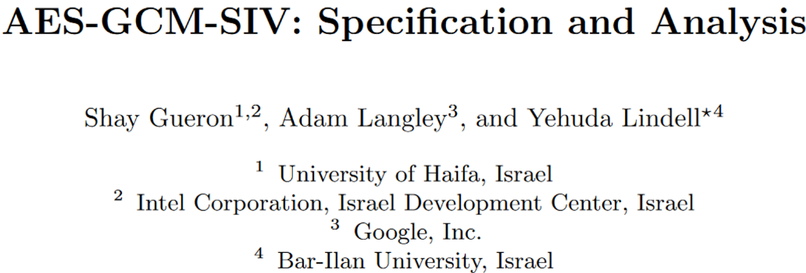
Combining GCM and SIV
Haswell | 1.17 cycle/byte
Broadwell | 0.92 cycle/byte
Notes:
Papers: https://eprint.iacr.org/2015/102 and https://eprint.iacr.org/2017/168.pdf

Slide 31
Authenticated encryption: state of the art so far
Nonce-based
IND$-CPA
(Potentially online) Nonce-based AEAD
Misuse-resistant /
Deterministic AEAD
…
Robust AE
IND$-CPA
IND$-CCA
Probabilistic AEAD
For more info, read about the ongoing Competition for Authenticated Encryption: Security, Applicability, and Robustness (CAESAR) at https://competitions.cr.yp.to/caesar.html
Notes:
Subtle change: now Dec has two inputs as well! Let’s leverage the fact that the nonce is public anyway.

Slide 32
End of Part 2
✉ key encapsulation
key K
key K
key K
✔
☏ protected
☏ communication
encode C = Enc(K, P)
private & auth
message P
recover P = Dec(K, C),
or receive error ┴
???

Slide 33
Starting next time: Generating, distributing, updating keys
Math Tools
Primitives
Algorithms
Protocols
Modular arithmetic
Auth key exchange
Key evolution
Signal: messaging
Key encapsulation
TLS: internet PGP: email
(see CS 558)
Hash functions
✔
Random(ish) permutations
Protected communication
Block ciphers
☏ Minicrypt
Cryptomania ✉

