Slide 1
Lecture 16: Timely key distribution
Lab 7 posted, due this Friday, March 23 at 11pm
Attendance at office hours at 3-5pm today?

Slide 2
Review: Authenticated Encryption with Associated Data
KeyGen: randomly chooses key, as always
Enc(authenticated data A, private + auth data P, nonce N) → ciphertext C of length |C| > |P|
Dec(C, A, N) → P or
Strong security guarantees:
P
A, N
C, A, N
Auth Enc
Auth Dec
T
C
P or T
T
Enc$(-)
$
Dec$(-)
T

Slide 3
Review: Focus of this course
Note that Authenticated Encryption meets all four goals!
So… are we all safe now?
 | …at endpoints | …in transit
Authenticity | Identity verification Bob knows Alice sent C | Binding Eve cannot alter M
Privacy | Deniability (optional) Bob can’t prove Alice said M | Confidentiality Eve cannot learn M

Slide 4
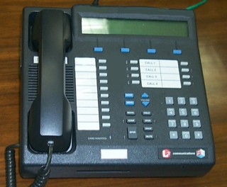
Review: Secure communication in presence of an adversary
✉ key encapsulation
key K
key K
key K
☏ protected
☏ communication
encode C = E(K, M)
message M
decode M = D(K, C)
???
Notes:
Remember: Bob could simply be a future version of Alice (think: full disk encryption)
Icons from https://www.iconfinder.com/iconsets/user-pictures
Analogy:
Envelopes sent through the US Postal System have pretty good privacy rules but long latency.
Telephones enable real-time communication but range widely in privacy, from “none” to Secure Terminal Equipment (https://en.wikipedia.org/wiki/Secure_Terminal_Equipment).

Slide 5
Today: Start of Part 3
The power of random-looking permutations
Cryptography meets systems: a love/hate story
Structured forgetfulness: dropping keys before they can be stolen
When reductions fail: dealing with the lowest layer
→

Slide 6
Three new ideas to study in Part 3
Key negotiation and exchange: how to create a shared key over the internet
Forward secrecy and key evolution: protecting privacy + integrity of messages from the past against key compromises in the future
Public authentication: signing a message so anybody knows you created it
Today, we begin our exploration into these three concepts individually. Later, we will put them together to design a strong message transmission system: the Signal messaging protocol.

Slide 7
Needham–Schroeder protocol for key transport
Objective: Alice and Bob want a shared symmetric key.
They rely upon a common, trusted server to mediate their connection.
Want to make a new shared symmetric key K_{AB}
Shared symmetric key K_{AS}
Shared symmetric key K_{BS}
Notes:
Let’s begin by using only symmetric key protocols

Slide 8
Needham–Schroeder: take 1
Basic idea: Let the trusted server choose K_{AB}
3: K_{AB}
2: K_{AB}
Problems?
Mallory can read the key
Alice doesn’t know if K_{AB} came from trusted server
Bob doesn’t know this either (even if Alice did)
1: A, B

Slide 9
Needham–Schroeder: take 2
New idea: Authenticate messages from the trusted server
3: A, {K_{AB}}_{BS}
2: {K_{AB}}_{AS}, {K_{AB}}_{BS}
Notation: Protect message contents using this key
1: A, B
Two Problems
Bob doesn’t know whether he’s really talking to Alice
Server creates messages intended for other parties

Slide 10
Problem 1 in more detail
Issue: Mallory can con Bob into producing messages that weren’t intended for Alice, and then forward them along anyway
3: A, {K_{AB}}_{BS}
3: M, {K_{AB}}_{BS}
{I hate you}_{AB}
{I hate you}_{AB}

Slide 11
Problem 2 in more detail
Because the server signs messages intended for other parties, Mallory can use this capability to emulate the actions of the trusted server!
3: A, {K_{MA}}_{MS}
???
2: {K_{MA}}_{AS},
2: {K_{MA}}_{MS}
1: A, B
1’: M, A
2’: {K_{MA}}_{MS}, {K_{MA}}_{AS}

Slide 12
Needham–Schroeder: take 3
Both problems were due to the fact that people misinterpreted some of the server’s responses as intended for other participants. So, have server be explicit.
3: A, {K_{AB}, A}_{BS}
2: {K_{AB}, B}_{AS}, {K_{AB}, A}_{BS}
1: A, B
Problem: freshness
Mallory can always repeat message #2 from before. This would defeat forward secrecy.

Slide 13
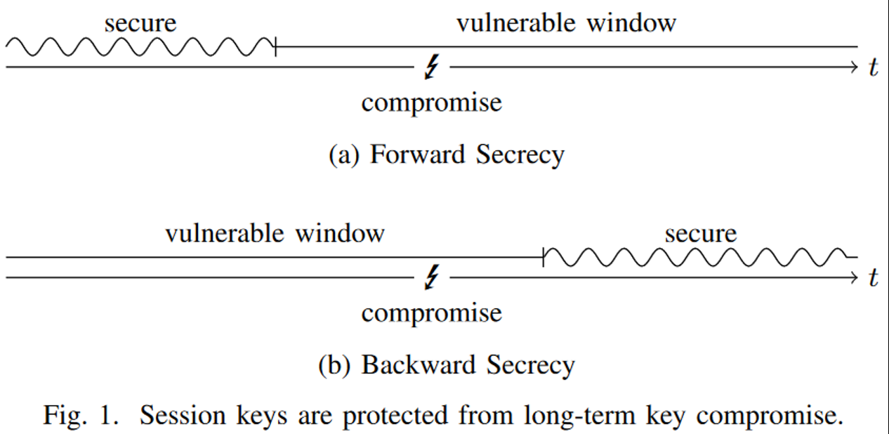
Perfect forward secrecy (PFS)
Goal: past messages remain private if secrets are exposed later
Term coined by Christoph Gunther
Notes:
Image source: http://www.jbonneau.com/doc/UDBFPGS15-IEEESP-secure_messaging_sok.pdf
Upshot: time matters!

Slide 14
Needham–Schroeder: take 4
Use nonces to ensure uniqueness messages 2 and 3 without maintaining state
3: A, {K_{AB}, A}_{BS}
2: { N_{A}, B, K_{AB}, {K_{AB}, A}_{BS} }_{AS}
1: A, B, N_{A}
Two Problems
Bob doesn’t know key is fresh
Alice doesn’t know if Bob received the key

Slide 15
Needham–Schroeder: take 5
Improvement: Have Alice and Bob immediately use their newly-received keys to make sure that they both have them and that they agree upon their freshness
1: …
3: A, {K_{AB}, A}_{BS}
4: {N_{B}}_{AB}
2: …
5: {N_{B}}_{AB}
Problem?
Anybody can produce message 5, since it equals message 4
We need Alice to do something that depends on the nonce but doesn’t equal it

Slide 16
Needham–Schroeder: take 6
Key idea: Alice sends a simple function of the nonce N_{B}
1: …
3: A, {K_{AB}, A}_{BS}
4: {N_{B}}_{AB}
2: …
5: {N_{B} - 1}_{AB}

Slide 17
Full Needham–Schroeder protocol (1978)
3: A, {K_{AB}, A}_{BS}
1: A, B, N_{A}
4: {N_{B}}_{AB}
2: { N_{A}, B, K_{AB}, {K_{AB}, A}_{BS} }_{AS}
5: {N_{B} - 1}_{AB}
Whew, we finally reproduced the full protocol
It has no remaining problems… right?

Slide 18
Denning and Sacco (1981)
3: A, {K_{AB}, A}_{BS}
1: A, B, N_{A}
4: {N_{B}}_{AB}
2: { N_{A}, B, K_{AB}, {K_{AB}, A}_{BS} }_{AS}
5: {N_{B} - 1}_{AB}
Problem: Bob’s involvement begins in step 4; he has no idea if the first three steps of the protocol occurred recently before then
If Mallory has compromised key K_{AB} when it was used in the past, she can replay message #3 to start a “new” Needham-Schoeder instance with Bob that he will think is fresh when it isn’t

Slide 19
Denning and Sacco’s fix
Key idea: Get Bob involved early in the protocol so he also knows it is fresh
-1: A
0: {A, N_{B}’}_{BS}
1: A, B, N_{A}, {A, N_{B}’}_{BS}
2: {N_{A}, B, K_{AB}, {K_{AB}, A, N_{B}’}_{BS}}_{AS}
3: A, {K_{AB}, A, N_{B}’}_{BS}
4: {N_{B}}_{AB}
5: {N_{B} - 1}_{AB}

Slide 20
Related work
Needham-Schroeder forms the basis of the Kerberos ticketing protocol that permits Alice and Bob also to prove their identity to each other
See next week’s reading assignment!
There is also a public key version of Needham–Schroeder
Allows Alice and Bob to learn each other’s public keys from a trusted intermediary
It has an even more subtle flaw that was noticed by Gavin Lowe in 1995

