Slide 1
Lecture 17: Cryptomania
Lab 8 will be posted later today, due next Friday, April 6
Test 2 on Monday, April 2
Covers all lectures after Test 1 through (but not including) today
Main topics: side channels, authenticated encryption, key exchange
Prof. Manuel Egele will give a guest lecture on Wed 4/11 about bad crypto implementations in Android programs
Dr. Alley Stoughton will give lectures in CS 512 on April 3 + 5 about getting a computer to verify the proper design of a symmetric encryption scheme from a block cipher

Slide 2
Review: Focus of this course
Note that Authenticated Encryption meets all four goals!
So… are we all safe now?
 | …at endpoints | …in transit
Authenticity | Identity verification Bob knows Alice sent C | Binding Eve cannot alter M
Privacy | Deniability (optional) Bob can’t prove Alice said M | Confidentiality Eve cannot learn M

Slide 3
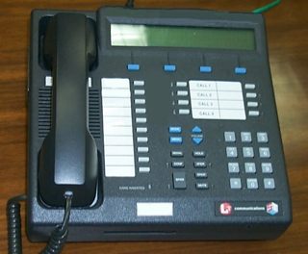
Review: Secure communication in presence of an adversary
✉ key encapsulation
key K
key K
key K
☏ protected
☏ communication
encode C = E(K, M)
message M
decode M = D(K, C)
???
Notes:
Remember: Bob could simply be a future version of Alice (think: full disk encryption)
Icons from https://www.iconfinder.com/iconsets/user-pictures
Analogy:
Envelopes sent through the US Postal System have pretty good privacy rules but long latency.
Telephones enable real-time communication but range widely in privacy, from “none” to Secure Terminal Equipment (https://en.wikipedia.org/wiki/Secure_Terminal_Equipment).

Slide 4
Three new ideas to study in Part 3
Key negotiation and exchange: how to create a shared key over the internet
Forward secrecy and key evolution: protecting privacy + integrity of messages from the past against key compromises in the future
Public authentication: signing a message so anybody knows you created it

Slide 5
Key distribution = initial agreement + subsequent evolution
Trusted server? | Crypto used | Method
Yes | Symmetric | Needham-Schroeder, which is the basis of the Kerberos system
No | Asymmetric | (Authenticated) Diffie-Hellman key exchange
No | Symmetric | Key evolution, once you have a single shared symmetric key
-1: A
0: {A, N_{B}’}_{BS}
1: A, B, N_{A}, {A, N_{B}’}_{BS}
2: {N_{A}, B, K_{AB}, {K_{AB}, A, N_{B}’}_{BS}}_{AS}
3: A, {K_{AB}, A, N_{B}’}_{BS}
4: {N_{B}}_{AB}
5: {N_{B} - 1}_{AB}

Slide 6
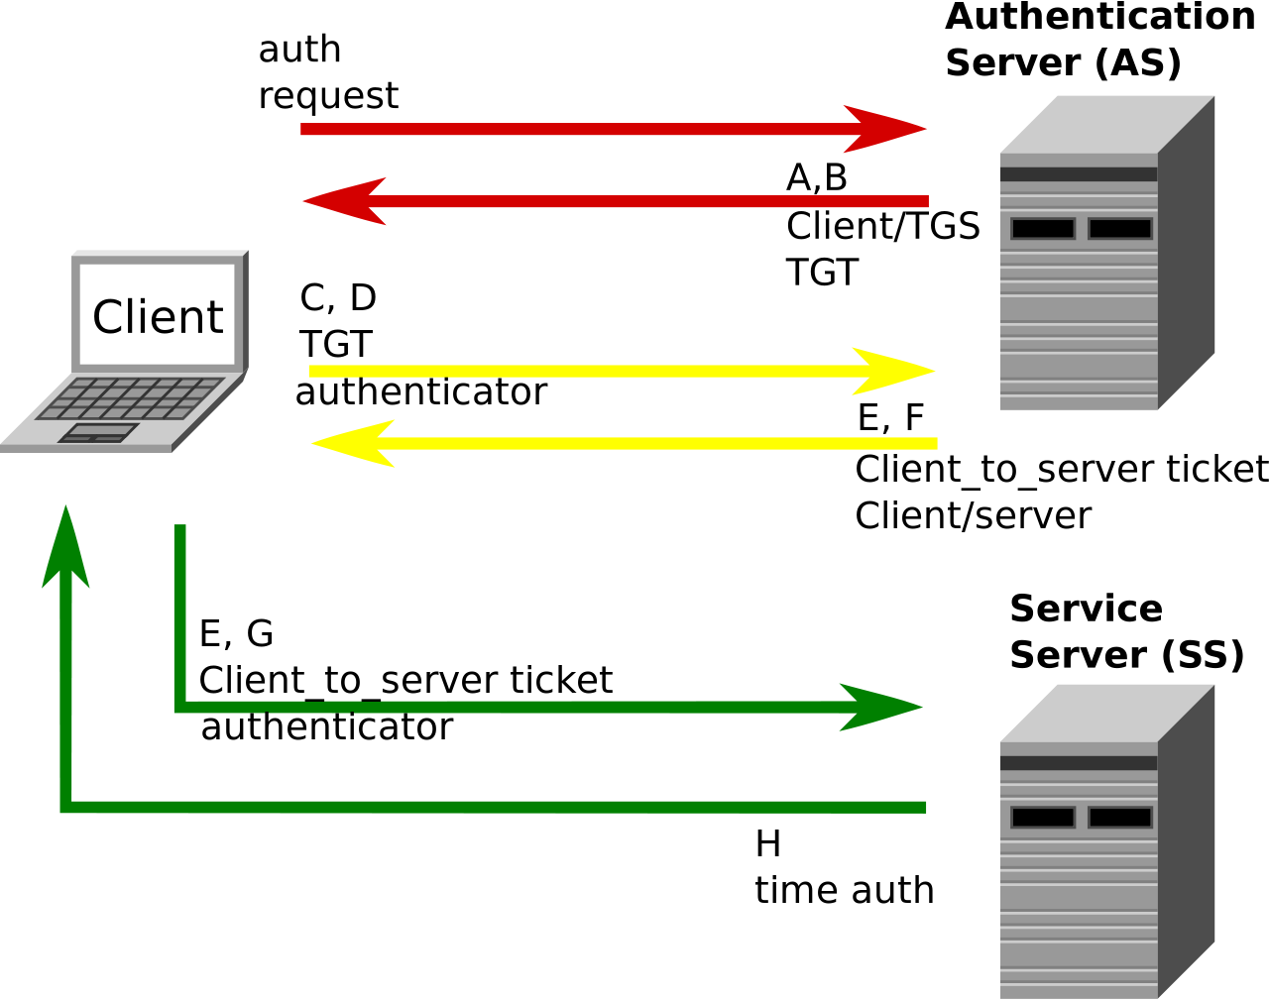
This week’s reading: Kerberos authentication system
Requirements
Users only enter passwords once, at the beginning of each session
The network itself is untrusted: passwords and authentication tokens need protection in transit
A service must be able to prove that the person using a ticket == the person to whom it was issued
Clients must authenticate services before sending sensitive info to them (mutual authentication)
Notes:
Requirements from the week 10 reading assignment http://web.mit.edu/Kerberos/www/dialogue.html
Figure from Wikipedia: https://en.wikipedia.org/wiki/Kerberos_(protocol)#/media/File:Kerberos.svg

Slide 7
Key distribution = initial agreement + subsequent evolution
Trusted server? | Crypto used | Method
Yes | Symmetric | Needham-Schroeder, which is the basis of the Kerberos system
No | Asymmetric | (Authenticated) Diffie-Hellman key exchange
No | Symmetric | Key evolution, once you have a single shared symmetric key

Slide 8
Complexity theoretic view of cryptography
Cryptomania (✉) = elegant
Millisecond speed
Built from modular arithmetic
Minicrypt (☏) = utilitarian
Nanosecond speed
Built from random-looking permutations
Notes:
Citation for terminology: Russell Impagliazzo. A Personal View of Average-Case Complexity.

Slide 9
Diffie-Hellman key exchange
Protocol (for a publicly known g)
Analysis
Choose a randomly
Compute A = gª
Choose b randomly
Compute B = g^{b}
Correctness: commutativity A^{b} = (gª)^{b} = g^{ab} = (g^{b})ª = Bª
Security: to learn the key, a passive Eve must solve following problem
Knows g, gª, g^{b}
Wants to find g^{ab}
Forward secrecy: Choices of a, b are ephemeral, can delete when done
Active attacker can cause problems!
A
B
Output Bª
Output A^{b}
Shared secret = g^{ab}
k_{AM}
k_{MB}
Notes:
Admittedly the slide is hand-wavy in certain aspects. To make this more formal, we need to:
Specify a space from which to choose a and b
Make sure that the problem listed in the ‘security’ portion of the analysis is actually hard.

Slide 10
Hard problems in (some!) finite groups
Let G = a set (or group) of size q together with a multiplication operation ×
Let g = some publicly-known constant within G
Discrete logarithm problem (DL): Challenger chooses h ← G uniformly at random Goal: find the exponent a ∈ {1, 2, …, q} such that gª = h
Computational Diffie-Hellman problem (CDH): Challenger chooses a, b ← [q] uniformly and computes h = gª, j = g^{b} Goal: given <g, h, j>, difficult to compute g^{ab}
Decisional Diffie-Hellman problem (DDH): Challenger chooses a, b ← [q] uniformly, and picks c = ab or uniform Goal: given <g, gª, g^{b}, g^{c}>, determine whether c = ab or not
Easier to solve
Key exchange relies on this
Notes:
Notation: [q] = {1, 2, …, q}
DDH problem: each of the two choices of c are chosen ½ of the time.

Slide 11
Candidate 1: Modular arithmetic
Let p be any prime number, and let F_{p}× = {1, 2, …, p-1}. Some properties:
The set F_{p}× = {1, 2, …, p-1} is finite
F_{p}× is closed under multiplication mod p: that is, one can take the product of any two elements in this set mod p and the result is another such element
Exists an inverse of any element a ∈ F_{p}×, aka b such that a · b = 1 mod p
Example: compute 3⁻¹ mod 5
Answer: 2, because 2 · 3 = 6 = 1 mod 5
F_{p}× = {1, 2, …, p-1} is cyclic under multiplication. That is: there exists some element g ∈ F_{p}× such that {g¹, g², g³, g⁴, …, g^{p-2}, g^{p-1}} = F_{p}×
Example: 3 is a generator for the group F₇×
{3, 3², 3³, 3⁴, 3⁵, 3⁶} = {3, 2, 6, 4, 5, 1} mod 7
Ergo, elements of F_{p}× = {1, 2, …, p-1} can be raised to integer powers. It’s only worth going up to p-1 though because a^{p-1} = 1 mod p for all a ∈ F_{p}×.

Slide 12
Real candidate 1: Half of the modular arithmetic group
We call p a safe prime if p = 2q + 1 for another prime q
Then F_{p}×: {g¹, g², g³, g⁴, g⁵, g⁶, …, g^{2q-1}, g^{2q}}
There happens to be a simple way to test whether an element is black or blue, and one can use this to break at least the decisional problem
Call the blue elements G_{q} = quadratic residues of F_{p}×
Claim: Diffie-Hellman problems are difficult to solve in G_{q}!

Slide 13
Candidate 2: Elliptic curves
Elliptic curve: a cubic equation y² = x³ + ax + b (mod p)
Consider the set of points on this curve
We can ‘multiply’ points using the rule P · Q · R = 1
Also difficult to break the Diffie-Hellman problems in elliptic curve groups
Notes:
Image from https://upload.wikimedia.org/wikipedia/commons/thumb/c/c1/ECClines.svg/680px-ECClines.svg.png

Slide 14
Diffie-Hellman key exchange
Protocol (for a publicly known g)
Choose a ← [q]
Compute A = gª
Choose b ← [q]
Compute B = g^{b}
A
How do Alice and Bob know that they’re talking with each other?
B
Output Bª
Output A^{b}
Shared secret = g^{ab}

Slide 15
Review: Message authentication codes
Algorithms
Security game
KeyGen: randomly choose key K of length λ as before, e.g. uniform in {0,1}^{λ}
MAC_{K} (A ∈ {0,1} ^{α}) → tag T ∈ {0,1} ^{τ}
Usually deterministic (but can be random)
Would prefer short tags: τ < α
Verify_{K} (T ∈ {0,1} ^{τ}) → yes/no
If deterministic, Verify = re-compute MAC
Even after viewing many (A, T) pairs, Mallory cannot create a new one
Alice
Mallory
❷ submit A
❶ choose K ← {0,1}^{λ}
receive T
Mallory wins if
It’s a valid forgery
It’s new
❸ output (A*, T*)
Notes:
Note: cannot reduce EU-CMA to a game of an indistinguishability style like the encryption ones were

Slide 16
Let’s build a public method to authenticate message origin
secret key SK
key K
key K
send A along with signature T = MAC_{K}(A)
public key PK
send A along with signature σ = Sign_{SK}(A)
auth msg A
validate T = MAC_{K}(A)
check Verify_{PK} (A, σ)
forge?
(make valid A, T)
In the symmetric case, Alice & Bob have a key that nobody else has
As a result, Bob knows Alice sent A and that the message was intended for him
Tag is also deniable because either Alice or Bob could have made it
In the public case, Alice has a secret SK and everyone knows corresponding PK
So, anyone in the world can verify that Alice wrote that message (to somebody…)
Also, asymmetry leads to non-deniability: Bob can’t make σ anymore

Slide 17
Security for public-key signatures
secret key SK
send A along with signature σ = Sign_{SK}(A)
public key PK
auth msg A
check Verify_{PK} (A, σ)
EU-CMA security similar to before: Alice baits Mallory into producing a forgery
Alice
Mallory
❷ submit A
Mallory wins if
Valid forgery
It’s new
❶ choose SK, give Mallory PK
❸ output(A*, σ*)
receive σ

Slide 18
ElGamal → (EC)DSA → Schnorr signatures
Protocol
Analysis
KeyGen:
Sample s ← [q]
Compute P = g^{s}
Sign_{s}(M):
Choose r ← [q], computes R = g^{r}
Let t = H(M || R) and σ = r – s · t
Output (σ, t)
Verify_{P}(M, (σ, t)):
Compute R’ = P^{t} · g^{σ}
Check if t’ = H(M || R’) equals t?
Correctness follows from linearity
σ = r – s · t, so r = σ + s · t
Now consider all of this in the exponent
R’ = P^{t} · g^{σ} = g^{st} + g^{σ} = g^{r} = R
Informal security argument
Suppose Mallory forges (σ, t)
t uniquely identifies R b/c hash H is second preimage resistant
σ uniquely identifies r = σ + s · t
Enforcing R = g^{r} requires breaking DL
Big concern: nonce reuse
σ₁ = r – s · t₁
σ₂ = r – s · t₂
Remember: signatures don’t need to be randomized, but this one is
size = 2 lg(q)
Notes:
This slide shows the construction of Schnorr signatures. They are a refinement of the Digital Signature Algorithm (DSA) standard, which are themselves a refinement of an idea from Tahar ElGamal back in the mid-1980s.

Slide 19
Combining symmetric encryption + public signatures
In the symmetric case, we learned that Enc-then-MAC is the best option
Intuition: Never expose the decryption key to an invalid message
Does this technique work as well with public key signatures?
PublicSign_{A}( SymEnc_{AB}(P) )

Slide 20
Combining symmetric encryption + public signatures
In the symmetric case, we learned that Enc-then-MAC is the best option
Intuition: Never expose the decryption key to an invalid message
Does this technique work as well with public key signatures?
No! Issue: Mallory can receive ciphertexts from Alice, claim them as her own!
Can lead to an oracle attack, as occurs with Apple’s iMessage
Pretend to be Alice,
send PublicSign_{A}( C )
Will decrypt C using the symmetric key K_{AB}!
Let C = SymEnc_{AM}(P)
Send PublicSign_{A}( C )
Notes:
For more details on the iMessage attack: https://isi.jhu.edu/~mgreen/imessage.pdf

Slide 21
Can build public-key encryption too
Public key signatures
Public key encryption
Authenticated
Private
Only Alice can generate signatures
Anybody can verify
Security guarantee: EU-CMA
Anybody can send ciphertexts
Only Bob can decrypt + read
Security guarantee: CPA or CCA

Slide 22
But don’t: consequence of losing control of is too high
Public key signatures
Public key encryption
Authenticated
Private
Problem: Eve forges msgs in future
Response: Alice can revoke her key
Problem: Eve reads msgs from past
Response: ???

Slide 23
Key Encapsulation
If you must use public key encryption, then only use it once in order to encrypt (or encapsulate) a symmetric key that you will use from now onward.
This object is formally called a key encapsulation mechanism (KEM).
This overall procedure is called hybrid encryption.
Private
Problem: Eve reads msgs from past
Response: ???

Slide 24
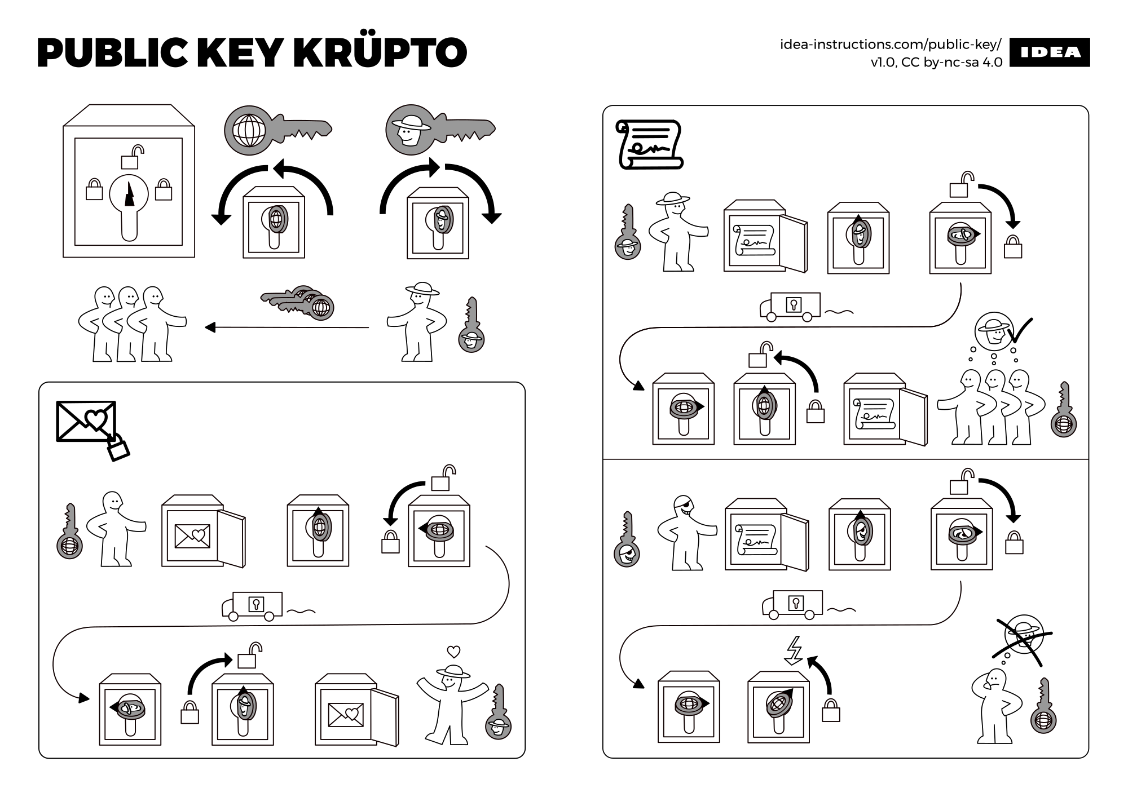
Notes:
Source: https://idea-instructions.com/public-key.png

Slide 25
https://www.google.com
Chrome:
Firefox:

Slide 26
BU’s login page
Chrome:
Firefox:

Slide 27
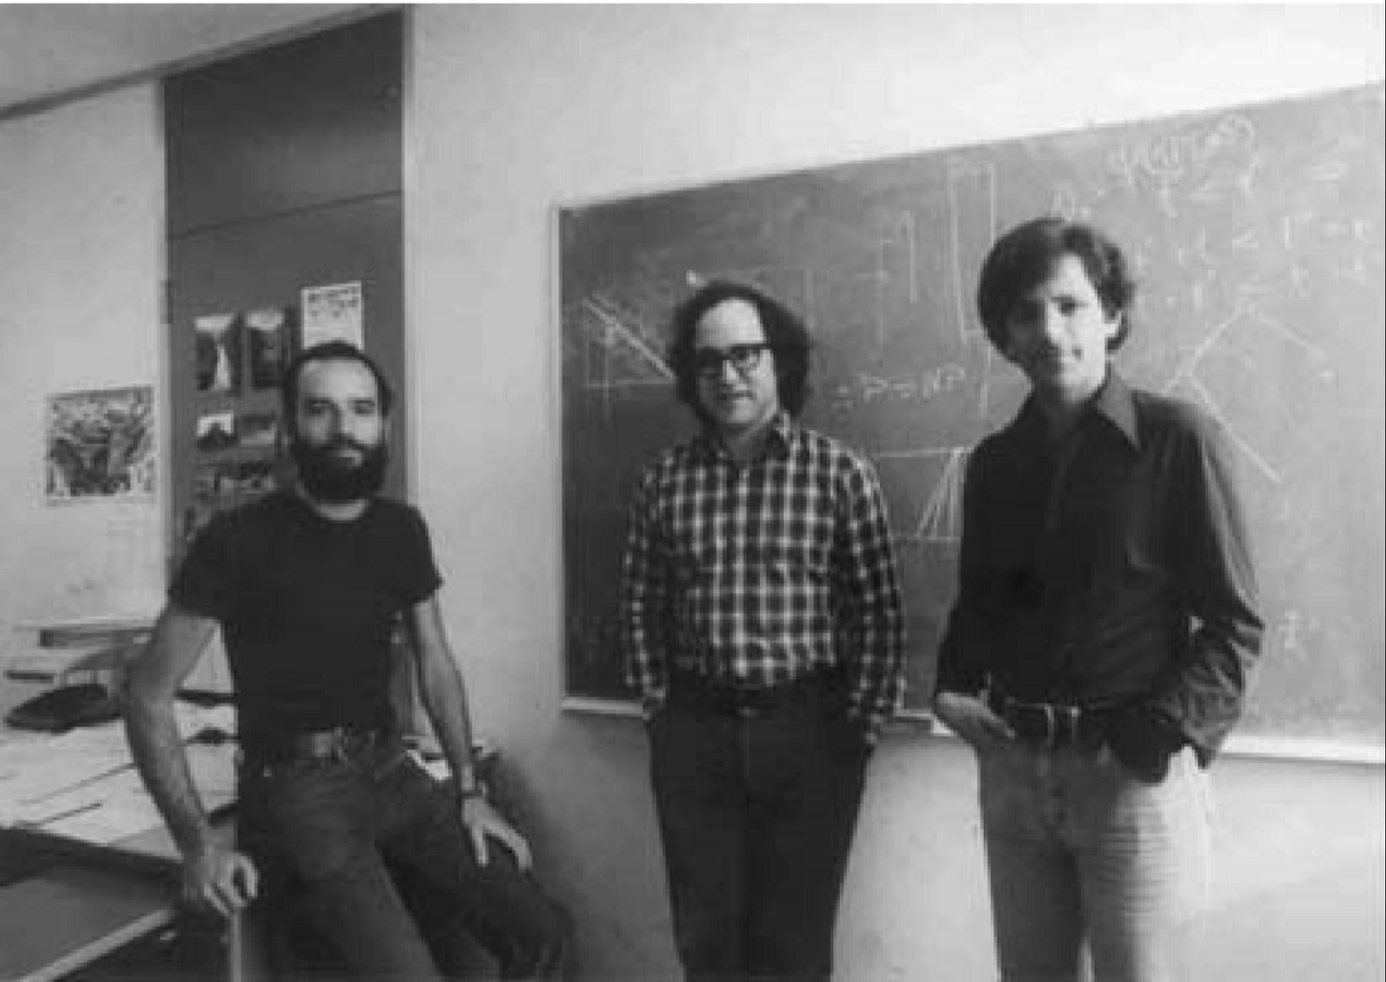
Public key cryptography: a partial timeline
1970: Key exchange by James Ellis, Clifford Cocks and Graham Williamson
1973: Public key encryption by Clifford Cocks
1976: Key exchange by Whitﬁeld Difﬁe, Martin Hellman and Ralph Merkle
1977: Public key encryption by Ron Rivest, Adi Shamir, and Leonard Adleman
1984-85: Taher ElGamal builds public key crypto in the Diffie-Hellman style
Early 90s: Improved signature schemes
Late 90s: UK’s GCHQ reveals…
2000s: Authenticated key exchange by Ran Canetti & Hugo Krawczyk, with follow-on works by others
Notes:
GCHQ = Government Communications Headquarters

Slide 28
Next time
Trusted server? | Crypto used | Method
Yes | Symmetric | Needham-Schroeder, which is the basis of the Kerberos system
No | Asymmetric | (Authenticated) Diffie-Hellman key exchange
No | Symmetric | Key evolution, once you have a single shared symmetric key

