Slide 1
Lecture 18: Key evolution & ratcheting
Test 2 on Monday, April 2
Covers all lectures after Test 1 through Monday, but not public key crypto
Topics: side channels, auth enc, key exchange (N-S and Kerberos reading)
Hanson to hold test prep session during Thursday office hours
Lab 8 has been posted, due next Friday, April 6
Dr. Alley Stoughton will give lectures in CS 512 on April 3 + 5 about getting a computer to verify the proper design of a symmetric encryption scheme from a block cipher
Prof. Manuel Egele will give a guest lecture on Wed 4/11 about bad crypto implementations in Android programs

Slide 2
Part 3
The power of random-looking permutations
Cryptography meets systems: a love/hate story
Structured forgetfulness: dropping keys before they can be stolen
Key negotiation and exchange: how to create a shared key over the internet
Forward secrecy and key evolution: protecting privacy + integrity of messages from the past against key compromises in the future
Public authentication: signing a message so anybody knows you created it
When reductions fail: dealing with the lowest layer
→

Slide 3
Key distribution = initial agreement + subsequent evolution
Trusted server? | Crypto used | Method
Yes | Symmetric | Needham-Schroeder, which is the basis of the Kerberos system
No | Asymmetric | (Authenticated) Diffie-Hellman key exchange
No | Symmetric | Key evolution, once you have a single shared symmetric key

Slide 4
Last time: Diffie-Hellman key exchange
Protocol (for a publicly known g)
Choose a ← [q]
Compute A = gª
Choose b ← [q]
Compute B = g^{b}
A
How do Alice and Bob know that they’re talking with each other?
B
Output Bª
Output A^{b}
Shared secret = g^{ab}

Slide 5
Last time: Public key signatures
Public key signatures
Public key encryption
Authenticated
Private
Only Alice can generate signatures
Anybody can verify
Security guarantee: EU-CMA
Anybody can send ciphertexts
Only Bob can decrypt + read
Security guarantee: CPA or CCA

Slide 6
But don’t: consequence of losing control of is too high
Public key signatures
Public key encryption
Authenticated
Private
Problem: Eve forges msgs in future
Response: Alice can revoke her key
Problem: Eve reads msgs from past
Response: ???

Slide 7
Forward and backward secrecy
Forward secrecy = past messages remain safe if secret state is exposed later
Backward secrecy = future messages remain safe if secret state is exposed previously (and the real user has since regained control of the machine)
Notes:
Image source: http://www.jbonneau.com/doc/UDBFPGS15-IEEESP-secure_messaging_sok.pdf

Slide 8
PGP: Why Johnny can’t get forward secrecy

Slide 9
Key Encapsulation
If you must use public key encryption, then only use it once in order to encrypt (or encapsulate) a symmetric key that you will use from now onward.
This object is formally called a key encapsulation mechanism (KEM).
This overall procedure is called hybrid encryption.
Private
Problem: Eve reads msgs from past
Response: ???

Slide 10
Key evolution
Trusted server? | Crypto used | Method
Yes | Symmetric | Needham-Schroeder, which is the basis of the Kerberos system
No | Asymmetric | (Authenticated) Diffie-Hellman key exchange
No | Symmetric | Key evolution, once you have a single shared symmetric key
The Signal message protocol combines the 2nd and 3rd rows

Slide 11
Key evolution
Question: Once Alice and Bob negotiate a shared symmetric key K_{AB} for authenticated encryption, must they re-execute another (expensive) key negotiation protocol each time they want to update the key?
Recall the algorithms for an AE scheme
KeyGen: randomly choose key K of length λ, e.g. uniform in {0,1}^{λ}
AuthEnc_{K} (private P, authenticated A, nonce N) → ciphertext C
AuthDec_{K} (C, A, N) → P or
KeyUpdate ( K ) → K’ such that
Alice and Bob agree to use from K’ now onward
Cannot compute K from K’. So, even if K’ is revealed to Mallory, prior uses are safe
T

Slide 12
Key evolution via hash functions
Idea: Once we have a single shared key K_{AB}, expand using a chain of hash funcs
K_{AB} → H( K_{AB} ) → H( H( K_{AB} ) ) → H( H( H( K_{AB} ) ) ) → …
Algorithm:
Alice & Bob use N-S to generate K_{AB}
They begin by using K = K_{AB} as their shared key for (say) authenticated enc
After some time has passed, they can evolve their key by updating K ← H( K )
Here, “time” can denote actual wall-clock time or a message counter
Alice and Bob must stay in sync, or else the chain dies & they’ll need to redo N-S
Crucially, they ensure that old values of K are deleted from their system! After all, Mallory cannot steal something that isn’t around to be stolen (and isn’t being computed over anymore, so no side channels about it leak).
AuthEnc_{K}(P₁)
AuthEnc_{H(K)}(P₂)
…

Slide 13
Tradeoff: space vs computing time
Let’s consider our chain of keys more generically, and let’s try to save space
K₀ → K₁ → K₂ → K₃
h₀₁ = H(K₀, K₁) h₂₃ = H(K₂, K₃)
h = H(h₀₁, h₂₃)
Suppose that:
Message flow is unidirectional, from Alice to Bob
We are only concerned with authenticity (i.e., a MAC), but not encryption
Then we can simplify life for Bob: he need only store the root of a Merkle tree
Alice still needs to remember all keys K_{i} (at least, until she uses + deletes them)
She can convince Bob of K_{i}’s veracity by providing pieces that “chain” back to root h
Notes:
Along with each message, Alice can provide the relevant pieces of the Merkle tree to permit Bob to verify that the leaf node is a piece of the tree.
While Bob saves space in storing a compact secret key, he does require more running time: specifically, lg(# keys) hash computations.

Slide 14
Dynamic group keying (Naor, Naor, Lotspiech 2001)
This “tree of keys” primitive is incredibly useful! Let’s do something else with it.
K₀ K₁ K₂ K₃
h₀₁ = H(K₀, K₁) h₂₃ = H(K₂, K₃)
h = H(h₀₁, h₂₃)
So far we have built dynamic keys that can be used by a static group of people.
This tree construction also permits sending messages to a dynamic group!
Each person gets a distinct set of keys, specifically all keys from that leaf to the root
We can send AuthEnc messages to the whole group simply by using the key h
Furthermore, we can kick people out of the group! Use covering set of “good” parties
Notes:
For more information, see eprint.iacr.org/2001/059

Slide 15
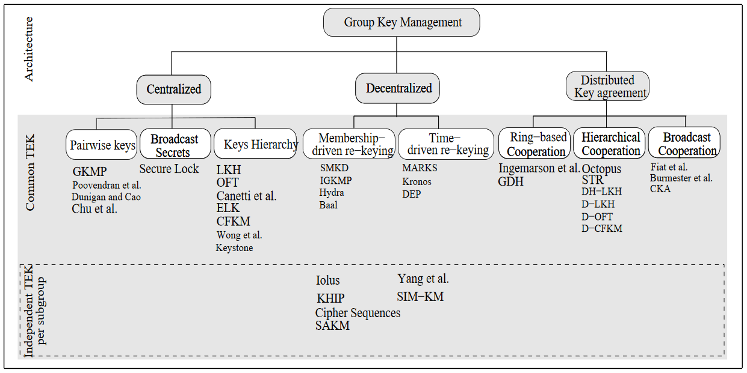
Dynamic group keying
Notes:
This is just one of many dynamic group keying schemes. See http://waset.org/publications/11804 for more info

Slide 16
Key evolution
Trusted server? | Crypto used | Method
Yes | Symmetric | Needham-Schroeder, which is the basis of the Kerberos system
No | Asymmetric | (Authenticated) Diffie-Hellman key exchange
No | Symmetric | Key evolution, once you have a single shared symmetric key
The Signal message protocol combines the 2nd and 3rd rows

Slide 17
Review: Goals of authenticated encryption
 | …at endpoints | …in transit
Authenticity | Identity verification Bob knows Alice sent C | Binding Eve cannot alter M
Privacy | Deniability (optional) Bob can’t prove Alice said M | Confidentiality Eve cannot learn M

Slide 18
Goals in a public key setting
This week’s reading: Just use Sign-then-Encrypt-then-Sign?
 | …at endpoints | …in transit
Authenticity | Identity verification Bob knows Alice sent C | Binding Eve cannot alter M
Privacy | Deniability (optional) Bob can’t prove Alice said M | Confidentiality Eve cannot learn M
Forward/backward secrecy
protecting privacy and integrity of messages against key compromise in the future/past

Slide 19
Dealing with deniability
Choose a ← [q]
Compute A = gª
Choose b ← [q]
Compute B = g^{b}
1. Diffie-Hellman key exchange
(* But use the authenticated version)
A
B
Output Bª
Output A^{b}
2. Derive a symmetric key
K = Hash(Bª)
K = Hash(A^{b})
AuthEnc_{K}(P₁)
3. Use authenticated encryption
AuthEnc_{K}(P₂)
…
But how can we get forward secrecy too?

Slide 20
Key evolution ⇒ forward secrecy! Can do at two levels
Choose a ← [q]
Compute A = gª
Choose b ← [q]
Compute B = g^{b}
Evolve public key
A
B
Output Bª
Output A^{b}
K = Hash(Bª)
K = Hash(A^{b})
AuthEnc_{K}(P₁)
Evolve symm key
AuthEnc_{K}(P₂)
…

Slide 21
Axolotl protocol, aka Signal protocol, aka double ratchet
Used in a messaging system near you!
Signal
WhatsApp
Facebook Messenger
Google Allo
Skype (coming soon)
Notes:
Source: https://whispersystems.org/docs/specifications/doubleratchet

Slide 22
Signal messaging protocol (simplified)
Key evolution
Use each key to encrypt only 1 message
Concern: If initial K is lost, whole chain is insecure
Message key
KDF
Message key
KDF
Message key
KDF
Notes:
The popular Signal messaging system provides both forward and backward secrecy. Let me quickly recap the essence of Signal.
KDF = key derivation function (Signal uses HMAC). We can use this to derive a chain of “message keys” where each one is used to auth-encrypt just a single message from Alice to Bob. (Messages sent in the other direction have their own chain.)
In this setup, the message key is forward secure but not backward secure. So compromise of a message key on the right will not harm messages on the left, but not vice versa.

Slide 23
Signal messaging protocol (simplified)
Key evolution
Use each key to encrypt only 1 message
Concern: If initial K is lost, whole chain is insecure
Key derivation
No direct link betweeen message keys
Engineering: Handle out of order messages?
Chain key
KDF
Message key
Chain key
KDF
Message key
Chain key
KDF
Message key
Notes:
Now compromise of a single message key won’t provide any info on how to reconstruct any other one. But we’ve just pushed the problem to a different layer: now the chain keys are still only forward secure though.

Slide 24
Signal messaging protocol (simplified)
Key evolution
Use each key to encrypt only 1 message
Concern: If initial K is lost, whole chain is insecure
Key derivation
No direct link betweeen message keys
Engineering: Handle out of order messages?
Key ratcheting
Can recover from chain key compromise
Opportunity: If “constant” has some entropy as well, then ∃ potential for post-compromise secrecy
Chain key
KDF
Shared secret₁
Message key
Chain key
KDF
Shared secret₂
Message key
Chain key
KDF
Shared secret₃
Message key
Notes:
Now the chain key is also backward secure. How do we generate new “shared secrets” out of thin air? This is where public Diffie-Hellman key exchange comes in!

Slide 25
Public ratchet
Diffie-Hellman key exchange is incredibly well-suited to ratcheting/evolution
Choose a1 ← [q]
A1 = g^{a1}
B1 = g^{b1}
Choose b1 ← [q]
Shared secret g^{a1 · b1}
Choose a2 ← [q]
A2 = g^{a2}
Shared secret g^{a2 · b1}
B2 = g^{b2}
Choose b2 ← [q]
Shared secret g^{a2 · b2}

