Slide 1
Lecture 20: Completing the Signal messaging protocol
Haven’t graded Test 2 yet; will do so later this week
Lab 8 due Friday, April 6
Dr. Stoughton’s guest lectures on formal methods + crypto
Second lecture is tomorrow (April 5) at 11am in MCS B25
There will be a third lecture next Tuesday

Slide 2
Today: The real end of Part 3
The power of random-looking permutations
Cryptography meets systems: a love/hate story
Structured forgetfulness: dropping keys before they can be stolen
When reductions fail: dealing with the lowest layer
→

Slide 3
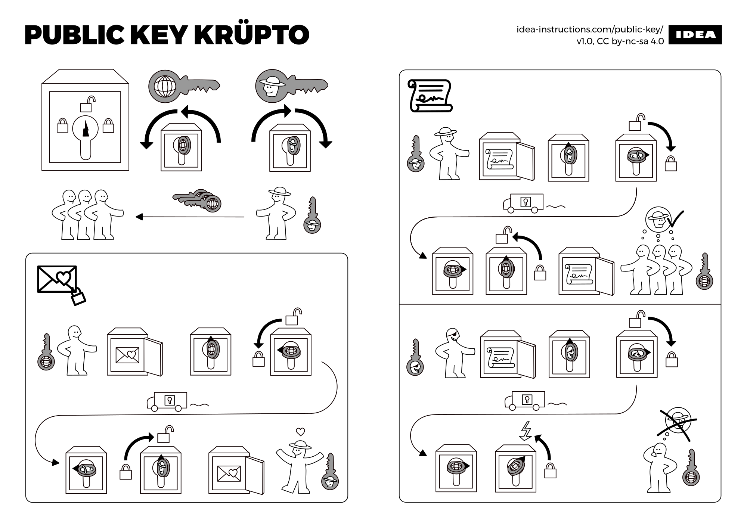
Notes:
Source: https://idea-instructions.com/public-key.png

Slide 4
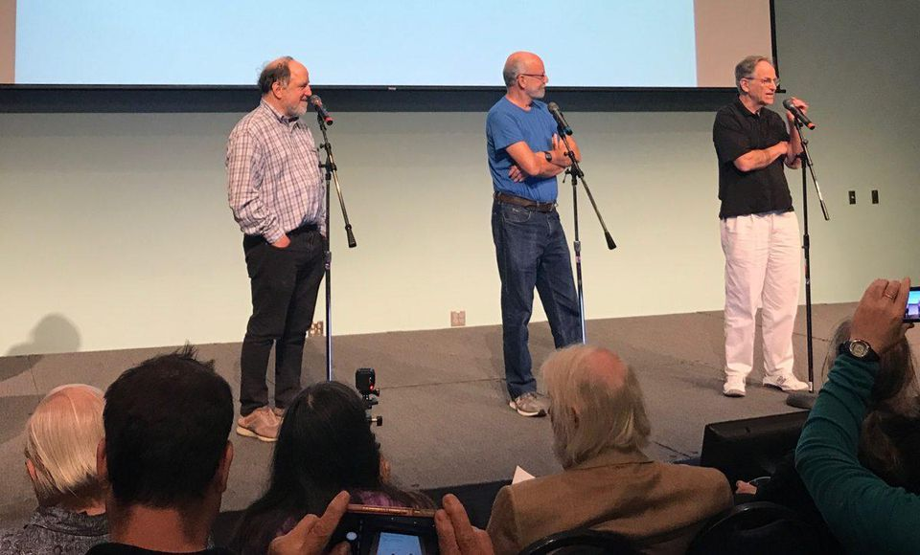
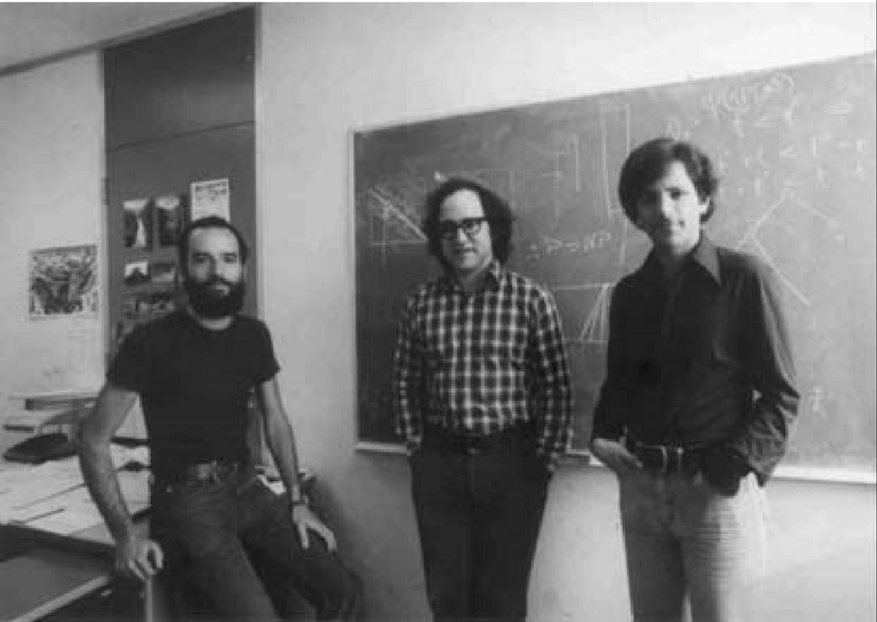
Public key cryptography: a partial timeline
1970: Key exchange by James Ellis, Clifford Cocks and Graham Williamson
1973: Public key encryption by Clifford Cocks
1976: Key exchange by Whitﬁeld Difﬁe, Martin Hellman, and Ralph Merkle
1977: Public key encryption by Ron Rivest, Adi Shamir, and Leonard Adleman
1984-85: Taher ElGamal builds public key crypto in the Diffie-Hellman style
Early 90s: Improved signature schemes
Late 90s: UK’s GCHQ reveals…
2000s: Authenticated key exchange by Ran Canetti & Hugo Krawczyk, with follow-on works by others
Notes:
GCHQ = Government Communications Headquarters

Slide 5
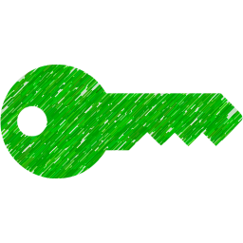
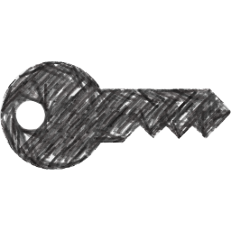
Secure message communication: the strawman
Construction
Integrity via public key sign
Confidentiality via public key enc
Issue: persistence
Non-repudiable
Risk of device compromise
What we want
Deniability
Forward secrecy
Sign_{Alice}
Sign_{Alice}
SignCrypt(message)
Enc_{Bob}
Enc_{Bob}
Sign_{Alice}
Enc_{Bob}

Slide 6
A better approach
Deniable
Forward secure
Choose a ← [q]
Compute A = gª
Choose b ← [q]
Compute B = g^{b}
A
B
Ephemeral secret
Evolve public key
Output Bª
Output A^{b}
K = Hash(Bª)
K = Hash(A^{b})
AuthEnc_{K}(P₁)
AuthEnc is deniable
Evolve symm key
AuthEnc_{K}(P₂)
…
Notes:
Remember that authenticated key exchange still requires a long-term signature scheme to guarantee authenticity. Ergo: with the picture thus far, Alice and Bob won’t be able to deny the mere fact that they’re having a conversation, or even the total length of this conversation. Such metadata is revealed to a network adversary even when using strong cryptography.

Slide 7
Axolotl protocol, aka Signal protocol, aka double ratchet
Used in a messaging system near you!
Signal
WhatsApp
Facebook Messenger
Google Allo
Skype (coming soon)
Notes:
Source: https://whispersystems.org/docs/specifications/doubleratchet

Slide 8
Signal: trustless key negotiation and evolution
Trust in server? | Crypto used | Method
Large | Symmetric | Needham-Schroeder, which is the basis of the Kerberos system
Small | Asymmetric | (Authenticated) Diffie-Hellman key exchange
None | Symmetric | Key evolution, once you have a single shared symmetric key

Slide 9
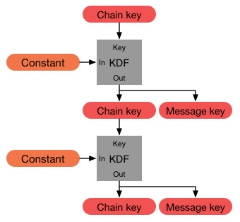
Symmetric ratchet
Remember the “chain of hash functions” idea
K → K1 = H( K ) → K2 = H( K1 ) → …
Constraints
Precondition: Alice & Bob have 1 shared secret K
Postcondition: Alice derives a new key per message sent to Bob, each msg key is used once + tossed
Signal’s ratcheting is more complex, uses HMAC with 2 inputs and 2 outputs
Questions
Engineering: How to handle out of order messages?
Concern: If 1st chain key is lost, whole chain is insecure
Opportunity: If the “constant” has some entropy as well, then ∃ potential for post-compromise secrecy
AuthEnc_{K1}(P₁)
AuthEnc_{K2}(P₂)
…
Notes:
Out of order within one party: “Because message keys aren't used to derive any other keys, message keys may be stored without affecting the security of other message keys. This is useful for handling lost or out-of-order messages”
Concurrent sending between the two parties: use different chains!
Source: https://whispersystems.org/docs/specifications/doubleratchet/

Slide 10
Public ratchet
Use Diffie-Hellman key exchange to create the “constants” on the previous slide
Choose a1 ← [q]
A1 = g^{a1}
B1 = g^{b1}
Choose b1 ← [q]
Shared const g^{a1 · b1}
Choose a2 ← [q]
A2 = g^{a2}
Shared const g^{a2 · b1}
B2 = g^{b2}
Choose b2 ← [q]
Shared const g^{a2 · b2}

Slide 11
Double ratchet rules
When a message is sent or received, a symmetric ratchet step is applied to the sending or receiving chain to derive the message key
When a new ratchet public key is received, a public ratchet step is performed prior to the symmetric-key ratchet to replace the chain keys
Now we just need to connect the ratchets to each other

Slide 12
Public ratchet seeds symmetric ratchets (one per direction)
Notes:
Source: https://whispersystems.org/docs/specifications/doubleratchet/

Slide 13
Public ratchet seeds symmetric ratchets (one per direction)
Notes:
Source: https://whispersystems.org/docs/specifications/doubleratchet/

Slide 14
Public ratchet seeds symmetric ratchets (one per direction)
Notes:
Source: https://whispersystems.org/docs/specifications/doubleratchet/

Slide 15
Public ratchet seeds symmetric ratchets (one per direction)
Notes:
Source: https://whispersystems.org/docs/specifications/doubleratchet/

Slide 16
Add a third chain to improve post-compromise secrecy

Slide 17
Alice’s full state
Alice has been initialized with
Bob's ratchet public key
A shared secret which is the initial root key
From this info, Alice derives
A new root key, whose “constant” depends on the public ratchet
The first sending key chain

Slide 18
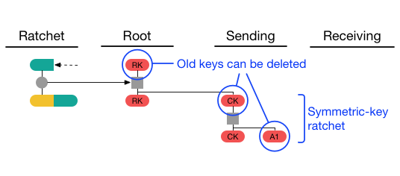
Alice’s full state
Alice sends her first message by
Ratcheting the sending key
Using the resulting single use message key to protect her new message
Engineering question:
Note that Bob must send before Alice can send Bob a message. So, how can Alice send messages if Bob isn’t online?

Slide 19
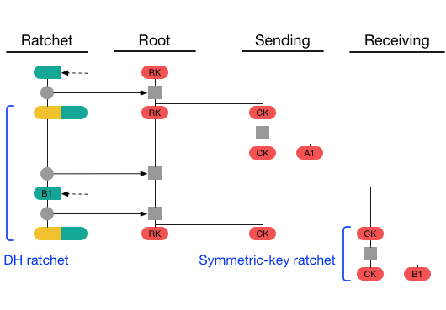
Alice’s full state
Suppose Bob sends a message next
Alice now has the other half of the key pair necessary to start a receiving chain
Bob’s message includes a new , so Alice can perform a public ratchet to make a new sending chain

Slide 20
Recap: Forward and backward secrecy
“The parties derive new keys for every Double Ratchet message so that earlier keys cannot be calculated from later ones.”
“The parties also send Diffie-Hellman public values attached to their messages. The results of Diffie-Hellman calculations are mixed into the derived keys so that later keys cannot be calculated from earlier ones.”
Notes:
Quotes: https://signal.org/docs/specifications/doubleratchet/
Image source: http://www.jbonneau.com/doc/UDBFPGS15-IEEESP-secure_messaging_sok.pdf

Slide 21
Ephemeral utopia
No long-term keys ⇒ great forward secrecy
Message key used to AuthEnc a message is used once and tossed
Chain key used to construct msg key is refreshed in each public ratchet
Diffie-Hellman key pairs chosen ephemerally in each public ratchet
Wait… actually, is this a utopia or a dystopia?
If you don’t have any long-term state, then who are you?!
Notes:
Source: https://whispersystems.org/blog/safety-number-updates/

Slide 22
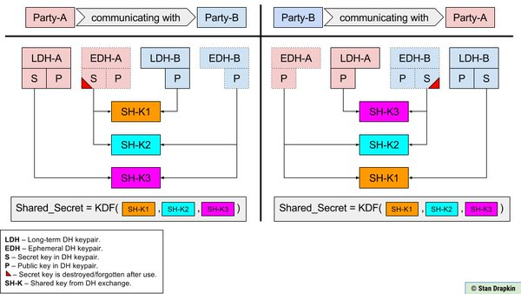
Solution: a more involved Triple-DH protocol
Notes:
Image source: https://twitter.com/sdrapkin/status/738419956371628033
For more details: https://whispersystems.org/docs/specifications/x3dh/

Slide 23
https://www.securemessagingapps.com

Slide 24
This week’s reading: EFF blog post
Notes:
Link: https://www.eff.org/deeplinks/2018/03/thinking-about-what-you-need-secure-messenger

