Slide 1
Lecture 21: Randomness
Announcements
Test 2 returned in class today
Curved score = 38 + 0.7 * raw score (I only wrote curved score on exams)
Similar grade distribution to last time, median grade = 73 raw, 89 curved
Lab 9 to be posted later this week and due sometime next week
Schedule for rest of semester
Today: Random number generation
Wed 4/11: Prof. Egele’s guest lecture on crypto in Android apps
Mon 4/16: Holiday, no class
Wed 4/18: Cryptanalysis
Week of 4/23: Computing on confidential data
Week of 4/30: Crypto and the law

Slide 2
Today: Start of Part 4
The power of random-looking permutations
Cryptography meets systems: a love/hate story
Structured forgetfulness: dropping keys before they can be stolen
When reductions fail: dealing with the lowest layer
Special topics
→

Slide 3
Course roadmap
Math Tools
Primitives
Algorithms
Protocols
Modular arithmetic
Auth key exchange
Key evolution
Signal: messaging
Key encapsulation
TLS: internet PGP: email
(see CS 558)
Hash functions
?
Random(ish) permutations
Protected communication
Block ciphers
True randomness
☏ Minicrypt
Cryptomania ✉
Focus for today: How to build random number generators

Slide 4
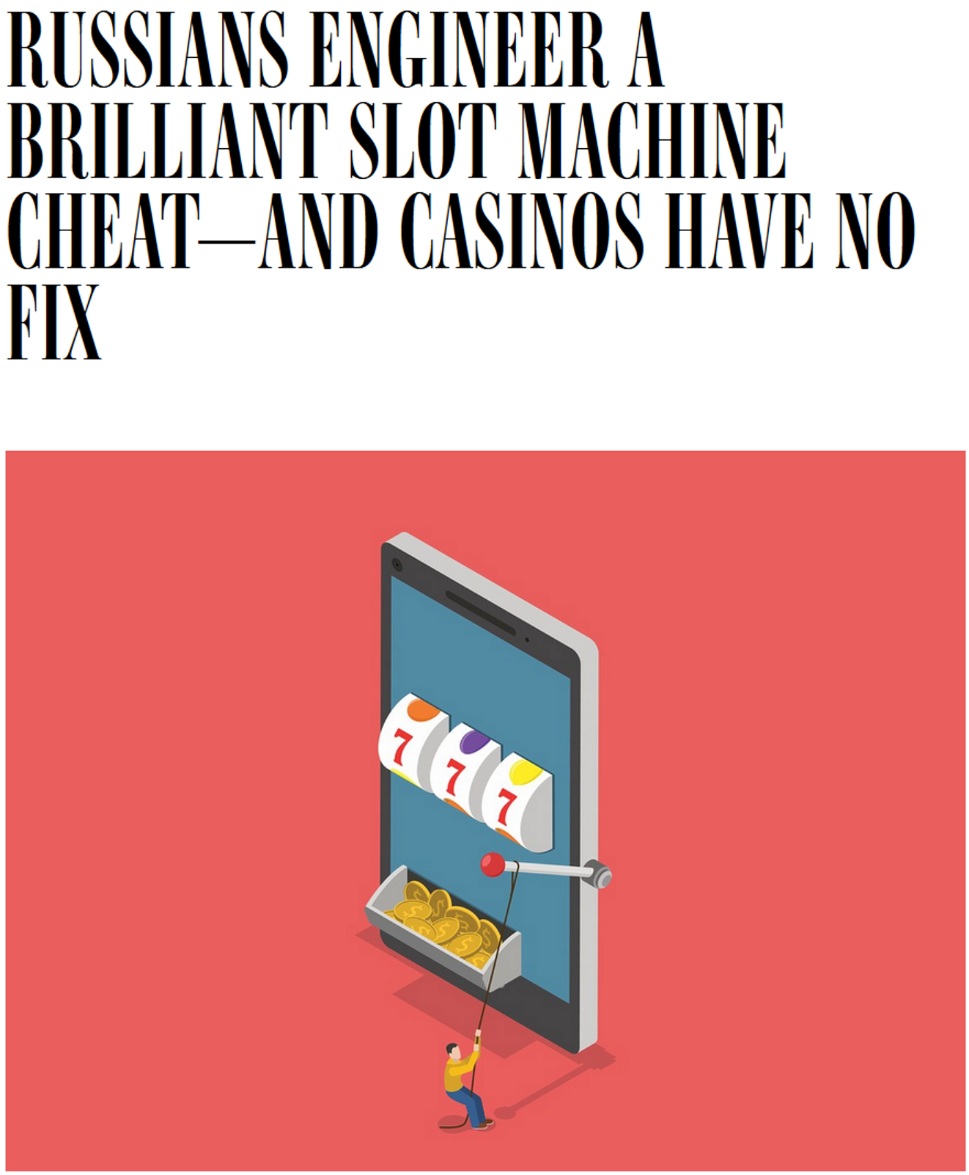
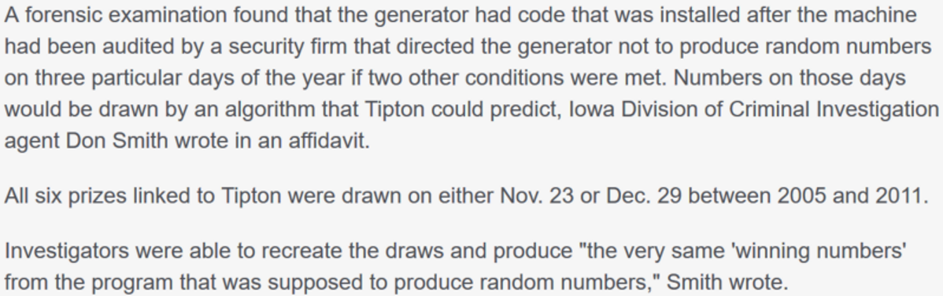
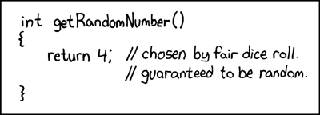
Bad randomness leads to
Lottery fraud
Weak SSL keys for 2 years on Debian machines
Weak RSA keys in the wild
and more…
Source: xkcd.com/221

Slide 5
Bad randomness in Debian
Bug forum discussion, 2003
Debian security advisory, 2008
I'm using Valgrind to debug a program that uses the OpenSSL libraries, and got warnings about uninitialized data in the function RSA_padding_add_PKCS1_type_2(), on the line with "} while (*p == '\0');" (line 171 in version 0.9.7a). The following patch ensures that the data is always modified, something that the bytes() method obviously fails to do.
--- openssl-0.9.7a/crypto/rand/rand_lib.c Thu Jan 30 2003
+++ openssl-0.9.7a-safe/crypto/rand/rand_lib.c Wed Feb 26 2003
@@ -154,6 +154,7 @@
int RAND_bytes(unsigned char *buf, int num)
{
[new code here]
Luciano Bello discovered that the random number generator in Debian's openssl package is predictable. This is caused by an incorrect Debian-specific change to the openssl package. As a result, cryptographic key material may be guessable.
This is a Debian-specific vulnerability which does not affect other operating systems which are not based on Debian. However, other systems can be indirectly affected if weak keys are imported into them.
It is strongly recommended that all cryptographic key material which has been generated by OpenSSL versions starting with 0.9.8c-1 on Debian systems is recreated from scratch. Furthermore, all DSA keys ever used on affected Debian systems for signing or authentication purposes should be considered compromised.
Notes:
For details on the Debian issue, see
https://rt.openssl.org/Ticket/Display.html?id=521&user=guest&pass=guest
http://taint.org/2008/05/13/153959a.html

Slide 6
Weak RSA keys

Slide 7
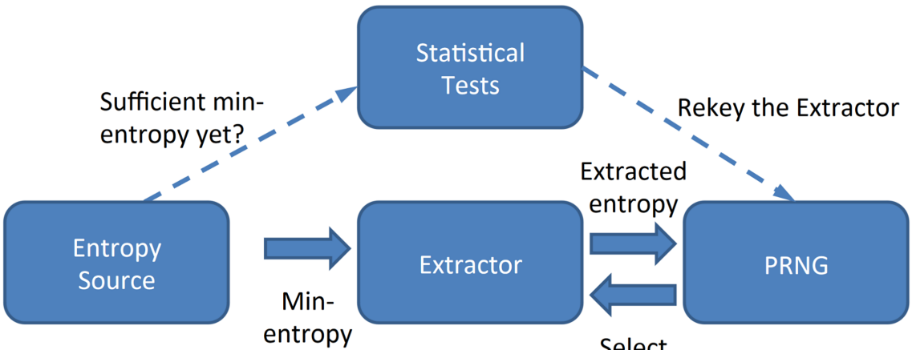
How should a computer generate randomness?
1. True randomness
Reliably produce a “pool” of entropy
2. Extractor
Produce ~128 nearly-uniform bits from the pool
3. Expansion via pseudorandomness
Deterministically produce an arbitrarily-large sequence of bits from seed + short state
Notes:
Source: https://crypto.stanford.edu/RealWorldCrypto/slides/jesse.pdf
For extractor, think “biometric/fingerprint” with large string yielding ~33 bits of entropy

Slide 8
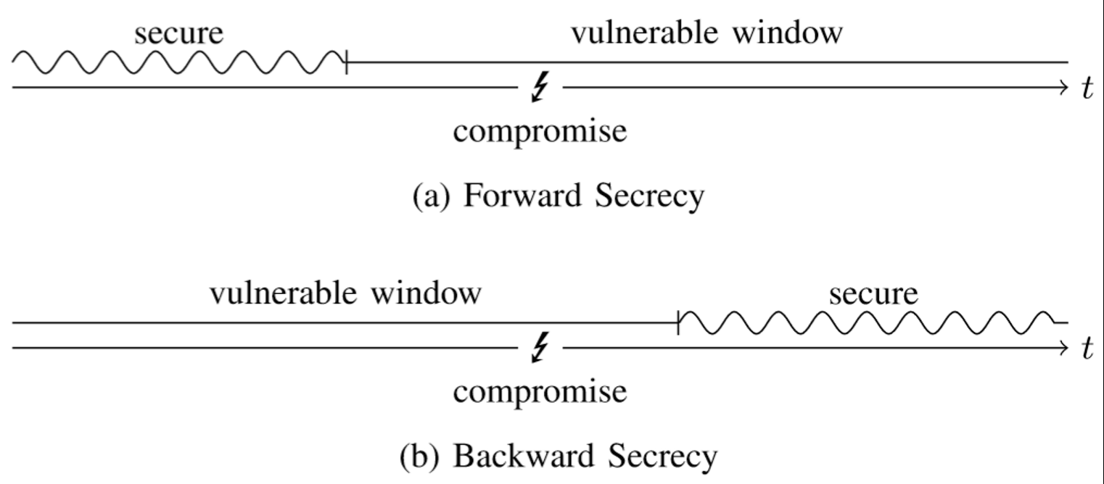
Security requirements
Performance: Be fast enough that people will use it
Hard fail: Only expand once the system has been adequately seeded with true entropy
Resilience: Adversary can’t predict future outputs, even if she can influence the source of true randomness
Forward (backward) secrecy: Adv cannot predict past (future) PRG outputs even if she knows seed + state
Notes:
How to accomplish
Resilience: have multiple sources + smart ways to combine them (cf. xor)
FS/BS: re-seed the PRG periodically with new TRG data

Slide 9
Generating randomness: Three step process
1. True randomness
Reliably produce a “pool” of entropy
2. Extractor
Produce ~128 nearly-uniform bits from the pool
3. Expansion via pseudorandomness
Deterministically produce an arbitrarily-large sequence of bits from seed + short state
Notes:
Source: https://crypto.stanford.edu/RealWorldCrypto/slides/jesse.pdf
For extractor, think “biometric/fingerprint” with large string yielding ~33 bits of entropy

Slide 10
Harvesting true randomness
“Fortunately, it’s not hard to harvest truly unpredictable randomness by tapping the chaotic universe that surrounds a computer's orderly, deterministic world of 1s and 0s. But how exactly do you do that?”
– IEEE Spectrum
Notes:
Source: https://spectrum.ieee.org/computing/hardware/behind-intels-new-randomnumber-generator

Slide 11
(Some) sources of entropy that computers capture
Physics
EM radiation
Temperature
Logical gates
Clock drift
Thermal noise
Quantum mechanics
Beam splitters & Polarization filters
Tunneling
Entanglement
Human
Keystroke timings
Mouse movements
HDD disk seek times
Smartphone sensors
Microphone
Camera
Gyroscope
GPS/wiki/Bluetooth signals
Notes:
I will say more about the topics on the left column.

Slide 12
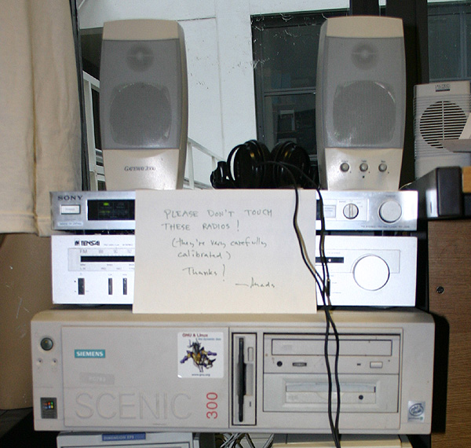
random.org/history
Physics
EM radiation
Temperature
Notes:
See https://www.random.org/history/ for more information about their iterative design of atmospheric noise sensors

Slide 13
Ring oscillators
Logical gates
Clock drift
Thermal noise
Apple’s Secure Enclave
Notes:
“Ring-oscillator-based analog design works by taking some of the thermal noise that's present in all resistors, amplifying it, then using the resulting jittery signal to change the period of a relatively slow-running clock. On each of the erratic ticks of that slow clock, the chip then samples the output of a second, fast-running clock, which cycles back and forth quite regularly between its two possible binary states: 0 and 1. That erratic sampling then produces a random sequence of 1s and 0s.” Source: https://spectrum.ieee.org/computing/hardware/behind-intels-new-randomnumber-generator

Slide 14
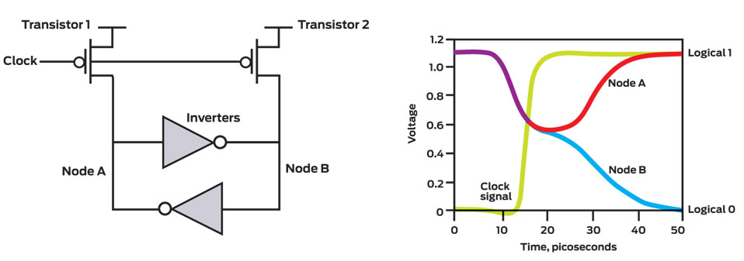
Intel’s hardware RNG
Logical gates
Clock drift
Thermal noise
Ironically, the solution [Intel] came up with breaks a cardinal rule of digital design: that a circuit should be in a well-defined state, outputting only logical 0s or logical 1s. A digital circuit element can, of course, spend short periods switching between these two possible states. But it should never remain teetering, uncertain of which way to go. That would introduce delays and could even produce system failures.
Notes:
See http://spectrum.ieee.org/computing/hardware/behind-intels-new-randomnumber-generator

Slide 15
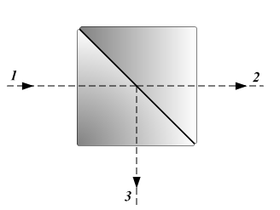
Measuring photons
Quantum mechanics
Beam splitters & Polarization filters
Tunneling
Entanglement

Slide 16
Generating randomness: Three step process
1. True randomness
Reliably produce a “pool” of entropy
2. Extractor
Produce ~128 nearly-uniform bits from the pool
3. Expansion via pseudorandomness
Deterministically produce an arbitrarily-large sequence of bits from seed + short state
Notes:
Source: https://crypto.stanford.edu/RealWorldCrypto/slides/jesse.pdf
For extractor, think “biometric/fingerprint” with large string yielding ~33 bits of entropy

Slide 17
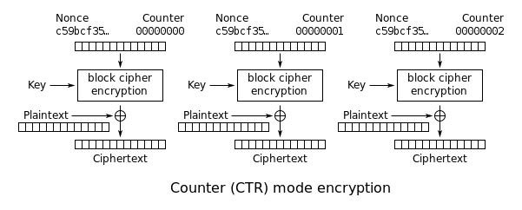
How to build a PRG
Use counter mode with a block cipher

Slide 18
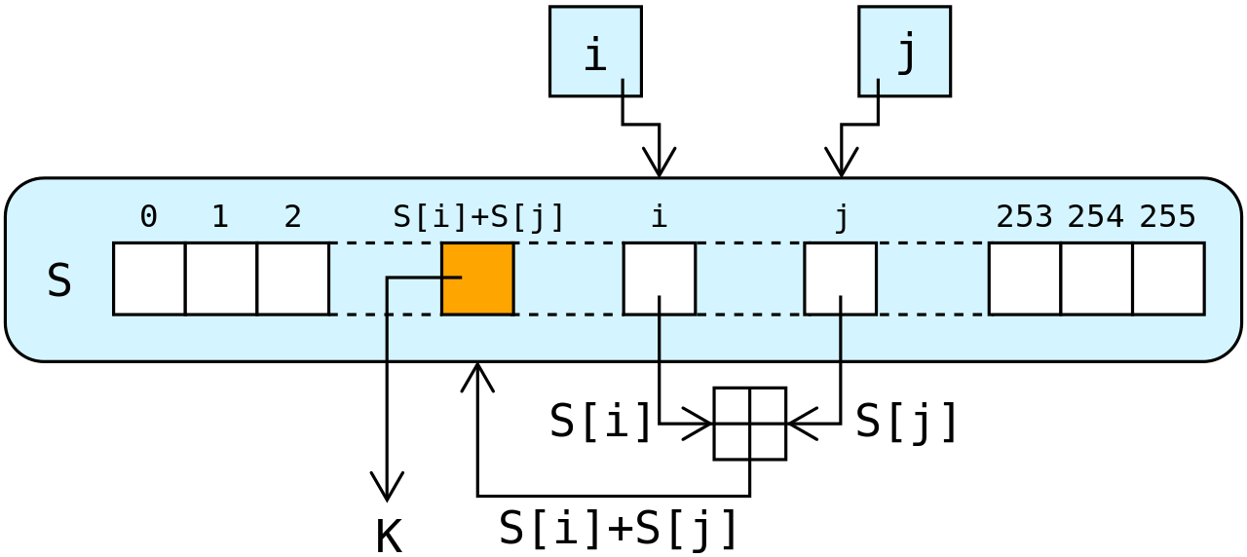
How to build a PRG
Build a dedicated stream cipher
Key scheduling
for i from 0 to 255
S[i] := i
endfor
j := 0
for i from 0 to 255
j := (j + S[i] + key[i mod keylength]) mod 256
swap values of S[i] and S[j]
endfor
Pseudorandom generation
i := 0
j := 0
while GeneratingOutput:
i := (i + 1) mod 256
j := (j + S[i]) mod 256
swap values of S[i] and S[j]
K := S[(S[i] + S[j]) mod 256]
output K
endwhile
Notes:
https://en.wikipedia.org/wiki/RC4

Slide 19
Four NIST-standardized DRBGs
Hash_DRBG
Source
NIST Special Publication 800-90A
Recommendation for Random Number Generation Using Deterministic Random Bit Generators
Notes:
http://csrc.nist.gov/publications/nistpubs/800-90A/SP800-90A.pdf

Slide 20
Four NIST-standardized DRBGs
Hash_DRBG
HMAC_DRBG
Source
NIST Special Publication 800-90A
Recommendation for Random Number Generation Using Deterministic Random Bit Generators
Notes:
http://csrc.nist.gov/publications/nistpubs/800-90A/SP800-90A.pdf

Slide 21
Four NIST-standardized DRBGs
Hash_DRBG
HMAC_DRBG
CTR_DRBG
Source
NIST Special Publication 800-90A
Recommendation for Random Number Generation Using Deterministic Random Bit Generators
Notes:
http://csrc.nist.gov/publications/nistpubs/800-90A/SP800-90A.pdf

Slide 22
Four NIST-standardized DRBGs
Hash_DRBG
HMAC_DRBG
CTR_DRBG
Dual_EC_DRBG
Notes:
http://csrc.nist.gov/publications/nistpubs/800-90A/SP800-90A.pdf

Slide 23
Four Three NIST-standardized DRBGs
Hash_DRBG
HMAC_DRBG
CTR_DRBG
Dual_EC_DRBG
Notes:
http://csrc.nist.gov/publications/nistpubs/800-90A/SP800-90A.pdf

Slide 24
Generating randomness: Three step process
1. True randomness
Reliably produce a “pool” of entropy
2. Extractor
Produce ~128 nearly-uniform bits from the pool
3. Expansion via pseudorandomness
Deterministically produce an arbitrarily-large sequence of bits from seed + short state
Notes:
Source: https://crypto.stanford.edu/RealWorldCrypto/slides/jesse.pdf
For extractor, think “biometric/fingerprint” with large string yielding ~33 bits of entropy

Slide 25
Hashing as an extractor?
Let’s begin by taking a hash function H as an extractor
Extractors operate on the principle that including more entropy sources can't hurt: H(x,y,z) is at least as good a random number as H(x,y), no matter how awful z is
Concern is with poor sources that are adaptively chosen
Simple attack by the entity that chooses z
Generate a random z
Try computing H(x,y,z)
If H(x,y,z) doesn't start with bits 0000, go back to step 1
Else, output this value of z
Attack forces H(x,y,z) to start with four known bits of 0000, even if x and y were perfectly random
Also, attack is fast, taking 16 computations of H on average
Notes:
Adapted from https://blog.cr.yp.to/20140205-entropy.html

Slide 26
Generating randomness: Three step process
1. True randomness
Reliably produce a “pool” of entropy
2. Extractor
Produce ~128 nearly-uniform bits from the pool
3. Expansion via pseudorandomness
Deterministically produce an arbitrarily-large sequence of bits from seed + short state
Notes:
Source: https://crypto.stanford.edu/RealWorldCrypto/slides/jesse.pdf
For extractor, think “biometric/fingerprint” with large string yielding ~33 bits of entropy

