Slide 1
Lecture 23: Linear & differential cryptanalysis
Announcements
Lab 9 to be posted later today, due next Friday 4/27
(Short) Lab 10 to be posted next week, due on the last day of class
Office hours today shortened to 3-4pm

Slide 2
Part 4: When reductions fail
Math Tools
Primitives
Algorithms
Protocols
Modular arithmetic
Auth key exchange
Key evolution
Signal: messaging
Key encapsulation
TLS: internet PGP: email
(see CS 558)
Hash functions
?
Random(ish) permutations
Protected communication
Block ciphers
Getting true randomness
☏ Minicrypt
Cryptomania ✉

Slide 3
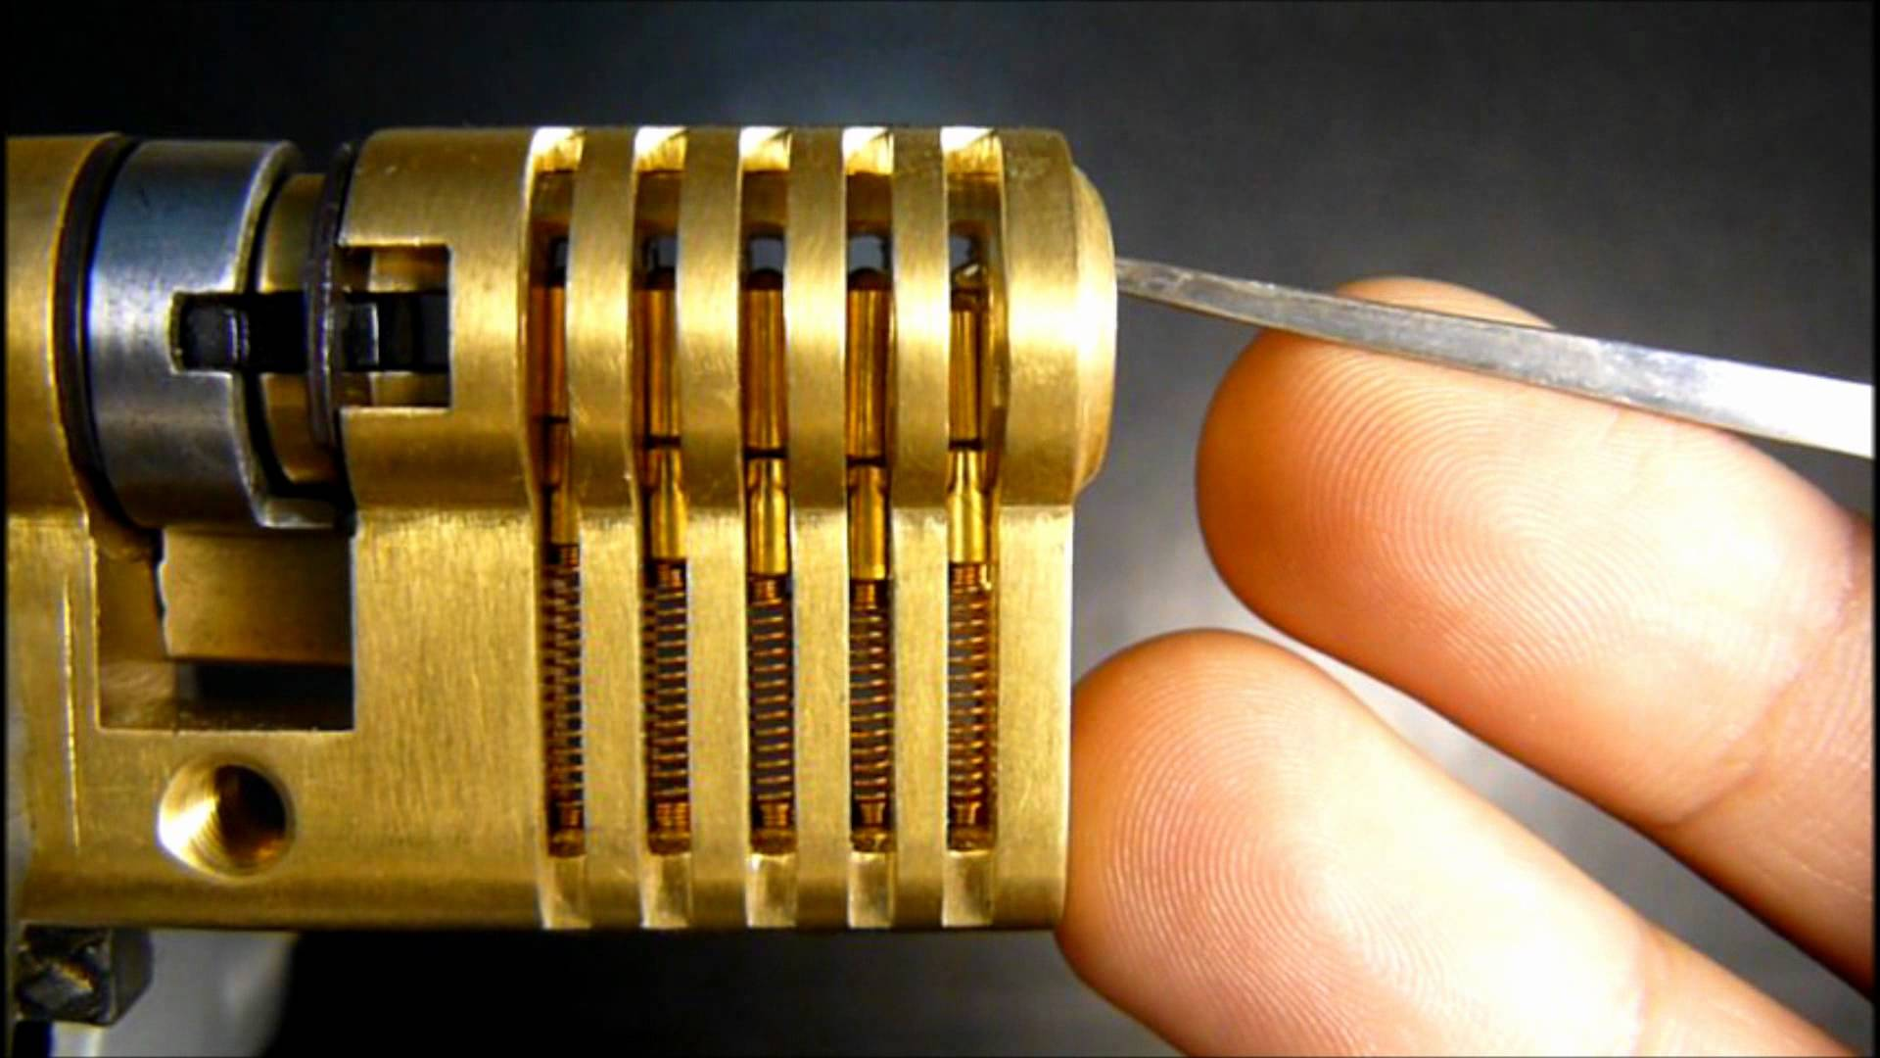
Today: Mathematical cryptanalysis
Cryptology
Cryptography
Cryptanalysis
Math of algorithm
Physics of implementation
Notes:
Today’s discussion will also follow a “divide and conquer” approach, though in a very different way than side channel attacks did.

Slide 4
Reminder: Even-Mansour
Question: What is the simplest possible construction of a block cipher that has a formal proof of security?
Even-Mansour 91: Apply Rivest’s DESx idea to any “public, random-looking perm”
Theorems
Resulting block cipher is strongly pseudorandom
…even if Π is publicly known
Construction is minimal in the sense that nothing can be removed
X
X
Π
K_{MASK}
P
Y
Y
A
A
Π
Π
B
B
Notes:
Note: I’m only showing the (non-strong) pseudorandomness picture here. I omit the full picture of strong pseudorandomness because it is rather busy. See the hidden slide at the end of the presentation.

Slide 5
Reminder: Path toward block ciphers
Problems?
How do we go about building a ‘truly random’ permutation Π?
Isn’t the truth table for Π huge?
Solution to 1: multiple rounds
Let’s make life easier: what if we make ρ that is somewhat random?
Then we can repeat ρ as much as we want in order to boost security
X
Π
ρ
K_{round}
K_{MASK}
Y
⋮
ρ
Y
Notes:
Minor detail: the different rounds need to have different round keys in order to thwart a “slide attack”

Slide 6
Reminder: Path toward block ciphers
Problems?
How do we go about building a single random permutation Π?
Isn’t the truth table for Π huge?
Solution to 2: simple round function ρ
Linear functions are very simple!
Err, perhaps too simple; we could then solve for the key
We need non-linearity somewhere
But let’s keep its truth table small
X
Π
ρ
K_{round}
K_{MASK}
Y
⋮
ρ
Y

Slide 7
Substitution-permutation method of cipher design
State at beginning of round
❶ Substitution box (S-box)
Provides confusion, but at a cost
Huge S-box: very confusing but slow
Tiny S-box: fast but not as confusing
S
…
S
S
…
S
❷ Linear permutation
Provides global diffusion
Permutation
❸ AES-specific middle step
“Instead of spending most of its resources on large S-boxes, the wide trail strategy aims at designing the round transformations such that there are no [linear or differential] trails/characteristics of low weight”
State at end of round
Middle
…
Middle

Slide 8
Quick refresher on block ciphers
Objective: family of permutations
Security: pseudorandomness
Design goals
Simple
Makes no sense
Simple to see that it makes no sense
X
Y
B_{K} looks like a truly random function, aka Mallory cannot tell them apart
Lofty goal! Quick question though: what function definitely isn’t pseudorandom?
B_{K}
B_{K}
⁻¹
B$
Π
Y
X
B$
Π
⁻¹
⁻¹
Notes:
Each K defines a new permutation B_{K}

Slide 9
Quick refresher on block cipher design
Key alternation
over several rounds
each with substitution & permutation
X
X
State at beginning of round
K
Π
K_{round}
ρ
S
…
S
S
…
S
Y
Y
⋮
Permutation
ρ
State at end of round
Y
Notes:
Inspired by Even-Mansour protocol (see Lecture 2 for more info)

Slide 10
Question: What if S is ‘too linear’?
Key alternation
over several rounds
each with substitution & permutation
X
X
State at beginning of round
K
Π
K_{round}
ρ
S
…
S
S
…
S
Y
Y
⋮
Permutation
ρ
State at end of round
Y
Notes:
Put ourselves in Mallory’s shoes! What choice of S would make life easier for her?

Slide 11
Question: What if S is ‘too linear’?
Form of the S-box
How to break a cipher
A linear function on all n bits
Linear ‘most of the time’
The 1st bit of output is a linear function of the 1st bit of input
Some subset of the output bits is linearly correlated with some subset of input bits
The difference in two S-box values is connected by a linear function
Solve a system of linear equations
Solve linear programming problem
Same as #1 (partial breaks count too)
Consider more correlations…
This is the derivative of the previous questions (in the calculus sense)

Slide 12
Claude Shannon’s two security goals for block ciphers
Confusion
Diffusion
Uncertainty of K → cannot predict Y given X or vice-versa
Tough even to correlate X and Y
Ideal goal: Prob[correlation] so small that attacker would prefer a brute force attack (takes 8 rounds in AES)
1 bit Δ X → huge ΔY
Hence, partial knowledge of input doesn’t help to learn output
Ideal goal: each output bit depends on all input bits (2 rounds in AES)
Notes:
See Shannon’s many excellent papers for more details
Communication Theory of Secrecy Systems
A Mathematical Theory of Communication
A Mathematical Theory of Cryptography

Slide 13
Question: What if S is ‘too linear’?
Confusion
Diffusion
Uncertainty of K → cannot predict Y given X or vice-versa
Tough even to correlate X and Y
1 bit Δ X → huge ΔY
Hence, partial knowledge of input doesn’t help to learn output
Linear cryptanalysis
Differential cryptanalysis
Exploits the fact that S may behave ‘similarly’ to a linear function
Exploits the fact that differences in inputs + outputs may be correlated
X
Y
ΔX
ΔY
S
S
Notes:
We will start with differential cryptanalysis. (This was also discovered first, chronologically speaking. IBM devised this type of attack when formulating/analyzing DES.)

Slide 14
Our first differential cryptanalysis
K
Consider a one-time pad
Claude Shannon (and others) showed that it is ‘perfectly hiding’
Concretely: if you don’t know K, then it is impossible to correlate X and Y
What about a two-time pad?
Suppose attacker has two X/Y pairs
Confusion disappears!
Concretely: even without knowing K, we can say for sure that ΔX = ΔY
ΔX = X ⊕ X’
ΔY = Y ⊕ Y’
X
Y
ΔX
ΔY
X’
Y’
K

Slide 15
The TOY Cipher
K₀
K₁
TOY cipher design = an S-box sandwiched by one-time pads
Concrete sizes
4-bit input X and output Y
8-bit total key
S-box has 2⁴ = 16 total inputs/outputs
Hope: can’t break TOY faster than a brute-force search of 256 keys
Sadly, this hope is false
X
S
Y

Slide 16
Differential cryptanalysis of TOY
K₀
K₁
Consider two input/output pairs
What do we know about differences?
ΔX = ΔI and ΔJ = ΔY, indep of key
This doesn’t directly relate ΔX and ΔY… but, at least we learned that it suffices to connect ΔI with ΔJ
Remember: ΔJ = J ⊕ J’ = S[I] ⊕ S[I’]
New plan: try all pairs I, I’ that differ by ΔI, see which yields a difference of ΔJ on the other side of the S-box
X
S
Y
I
J
ΔX = ΔI
ΔJ = ΔY
I’
J’
X’
S
Y’
K₀
K₁
Notes:
First

Slide 17
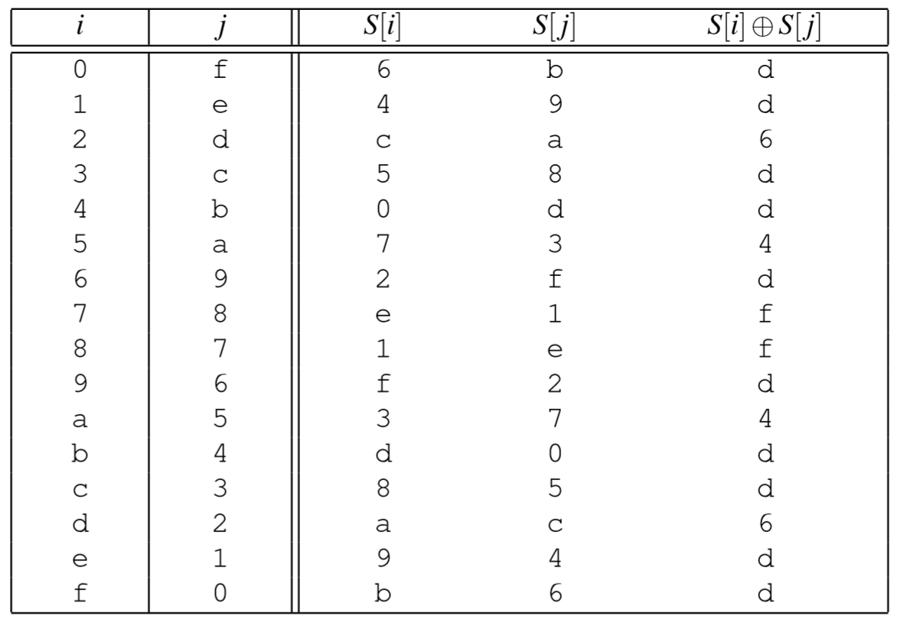
Concrete example
K₀
K₁
Input X = 0 maps to output Y = 11 (i.e., 0xB)
Input X’ = 15 maps to output Y’ = 15 (i.e., 0xF)
X
S
Y
I
J
K₀ =
I
I’
S[I]
S[I’]
S[I] ⊕ S[I’]
ΔX = ΔI ΔX = 15
ΔJ = ΔY ΔB = 4
I’
J’
X’
S
Y’
K₀
K₁
Two possible keys: (5,C) and (A,8)
Notes:
This table exhaustively tries all 16 possible values for I and I’ that are consistent with ΔI = 15. For each of them, the table computes the resulting ΔJ = ΔY values. Note that trying all possible I is equivalent to trying all possible K₀, and this is where the divide-and-conquer property comes into play. (I could’ve written all of this from the other direction instead if desired, where we tried all possible K₁ and thus all possible J. This observation will matter on the next slide.)

Slide 18
Differential cryptanalysis of 2TOY
K₀
K₁
K₂
Main rule of cipher design: if cipher breaks, simply add more rounds
Now we don’t know all differences
But if we did know ΔH = ΔI then we would be back to TOY’s analysis
Let’s see if we can fake it!
Suppose ΔX = 0xF just as before
Then ΔI = 0xD with prob 10/16
Simply assume that’s the case, and conduct the TOY cryptanalysis attack
Find which values of K₂ are consistent with ΔI = S⁻¹[Y] + S⁻¹[Y’]
If Pr[guess] is high enough, then will often get the right answer
X
S
S
Y
G
H
I
J
ΔX = ΔG
ΔH = ΔI
ΔJ = ΔY
G’
H’
I’
J’
X’
S
S
Y’
K₀
K₁
K₂
Notes:
Maybe “main hope” instead of “main rule”?

Slide 19
Differential trails through 3TOY
K₀
K₁
K₂
K₃
X
S
S
S
Y
Y ?
Differential trail:
ΔX
ΔI₁
ΔI₂
ΔY
Y’ ?
Two central themes of differential cryptanalysis
Internal variables might depend on the key, but differences between them may not!
Narrow key space by testing when (parts of) the key are consistent with known Δs
Notes:
Item #2 is the “divide and conquer” of the mathematical cryptanalysis world

Slide 20
Differential trails through 3TOY
X
S
S
S
Y
Differential trail:
ΔX
ΔI₁
ΔI₂
ΔY
Example:
F
D
6
4
Question: What is the probability of this trail occurring?
Notes:
First

Slide 21
Differential trails through 3TOY
K₀
K₁
K₂
K₃
X
S
S
S
Y
Differential trail:
ΔX
ΔI₁
ΔI₂
ΔY
Example:
F
D
6
4
Question: What is the probability of this trail occurring?
Notes:
First

Slide 22
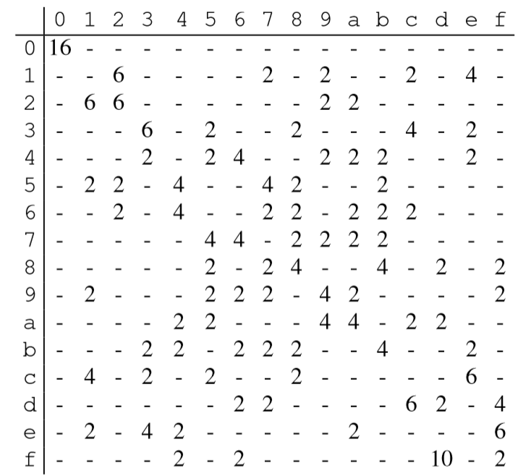
Difference propagation table
Output difference
Table is based upon S-box alone
Try all inputs differing by row value, see how often their outputs differ by column value
I
I’
S[I]
S[I’]
S[I] ⊕ S[I’]
Input difference

Slide 23
Difference propagation table
Output difference
Table is based upon S-box alone
Try all inputs differing by row value, see how often their outputs differ by column value
Computing Pr[trail]
Look up probability of each link, and multiply them together
Pr[ F → D → 6 → 4]
≈ Pr[ F → D] · Pr[D → 6] · Pr[6 → 4]
= 10/16 · 2/16 · 4/16 = 5/64
(Actually, the probabilities are not independent, whoops. But it tends to yield a value close to the right answer.)
Input difference

Slide 24
Difference propagation table
Output difference
Input difference
Def. Max difference propagation
Largest one-round difference propagation in the entire table

Slide 25
Max difference propagation in the AES S-box
Notes:
Here are a few lines of code in the computer algebra system SageMath.

Slide 26
Wide trail strategy through 4 rounds of AES
Picture depicts 4 rounds of AES
≥ 25 active S-boxes in 4 rounds
Each has max diff propagation of 2⁻⁶
So Pr [four-round trail] ≈ 2⁻¹⁵⁰
An 8-round trail has C < 2⁻³⁰⁰
A 12-round trail has C < 2⁻⁴⁵⁰
Brute force search is better
“Instead of spending most of its resources on large S-boxes, the wide trail strategy aims at designing the round transformations such that there are no [linear or differential] trails/characteristics of low weight”

Slide 27
Question: What if S is ‘too linear’?
Differential cryptanalysis
Linear cryptanalysis
Exploits the fact that differences in inputs + outputs may be correlated
Exploits the fact that inputs & outputs of an S-box may be linearly correlated
ΔX
ΔY
X
Y
S
S

Slide 28
Non-linearity of S
Question: How can we measure the non-linearity of S?
One approach: calculate algebraic degree (example: AES’ S-box has deg 254)
Unfortunately, sometimes, non-linear functions can look ‘very close’ to linear ones
That is, there may exist a linear function L such that S(x) = L(x) most of the time
New defender goal: S should be ‘very far’ from any linear function
Unfortunately even this goal has its limits…

Slide 29
Correlation
For now, let’s restrict our attention to functions that output only 1 bit
Def. The correlation between two functions F, G: {0,1}^{n} → {0,1} is
C(F, G) = Pr[ F(x) = G(x) ] – Pr[ F(x) ≠ G(x) ]
Extremes:
C(F, G) = 1
C(F, G) = 0
C(F, G) = -1
|C(F, G)| tells you how well f can be used to predict g, and the sign tells you the direction of the connection
⇒ F and G are the same function (F = G)
⇒ F and G are independent: knowing F won’t help to predict G
⇒ F and G differ everywhere (F = G ⊕ 1)

Slide 30
Defining linearity
Question:
When considering functions that output only one bit, which functions L: {0,1}^{n} → {0,1} should we call linear?
Answer:
Take ⊕ of a subset of the input bits
Let u be a vector in {0,1}^{n}
Form the linear function
L _{u} ( x ) = <u, x> = ⊕_{i} ( u_{i} · x_{i} )
All coefficients in u are either 0 or 1, so we take the ⊕ of some of the x_{i}’s
Follow-up question:
What is the correlation between linear functions?
Answer: C( L_{u}, L_{v} ) =
→
→
1 if u = v
0 otherwise
→
→
→
→
→
→
→
→

Slide 31
Limits to non-linearity
Now consider the correlation of a linear function L_{u} with a non-linear function F
Thm [Parseval]. For any function F: Σ _{u} C( F, L _{u} )² = 1
Corollary. For any F, there exists a linear function such that | C( F, L _{u} ) | > 2^{-n/2}
If F has N inputs, there’s a linear function that matches it with advantage at least N
In the case of AES: N = 256, so N = 16
But hang on a second: AES S-box has more than 1 bit of output!
→
→
→
→

Slide 32
Recall our concerns about S being ‘too linear’
K₀
K₁
X
S
Y
Form of the S-box
How to break a cipher
A linear function on all n bits
Linear ‘most of the time’
Has 1 bit of output that is a linear function of 1 bit of input
Subset of the output bits is linearly correlated with subset of input bits
Solve a system of linear equations
Solve linear programming problem
Same as #1 (partial breaks count too)
Consider more correlations…

Slide 33
Correlations in multiple bit functions
Now let’s consider an arbitrary function F: {0,1}^{n} → {0,1}^{m}
The correlation function we described before no longer works
It only describes functions with one bit of output
To understand bigger functions, simply measure all of its projections to 1 bit
Form a 2^{n} × 2^{m} matrix of correlations between subsets of outputs & inputs
C_{u,v} = C(u · x, v · F(x) )
For an S-box, we want to know how well this correlation can be
We refer to this relationship as a linear trail u ↦ v
u · x
v · y
S

Slide 34
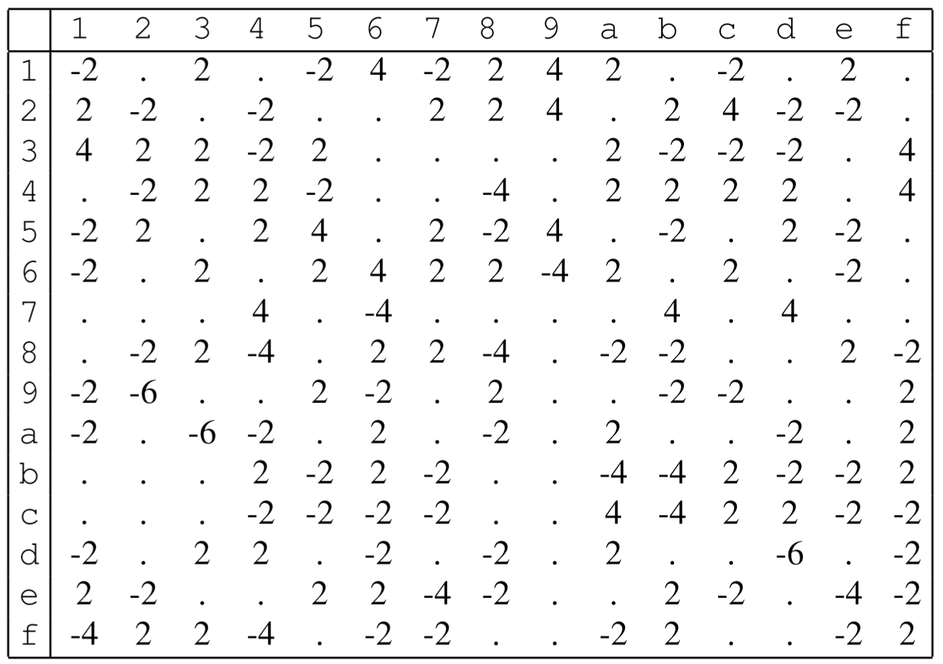
Linear approximation table
Parity of outputs
Take an S-box (here, the one for TOY)
For each row u and column v, compute how often u · x = v · F(x)
This will happen ½ of the time by chance
Record the difference
Def. Max linear bias
Biggest number in this table, in absolute value
Partiy of inputs
Notes:
Source: The Block Cipher Companion, table 7.1

Slide 35
Properties of correlation matrices
Composition: if H = F ∘ G, then C^{H} = C^{G} × C^{F}
XOR with a constant: if F(x) = x ⊕ k, then C^{F} is diagonal matrix with ±1 entries
Constant mult: if F(x) = Mx for a matrix M, then C^{F} is a permutation matrix
Properties ⇒ only the values in C^{S} matter when analyzing a block cipher

Slide 36
Linear trails through multiple rounds
i
j
x
S
S
S
y
u₀ · x
u₁ · i
u₂ · j
u₃ · y
Linear trail:
u₀
u₁
u₂
u₃
Remember, only the S-box affects the strength of linear correlations
But we may need to correlate different subsets of inputs vs. outputs
A linear trail continues this connection across multiple rounds
C[ trail ] = Π C[ each step ]

Slide 37
Linear bias in the AES S-box
Notes:
Here are a few lines of code in the computer algebra system SageMath.

Slide 38
Wide trail strategy through 4 rounds of AES
DC argument holds for LC too
≥ 25 active S-boxes in 4 rounds
Each has max linear bias of 2⁻³
So C [four-round trail] ≈ 2⁻⁷⁵
An 8-round trail has C < 2⁻¹⁵⁰
A 12-round trail has C < 2⁻²²⁵
Brute force search is better
“Instead of spending most of its resources on large S-boxes, the wide trail strategy aims at designing the round transformations such that there are no [linear or differential] trails/characteristics of low weight”

Slide 39
Cryptanalysis: the last 20 years
Additional metrics to measure confusion & diffusion
Auto-correlation and cross-correlation
Propagation/avalanching criteria and correlation immunity
Additional types of attacks
Impossible differential cryptanalysis
Boomerang attacks, and other high-order differential attacks
Differential-linear attacks
Saturation attacks
Key schedule attacks
Related key attacks
Cube attacks
…

Slide 40
Impossible differential cryptanalysis
Output difference
Input difference
Find long trails that never occur. If a key would cause this trail, then that key must be incorrect.

