Slide 1
Lecture 25: Computing on Encrypted Data
Announcements
Lab 9 due Friday 4/27
Lab 10 to be posted later today, due Wed 5/2
Andy Sellars to give guest lectures on crypto + law next week
Complete online course evaluation if you haven’t already done so
Final exam
Within scope: all lectures + required reading, except guest lectures
Less detailed, more conceptual than the two tests
  Example: don’t worry about memorizing all constructions for modes of operation, focus instead on the concepts that motivate their design + new features added

Slide 2



Goal: Secure communication in presence of an adversary
key K
key K
encode C = E(K, M)
message M
decode M = D(K, C)
???
Notes:
Remember: Bob could simply be a future version of Alice (think: full disk encryption)
Icons from https://www.iconfinder.com/iconsets/user-pictures

Slide 3
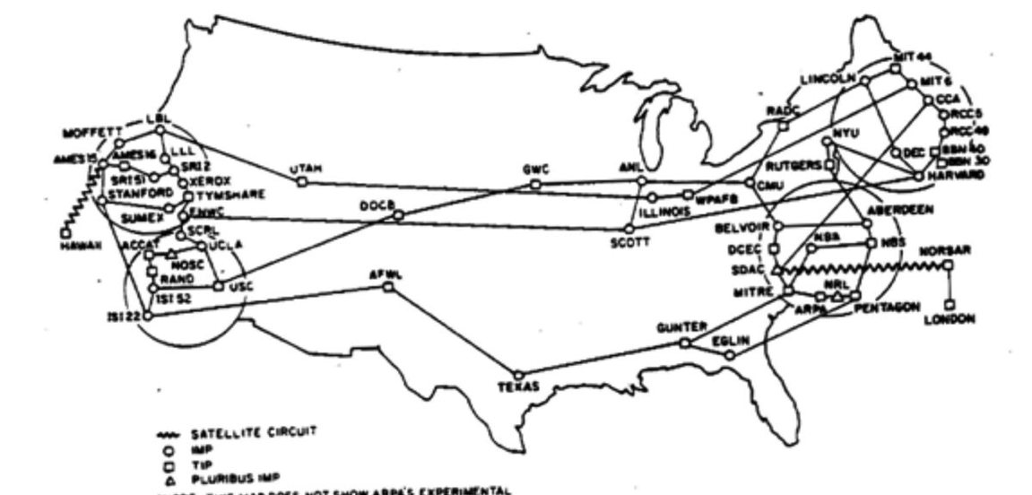
The Internet: 1968
Notes:
Source: https://twitter.com/pwnallthethings/status/935395453482520576

Slide 4
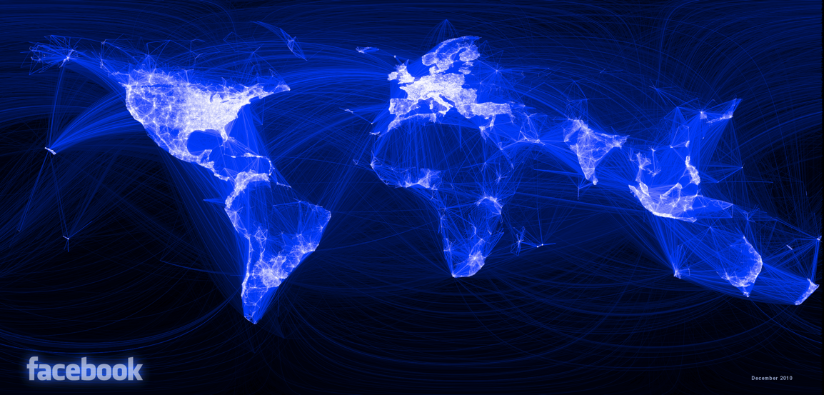
The Internet Today
Notes:
Source: https://www.facebook.com/note.php?note_id=469716398919

Slide 5
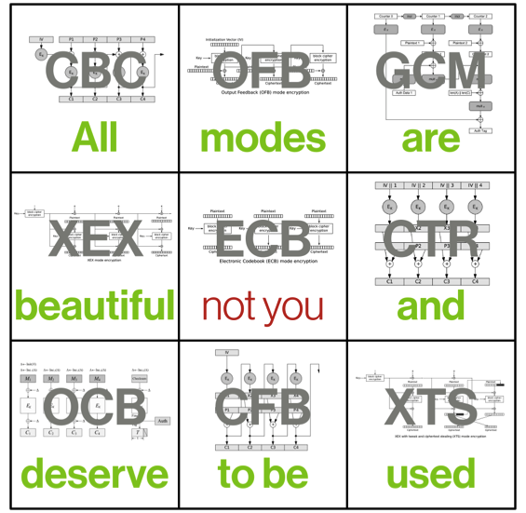
Modes of Operation for Authentication and/or Encryption
Cryptographic doom principle
If you have to perform any crypto operation before verifying the MAC on a message you’ve received, it will somehow inevitably lead to doom!
– Moxie Marlinspike

Slide 6
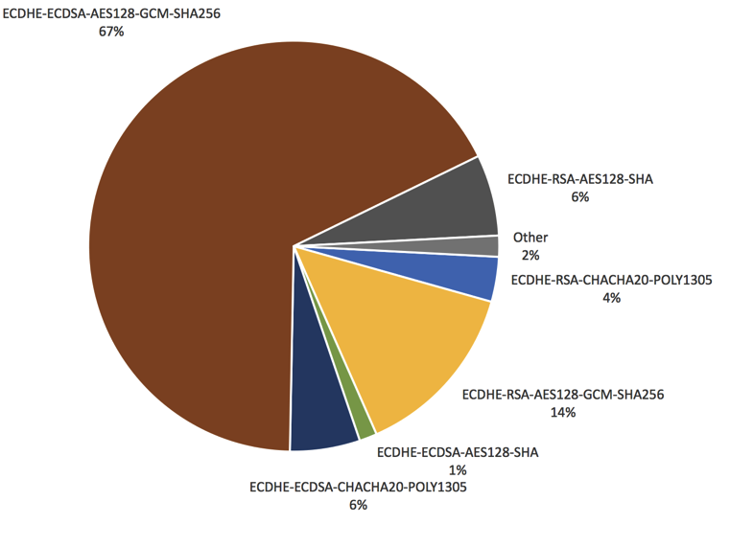
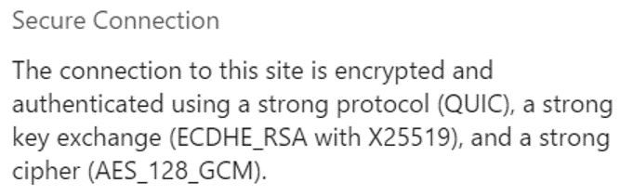
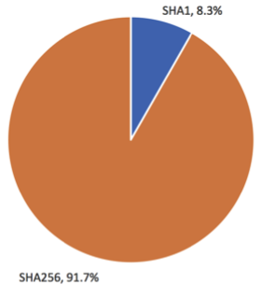
Widespread Use of Good Primitives: AE, SHA-2, …
Notes:
Left panel: Accessed via Google Chrome on 1/31/2017
Right panel source: https://blog.cloudflare.com/how-expensive-is-crypto-anyway/

Slide 7
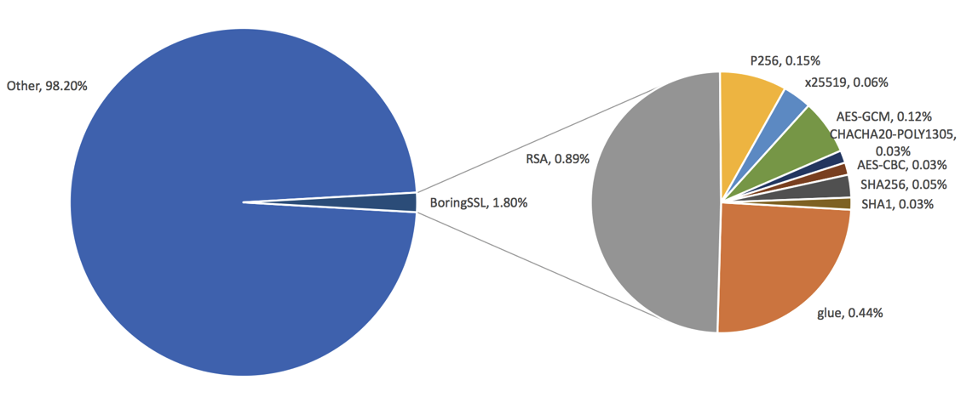
Crypto in TLS == Really Fast!
everything else the server does

Slide 8
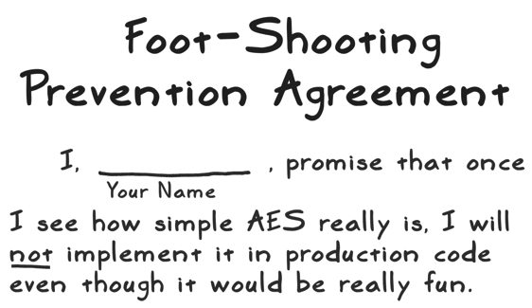
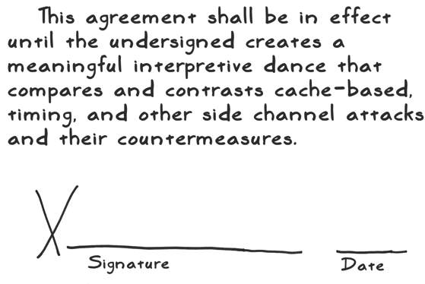

Divide-and-Conquer ⇒ Side Channels
Source:
moserware.com/2009/09/stick-figure-guide-to-advanced.html

Slide 9
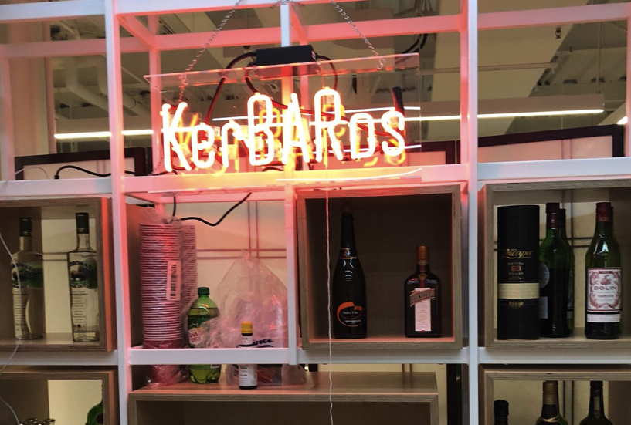
Key Management for Access Control
“This bar is pretty good, but you have to go stand in line for a ticket before they serve you.”
Notes:
Source: https://twitter.com/sweis/status/982272891948421120

Slide 10

Reduce Everything to the Lowest Layer
Math Tools
Primitives
Algorithms
Protocols
Modular
arithmetic
Auth key
exchange
Key evolution
Signal: messaging
Key encapsulation
TLS: internet
PGP: email
(see CS 558)
Hash
functions
Random(ish)
permutations
Protected
communication
?
Block
ciphers
Getting true
randomness
☏ Minicrypt
Cryptomania ✉

Slide 11
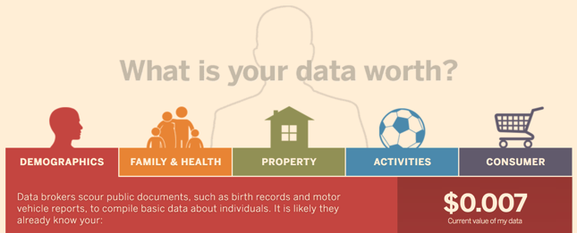
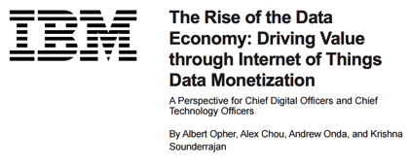
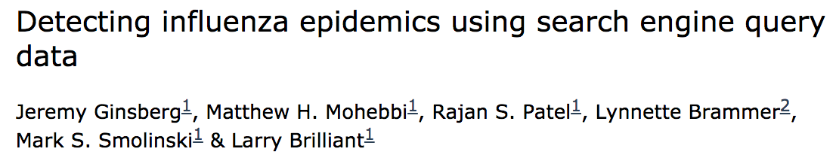
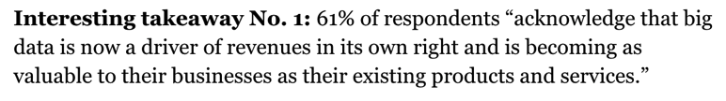
The Data Economy
“Data is the new oil”
– Shivon Zilis, Bloomberg Beta
“Data will become a currency”
– David Kenny, IBM Watson
“… the fourth industrial revolution is connectivity and data”
– Mukesh Ambani, Reliance
Notes:
Big data has become an incredibly important asset to both companies and individuals. Many companies value their data more highly than their IP, products, and employee base. It has great value.

Slide 12
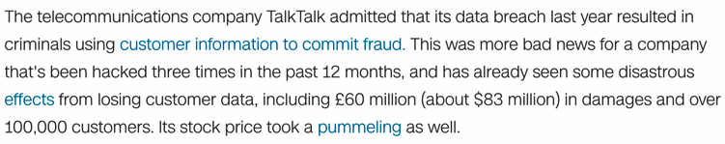
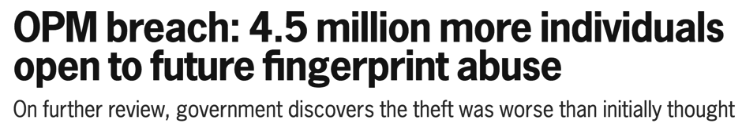
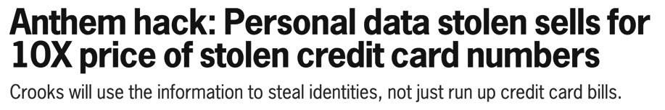
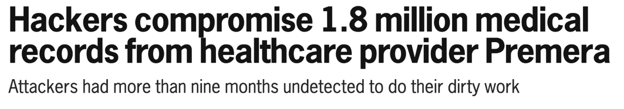
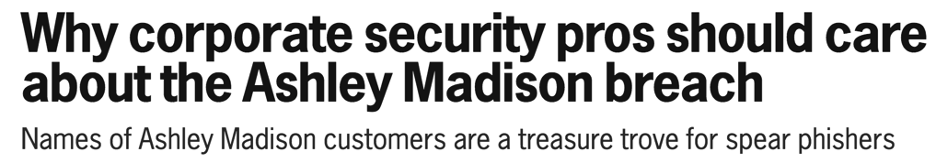
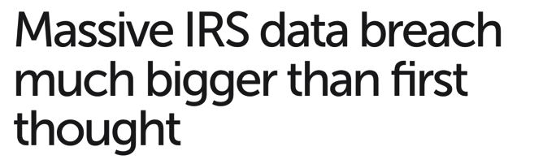
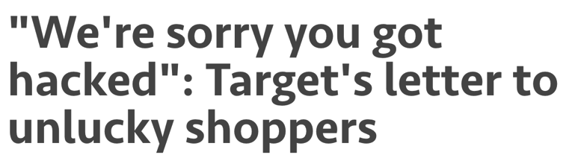
Value Implies Risk
“Data is a toxic asset”
– Bruce Schneier, 2016
Notes:
Unfortunately, with value comes risk. I don’t need to go over every data breach of the last five years. Companies have found it difficult to protect their critical data from determined attackers. You could easily update this slide with the attacks of the last week.
Bruce Schneier went so far last year to say that data is a toxic asset and that companies are finding value in not having access to their data.

Slide 13
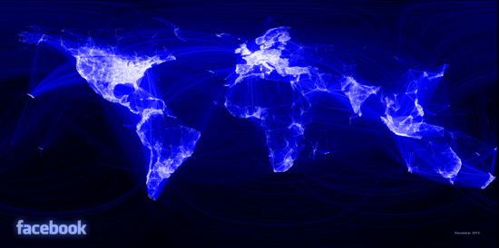
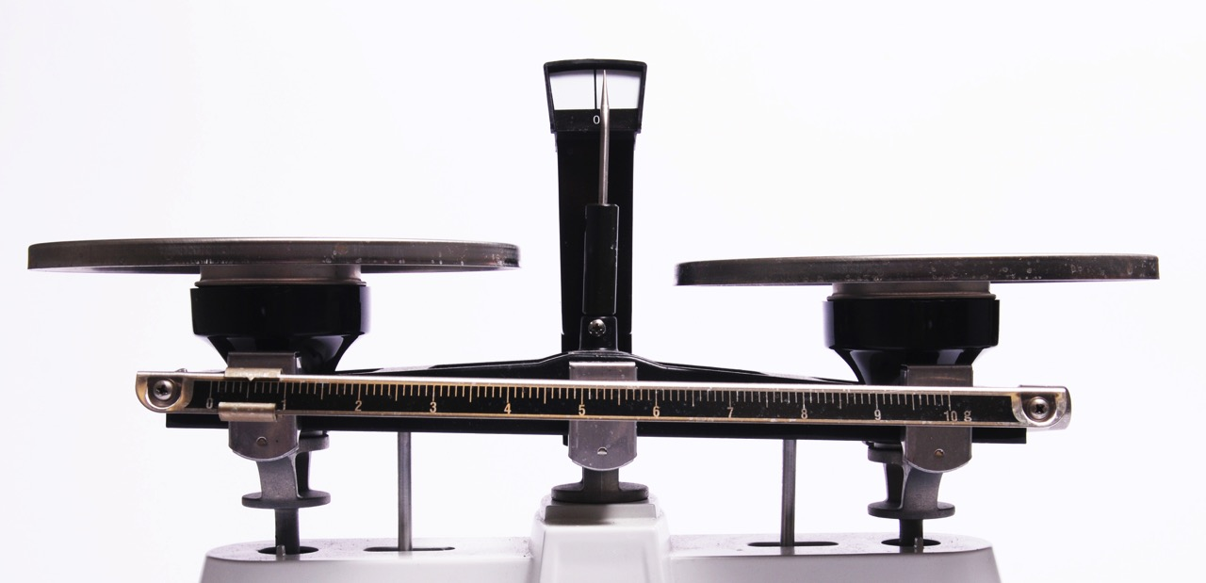

Valuable
Toxic
Images: Facebook, Wikipedia
Notes:
There is a tension that arises when individuals, companies, or governments deal with sensitive data. On the one hand, data science is a fundamental component of the information age. We often hear that “data is the new oil”: there is immense financial and social value to be gained by acquiring as much of it in raw form as possible and then extracting as much value from it as we can.
But paradoxically, the more value that there is to be gained by piecing data together, the more cautious everyone has become about data sharing since data breaches can cause financial, legal, and political harms. Bruce Schneier articulated this view in 2016 when he said that “data is a toxic asset.”
This appears to be a central tradeoff: we can share data in order to learn new insights that benefit us as a society, or we can isolate data into protected silos that safeguard our individual privacy.
[Scale image source: https://commons.wikimedia.org/wiki/File:Simple_balance_scales-01.jpg. Facebook image source: https://www.facebook.com/notes/facebook-engineering/visualizing-friendships/469716398919]

Slide 14

Cryptography enables secure data analysis for social benefit
Notes:
The central thesis of today’s discussion is that that this apparent tradeoff is false: cryptography enables us to perform statistical analyses jointly over data held by several organizations in such a way that no entity ever cedes control of its own data.

Slide 15
Let’s Encrypt Data!
possible threats?
Data owner
Database server
Backend storage
Analyst
Notes:
The natural response to this risk is try and encrypt the data. What exactly does it mean to encrypt big data? Data is usually stored in some large database.
First let’s understand entities in a standard DB configuration. The data owner provides the data to a database server. This is then stored on a backend storage system and queries interact with the server. We will distinguish between two party case for outsourcing of data and three party case for sharing of sensitive data.
What threats can encryption protect against? If we’re going to encrypt data we need to think about what kind of attacker we are defending against.

Slide 16
Encryption in Transit
possible threats?
Data owner
Database server
Backend storage
Analyst
Notes:
Network-based attacks can easily be defended (for the most part) using standard secure channel techniques such as TLS

Slide 17
Encryption at Rest
possible threats?
Data owner
Database server
Backend storage
Analyst
Notes:
Another potential threat is on the backend storage. This has been the target in some previous attacks.
However, it is possible to encrypt data at rest. Furthermore, it is a requirement for some applications and then capability exists (even on a granular level) in databases

Slide 18
Encryption During Use
possible threats?
Data owner
Database server
Backend storage
Analyst
Notes:
We can protect against an analyst querying unauthorized information by controller what information can be disclosed to each analyst using access control.

Slide 19
Encryption During Use
possible threats?
Data owner
Database server
Backend storage
Analyst
Notes:
What seems difficult to protect is an attacker that compromises the database server itself. We can’t just encrypt data at the database server it needs to be able to answer queries.

Slide 20
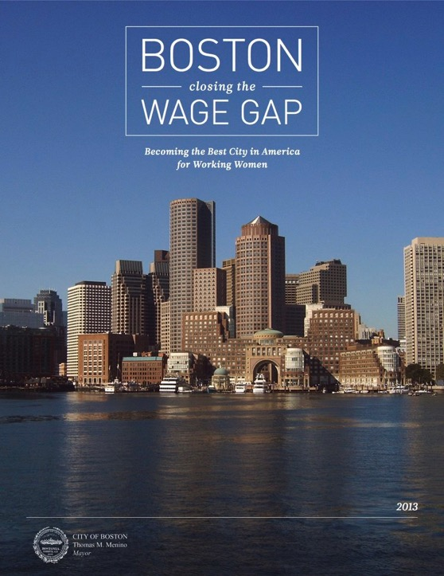



Notes:
My story begins in 2013, when the former Mayor of Boston, Tom Menino, pledged to “make Boston the premier city for working women.” To identify ways to close the gender wage gap, he established a “Women’s Workforce Council” comprising industry leaders in businesses large and small across all sectors of Boston’s economy along with social advocates in politics and academia.
The workforce council established a pledge, or “100% Talent compact.” They have gotten more than 200 companies in the Boston area to sign it.
Compact signatories pledge to do 3 things: understand the root causes of the wage gap, use evidence-based methods to close the gap, and measure their progress over time.
In this talk, I’ll focus on the final of the 3 goals of the compact. Under the mantra that “what gets measured gets done,” the compact states that employers should jointly compute the overall pay disparity across all Compact signers every year or two, so that the city overall holds itself publicly accountable for moving toward a world with 100% equal pay for equal work.

Slide 21



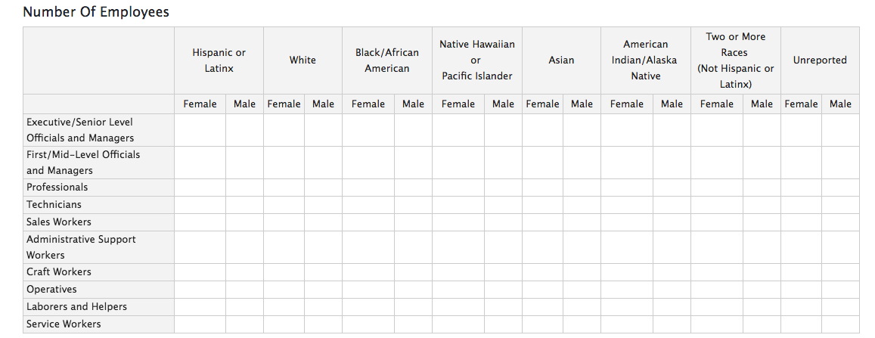
Notes:
Here is the portal that we built for companies to submit their data, which you can play with yourself by visiting 100talent.org. The target audience for this portal are the HR employees and diversity officers at the Compact-signing organizations.

Slide 22
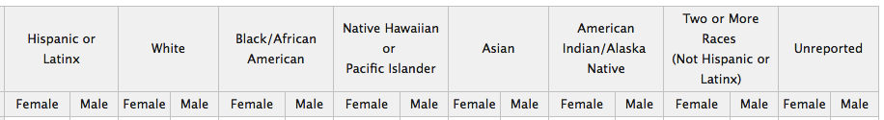
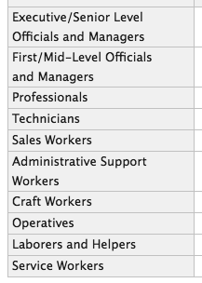
Notes:
The top of the page requests demographic information: counts of the number of employees grouped by gender, race, and job category. This spreadsheet exactly follows the format of an Equal Employment Opportunity Commission form that all employers with more than 100 employees must complete annually. Ergo, most of the Compact signers already have this information available.

Slide 23
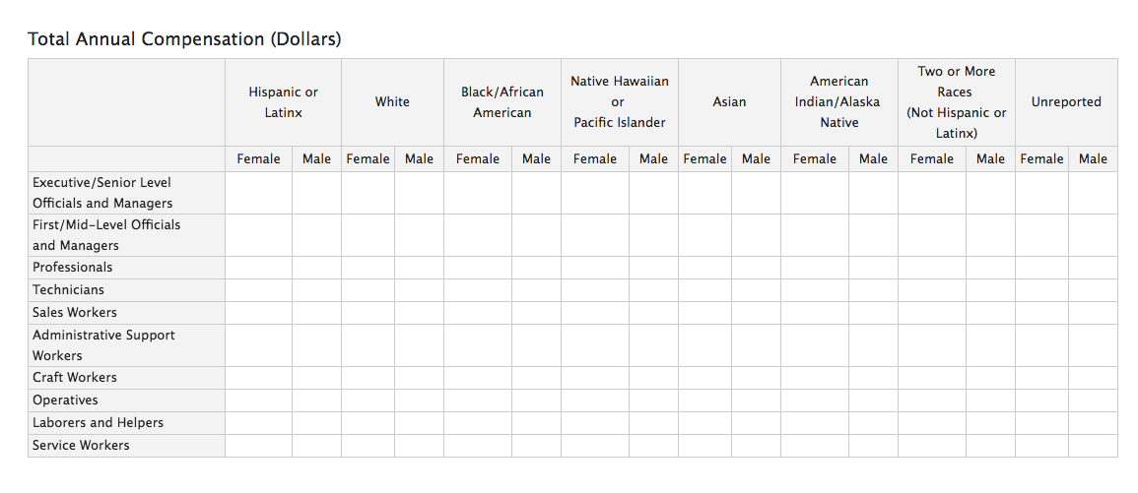
Notes:
Scrolling down, we augment the government’s existing collection of demographic information by asking also for total salaries, again grouped by gender, race, and job category. With this information, we can not only measure the overall pay gap but also understand better its root causes.
For instance, we can distinguish between the cases where men and women are paid differently at junior levels, where a gap is created later on in the promotion path, or where men and women are paid the same at each level but simply are promoted at different rates. … Just to be clear, all three of those scenarios are bad; but they are bad in different ways, and they may need different types of organizational responses to rectify.

Slide 24
Goal 3: Evaluating Success
Employers agree to… contribute data to a report compiled by a third party on the Compact’s success to date. Employer-level data would not be identified in the report.
Notes:
The text of the compact portrays the delicate balance desired between privacy for individual employers versus value for the city as a whole. The goal here isn’t to shame individual bad actors, but rather to collectively improve over time. As a result, only city-wide metrics are reported. Individual employee and employer salary data remain confidential: they are neither released to the general public nor are they even shared with other Compact signers.
But then the question arises: how do we calculate the city-wide pay disparity metrics in the first place? The Compact vaguely hints at the use of an external “third party.”

Slide 25

Trust Spectrum
Trust us
Notes:
The use of an outside entity raises the question of trust. The Compact signers, like anyone who holds sensitive data, want to minimize the likelihood that the third party (or anyone who might compromise it) could learn their data. There are several different methods that we can use to calculate pay disparity, each with their own trust profile.
One option is for companies to hand their salary data to the third party in the clear, in which case they put their faith and trust entirely that the third party does not misuse or lose their data. This “trust us” paradigm is the basis of the cloud computing transformation that has dramatically reduced cost and increased performance for computing.
In fact, this is the model that the Boston Women’s Workforce Council initially tried to use: they asked a tech company and then a university whether they would serve as the trusted third party.
However, by 2014 it was clear that the “trust us” model wasn’t going to work. On the one hand, the Compact signers’ lawyers and HR employees protested about giving their salary data to any outside entity… and remember that this is in spite of the fact that their own CEOs already signed the Compact and directed them to assist in the data collection. On the other hand, the potential third party recipients also backed out of their role, as their lawyers realized that the liability risk was too great: if the data were ever breached, they might be sued by hundreds of companies and thousands of city employees, all at the same time.

Slide 26

Trust Spectrum
Trust us
Trust no one
Notes:
On the other side of the trust spectrum, emerging cryptographic systems like fully homomorphic encryption and functional encryption, would allow the companies to submit encrypted data in such a way that the third party could operate over the data without ever seeing it. Ergo, the Compact signers wouldn’t need to trust the third party at all, as there is little damage that can be done from misusing or losing the encrypted data. However, at the moment these technologies lack the performance and (more importantly) software maturity to deploy today.

Slide 27

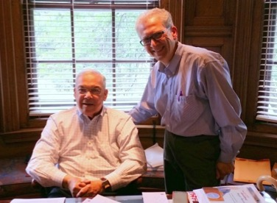










Trust Spectrum
Trust us
Trust anyone
Trust no one
Notes:
Secure multi-party computation, or MPC, offers a middle ground. Rather than placing sole trust in a single third party, the companies can federate their trust amongst multiple third parties. I want to stress that this is not a setup that is as weak as the weakest link in the chain. It is exactly the opposite: as strong as the strongest link in the chain.
--
This is where we come into the story: in 2014 Mayor Menino met with Prof. Azer Bestavros at BU and described the Women’s Workforce Council’s conundrum with finding a third party, and in response Azer explained that we can help the city by deploying MPC. Thus began our 3-year journey in building a secure computing platform that was accessible and usable by the Compact signatories.

Slide 28



Secure Multi-Party Computation (MPC)
Notes:
Here is the logical workflow of MPC. There is client-side Javascript on our website that shards or splits each cell of a company’s wage data into two pieces that are useless individually and only valuable collectively.The company’s data remain confidential as long as one of them behaves properly.
Each of the two shares on its own looks like randomly-generated gobbledygook. Together though, the companies can use these pieces, or “shares” of the data to calculate a global statistic of value. As Hillary Clinton might say: the computing parties in MPC are stronger together.
--
That’s the logical workflow, anyway. We can simplify the front-end of this process by having the company send both of its shares to one compute party, with standard public-key encryption so that one of the shares is protected in transit until it reaches the second compute party. Our system splits data between two “third party” entities: the Boston Women’s Workforce Council and us at BU, with employer data protected as long as one of the two shares is kept confidential (and in practice the companies trust the Council, not us). Additionally, everything involving the Compact signers and the Council is done entirely using JavaScript in a browser; only BU has a web server. Furthermore, BU never sees any inputs, outputs, or intermediate results throughout the entire calculation. As a result, with our system the most computationally powerful and technology-savvy entity is also the least trusted one… which is pretty much the opposite of how cloud computing works today.

Slide 29



$9
$7
Notes:
Let me illustrate the process at small scale. Suppose we have just one company with two employees, one male and one female, with salaries of $9 and $7 respectively. (While these numbers are artificially small to simplify the math, sadly they are in line with the pay gap ratio we observe in Boston today.)
Our objective is for the Women’s Workforce Council to calculate the wage disparity (in this case $2) while hiding each employee’s salary from each other and from both outsourced parties.

Slide 30
11
=
10
+
$9
=
+
3
4
$7
Notes:
Disperse the sensitive salary information amongst the Boston Women’s Workforce Council and Boston University…
Note that individually, neither BU nor the Council knows either the men’s or women’s salaries.

Slide 31
11
10
–
–
3
4
8
6
Notes:
Nevertheless, they can calculate the wage disparity by working together. First, they individually calculate the difference in time between their two clocks: 4 hours before 10 o’clock equals 6 o’clock, and so on.
--
Second, BU can tell its difference (6 in my example) to the Boston Women’s Workforce Council, who adds it to their own locally-calculated difference of 8.

Slide 32
11
$9
–
–
3
$7
$2
8
6
Notes:
…in order to recover the overall pay disparity of 2.
Note that BU and the Council could also reconstruct the sensitive input wage data by sharing their pieces of the blue or red clocks. This is precisely why MPC doesn’t achieve a “trust no one” goal but rather a “trust anyone” goal: employers should only contribute their salary data if they feel confident that at least one of the two outsourced parties won’t misuse their piece.
Also, even though my slide only shows calculation of the difference in two inputs from a single employer, the same secret sharing ideas can be used for more expressive arithmetic and boolean operations to aggregate data across multiple employers.

Slide 33
Performance on AES
Notes:
MPC has finally evolved to the point where performance shouldn’t be considered the primary impediment to use.
This is a well-studied and mature technology, with theoretical constructions going back 35 years along with substantial improvement in algorithmic and engineering design over the past decade to improve performance. The MPC community has adopted a de-facto benchmark of performing AES encryption between two participants, one with a message to encrypt and the other with a secret key. AES comprises a variety of arithmetic and boolean operators, and as such is well-suited for computing both directly in hardware and via MPC. As you can see from the graph, secure computation of AES has improved by 4-5 orders of magnitude over the past decade. Both for comparison purposes and to account for the effects of Moore’s law, I also show the performance of native AES computation over the same time period.
MPC is still undoubtedly slower than native computing and thus it isn’t suited for every application. Nevertheless, MPC can provide significant benefits in scenarios where acquiring raw data is too costly, time consuming, or impossible due to legal, ethical, or competitive constraints.

Slide 34

Image: Wikipedia
Notes:
The Boston Women’s Workforce council and we have deployed the 100talent software 3 times to collect data in 2015, 2016, and 2017. The first analysis was never published due to the small sample size (and thus even we don’t know what it says), but the results from the last two have been posted on the boston.gov website. The last two analyses have been published, and thus I show the scale of the data collected here. We have received inputs from 69 and 114 companies in the two years, which is fairly impressive for a voluntary system that doesn’t even keep any records of who submits. The data encompass a noticeable fraction of the city’s workforce.
[Image source: https://commons.wikimedia.org/wiki/File:Boston_skyline_at_earlymorning.jpg]

Slide 35
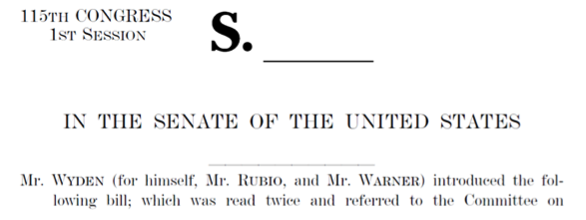
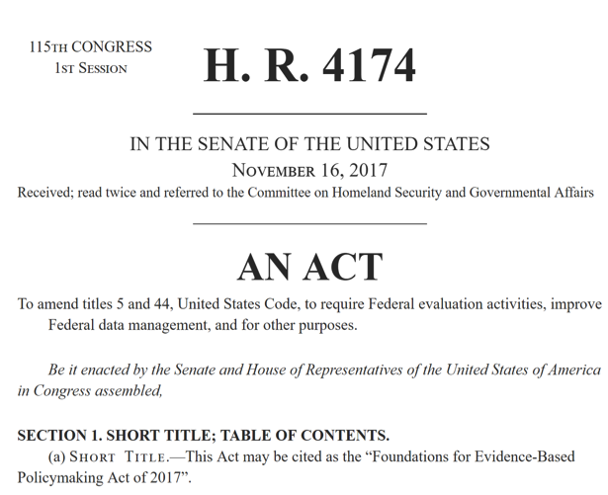
“in designing, establishing, and maintaining the higher education data system, … the Commissioner shall use secure multiparty computation technologies”
“establishment of a shared service to facilitate data sharing, enable data linkage, and develop privacy enhancing techniques”
Notes:
Furthermore, Congress is currently considering two bills that mention MPC. First, Senators Wyden, Rubio, and Warner have jointly sponsored the “Student Right to Know Before You Go” bill, which would empower prospective college students to make more informed decisions by measuring the annual earnings and accumulated debt of recent graduates in a privacy-preserving manner. The bill specifically states that this data system must use secure multi-party computation or anything that delivers greater student privacy and security.
Second, the House has passed a bill sponsored by Speaker Ryan that would require the government to use privacy enhancing technologies when collecting data used in evidence-based policymaking.
Congressional press releases related to both bills specifically mention our pay equity project and other prior deployments of MPC to demonstrate the feasibility of adopting it within the federal government.

Slide 36


Setting: Outsourced Database
Data, Policy
Data
Data,
Policy
Cloud
Data,
Policy
Owner
Client
Query
Cloud Learns
Data
Query & response
Query structure
Query access patterns
Policy
Client Learns
Response
Owner Learns
Data
Policy
Client Learns
Response, but only
if query is valid
Policy
Fast, expressive searches, but database holder sees everything!
Notes:
This picture abstracts away many important differences between database technologies today, such as SQL/NoSQL, centralized/distributed storage, performance requirements, etc.
Policy could be record based or (more interestingly) query based.

Slide 37
Ideal Scenario
Encrypted Data
Data,
Policy
Owner
Cloud
Client
Query
Owner Learns
Data
Policy
Cloud Learns
Data
Query & response
Query structure
Query access patterns
Policy
Client Learns
Response, but only
if query is valid
Policy
Can achieve strong privacy,
but impractically slow & poor query expressivity
Notes:
Symmetric private information retrieval

Slide 38
A Compromise
Encrypted Data
Data,
Policy
Owner
Cloud
Client
Query
Owner Learns
Data
Policy
Query structure
Cloud Learns
Data
Query & response
Query structure
Query access patterns
Policy
Client Learns
Response, but only
if query is valid
Policy
Balance privacy, performance, and query expressivity

Slide 39
Cryptographically Protected Search
No server protections
(encrypt data at rest)
Risk of data compromise
Property preserving encryption
Symmetric searchable encryption
Multi-party computation
Return whole dataset encrypted
Utility of stored data
Notes:
This talk includes discussion of symmetric searchable encryption or SSE and property preserving encryption. We will not consider approaches that use trusted hardware, though they can be complementary to cryptographic techniques.

Slide 40
State of the Art
No server protections
(encrypt data at rest)
Risk of data compromise
Multi-party computation
Return whole dataset encrypted
Utility of stored data
Notes:
We are systematizing this area for a few important reasons:
Its been an area of rapid growth since 2000, there are 50+ papers on ePrint. Multiple sessions at last year’s CCS.
Emergence of commercial products/extensive funding
Both axes are difficult to compare, we’ll start with risk or security

Slide 41
Abstract View of a Single-Table DB
id | fname | lname | Age | Income | Photo
1 | Alice | Jones | 20 | 71,000 | <alice.jpg>
2 | Bob | Jones | 25 | 58,000 | <bob.jpg>
3 | Charlie | Smith | 50 | 62,000 | <charlie.jpg>
4 | David | Williams | 55 | 75,000 | <david.jpg>
  Searchable
  Unsearchable
Index
Enc(records)
  Small data structure: map searchable terms to associated record ids
  Large file store: standard authenticated encryption applied to each record

Slide 42
❶ Property Preserving Encryption
Goal: Apply transformation that preserves relevant features, then insert into a legacy database for indexing & searching
id | fname | lname | Age | Income
1 | Alice | Jones | 20 | 71,000
2 | Bob | Jones | 25 | 58,000
3 | Charlie | Smith | 50 | 62,000
4 | David | Williams | 55 | 75,000
id | fname | lname | Age | Income
1 | qIap1 | Lf4Pz | cnr | g⁷¹ r⁹⁰
2 | 7fBwo | Lf4Pz | duo | g⁵⁸ r⁸⁴
3 | AKx0k | sw2AD | syv | g⁶² r²²
4 | CK6ZD | 6lVTH | tng | g⁷⁵ r³⁸
Operation | DET (=) | OPE (<)
Method | Choose function at random | Choose monotonic function randomly
Drawback | Cloud sees equality patterns | Cloud sees < and ~distances
Operation | DET (=)
Method | Choose function at random
Drawback | Cloud sees equality patterns
Operation | DET (=) | OPE (<) | HOM (+, x)
Method | Choose function at random | Choose monotonic function randomly | Public-key crypto
Drawback | Cloud sees equality patterns | Cloud sees < and ~distances | Slow

Slide 43
❶ Property Preserving Encryption
Fast & legacy compliant
Supported by a database near you!
  Google: Encrypted BigQuery
  Microsoft: SQL Server 2016, Azure SQL Database
  Startups: Bitglass, Ciphercloud, CipherQuery, Crypteron, IQrypt, Kryptonostic, PreVeil, Skyhigh, ZeroDB
Weakness: leakage provided to cloud is strong enough to permit data & query reconstruction attacks

Slide 44
❷ Searchable Symmetric Encryption
Privacy: reveals or “leaks” less information to the database server
Query expressivity: large subset of SQL
Scale: tested on databases with 100m records
Performance: within 5x of MariaDB

Slide 45
❷ Blind Seer (Columbia & Bell Labs)
Consider a tree in which each node stores a set
  Leaves: set of keywords in that record
  Other nodes: union of children
Roles
  Owner preps tree
  Cloud & client
  jointly traverse
Consider the query
name = Alice ∧ age = 25
fname = Alice
age = 20
fname = Charlie
age = 50
fname = Bob
age = 25
fname = David
age = 55
All keywords
n=Alice, a=20,
n=Bob, a=25
fname = Alice
age = 20
n=Charlie, a=50,
n=David, a=55
fname = Charlie
age = 50
fname = Bob
age = 25
fname = David
age = 55
✔
✘
✔
✘
✘

Slide 46
❷ Blind Seer (Columbia & Bell Labs)
Main cryptographic weakness: tree search pattern reveals info about data
fname = Alice
age = 20
fname = Charlie
age = 50
fname = Bob
age = 25
fname = David
age = 55
All keywords
n=Alice, a=20,
n=Bob, a=25
fname = Alice
age = 20
n=Charlie, a=50,
n=David, a=55
fname = Charlie
age = 50
fname = Bob
age = 25
fname = David
age = 55
✔
✘
✔
✘
✘

Slide 47
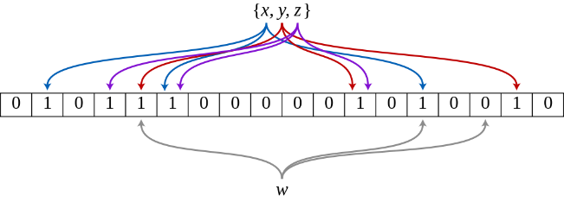
❷ Blind Seer (Columbia & Bell Labs)
Main cryptographic weakness: tree search pattern reveals info about data
Main cryptographic innovation
  Represent the set as an (encrypted) Bloom filter
  Evaluate node using secure two-party computation
n=Alice, a=20,
n=Bob, a=25
Image source: Wikipedia

Slide 48
Common Language for Leakage
Protected search schemes reveal or leak some information about the query, data set, and result set to each party.
Structure: size of an object, e.g. length of a string or cardinality of a set
Identifiers: pointers to objects that persist across multiple accesses
Predicates: identifiers with additional information, e.g. “identifier x is for value in the range [a,b]”
Equality or Order of values
Some schemes leak:
At Initialization on entire DB
At Query on relevant records

Slide 49
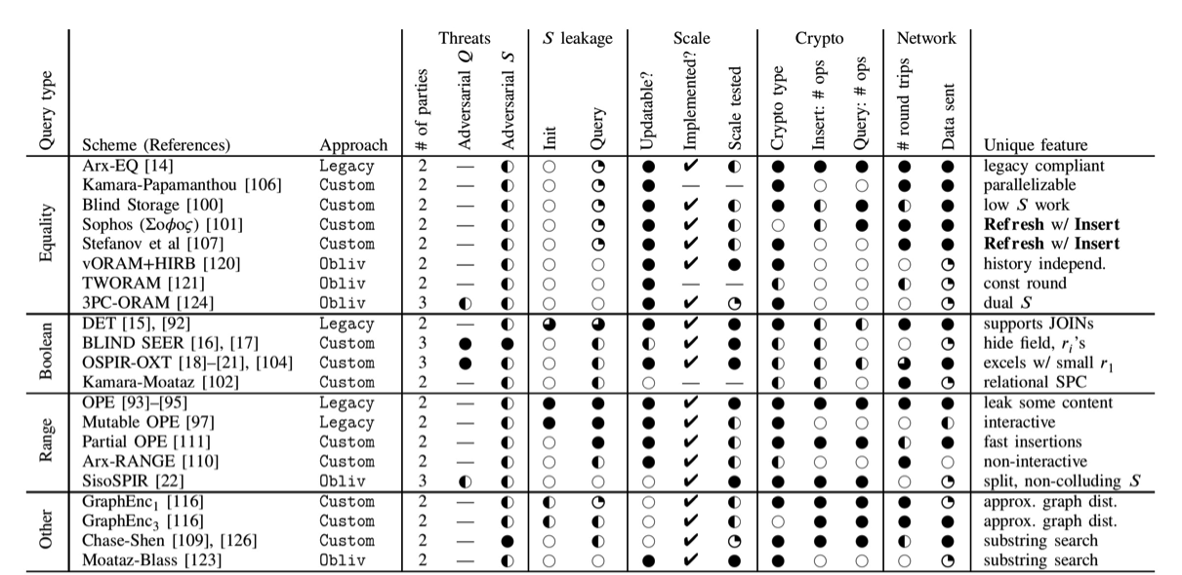
Protected Databases: The Pareto Frontier

Slide 50
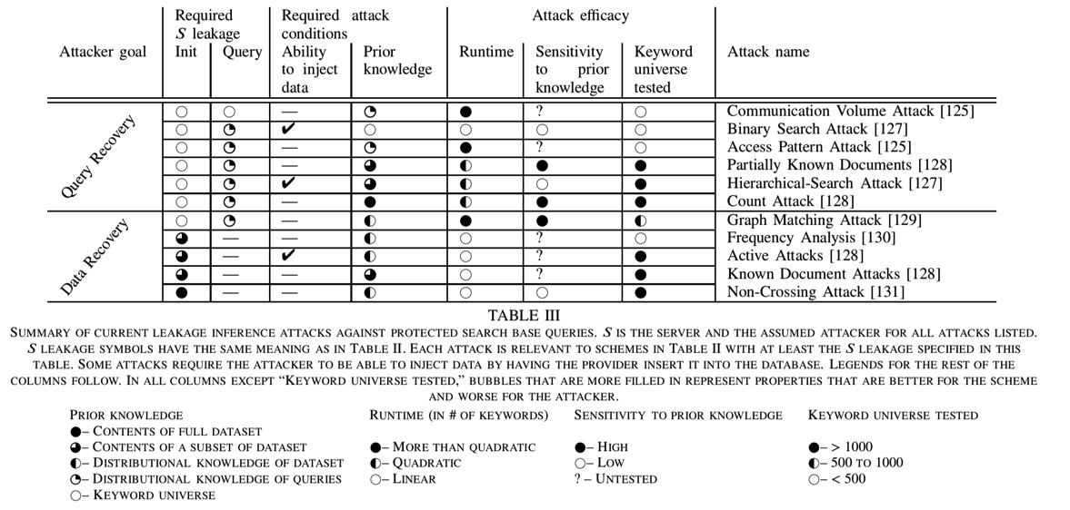
Mapping: Leakage Functions → Attacks
Notes:
In our paper we provide a mapping from leakage functions to relevant statistical attacks.
The quality and difficulty of known leakage attacks depend on:
How accurate the prior/auxiliary information is.
How different the number of records is for different values of the field (for frequency analysis).
What kinds of correlation exist between data fields.

Slide 51
Queries Handled by Protected Databases
Natural approach: what fraction of a unprotected database language is supported?
Systems implement base queries w/ crypto
  Keyword Equality
  Range
  Boolean Combination
  Other (graph alg and substring)
Combine base queries:
  Range → Equality, search for [a, a]
  Boolean → Range, using set covers
  Range → Substring, by inserting prefixes
Combiners less efficient, more leakage
Allow for rapid expansion of query functionality

