Slide 1
Intent

Slide 2
Contents
•What is intent?
•Why intent?
•Type of intents?
•How intents are received?
•How intents are resolved?
•Intent filter?
•Intent Chooser?

Slide 3
What is an intent?
•Intent is an intention to do something.
•Intent contains an action carrying some information.
•Intent is used to communicate between android components
To start an activity
To start a service
To deliver a broadcast

Slide 5
Why intent?
Intent is used to communicate, share data between components.
Intent contains the following things
Component name
Action
Data
Extras
Category
Flags

Slide 6
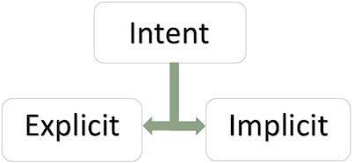
Types of intent
•Explicit intents
•Implicit intents

Slide 7
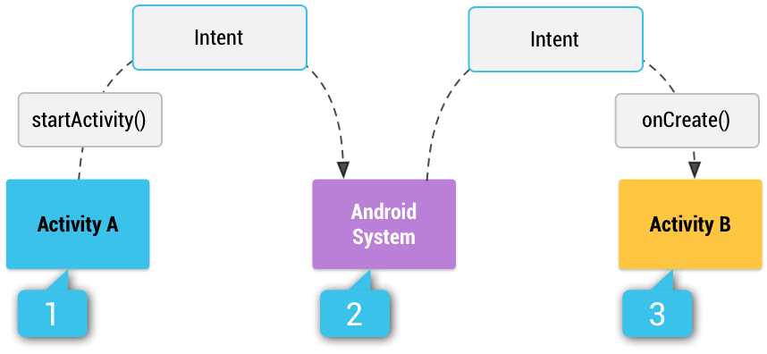
Figure 1. Illustration of how an implicit intent is delivered through the system to start another activity:
[1] Activity A creates an Intent with an action description and passes it to startActivity().
[2] The Android System searches all apps for an intent filter that matches the intent. When a match is found
[3] the system starts the matching activity (Activity B) by invoking its onCreate() method and passing it the Intent.

Slide 8
Implicit intents
Specify an action that can invoke an app on the device that can perform the action.
Useful when your app can not perform the action but other apps do and you let user to pick up the app.
It is possible that there may not be any that handle the implicit intent.

Slide 9
Example
// Create the text message with a string
Intent sendIntent = new Intent();
sendIntent.setAction(Intent.ACTION_SEND);
sendIntent.putExtra(Intent.EXTRA_TEXT, textMessage);
sendIntent.setType(HTTP.PLAIN_TEXT_TYPE); // "text/plain" MIME type
// Verify that the intent will resolve to an activity
if (sendIntent.resolveActivity(getPackageManager()) != null)
{
startActivity(sendIntent);
}

Slide 10
Explicit intents
•Used to launch a specific component like activity or a service.
•In this case, android system directly forwards this intent to that specific components.
•It is faster.
•Only use, when you know the name of the component(Activity, Service, Broadcast receiver)

Slide 11
Example
1.// Executed in an Activity, so 'this' is the Context
2.// The fileUrl is a string URL, such as "http://www.slidenerd.com/logo.png"
3.Intent downloadIntent = new Intent(this, DownloadImageService.class);
4.downloadIntent.setData(Uri.parse(fileUrl));
5.startService(downloadIntent);

Slide 12
How intent are received?
Till now we have seen how intents are used to invoke some other components, now lets explore how these components received these intents
Receiving implicit intent
Receiving explicit intent
Explicit intents are directly deliver to target as intent has the target component class specified in it.

Slide 13
Receiving implicit intents
Your app should advertise what intents it can handle using <intent-filter> tag in the manifest file under <activity> or <service> or <receiver> tag.
You can mention one or more of these three elements under <intent-filter>
Action
Data
Category

Slide 14
How intents are resolved?/ Intent resolution
When the system receives an implicit intent to start an activity, it searches for the best activity for the intent by comparing the intent to intent filters based on three aspects:
The intent Action(Action Test)
Ex: ACTION_SEND
The intent category(Category Test)(both URI and data type)
Ex: CATEGORY_HOME
The Data(Data Test)
Ex: android: mimetype=“video/mpeg”

Slide 15
Action test
To specify accepted intent actions, an intent filter can declare zero or more <action> elements. For example:
To pass this filter, the action specified in the Intent must match one of the actions listed in the filter.

Slide 16
Category test
To specify accepted intent categories, an intent filter can declare zero or more <category> elements. For example:
For an intent to pass the category test, every category in the Intent must
match a category in the filter.

Slide 17
Data test
To specify accepted intent data, an intent filter can declare zero or more <data> elements. For example:
Each <data> element can specify a URI structure and a data type (MIME media type). Each part of the URI is a separate attribute: scheme, host, port, and path:
<scheme>://<host>:<port>/<path>

Slide 18
Intent filter
Register activities, services and broadcast receivers(as being capable of performing an action on a set of data)
It is used in manifest file

Slide 19
Example

Slide 20
Intent chooser
If multiple apps can respond to the intent and the user might want to use a different app each time, you should explicitly show a chooser dialog.
The chooser dialog asks the user to select which app to use for the action every time

Slide 21
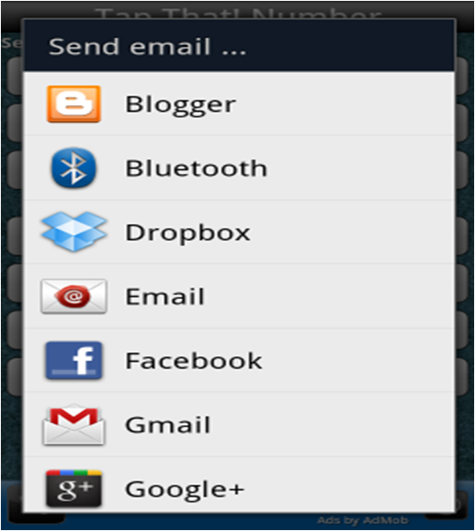
Example
If a user send want to send or share his/her picture to any application, then by using intent chooser they have more than one options to choose for.

Slide 22
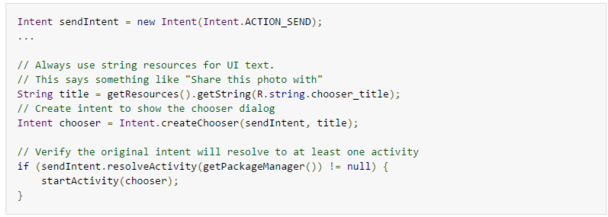
Intent chooser
Notes:
https://developer.android.com/guide/components/intents-filters.html

Slide 23
Intent Read
http://www.vogella.com/tutorials/AndroidIntent/article.html

