Slide 1
Android Fragments
An introduction

Slide 2
About Fragments
New in Android 3.0 (Honeycomb, API 11)
Usable in previous versions with support library
Intended to reuse layouts between tablets and phones
But usable for many more...
Definition:
A Fragment represents a behavior or a portion of user interface in an Activity.

Slide 3
Introduction
Creating a dynamic and multi-pane user interface on Android, need to encapsulate UI components and activity behaviors into modules that you can swap into and out of your activities.
Fragment class can be used to create these modules, which behaves somewhat like a nested activity that can define its own layout and manage its own lifecycle.
It represents a behavior or a portion of user interface in an Activity.

Slide 4
Introduction
Developer can combine multiple fragments in a single activity to build a multi-pane UI and reuse a fragment in multiple activities.
Fragment can be considered as a modular section of an activity, which has its own lifecycle, receives its own input events
Fragment can be added or removed while the activity is running
Fragment introduced primarily to support more dynamic and flexible UI designs on large screens, such as tablets.

Slide 5
Interaction with Activities
A fragment is a modular section of an activity, which has its own lifecycle...
But, a fragment's lifecycle is directly affected by the host activity's lifecycle
Activity paused: fragments paused
Activity destroyed: fragments destroyed
Activity running: fragments can have different states

Slide 6
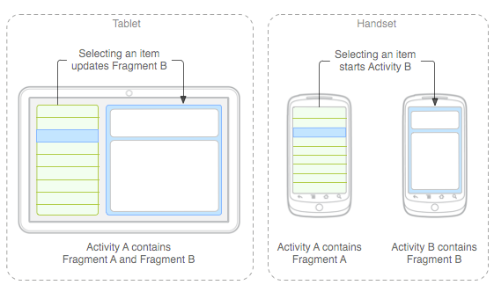
Design
Fragments should be modular and reusable

Slide 7
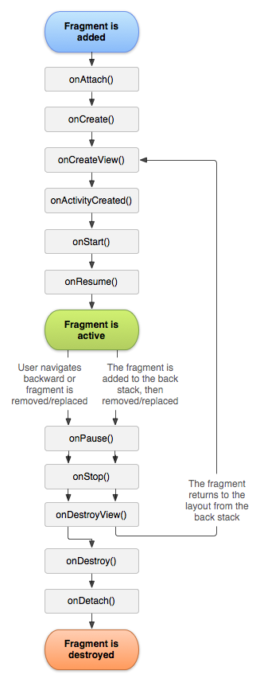
Fragment Lifecycle
onCreate()
The system calls this when creating the fragment.
onCreateView()
The system calls this when it's time for the fragment to draw its user interface for the first time.
onPause()
The system calls this method as the first indication that the user is leaving the fragment (though it does not always mean the fragment is being destroyed).

Slide 8
Creating a Fragment
public static class ExampleFragment extends Fragment {
@Override public View onCreateView(LayoutInflater inflater, ViewGroup container, Bundle savedInstanceState) { // Inflate the layout for this fragment return inflater.inflate(R.layout.example_fragment, container, false); } }
View inflate (int resource, ViewGroup root, boolean attachToRoot)
int resource: The resource ID of the layout you want to inflate.
root: Parent of the inflated layout
attachToRoot: A boolean indicating whether the inflated layout should be attached to the ViewGroup

Slide 9
Adding a fragment to an activity
<?xml version="1.0" encoding="utf-8"?>
<LinearLayout xmlns:android="http://schemas.android.com/apk/res/android" android:orientation="horizontal" android:layout_width="match_parent" android:layout_height="match_parent"> <fragment android:name="org.catdroid.fragments.FirstFragment" android:id="@+id/firstFragment" android:layout_weight="1" android:layout_width="match_parent" android:layout_height="match_parent" /> <fragment android:name="org.catdroid.fragments.SecondFragment" android:id="@+id/secondFragment" android:layout_weight="2" android:layout_width="match_parent" android:layout_height="match_parent" /> </LinearLayout>

Slide 10
Managing fragments
a) Create a Fragment Transaction (from Activity!)
FragmentManager fragmentManager = getFragmentManager(); FragmentTransaction fragmentTransaction = fragmentManager.beginTransaction();
b) Establish transaction properties (transitions!)
Fragment newFragment = new ExampleFragment();
transaction.replace(R.id.fragment_container, newFragment);
transaction.addToBackStack(null);
c) Commit!
transaction.commit();

Slide 11
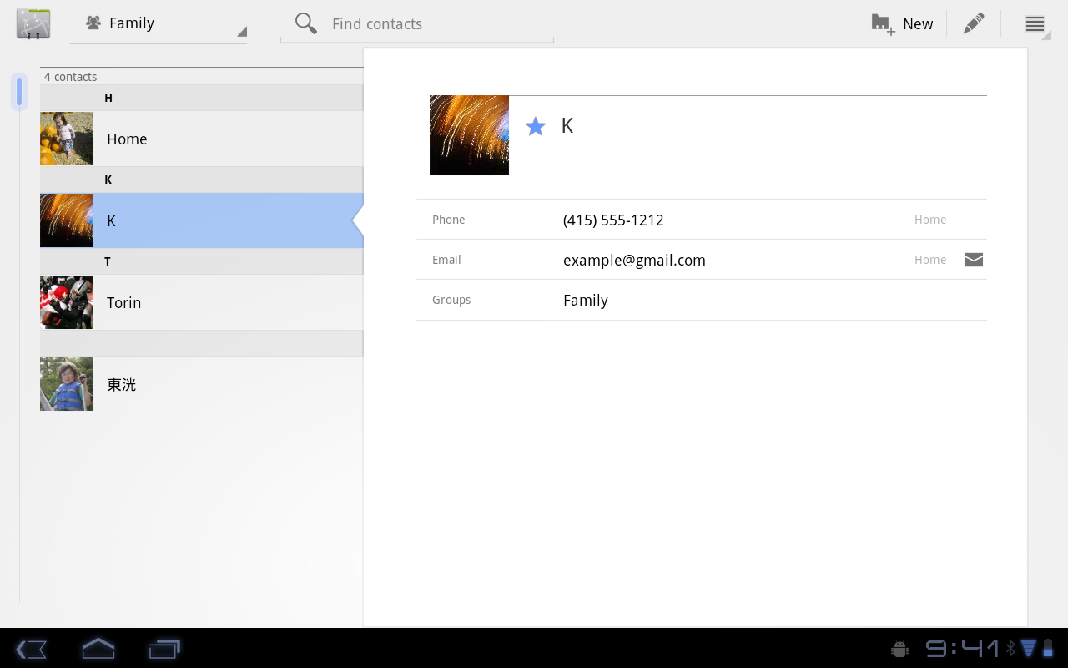
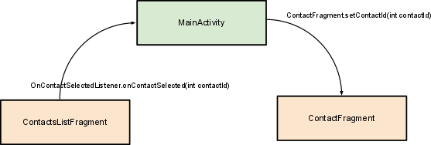
Communicationg between fragments
MainActivity
ContactsListFragment
ContactFragment

Slide 12
Fragment Support Library
The Support Library provides a version of the Fragment APIs that you can use on Android 1.6 (API level 4) and higher.
Adding Support library to project
Right click-> Android tools -> Add Support Library
To be sure that you don't accidentally use new APIs on an older system version, import the Fragment class and related APIs from the android.support.v4.app package:
import android.support.v4.app.Fragment; import android.support.v4.app.FragmentManager;

Slide 13
End

