Slide 1
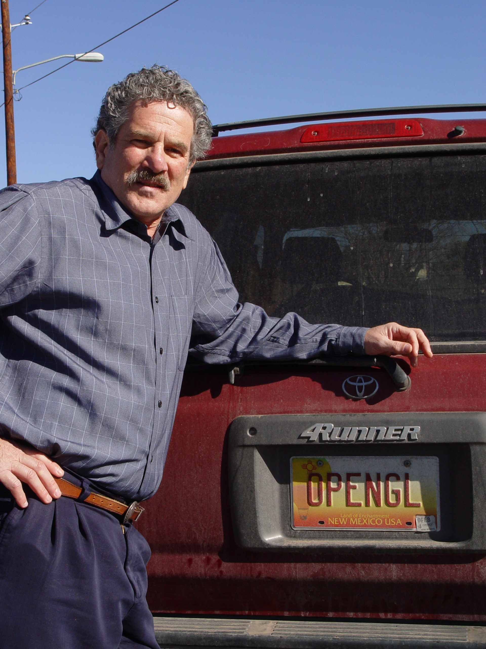
Introduction to Computer Graphics with WebGL
Ed Angel
Professor Emeritus of Computer Science
Founding Director, Arts, Research, Technology and Science Laboratory
University of New Mexico

Slide 2
Overview
These lectures are for a senior/graduate elective for computer science and engineering majors(and others with good programming skills)
The course is based on a modern approach using programmable shaders in the new textbook: Ed Angel and Dave Shreiner, Interactive Computer Graphics, A Top-down Approach with WebGL(Seventh Edition), Addison-Wesley
These lectures cover Chapters 1-7 in detail and survey Chapters 8-12

Slide 3
Week 1
Video 1.1: Introduction
Video 1.2: Detailed Outline and Examples
Video 1.3: Example Code in JS
Video 1.4: What is Computer Graphics?
Video 1.5: Image Formation
Reading: Chapter 1
Exercises: Run some examples on your browser

Slide 4
Video 1.1
Course Overview
Required Background
References

Slide 5
Contact Information
angel@cs.unm.edu
www.cs.unm.edu/~angel

Slide 6
Objectives
Broad introduction to Computer Graphics
Software
Hardware
Applications
Top-down approach
Shader-Based WebGL
Integrates with HTML5
Code runs in latest browsers

Slide 7
Prerequisites
Good programming skills in C (or C++)
Basic Data Structures
Linked lists
Arrays
Geometry
Simple Linear Algebra
Note: CS/ECE 412 is neither a pre- or corequisite
Considerable overlap
Should not take both for credit

Slide 8
Requirements
3 Assigned Projects
Simple
Interactive
3D
Term Project
You pick
See
www.cs.unm.edu/~angel/ONLINE_GRAPHICS
for assignments, projects and other info

Slide 9
Why is this course different?
Shader-based
Most computer graphics use OpenGL but still use fixed-function pipeline
does not require shaders
Does not make use of the full capabilities of the graphics processing unit (GPU)
Web
With HTML5, WebGL runs in the latest browsers
makes use of local hardware
no system dependencies

Slide 10
References
Interactive Computer Graphics (7th Edition)
The OpenGL Programmer’s Guide (the Redbook) 8th Edition
OpenGL ES 2.0 Programming Guide
WebGL Programming Guide
WebGL Beginner’s Guide
WebGL: Up and Running
JavaScript: The Definitive Guide

Slide 11
Web Resources
www.cs.unm.edu/~angel/
www.cs.unm.edu/~angel/WebGL/7E
www.opengl.org
get.webgl.org
www.kronos.org/webgl
www.chromeexperiments.com/webgl
learningwebgl.com

Slide 12
Introduction to Computer Graphics with WebGL
Ed Angel
Professor Emeritus of Computer Science
Founding Director, Arts, Research, Technology and Science Laboratory
University of New Mexico

Slide 13
Video 1.2
Course Outline
Examples at
www.cs.unm.edu/~angel/WebGL/7E

Slide 14
Outline: Part 1
Introduction
Text: Chapter 1
Week 1
What is Computer Graphics?
Applications Areas
History
Image formation
Basic Architecture

Slide 15
Outline: Part 2
Basic WebGL Graphics
Text: Chapter 2
Weeks 2-4
Architecture
JavaScript
Web execution
Simple programs in two and three dimensions
Basic shaders and GLSL

Slide 16
Outline: Part 3
Interaction
Text: Chapter 3
Week 5
Client-Server Model
Event-driven programs
Event Listeners
Menus, Buttons, Sliders
Position input

Slide 17
Outline: Part 4
Three-Dimensional Graphics
Text: Chapters 4-6
Weeks 6-9
Geometry
Transformations
Homogeneous Coordinates
Viewing
Lighting and Shading

Slide 18
Outline: Part 5
Discrete Methods
Text: Chapter 7
Weeks 10-12
Buffers
Pixel Maps
Texture Mapping
Compositing and Transparency
Off-Screen Rendering

Slide 19
Outline: Part 6
Hierarchy and Procedural Methods
Text: Chapters 9-10
Weeks 13-14
Tree Structured Models
Traversal Methods
Scene Graphs
Particle Systems
Agent Based Models

Slide 20
Outline: Part 7
Advanced Rendering
Text: Chapter 12
Week 15

Slide 21
Examples
Book website:
www.cs.unm.edu/~angel/WebGL/7E

Slide 22
Introduction to Computer Graphics with WebGL
Ed Angel
Professor Emeritus of Computer Science
Founding Director, Arts, Research, Technology and Science Laboratory
University of New Mexico

Slide 23
Video 1.3
Example: Draw a triangle
Each application consists of (at least) two files
HTML file and a JavaScript file
HTML
describes page
includes utilities
includes shaders
JavaScript
contains the graphics

Slide 24
Coding in WebGL
Can run WebGL on any recent browser
Chrome
Firefox
Safari
IE
Code written in JavaScript
JS runs within browser
Use local resources

Slide 25
Example: triangle.html

Slide 26
Example Code
<!DOCTYPE html>
<html>
<head>
<script id="vertex-shader" type="x-shader/x-vertex">
attribute vec4 vPosition;
void main(){
gl_Position = vPosition;
}
</script>
<script id="fragment-shader" type="x-shader/x-fragment">
precision mediump float;
void main(){
gl_FragColor = vec4( 1.0, 0.0, 0.0, 1.0 );
}
</script>

Slide 27
HTML File (cont)
<script type="text/javascript" src="../Common/webgl-utils.js"></script>
<script type="text/javascript" src="../Common/initShaders.js"></script>
<script type="text/javascript" src="../Common/MV.js"></script>
<script type="text/javascript" src="triangle.js"></script>
</head>
<body>
<canvas id="gl-canvas" width="512" height="512">
Oops ... your browser doesn't support the HTML5 canvas element
</canvas>
</body>
</html>

Slide 28
JS File
var gl;
var points;
window.onload = function init(){
var canvas = document.getElementById( "gl-canvas" );
gl = WebGLUtils.setupWebGL( canvas );
if ( !gl ) { alert( "WebGL isn't available" );
}
// Three Vertices
var vertices = [
vec2( -1, -1 ),
vec2( 0, 1 ),
vec2( 1, -1 )
];

Slide 29
JS File (cont)
// Configure WebGL
//
gl.viewport( 0, 0, canvas.width, canvas.height );
gl.clearColor( 1.0, 1.0, 1.0, 1.0 );
// Load shaders and initialize attribute buffers
var program = initShaders( gl, "vertex-shader", "fragment-shader" );
gl.useProgram( program );
// Load the data into the GPU
var bufferId = gl.createBuffer();
gl.bindBuffer( gl.ARRAY_BUFFER, bufferId );
gl.bufferData( gl.ARRAY_BUFFER, flatten(vertices), gl.STATIC_DRAW );

Slide 30
JS File (cont)
// Associate out shader variables with our data buffer
var vPosition = gl.getAttribLocation( program, "vPosition" );
gl.vertexAttribPointer( vPosition, 2, gl.FLOAT, false, 0, 0 );
gl.enableVertexAttribArray( vPosition );
render();
};
function render() {
gl.clear( gl.COLOR_BUFFER_BIT );
gl.drawArrays( gl.TRIANGLES, 0, 3 );
}

Slide 31
Exercise
Run triangle.html from the class website
Load the triangle.html and triangle.js to your computer and run them from there
Edit the two files to change the color and display more than one triangle

Slide 32
JavaScript Notes
JavaScript (JS) is the language of the Web
All browsers will execute JS code
JavaScript is an interpreted object-oriented language
References
Flanagan, JavaScript: The Definitive Guide, O’Reilly
Crockford, JavaScript, The Good Parts, O’Reilly
Many Web tutorials

Slide 33
JS Notes
Is JS slow?
JS engines in browsers are getting much faster
Not a key issues for graphics since once we get the data to the GPU it doesn’t matter how we got the data there
JS is a (too) big language
We don’t need to use it all
Choose parts we want to use
Don’t try to make your code look like C or Java

Slide 34
JS Notes
Very few native types:
numbers
strings
booleans
Only one numerical type: 32 bit float
var x = 1;
var x = 1.0; // same
potential issue in loops
two operators for equality == and ===
Dynamic typing

Slide 35
Scoping
Different from other languages
Function scope
variables are hoisted within a function
can use a variable before it is declared
Note functions are first class objects in JS

Slide 36
JS Arrays
JS arrays are objects
inherit methods
var a = [1, 2, 3];
is not the same as in C++ or Java
a.length // 3
a.push(4); // length now 4
a.pop(); // 4
avoids use of many loops and indexing
Problem for WebGL which expects C-style arrays

Slide 37
Typed Arrays
JS has typed arrays that are like C arrays
var a = new Float32Array(3)
var b = new Uint8Array(3)
Generally, we prefer to work with standard JS arrays and convert to typed arrays only when we need to send data to the GPU with the flatten function in MV.js

Slide 38
A Minimalist Approach
We will use only core JS and HTML
no extras or variants
No additional packages
CSS
JQuery
Focus on graphics
examples may lack beauty
You are welcome to use other variants as long as I can run them from your URL

Slide 39
Introduction to Computer Graphics with WebGL
Ed Angel
Professor Emeritus of Computer Science
Founding Director, Arts, Research, Technology and Science Laboratory
University of New Mexico

Slide 40
What is Computer Graphics?
Ed Angel
Professor Emeritus of Computer Science,
University of New Mexico

Slide 41
Computer Graphics
Computer graphics deals with all aspects of creating images with a computer
Hardware
Software
Applications

Slide 42
Example
Where did this image come from?
What hardware/software did we use to produce it?

Slide 43
Preliminary Answer
Application: The object is an artist’s rendition of the sun for an animation to be shown in a domed environment (planetarium)
Software: Maya for modeling and rendering but Maya is built on top of OpenGL
Hardware: PC with graphics card for modeling and rendering

Slide 44
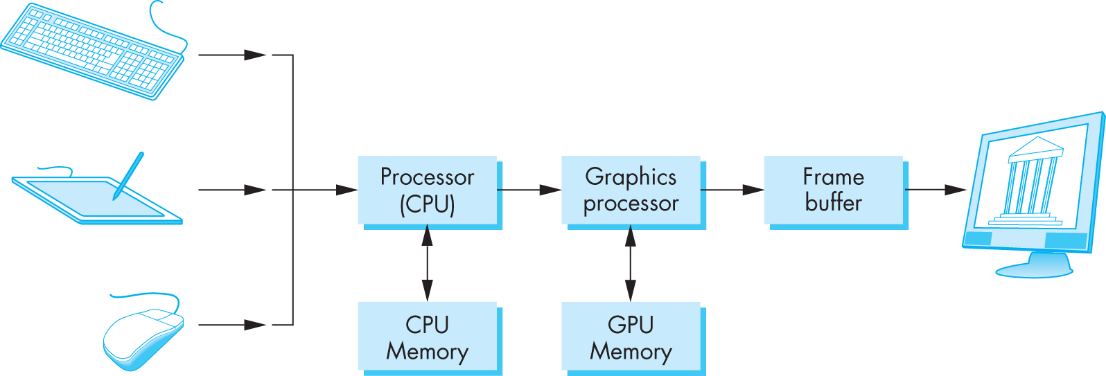
Basic Graphics System
Output device
Input devices
Image formed in frame buffer

Slide 45
Computer Graphics: 1950-1960
Computer graphics goes back to the earliest days of computing
Strip charts
Pen plotters
Simple displays using A/D converters to go from computer to calligraphic CRT
Cost of refresh for CRT too high
Computers slow, expensive, unreliable

Slide 46
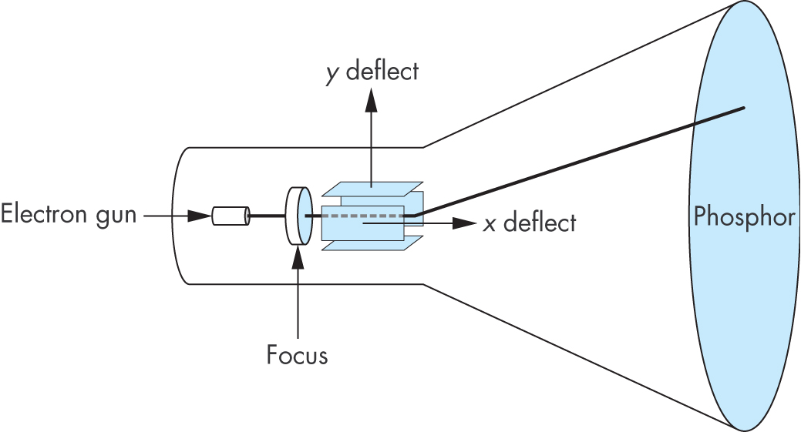
Cathode Ray Tube (CRT)
Can be used either as a line-drawing device (calligraphic) or to display contents of frame buffer (raster mode)

Slide 47
Shadow Mask CRT

Slide 48
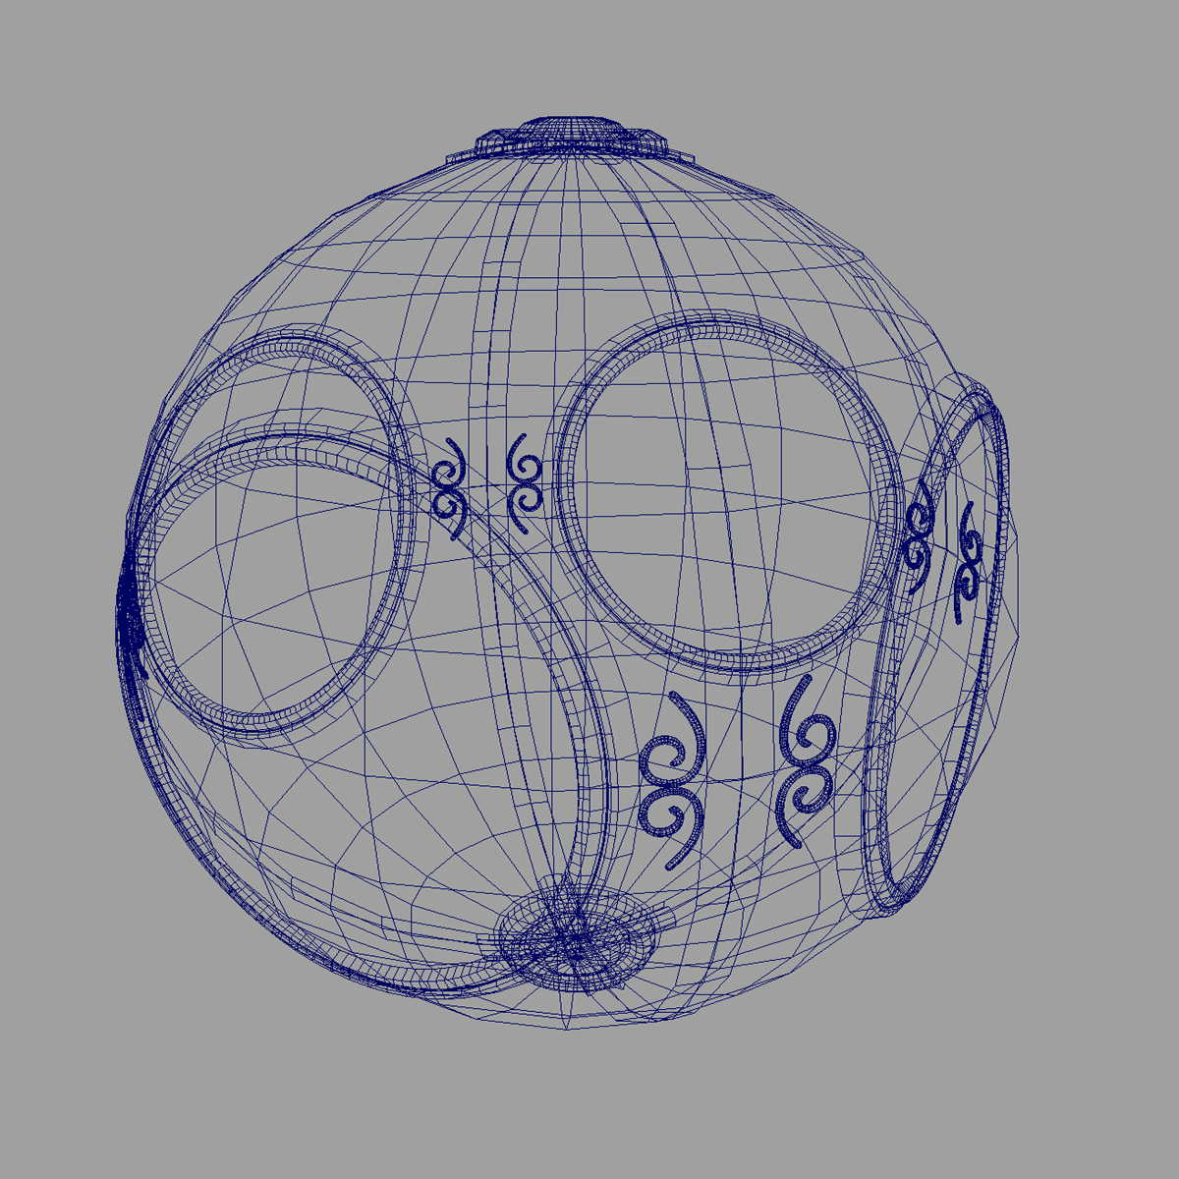
Computer Graphics: 1960-1970
Wireframe graphics
Draw only lines
Sketchpad
Display Processors
Storage tube
wireframe representation
of sun object

Slide 49
Sketchpad
Ivan Sutherland’s PhD thesis at MIT
Recognized the potential of man-machine interaction
Loop
Display something
User moves light pen
Computer generates new display
Sutherland also created many of the now common algorithms for computer graphics

Slide 50
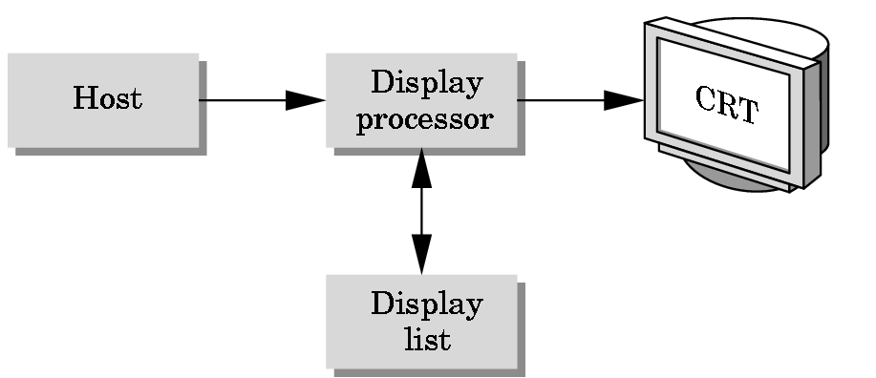
Display Processor
Rather than have the host computer try to refresh display use a special purpose computer called a display processor (DPU)
Graphics stored in display list (display file) on display processor
Host compiles display list and sends to DPU

Slide 51
Computer Graphics: 1970-1980
Raster Graphics
Beginning of graphics standards
IFIPS
GKS: European effort
Becomes ISO 2D standard
Core: North American effort
3D but fails to become ISO standard
Workstations and PCs

Slide 52
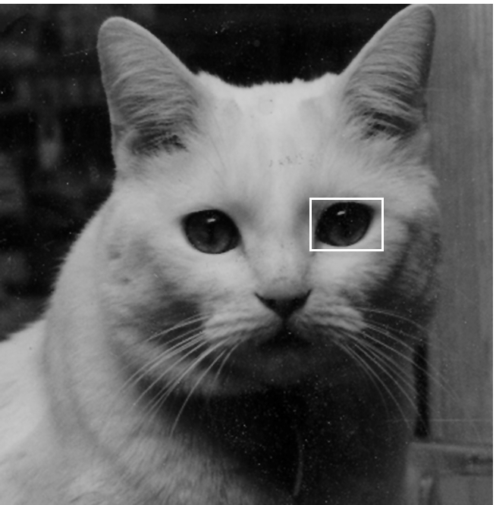
Raster Graphics
Image produced as an array (the raster) of picture elements (pixels) in the frame buffer

Slide 53
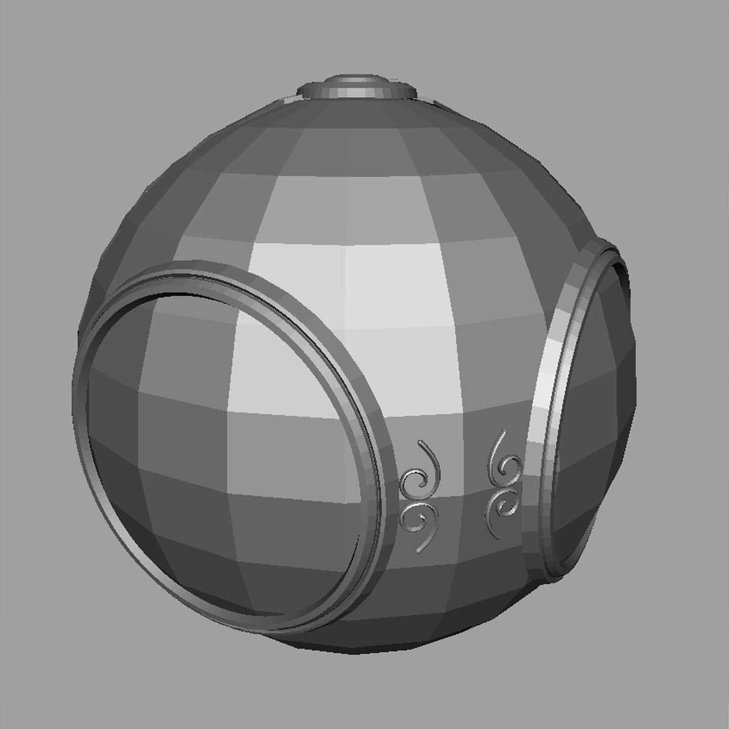
Raster Graphics
Allows us to go from lines and wire frame images to filled polygons

Slide 54
PCs and Workstations
Although we no longer make the distinction between workstations and PCs, historically they evolved from different roots
Early workstations characterized by
Networked connection: client-server model
High-level of interactivity
Early PCs included frame buffer as part of user memory
Easy to change contents and create images

Slide 55
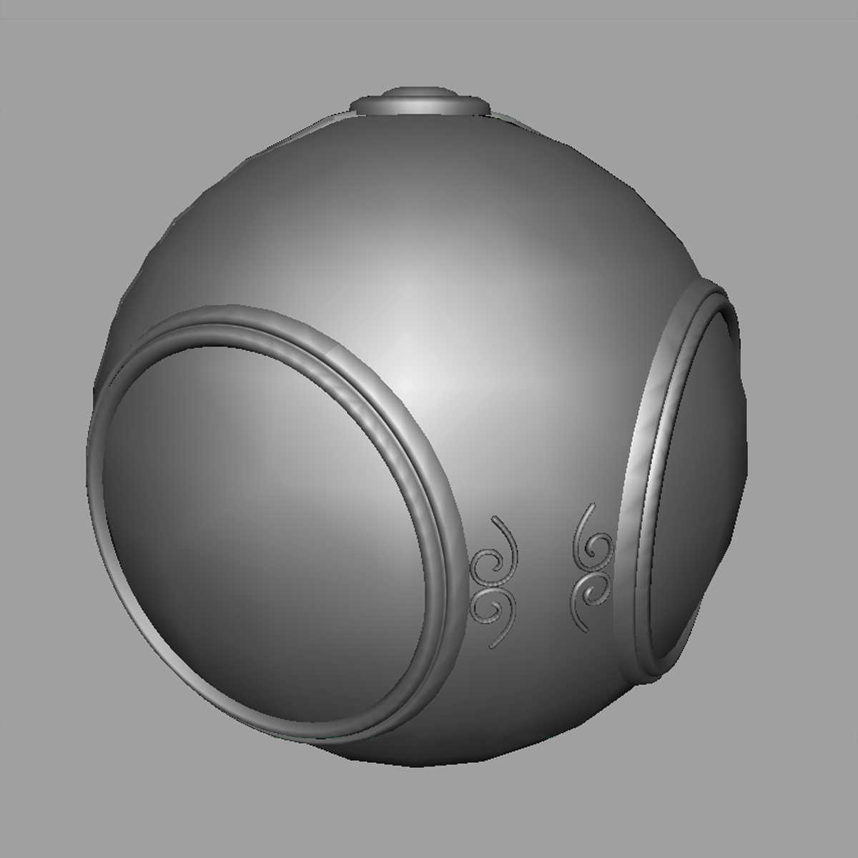
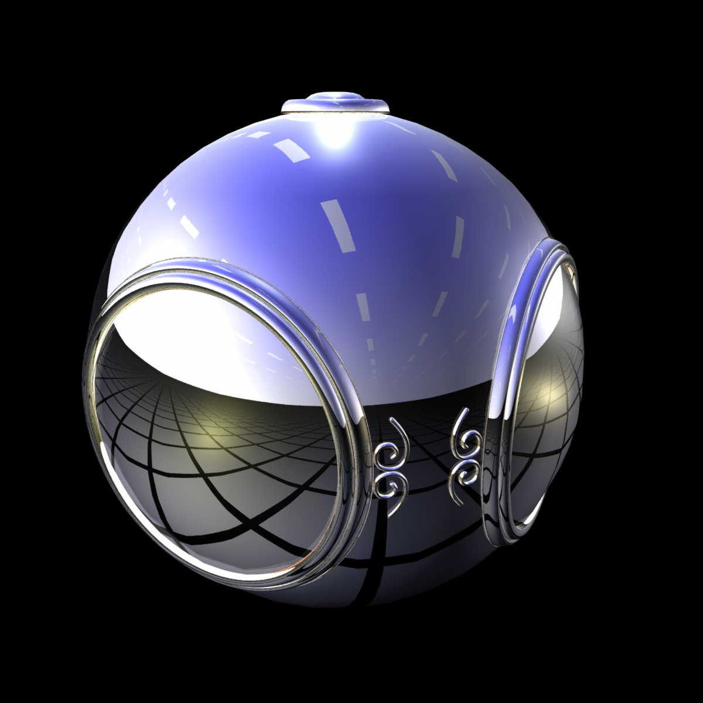
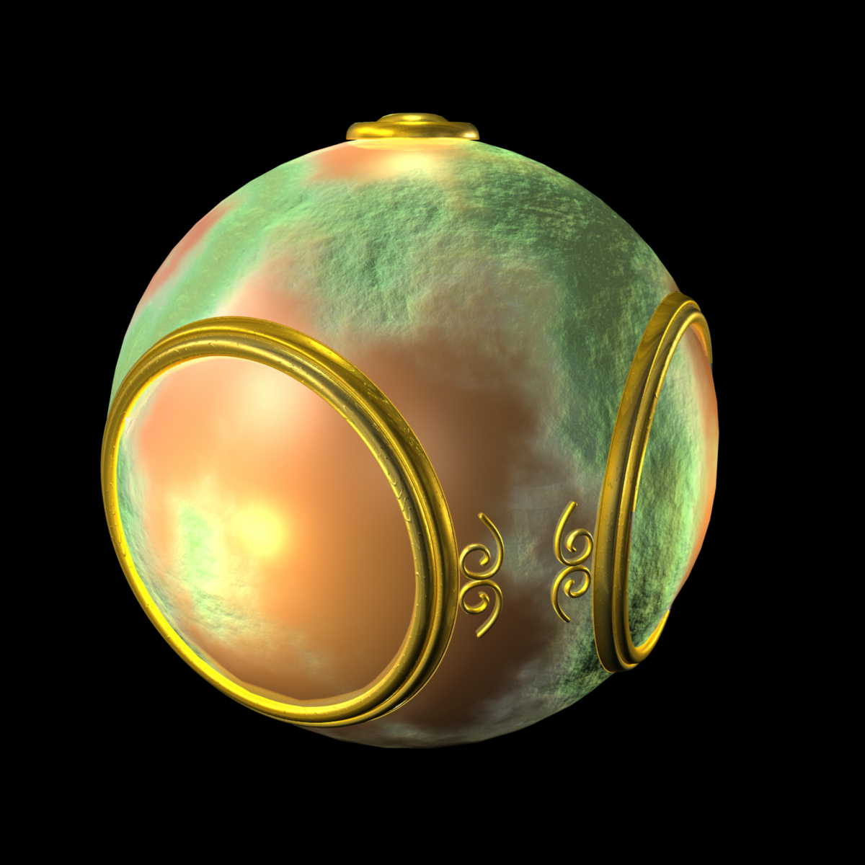
Computer Graphics: 1980-1990
Realism comes to computer graphics
smooth shading
environment
mapping
bump mapping

Slide 56
Computer Graphics: 1980-1990
Special purpose hardware
Silicon Graphics geometry engine
VLSI implementation of graphics pipeline
Industry-based standards
PHIGS
RenderMan
Networked graphics: X Window System
Human-Computer Interface (HCI)

Slide 57
Computer Graphics: 1990-2000
OpenGL API
Completely computer-generated feature-length movies (Toy Story) are successful
New hardware capabilities
Texture mapping
Blending
Accumulation, stencil buffers

Slide 58
Computer Graphics: 2000-2010
Photorealism
Graphics cards for PCs dominate market
Nvidia, ATI
Game boxes and game players determine direction of market
Computer graphics routine in movie industry: Maya, Lightwave
Programmable pipelines
New display technologies

Slide 59
Generic Flat Panel Display

Slide 60
Computer Graphics 2011-
Graphics is now ubiquitous
Cell phones
Embedded
OpenGL ES and WebGL
Alternate and Enhanced Reality
3D Movies and TV

Slide 61
Introduction to Computer Graphics with WebGL
Ed Angel
Professor Emeritus of Computer Science
Founding Director, Arts, Research, Technology and Science Laboratory
University of New Mexico

Slide 62
Image Formation
Ed Angel
Professor Emeritus of Computer Science,
University of New Mexico

Slide 63
Objectives
Fundamental imaging notions
Physical basis for image formation
Light
Color
Perception
Synthetic camera model
Other models

Slide 64
Image Formation
In computer graphics, we form images which are generally two dimensional using a process analogous to how images are formed by physical imaging systems
Cameras
Microscopes
Telescopes
Human visual system

Slide 65
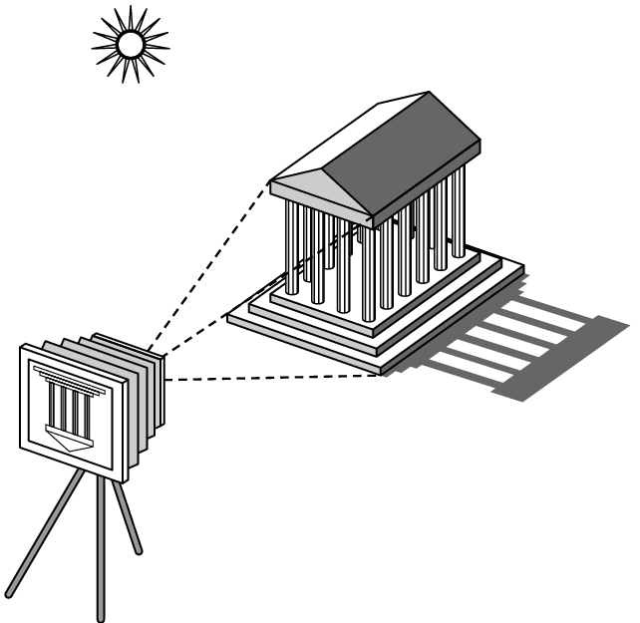
Elements of Image Formation
Objects
Viewer
Light source(s)
Attributes that govern how light interacts with the materials in the scene
Note the independence of the objects, the viewer, and the light source(s)

Slide 66
Light
Light is the part of the electromagnetic spectrum that causes a reaction in our visual systems
Generally these are wavelengths in the range of about 350-750 nm (nanometers)
Long wavelengths appear as reds and short wavelengths as blues

Slide 67
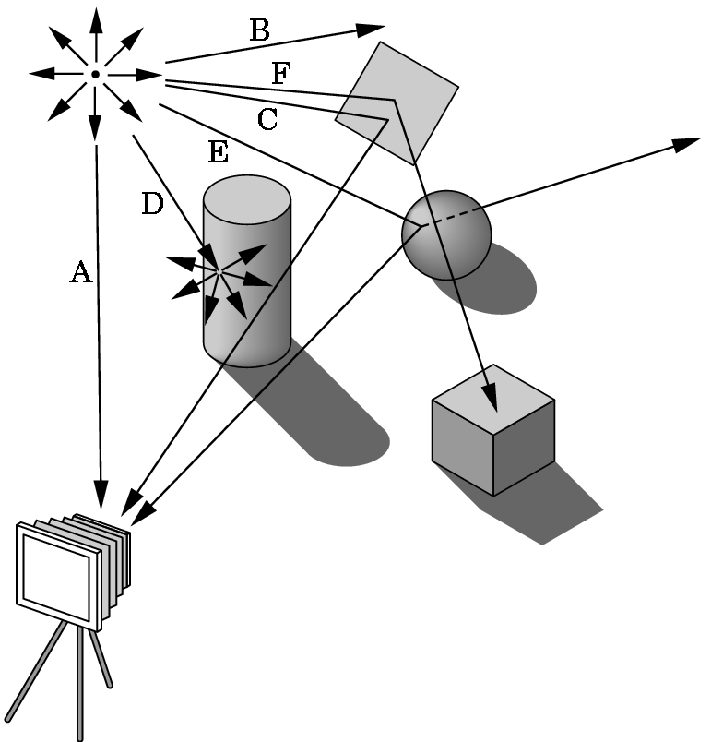
Ray Tracing and Geometric Optics
One way to form an image is to
follow rays of light from a
point source finding which
rays enter the lens of the
camera. However, each
ray of light may have
multiple interactions with objects
before being absorbed or going to infinity.

Slide 68
Luminance and Color Images
Luminance Image
Monochromatic
Values are gray levels
Analogous to working with black and white film or television
Color Image
Has perceptional attributes of hue, saturation, and lightness
Do we have to match every frequency in visible spectrum? No!

Slide 69
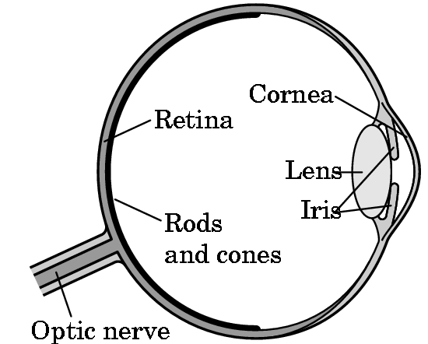
Three-Color Theory
Human visual system has two types of sensors
Rods: monochromatic, night vision
Cones
Color sensitive
Three types of cones
Only three values (the tristimulus
values) are sent to the brain
Need only match these three values
Need only three primary colors

Slide 70
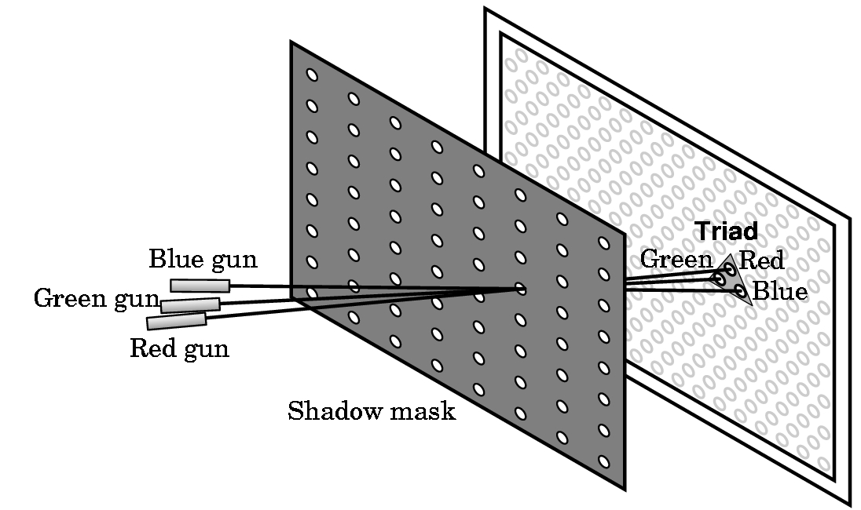
Shadow Mask CRT

Slide 71
Additive and Subtractive Color
Additive color
Form a color by adding amounts of three primaries
CRTs, projection systems, positive film
Primaries are Red (R), Green (G), Blue (B)
Subtractive color
Form a color by filtering white light with cyan (C), Magenta (M), and Yellow (Y) filters
Light-material interactions
Printing
Negative film

Slide 72
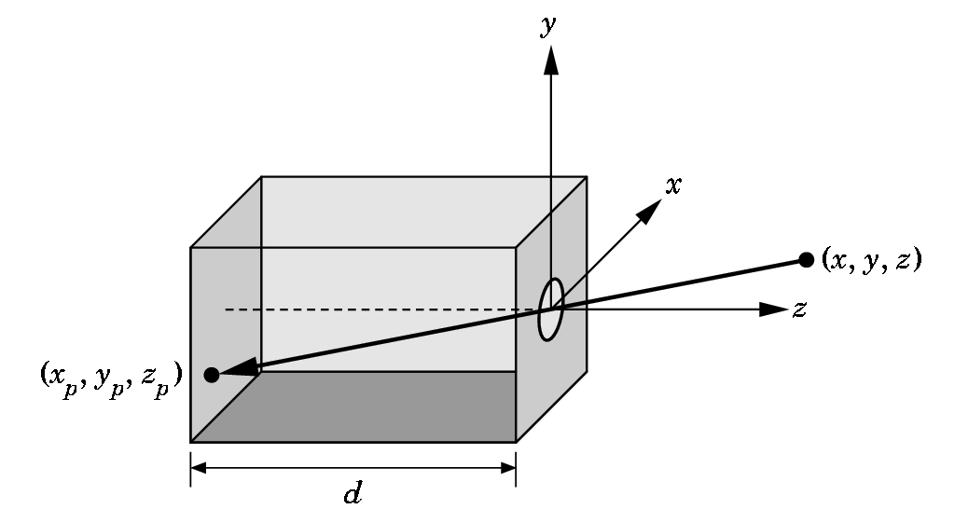
Pinhole Camera
Use trigonometry to find projection of point at (x,y,z)
x_{p}= -x/z/d
y_{p}= -y/z/d
z_{p}= d
These are equations of simple perspective

Slide 73
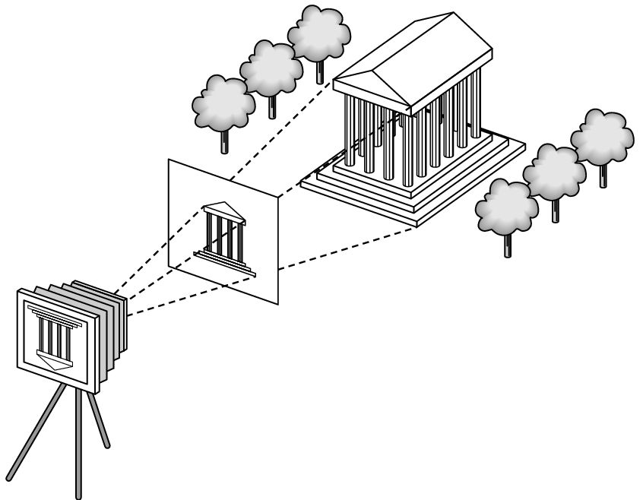
Synthetic Camera Model
projector
p
image plane
projection of p
center of projection

Slide 74
Advantages
Separation of objects, viewer, light sources
Two-dimensional graphics is a special case of three-dimensional graphics
Leads to simple software API
Specify objects, lights, camera, attributes
Let implementation determine image
Leads to fast hardware implementation

Slide 75
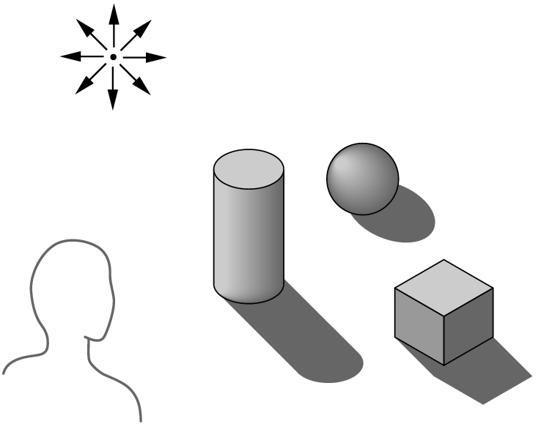
Global vs Local Lighting
Cannot compute color or shade of each object independently
Some objects are blocked from light
Light can reflect from object to object
Some objects might be translucent

Slide 76
Why not ray tracing?
Ray tracing seems more physically based so why don’t we use it to design a graphics system?
Possible and is actually simple for simple objects such as polygons and quadrics with simple point sources
In principle, can produce global lighting effects such as shadows and multiple reflections but ray tracing is slow and not well-suited for interactive applications
Ray tracing with GPUs is close to real time

